Slide 1
How to Obtain High Customers’ Review Scores
Analyze Airbnb Customers’ Reviews in Boston
Qixuan Zhang

Slide 2

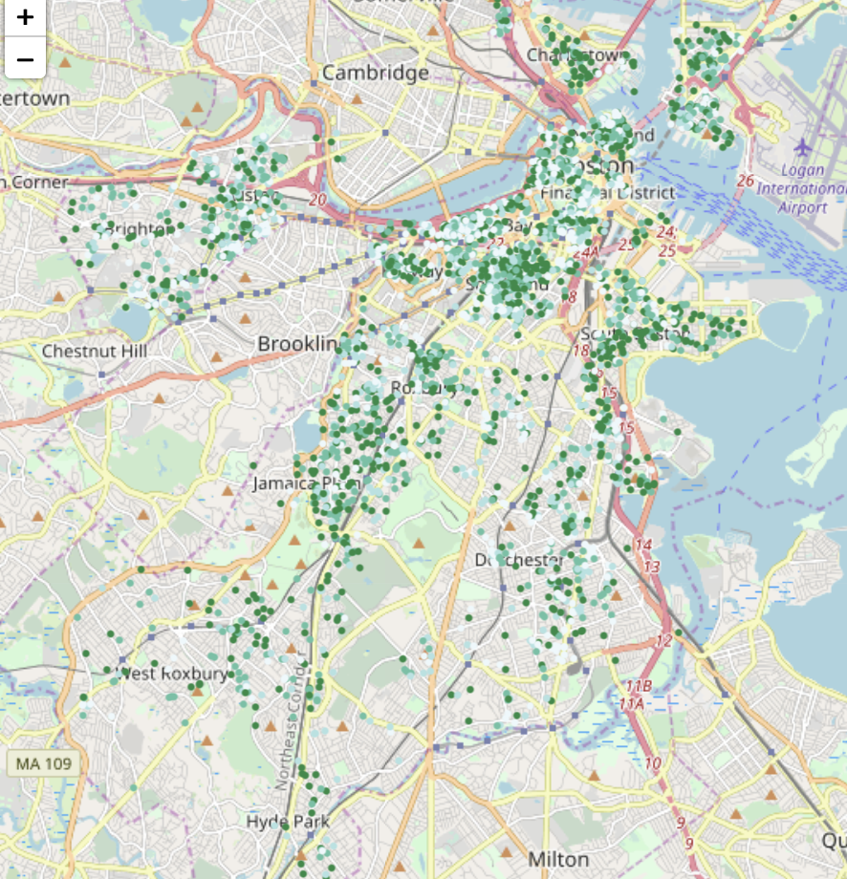
Customers’ Review Scores in Boston
To give our reader a more observable visualization,
we made a leaflet to describe the overall review scores distribution in different area in Boston at first.
With stronger and stronger of the green color, the overall review scores are higher.

Slide 3
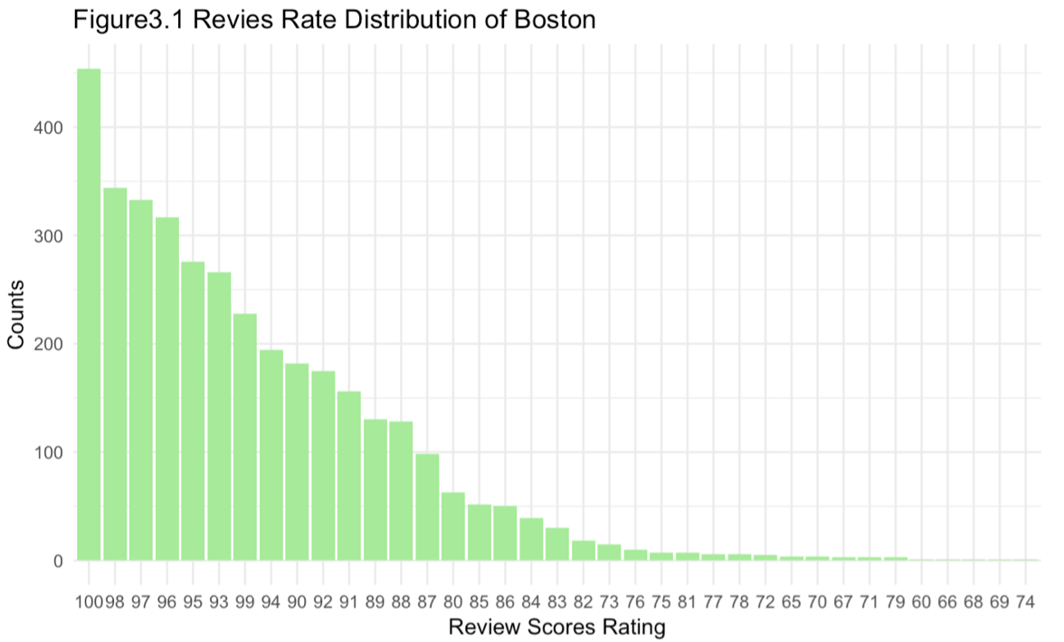
Review Scores Distribution in Boston
Following leaflet plot of Boston customers' reviews, we made a histogram plot to describe reviews of Boston.

Slide 4
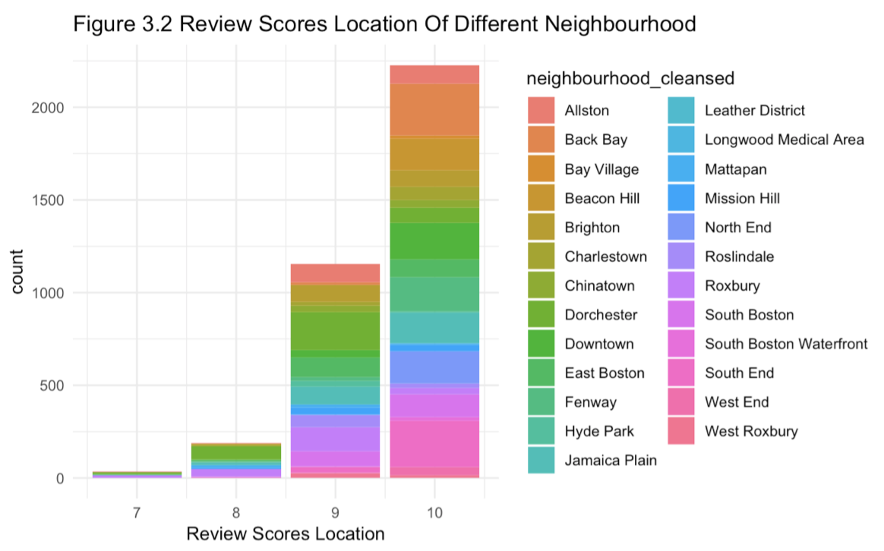
Review Scores of Different Neighbourhood
Initially, we want to figure out overall review scores distribution of different neighborhoods. We made a bar plot to illustrate counts of different location related to their customers reviews scores for location, in Figure 3.2 we could find the best location of Airbnb apartments is in Allston. Because more than 2000 apartments located in Allston was given 10 scores by customers.

Slide 5
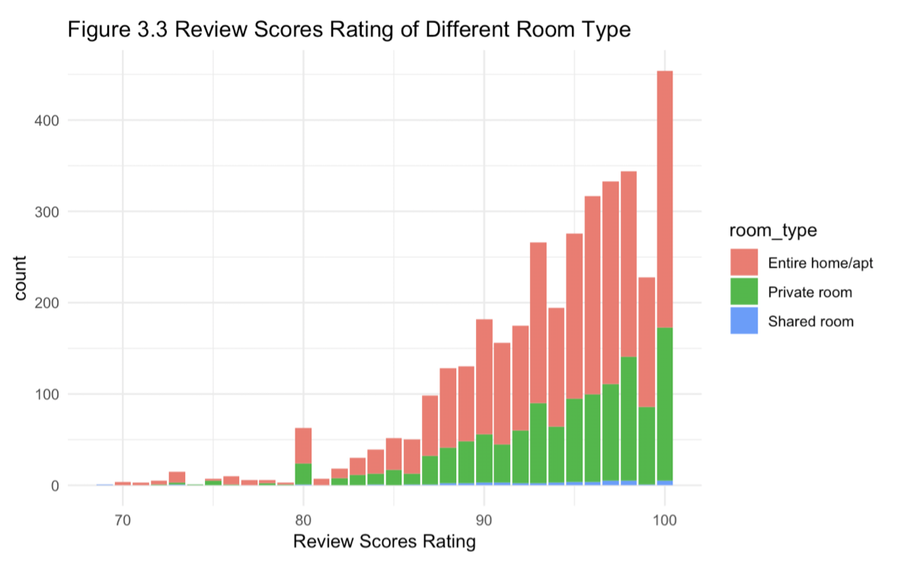
Review Scores Rating of Different Room Type
Based on the inspiration of neighborhood related to customers' reviews scores, we analyzed plots of property type, room type and price related to customers' reviews. From Figure 3.3, we found that the most common and popular room type is Entire home/apt, and there are few Shared room in Airbnb.

Slide 6
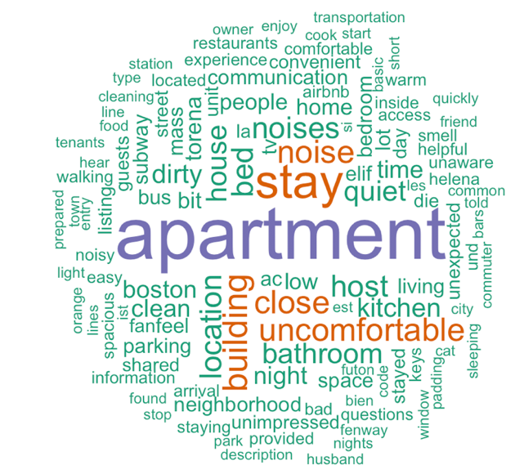
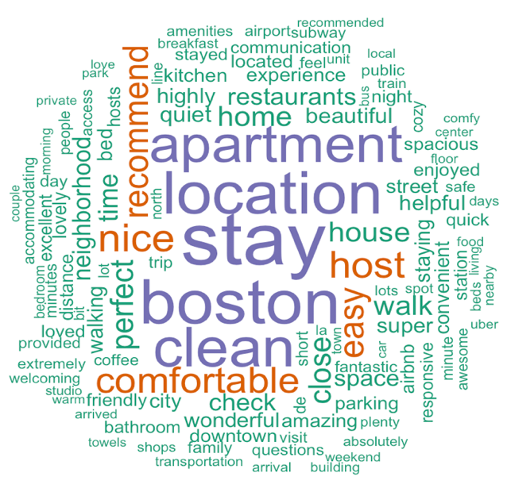
Compared WordCloud of High and Low Review Scores
Low Review Scores
High Review Scores

Slide 7
Conclusion
In this study, based on the inspire of latent rating regression model (Wang,2011), I created a unique Airbnbsentiments scores of Airbnb customers' comments and reviews scores of location, cleanliness and description etc. aspects from Airbnb to get more accuracy results. Based on above analysis, we will choose Latent Linear Regression model to analyze key attributes of customers' reviews and give some suggestions to improve future customers' reviews for Airbnb hosts.
The conclusion for key attributes of Aribnb in Boston is that only the overall review scores of different aspects did not include all the enough and reliable information. As we can see, combined with sentiment scores, we could get more accuracy predict results.

Slide 8
Further Direction
The first goal is to combine more dataset of major cities in United States and create an Airbnb sentiment words analysis dataset. When we want to calculate the overall customers' review scores of specific trips, we will combine the scores the customer given with his/her comment's sentiment scores. Based on this reliable information, we could build a more sufficient, reasonable and reliable customer reviews scores rating system. Both Airbnb and hosts in Airbnb could get feedback to improve their service from the scores given by customers.

