Slide 1
EDES 301 Light-Detect Curtains Project Proposal
09/30/2024
Emma Kirchhoff

Slide 2
Background Information
What is being proposed?
Natural alarm clock that opens curtains in response to sunlight
Better for your body to wake up in response to sunlight than noisy alarm
Curtain-opening mechanism that will trigger curtain opening in the morning in response to sunlight
Stepper motor: https://www.hackster.io/ingo-lohs/stepper-a-first-introduction-to-nema-17-ac15d7
Similar to existing projects:
https://www.instructables.com/Alexa-Curtain-Control-System-3D-Printable-and-Low-/
https://www.instructables.com/Automatic-Curtain-With-Arduino/
Will likely not include the 3-D printed components/similar due to time constraints
To start, will just open curtain (not close) – this will help simplify the mechanical components
Improvement/addition to current project: Light sensor triggers curtain-opening mechanism once threshold is reached (rather than programming via timer or controlling with phone)

Slide 3
System Block Diagram
Create a System Block Diagram – please see power block diagram for concept for now
Still need to research connections of the individual components and how they fit together
Label interfaces / pins
Components (part numbers if possible)
Need Moderate Level of Detail

Slide 4
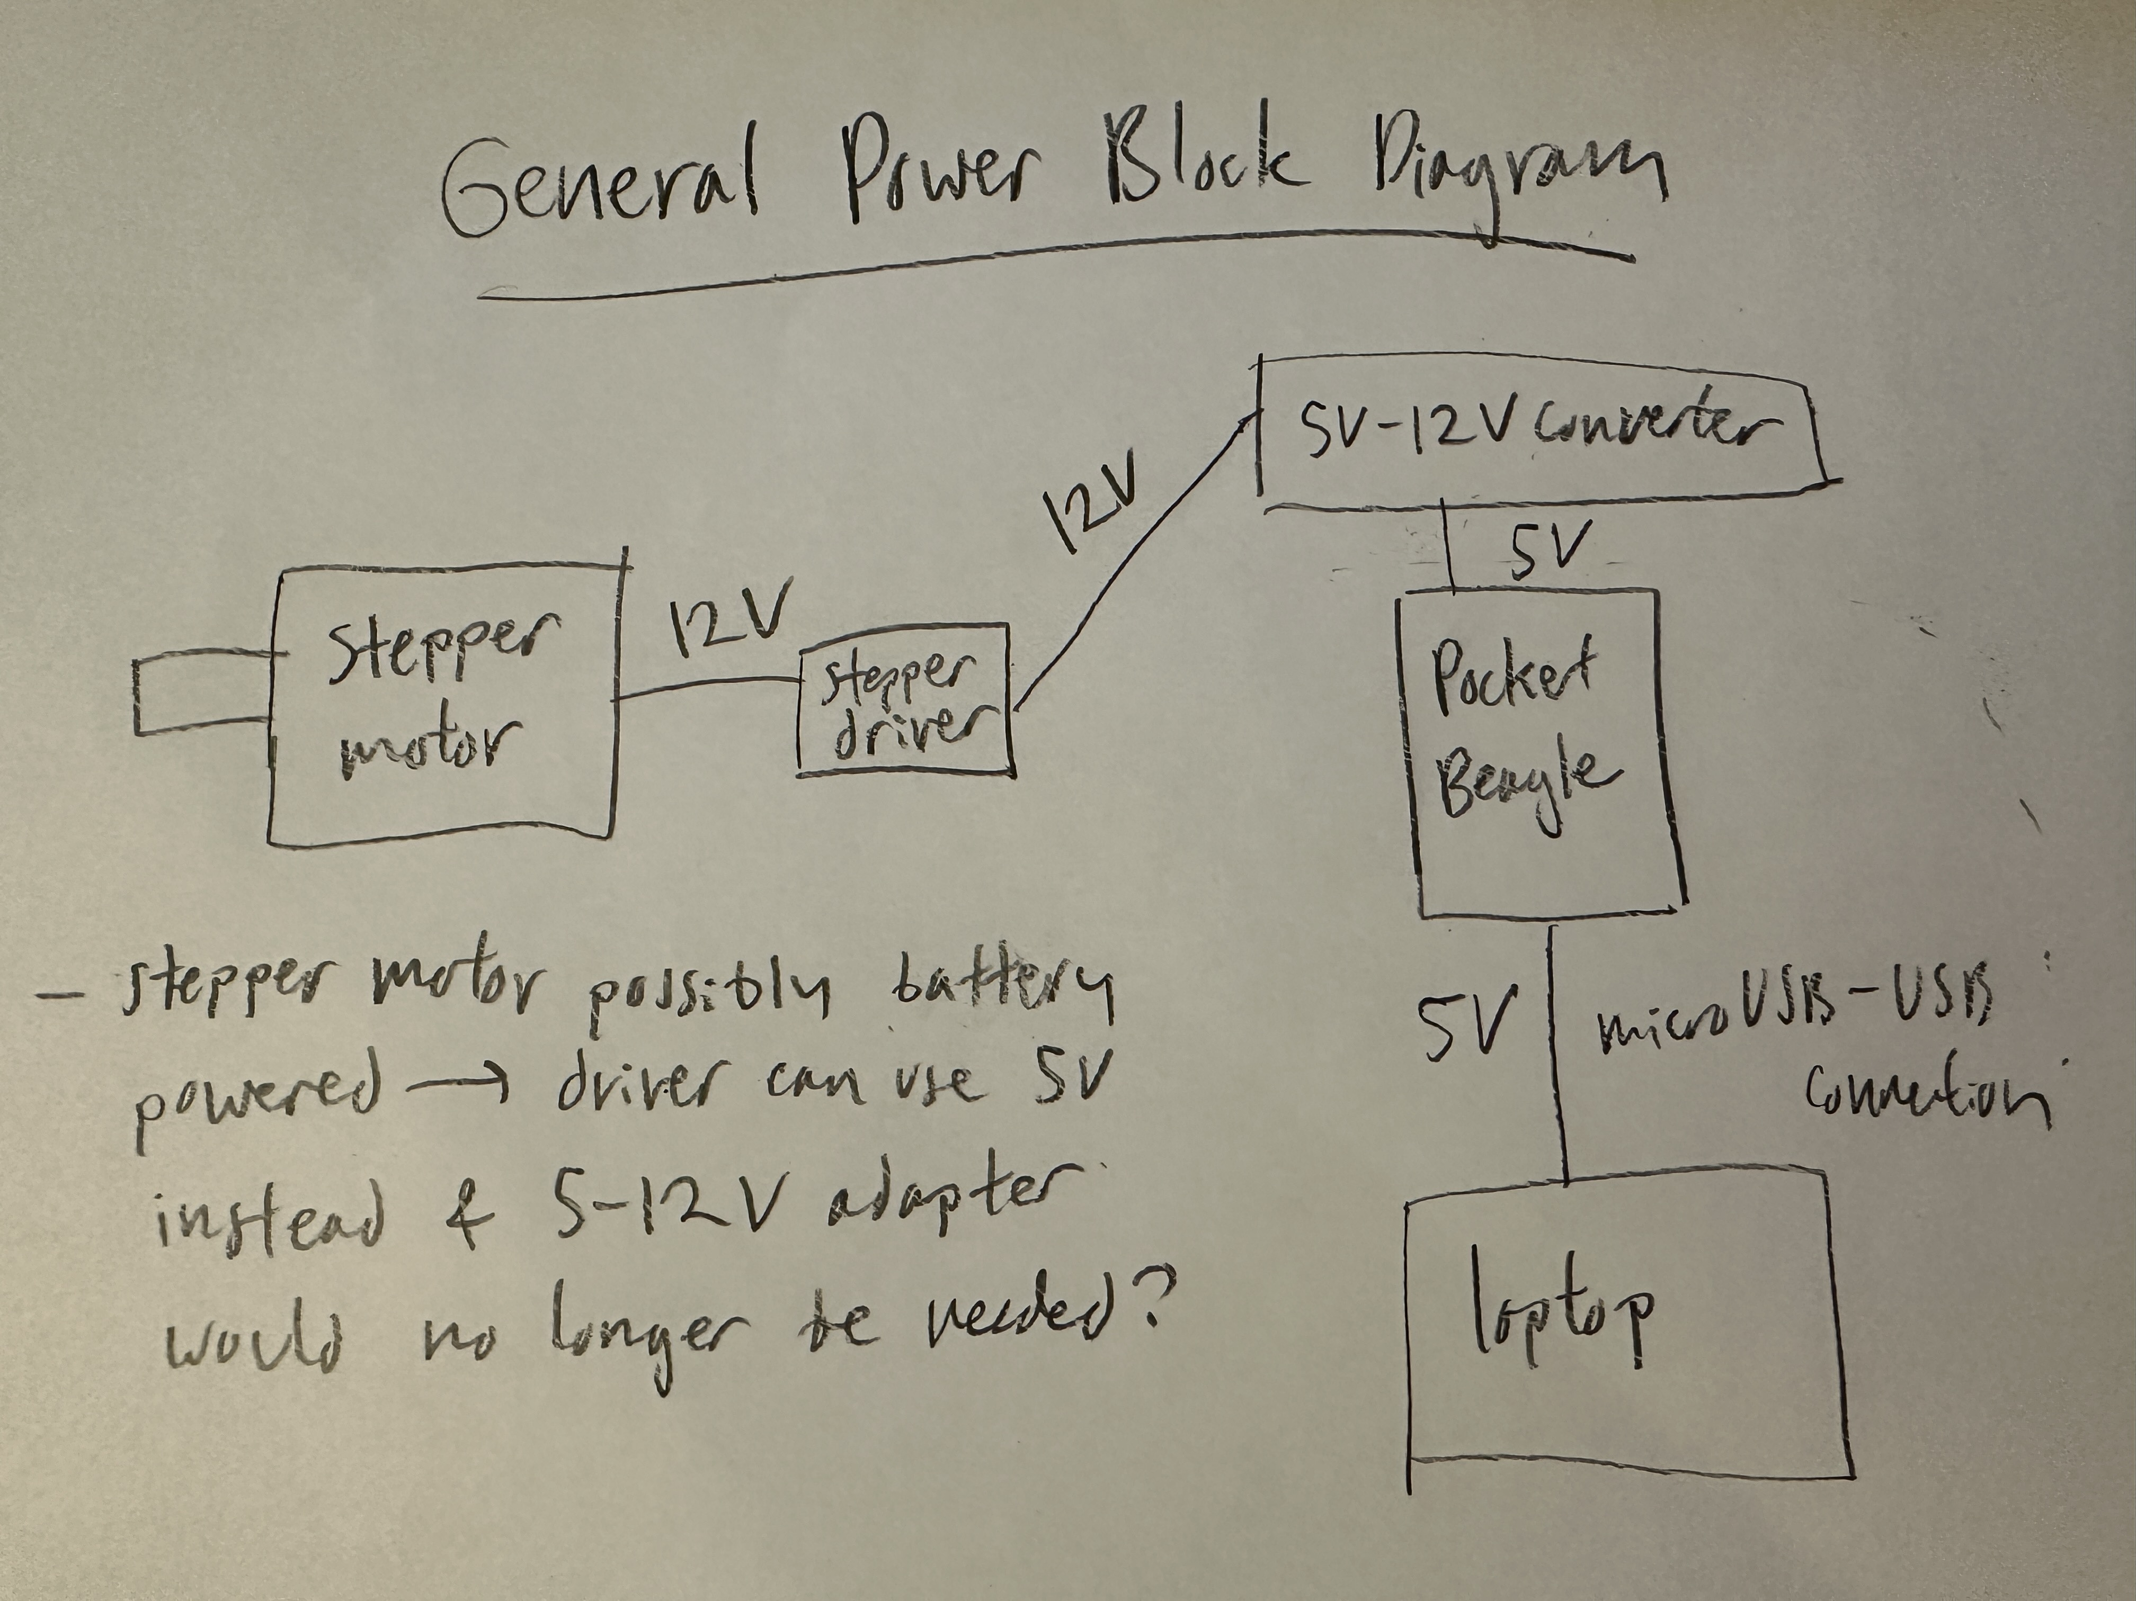
Power Block Diagram
Create a Power Block Diagram
Label voltages / currents of components
Need to find more details about these components to make a more high fidelity power block diagram

Slide 5
Components / Budget
Component | EDES301 to Buy? | Cost
Stepper motor driver (from parts list) | yes | $2.04
Stepper motor (from parts list) | yes | $7.99
Light sensor (from parts list) | yes | $4.50
Spindle/mechanism to hold fishing wire (ideally 3D print at OEDK) | n/a | free
Possibly a pulley if needed for curtain opening mechanism | no | n/a
Braided Fishing Wire (amazon, may have this available at the OEDK) | maybe | $13.88
12V – 5V adapter/converter | yes | $8.89
+ PocketBeagle, jumper cables, breadboard, general circuit components from parts kit (free)

