Slide 1

Genetic Disorder Prediction Early Genetic Disorder Prediction from Diagnosis and Inheritance Patterns
Emma Oo
Sindhu Bhattarai
Dave Friesen

Slide 2
Overview
Opportunity – background and problem
Objective – purpose and hypothesis
Data – summary and EDA
Model – approaches and results
Discussion – hypothesis review; opportunities
Data mining project walk-through
Example

Slide 3
Opportunity
Document reviews like patent applications are often highly manual
Modern data science and natural language processing (NLP) provides an opportunity to automate these reviews by identifying phrases with similar “meanings” across patent applications
“Semantic similarity” pattern extends to many domains and use cases, from sentiment analysis to knowledge curation
Background and problem statement
Example

Slide 4
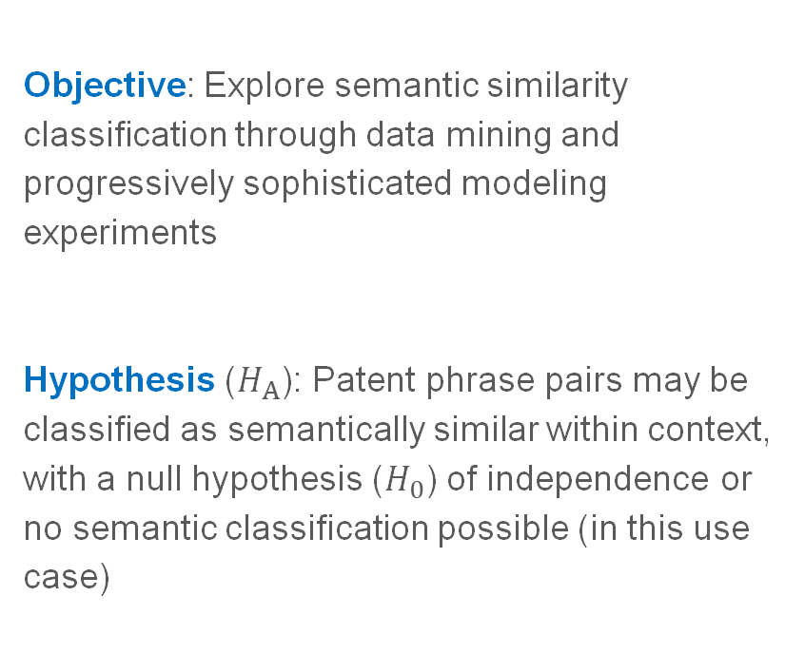
Objective
Objective: Explore semantic similarity classification through data mining and progressively sophisticated modeling experiments
Hypothesis ($H_{A}$): Patent phrase pairs may be classified as semantically similar within context, with a null hypothesis ($H_{0}$) of independence or no semantic classification possible (in this use case)
Purpose and
hypothesis
Example

Slide 5
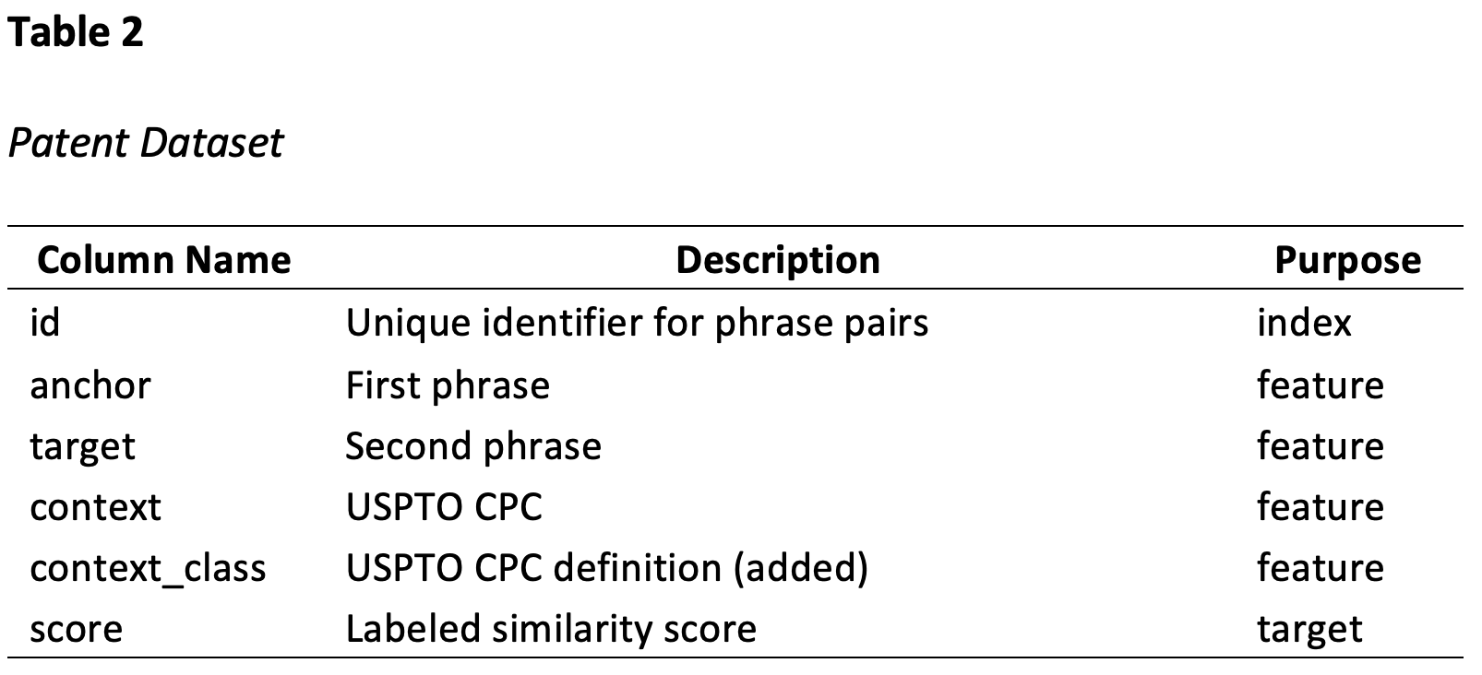
Data
Secondary USPTO data^{4,5}, including 36,473 sample phrase pairs across eight patent groups
phrase pair: anchor and target
context: USPTO code, ugmented with context_class
score: 1.0 = Close Match; 0.75 = Close Synonym; 0.50 = Synonym; 0.25 = Somewhat Related; and 0 = Unrelated
Word count range 1-15; μ and M of ~2
Exploratory Data Analysis, including data acquisition, preparation, preliminary mining, and representation
Example

Slide 6
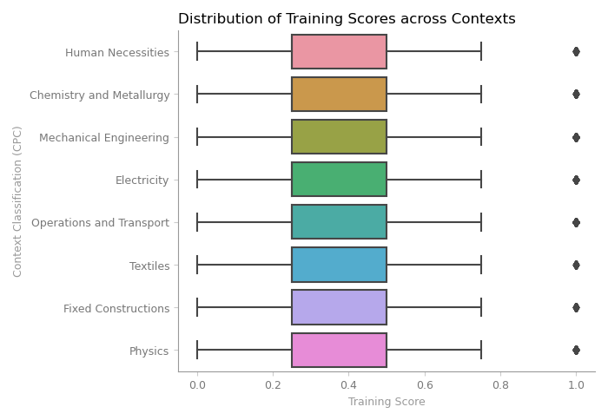
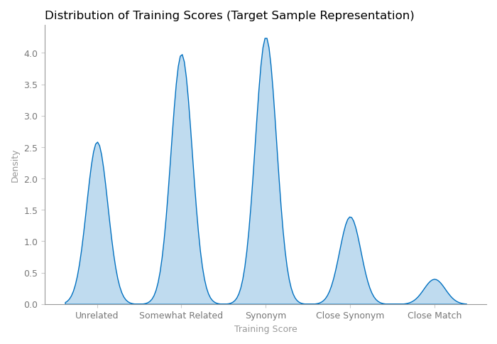
Data cont’d
Class balance review: distribution across classifications and scores
Example

Slide 7
Modeling Step 1
Considering hypothesis that patent phrase pairs may be classified as similar within context
Q: Phrase relationship with USPTO class?
Approach: Multiclass logistic regression to classify context_class from anchor phrase
Required additional pre-processing, including anchor vectorization³
Data split 70/30, successfully cross-validated, and model test run
Modeling for Context through logistic regression
Example

Slide 8
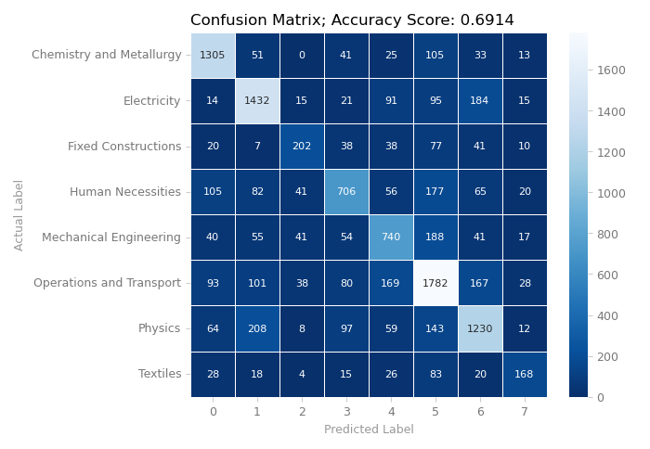
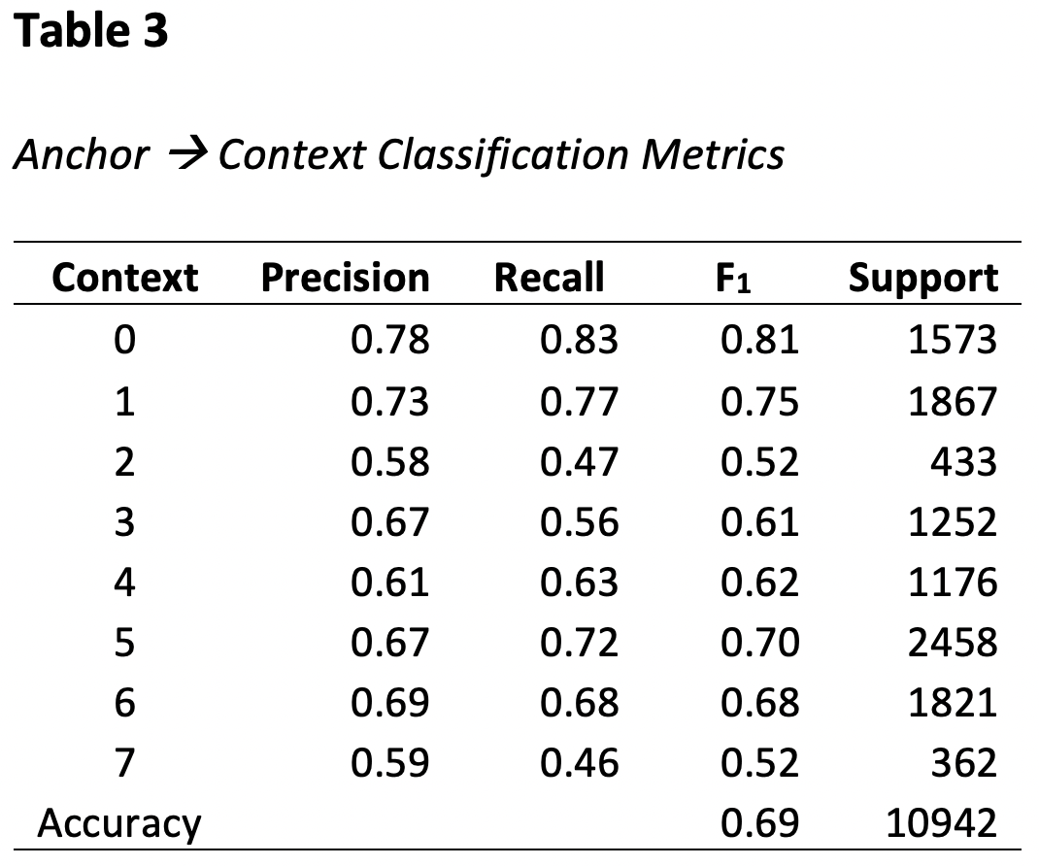
Step 1, Modeling for Context – cont’d
In aggregate, appears ~possible to classify context from phrase pairs; individual F₁ scores (Σwx/Σw of Precision and Recall) add perspective
Example

Slide 9
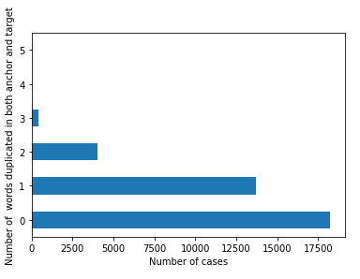
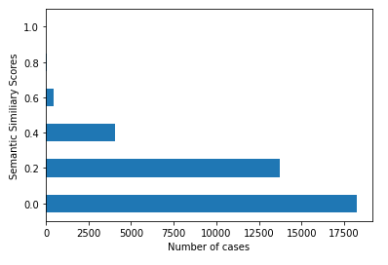
Modeling Step 2
Searching for words that appear exactly in both anchor and target
Modeling for Word Similarity
Example

Slide 10
Modeling Step 3
Steps 1 and 2 have limitations, including mechanical view of words without considering “meaning” (semantics)¹
Bidirectional Encoder Representation from Transformers (BERT) →
deep learning NLP technique from Google
similar to recurrent neural networks (RNNs)
shown to outperform more mechanical approaches
optional to use models pre-trained on wide corpora
Full set of anchor and target pairs tested using pre-trained model²; cosine similarity calculated from resulting vectors for comparison to label
Modeling for Semantic Similarity through deep learning
Example

Slide 11
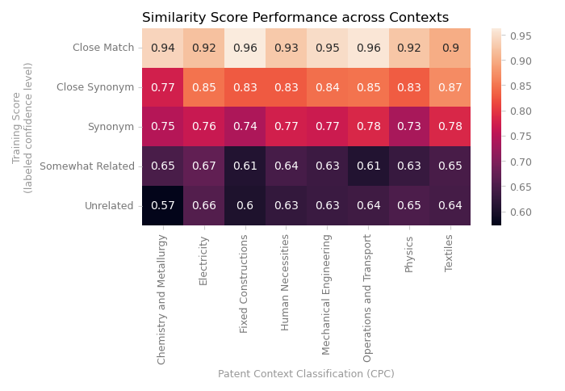
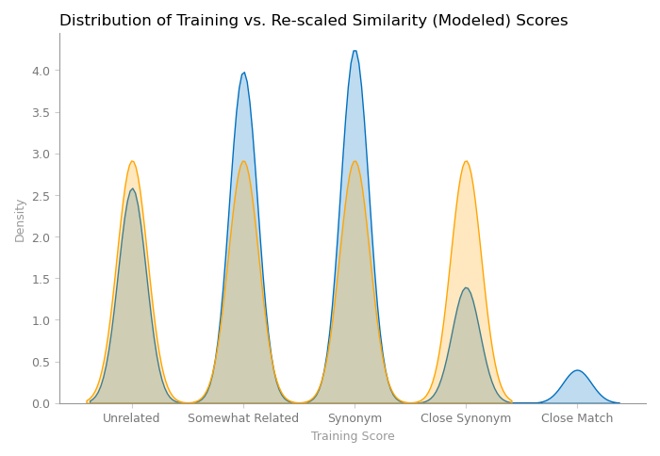
Step 3, Modeling for Semantic Similarity – cont’d
Comparing BERT-cosine similarity scores vs. labeled scores; progress, yet further room for improvement
Example

Slide 12
Discussion
Progression of approaches helped to explore data and refine NLP understanding
Ultimately, BERT approach demonstrated that semantic similarity classification (automation) is possible, rejecting a null hypothesis
Only a first step; opportunities to extend BERT research and improve results, including more robust consideration for patent domain-based corpora and overall context weighting
Hypothesis review;
Strengths, weaknesses, opportunities
Example

Slide 13
Thank you!
Example

Slide 14
References
¹ González-Carvajal, S., Garrido-Merchán, E.C. (2020). Comparing BERT against traditional machine
learning text classification. https://doi.org/10.48550/arXiv.2005.13012
² Reimers, N., Gurevych, I. (2018). Sentence-BERT: Sentence Embeddings using Siamese BERT-Networks. https://doi.org/10.48550/arXiv.1908.10084
³ Srinivasa-Desikan, B. (2018). Natural Lange Processing and Computational Linguistics. Packt.
⁴ U.S. Patent and Trademark Office (USPTO) (2022). *.csv [Data Set]. Kaggle Inc. https://www.kaggle.com/competitions/us- patent-phrase-to-phrase-matching/data; https://www.kaggle.com/datasets/xhlulu/cpc-codes
CoinMarketCap (2022, January 16). Global Cryptocurrency Charts. CoinMarketCap. https://coinmarketcap.com/charts/
⁵ U.S. Patent and Trademark Office (USPTO) (2022, April 13). USPTO Classification Resources. USPTO. https://www.uspto.gov/web/patents/classification/cpc/html/cpc.html
Example

