Slide 1

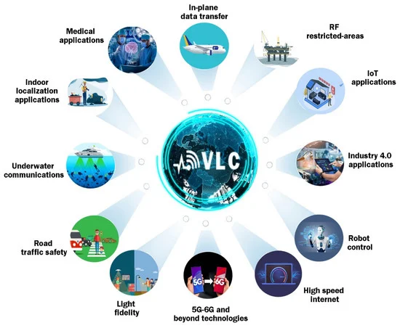
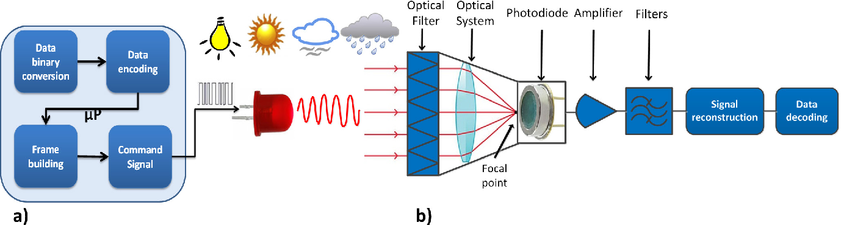
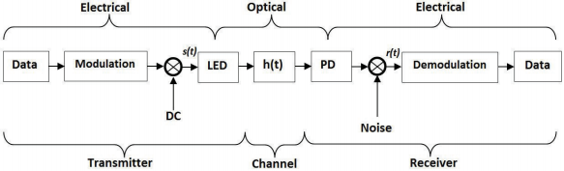
A Critical Evaluation of Visible Light Communication
Wenrui Zou 2253589
Information and Computer Science, Xi’an Jiaotong-Liverpool University, Suzhou, China
INTRODUCTION
CRITERIA & EVALUATION
LIMITATIONS
&
SOLUTIONS
Definition : In VLC, Information is transmitted through the modification of light sources
CRITERIA
Security
Data confidentiality, integrity, and reliability.
Speed
Increased speed, which opens up new opportunities for secure and fast data transmission.
LIMITATIONS
Insufficient sample sizes or restricted references.
Insufficient comprehensive research data
Fig. 1. Application of VLC
SOLUTIONS
Such as LEDs or fluorescent lamps.
Application: Internet of Things (IoT), smart homes, healthcare, intelligent transportation
Attributes: Efficiency, Security, and Eco-friendliness
Collect more research data
Enhance public environment security features
Broaden application scope
Fig. 3. Security system of VLC
EVALUATION
Security
Strengths
Ensuring during transmission, unauthorized parties cannot access, steal, or manipulate with data.
OPERATIONAL PRINCIPLES
REFERENCE LIST
General Principles
[1] Z. Geng, F. N. Khan, X. Guan, and Y. Dong, "Advances in Visible Light Communication Technologies and Applications," Photonics, vol. 9, no. 12, pp. 893-894, Nov. 2022, doi: 10.3390/photonics9120893.
[2] M. K. Hasan, M. Shahjalal, M. Z. Chowdhury, and Y. M. Jang, "Application-Based Comparative Performance Analysis of Visible Light Communication Technologies," presented at the Symposium of the Korean Institute of Communications and Information Sciences, 2019, pp. 1450-1453.
[3] A. Poulose, "Simulation of an Indoor Visible Light Communication System Using Optisystem," Signals, vol. 3, no. 4, pp. 765–793, Nov. 2022, doi: 10.3390/signals3040046.
[4].V. Rodoplu, K. Hocaoğlu, A. Adar, R. O. Çikmazel, and A. Saylam, "Characterization of Line-of-Sight Link Availability in Indoor Visible Light Communication Networks Based on the Behavior of Human Users," IEEE Access, vol. 8, pp. 39336-39348, 2020.
[5] R. F. Miranda et al., "A Review of Cognitive Hybrid Radio Frequency/Visible Light Communication Systems for Wireless Sensor Networks," Sensors, vol. 23, no. 18, pp. 7815-7816, Sep. 2023, doi: 10.3390/s23187815.
Optical communication technology
An optical receiver to demodulate the optical signal
Weaknesses
High level of secrecy is merely relative.
Particularly in public areas.
Special Principles
Speed
Synchronization identification and detection signals added when needed
Strengths
Flexibility in wireless communication
High speed in optical communication.
Accomplish Gbps-level high-speed data delivery.
Weaknesses
The application range were constrained by data rate
Route losses
Restriction of high data rate
Fig. 2. Model of VLC communication system.

