Slide 1

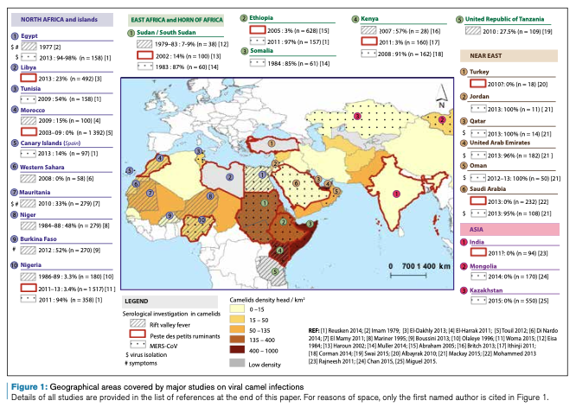
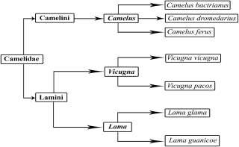
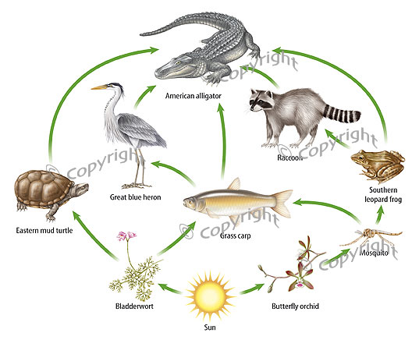
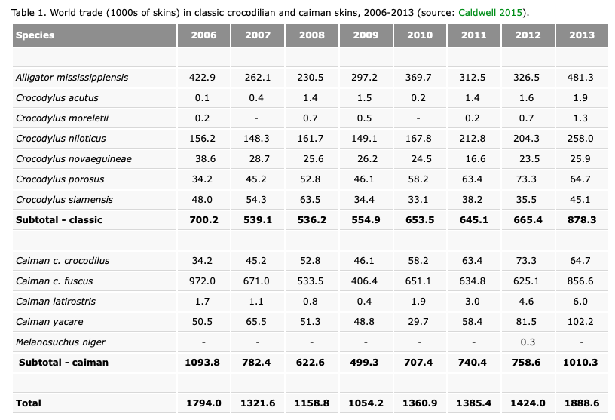
Animals and Us
A Comparison Between Dromedary Camels and Freshwater Crocodiles
SID 540026999
1
Biodiversity
3
How Do Cultural Backgrounds Influence Decision Making?
Biodiversity in regions where dromedary camels inhabit includes a wide array of plant, animal, and microbial species specific to the unique ecological conditions of these habitats. This encompasses various desert flora and fauna¹. Such as acacia trees, succulent plants like cacti, and drought-resistant shrubs; dromedary and Bactrian camels, desert foxes, sand gazelles, and various bird species like desert sparrows and larks. While for biodiversity in region where crocodile inhabited also include a wide range of plant , animal and microbial species which featured an intricate ecosystem with various species of animals, flora and fauna adapted to the unique conditions of these habitats. E.g. Fish. Freshwater Crocodiles are apex predators in aquatic environments, preying on fish species such as tilapia, catfish, and various freshwater species. Amphibians: such as frogs and toads. Other Reptiles: Freshwater Crocodiles may interact with other reptile species, including turtles, snakes, and other crocodile species if their ranges overlap.
Both dromedary camels and freshwater crocodiles represented certain meaning regarding to their own features⁴. In many cultures within the historic and current range of camels, these animals hold significant cultural and symbolic importance. For example, in several Middle Eastern and North African cultures, camels have been revered for their resilience, adaptability to desert environments, and their crucial role in transportation across vast arid landscapes. Camels are often depicted in art, literature, and folklore as symbols of endurance, patience, and strength. Additionally, in some nomadic and pastoralist societies, camels are considered invaluable companions, providing transportation, milk, and sometimes meat⁵.
Figure 3: Geographical area s covered by major studies on viral camel infections
Details of all studies are provided in the list of reference at the end of this paper.
Figure 1: Classification of camels
For cultures historically and presently inhabiting regions where freshwater crocodiles are found, these reptiles hold symbolic and spiritual significance. They may be revered as sacred animals or associated with deities and myths. In such cultures, there may be taboos against harming or killing crocodiles, leading to conservation efforts driven by cultural values⁶. Conversely, in cultures where crocodiles have been traditionally hunted for food, skins, or other purposes, there may be less inclination towards conservation. In these contexts, crocodiles may be viewed primarily as a valuable resource rather than as a species in need of protection. Additionally, in areas where crocodiles pose risks to human safety or livelihoods through attacks on humans or livestock, they may be perceived as pests or threats. This can lead to negative attitudes towards crocodiles and efforts to control or eradicate them, potentially undermining conservation initiatives.
2
Ecosystem Functioning
4
Inherent Intrinsic Value
Figure 2: Role of crocodiles played
For inherent intrinsic value between each species and ecosystem lies in their interconnectedness and mutual dependence within the natural environment. Either dromedary camels and freshwater crocodiles, as integral components of their ecosystems, contribute to the functioning and stability of these habitats through various ecological roles and interactions. Likewise, ecosystems provide essential resources and services that sustain their livelihoods and well-being. Dromedary camels play vital roles in shaping vegetation distribution, nutrient cycling, and soil fertility through
In desert ecosystems where dromedary camels are prevalent, their feeding activities involve consuming desert vegetation like thorny shrubs, dry grasses, and desert plants². As they digest this vegetation, they contribute to nutrient cycling through their excretion, which enriches the soil with organic matter. Their presence also influences the growth of certain plants by dispersing seeds through their droppings.
Similarly, crocodile also play an important role in maintaining the balance of ecosystem which they inhabited in. For example freshwater Crocodiles help regulate the populations of their prey species through predation. By controlling the numbers of fish, birds, and other animals they consume, crocodiles prevent the overpopulation of certain species, which in turn helps maintain the overall biodiversity of the ecosystem³.
their feeding, browsing, and grazing activities. By consuming plant material and dispersing seeds through their droppings, camels influence the structure and composition of plant communities, thereby impacting the overall biodiversity and functioning of ecosystems.
The Prioritizing Conservation Efforts…
Table 1: World trade(1000s of skins) in dromedary crocodilian and caiman skins, 2006 – 2013
For dromedary camels over freshwater crocodiles depends on various factors, including ecological importance, conservation status, and human-animal interactions:
Dromedary camels hold significant cultural and economic importance in many regions where they are found. Prioritizing their conservation can support local economies and preserve cultural heritage.
Dromedary camels may face threats such as habitat loss, overgrazing, and competition with introduced species. If their populations are declining or they are at risk of extinction, prioritizing conservation efforts can help prevent further declines and maintain ecosystem stability.
Dromedary camels are keystone species in arid and semi-arid ecosystems, playing crucial roles in seed dispersal, nutrient cycling, and vegetation management. Their presence can have significant impacts on ecosystem structure and function
While freshwater crocodiles also play important ecological roles and may face conservation challenges, the prioritization of conservation efforts should be based on a careful assessment of the specific context
For inherent intrinsic value between each species and ecosystem lies in their interconnectedness and mutual dependence within the natural environment. Either dromedary camels and freshwater crocodiles, as integral components of their ecosystems, contribute to the functioning and stability of these habitats through various ecological roles and interactions. Likewise, ecosystems provide essential resources and services that sustain their livelihoods and well-being.
Dromedary camels play vital roles in shaping vegetation distribution, nutrient cycling, and soil fertility through their feeding, browsing, and grazing activities. By consuming plant material and dispersing seeds through their droppings, camels influence the structure and composition of plant communities, thereby impacting the overall biodiversity and functioning of ecosystems⁷.
The inherent intrinsic value of freshwater crocodiles lies in their existence as a unique and irreplaceable species within the web of life on Earth. Like all living organisms, crocodiles have evolved over millions of years, adapting to their environments and playing specific roles in ecosystems. Their intrinsic value stems from their intrinsic worth as living beings, deserving of moral consideration and respect simply by virtue of their existence.
Freshwater crocodiles, like other apex predators, contribute to the stability and functioning of ecosystems through their interactions with prey species and other organisms. They are part of complex food webs and ecological processes that maintain the balance of natural systems. Additionally, crocodiles possess biological and behavioral adaptations that make them fascinating subjects for scientific study and contribute to our understanding of evolutionary processes⁸.
Reference
[1] . Miguel, E., El Idrissi, A., Chevalier, V., Caron, A., Faye, B., Peiris, M., & Roger, F. (2016). Ecological and epidemiological roles of camels: lessons from existing and emerging viral infections. Empres-animal health 360, (46).
[2]. Faye, B., & Bonnet, P. (Year). Camel Sciences and Economy in the World: Current Situation and Perspectives. UMR SELMET, Campus International de Baillarguet, TA C/Dir B, CIRAD-ES, 34398 Montpellier, France.
[3]. Wheeler, J.C. (Year). South American Camelids - Past, Present and Future. Instituto de Investigación y Desarrollo de Camélidos Sudamericanos - CONOPA Los Cerezos 106, Lima 3, Perú.
[4]. Hines, K. N., & Kroblin, A. (2010). Australian Freshwater Crocodile (Crocodylus johnstoni) Attacks on Humans. Herpetological Review, 44, 430-435. © 2010 by Society for the Study of Amphibians and Reptiles.
[5]. Bouyer, F., Seck, M. T., Dicko, A. H., Sall, B., Lo, M., Vreysen, M. J., Chia, E., Bouyer, J., & Wane, A. (2014). Ex-ante benefit–cost analysis of the elimination of a Glossina palpalis gambiensis population in the Niayes of Senegal. PLoS Neglected Tropical Diseases, 8(10), e3112.
[6]. Cecchi, G., Paone, M., Franco, J. R., Fèvre, E., Diarra, A., Ruiz, J., Mattioli, R., & Simarro, P. P. (2009). Towards the atlas of human African Trypanosomiasis.
[7]. Cecchi, G., Paone, M., Argilés Herrero, R., Vreysen, M. J., & Mattioli, R. C. (2015). Developing a continental atlas of the distribution and trypanosomal infection of tsetse flies (Glossina species). Parasites & Vectors, 8, 284.
[8]. Fillali, R. Z., & Shaw, R. (Year). Water Balance in the Camel (Camelus dromedarius). Dept. of Physiology, Institut Agronomique et Veterinaire Hassan II, Rabat, Morocco; Dept. of Physiology, College of Veterinary Medicine, Cornell University, Lhaca VY, USA.

