Slide 1

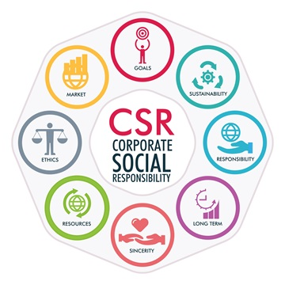
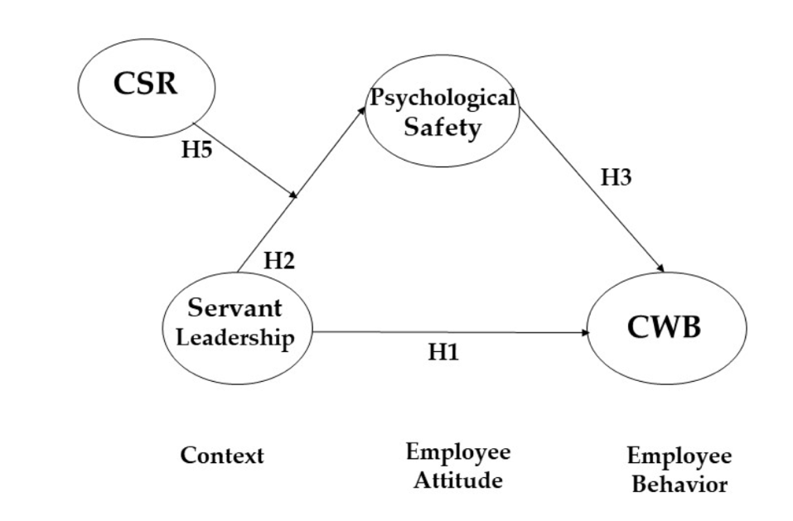
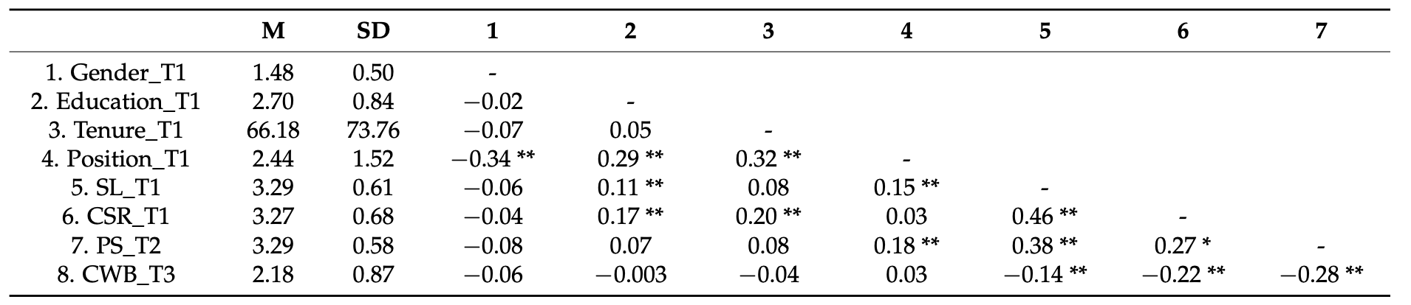
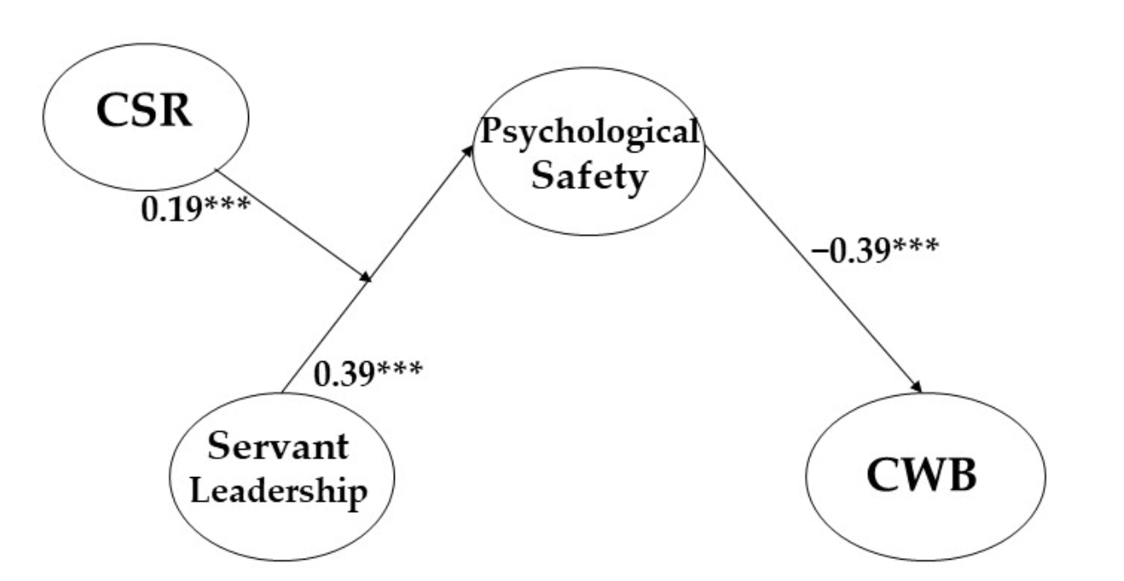
Literature Review of Relationship Between Servant
Leadership and Organizational Outcomes of CSR
Author: Jiang Xingzhi
Introduction
Mechanisms
Sense of Community
Reed et al. (2011) :
Servant leadership focuses on teamwork, serving others, and building a sense of community, which generates an ethical organizational culture.
Ethical Culture
Moreover, Choi et al.’s (2015):
How ethical culture influences outcomes of CSR by revealing ethical culture enhances followers’ positive attitudes toward CSR.
Psychological Safety
Taewoo Roh (2023) :
Drawing on the context – attitude – behavior framework, underscores the mediating role of psychological safety in the intricate dynamics of the effects of CRS, especially servant leadership on employee behavior.
Data Collection
There is scant literature about influence of leadership style on organisational outcomes
of CSR. This literature review is narrowed to
Participants and Procedure
Encompassed working professionals from certain age, country and industry.
Recruitment: online research entity boasting a participant pool
Surveys: participants in three separate batches & collected individuals’ occupations and contact details
review academic literature pertaining to servant leadership given that servant leadership stands out among leadership styles by emphasizing ethical behavior, and stakeholder engagement in alignment with CSR principles. The review will first evaluate literature about definitions of CSR and servant leadership, and then it will focus on critically evaluating literature on relationship between servant leadership and organisational outcomes of CSR. After figuring out, we will explore the mechanisms and find the one interested us most. Ultimately, research questions based on former study will be proposed.
Justification
Efficacious for securing a heterogeneous participant sample
A direct and immediate mode of communication: allowing for any real-time clarifications, reminders, and prompt assistance during our study.
Analytical Methods
Basic Descriptive Statistics
Research Question:
Means, Standard Deviations, and Intercorrelations of all study variables
Cronbach’s alpha : Assessing the internal consistency of scales
A threshold value of 0.70 was considered acceptable.
Summary of Literature Review:
How does servant leaders influence psychological safety in organizations to promote active employee participation in CSR?
Relationship
Kincaid (2012):
How principles of servant leadership (e.g. listening, empathy, healing) enhance positive outcomes of CSR efforts.
Coetzer et al. (2017):
Servant leadership is associated with two organisational outcomes, namely, improved customer service and enhanced procedural justice.
Research Design:
Multiple Regression Analysis
CWB : Counterproductive Work Behavior)
Direct effects between the Independent variable (servant leadership)
Mediator (psychological safety)
Moderator (corporate social responsibility)
Dependent variable (employee behavior)
A Promising Way
Van de Bunt and Salomons’s (2018):
How servant leadership traits can influence and inspire CSR practices to be implemented in the context of pharmaceutical industry.
The Moderated Mediation Model
Figure 1. Theoretical model.
To ascertain if the indirect effect of servant leadership on employee behaviour via psychological safety is conditional upon levels of CSR.
Encouraging Pro‐environmental Behaviors
Afsar et al. (2018) :
Based on a quantitative analysis of data collected from a survey among sample of 298 employees in different industries. Thus,the sample is much more representative, and the findings can be generalised to different industries.
?
?
?
Bootstrapping & Confirmatory Factor Analysis (CFA)
Provides bias-corrected confidence intervals
Validated the measurement model, entailed examining a moderated mediation model
What’s the relationship and strength between Servant Leaders & Psychological Safety & CSR?
[1]Afsar, B., Cheema, S. and Javed, F., 2018. Activating employee's pro‐environmental behaviors: The role of CSR, organizational identification, and environmentally specific servant leadership. Corporate Social Responsibility and Environmental Management, 25(5), pp.904-911.
[2] van de Bunt, S. and Salomons, L., 2018. Servant leadership as a key for the successful implementation of corporate social responsibility in the pharmaceutical industry. The Palgrave Handbook of Workplace Spirituality and Fulfillment, 1, pp.397-422.
[3]Kincaid, M., 2012. Building corporate social responsibility through servant-leadership. International Journal of Leadership Studies, 7(2), pp.151-171.
[4]Coetzer, M.F., Bussin, M. and Geldenhuys, M., 2017. The functions of a servant leader. Administrative Sciences, 7(1), p.5.
[5] Taewoo Roh 1, Min-Jik Kim 2, and Yunsook Hong 3,., 2023. The Mediating Role of Psychological Safety and the Moderating Effect of Corporate Social Responsibility 101, pp.415-434
Reference

