Slide 1
Meeting 12/4

Slide 2
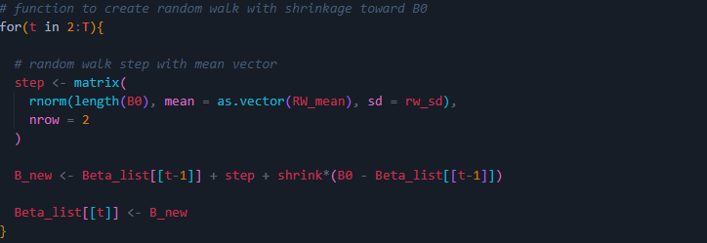
Random Walk of Time-Varying Parameters
Set the RW SD and shrinkage
Initialize a list of length T
The first element is specified B0
For every occasion where T>1
We create a random walk step, which is just a deviation from the previous B.
We draw it with mean 0 and sd rw_sd from a normal
Then create the new Beta as the old + step size but shrink the deviation of the previous step back to the mean by x%.

Slide 3
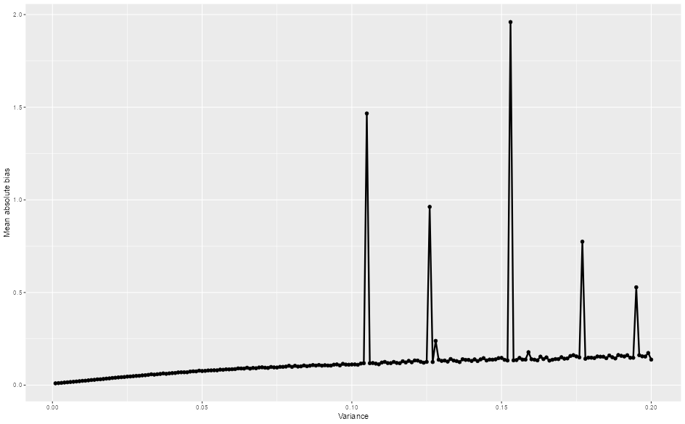
Bias of the RI-CLPM

Slide 4
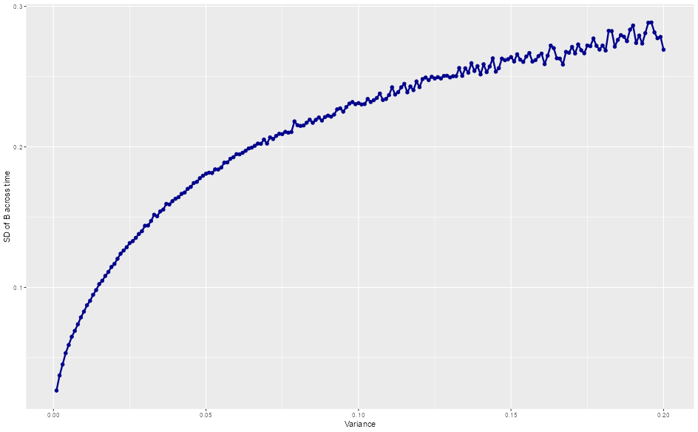
Standard deviation of B

Slide 5
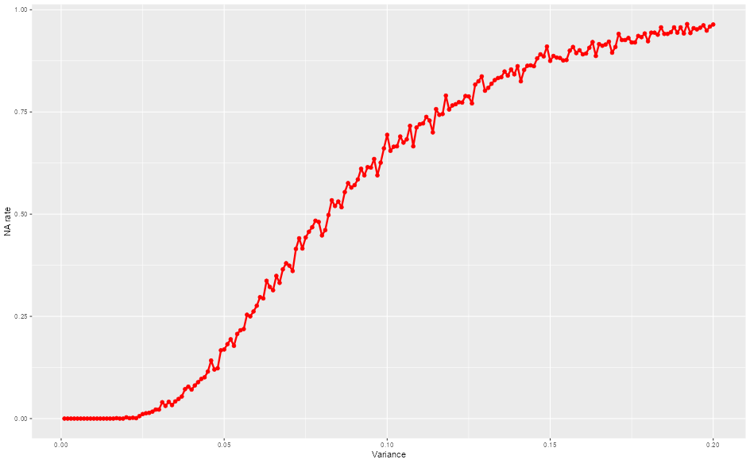
Higher variance = no stationarity

Slide 6
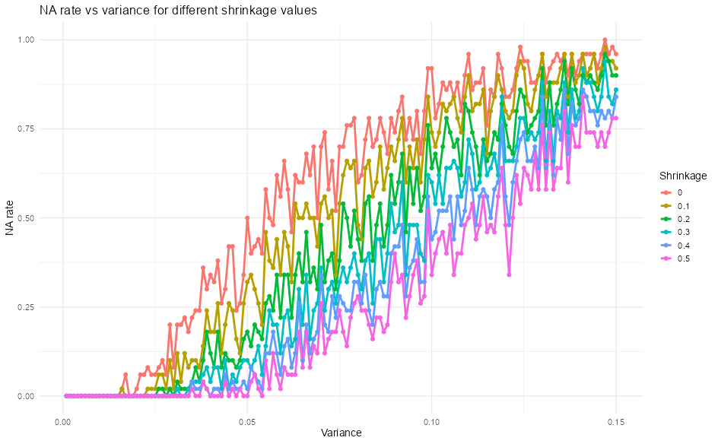
Stationarity

Slide 7
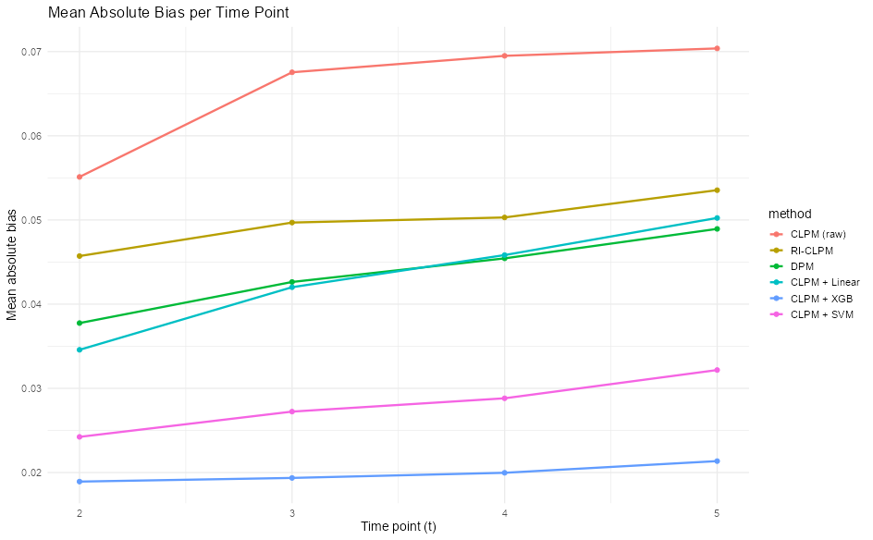
Non-linear varying confounders

Slide 8
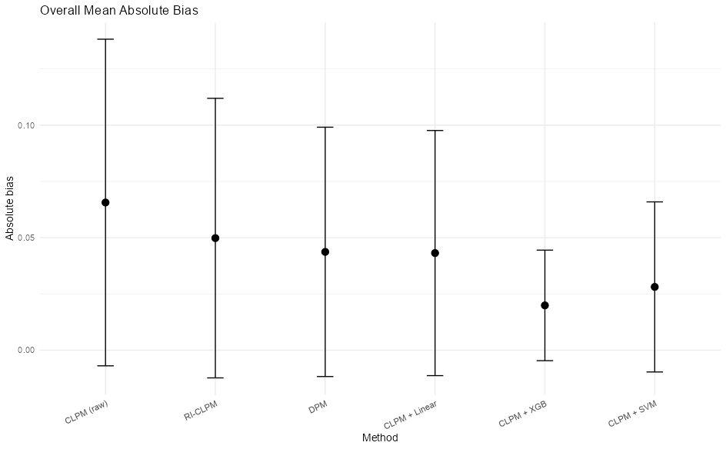
Non-linear varying confounders

