Slide 1
Meeting 3/27/26

Slide 2
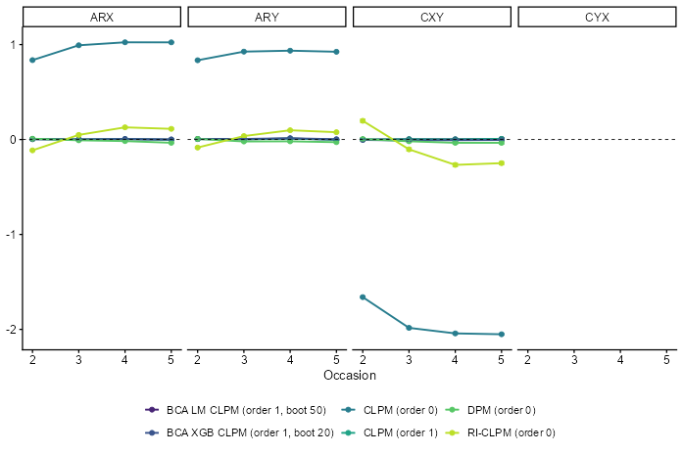
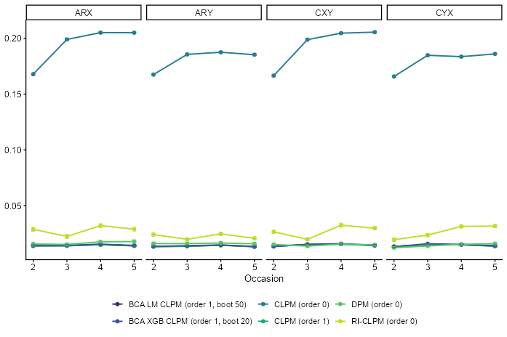
Sim results vorige week (N=5000).
Cov(Rix, Riy) > 1.
Relative bias
RMSE

Slide 3
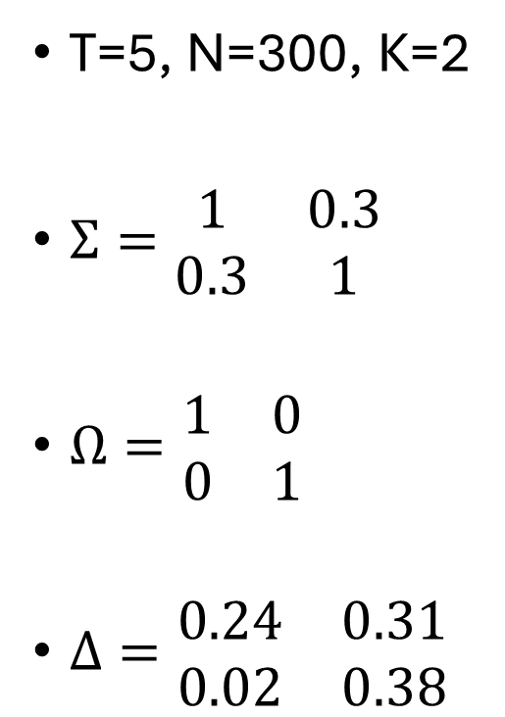

DGM
T=5, N=300, K=2
$Σ=\begin{matrix}1 & 0.3 \\ 0.3 & 1\end{matrix}$
$Ω=\begin{matrix}1 & 0 \\ 0 & 1\end{matrix}$
$Δ=\begin{matrix}0.24 & 0.31 \\ 0.02 & 0.38\end{matrix}$
$Φ=\begin{matrix}0.2 & 0 \\ 0.1 & 0.2\end{matrix}$

Slide 4
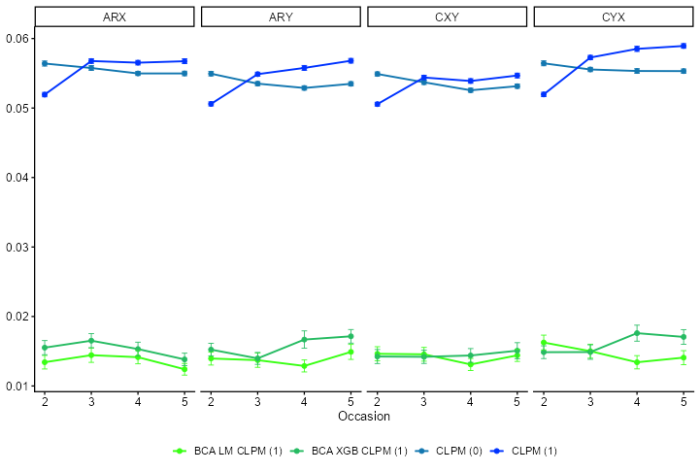
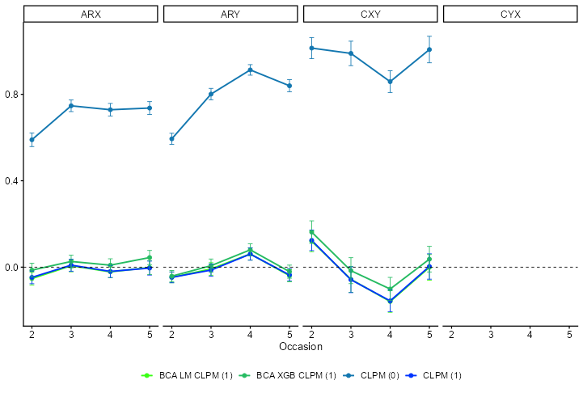
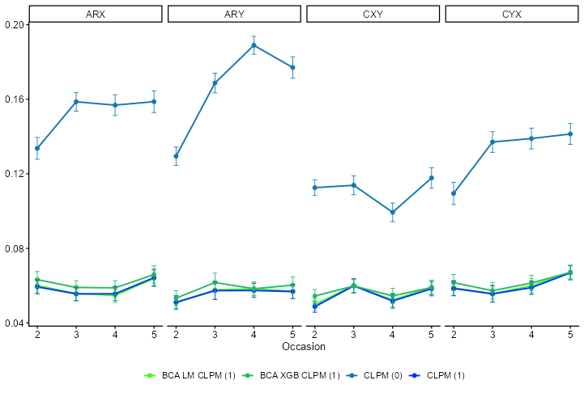
CLPM
S.E.
Relative bias
RMSE

Slide 5
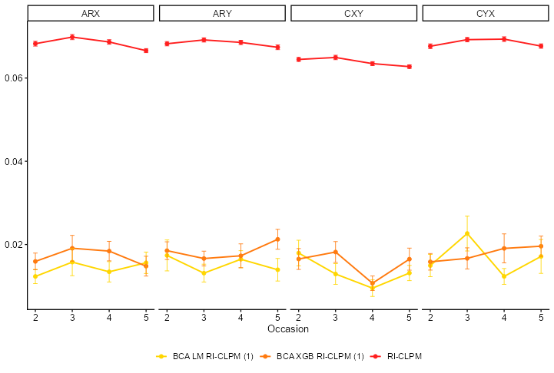
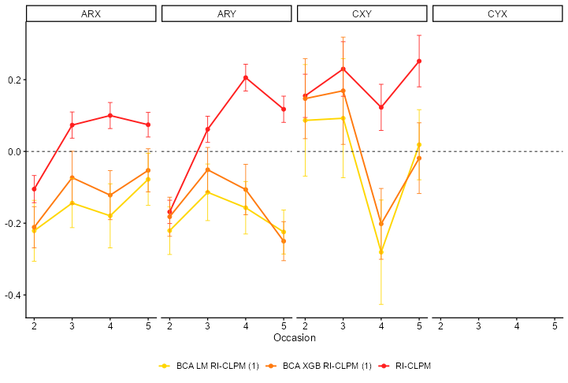
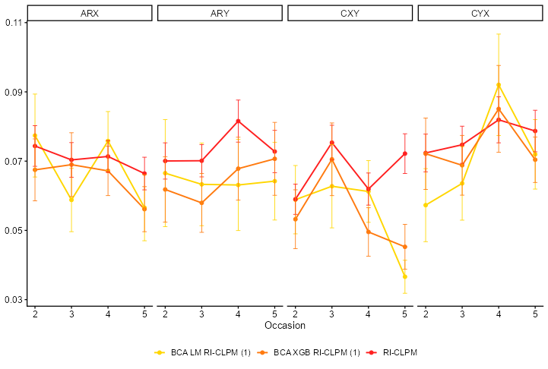
RICLPM
S.E.
Relative bias
RMSE

Slide 6
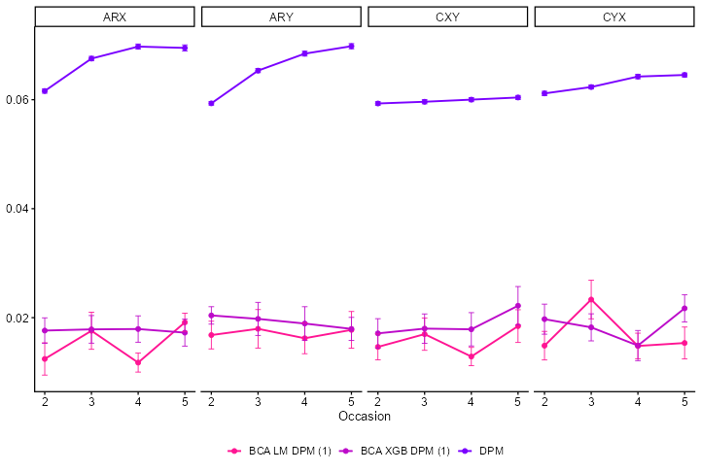
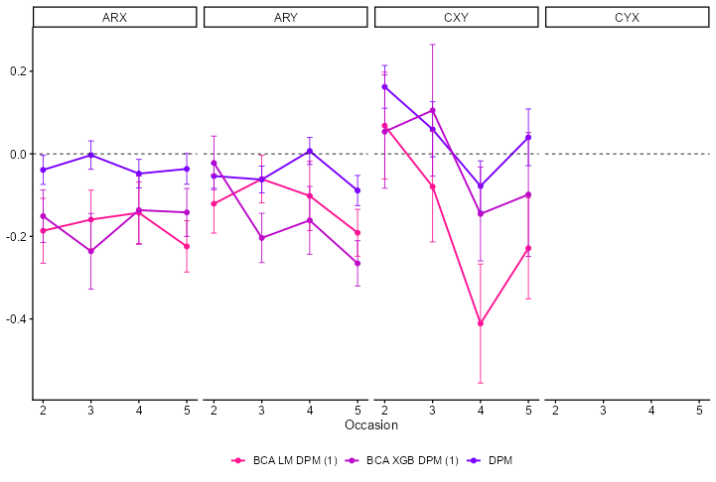
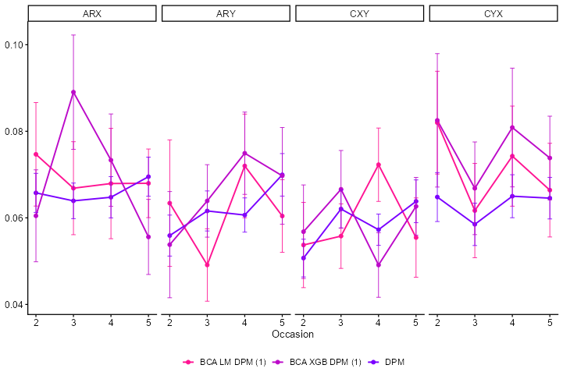
DPM
S.E.
Relative bias
RMSE

Slide 7
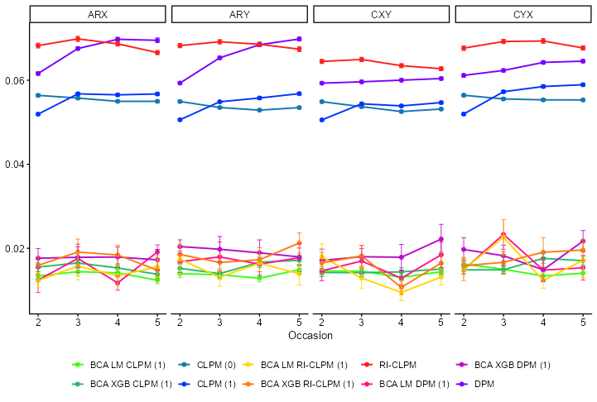
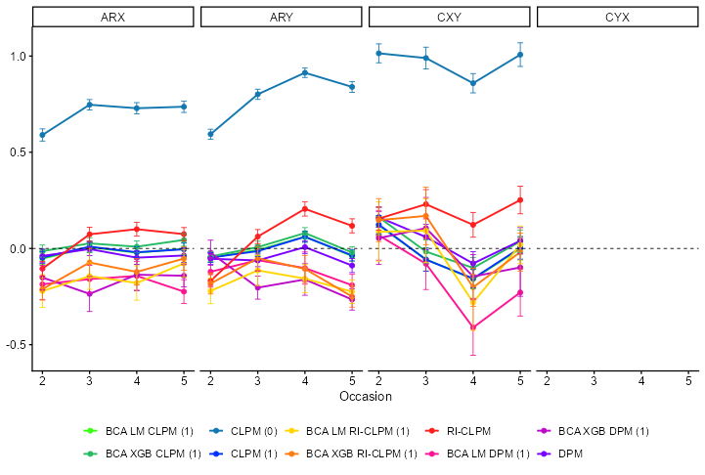
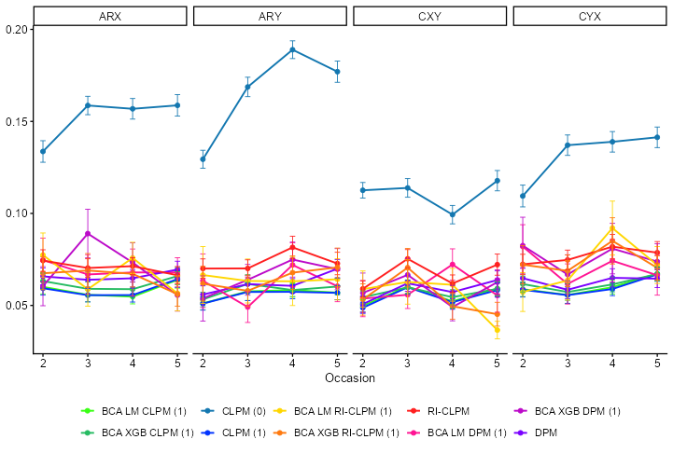
Compleet
S.E.
Relative bias
RMSE

