Slide 1
Baseline Covariate Adjustment For longitudinal research in the social sciences
Mano van Holten

Slide 2
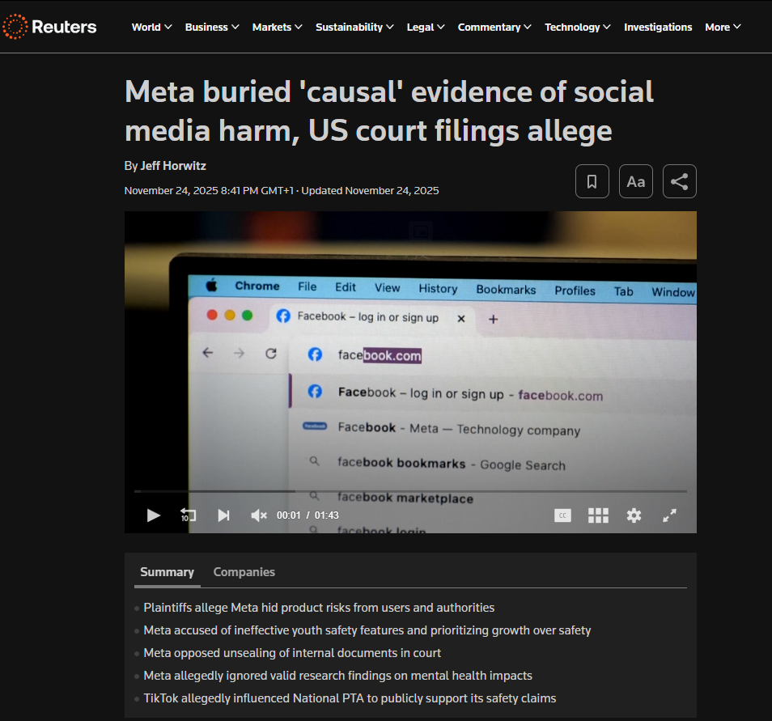

Slide 3
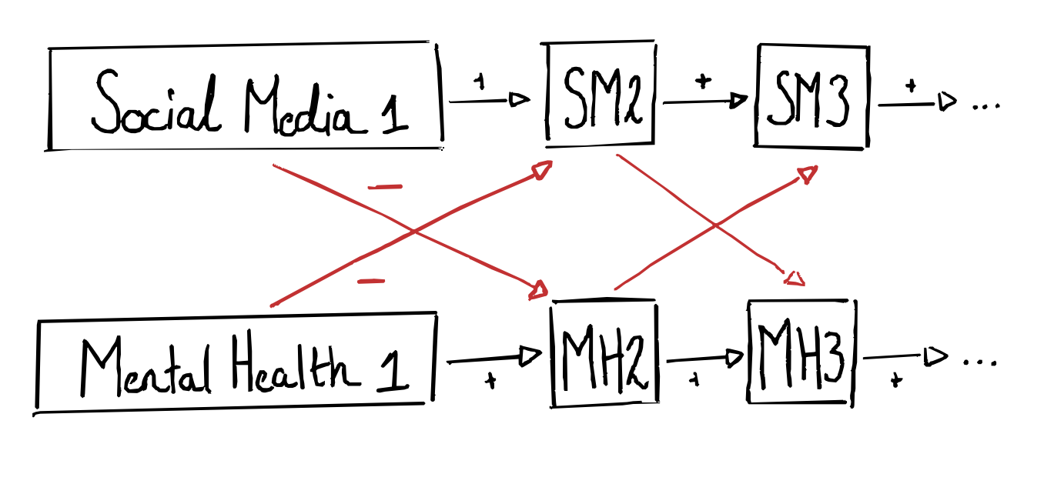
Panel data

Slide 4
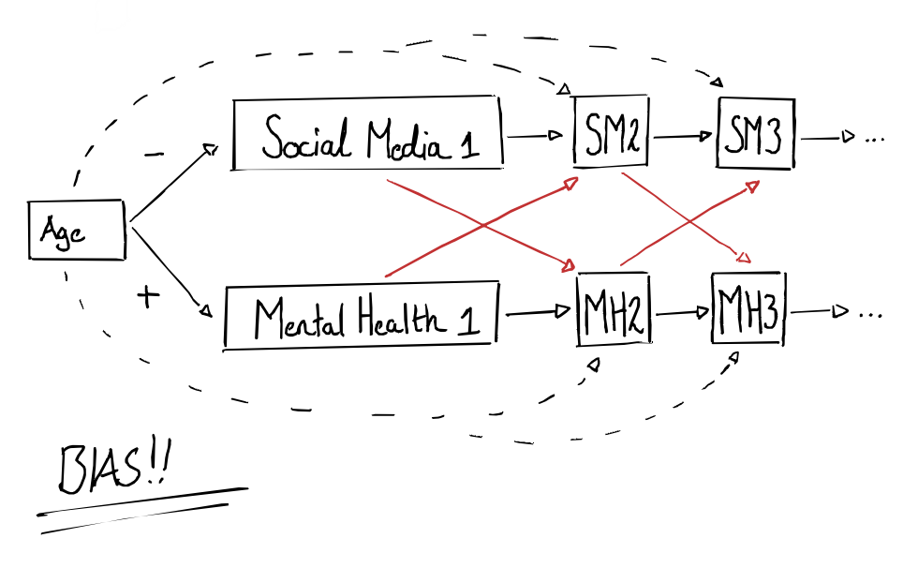
Problem 1: Confounders

Slide 5
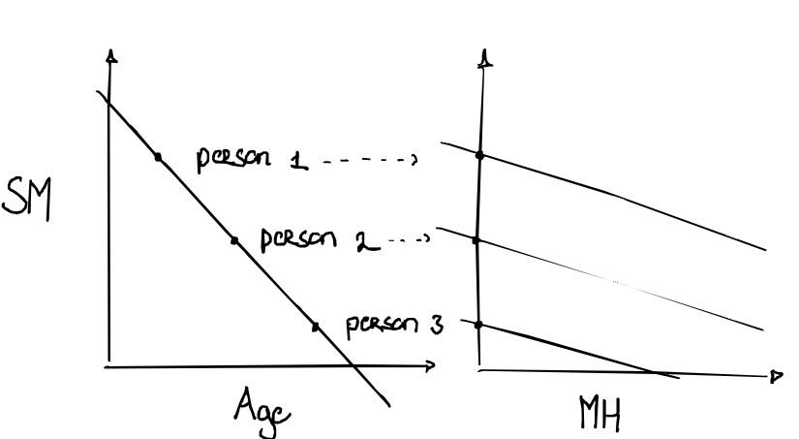
Solution 1: RI-CLPM

Slide 6
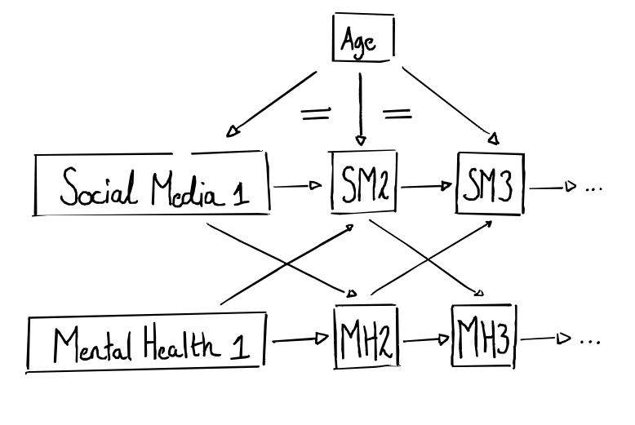
Problem 2: Variation

Slide 7
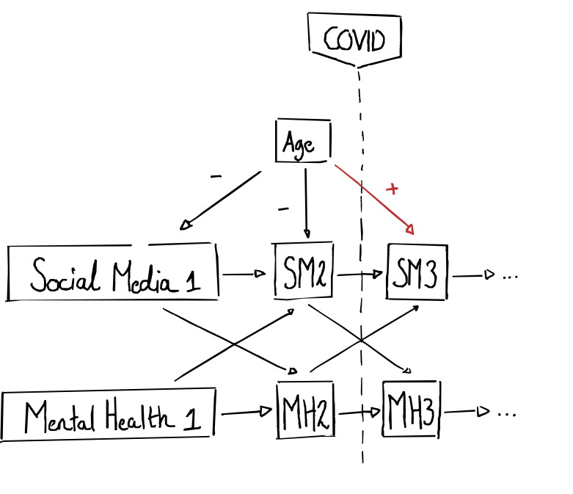
Problem 2: Variation

Slide 8
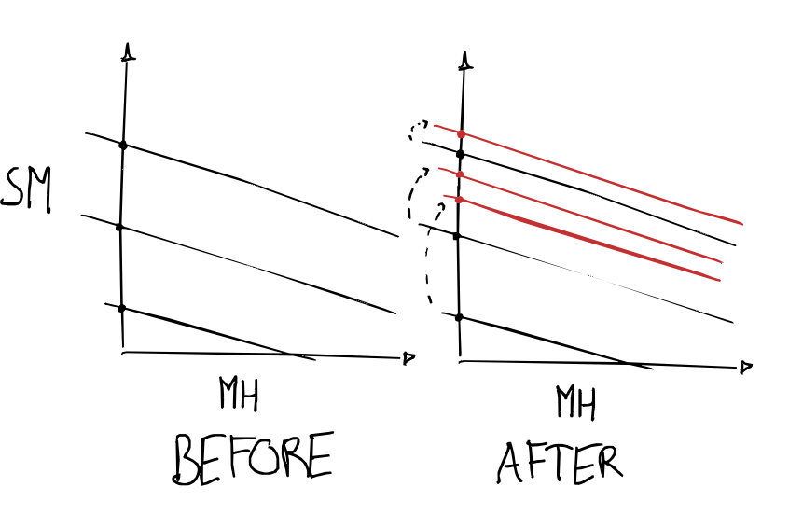
Problem 2: Variation

Slide 9
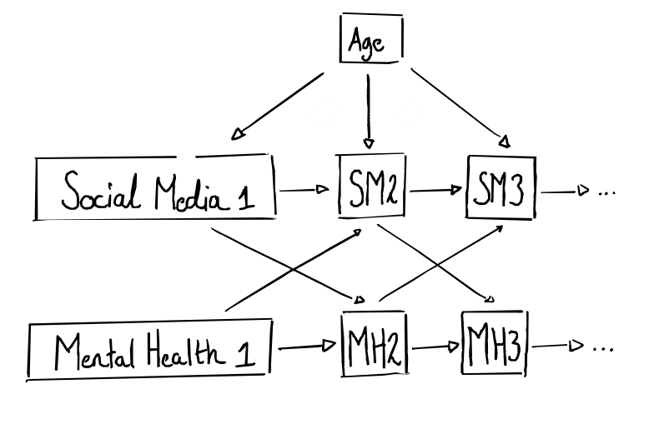
Solution 2: linear BCA

Slide 10
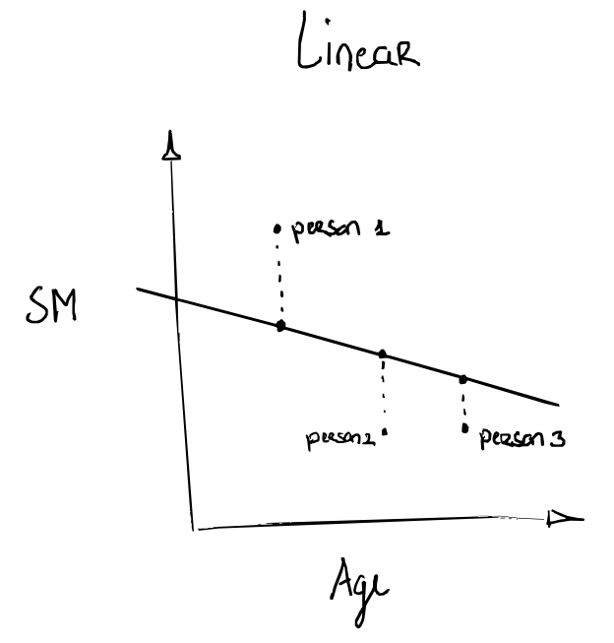
Solution 2: linear BCA

Slide 11
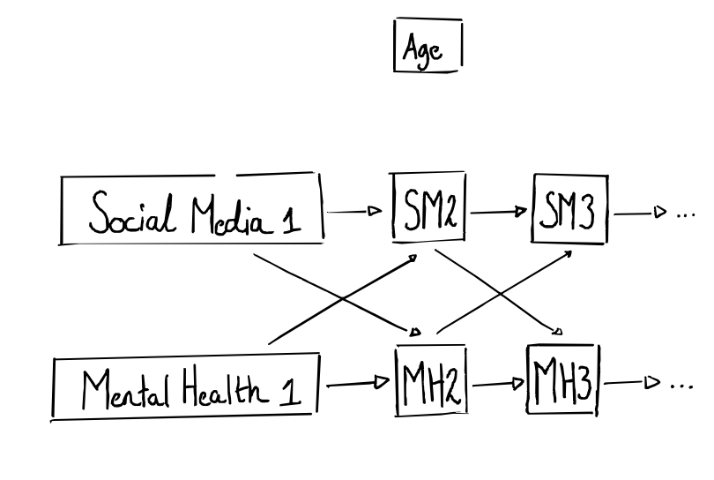
Solution 2: linear BCA

Slide 12
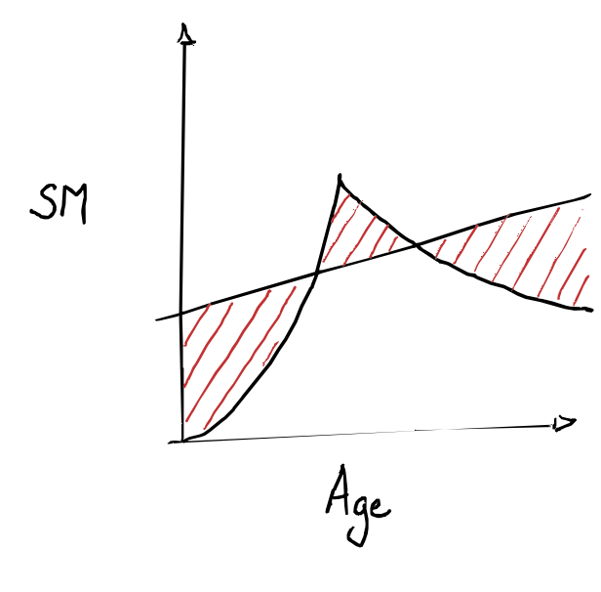
Problem 3: Non-linearity

Slide 13
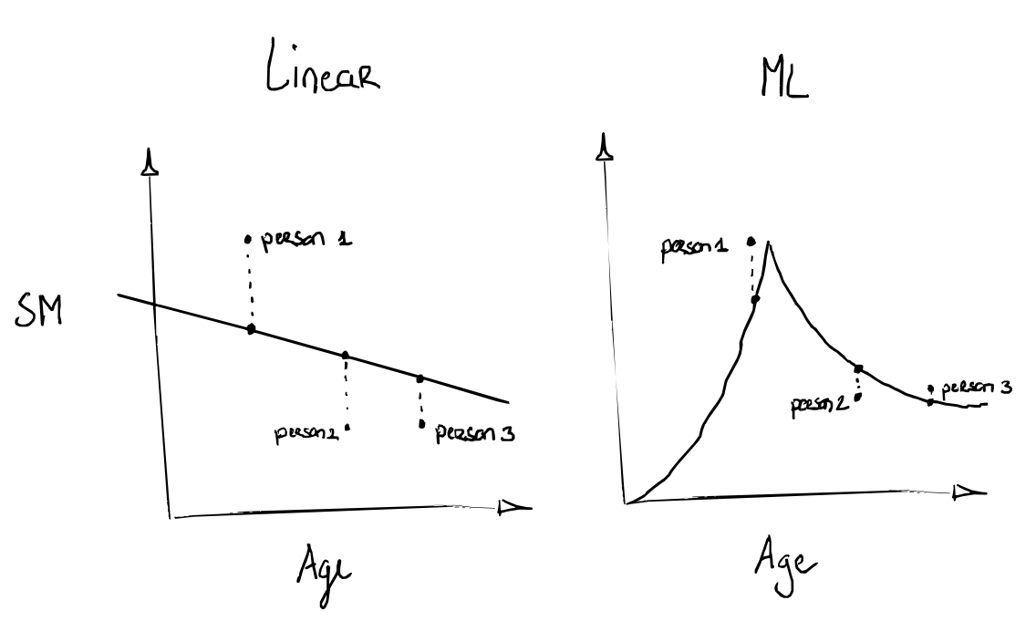
Solution 3: Machine learning

Slide 14
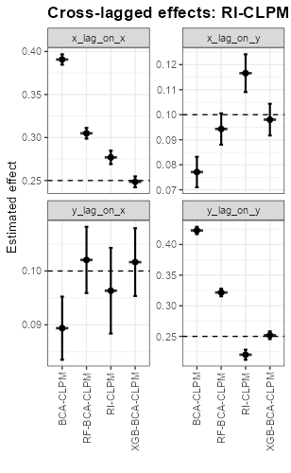
Conclusion

