Slide 1
Thesis
Baseline Covariate Adjustment for CLPM’s

Slide 2
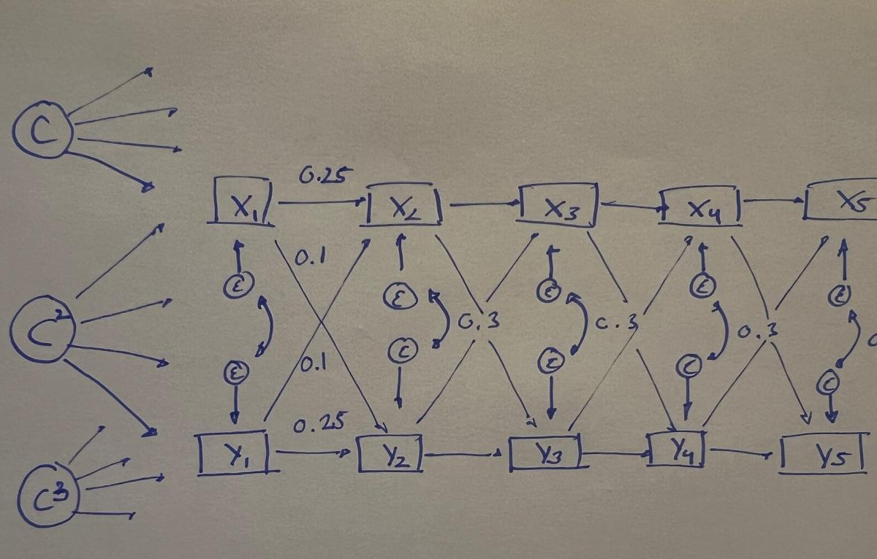
Problem / RQ
Notes:
Time-invariant confounders
Methods exist to deal with linear unobserved confounders
Methods exist to deal with non-linear confounders if we know their functional form

Slide 3
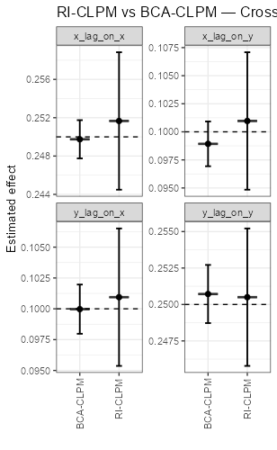
Problem / RQ Linear data.
Notes:
Time-invariant confounders
Methods exist to deal with linear unobserved confounders
Methods exist to deal with non-linear confounders if we know their functional form

Slide 4
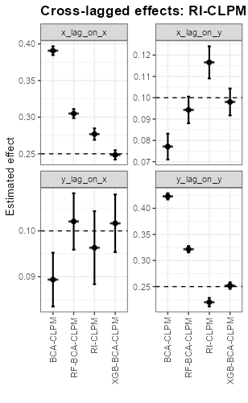
Problem / RQ. Linear data.
Notes:
Time-invariant confounders
Methods exist to deal with linear unobserved confounders
Methods exist to deal with non-linear confounders if we know their functional form

Slide 5
BCA SEM
Step 1: Regress X_t (and Y_t) on C
Step 2: Save the residuals
Step 3: Do your standard CLPM
Step 4: Oops we should have bootstrapped to estimate our errors.
Notes:
Time-invariant confounders
Methods exist to deal with linear unobserved confounders
Methods exist to deal with non-linear confounders if we know their functional form

Slide 6
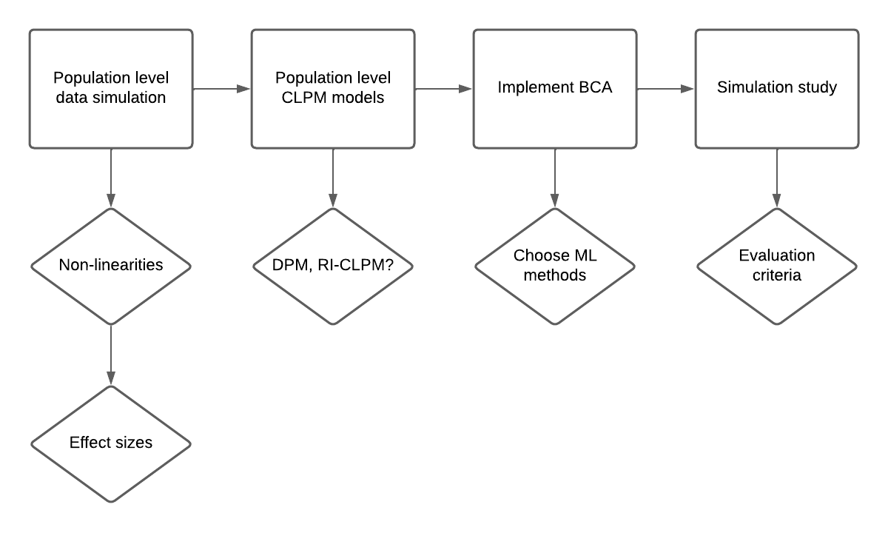
Workflow
Notes:
Time-invariant confounders
Methods exist to deal with linear unobserved confounders
Methods exist to deal with non-linear confounders if we know their functional form

Slide 7
Problem / RQ
Notes:
Time-invariant confounders
Methods exist to deal with linear unobserved confounders
Methods exist to deal with non-linear confounders if we know their functional form

Slide 8
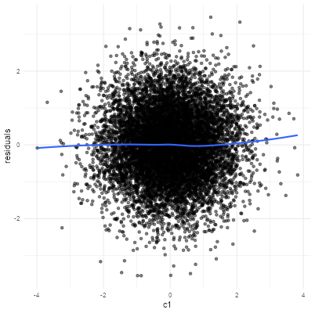
Linear data
Notes:
Time-invariant confounders
Methods exist to deal with linear unobserved confounders
Methods exist to deal with non-linear confounders if we know their functional form

Slide 9
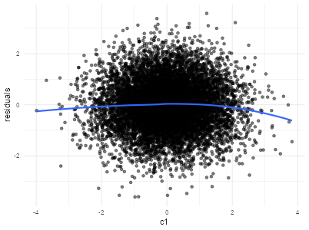
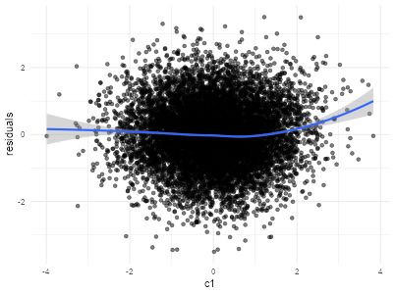
Data: Cubic & Cutoff
Notes:
Time-invariant confounders
Methods exist to deal with linear unobserved confounders
Methods exist to deal with non-linear confounders if we know their functional form

Slide 10
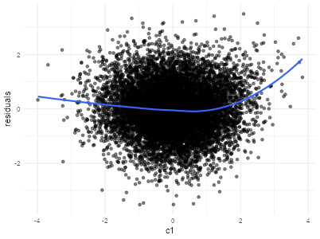
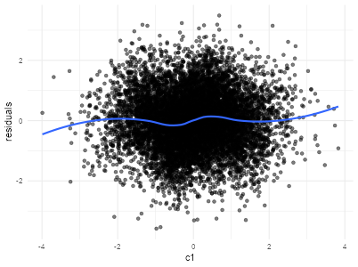
Data: Exponential & Sine
Notes:
Time-invariant confounders
Methods exist to deal with linear unobserved confounders
Methods exist to deal with non-linear confounders if we know their functional form

Slide 11
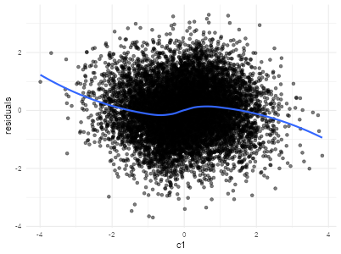
Data: tanh
Notes:
Time-invariant confounders
Methods exist to deal with linear unobserved confounders
Methods exist to deal with non-linear confounders if we know their functional form

Slide 12
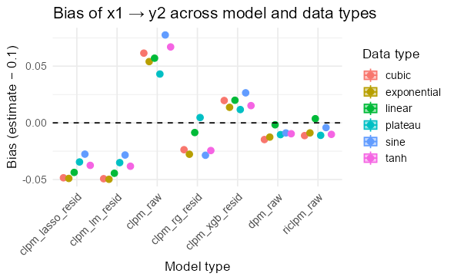
Models
Notes:
Time-invariant confounders
Methods exist to deal with linear unobserved confounders
Methods exist to deal with non-linear confounders if we know their functional form

Slide 13
Models: Linear confounding
Notes:
Time-invariant confounders
Methods exist to deal with linear unobserved confounders
Methods exist to deal with non-linear confounders if we know their functional form

Slide 14
Models: non-linear confounding
Notes:
Time-invariant confounders
Methods exist to deal with linear unobserved confounders
Methods exist to deal with non-linear confounders if we know their functional form

Slide 15
Workflow
Notes:
Time-invariant confounders
Methods exist to deal with linear unobserved confounders
Methods exist to deal with non-linear confounders if we know their functional form

Slide 16
Dit was mijn spreekbeurt. Zijn er nog vragen?
Notes:
Time-invariant confounders
Methods exist to deal with linear unobserved confounders
Methods exist to deal with non-linear confounders if we know their functional form

