Slide 1
Baseline Covariate Adjustment For longitudinal research in the social sciences
Mano van Holten

Slide 2
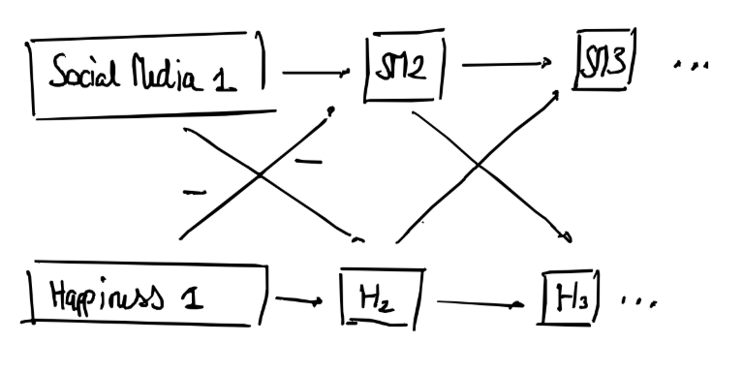

Slide 3
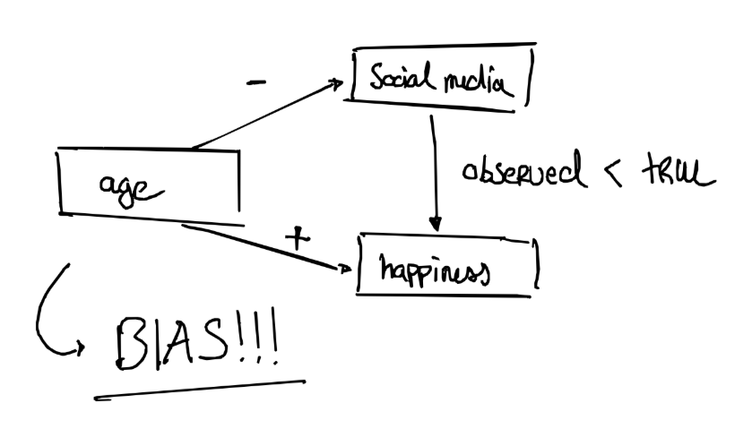

Slide 4
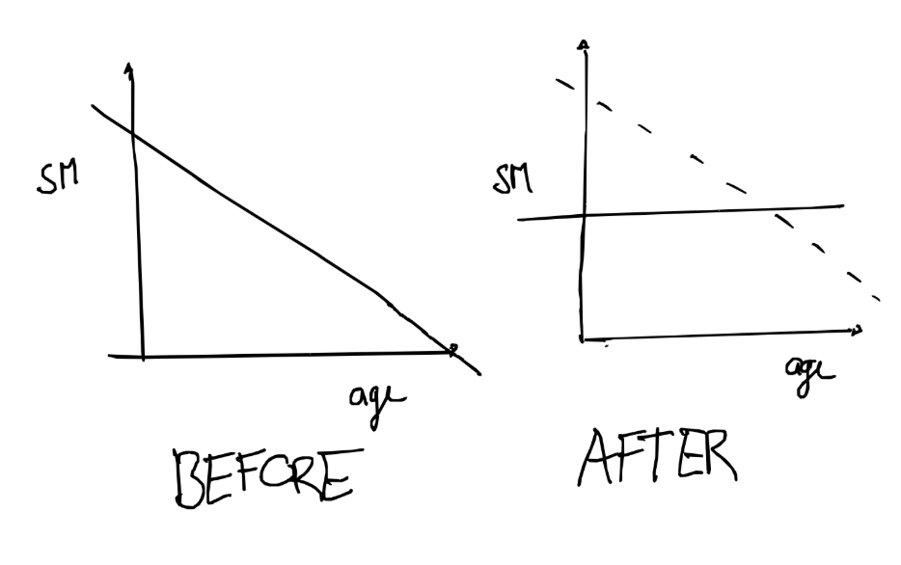
Random
Intercepts
-
Cross
Lagged
Panel
Models

Slide 5
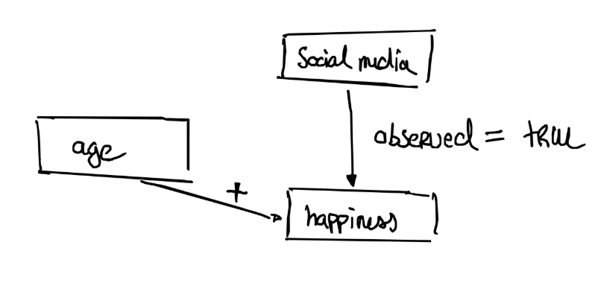

Slide 6
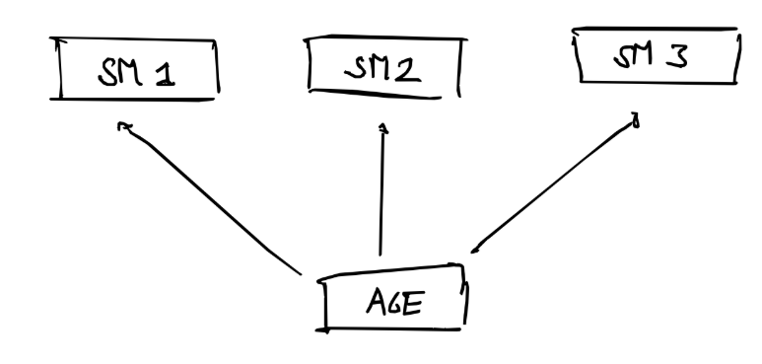

Slide 7
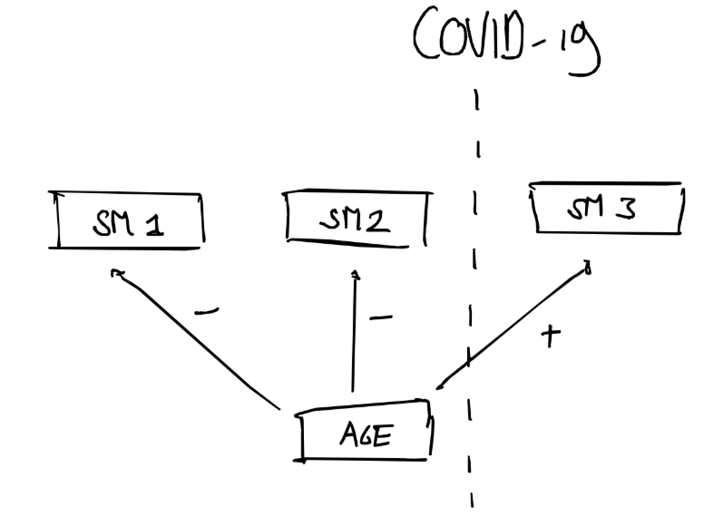

Slide 9
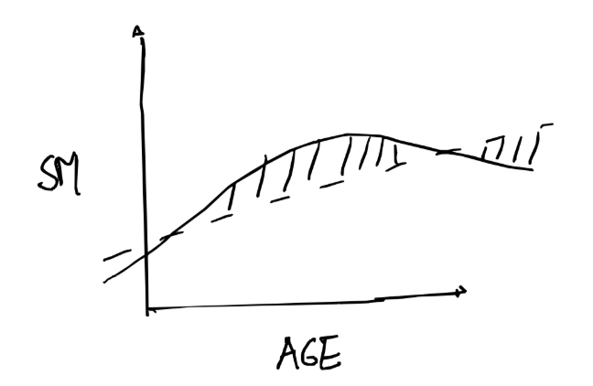

Slide 10
