Slide 1
Thesis Meeting 17/3
Mano

Slide 2
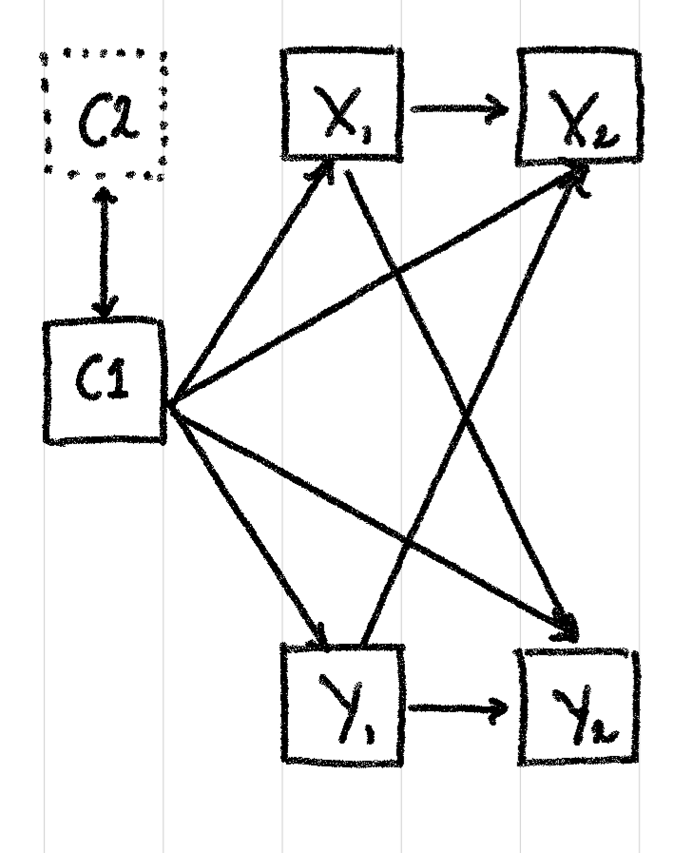
Problem

Slide 3
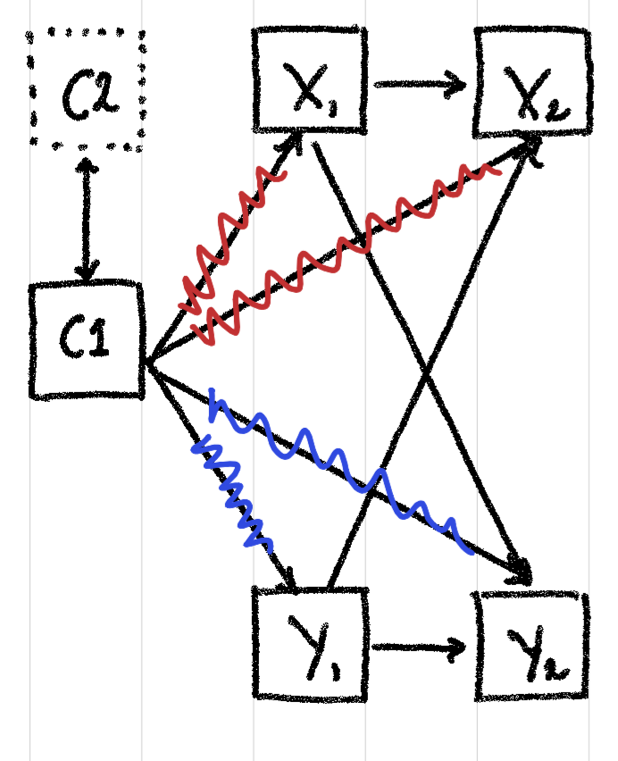
Solutions
Explicit control in the model.
Outcome model.
Treatment model.
Control using latent variables.
Instrumental variables.

Slide 4
Problems
We do not observe one or more baseline confounders.
The time-invariant confounder has a varying effect.
The effect of the confounder is not linear.
The confounder is not normally distributed.

Slide 5
When do we have an issue?
Problem | Latent variable approaches | Linear adjustment | Flexible adjustment
Unobserved confounders | No | Yes | Yes
Varying effects | Vink et al (in prep) | No | No
Non-linear effects | No | Yes | No
Non-normality | Probably | Probably | No

Slide 6
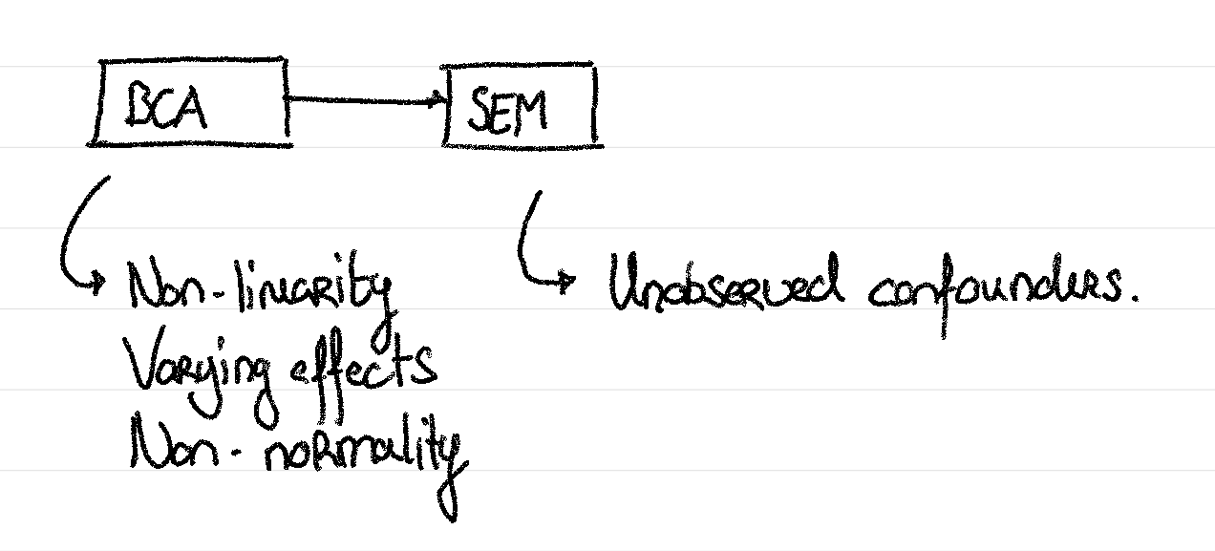
Combining approaches

Slide 7
Overview
Data Generation
BCA
SEM
Confounder effects at t=1
Methods
Freed Factor loadings
Confounder effects at t>1
Bootstrapping
BCA + Latent Vars
Variance calculations

Slide 8
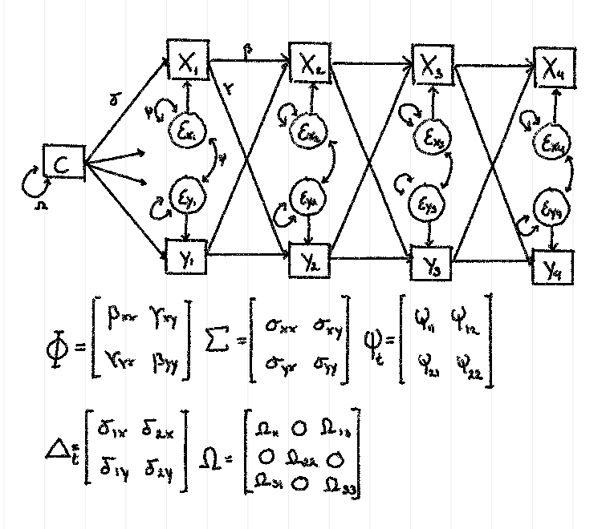
Data generation
Var(X) = Var(Y) = 1
Omega looks like that only in the case that:
C ~ N(0,1)

Slide 9
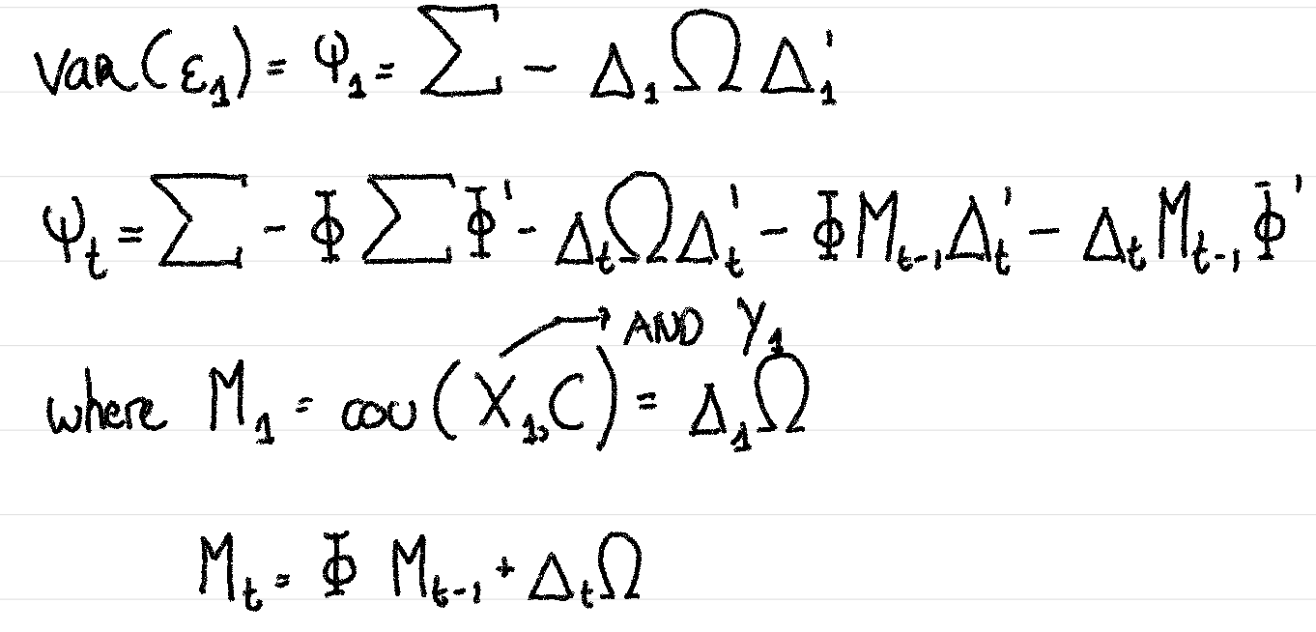
Data generation

Slide 10
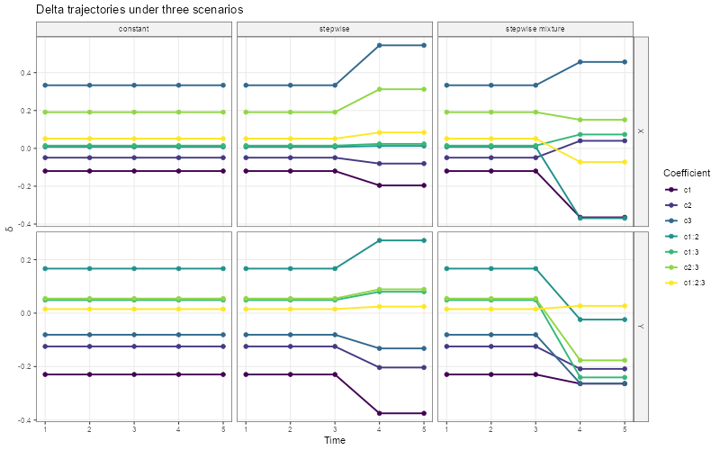
The delta matrix

Slide 11
BCA
Model capacity: bias variance trade-off.
Xgboost
TBA: Lasso regression
TBA: TabPFN
Bootstrap s.e. estimates.

Slide 12
SEM
RICLPM
DPM

Slide 13
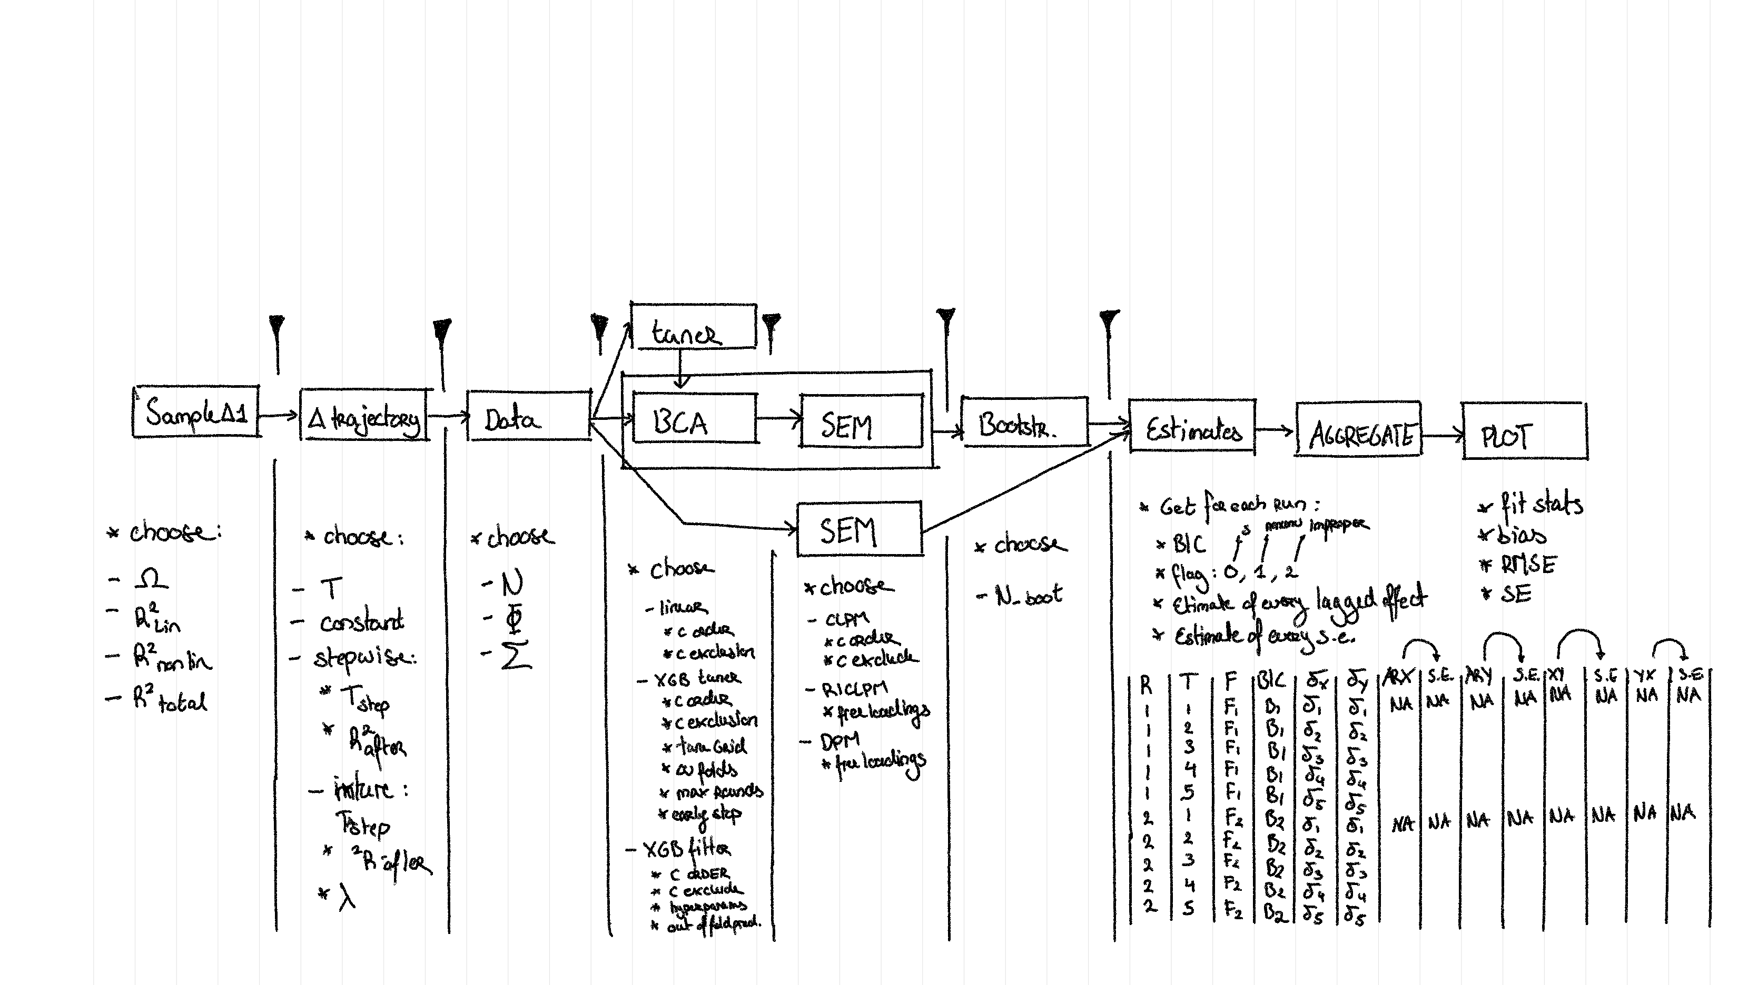

Slide 14
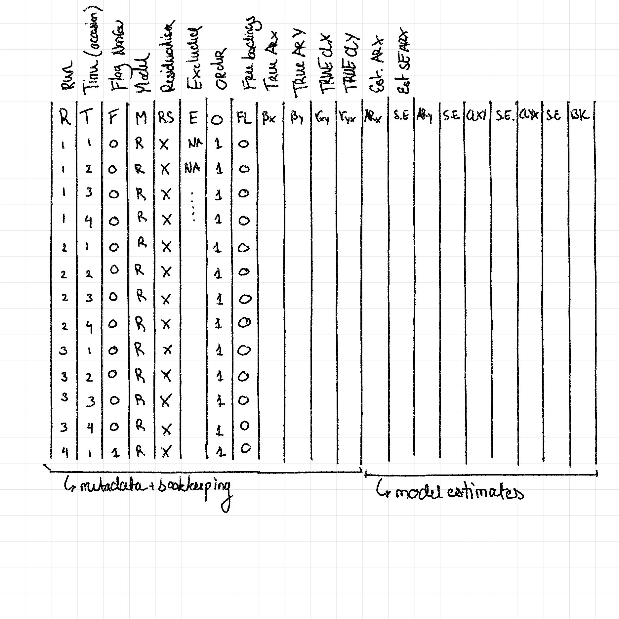

Slide 15
Sim studies (1)
Model | Delta station. | Linearity | All observed | Normality | Interest
True |  |  |  |  | Upper bound
Worse case |  |  |  |  | Lower bound
BCALM CLPM
BCAXGB CLPM
RICLPM
DPM
RICLPM free
DPM free

Slide 16
Sim studies (2)
Model | Delta station. | Linearity | All observed | Normality | Interest
BCALM RICLPM
BCAXGB RICLPM
BCALM DPM
BCAXGB DPM
?

Slide 17
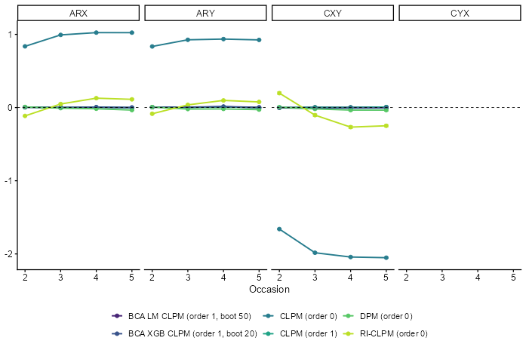
Sim study 1 (N=5000)

Slide 18
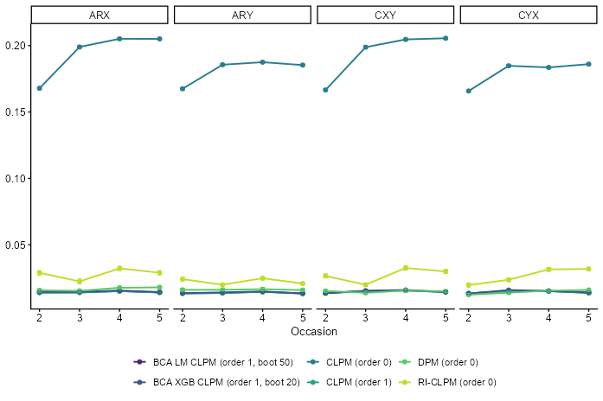
Sim study 1 (N=5000)

Slide 19
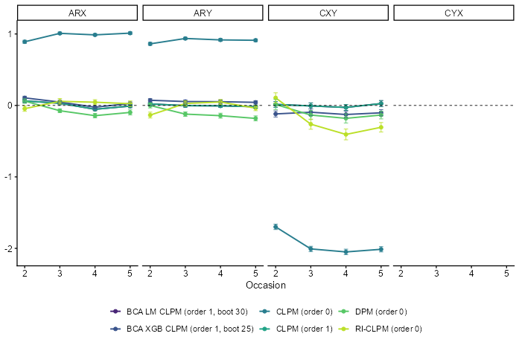
Sim study 2 (N=300)

Slide 20
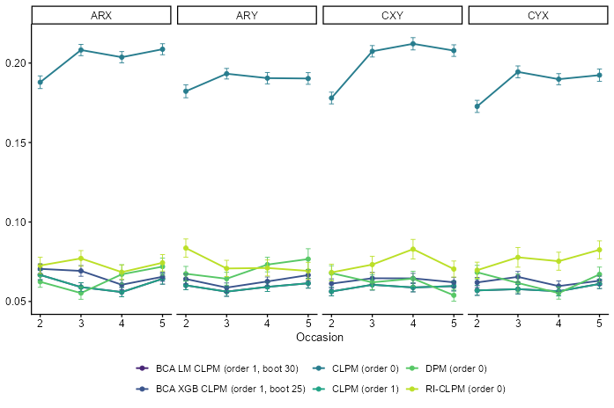
Sim study 2 (N=300)

