Slide 1
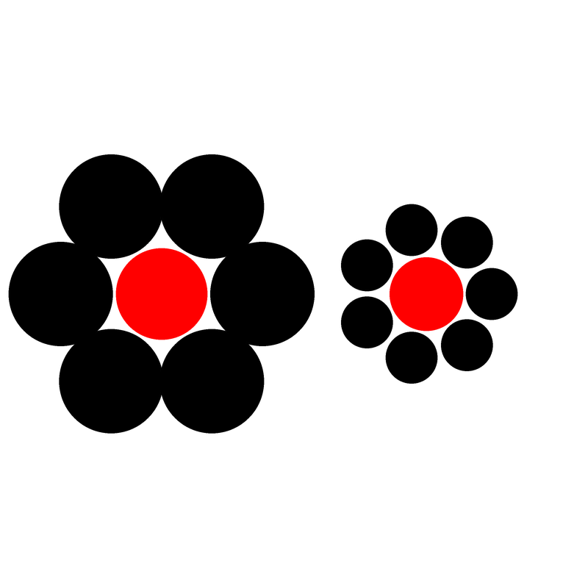


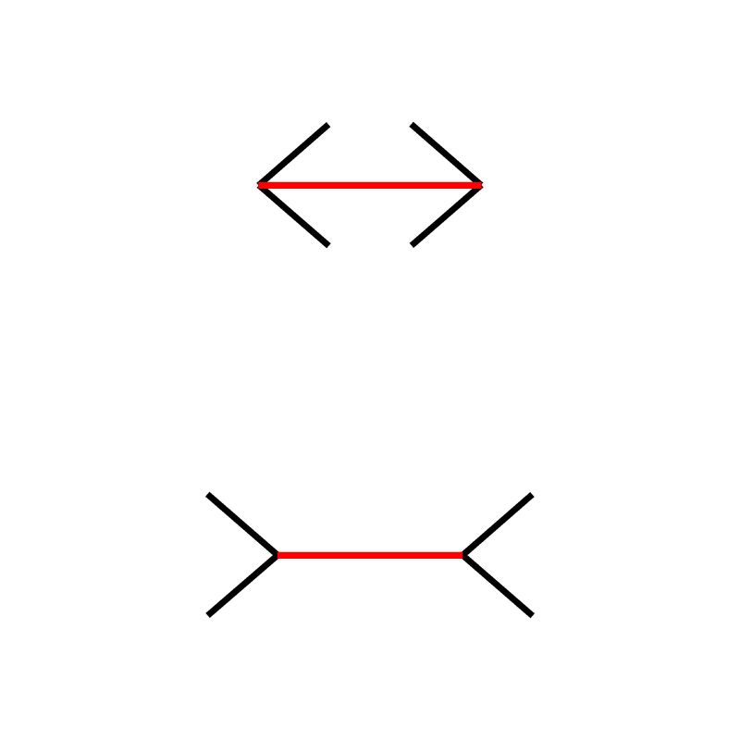
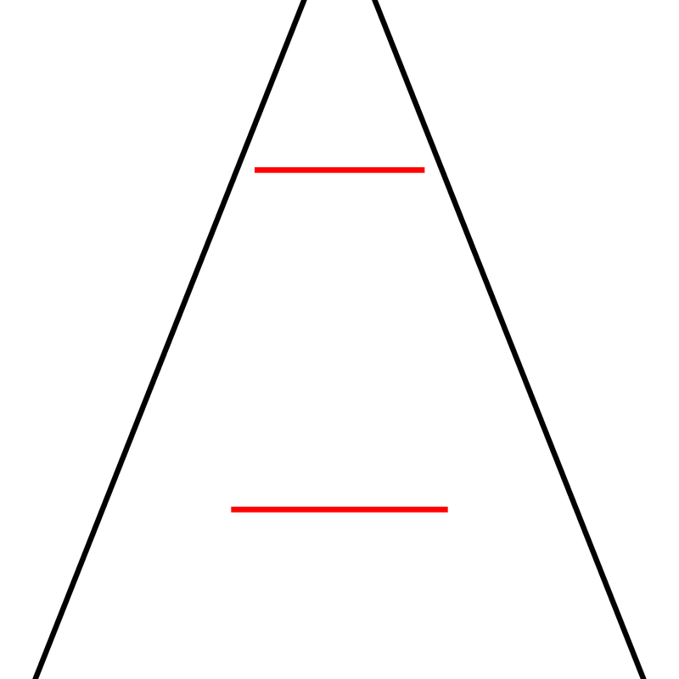
Illusion | Example | Task | Description
Ebbinghaus |  | Which red circle is bigger? | Two circles surrounded by other circles. The circle surrounded by smaller circles appears larger than the one with the larger surrounding circles.
Müller-Lyer |  | Which red line is longer? | Two parallel segments that end with inwards/outwards pointing arrow-like fins. The segment with inward-pointing fins is typically perceived to be longer.
Vertical-Horizontal |  | Which red line is longer? | Two lines segments, one horizontal and one angled. The angled line is usually perceived as longer.

