Slide 1
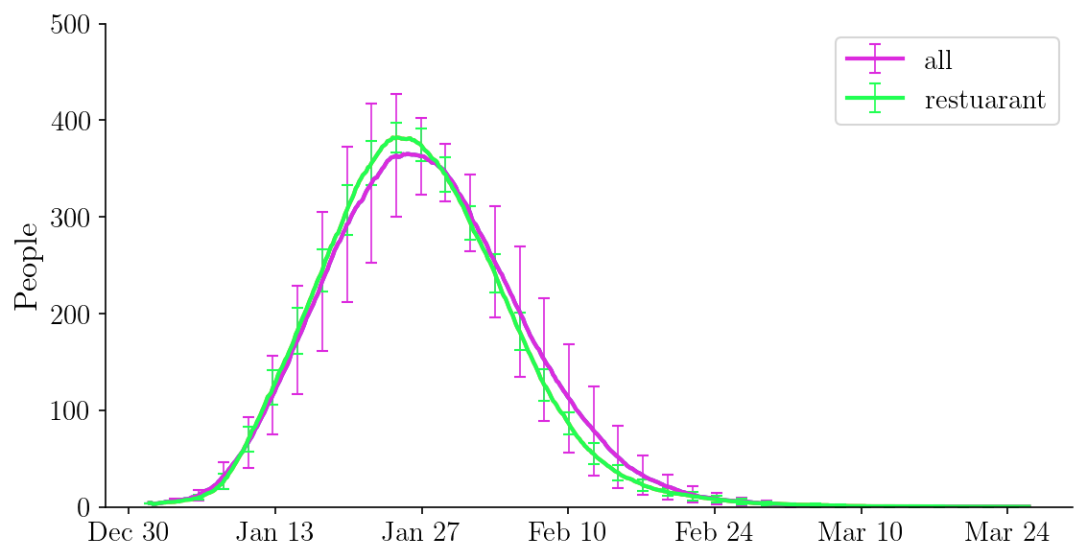
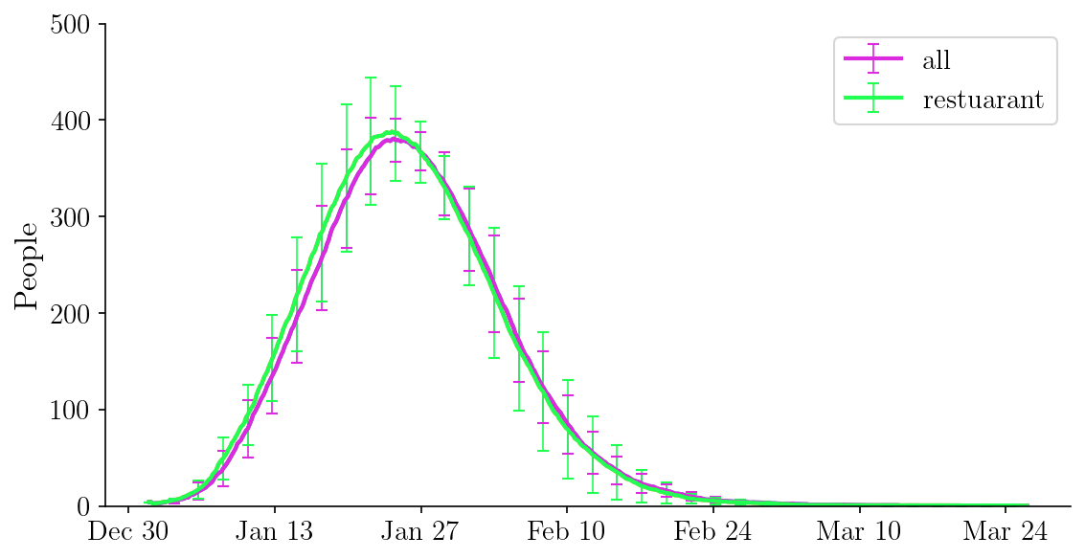
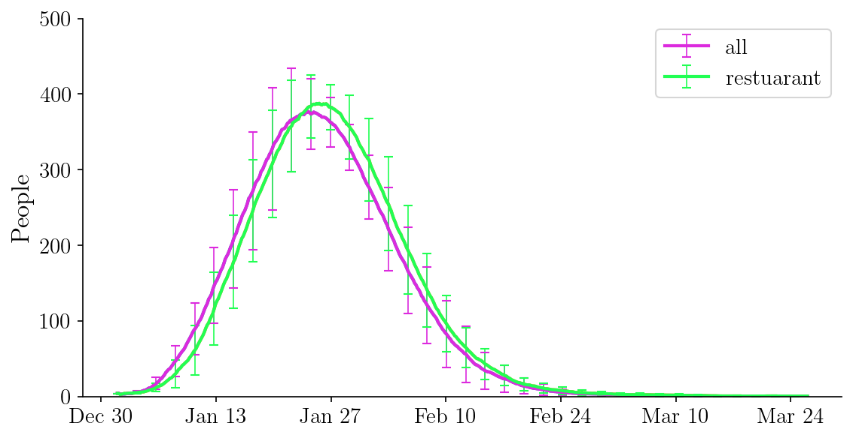
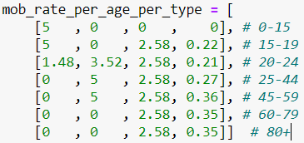


113 individuals comply (12%), 10 repeats, 3 runs
Randomly distributed in all age groups vs all of 113 are restaurant workers
Weighted avg mob rate

Slide 2
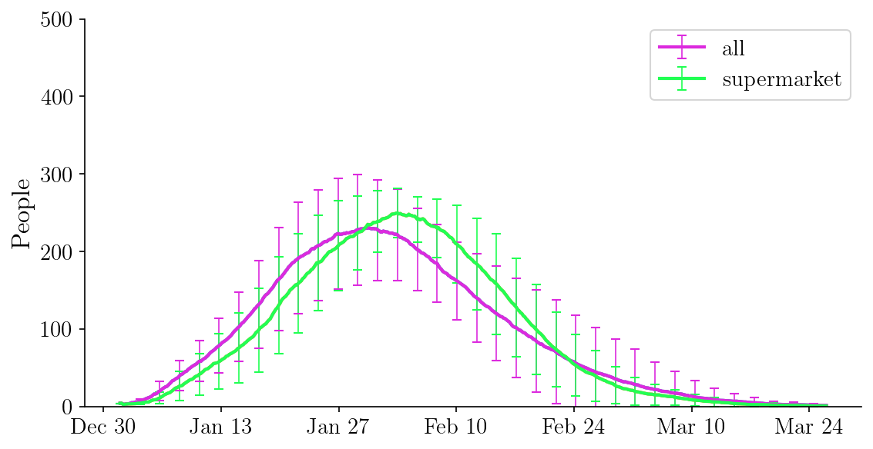
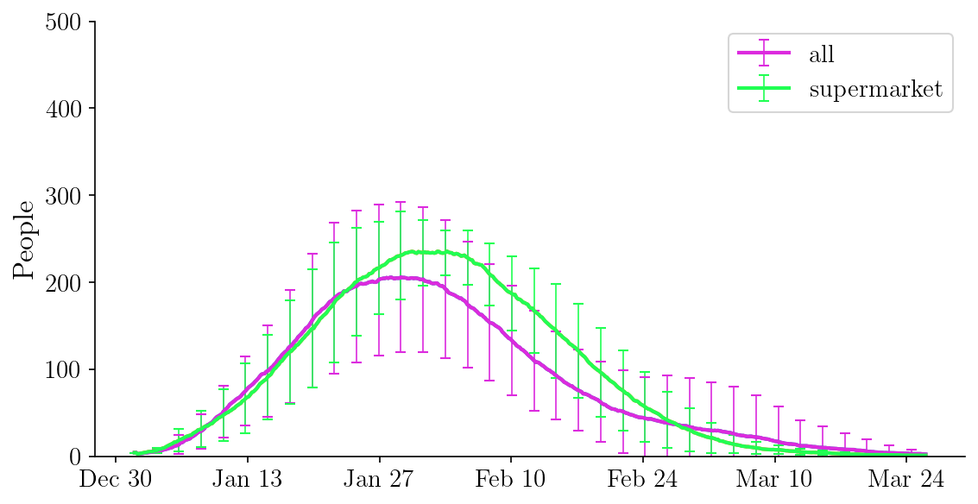
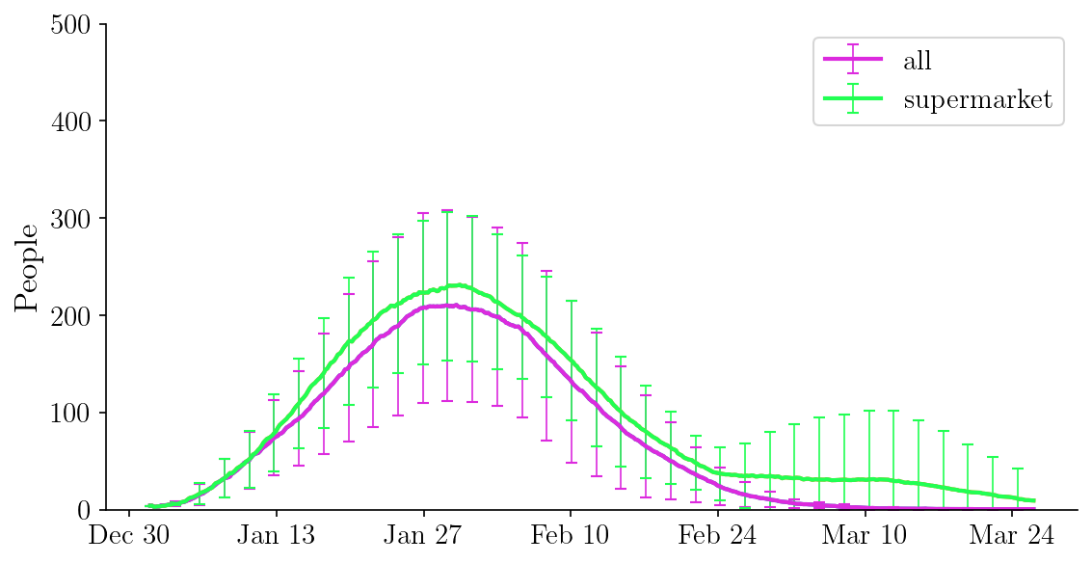


113 individuals comply (12%), 10 repeats, 3 runs
Randomly distributed in all age groups vs all of 113 are supermarket workers
Weighted avg mob rate

Slide 3
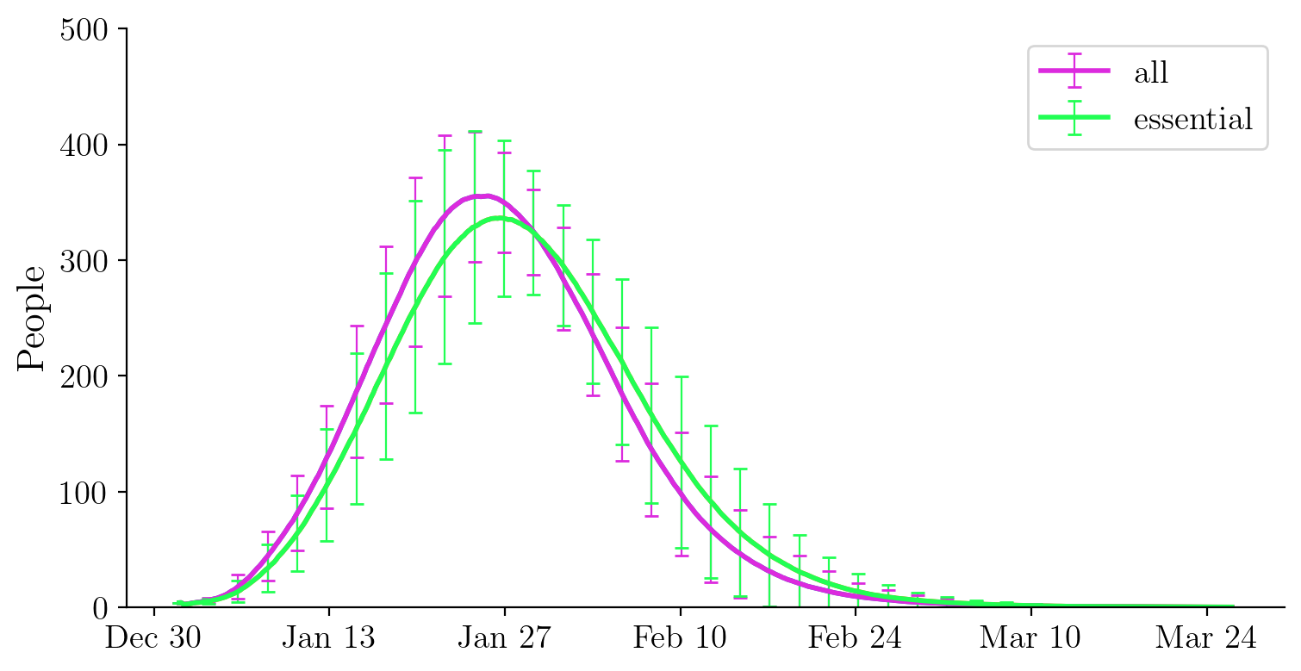
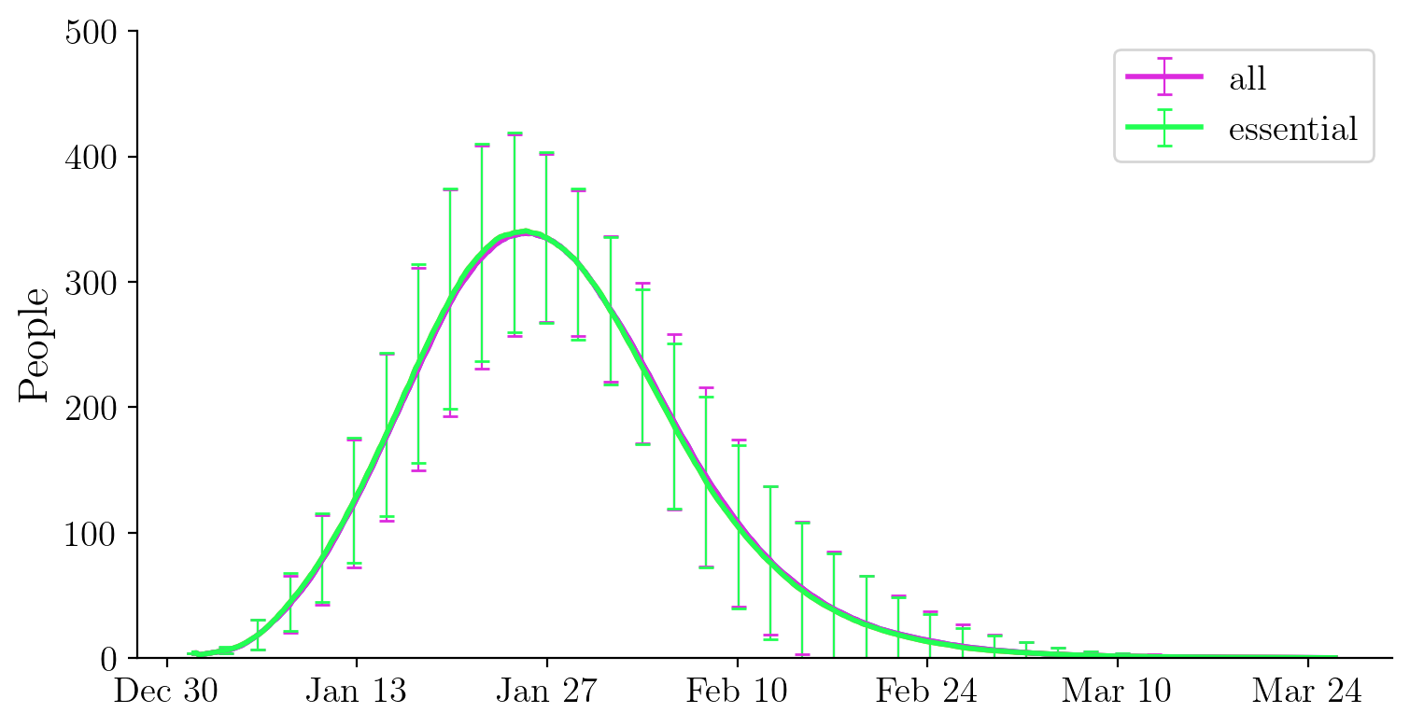
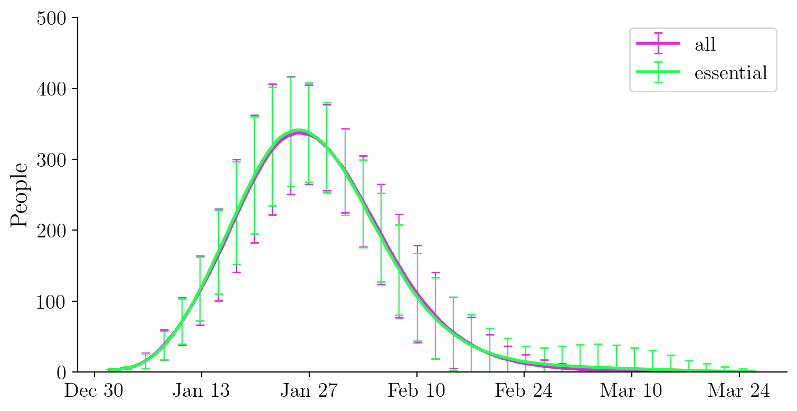


100 repeats, 3 runs, not distinguishing essential non-essential workers
10% compliant vs 100% compliant
$$10 \%$$
$$100 \%$$
$$10 \%$$
$$100 \%$$
$$10 \%$$
$$100 \%$$

Slide 4
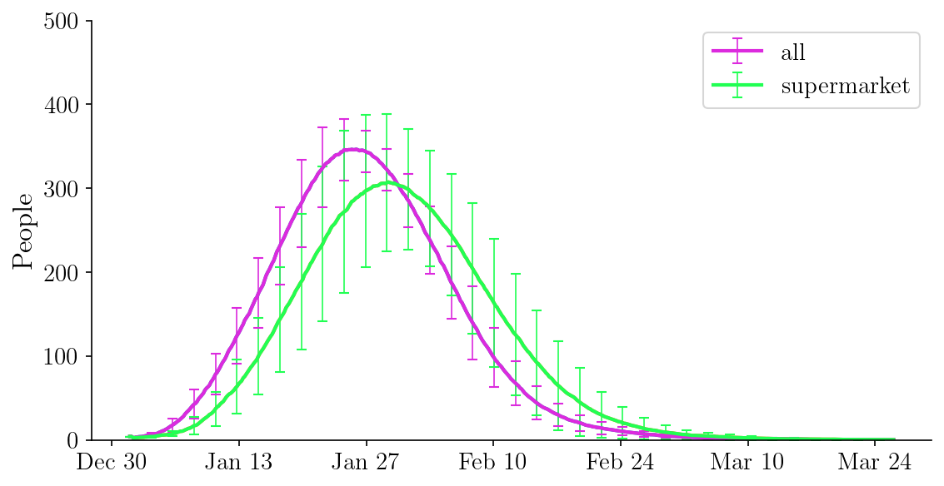
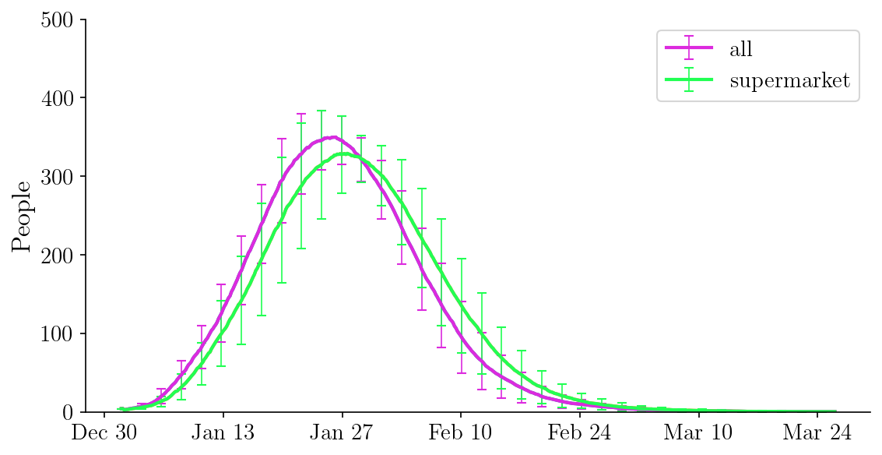
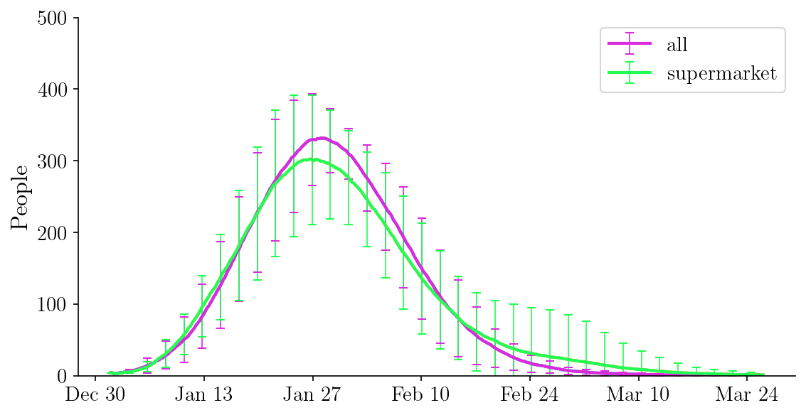
20 repeats, 3 runs, not distinguishing essential non-essential workers
10% compliant vs 100% compliant

