Slide 1
Type 2: social place essential workers
SF data: downsampled 200
total population: 4254 , sites: 37
Age group | 0-4 | 5-14 | 15-19 | 20-24 | 25-44 | 45-59 | 60-79 | 80+ | Total
Total population | 194 | 296 | 154 | 263 | 1646 | 835 | 682 | 181 | 4254
10% essential | 0 | 0 | 17 | 25 | 233 | 127 | 21 | 0 | 423
30% essential | 0 | 0 | 51 | 76 | 701 | 382 | 63 | 0 | 1273
50% essential | 0 | 0 | 85 | 127 | 1168 | 637 | 106 | 0 | 2177

Slide 2
Type 2: social place essential workers
SF data: total population: 4254 , sites: 37
Site type | edu | office | social | supermarket | total
# of sites | 2 | 3 | 17 | 15 | 47
Site ID |  | 35 | 30 | 14 | 26 | 12 | 22 | 4 | 23
# of workers | 10% essential/total | 23 | 28 | 22 | 23 | 24 | 32 | 25 | 35
 | 30% essential/total | 68 | 81 | 79 | 97 | 84 | 89 | 65 | 72
 | 50% essential/total | 141 | 117 | 151 | 99 | 141 | 128 | 135 | 120
Site ID |  | 15 | 17 | 20 | 21 | 18 | 13 | 0 | 16 | 25
# of workers | 10% essential/total | 28 | 24 | 20 | 19 | 27 | 31 | 14 | 30 | 25
 | 30% essential/total | 64 | 80 | 68 | 76 | 72 | 71 | 72 | 88 | 76
 | 50% essential/total | 127 | 135 | 124 | 114 | 120 | 140 | 124 | 151 | 110

Slide 3
Type 2: social place essential workers
Age group | edu | office | Social place | supermarket
0-4 | 5 | 0 | 0 | 0
5-14 | 5 | 0 | 0 | 0
15-19 | 5 | 0 | 3.6 | 0.22
20-24 | 1.48 | 3.52 | 3.6 | 0.22
25-44 | 0 | 5 | 3.6 | 0.27
45-59 | 0 | 5 | 3.6 | 0.36
60-79 | 0 | 0 | 3.6 | 0.35
80+ | 0 | 0 | 3.6 | 0.35
Essential workers | 0 | 0 | 5 | 0.27
Dwell time | edu | office | Social place | supermarket
Regular | 5 | 5 | 0.64 | 0.4
Essential workers | 0 | 0 | 5 | 0.4

Slide 4
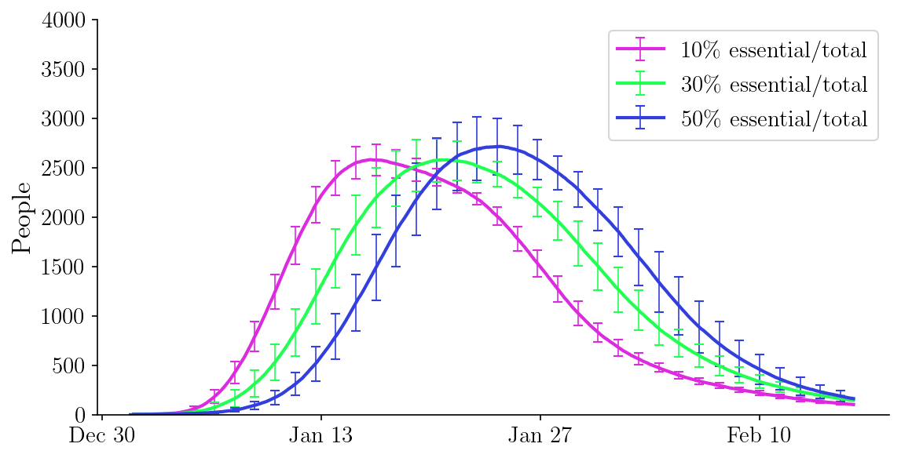
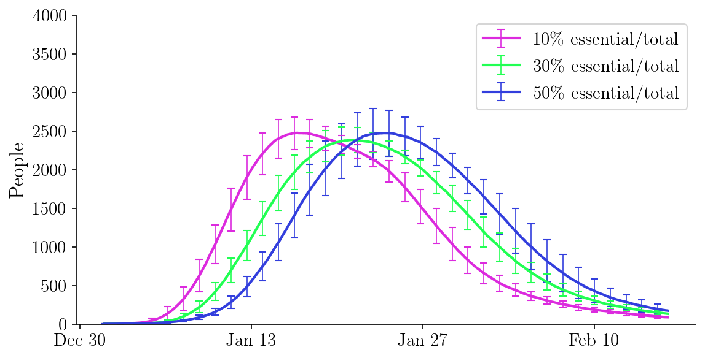
Type 2: social place, different essential/total ratio
All essential workers comply
Random individuals comply

Slide 5
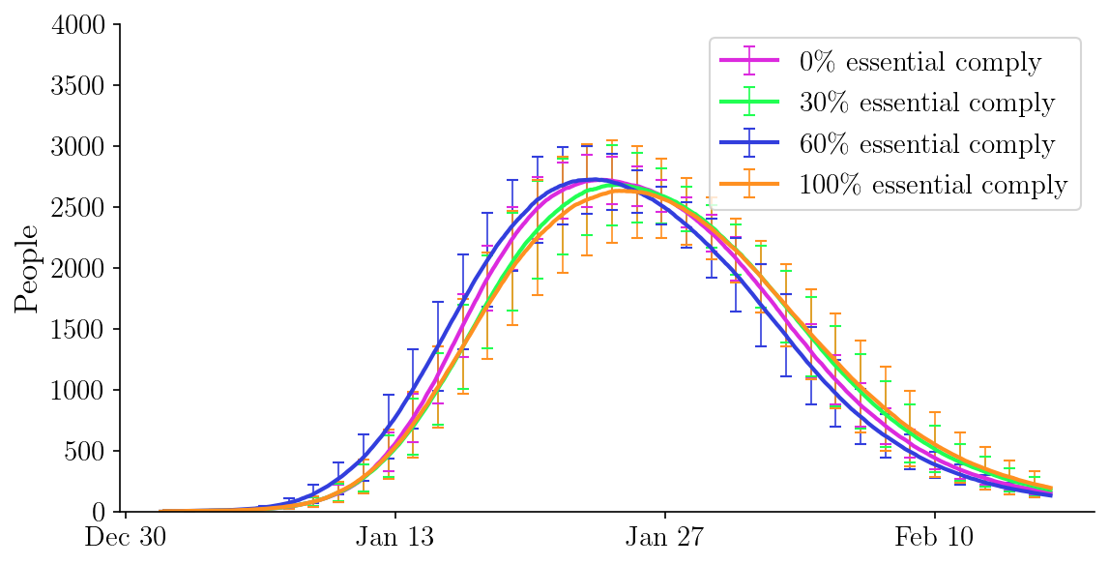
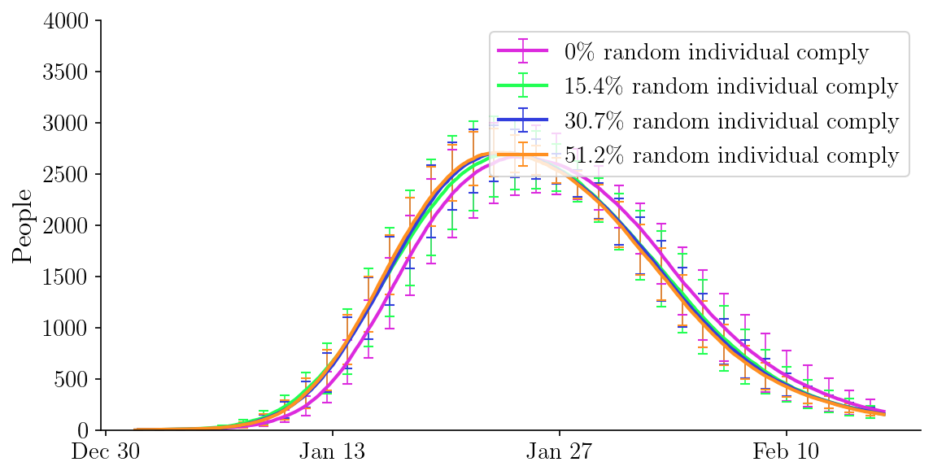
Type 2: social place, different compliance rate
50 % of essential/total ratio

