Slide 1
supermarket
# downsized 100 by pop, 20 by town, 40 random repeats
# 47.19% essential to total prop, essential: 429, non-essential: 480, total: 909, sites:47
# compare supermarket workers compliant vs. random complaint, number of compliant ~=
# compare 10%, 40%, 70%, 100% compliance for essential
# mob rate regular: same as German town
# mob rate supermarket: 7 days per week,8 hours per day
# essential_mob_rate_per_type = [0,0,0,0,7],essential_dur_mean_per_type = [0,0,0,0,8]
# mob rate zero elsewhere

Slide 2
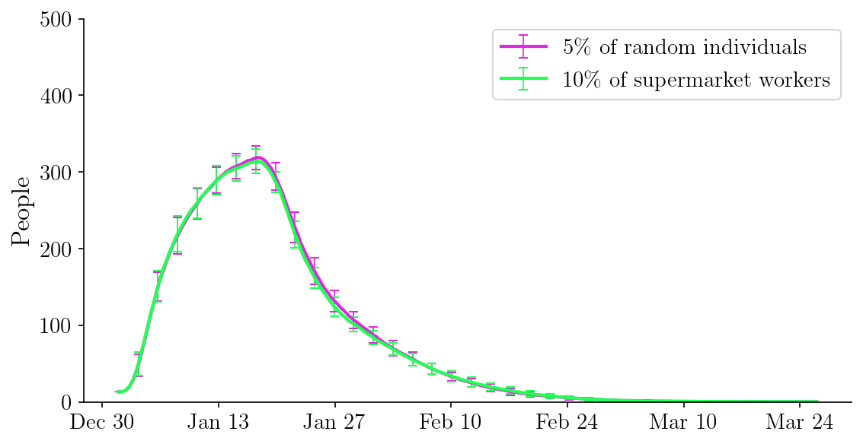
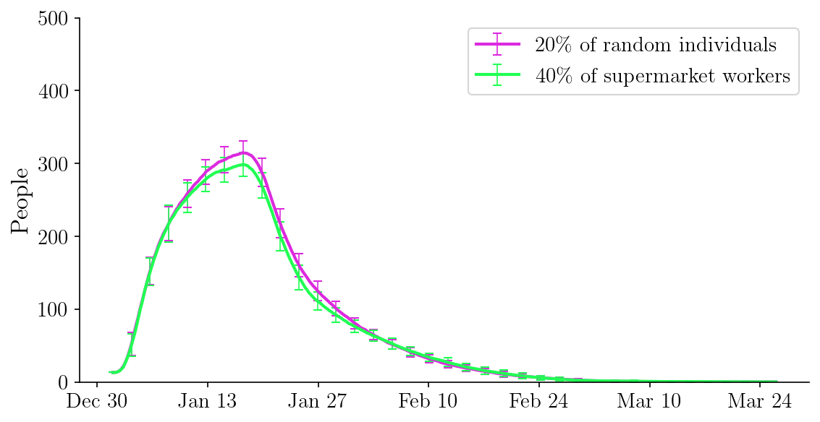
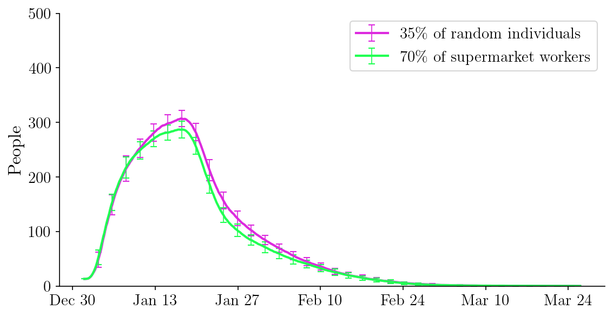
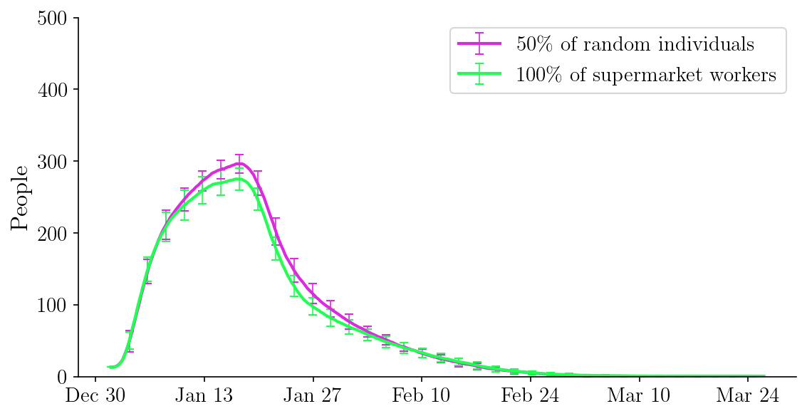

Slide 3
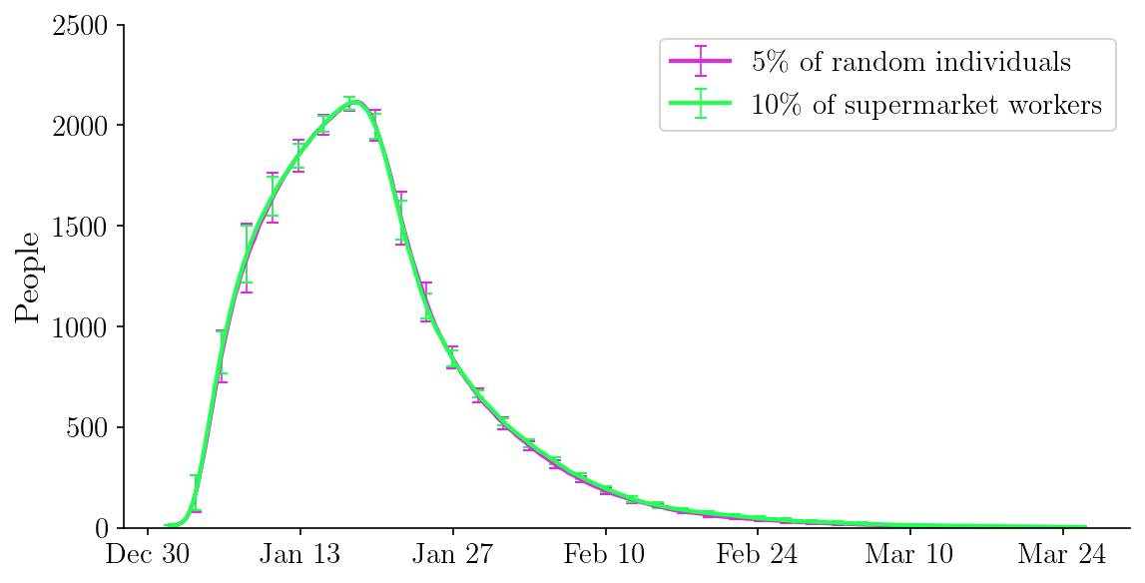
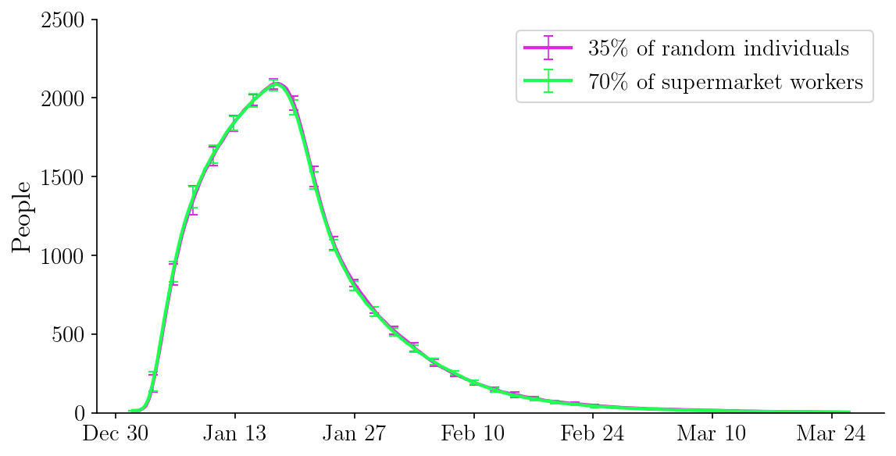
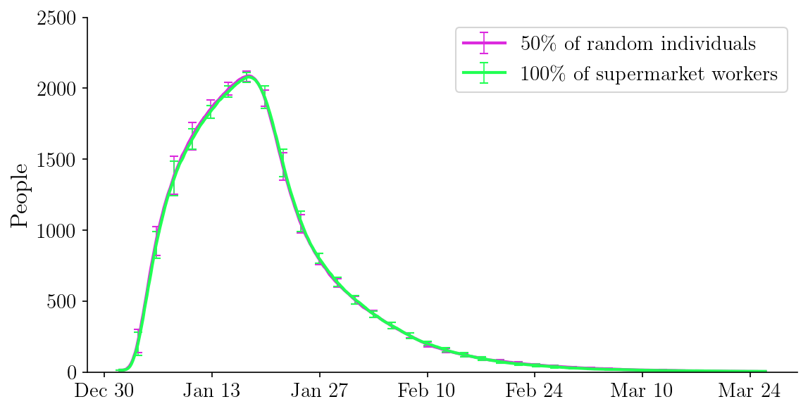

Slide 4
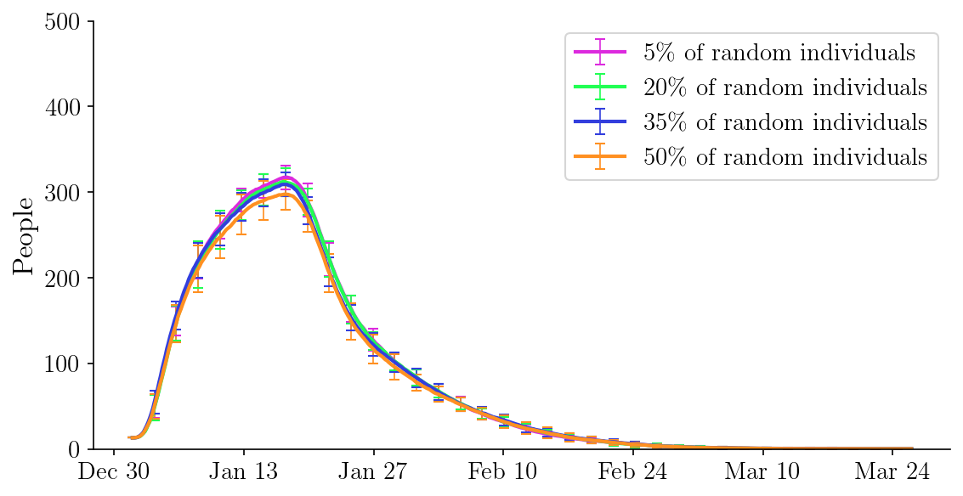
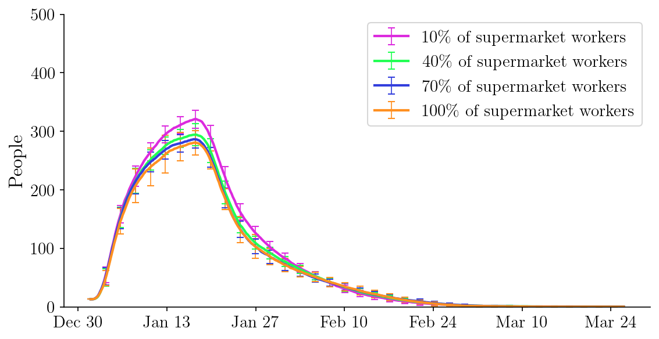

Slide 6
office
# downsized 100 by pop, 20 by town, 40 random repeats
# 47.19% essential to total prop, essential: 429, non-essential: 480, total: 909, sites:47
# compare office workers compliant vs. random complaint, number of compliant ~=
# compare 10%, 40%, 70%, 100% compliance for essential
# mob rate regular: same as German town
# mob rate office: 7 days per week,8 hours per day
# essential_mob_rate_per_type = [0,0,0,7,0],essential_dur_mean_per_type = [0,0,0,8,0]
# mob rate zero elsewhere

Slide 7
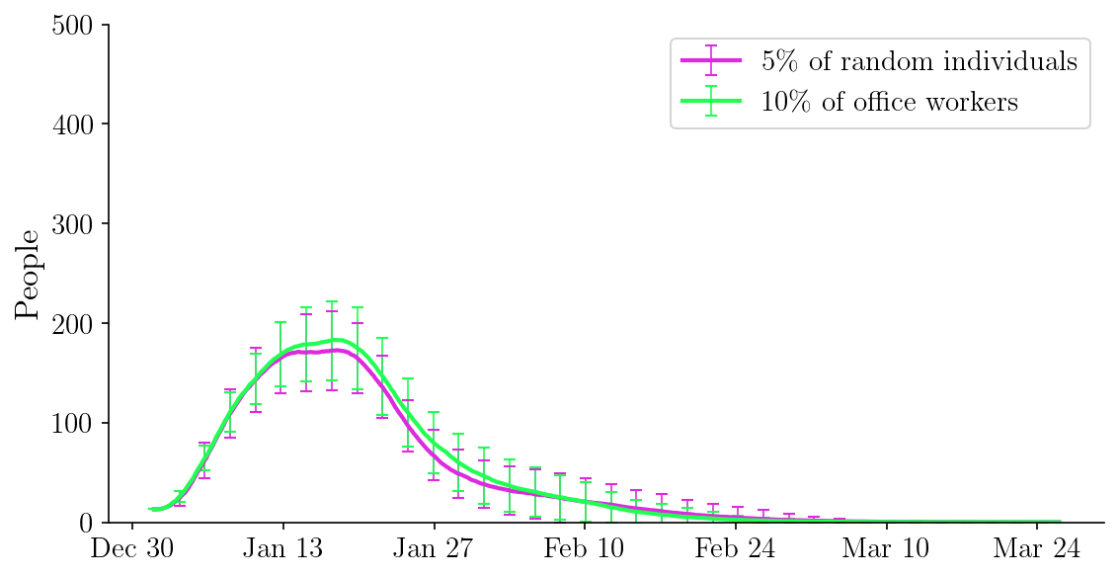
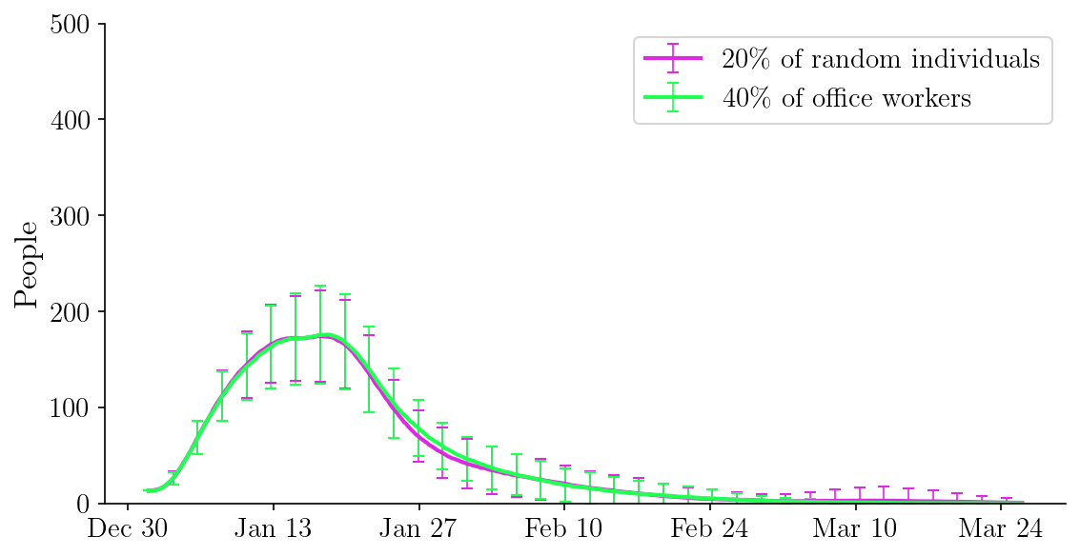
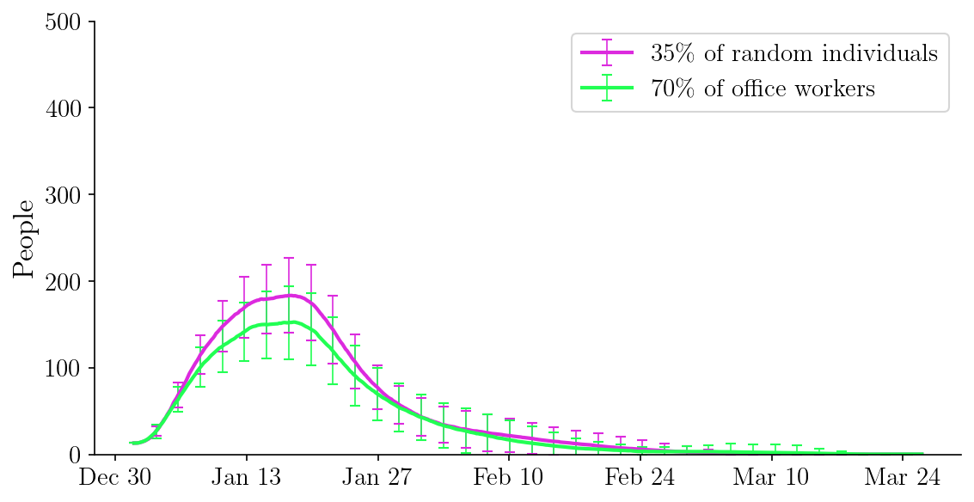
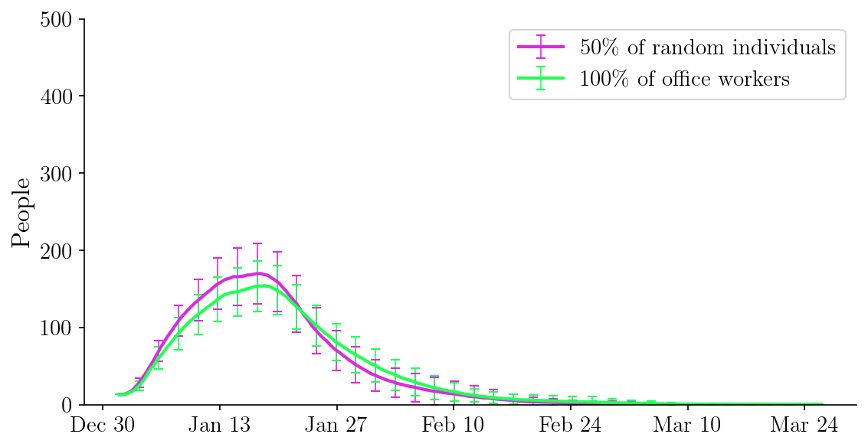

Slide 8
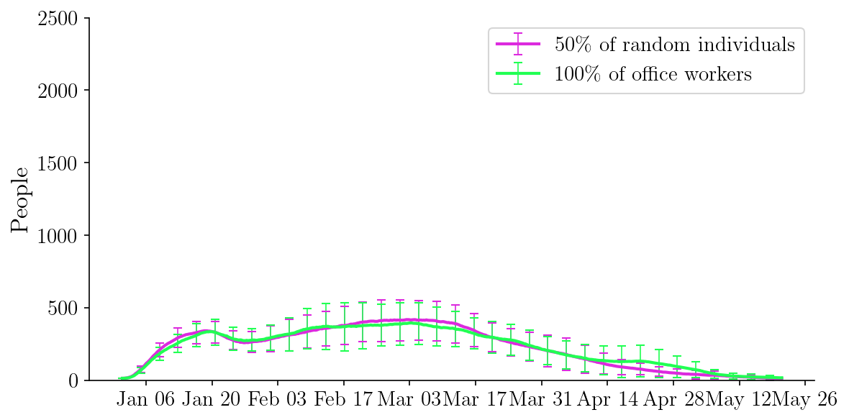

Slide 9
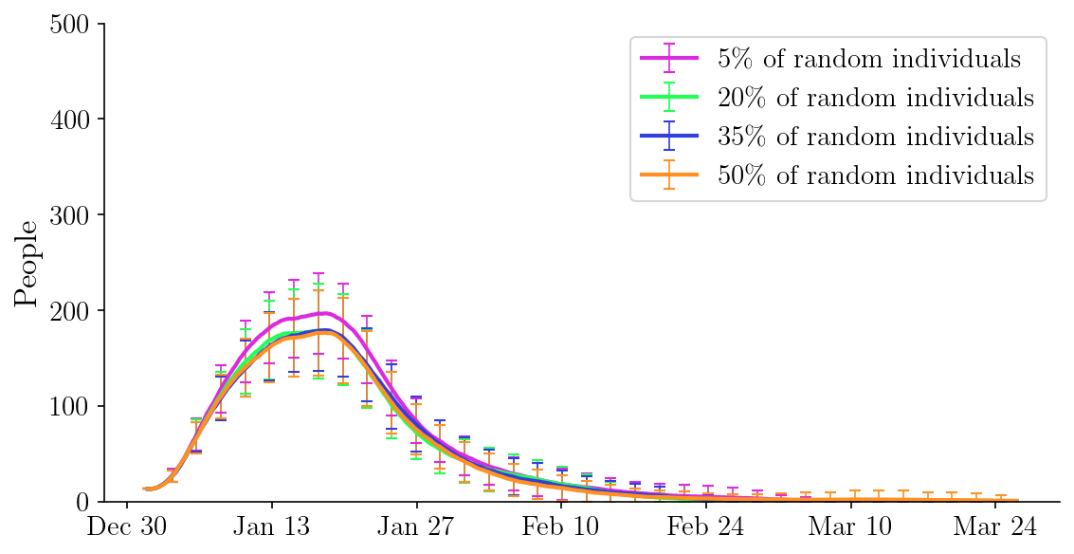
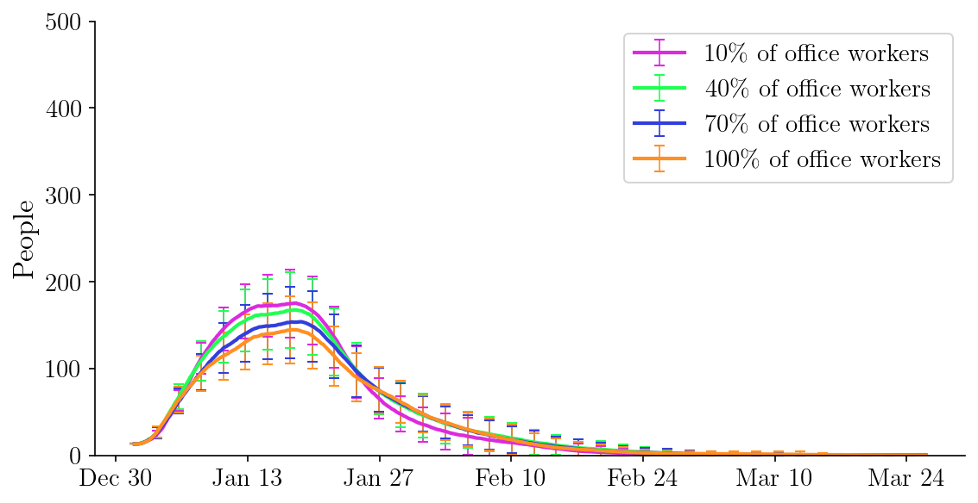

Slide 10
transportation
# downsized 100 by pop, 20 by town, 40 random repeats
# 47.19% essential to total prop, essential: 429, non-essential: 480, total: 909, sites:47
# compare trans workers compliant vs. random complaint, number of compliant ~=
# compare 10%, 40%, 70%, 100% compliance for essential
# mob rate regular: same as German town
# mob rate trans: 7 days per week,8 hours per day
# essential_mob_rate_per_type = [0,0,7,0,0],essential_dur_mean_per_type = [0,0,8,0,0]
# mob rate zero elsewhere

Slide 11
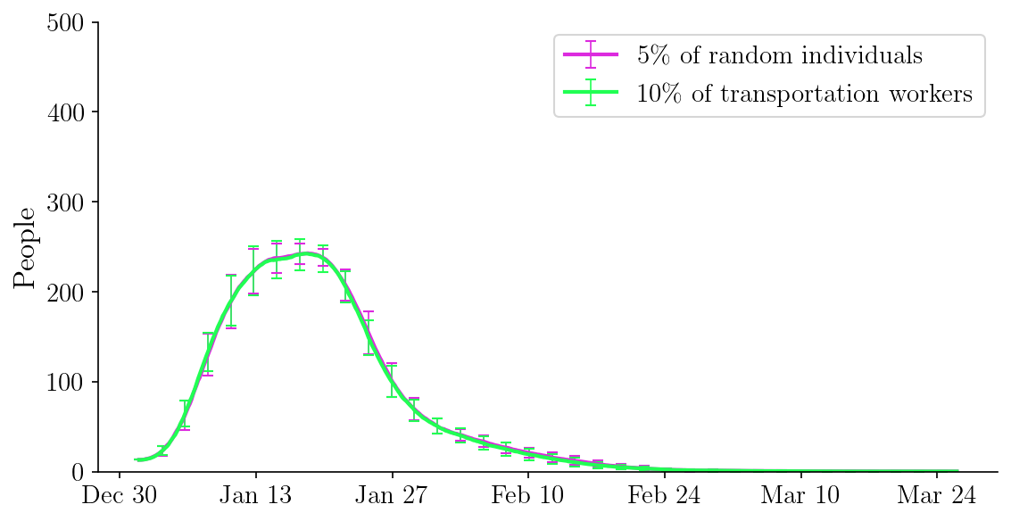
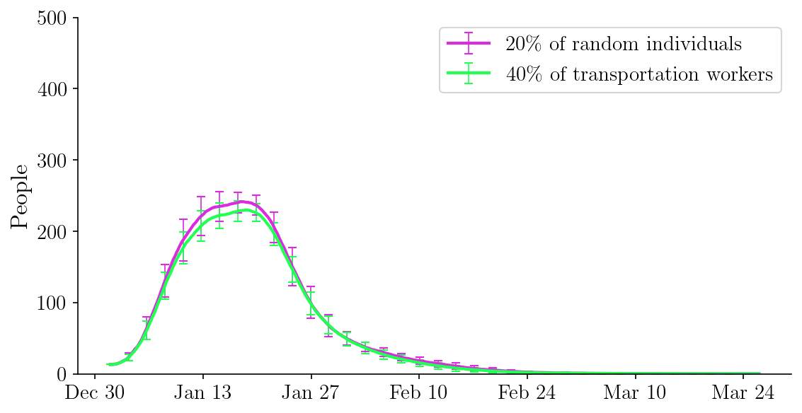
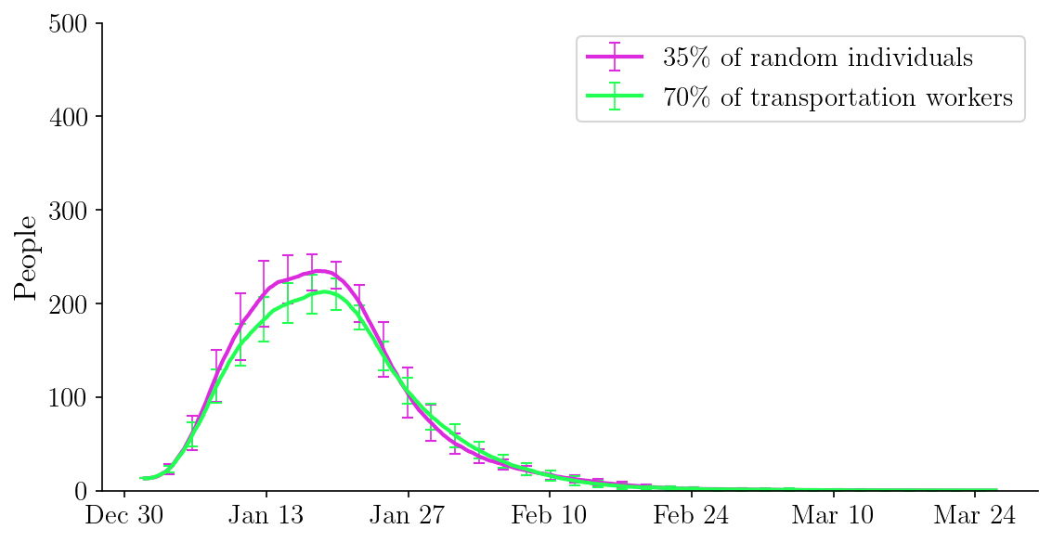
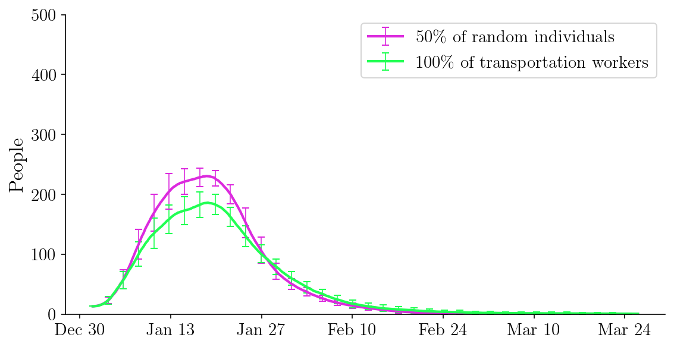

Slide 12
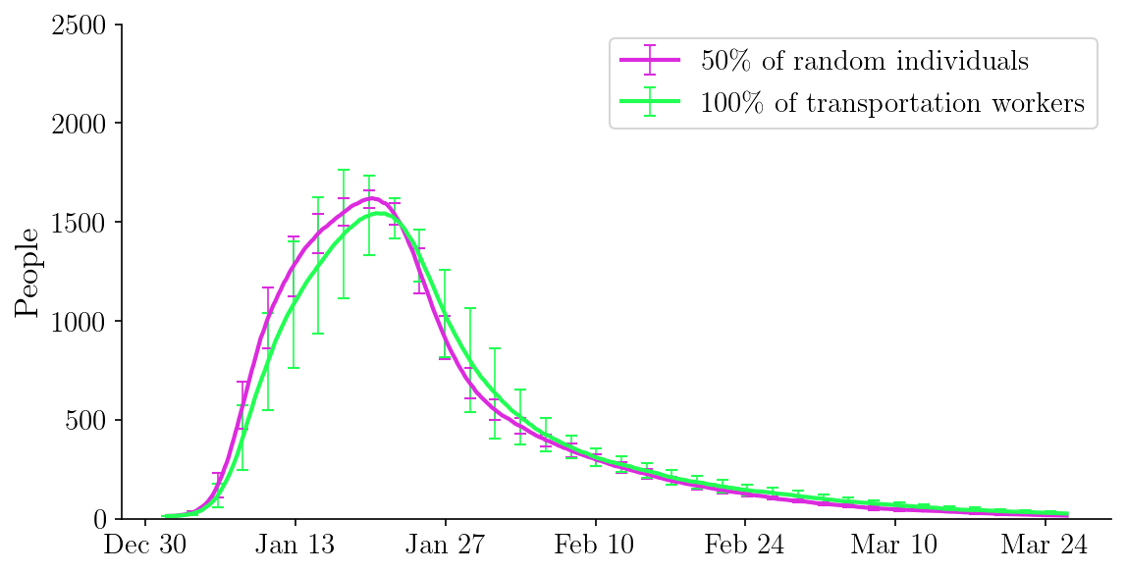

Slide 13
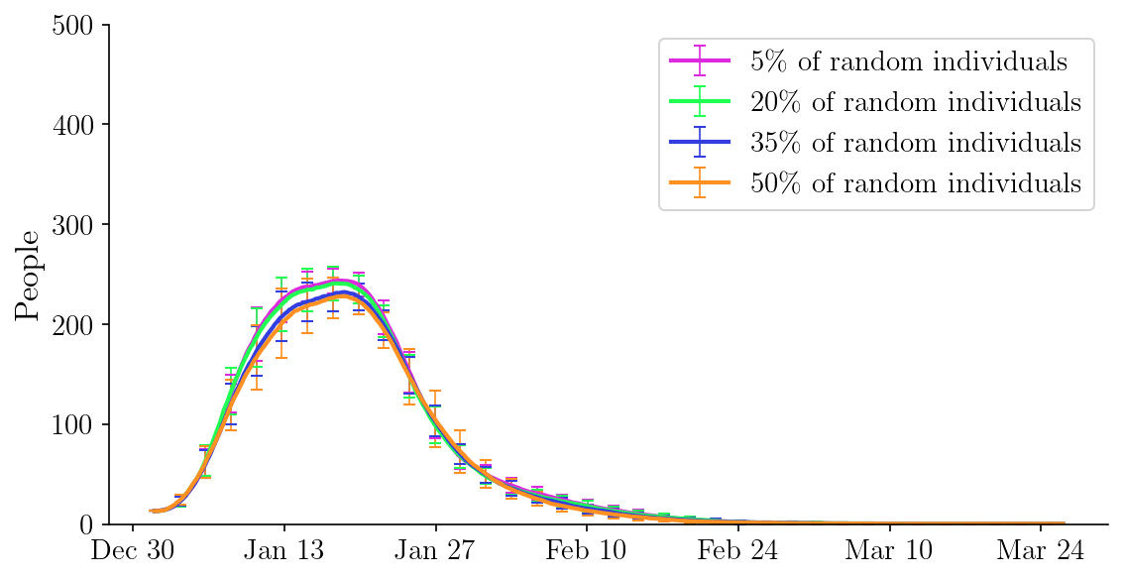
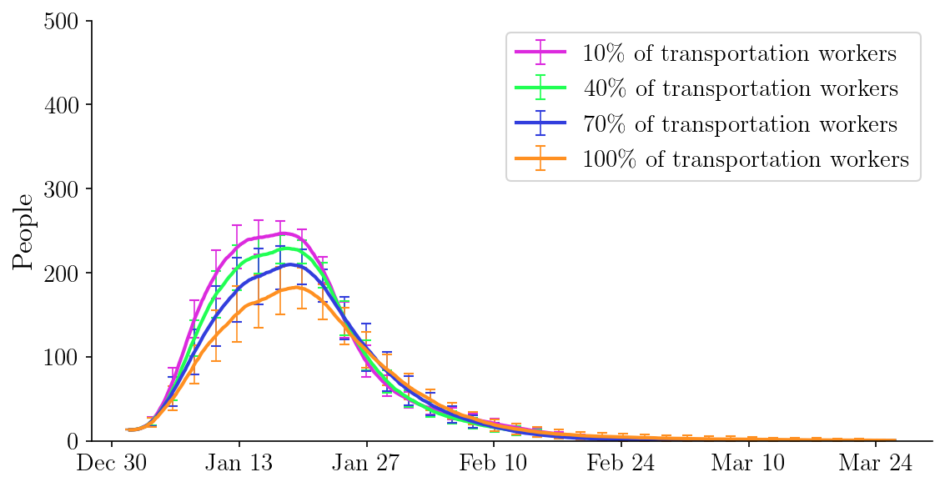

Slide 14
social
# downsized 100 by pop, 20 by town, 40 random repeats
# 47.19% essential to total prop, essential: 429, non-essential: 480, total: 909, sites:47
# compare social essential workers compliant vs. random complaint, number of compliant ~=
# compare 10%, 40%, 70%, 100% compliance for essential
# mob rate regular: same as German town
# mob rate trans: 7 days per week,8 hours per day
# essential_mob_rate_per_type = [0,7,0,0,0],essential_dur_mean_per_type = [0,8,0,0,0]
# mob rate zero elsewhere

Slide 15
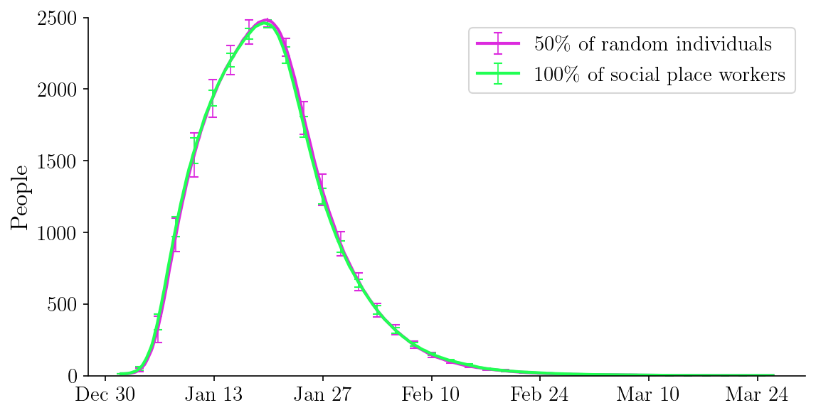

Slide 16
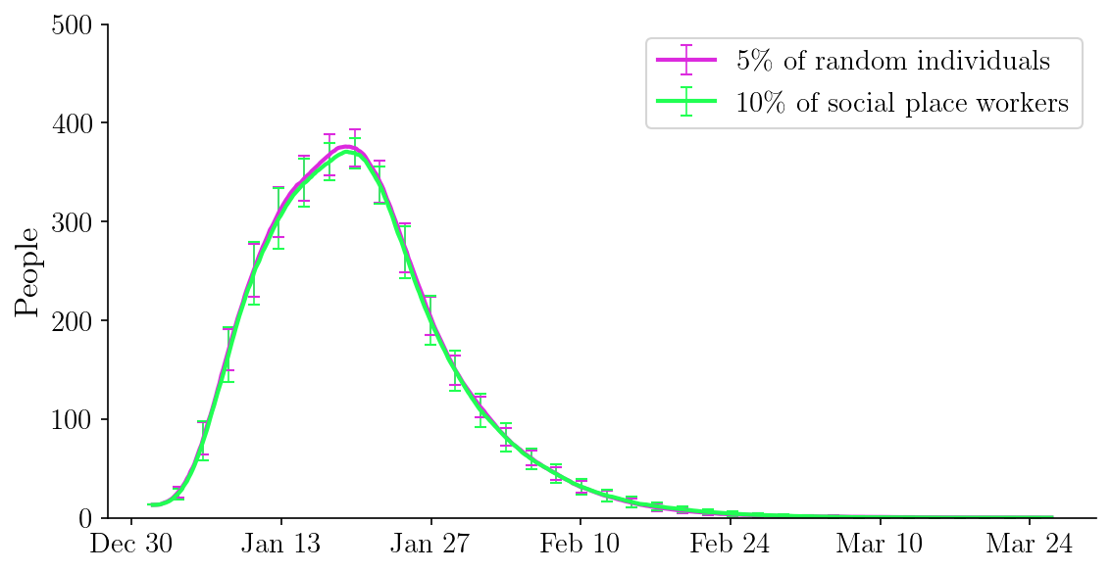
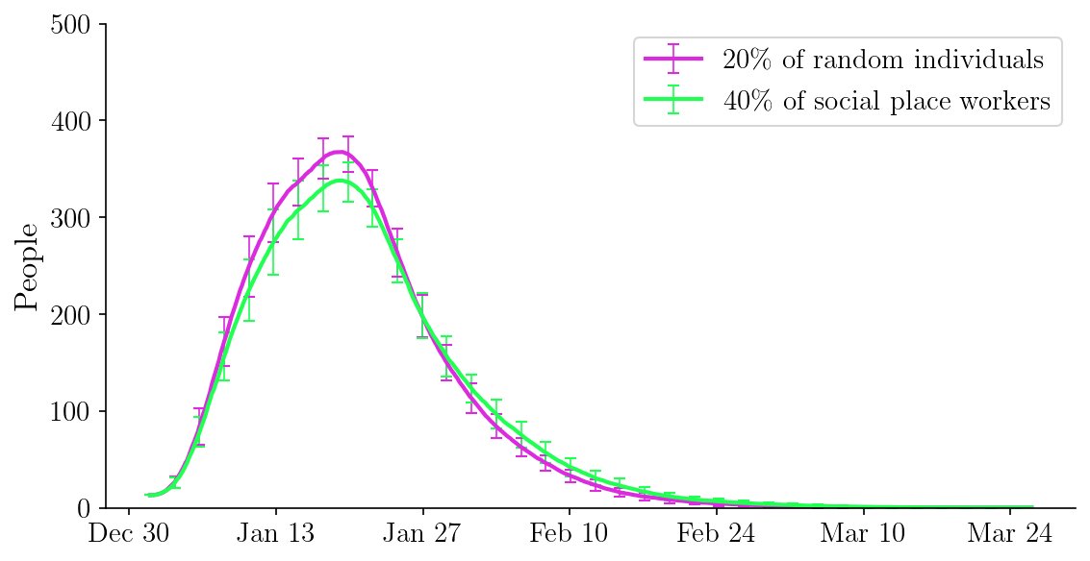
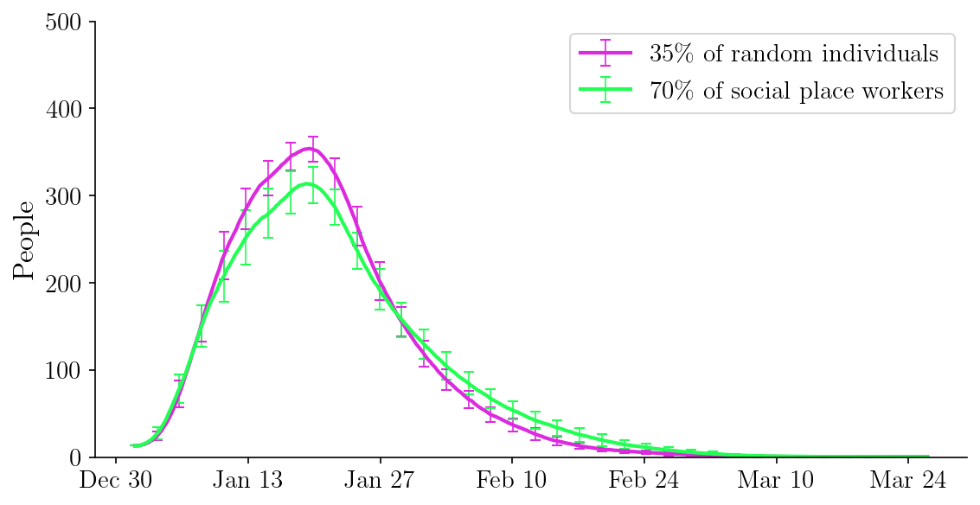
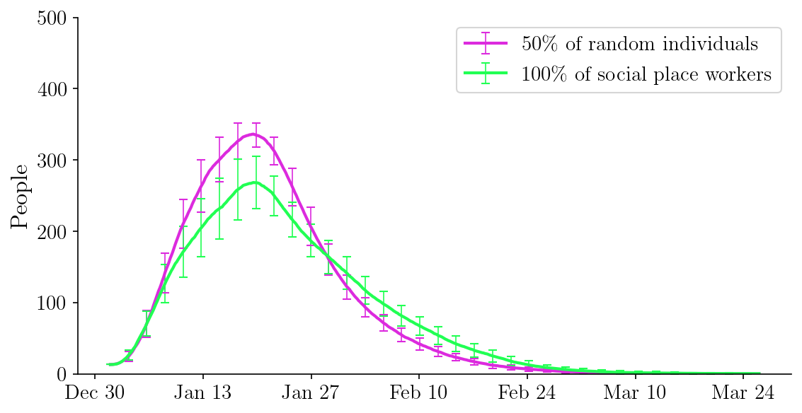

Slide 17
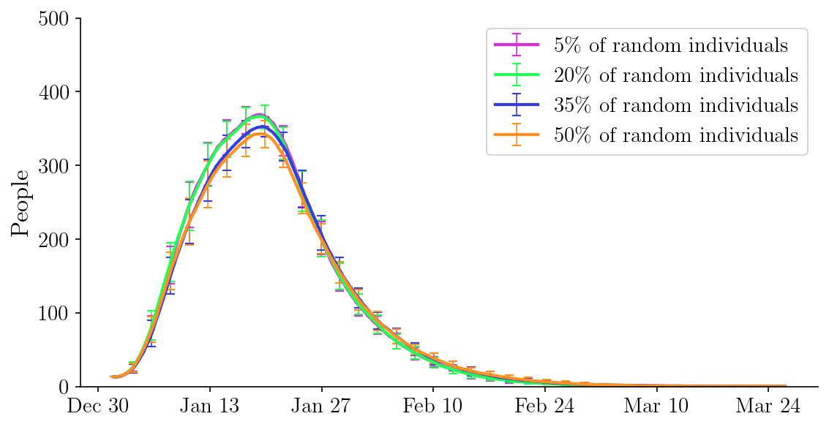
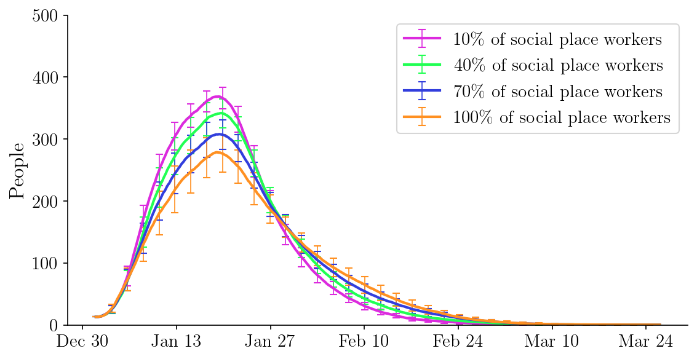

Slide 18
school
# downsized 100 by pop, 20 by town, 40 random repeats
# 47.19% essential to total prop, essential: 429, non-essential: 480, total: 909, sites:47
# compare school essential workers compliant vs. random complaint, number of compliant ~=
# compare 10%, 40%, 70%, 100% compliance for essential
# mob rate regular: same as German town
# mob rate school: 7 days per week,8 hours per day
# essential_mob_rate_per_type = [0,7,0,0,0],essential_dur_mean_per_type = [0,8,0,0,0]
# mob rate zero elsewhere

Slide 19
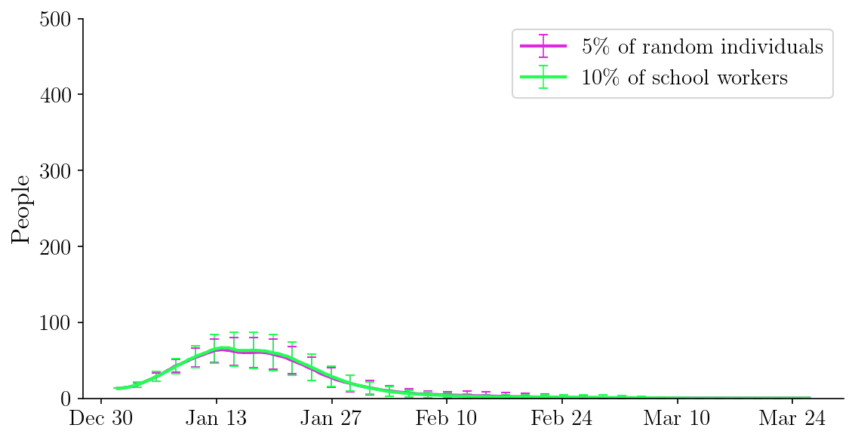
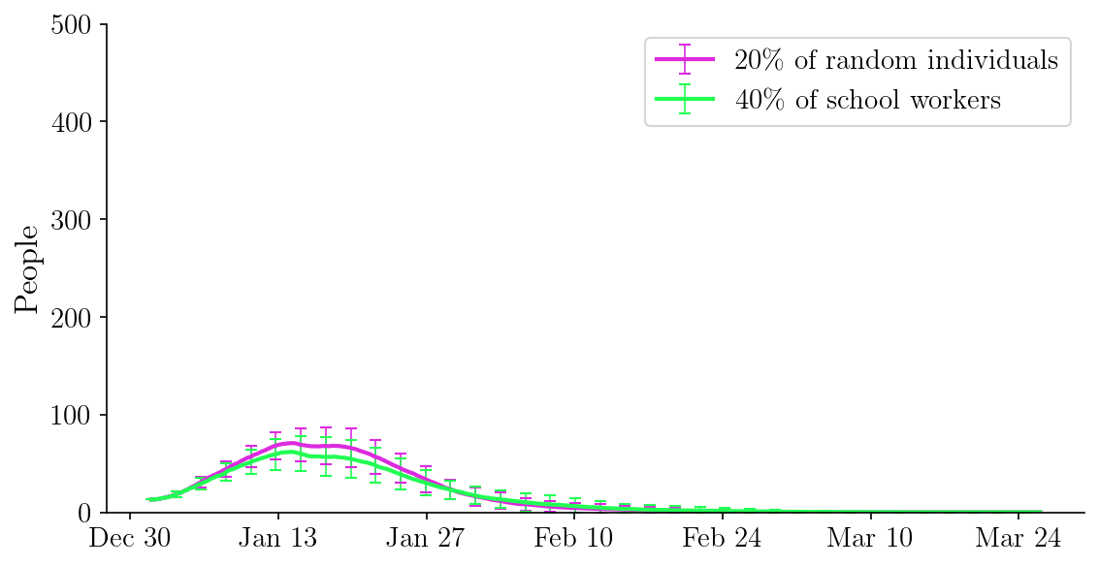

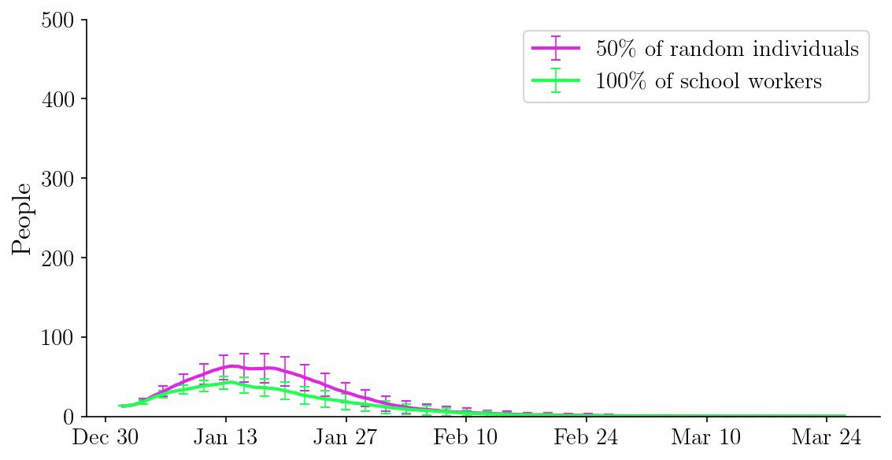

Slide 20
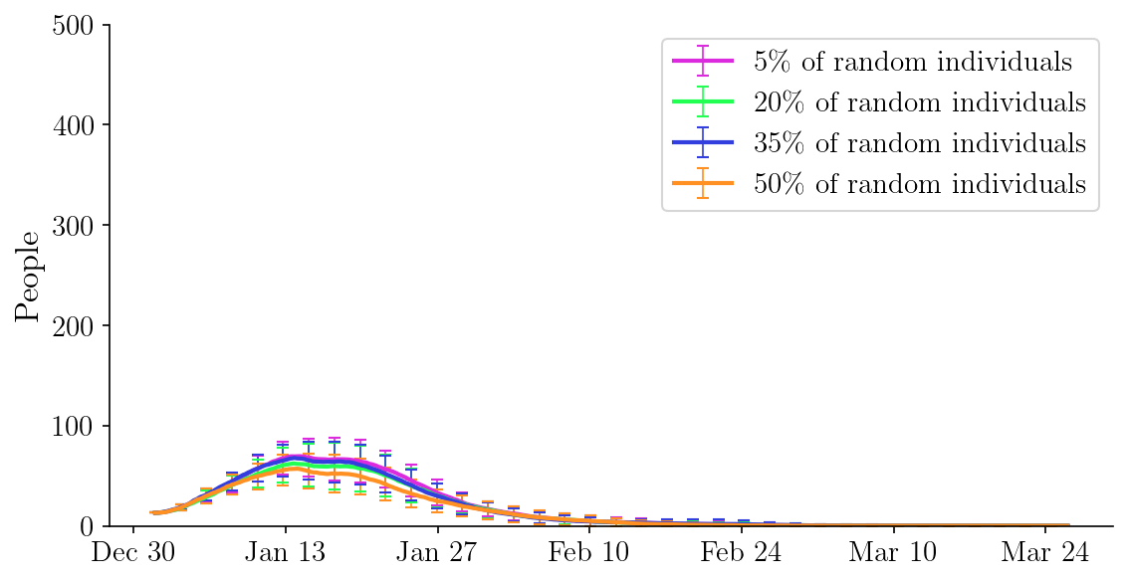
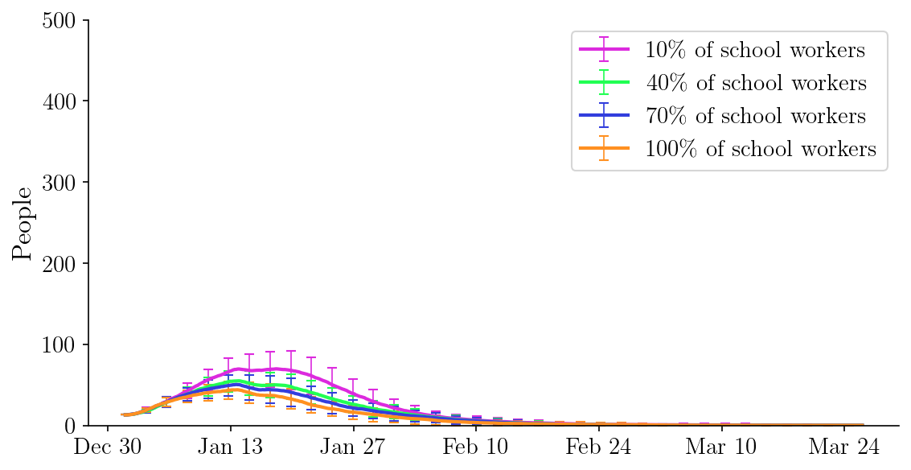

Slide 21
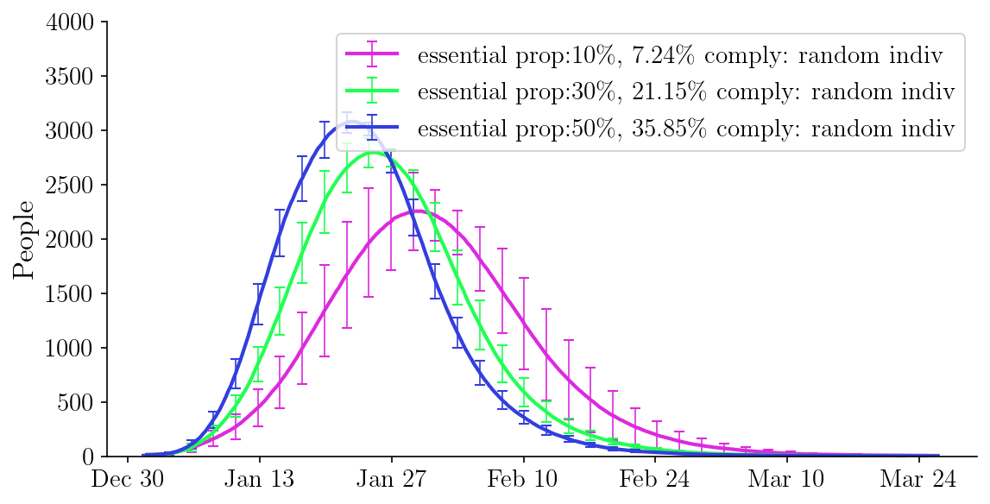
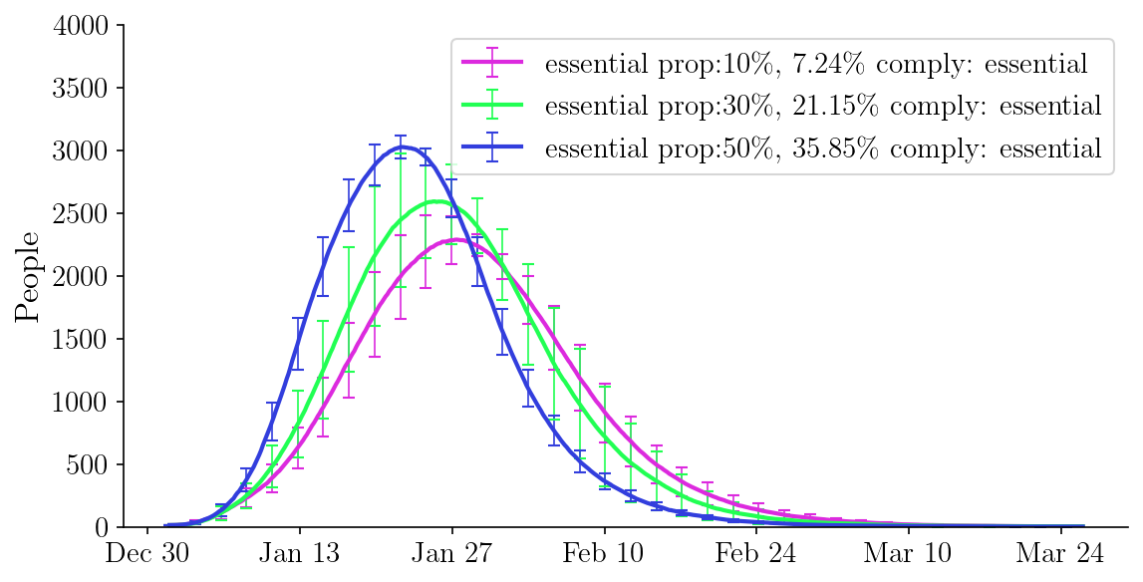

Slide 22
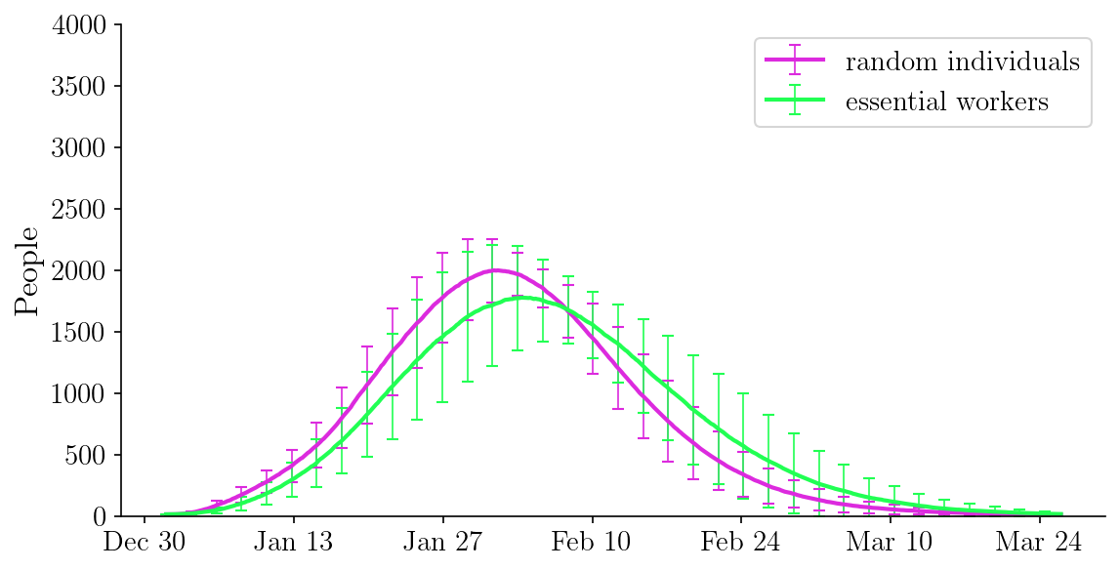
Total population: 5812 Sites: 163
Essential population: 602 Non-essential: 5219 Essential/total: 10.34%
Green: all essential workers have CT, and comply (~ 602 people have CT)
Pink: random individuals have CT, and comply (~ 602 people have CT)

