Slide 1


Day 3

Slide 2


Agenda
I2C
Sensor
I2C
Sensor
OLED
Task 1
Task 2

Slide 3

Agenda
I2C
Sensor
OLED
Notes:
We’ve already written the driver for the ADC. The OLED driver on the extension board driver is also handed out to you along with a graphics module. So the only thing which is left is to write a SPI driver, which is the communication protocol between the AVR128DB48 and the OLED on the expansion board.

Slide 4
I2C – In general
Host ↔ Client communication

Slide 5
I2C – In general
Open drain

Slide 6
I2C – In general
VCC
Host
Client
SCL
SCL
SDA
SDA
SCL - Serial Clock Line
SDA - Serial Data Line
Notes:
SPI is a master-slave protocol with 4 wires. It is full duplex, meaning that we can send data both ways simultaneously. We usually send a byte per transfer.

Slide 7
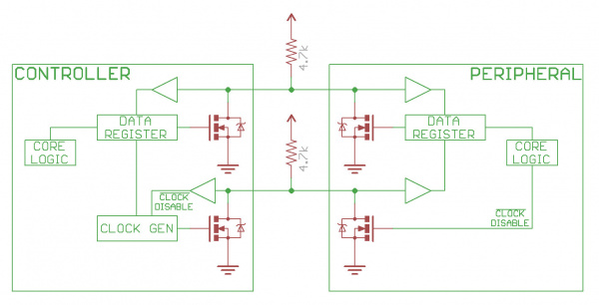
I2C – In general
https://learn.sparkfun.com/tutorials/i2c/all
Notes:
SPI is a master-slave protocol with 4 wires. It is full duplex, meaning that we can send data both ways simultaneously. We usually send a byte per transfer.

Slide 8
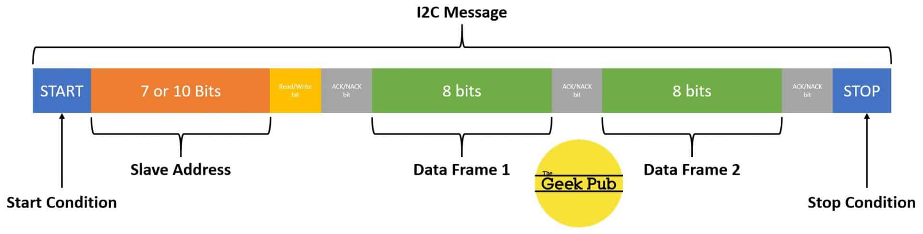
I2C – In general
https://www.thegeekpub.com/18351/how-i2c-works-i2c-explained-simply/
Notes:
SPI is a master-slave protocol with 4 wires. It is full duplex, meaning that we can send data both ways simultaneously. We usually send a byte per transfer.

Slide 9
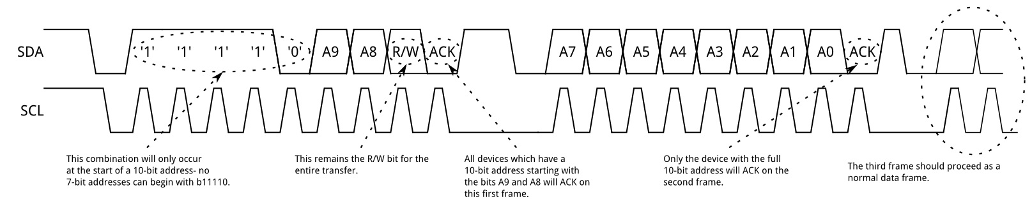
I2C – In general
https://learn.sparkfun.com/tutorials/i2c/all
Notes:
SPI is a master-slave protocol with 4 wires. It is full duplex, meaning that we can send data both ways simultaneously. We usually send a byte per transfer.

Slide 10
I2C – In general
I2C is one to many (max 127)

Slide 11
I2C – In general
VCC
Host
Client 1
SCL
SCL
SDA
SDA
Client 2
SCL
SDA
SCL - Serial Clock Line
SDA - Serial Data Line
Notes:
SPI is a master-slave protocol with 4 wires. It is full duplex, meaning that we can send data both ways simultaneously. We usually send a byte per transfer.

Slide 12
I2C – In general
Why do we care?
Notes:
SPI is a really simple and fast protocol, I would argue that it is simpler than USART in how the transmission is done even though we have more lines in the protocol. Many sensors use it and we can hook up a network, such that we have 3 main lines for every sensor (MISO, MOSI and SCK) + N chip select lines. For 5 sensor that results in 8 wires, whereas for USART that would be 10. But in short, in my opinion it’s a nice protocol to know about since can be extremely fast and in general is quite simple.

Slide 13
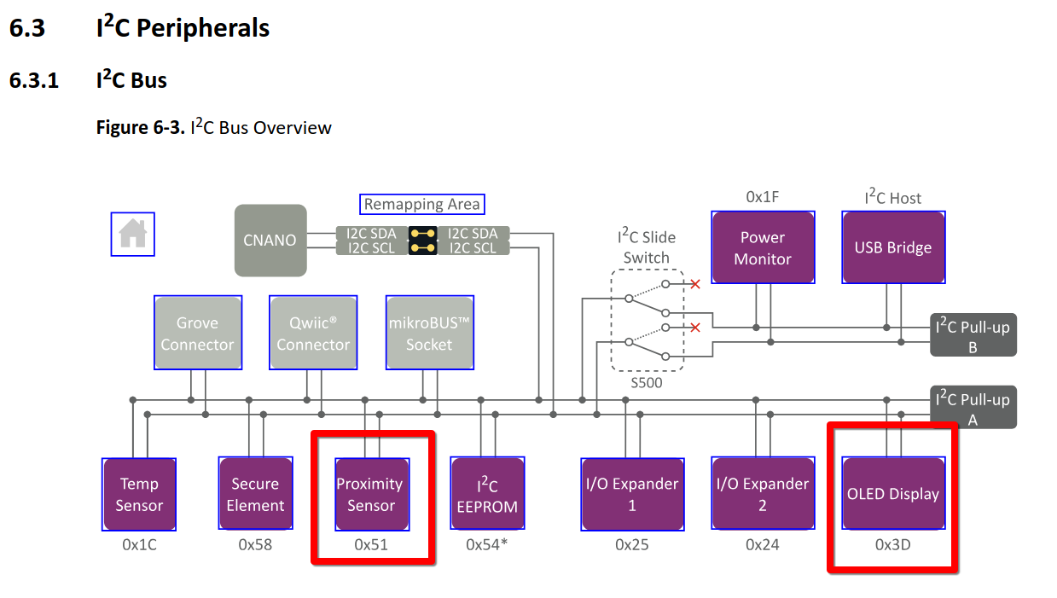
I2C – In general
Notes:
SPI is a really simple and fast protocol, I would argue that it is simpler than USART in how the transmission is done even though we have more lines in the protocol. Many sensors use it and we can hook up a network, such that we have 3 main lines for every sensor (MISO, MOSI and SCK) + N chip select lines. For 5 sensor that results in 8 wires, whereas for USART that would be 10. But in short, in my opinion it’s a nice protocol to know about since can be extremely fast and in general is quite simple.

Slide 14
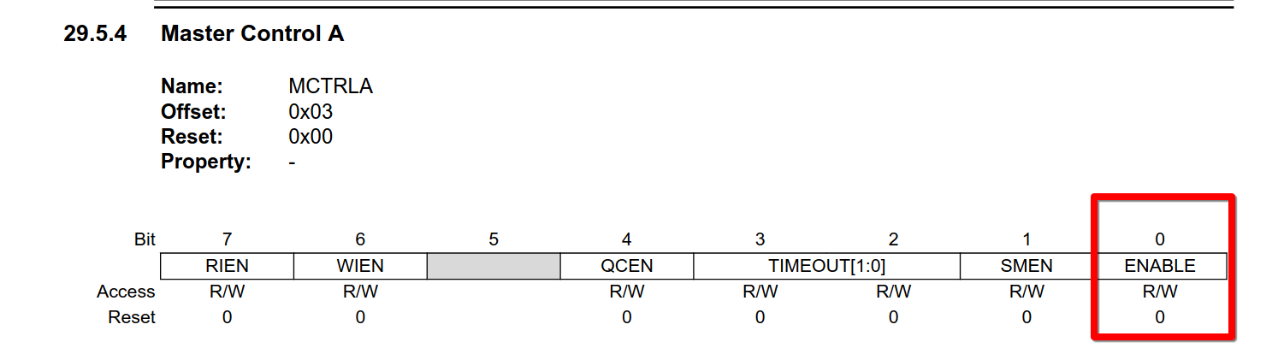
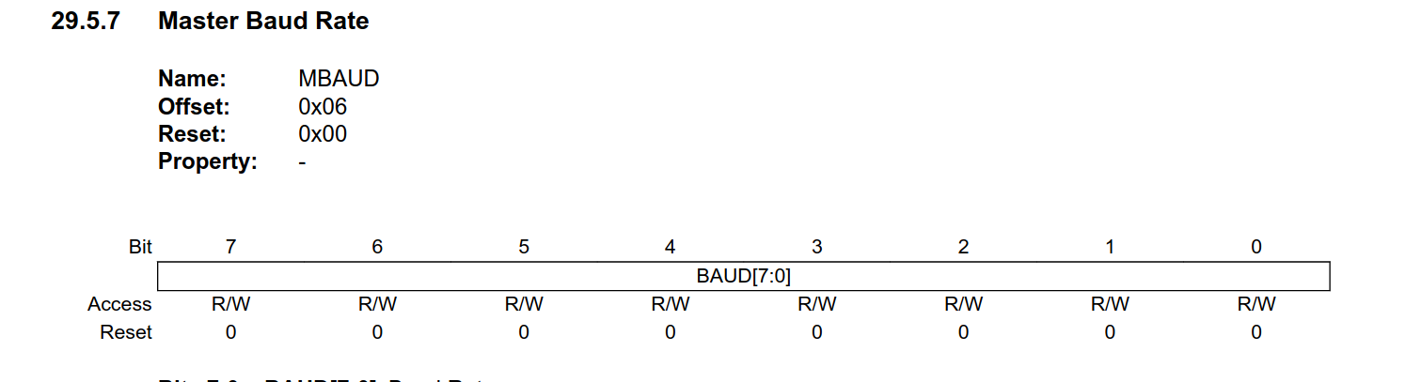
I2C – How to set up
Set up pins (SCL and SDA as outputs).
Set the baudrate (TWI0.MBAUD)
Enable the I2C Master module (TWI0.MCTRLA register).

Slide 15
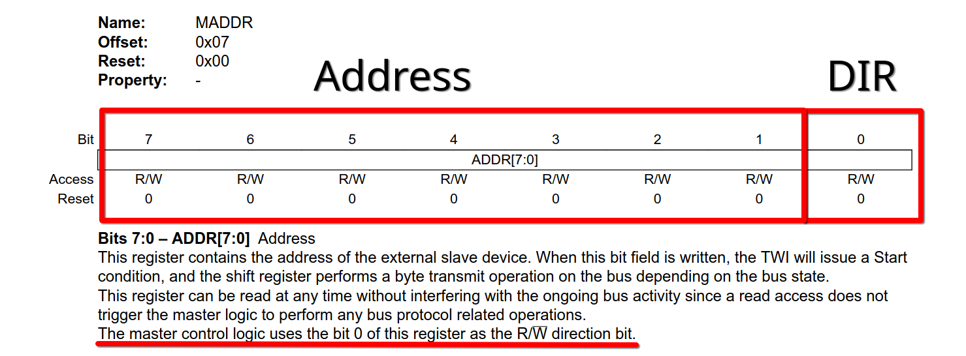
I2C – How to send data
Load the client address and direction (TWI0.MADDR)
Fill in the data
(TWI0.MDATA)
Wait until data is sent.
Send the stop condition (TWI0.MCTRLB)
Notes:
Refer to chapter 24.3.2.1.2 for the dummy read

Slide 16
I2C – Final remarks
I2C is one of the simplest protocols out there, it is ubiquitous
Notes:
SPI is one of the fastest protocols we work with. It is only limited by the clock signal, and thus the minimum of the two clock frequencies of the two devices. It’s also quite simple and easy to use! You’re only shifting out data.

Slide 17
I2C
Questions?

Slide 18
I2C
Sensor
I2C
Sensor
OLED
Task 2
Task 1
Task 2
Task 1
Notes:
That’s all, you have all the pieces you need to complete today’s tasks. The rest of the modules are given as mentioned. You only need to figure out how to use them. So, in short, the only thing you need to write today is the SPI driver and the code in the main file which brings these modules together. There are comments in the code which should guide you in the correct direction.

