Slide 1
The Attention Mechanism

Slide 2
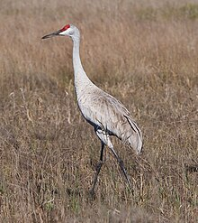
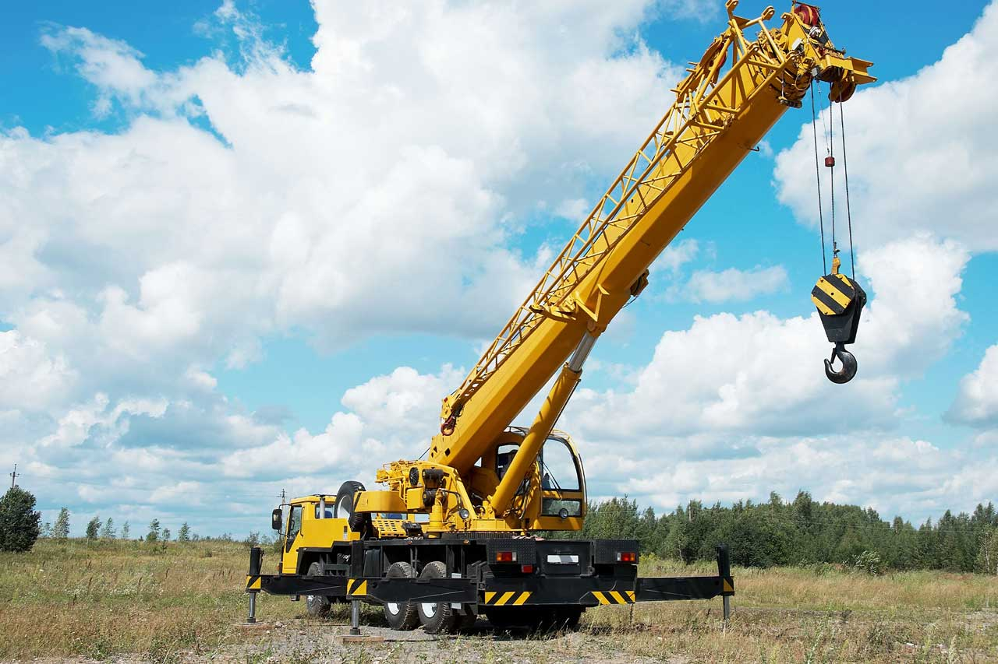
Building Intuition
What is the meaning of the word “crane”?
  Hard to say the exact meaning without looking at the context
Example:
  This bird is a crane.
  They needed a crane to lift the object.
To understand the meaning, we need the context.
  That is, we must attend to (or pay attention to) the other words in the sentence.
Key idea of attention: new context vector at every time step. Each context vector will attend to different input regions.
This is how we interpret words as humans.

Slide 3
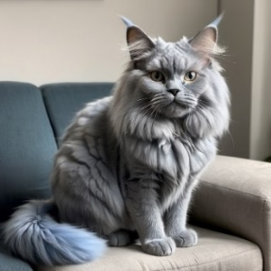
Where We Use Attention
The idea originated from the field of Natural Language Processing, but is now also used for many other applications including Computer Vision.
A very famous use of the attention mechanism is in ChatGPT.
  GPT stands for Generative Pre-trained Transformer.
  Transformers are a relatively new architecture of NN, and the attention mechanism is a crucial part of the architecture.
In general, its usages could include:
  Generating text (like ChatGPT)
  Inscribing voice to text
  Text-to-image
  Computer Vision tasks like image generation
fluffy blue cat with long ears sitting on a couch
DALL-E 3

Slide 4
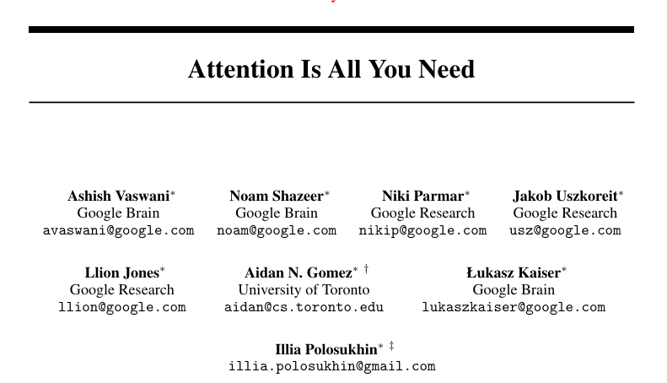
31st Conference on Neural Information Processing Systems (NIPS 2017), Long Beach, CA, USA
Citations: 169,248

Slide 5
Next Word Prediction
In NLP, you can give some seed text and ask the model to predict the next word. For example:
Predictions might look like:
  “Suddenly, one of them
  stopped and pointed ___”
Seed Text: “The explorers ventured deep into the uncharted jungle, guided only by the faint traces of a centuries-old map. The air was thick with humidity, and every step seemed to whisper secrets of a forgotten world. Suddenly, one of them stopped and pointed”
Model Prediction: “ahead . Through the dense foliage, a massive stone structure emerged, covered in vines and moss. It was a pyramid, unlike any they had seen before, with intricate carvings that seemed to glow faintly in the dim light. The group approached cautiously, their hearts pounding with a mix of excitement and fear. As they stepped closer, a low hum filled the air, and the ground beneath them began to tremble."
Probability of being the next word
and: 1%
..
ahead: 43%
..
be: 0.2%
..
..
zoo: 0.001%
GPT

Slide 6
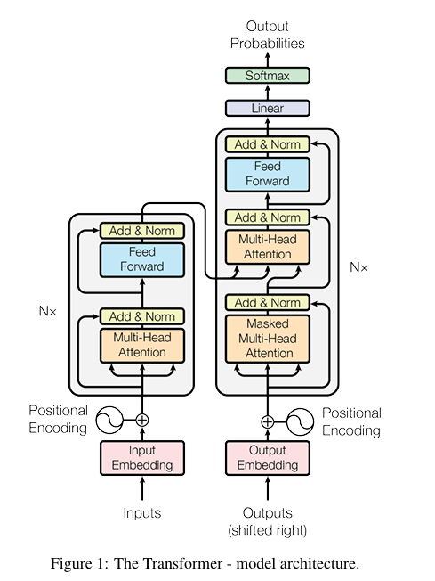
Input
(tokens)

Slide 7


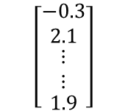


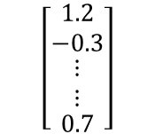

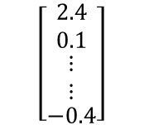
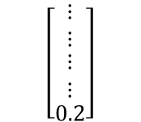




Input Token
How does a computer see words?
Suddenly, one of them stopped and pointed ____
Tokenize
Suddenly , one of them stopped and pointed ____
$$\left[\begin{matrix}1.2 \\ −0.3 \\ \begin{matrix}\begin{matrix}⋮ \\ ⋮\end{matrix} \\ 0.7\end{matrix}\end{matrix}\right]$$
$$\left[\begin{matrix}−0.3 \\ 2.1 \\ \begin{matrix}\begin{matrix}⋮ \\ ⋮\end{matrix} \\ 1.9\end{matrix}\end{matrix}\right]$$
$$\left[\begin{matrix}⋮ \\ ⋮ \\ \begin{matrix}\begin{matrix}⋮ \\ ⋮\end{matrix} \\ 0.2\end{matrix}\end{matrix}\right]$$
$$\left[\begin{matrix}2.4 \\ 0.1 \\ \begin{matrix}\begin{matrix}⋮ \\ ⋮\end{matrix} \\ −0.4\end{matrix}\end{matrix}\right]$$
$$…$$
$$…$$
$$…$$
$$…$$
Each token is represented as a vector, called the embeddings
Each token is mapped to a dense vector representation (embedding) using a learned weight matrix, called the embedding matrix.
The size of the embedding matrix in GPT3 (for the largest model) is:
vocab_size x d_model =50,257x12,288
Notes:
Now we have chatGPT5

Slide 8
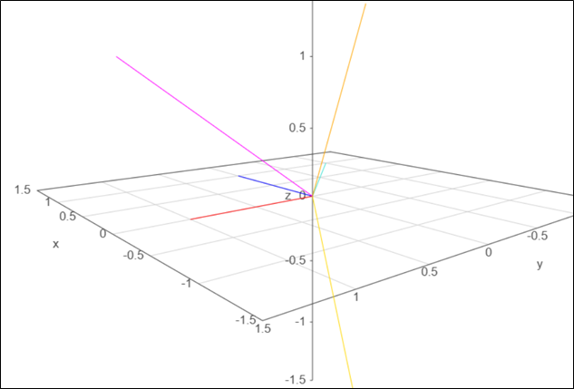
What is an Embedding?
Since embeddings are just vectors of fixed size (say of size D), you can imagine them as points in D-dimensional space!
Here’s a sample visualization of 3-dimensional word embeddings:
pointed
suddenly
them
stopped
Each word is represented by a vector in this 3D space. The three axes x,y, and z each represent different qualities of the words. For instance, these qualities could include being an adjective, an action, or a pronoun.

Slide 9
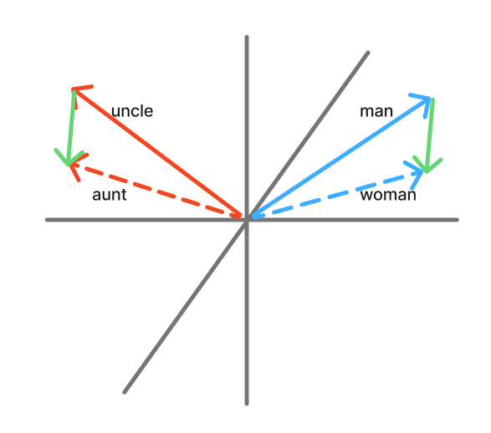
Embedding Dimensions
Here is another example of how directions in the embedding space can have meanings:
Let’s say we have vectors for “man” and “woman”.
If we take the difference between these two vectors, we get another vector z. In other words, if we add vector z to the embedding of ‘man’, we get the embedding of ‘woman’.
Similarly, if we add the vector z to the embedding of ‘uncle’, we might get the word ‘aunt’!
This means that the geometric co-alignment between ‘man’ and ‘woman’, i.e. that direction in the embedding space, “understands” the notion of gender!

Slide 10
Note on Tokens and Embeddings
In reality, embeddings are typically very high-dimensional. For example, GPT-2 used 768-dimensional word embeddings.
  However, the intuition remains the same.
  This helps the model encode more complex qualities of a token, such as gender, plurality, hierarchy, appearance, belonging, etc, which improves the model “understanding”.
In reality, for applications like text generation, tokenization does not use whole words, but instead parts of words, i.e. groupings of characters that are commonly seen together. There are many research papers on this, but for simplicity in this course we will treat a token as one word.
Used in modern models
Suddenly, one of them stopped and pointed ??????
Naïve tokenization

Slide 11
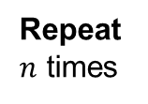
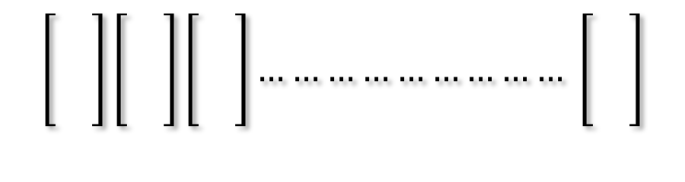
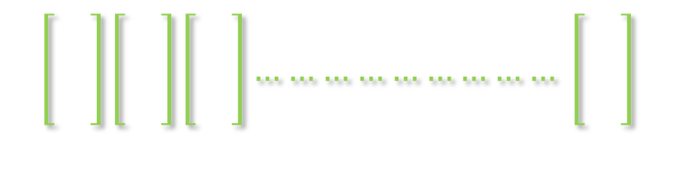
Simplified Architecture of an Encoder
MLP
$$\left[\begin{matrix} \\ \\ \end{matrix}\right]\left[\begin{matrix} \\ \\ \end{matrix}\right]\left[\begin{matrix} \\ \\ \end{matrix}\right]……………………… \left[\begin{matrix} \\ \\ \end{matrix}\right]$$
Repeat $n$ times
Modified word embeddings
Attention
mechanism
$$\left[\begin{matrix} \\ \\ \end{matrix}\right]\left[\begin{matrix} \\ \\ \end{matrix}\right]\left[\begin{matrix} \\ \\ \end{matrix}\right]……………………… \left[\begin{matrix} \\ \\ \end{matrix}\right]$$
Suddenly , one pointed

Slide 12
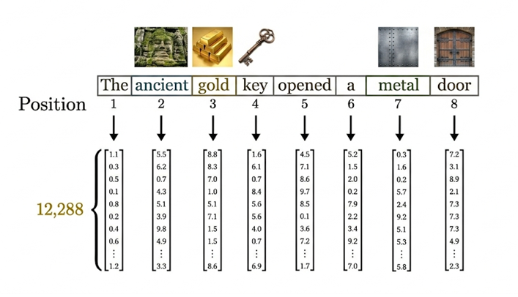
Core Concept of Attention
Consider this example of a sentence, using 12,288-dimensional embeddings. For the sake of this example, let's assume the positional information is somehow included in the embeddings.

Slide 13
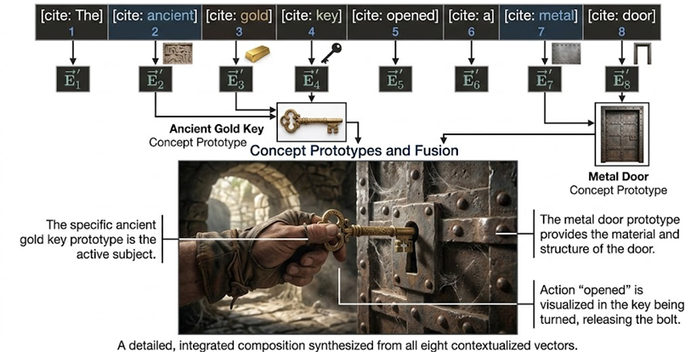
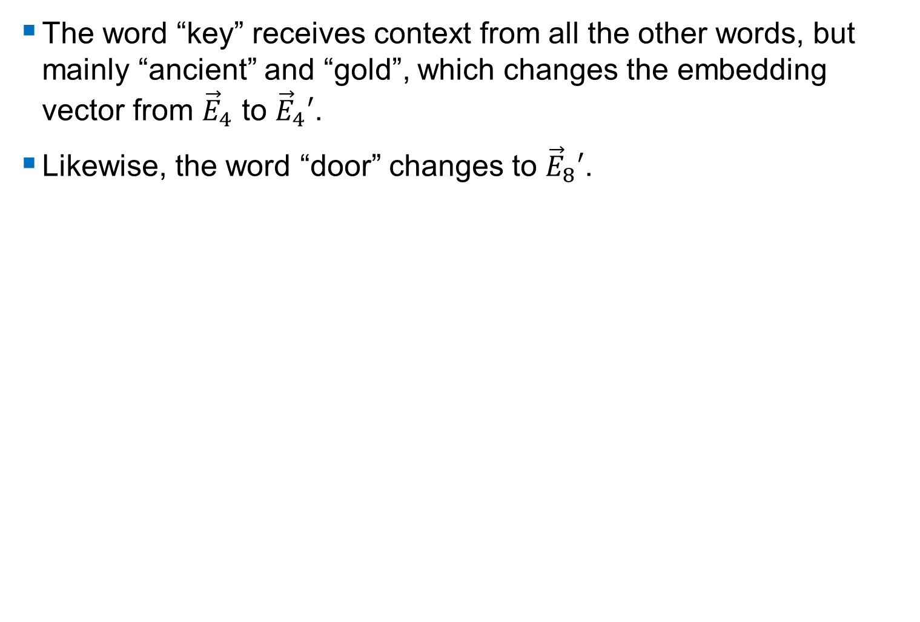
Core Concept of Attention
The word “key” receives context from all the other words, but mainly “ancient” and “gold”, which changes the embedding vector from ${\vec{E}}_{4}$ to ${\vec{E}}_{4}′$.
Likewise, the word “door” changes to ${\vec{E}}_{8}′$.
You can imagine that changing the embedding vector is the like moving the vectors in
D-dimensional space closer to their true meanings in the given context.

Slide 14








Geometric View
In a D-dimensional space, this can be viewed as follows:
$E_{i}$’: modified embedding for “key” that is “gold” and “ancient
$E_{i}$+ some effect from token “ancient”
$E_{i}$ + some effect from token “gold”
$E_{i}$: embedding for “key”

Slide 15
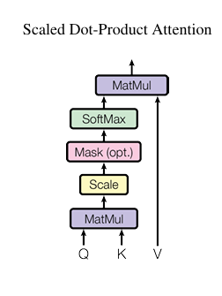
Attention in Transformers
Let’s look at the attention mechanism within transformers, and how it works in detail.
Ignore the “multi” as we will explain “single-head attention” first
We will first explain Queries, Keys, and Values
  Queries (Q): What I’m looking for
  Keys (K): What I can offer
  Values (V): What value I will give you if you choose me

Slide 16
Queries, Keys and Values Intuition
Consider how YouTube works when you search:
Scenario: You search for "funny cat videos"
Matching Query with Keys Attention score = how well your query matches each video's key → YouTube ranks videos by relevance (this is the dot product Q·Kᵀ). A video on “cats fighting" gets a high score, while a video on "Deep Sea Creatures" gets a low score.
Output = weighted sum of values → your feed is a blend dominated by the most relevant videos
Component | Meaning | Example
Query (Q) | What you're searching for | "funny cat videos"
Key (K) | Each video's tags/metadata | "cats, humor, animals"
Value (V) | The actual video content | The video itself

Slide 17
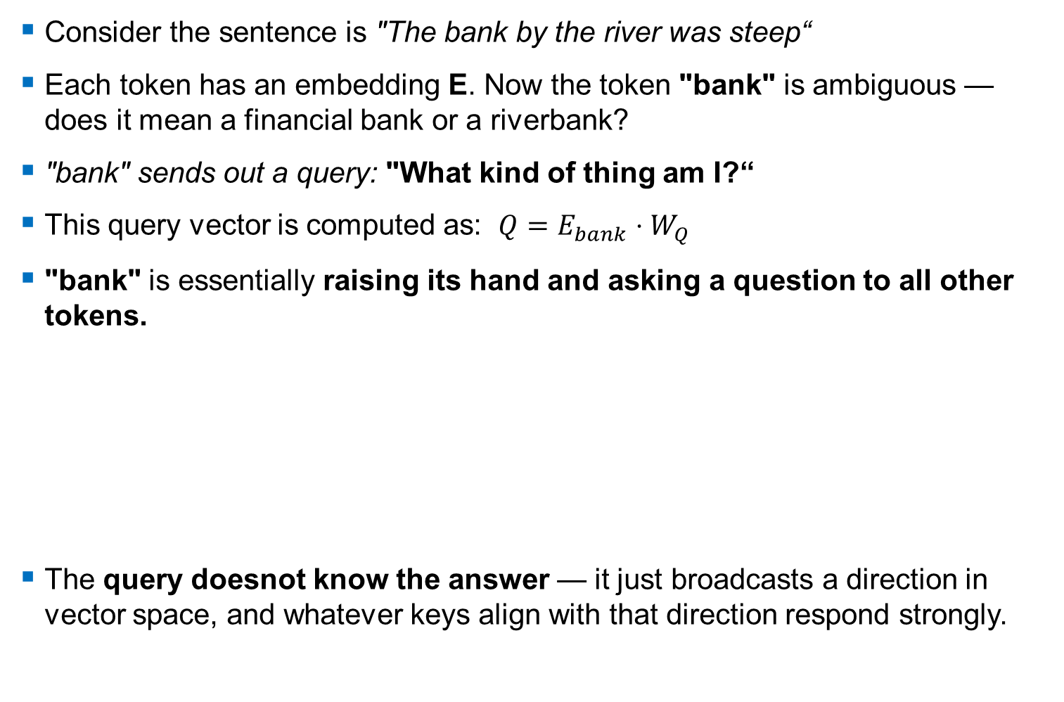
Queries
Consider the sentence is "The bank by the river was steep“
Each token has an embedding E. Now the token "bank" is ambiguous — does it mean a financial bank or a riverbank?
"bank" sends out a query: "What kind of thing am I?“
This query vector is computed as: $Q=E_{bank}⋅W_{Q}$
"bank" is essentially raising its hand and asking a question to all other tokens.
The query doesnot know the answer — it just broadcasts a direction in vector space, and whatever keys align with that direction respond strongly.
Token | What "bank" is asking toward
"river" | ✅ High score → "I'm probably a riverbank"
"steep" | ✅ Medium score → reinforces physical terrain
"The" | ❌ Low score → not informative

Slide 18
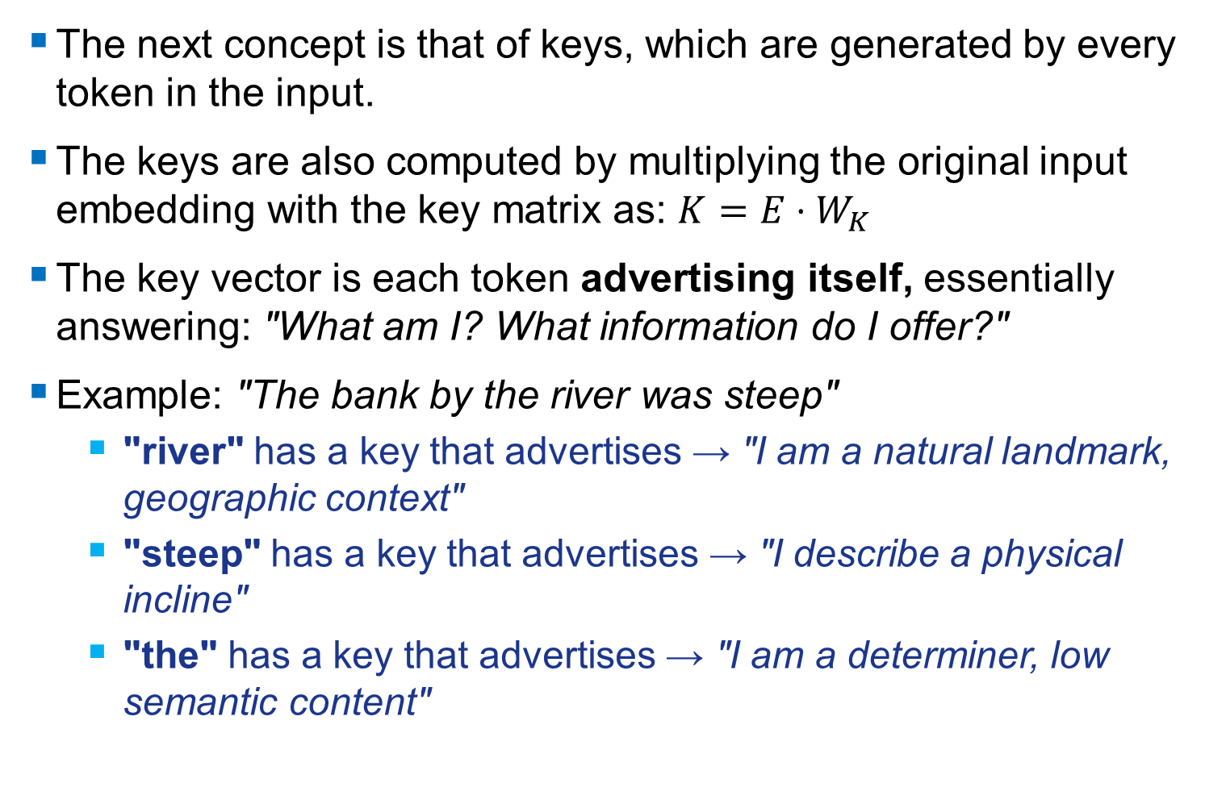
Keys
The next concept is that of keys, which are generated by every token in the input.
The keys are also computed by multiplying the original input embedding with the key matrix as: $K=E⋅W_{K}​$
The key vector is each token advertising itself, essentially answering: "What am I? What information do I offer?"
Example: "The bank by the river was steep"
  "river" has a key that advertises → "I am a natural landmark, geographic context"
  "steep" has a key that advertises → "I describe a physical incline"
  "the" has a key that advertises → "I am a determiner, low semantic content"

Slide 19
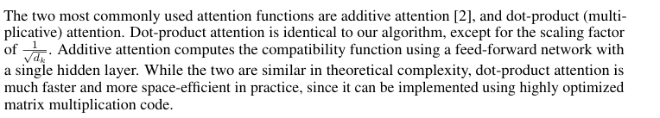
Computing Attention
Excerpt from “Attention is All You Need” paper by Vaswani et. al 2017 on method of computing attention using the key and query vectors:
(more on the scaling factor later)

Slide 20



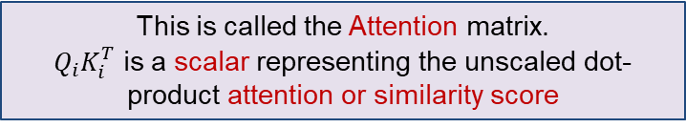




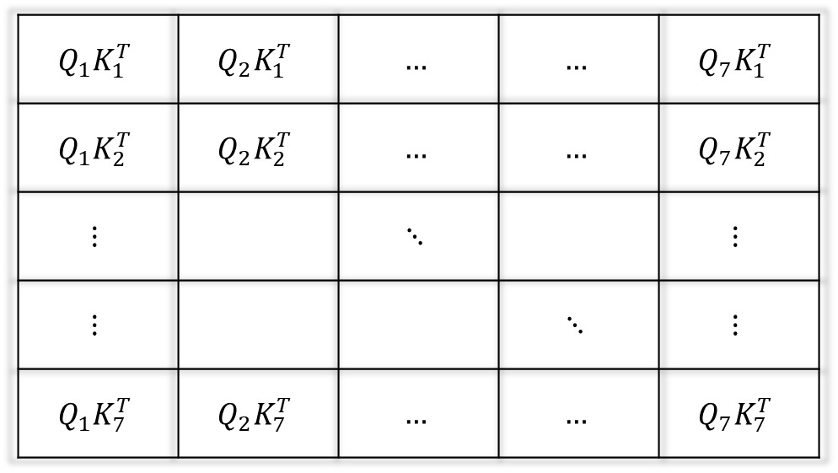








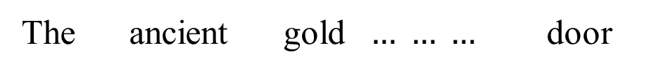



Attention Matrix
The ancient gold $… … …$ door
We take the dot product of the Key and Query vectors, for each token, with every other token
$$E_{1}$$
$$E_{2}$$
$$E_{7}$$
$$W_{Q}$$
$$W_{Q}$$
$$W_{Q}$$
$$Q_{1}$$
$$Q_{2}$$
$$Q_{7}$$
The
$$E_{1}$$
$$K_{1}$$
$$Q_{1}K_{1}^{T}$$ | $$Q_{2}K_{1}^{T}$$ | $$…$$ | $$…$$ | $$Q_{7}K_{1}^{T}$$
$$Q_{1}K_{2}^{T}$$ | $$Q_{2}K_{2}^{T}$$ | $$…$$ | $$…$$ | $$Q_{7}K_{2}^{T}$$
$$⋮$$ |  | $$⋱$$ |  | $$⋮$$
$$⋮$$ |  |  | $$⋱$$ | $$⋮$$
$$Q_{1}K_{7}^{T}$$ | $$Q_{2}K_{7}^{T}$$ | $$…$$ | $$…$$ | $$Q_{7}K_{7}^{T}$$
$$W_{K}$$
ancient
$$E_{2}$$
$$K_{2}$$
$$W_{K}$$
gold
$$⋮$$
$$⋮$$
$$⋮$$
This is called the Attention matrix.
$Q_{i}K_{i}^{T}$ is a scalar representing the unscaled dot-product attention or similarity score
door
$$E_{7}$$
$$K_{7}$$
$$W_{K}$$

Slide 21

Attention Score
So, we measure the similarity between two tokens using the dot-product.
However, there is one issue with the resulting attention matrix:
  The resulting vectors in the attention matrix, i.e. the columns of the attention matrix are not normalized.
  Solution: use the Softmax function, applied over each column of the attention matrix individually. This creates a distribution, emphasizes larger scores and suppresses lower scores, while also dealing with negative attention scores.
$$σ\left(t\right)=\frac{e^{t}}{∑e^{t}}$$

Slide 23
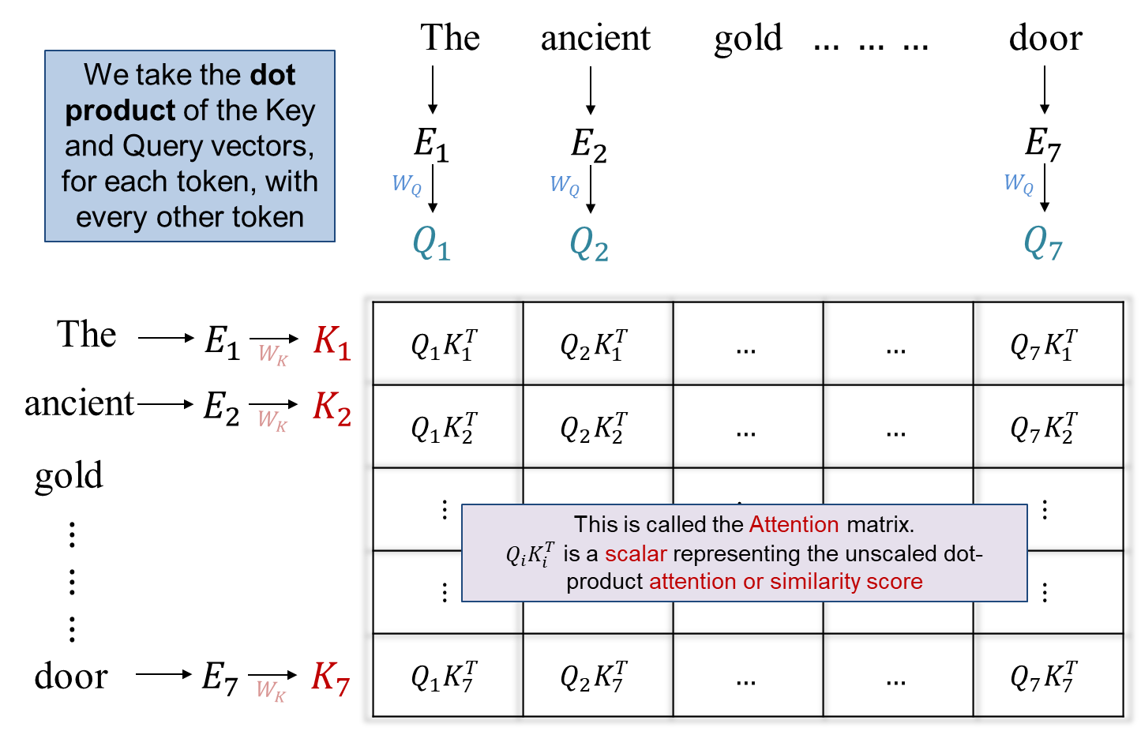
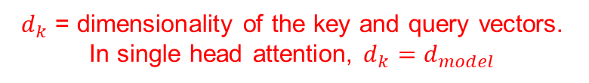
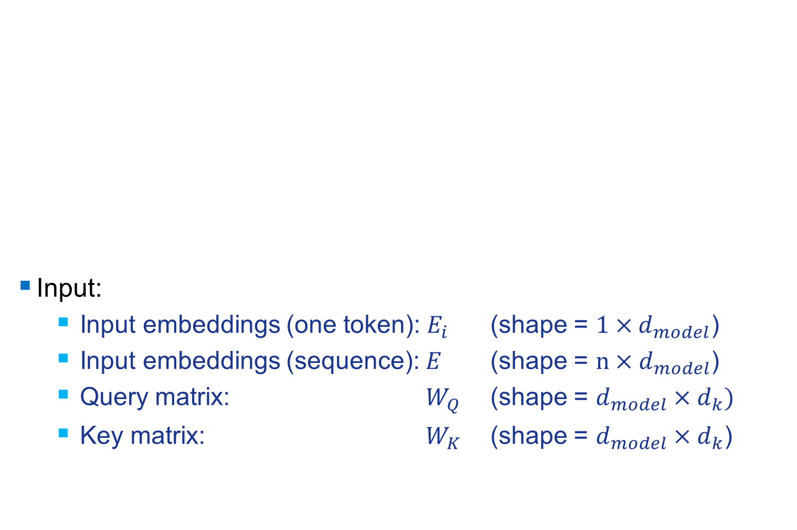
Notation
Input:
  Input embeddings (one token): $E_{i}$ (shape = $1×d_{model}$)
  Input embeddings (sequence): $E$ (shape = $n×d_{model}$)
  Query matrix: $W_{Q}$ (shape = $d_{model}×d_{k})$
  Key matrix: $W_{K}$ (shape = $d_{model}×d_{k}$)
$d_{k}$ = dimensionality of the key and query vectors. In single head attention, $d_{k}=d_{model}$

Slide 24
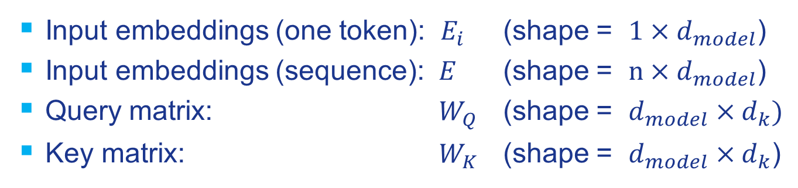
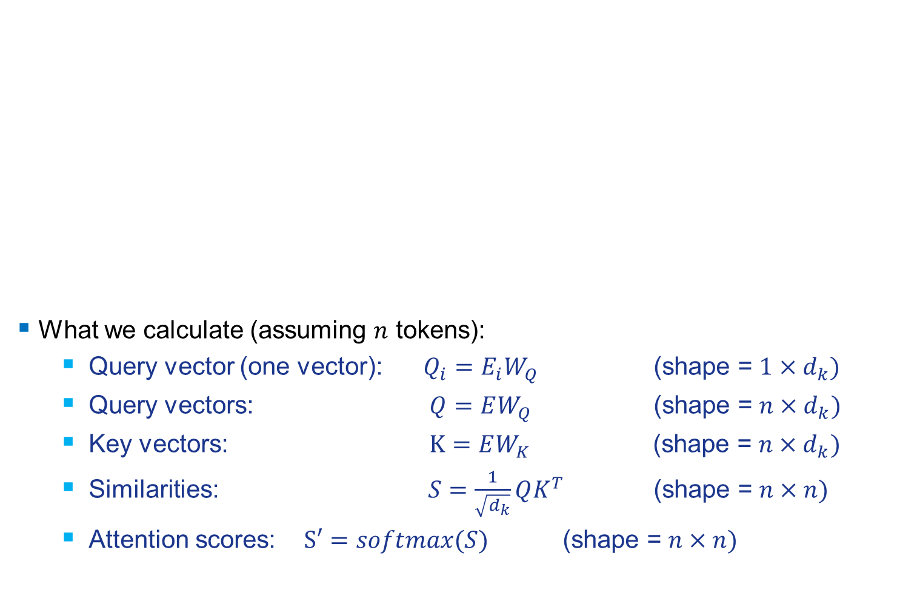
Notation
What we calculate (assuming $n$ tokens):
  Query vector (one vector): $Q_{i}=E_{i}W_{Q}$ (shape = $1×d_{k})$
  Query vectors: $Q=EW_{Q}$ (shape = $n×d_{k})$
  Key vectors: $K=EW_{K}$ (shape = $n×d_{k})$
  Similarities: $S=\frac{1}{\sqrt{d_{k}}}QK^{T}$ (shape = $n×n)$
  Attention scores: $S′=softmax(S)$ (shape = $n×n)$
$d_{k}$ = dimensionality of the key and query vectors. In single head attention, $d_{k}=d_{model}$

Slide 25
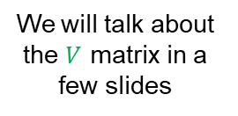
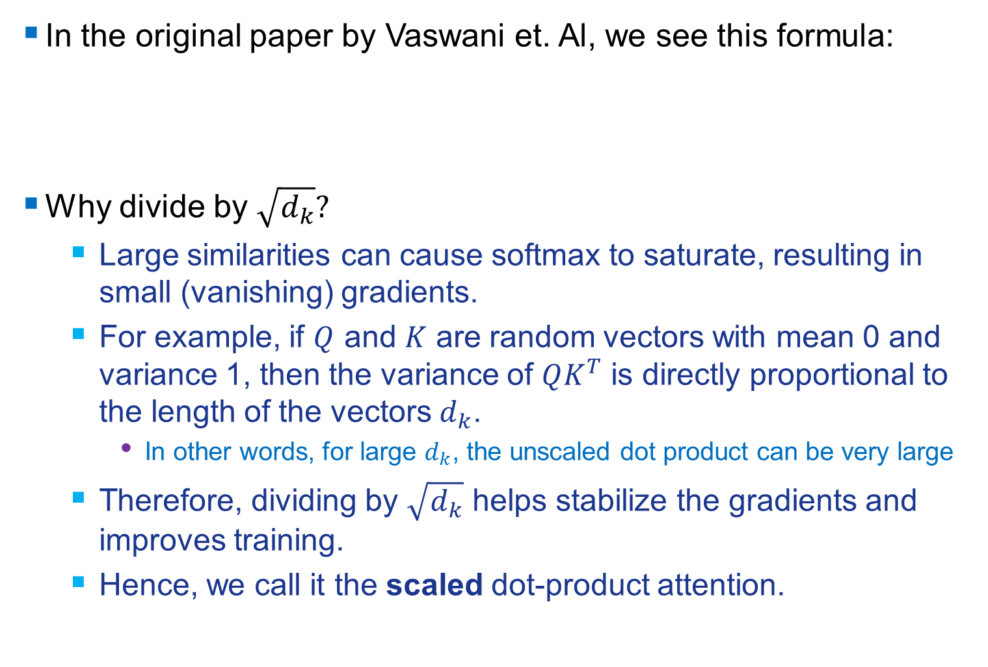
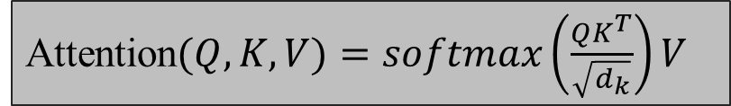
Scaled Dot-Product Attention
In the original paper by Vaswani et. Al, we see this formula:
Why divide by $\sqrt{d_{k}}?$
  Large similarities can cause softmax to saturate, resulting in small (vanishing) gradients.
  For example, if $Q$ and $K$ are random vectors with mean 0 and variance 1, then the variance of $QK^{T}$ is directly proportional to the length of the vectors $d_{k}$.
    In other words, for large $d_{k}$, the unscaled dot product can be very large
  Therefore, dividing by $\sqrt{d_{k}}$ helps stabilize the gradients and improves training.
  Hence, we call it the scaled dot-product attention.
Attention$(Q,K,V)=softmax\left(\frac{QK^{T}}{\sqrt{d_{k}}}\right)V$
We will talk about the $V$ matrix in a few slides

Slide 26



Scaled Dot-Product Attention
$$S′=softmax(S)$$
“Mask” means we hide future tokens (no look ahead) – this is only applied in the decoder
(more on this later)
$$S=\frac{QK^{T}}{√d_{k}}$$
$$QK^{T}$$
This is now the last remaining step, we multiply $S′$ by $V$

Slide 27



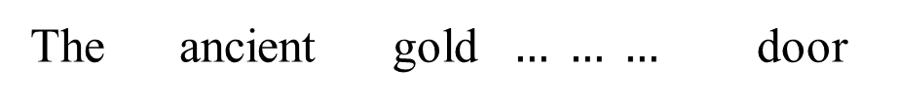




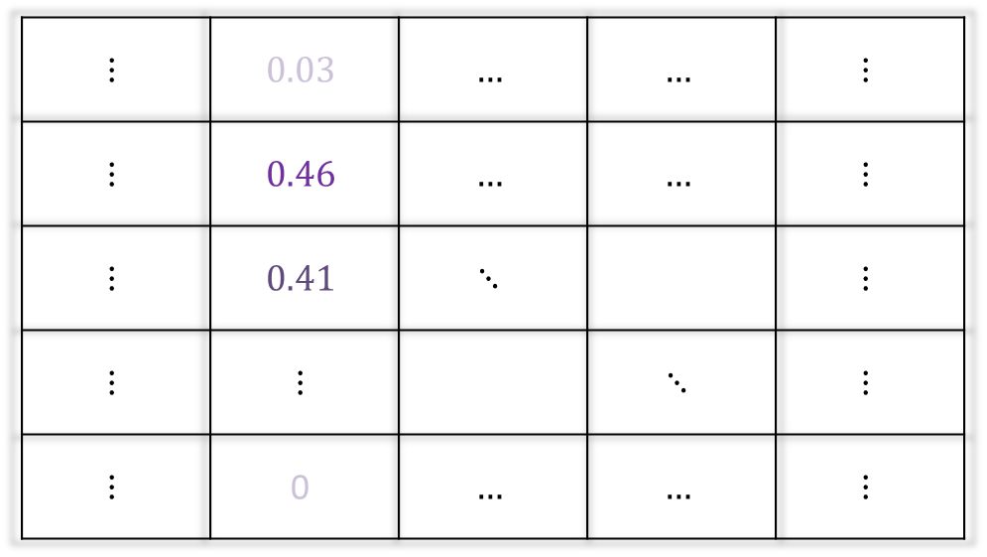












Recap: Attention Matrix So Far
The main idea for what we have done so far is to identify which tokens from the sentence to “attend to” the other tokens, and make a distribution out of the resulting attention scores
The ancient gold $… … …$ door
$$E_{1}$$
$$E_{2}$$
$$E_{7}$$
$$W_{Q}$$
$$W_{Q}$$
$$W_{Q}$$
$$Q_{1}$$
$$Q_{2}$$
$$Q_{7}$$
The
$$E_{1}$$
$$K_{1}$$
$$⋮$$ | $$0.03$$ | $$…$$ | $$…$$ | $$⋮$$
$$⋮$$ | $$0.46$$ | $$…$$ | $$…$$ | $$⋮$$
$$⋮$$ | $$0.41$$ | $$⋱$$ |  | $$⋮$$
$$⋮$$ | $$⋮$$ |  | $$⋱$$ | $$⋮$$
$$⋮$$ | $$\text{0}$$ | $$…$$ | $$…$$ | $$⋮$$
$$W_{K}$$
ancient
$$E_{2}$$
$$K_{2}$$
$$W_{K}$$
gold
$$E_{3}$$
$$K_{3}$$
$$W_{K}$$
$$⋮$$
$$⋮$$
$$⋮$$
door
$$E_{7}$$
$$K_{7}$$
$$W_{K}$$

Slide 28
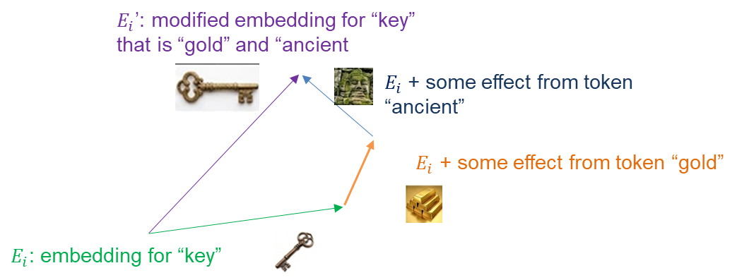
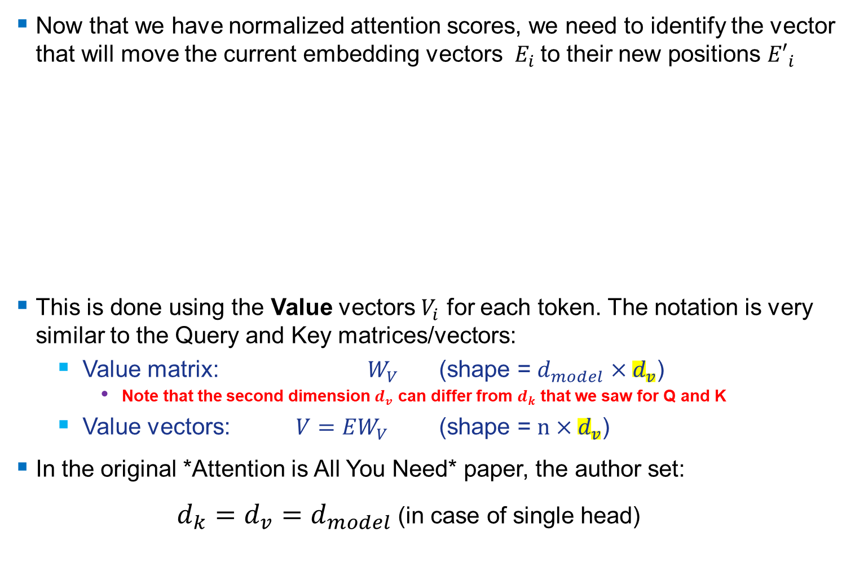
How We Use These Scores: Values (V)
Now that we have normalized attention scores, we need to identify the vector that will move the current embedding vectors $E_{i}$to their new positions ${E′}_{i}$
This is done using the Value vectors $V_{i}$ for each token. The notation is very similar to the Query and Key matrices/vectors:
  Value matrix: $W_{V}$ (shape = $d_{model}×d_{v}$)
    Note that the second dimension $d_{v}$ can differ from $d_{k}$ that we saw for Q and K
  Value vectors: $V=EW_{V}$ (shape = $n×d_{v}$)
In the original *Attention is All You Need* paper, the author set:
$d_{k}=d_{v}=d_{model}$ (in case of single head)

Slide 29



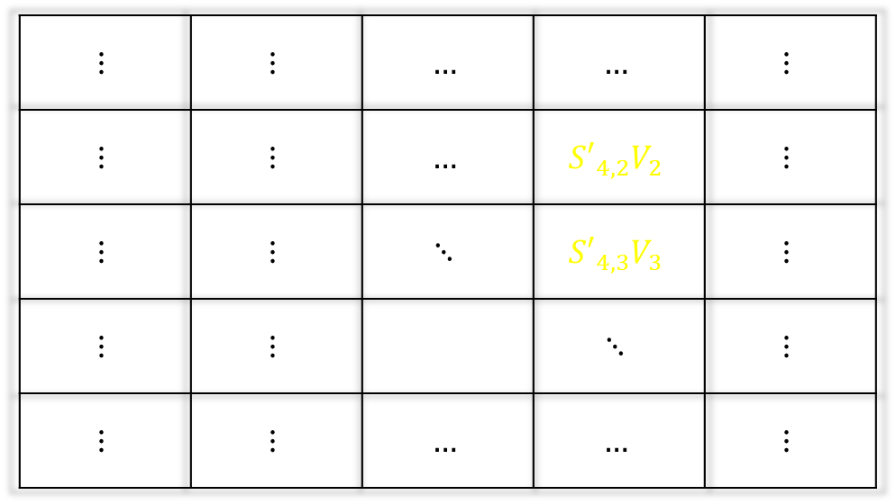









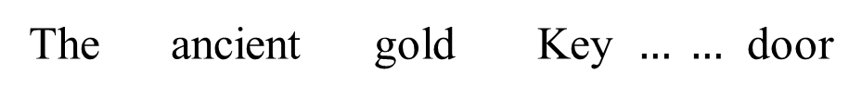







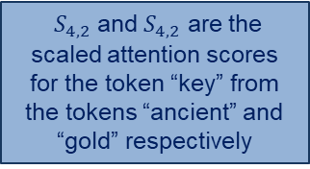

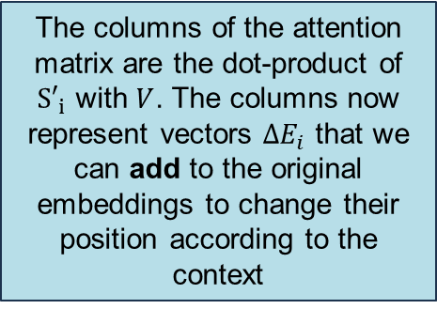









Attention Matrix: Final
The columns of the attention matrix are the dot-product of ${S′}_{i}$ with $V$. The columns now represent vectors ${ΔE}_{i}$ that we can add to the original embeddings to change their position according to the context
The ancient gold Key $… …$ door
$$E_{1}$$
$$E_{2}$$
$$E_{3}$$
$$…$$
$$E_{7}$$
Compute attention scores
$${S′}_{1}$$
$${S′}_{2}$$
$${S′}_{3}$$
$${S′}_{4}$$
$$……$$
$${S′}_{7}$$
The
$$E_{1}$$
$$V_{1}$$
$$⋮$$ | $$⋮$$ | $$…$$ | $$…$$ | $$⋮$$
$$⋮$$ | $$⋮$$ | $$…$$ | $${S′}_{4,2}V_{2}$$ | $$⋮$$
$$⋮$$ | $$⋮$$ | $$⋱$$ | $${S′}_{4,3}V_{3}$$ | $$⋮$$
$$⋮$$ | $$⋮$$ |  | $$⋱$$ | $$⋮$$
$$⋮$$ | $$⋮$$ | $$…$$ | $$…$$ | $$⋮$$
$$W_{V}$$
ancient
$$E_{2}$$
$$V_{2}$$
$$W_{V}$$
$S_{4,2}$ and $S_{4,2}$ are the scaled attention scores for the token “key” from the tokens “ancient” and “gold” respectively
gold
$$E_{3}$$
$$V_{3}$$
$$W_{V}$$
key
$$E_{4}$$
$$V_{4}$$
$$W_{V}$$
$$⋮$$
$$⋮$$
door
$$E_{7}$$
$$V_{7}$$
$$W_{V}$$
$$ΔE_{4}$$

Slide 30
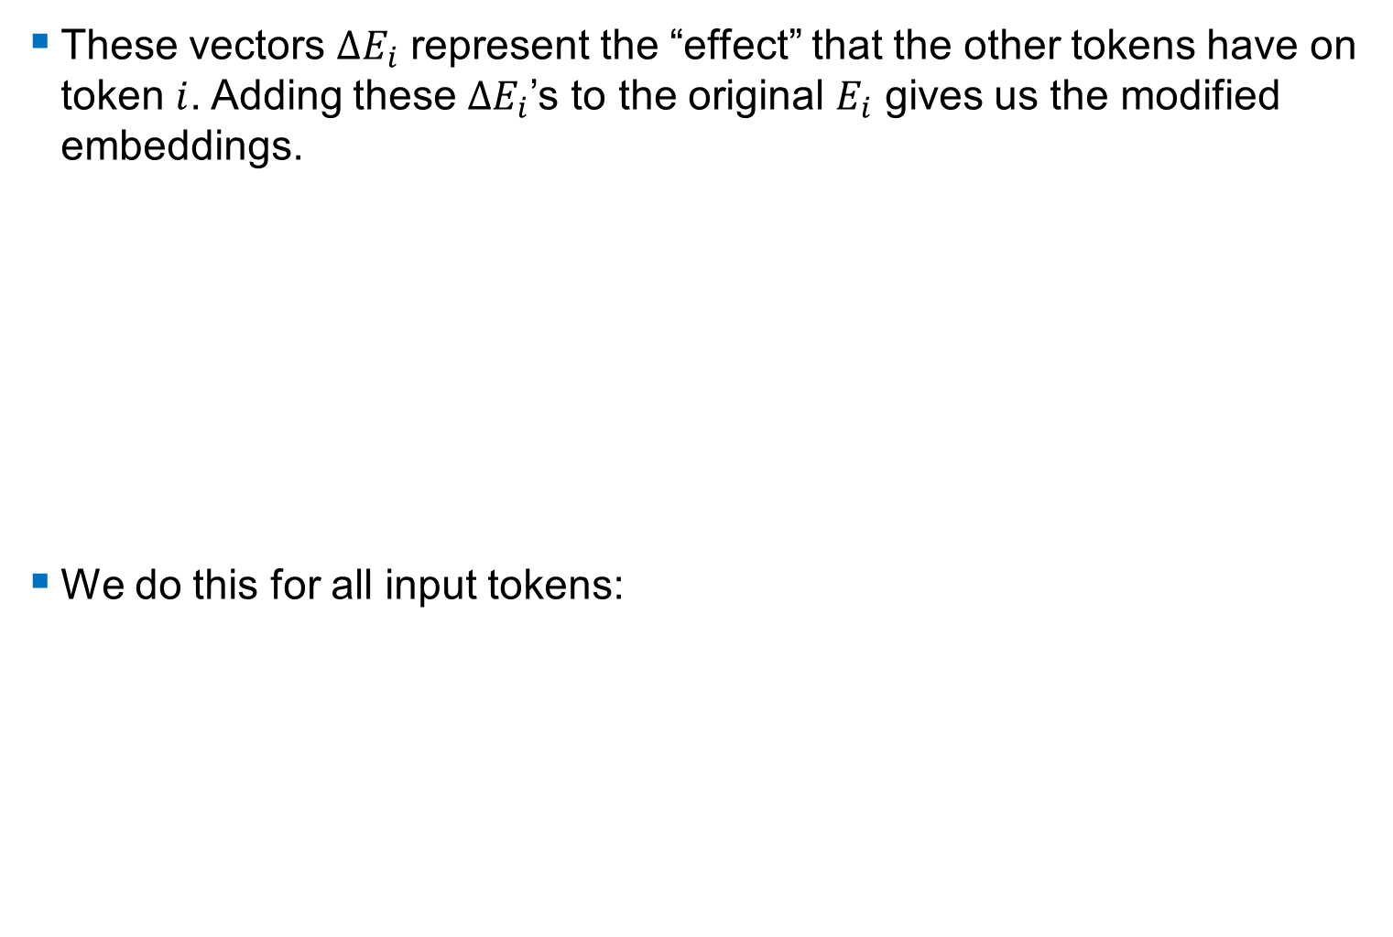
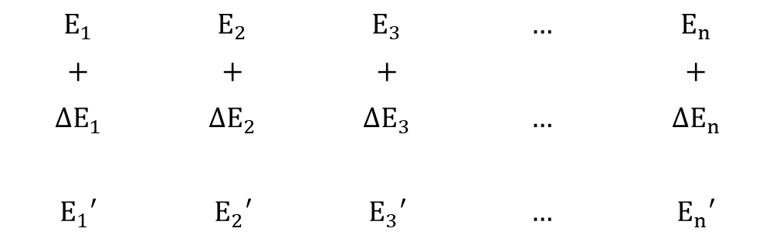




Moving the Original Embeddings
These vectors $ΔE_{i}$ represent the “effect” that the other tokens have on token $i$. Adding these $ΔE_{i}$’s to the original $E_{i}$ gives us the modified embeddings.
We do this for all input tokens:
$E_{4}$’: modified embedding for “key”
small effects from all other tokens
Note: this is only a 2D representation of the “modifications”; in reality, each of these “modifications” is happening along different dimensions of the embedding vector
$$E_{4,3}+ΔE_{4,3}$$
$$E_{4,2}+ΔE_{4,2}$$
$E_{4}$: embedding for “key”
$$E_{1}$$ | $$E_{2}$$ | $$E_{3}$$ | $$…$$ | $$E_{n}$$
$$+$$ | $$+$$ | $$+$$ |  | $$+$$
$${ΔE}_{1}$$ | $${ΔE}_{2}$$ | $${ΔE}_{3}$$ | $$…$$ | $${ΔE}_{n}$$
$$E_{1}′$$ | $$E_{2}′$$ | $$E_{3}′$$ | $$…$$ | $$E_{n}′$$

Slide 31
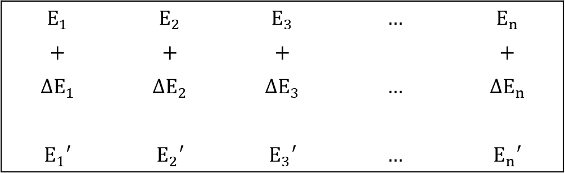
Single Head Attention
This entire process is called single head attention.
More specifically, this is called single head self-attention, which is different from cross-attention (more on this later).
$$E_{1}$$ | $$E_{2}$$ | $$E_{3}$$ | $$…$$ | $$E_{n}$$
$$+$$ | $$+$$ | $$+$$ |  | $$+$$
$${ΔE}_{1}$$ | $${ΔE}_{2}$$ | $${ΔE}_{3}$$ | $$…$$ | $${ΔE}_{n}$$
$$E_{1}′$$ | $$E_{2}′$$ | $$E_{3}′$$ | $$…$$ | $$E_{n}′$$
We will talk about the ‘multi’ in “Multi-Head Attention, and the ‘norm’ in “Add & Norm” in a few slides.
Layer Normalization
+
Self-attention
This addition also serves as a “residual connection”, which helps with gradient flow.
Input Embeddings

Slide 32



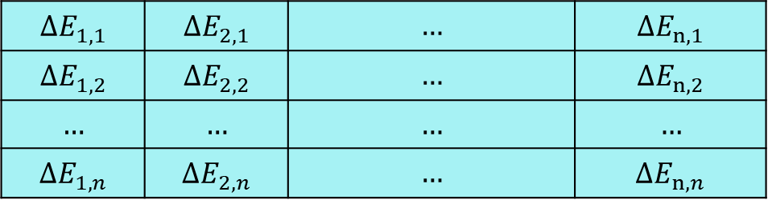



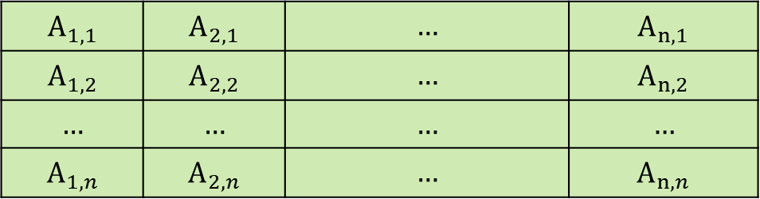






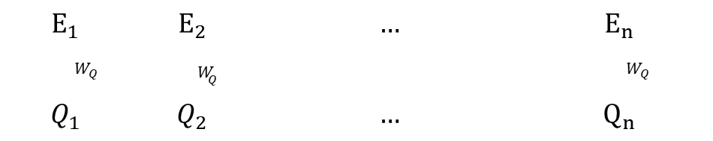


Overall Architecture So Far
FLOW
$$E_{1}$$ | $$E_{2}$$ | $$…$$ | $$E_{n}$$
$$W_{Q}$$ | $${ W}_{Q}$$ |  | $${ W}_{Q}$$
$$Q_{1}$$ | $$Q_{2}$$ | $$…$$ | $$Q_{n}$$
$$W_{K}$$
$$K_{1}$$
$$A_{1,1}$$ | $$A_{2,1}$$ | $$…$$ | $$A_{n,1}$$
$$A_{1,2}$$ | $$A_{2,2}$$ | $$…$$ | $$A_{n,2}$$
$$…$$ | $$…$$ | $$…$$ | $$…$$
$$A_{1,n}$$ | $$A_{2,n}$$ | $$…$$ | $$A_{n,n}$$
$$W_{K}$$
$$K_{2}$$
$$⋮$$
$$W_{K}$$
$$K_{n}$$
Softmax along each column
$$W_{V}$$
$$V_{1}$$
$${ΔE}_{1,1}$$ | $${ΔE}_{2,1}$$ | $$…$$ | $${ΔE}_{n,1}$$
$${ΔE}_{1,2}$$ | $${ΔE}_{2,2}$$ | $$…$$ | $${ΔE}_{n,2}$$
$$…$$ | $$…$$ | $$…$$ | $$…$$
$${ΔE}_{1,n}$$ | $${ΔE}_{2,n}$$ | $$…$$ | $${ΔE}_{n,n}$$
$$W_{V}$$
$$V_{2}$$
$$⋮$$
$$W_{V}$$
$$V_{n}$$
Column-wise addition
$$E_{1}′$$
$$E_{2}′$$
$$E_{3}′$$

Slide 33



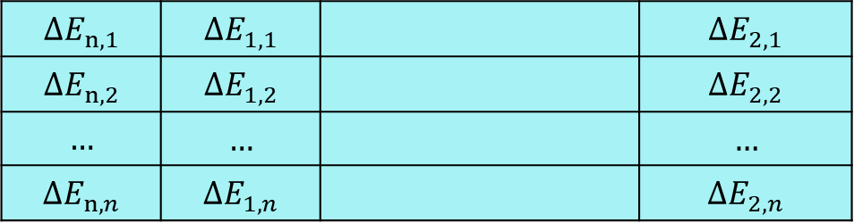



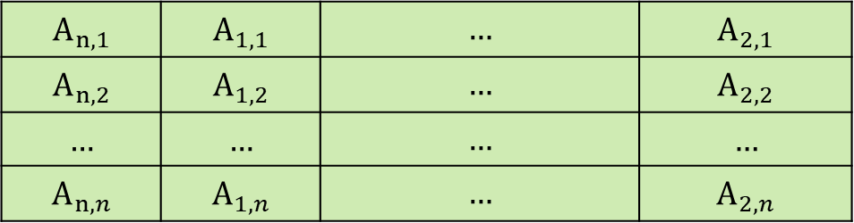


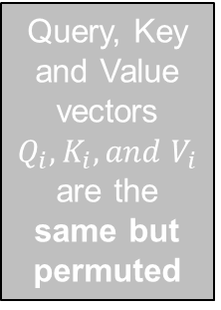
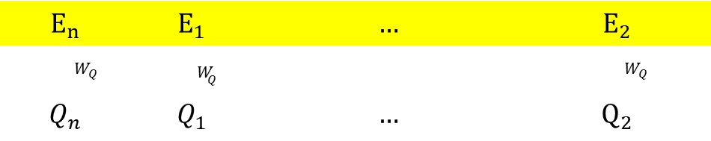

What if We Permute the Input Sequence?
$$E_{n}$$ | $$E_{1}$$ | $$…$$ | $$E_{2}$$
$$W_{Q}$$ | $${ W}_{Q}$$ |  | $${ W}_{Q}$$
$$Q_{n}$$ | $$Q_{1}$$ | $$…$$ | $$Q_{2}$$
$$W_{K}$$
$$K_{n}$$
$$A_{n,1}$$ | $$A_{1,1}$$ | $$…$$ | $$A_{2,1}$$
$$A_{n,2}$$ | $$A_{1,2}$$ | $$…$$ | $$A_{2,2}$$
$$…$$ | $$…$$ | $$…$$ | $$…$$
$$A_{n,n}$$ | $$A_{1,n}$$ | $$…$$ | $$A_{2,n}$$
$$W_{K}$$
$$K_{1}$$
Similarities are the same but permuted
Query, Key and Value vectors $Q_{i}, K_{i}, and V_{i}$ are the same but permuted
$$⋮$$
$$W_{K}$$
$$K_{2}$$
Softmax along each column
$$W_{V}$$
$$V_{n}$$
$${ΔE}_{n,1}$$ | $${ΔE}_{1,1}$$ |  | $${ΔE}_{2,1}$$
$${ΔE}_{n,2}$$ | $${ΔE}_{1,2}$$ |  | $${ΔE}_{2,2}$$
$$…$$ | $$…$$ |  | $$…$$
$${ΔE}_{n,n}$$ | $${ΔE}_{1,n}$$ |  | $${ΔE}_{2,n}$$
$$W_{V}$$
$$V_{1}$$
Attention matrix is the same but permuted
$$⋮$$
$$W_{V}$$
$$V_{2}$$
Column-wise addition
$$E_{n}′$$
$$E_{1}′$$
$$E_{2}′$$

Slide 34


Output is the same but permuted
$→$ Self-attention layer is Permutation Equivariant $f(s(x)) = s(f(x))$

Slide 35




Positional Encodings
Permutation equivariance means that self-attention does not care about the order of the input.
Solution: we need to encode some sort of positional information about the relative or absolute position of the tokens, into the embeddings. There are various ways to achieve this, but in the paper:
  $pos$ is the position of the token in the sequence
  $i$ is the dimension index
  $d_{model}$ is the embedding dimensionality (e.g. 512)
The intuition is what really matters for self-attention is
how far apart words are (i.e., their relative positions).
$PE_{(pos,2i)}=sin(\frac{pos}{{(10000)}^{2i/d_{model}}}$)
$PE_{(pos,2i+1)}=cos(\frac{pos}{{(10000)}^{2i/d_{model}}}$)

Slide 36





Example
Here is an example with a 4-dimensional embedding ($d_{model}=4$) and token position $(pos)$ is 3:
  Index 0: $PE\left(3,0\right)=sin\left(\frac{3}{{10000}^{\frac{0}{4}}}\right)=sin⁡(3\text{)}$
  Index 1: $PE\left(3,1\right)=cos\left(\frac{3}{{10000}^{\frac{0}{4}}}\right)=cos⁡(3\text{)}$
  Index 2: $PE\left(3,2\right)=sin\left(\frac{3}{{10000}^{\frac{2}{4}}}\right)$
  Index 3: $PE\left(3,3\right)=cos\left(\frac{3}{{10000}^{\frac{2}{4}}}\right)$
$PE_{(pos,2i)} =sin(\frac{pos}{{10000}^{2i/d_{model}}}$)
$PE_{(pos,2i+1)}=cos(\frac{pos}{{10000}^{2i/d_{model}}}$)
$$P_{i}{\left(t\right)}^{T}={{\left[\begin{matrix}sin⁡(ω_{1},t) \\ cos⁡(ω_{1},t) \\ \begin{matrix}sin⁡(ω_{2},t) \\ \begin{matrix}cos⁡(ω_{2},t) \\ ⋮\end{matrix} \\ \begin{matrix}sin⁡(ω_{d/2},t) \\ cos⁡(ω_{d/2},t)\end{matrix}\end{matrix}\end{matrix}\right]}^{T}}_{d_{model}×1}$$
where $t=pos, d=d_{model}, and$
$$ω_{i}=\frac{1}{{10000}^{\frac{2i}{d_{model}}}}$$

Slide 37


Input Embeddings
The positional encodings are added to the token embeddings element-wise before feeding them into the Encoder:
Input to Transformer = Token Embeddings + Positional Encodings
The embedding vector and the positional encoding vector have the same dimension ($d_{model}$).
This means that each $E$ captures its semantic meaning (from the word embeddings) as well as its position in the sequence.
Learned vs. Sinusoidal Positional Encodings:
  The original Transformer paper uses sinusoidal positional encodings, which are fixed and not learned during training.
  Some modern Transformers use learned positional embeddings, which allow the model to learn position representations dynamically but may not generalize as well to longer sequences.
  In the original paper. The authors say “We also experimented with using learned positional embeddings instead, and found that the two versions produced nearly identical results”
Input Embeddings $=E_{i}+P_{i}(t)$
Notes:
The key idea is that the position of the token should matter, and we add positional information using these positional embeddings.

Slide 38



Multi Head Attention (MHA)
Instead of performing a single attention function with $d_{model}$ dimensional queries $Q$, keys $K$ and values $V$, the authors of the paper found it that it was better to project them down to $d_{k}, d_{k}$ and $d_{v}$-dimensions, respectively, and to have $h$ different such projections. Then, they performed attention using each of these $h$ sets of $Q_{i}$, $K_{i}$ and $V_{i}$, in parallel.
Each “set of projections” is called a head, and each head has its own learnable projections (weight matrices) for $W_{i}^{Q},W_{i}^{K}$ and $W_{i}^{V}$
Mathematically, assume we have $n$ tokens, d_model is the size of the embeddings, and for each head $i$, we have:
$${E∈ℝ^{n×d_{model}}, W}_{i}^{Q}∈ℝ^{d_{model}×d_{k}},W_{i}^{K}∈ℝ^{d_{model}×d_{k}},W_{i}^{V}∈ℝ^{d_{model}×d_{v}}$$
$∴Q_{i}=EW_{i}^{Q}∈ℝ^{n×d_{k}}$ and similarly $K_{i}∈ℝ^{n×d_{k}}$, and $V_{i}∈ℝ^{n×d_{v}}$
In Single-Head Attention: $d_{k}=d_{model}$
In Multi-Head Attention (MHA): $d_{k}=\frac{d_{model}}{h}$
Notes:
- Here, the “projection” is just a matrix multiplication that gets a result of lower dimension
-- d_v may be different from d_k, it is a hyperparameter we can choose, but in the paper d_v = d_k. In this lecture we will use d_v = d_k

Slide 39




Multi Head Attention
Each of those heads can be thought of as regular single-head attention as before, but since the computation between each head is independent, we can do the computations in parallel which is more efficient.
After all the computations, we have $h$ different ${n×d}_{v}$ dimensional outputs (one per head). In the paper, they concatenate all $h$ matrices into one ${n×(h⋅d}_{v})$-dimensional matrix, and then do another linear projection to map it back down to ${n×d}_{model}$
$$W^{O}∈ℝ^{hd_{v}×d_{model}}$$
Notes:
- (h . d_v) may be larger than d_model if d_v > d_k.
However, if d_v = d_k then the concatenated matrix n x (h . d_v) is the same size as n x d_model since d_k = d_v = d_model/h
It is STILL a good idea to have a linear projection even if we don’t need to reduce dimensionality – reasons explained in upcoming slides

Slide 40




Example
Here is an example to demonstrate the dimensionality of the various matrices in single-head attention vs multi-head attention.
Consider: $d_{model}=512$ and for multi-head, we’ll use $h=8$ with $d_{k}=d_{v}$
Multi-head:
$$Q_{i}=E_{n×512}{ (W_{i})}_{512×64}^{Q}$$
$$K_{i}=E_{n×512}{(W_{i})}_{512×64}^{K}$$
$$V_{i}=E_{n×512}{{(W}_{i})}_{512×64}^{V}$$
for $i=1,2,…8$, and
$W^{O}∈ℝ^{512×512}$(output linear project.)
Output is also $n×512$
$$d_{k}=d_{v}=\frac{d_{model}}{h}= \frac{512}{8}=64$$
Single-head:
$$Q=E_{n×512}W_{512×512}^{Q}$$
$$K=E_{n×512}W_{512×512}^{K}$$
$$V=E_{n×512}W_{512×512}^{V}$$
Output is $n×512$

Slide 41
Why Multi-Head Attention
While computation in theory is similar (multi-head attention has an extra linear projection), however, with parallel computing, the multi-head attention is more efficient.
Multiple representations: each head learns and focuses on different contexts between its Q and K matrices. Multiple heads allows for capturing diverse patterns and relationships between tokens.
Multi-head attention is better at handling long-range dependencies between tokens.
Multi-head attention is like an ensemble of single-head attention heads working independently
  Leads to being more robust against noise, and less prone to overfitting to relationships in the training tokens.

Slide 42


Multihead Attention Example with Code
Let’s use input sequence = “Cat chases mouse around”
Let’s say we have batch size of 1 (model only processes one sequence at a time), and we use 16 heads, with a $d_{model}$ of 512.
So, we know $d_{k}=\frac{512}{16}=32$
Step 1) Convert input sequence to correct shape.
Input $X$ should have shape (batch_size, seq_len, d_model)
  Here, that is shape (1, 4, 512)
Example 4 token input with $d_{model}=16$
batch_size = 1
seq_len = 4
d_model = 512
num_heads = 16
d_k = d_model // num_heads # Dimension per head (32)
# Simulated input embedding
E = torch.rand(batch_size, seq_len, d_model) #random numbers generated from a uniform distribution [0, 1)
print("Input shape:", E.shape) # Expected: (1, 4, 512)
print("Input embeddings:", E)

Slide 43

$$Q=E{ W}^{Q}, K=E{ W}^{K}, V=E{ W}^{V}$$
Step 2) Linear projection to $Q,K,V$
Initialize learnable matrices of dimension 512x512, for $W^{Q},W^{K},W^{V}$, which will be randomly initialized
Apply linear layer to input $X$, using Q = W_Q(E), which computes $Q=E{ W}^{Q}$
W_Q = torch.nn.Linear(d_model, d_model) # (512, 512)
W_K = torch.nn.Linear(d_model, d_model) # (512, 512)
W_V = torch.nn.Linear(d_model, d_model) # (512, 512)
# Generate Q, K, V matrices
Q = W_Q(E) # (1, 4, 512)
K = W_K(E) # (1, 4, 512)
V = W_V(E) # (1, 4, 512)
print("Q:", Q)
torch.nn.Linear creates a linear projection layer; it is a dense, fully-connected layer connecting the input E and the respective output

Slide 44
















Step 3) Split into multiple heads: $Q,K,V →Q_{i},K_{i}, V_{i}, i=1,2,…16$
First, we reshape (batch_size, seq_len, d_model) into shape (batch_size, seq_len, h, d_k)
Then, we permute this into shape (batch_size, h, seq_len, d_k)
batch_size = 1
Each row represents one input token
batch_size = 1
$$Q$$
$$Q reshaped$$
$$Q_{i }\text{for} i=1,2,..16$$
$$d_{k}=32$$
$$n=4$$
$$n=4$$
$$h_{1}$$
$$h_{2}$$
$$⋱$$
$$h_{16}$$
$$d_{model}=512$$
$$[1×4×512]$$
(batch_size, n, d_model)
$$[1×4×16×32]$$
(batch_size, n, h d_k)
$$[1×16×4×32]$$
(batch_size, h, n, d_k)

Slide 45
# Reshape and permute for multi-head attention
Q = Q.view(batch_size, seq_len, num_heads, d_k).permute(0, 2, 1, 3)
K = K.view(batch_size, seq_len, num_heads, d_k).permute(0, 2, 1, 3)
V = V.view(batch_size, seq_len, num_heads, d_k).permute(0, 2, 1, 3)
print("Shape of Q after splitting into heads:", Q.shape) # (1, 16, 4, 32)
print("Shape of K after splitting into heads:", K.shape) # (1, 16, 4, 32)
print("Shape of V after splitting into heads:", V.shape) # (1, 16, 4, 32)

Slide 46

Step 4) Scaled dot-product attention on each head
Attention$(Q_{i},K_{i},V_{i})=softmax\left(\frac{Q_{i}K_{i}^{T}}{\sqrt{d_{k}}}\right)V_{i}$
import torch.nn.functional as F
# Calculate attention scores
scores = torch.matmul(Q, K.transpose(-2, -1)) / (d_k ** 0.5)
print("Attention scores shape:", scores.shape) # (1, 16, 4, 4)
# Apply softmax to get attention weights
attention_weights = F.softmax(scores, dim=-1)
print("Attention weights shape:", attention_weights.shape) # (1, 16, 4, 4)
# Calculate the weighted sum of values
attention_output = torch.matmul(attention_weights, V)
print("Attention output shape:", attention_output.shape) # (1, 16, 4, 32)
Transpose is done on last two dimensions
Softmax along columns

Slide 47


Step 5) Concatenate heads and final linear layer
# Concatenate attention output from all heads
# (batch_size, seq_len, num_heads, d_k) -> (batch_size, seq_len, d_model)
attention_output = attention_output.permute(0, 2, 1, 3).contiguous()
attention_output = attention_output.view(batch_size, seq_len, d_model)
print("Shape after concatenating heads:", attention_output.shape) # (1, 4, 512)
# Final linear layer to project back to d_model
W_O = torch.nn.Linear(d_model, d_model) # (512, 512)
final_output = W_O(attention_output)
print("Final output shape:", final_output.shape) # (1, 4, 512)
print("Final output:", final_output) # (1, 4, 512)
This is the final $ΔE$ that will be added to $E$ to produce $E′$

Slide 48

Why We Need The Final Projection
Why not just stop after concatenation?
The final linear layer blends information using a weighted combination across heads, so that different information from each head is taken into consideration
The final linear weight matrix $W^{O}$ also consists of learnable parameters, meaning that the model can learn complex dynamic relationships between heads and the information that they can capture.
Of course, if $d_{k}≠d_{v}$ and consequently $h⋅d_{v}≠d_{model}$, then the output after concatenation will not the expected output size, so the final projection ensures that the output of multi-head attention has dimension $d_{model}$

Slide 49

Layer Normalization
Recall batch normalization from previous classes.
We can do similar normalization but instead of normalizing values across a batch, we can normalize a single training (a single sequence) across the embedding dimension.
  i.e. the statistics – mean and standard deviation are calculated per vector
This is called layer normalization.
Layer norm helps with optimization.

Slide 50

Feed Forward Network (FFN)
This is a fully-connected layer, like we studied before (also called an MLP).
It is applied to each embedding individually.
While the attention mechanism can integrate context, the purpose of this MLP is to introduce non-linearity, since all the operations in the attention mechanism are linear operations.
  Non-linearity allows the model to learn even more complex representations beyond what linear attention mechanisms may allow.
It also acts as a kind of “feature transform”
  The MLP is usually configured to have two linear layers, the first transforms the embeddings to a higher dimensionality than $d_{model}$, the second transforms it back to $d_{model}$
Notes:
“Applied to each embedding individually” means that if we have 4 token sequence then input with 4 vectors ($x_{1},x_{2},x_{3},x_{4}) →$output would be (${FFN(x}_{1}),FFN(x_{2}),{FFN(x}_{3}),FFN(x_{4}))$
So while the same weights are used for all the vectors, they are applied to each vector separately and the vectors don’t interact with each other

Slide 51

MLP Applied To Each Vector

Slide 52

Mathematical Representation of the MLP
First Linear Transformation:
  X' = ReLU(X W1 + b1)
  X: Input tensor (batch_size, seq_len, d_model)
  W1: Weight matrix (d_model, d_ff)
  b1: Bias vector (d_ff)
ReLU prevents model from collapsing to a linear transformation
Second Linear Transformation:
  Y = X' W2 + b2
  W2: Weight matrix (d_ff, d_model)
  b2: Bias vector (d_model)
The FFN expands the input dimension from $d_{model}$ to $d_{ff}$, then projects back to $d_{model}$.
  Typically, $d_{ff}=4×d_{model}$. So in the standard transformer, $d_{ff}=2048$.
  This “bottleneck” effect helps learn complex interactions.

Slide 53

Next Time: Transformers

