Slide 1


Prevalence of Gender in Mental disorders
By: Emma Mukuri Maka

Slide 2
Problem statement
In the next 8 months, this project will utilize a 2019 dataset to quantitatively analyze gender-based mental health disparities globally, focusing on eating disorders and bipolar disorder. By applying statistical methods, the project aims to provide measurable insights into prevalence rates, regional variations, and access to mental health care resources, with the goal of proposing actionable strategies for improvement.

Slide 3
Data
5 different CSV files
Eating disorders
Bipolar disorders
Depression
Schizophrenia
Anxiety disorder

Slide 4
Data Wrangling
Consisted of cleaning and getting rid of missing values.
All 5 tables were similar
Started with a shape of (56395, 8)
Ended with a shape of (56394, 7)

Slide 5
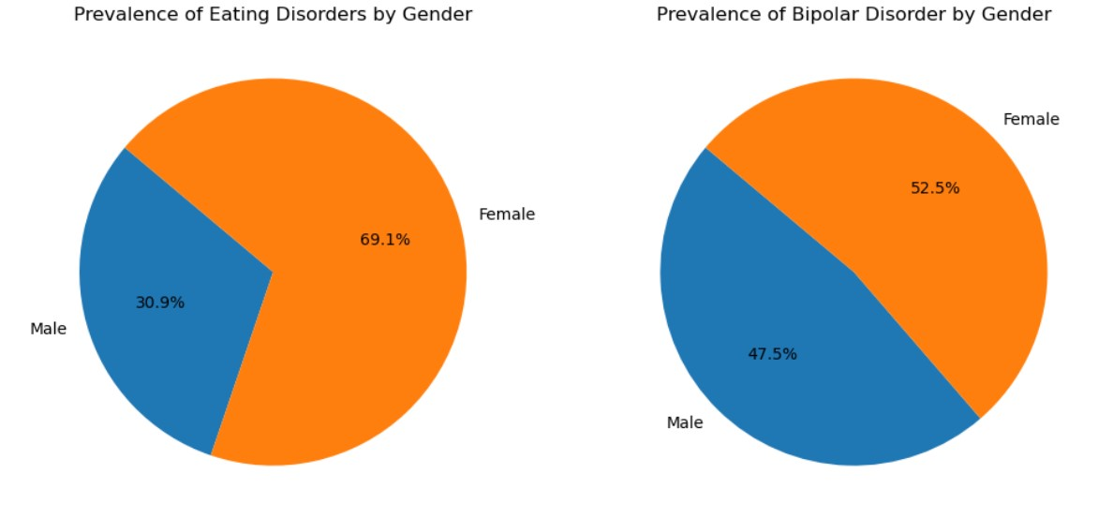

Slide 6
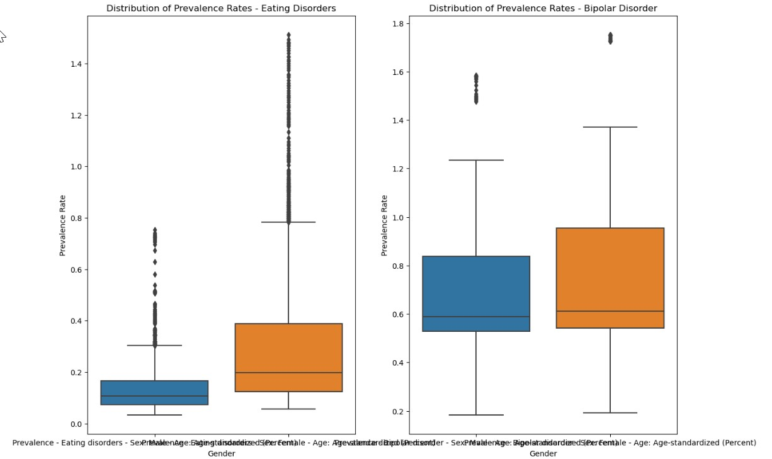

Slide 7
EDA
Objective in this analysis is to present this rich dataset in a visually accessible format, facilitating a profound comprehension of the profound impacts these disorders have on individuals and communities alike.

Slide 8
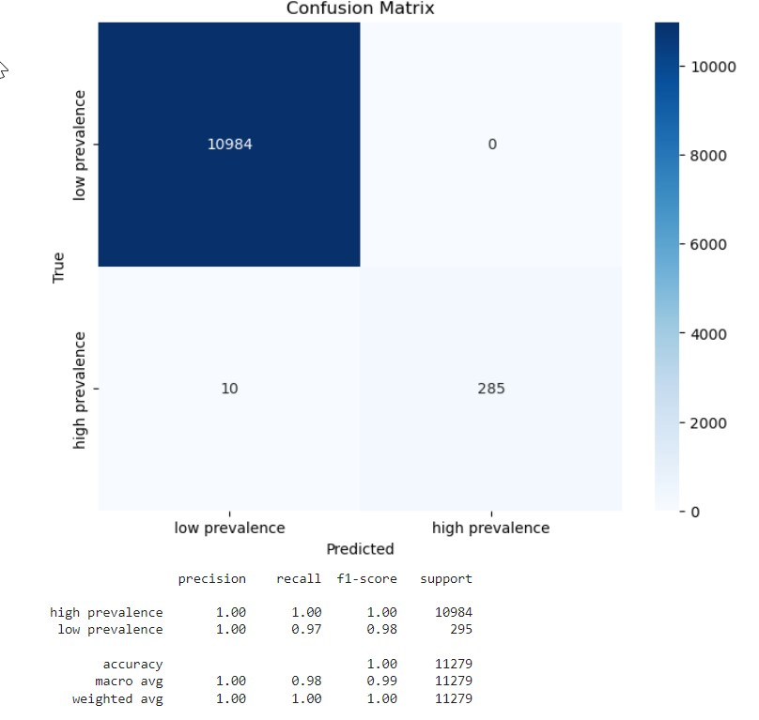
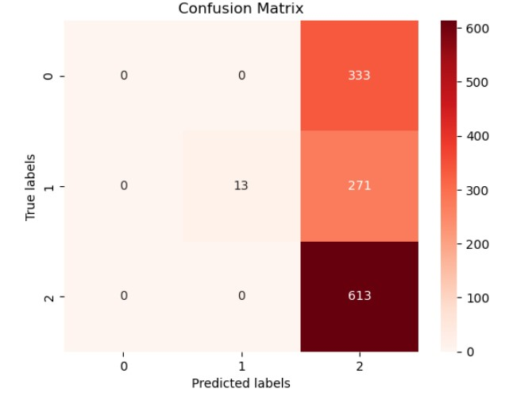
Bipolar Disorders
Logistic Regression
Support Vector Machine

Slide 9
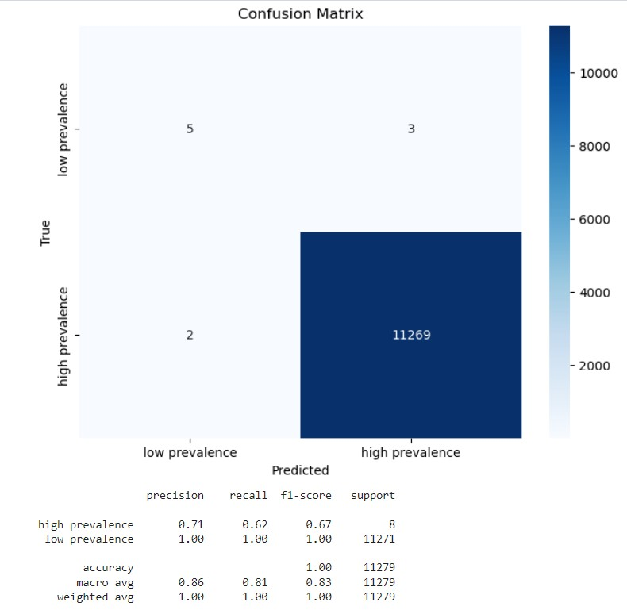
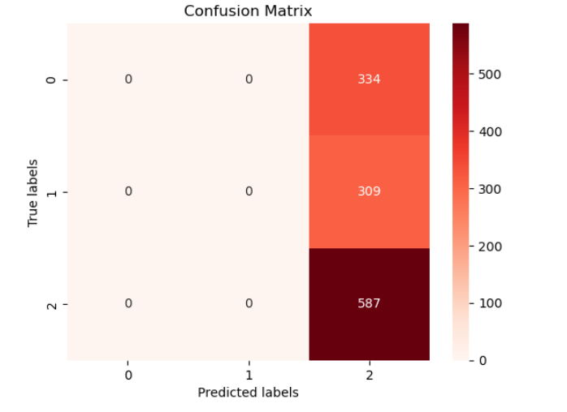
Eating Disorders
Logistic Regression
Support Vector Machines

Slide 10




Conclusion
Much more prevalent in women.

Slide 11
Future
Future ways to improve on research:
Each different country do their own study.
Ways to improve numbers:
More talk of mental health in early education system.
More clinics catered to women.
Maybe more mandatory mental health check ups.
Notes:
Different variables, such as culture, religion, societal norms and expectations can change the way this is viewed by different ethnicities.

Slide 12

Questions?

