Slide 1
Instructor Engagement Analysis
A Data Science Project Presentation
Erudite Team
Chibuogwu Onyemaechi
Chiogo Cecilia Uzowulu
Uche Bointa
Onogwu Emmanuel
Oluwakemi Oluwatoyin Osagbemi

Slide 2
Project Overview
This project analyzes student feedback using NLP techniques to identify instructor engagement issues.
It aims to transform unstructured reviews into actionable insights for instructors and administrators.

Slide 3
Problem Statement
- Student feedback is unstructured
- Need to classify sentiment and detect complaints
- Visualize insights per instructor/course

Slide 4
Tools & Technologies
Python (Pandas, NLTK, Scikit-learn, Gensim, TextBlob)
Dashboarding: Power BI
Deployment: Streamlit
Version Control: Git, GitHub

Slide 5
Project Workflow
1. Load and preprocess data
2. Perform sentiment labeling
3. Train model (TF-IDF + Naive Bayes)
4. Conduct topic modeling (LDA)
5. Export results for dashboarding and reporting

Slide 6
Sentiment Modeling Process
Sentiment is labeled based on rating scores:
1–2: Negative
3: Neutral
4–5: Positive
Model: TF-IDF + Multinomial Naive Bayes

Slide 7
Topic Modeling (LDA)
Latent Dirichlet Allocation (LDA) is used to detect common themes in reviews. Helps reveal recurring complaints like lack of patience or unclear explanations.

Slide 8
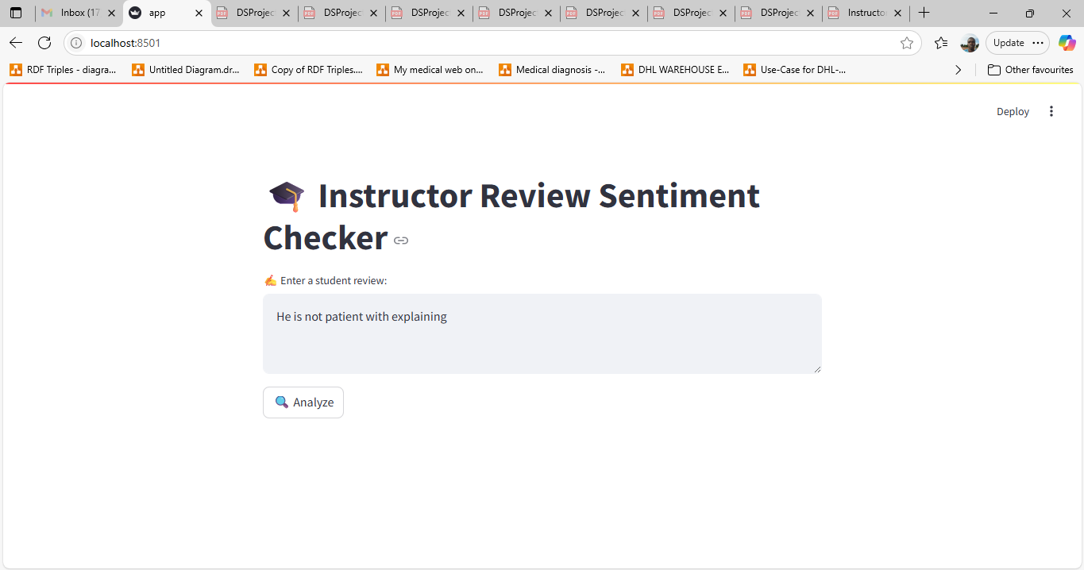
Streamlit Sentiment Checker
A Streamlit-based web interface was built to allow real-time student review analysis.

Slide 9
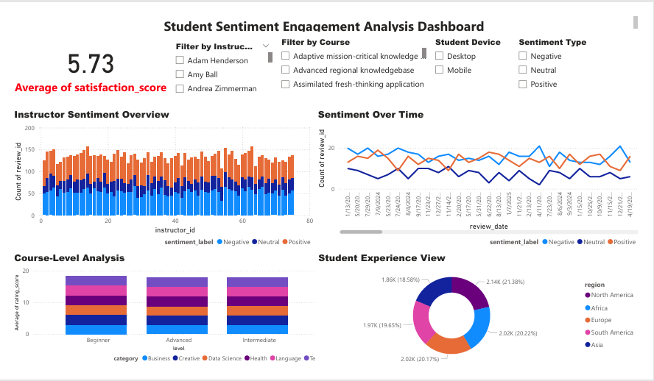
Dashboard Overview
Interactive dashboard provides insights by instructor, course, and region. Includes filters and temporal sentiment trends.

Slide 10
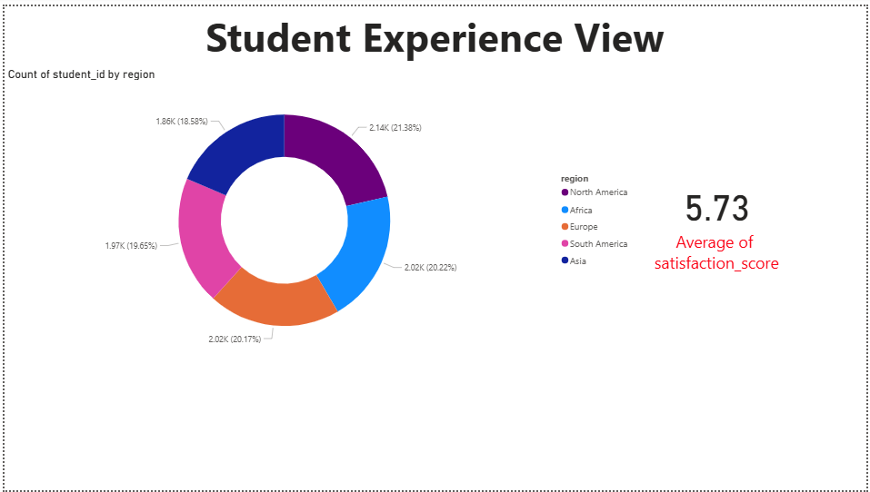
Student Experience View
Regional and device-based satisfaction trends are visualized. North America and Europe show higher satisfaction.

Slide 11
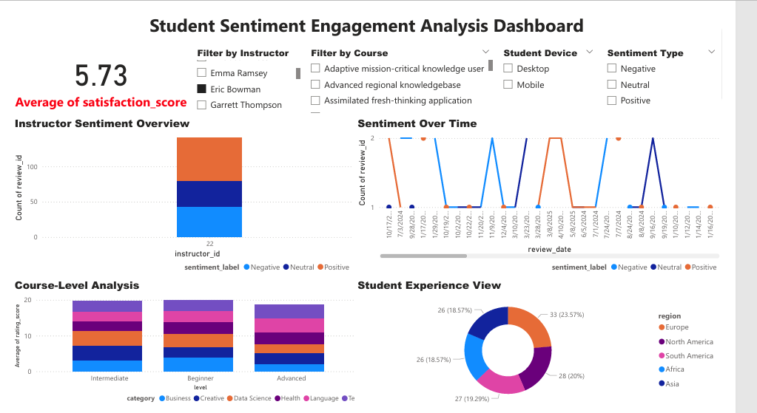
Instructor Performance
Performance reports for each instructor generated as PDFs based on sentiment distribution.

Slide 12
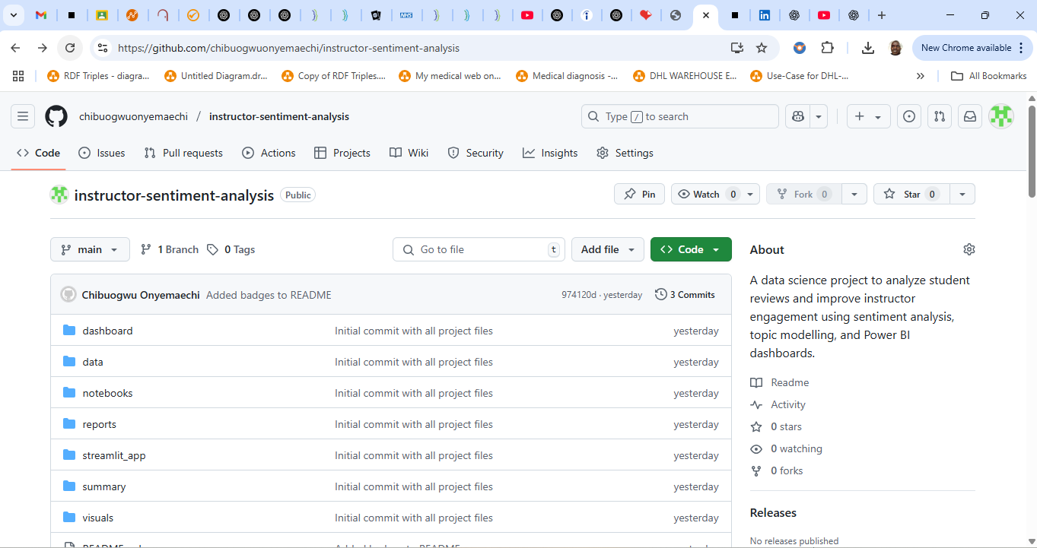
Version Control
Project repository and source code are publicly available on GitHub.

Slide 13
Project Deliverables
- Processed CSV: Sentiment_Analysis_Results_Full.csv
- Dashboard: Instructor_Sentiment.pbix
- Reports: Instructor_Report_[Name].pdf
- Streamlit App: app.py
- GitHub Repo

Slide 14
Recommendations
- Provide communication training for low-rated instructors
- Supplement advanced courses with extra practice
- Revisit curriculum for better clarity

Slide 15

Thank You!
Questions?

