Slide 1

Taming the Hydra
Managing Monorepos with Lerna
Emma Ramirez

Slide 2

To Monorepo, or to not Monorepo,
That is the question.
Hamlet

Slide 3
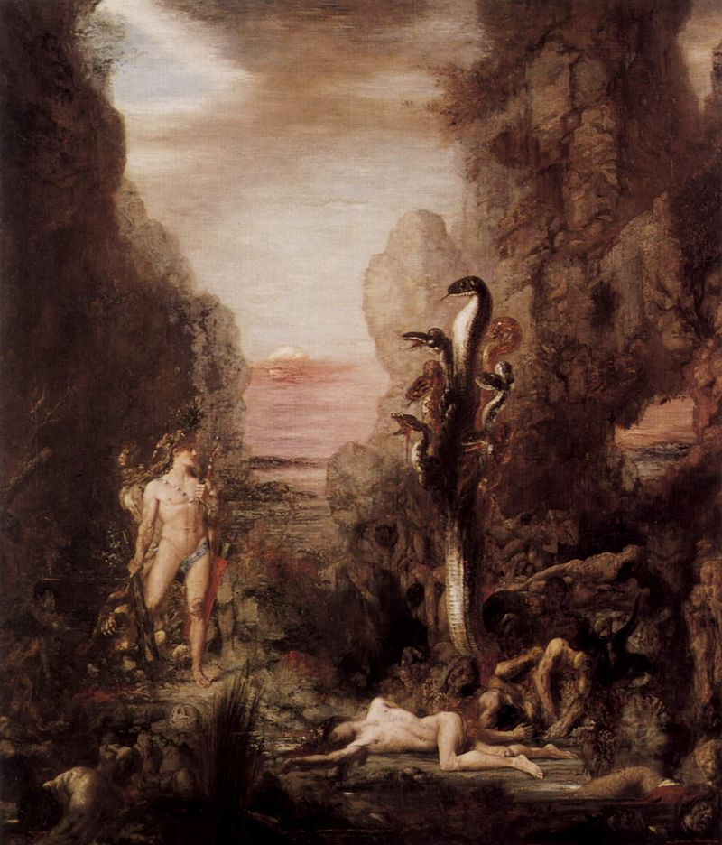
The codebase is maintained by multiple people
The code comprises one “system”
The codebase has shared dependencies
Packages are independent of each other & modular in design
Projects have similar release cycles
Hercules and the Lernean Hydra, 1875/6 Oil on canvas

Slide 4
Monorepo Utilities
Aside: Structure of A Monorepo
/ -
package.json
package-lock.json or yarn.lock
packages/
sword/
package.json
shield/
package.json
- Bolt
Rush
Lerna

Slide 5
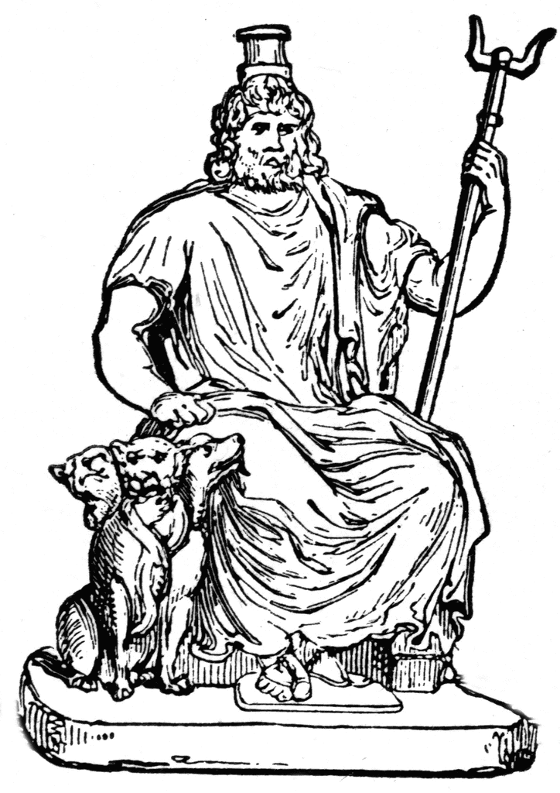
Commands
Parallelization
lerna add [package]
lerna diff
lerna ls
lerna run <script> — (args)
lerna exec — (command, args)

Slide 6
More Commands
lerna import <external-repo>
lerna link
Release mechanisms
lerna publish
— conventiona-commits
—scope

Slide 7
Workspaces
Yarn has support for workspaces
Linked dependencies
Single lock file
Low-level
Can’t nest

Slide 8
Caution!
The Initial Refactor
Using the workflow
Singular git history
=> import multiple git histories!

Slide 9
Further Reading
Github Repo with Example + Slides
=> http://github.com/EmmaRamirez/taming-the-hydra
Lerna-Semantic-Release
=> https://github.com/atlassian/lerna-semantic-release
ClipArt Etc
=> https://etc.usf.edu/clipart
Lerna Wizard
=> https://github.com/szarouski/lerna-wizard

Slide 10
Thank You

