Slide 1


An Empirical Study of Anonymous, Unmoderated, and Online Peer-to-Peer Programming Tutoring Conversations
Priscila Santiesteban, Emma Shedden, Madeline Endres, Westley Weimer

Slide 2
We learn CS outside of the classroom
MOOCS:
Khan Academy
Chat rooms:
Discord
Peer tutoring:
PythonTutor
Forums:
Stack Overflow
AI assistants:
ChatGPT
Notes:
Increasingly, students are learning CS using nontraditional resources, instead of traditional classrooms
This includes online classes, Q&A forums, informal chatrooms, and most recently AI chatbots
Today we’re going to zoom in on one particular instance of this, PythonTutor
This platform has had over 10 million users all over the world
These tools are particularly helpful for nontraditional students.
Osbert says not useful, goal is to understand how peer tutoring works – want to be able to say it’s representative of others, or different in an interesting way – e.g. novice-oriented
AI out of place
Say web ide here
Maddy says make these icons in powerpoint

Slide 3
We learn CS outside of the classroom
MOOCS:
Khan Academy
Chat rooms:
Discord
Peer tutoring:
PythonTutor
Forums:
Stack Overflow
AI assistants:
ChatGPT
Notes:
Increasingly, students are learning CS using nontraditional resources, instead of traditional classrooms
This includes online classes, Q&A forums, informal chatrooms, and most recently AI chatbots
Today we’re going to zoom in on one particular instance of this, PythonTutor
This platform has had over 10 million users all over the world
These tools are particularly helpful for nontraditional students.
Osbert says not useful, goal is to understand how peer tutoring works – want to be able to say it’s representative of others, or different in an interesting way – e.g. novice-oriented
AI out of place
Say web ide here
Maddy says make these icons in powerpoint

Slide 4
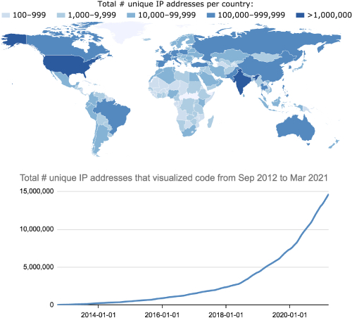
Why study PythonTutor?
Education research platform
10+ million users
10+ years online
Novice-oriented
Free to use, anonymous, unmoderated, synchronous
Total # unique IP addresses per country
Ten Million Users and Ten Years Later: Python Tutor’s Design Guidelines for Building Scalable and Sustainable Research Software in Academia (P Guo, UIST 2021)
Notes:
Map is Guo 2021 Figure 1, Sep 2012 - Mar 2021
What/why PythonTutor? Research platform, wide reach, over 10M users, see map. Novice oriented, which is the group we’re interested in, and it has all those characteristics I mentioned in the title/had on the title slide.

Slide 5
PythonTutor tested tutoring support:
1
2
3
4
5
6
l = ["10", "2", "5",... , "Q"]
l.sort()
run = 0
for i in range(len(l) - 1):
if l[i] == l[i + 1]:
Chat
the code is supposed to remove all pairs from the list. It half works
Python 3.11
I see... remove both duplicates right?
Visualize execution
Learner
Get live help! [NEW]
Stop chat session
Helper
Notes:
Concretely, PT is web IDE, supports Python but also other languages (left). We’re interested in what they tested (right), peer chat sessions. Multiple users shared code editor. We will use this Learner/Helper terminology. Also colors and shapes.
Our dataset is 108 of these chat sessions

Slide 6
“the code is supposed to remove all pairs from the list. It half works”
“omgggg wth thank you so much !!!!!!”
“do you mind explaining what you did ?”
Learner starts chat
Helper enters chat
“I see…”
“fixed”
“ :) ”
Issue #2
Issue #1
Request (code comprehension) triggers Issue #2
Request (bug fix) triggers Issue #1
Outcome (successful) triggers end of Issue #1
Chat session
Notes:
Let me show you what they look like. Learner maybe has some code, asks for help. Helper on different page, sees list of sessions they can join, joins chat. Next, we observe that conversation segments into a series of issues. This is terminology we borrow from open-source projects, basically denoting that something needs to be accomplished, there’s some overarching problem. Our example: bug fixing. Ends when resolved S/F.
Here’s what the actual raw data looks like: [read message], two users go back and forth, etc.

Slide 7
What we did:
We study the dynamics of these peer tutoring conversations.
We analyze 108 peer tutoring sessions (9K messages).
Most exhibit positive communication behaviors and outcomes.
We find these analysis methods effective:
Qualitative analysis, two ways: conversation structure and content
GLMER analysis of annotated data
Notes:
So: we want to understand dynamics of peer tutoring conversations. We qualitatively and quantitatively analyzed 108 conversations on PT (133 issues). For more info on methods, see paper or talk to me!
Now gonna focus on what we learned.

Slide 8
Who uses peer tutoring, and why?
RQ1
Notes:
If we want to understand peer tutoring convos we first need to know who participates and why. This platform is geared toward novices…

Slide 9

88.0% of Learners are Python novices
RQ1
They present CS1-level coding problems
Also, some self-describe or say they don’t understand a CS1 concept
$≥$25.9% of Learners are enrolled in a traditional CS course
Online peer tutoring is a secondary resource
“I went to office hours today and they somehow only confused me more”
“the reading isn't explaining the python code very well”
Notes:
…and we do indeed find that Learners are mostly at the CS1 level, based on coding problems. Surprisingly, we also find that many Learners are not entirely nontraditional students. Instead, they’re enrolled in standard intro programming classes, but turn to online peer tutoring because they need more support. Examples: not getting enough from readings/OH. Now, we’re studying an anonymous platform, so officially, we only know this about the quarter of Learners who explicitly say so. But very very likely the actual number is much higher than that
So, what are the problems that CS1 students need extra help with, beyond what they can get in traditional classes?

Slide 10
“the code is supposed to remove all pairs from the list. It half works”
“omgggg wth thank you so much !!!!!!”
“do you mind explaining what you did ?”
Learner starts chat
Helper enters chat
“I see…”
“fixed”
“ :) ”
Issue #2
Issue #1
Request (code comprehension) triggers Issue #2
Request (bug fix) triggers Issue #1
Outcome (successful) triggers end of Issue #1
Chat session
Notes:
We took the help requests that kick started each ‘issue’ I showed before, and categorized them. First example is debugging, or in the second issue, they want help with code comprehension.

Slide 11
They want help writing and debugging code
RQ1
Code comprehension
11.3%
Code
improvement
4.5%
Code writing
42.9%
Bug fixing
41.4%
Notes:
In the whole dataset, we see mostly code writing and debugging requests. This makes sense, it’s what the platform is designed for, well and good, but it’s also imo encouraging to see a nontrivial slice of requests for help understanding or improving code that already works.

Slide 12
What happens in peer tutoring conversations?
RQ2
Notes:
OK so we know who the Learners are, why they’re here for peer tutoring, what they want help with. What happens next?
We analyzed the frequencies of topics (14 total), how many times they came up (as a message being sent) in each issue, and found…

Slide 13
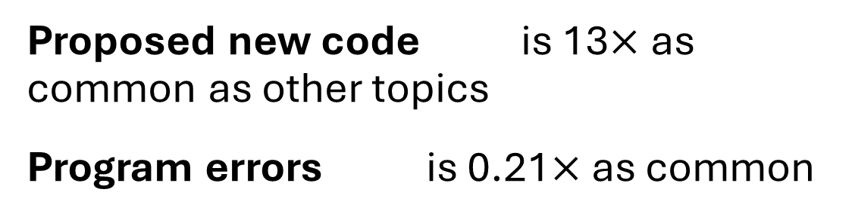
Users focus on code synthesis
RQ2
“instead using list I recommend using dict”
Proposed new code is 13$×$ as common as other topics
Program errors is 0.21$×$ as common
Emphasizing code synthesis may limit space for clear communication and good SE practices!
“this is a question from an exam. im having trouble understanding...”
Notes:
…that proposed new code was overwhelmingly the most common topic in peer tutoring conversations. Way down at the bottom of the list is error traces/messages/line numbers.
Two takeaways from this. Emphasis on new code influences Helper behavior, they may assume this is always the best way to help the Learner instead of checking. In this example the Learner actually wants help understanding a concept but Helper assumes otherwise → misunderstanding
Secondly, recall >40% of help requests for debugging. Yet details of program errors are actually at the bottom of the topics list, meaning peer tutors aren’t really aligned with our best practices for SE.
So this was modelling how frequent each topic is. For each message that we recorded a topic for though, we also recorded how that topic was communicated: for example, Helper could directly implement the answer, vs ask a guiding question to try to lead the Learner there. We also looked at how frequent each communication method was, see paper for details.

Slide 14
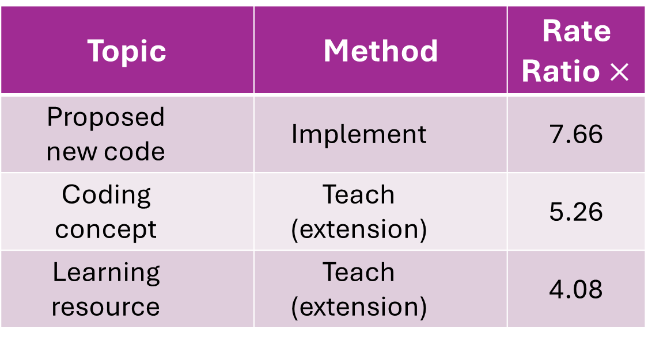
Relating the what and the how
vs. the null
Topic | Method | Rate Ratio $×$
Proposed new code | Implement | 7.66
Coding concept | Teach (extension) | 5.26
Learning resource | Teach (extension) | 4.08
Helpers go above and beyond
Surprisingly, Helpers take initiative to cover lecture-style CS concepts!
Notes:
But the next thing we do is a little more nuanced. We look at which topics and methods co-occur with each other. So for example we control for proposed new code being a common topic, and implementing being a common communication mechanism. But on top of that, proposed new code being communicated by direct implementation happens 7x extra.
Similarly, CS concepts and further learning resources are particularly communicated when Helpers choose to teach things beyond what’s asked of them. Meaning that when these topics come up, it’s not that Learners are asking questions about this — Helpers are driving that conversation.

Slide 15
When are Learners satisfied with a peer tutoring experience?
RQ3
Notes:
Finally, let’s talk about outcomes. Not learning outcomes. In online peer tutoring, there’s no curriculum, and no mechanism forcing Learners back to class every day. This is a self-motivated activity. So we’re going to look at user satisfaction. Learners have decided they need help, so when do they decide they’ve achieved this goal?

Slide 16
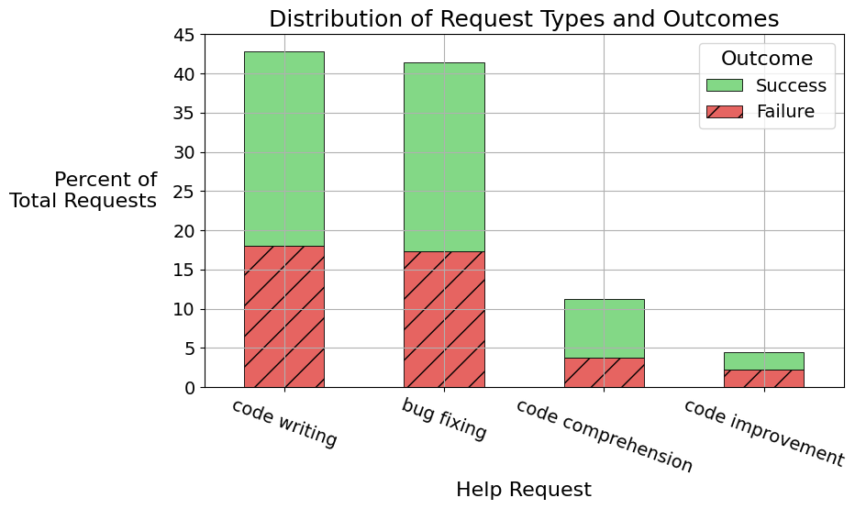
RQ3
Despite using a coding-oriented platform, peer tutoring code comprehension is just as likely to be successful!
Notes:
First, look again at our 4 request types. PythonTutor is implementation oriented, so we might expect that type of request to have a better success rate. Encouragingly, we actually find that code comprehension requests are just as likely to be successful.

Slide 17
Communication is indicative of outcome
RQ3
Successful interactions exhibit:
20% more direct implementation
40% more gratitude
29% less frustration
28% less expressing that the user feels lost
Users give useful feedback during sessions (not just at the end)!
Notes:
Now let’s look at what happens inside successful conversations. First, they exhibit more direct implementation, meaning successful interactions tend to be more hands-on. We also see that users are vocal about emotions that align with conversation outcomes. This is good to know, because it’s happening before the end of the conversation. So users are getting this feedback when there’s time to correct course. Some intervention might train or nudge them to more effectively do so.

Slide 18
Success depends on who says what
RQ3
In successful conversations,
unsuccessful
Ask personal questions
Discuss prior coding experience
Talk about test cases
Learners more than Helpers.
Helpers
Learners
Notes:
Lastly, Learner satisfaction doesn’t just depend on what was said in conversations, but also who says what. We found that in successful convos, Learners are more likely to ask personal questions of Helpers than vice versa. They’re also more likely to discuss prior experience and test cases. In unsuccessful convos, the reverse is true: Helpers are more likely to ask personal questions than Learners and so on.
Honestly, idk what to do with this info. But it does mean that even in these collaborative peer tutoring sessions, the role of Learner and Helper are still quite distinct, and this should inform any kind of intervention we try to take in this setting.

Slide 19
An Empirical Study of Anonymous, Unmoderated, and Online Peer-to-Peer Programming Tutoring Conversations
Learners are novices who lack support from structured courses, but are satisfied with peer tutoring experiences
RQ1
Surprisingly, peer tutors teach CS concepts, but don’t emphasize program errors
RQ2
Peer tutoring outcomes relate to who says what (e.g., it’s better when Learners talk about testing)
RQ3
Emma Shedden, eshedden@seas.upenn.edu
Notes:
https://github.com/pasantiesteban/ICSE_SEET2026_Chats

Slide 20
Extras

Slide 21
Intro to PythonTutor
Online Python Tutor: Embeddable Web-Based Program Visualization for CS Education (Guo 2013, SIGCSE)
Learnersourcing at Scale to Overcome Expert Blind Spots for Introductory Programming: A Three-Year Deployment Study on the Python Tutor Website (Guo et al 2020, L@S)
Ten Million Users and Ten Years Later: Python Tutor’s Design Guidelines for Building Scalable and Sustainable Research Software in Academia (Guo 2021, UIST)
Notes:
Map is Guo 2021 Figure 1, Sep 2012 - Mar 2021
Things to note:
Seems implementation-oriented
Interface screenshot (Figure 2)
Introduce Learners/Helpers when introducing PythonTutor
Priscila canva figure for chat summary (just one issue though)
Merge slide 3
Keep as bonus slide

Slide 22
Research Questions
Why do Learners use Python Tutor?
How are Helpers characterized on Python Tutor?
What is the content of Python Tutor interactions?
How do people feel about their Python Tutor interactions?
What leads to successful interactions on Python Tutor?
Notes:
Get rid of it

Slide 23
Multi-dimensional codes capture rich content
Question goal
Specificity
Questioning ?
Answering ✅
Content domain
Confidence
Mechanism
Notes:
Is it confusing that I switched the colors vs the paper? I just feel like this makes more sense.

Slide 24
88.0% of Learners are Python novices
“I'm trying to take string such as "5+5+6", then calculate…”
“i just started learning python”
“I’m struggling with lists and how to use them obviously”
Notes:
I’m struggling with lists and how to use them obviously
I'm trying to take string such as "5+5+6", then calculate this without using .math

Slide 25
Some feel unsupported by traditional courses
25.9% of Learners say they are enrolled in a structured CS course
PythonTutor is a secondary resource
“the reading isn't explaining the python code very well”
“because we didnt leran that :(”
“I went to office hours today and they somehow only confused me more”
“i am not much of a coder so i have been struggling”
Notes:
this is week 3 of this class and the reading isn't explaining the python code very well
university is tough
he wants it to look like that. i am not much of a coder so i have been struggling
thats great to know! i struggled with alignment for another assignment
our class needs updating itself. they reuse the courses
Yeah I'm struggling a lot with it, I went to office hours today and they somehow only confused me more
it's due at my school today but they never taught us how to make an input into a list
because we didnt leran that :(

Slide 26
Content domain
“And then you try to append to user, which is now a string, not a list”
Original code
“You need separate variables for your
list of values and your user input”
“give a test where
it doesn't work”
Test cases
“your variable names are kind of weird.”
New code
“i used this once a long time ago”
Experience
Code opinion
Notes:
Helper questions
Can I fix typographical things for audience comprehension?
your variable names are kind of weird.
More examples:

Slide 27
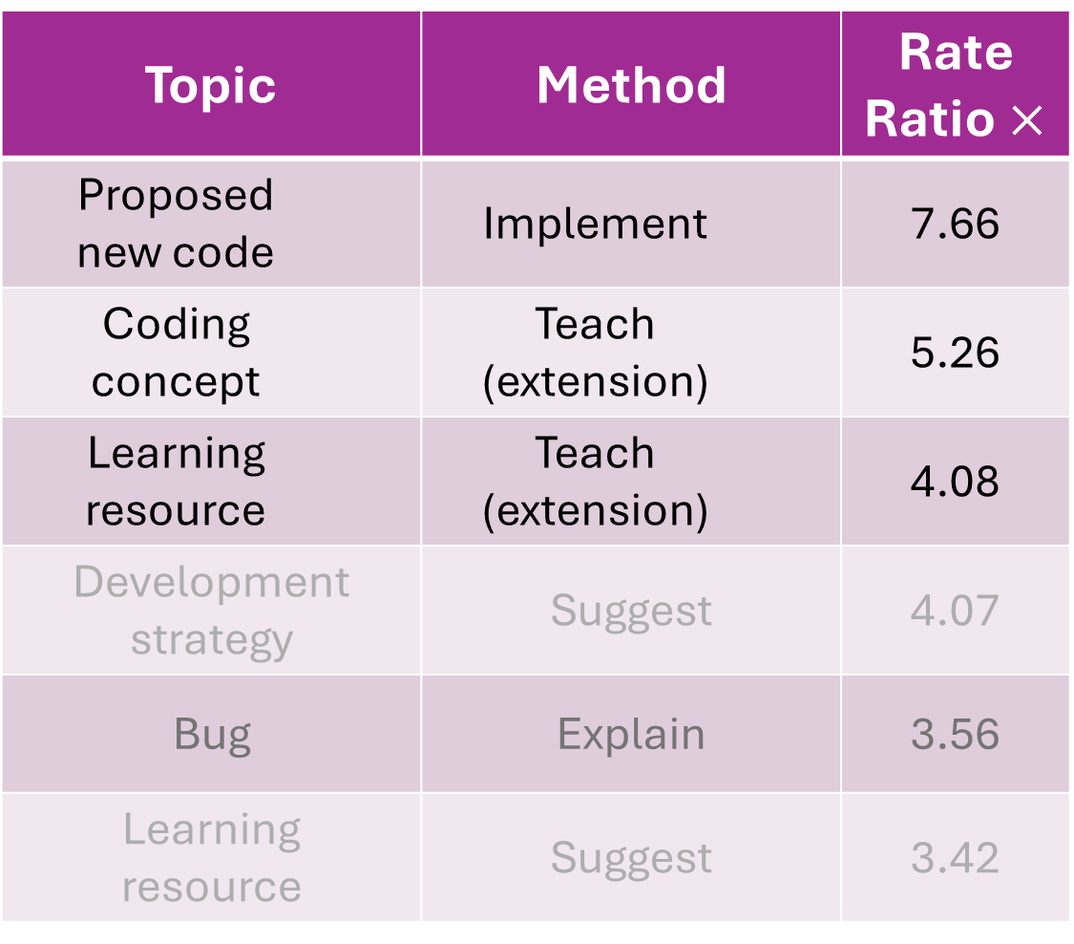
What vs how
Topic | Method | Rate Ratio $×$
Proposed new code | Implement | 7.66
Coding concept | Teach (extension) | 5.26
Learning resource | Teach (extension) | 4.08
Development strategy | Suggest | 4.07
Bug | Explain | 3.56
Learning resource | Suggest | 3.42
Notes:
‘Rate ratio: vs if topic and mechanism were independent’

Slide 28
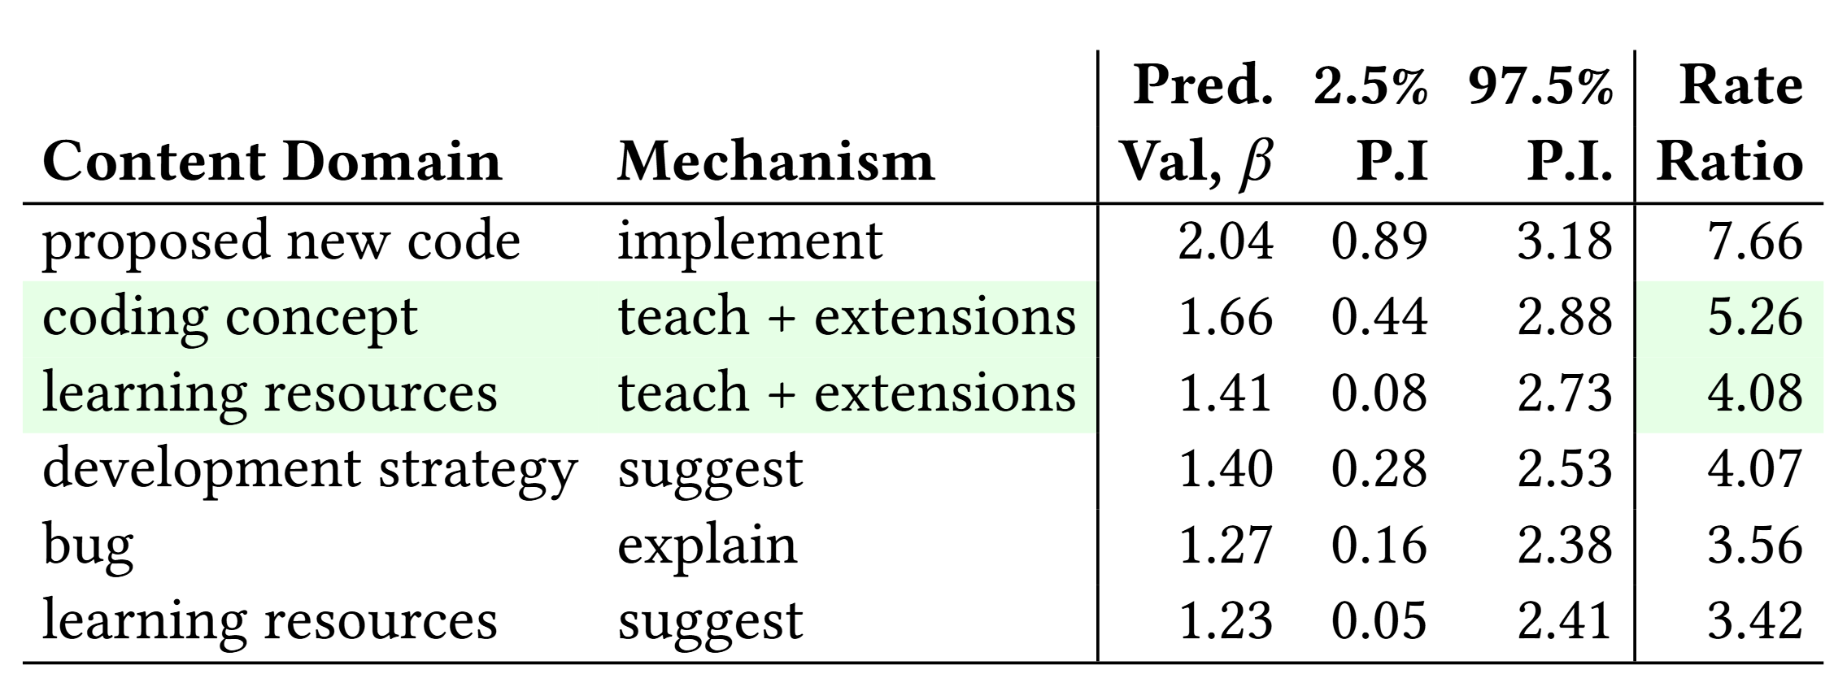

Topics vs methods
RQ2
Disproportionately (vs null), coding concepts (5.26$×$) and further learning resources (4.08$×$) are taught as Helper-instigated extensions to what Learners have asked for.
Notes:
What we care about here is the interactions with topics
We define 9 communication mechanisms and model how they interact with topics
Iirc coding concepts were roughly 4th most-common message topic
Clarify that these are part of the 14 topics, not surprising that helpers are altruistic, but be clear that this is positive, first sentence is hard to parse
This is what we observe (fact) this suggests x takeaway (opinion)
Table is distracting, get rid of it
Consistent icons to help people keep track of terms

Slide 29
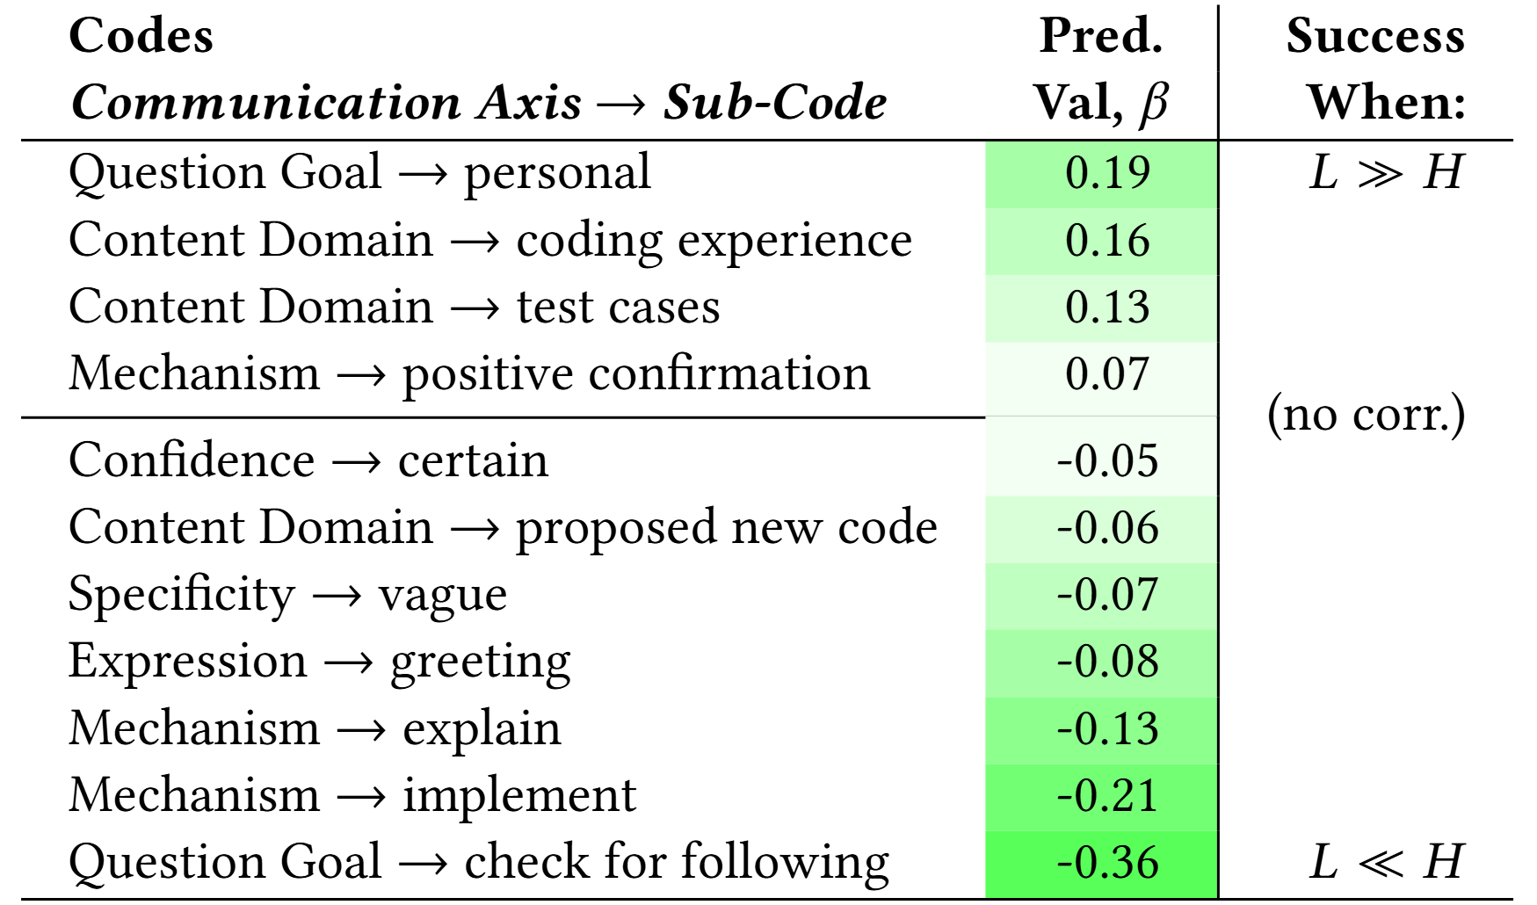
Speaker-stratified effects on success
RQ3

Slide 30
TL;DR
We analyze 108 peer tutoring sessions (9K messages).
Most of these exhibit positive communication behaviors and outcomes.
Learners are predominantly novices. Many express dissatisfaction with their traditional CS courses.
Some behaviors are associated with successful outcomes. Others are effective from Learners but not Helpers.
We find these analysis methods effective:
Qualitative coding, analyzing structure and multiple dimensions
GLMER analysis, considering diff-in-diff speaker-stratified effects
User satisfaction as a measure of outcome
Notes:
Osbert says cut (some stuff needed, but move to after platform)
Web IDE
Screenshot (not redundant to timeline)
Edu research platform
Missing high level motivation

