Slide 1
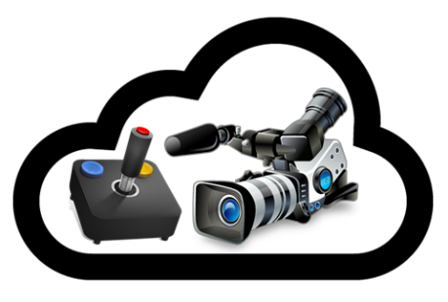
CDN: Architecture and Applications
Ben Bloom, Sr. Manager, Media+Gaming
24 March 2016

Slide 2
Agenda
Introduction
CDN architecture
Problem statement (routing around congestion, selecting optimal server to connect)
Original solution ("mapping" and improvements to routing)
Akamai platform design (massively distributed network)
Building real world solutions
Securing and accelerating sites
Distributed applications
Media workflows
Deep dive into Media workflows
Live vs. On-demand
Workflow components
Operating an online broadcast at scale
Q+A

Slide 3






CDN: Basic Architecture
Edge closest to origin
Edge closest to end-user
Akamai Intelligent Platform
Scale
Offload
Availability
Performance
Accelerate
Prefetch
Reduce Requests
Minimize Payload
Expedite Rendering
Intelligence
Insight
Logic
Notes:
And the best part of that Ion takes advantage of the market leading Akamai Intelligent Platform.
Ion runs on the Akamai Intelligent Platform
The most pervasive, highly-distributed cloud optimization platform with over 150,000 servers in over 92 countries within over 1,200 networks
Delivers between 15-30% of all Web traffic
90% of the world’s Internet users are within a single “network hop” of an Akamai server
So how can Akamai help?
Scale – offload expensive Web infrastructure while scaling globally & under peak traffic conditions - without additional infrastructure investment
Performance - deliver fast, quality web experiences to all end-users - no matter what location, browser, device or network - to grow the business
Intelligence – understand end-users’ web experiences and tailor optimizations based on their situations
In more detail -
Get content closer to end-users
Maximize origin scalability and availability
Maximize origin offload
Accelerate requests back to origin
Aggressively prefetch DNS, objects and pages to Edge & browser
Aggressively reduce requests for fewer round trips
Aggressively minimize payload for fewer bytes delivered
Expedite rendering for better perceived performance
Improve visibility into end-user web experiences
Empower the edge & origin

Slide 4



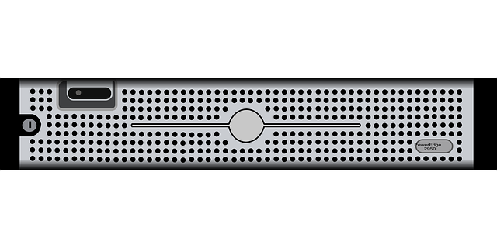




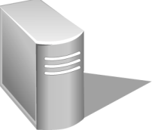


















Security Workflow
Cloud or Prem Datacenter
End Users
End Users
Video Encoding System
Fire
Wall
Edge
Servers
WAF
Live Streaming Entrypoint
Client Reputation
Edge
Servers
Transaction Server
Web Servers
Tiered
Distribution
Network Storage
Load Balancer
Edge
Servers
Directory/ Policy Server
PROLEXIC
In-the-cloud
Security Operations Center
Edge
Servers
SiteShield
Edge
Servers
Edge
Servers
Legacy
Systems
App Servers
DNS Server
WAF
End Users
Database
Back-Up Site or Load Balanced Multi-Data Center
End Users
Security Availability Scalability Visibility Performance
Notes:
Here is a simplified model of the interactions between a typical data center and the internet … and shows the Critical role Akamai plays in accelerating and securing these communications.
Whether your web server environment is a collection of machines on your premises or out in the cloud, the role is essentially the same. A firewall and load balancer separate outside communications from the critical systems inside. On the far end opposite of the connection are the end users attempting to access your systems. Most of these are “good guys” while some are bad. Without Akamai, all make connections directly to your infrastructure, straining your bandwidth, your server capacity, and your perimeter of protection.
Enter Akamai. Working as a giant reverse proxy, by geographically dispersing our servers into the various ISPs around the globe, we have the ability to offload most of the static content and requests from your servers and place it within one hop of 90% of Internet users. This is what we call “the edge of the internet.” When Akamai is provisioned into the mix, we determine in real time an optimal Edge server for the connecting user. No manual intervention is required.
To keep our dispersed network from replicating the end user swarm, we cache in two places. This Tiered Distribution model ensures Akamai talks to Akamai more, reducing the number of requests made to your origin, and the number of servers making those requests. Site Shield is a flavor of Tiered Distribution that fixes the IPs for these parent servers so your firewall can be tuned to deny outside traffic and trust only Akamai to make requests to you.
NetStorage further offloads content for you by giving you a place to permanently store static assets. By moving this content from your infrastructure to ours, you lower the demand on your bandwidth and server resources even more.
DNS is at the core of Akamai technology. Because real-time decisions are made at a DNS level to select an optimal server for your Web site, we must maintain a robust DNS presence in each of the 2,300+ data centers around the globe. That massive capacity in turn can be leveraged by you to offload your public-facing DNS requests to Akamai, guaranteeing 100% uptime for your DNS.
Web Application Firewall technology, WAF for short, is compiled into each of Akamai’s edge servers and may be leveraged to help stop a host of attacks out on the edge, far from your origin data centers where the sensitive information and technology is housed. WAF looks for high rate activity, suspicious requests, and known sources of bad behavior and can prevent them from being served.
Lastly, there are Akamai’s Prolexic Scrubbing centers, placed strategically around the globe. For attacks that go beyond the World Wide Web, targeting other ports and protocols and your data center infrastructure as a whole, you can route your entire traffic to Akamai. With more than 3.4 Tbps of dedicated capacity for attack mitigation, we can help protect you end to end.

Slide 5






















Online Video: Changing Expectations
Mission Critical
7 Tbps
Business Requirement
Nice to Have
1.4 Tbps
444 Gbps
1.3 Tbps
Novelty
1.08 Tbps
4G
LTE
1Gbps
21.0 Gbps
<1 Gbps
15.9 Gbps
1999
2002
2004
2007
2008
2009
2010
2011
2012
2013
2014+
Notes:
1999 Victoria’s Secret Fashion Show
- Most famous event that no one saw
- 1.5M visitors driven from the Superbowl.
- Flash crowd, Small fraction of viewers saw it.
- Expedition left without a tent

Slide 6

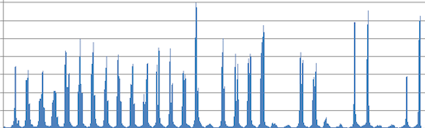



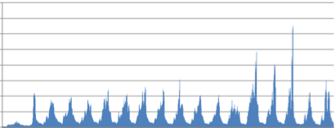


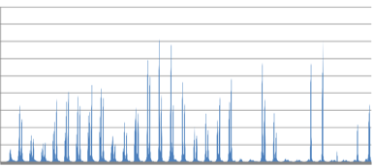

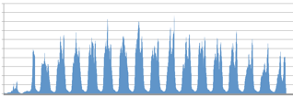

Peak Perspective – A Difference of Few Years
7
6
2014
5
2010
4
2012
Terabits per second
3
2
1
0

Slide 7




















Akamai Media Delivery – Live/Linear Video Streams
Akamai Intelligent Platform
Media Services - Live
Encrypt
Encode/
Transcode
Package
Package
Ingest
Live
DVR
Media Analytics
Upload
NetStorage
Present
Prepare
Publish
Deliver
Play
Notes:
How do we help today and tomorrow?
High speed upload
ASPERA
Improved netstorage for nearline content
no limits
improved redundancy
cold storage
Improved ingest intelligence
High bitrate ingest (8-10Mbps)
redundancy
Transcoding
more formats in
more formats out
security
Edge
Client technology improves quality
Multicast technology
Regardless of the complexity, all the workflows have some aspect of similairity
Creation to consumption with a goal of delivering the best quality to the end users
Acquire
Content Acquisition
Signal Acquisition
File Acquisition
Secure
Stable
Reliable
Prepare
Transcoding
Encoding
CMS
DAME/MAME
Metadata
Cold Storage
Avails MGMT
Scalable
High Quality
Interoperable
Publish
Origin Storage
Entitlement
Protection
Scalable
Redundant
Secure
Stable
FAST
Deliver
Origin Storage
Entitlement
Protection
Scalable
Redundant
Secure
Stable
FAST
Consume
Player/Apps
Storefront
Subscription
SEO/SEM
Client Tech
Global
Visual Quality
Searchable
Consistent QoE
Analyze
Reporting
Decisioning
Analytics
Monitoring
Comprehensive
Intelligent
Client Side
By keying into Delivery and analytics we see the importance of proper content preparation and publishing.
In 2013, we launched into our Transcoding and Ad Technology soltuions and we will continue to simplify this workflow while focusing on the best quality delivery.

Slide 8


Akamai Media Delivery – VoD Streams
Akamai Intelligent Platform
DRM
Media Services
– On Demand
Transcode
VoD Files
Package
Media Analytics
One
Master
NetStorage
NetStorage
Upload
Acquire
Prepare
Publish
Deliver
Play
Notes:
How do we help today and tomorrow?
High speed upload
ASPERA
Improved netstorage for nearline content
no limits
improved redundancy
cold storage
Improved ingest intelligence
High bitrate ingest (8-10Mbps)
redundancy
Transcoding
more formats in
more formats out
security
Edge
Client technology improves quality
Multicast technology
Regardless of the complexity, all the workflows have some aspect of similairity
Creation to consumption with a goal of delivering the best quality to the end users
Acquire
Content Acquisition
Signal Acquisition
File Acquisition
Secure
Stable
Reliable
Prepare
Transcoding
Encoding
CMS
DAME/MAME
Metadata
Cold Storage
Avails MGMT
Scalable
High Quality
Interoperable
Publish
Origin Storage
Entitlement
Protection
Scalable
Redundant
Secure
Stable
FAST
Deliver
Origin Storage
Entitlement
Protection
Scalable
Redundant
Secure
Stable
FAST
Consume
Player/Apps
Storefront
Subscription
SEO/SEM
Client Tech
Global
Visual Quality
Searchable
Consistent QoE
Analyze
Reporting
Decisioning
Analytics
Monitoring
Comprehensive
Intelligent
Client Side
By keying into Delivery and analytics we see the importance of proper content preparation and publishing.
In 2013, we launched into our Transcoding and Ad Technology soltuions and we will continue to simplify this workflow while focusing on the best quality delivery.

Slide 9








s/datacenter/cloud/
Customer
Ingest
Customer
Preparation
Customer
Origin Store
Adaptive
Media Delivery
Adaptive
Media Player
Customer
Player
MEDIA SERVICES
NetStorage
VoD
INGEST
PREPARE
ORIGIN
STORE
DELIVER
PLAY
Live
IMPROVE
COLLECT & ANALYZE
EVALUATE
MEDIA ANALYTICS
CUSTOMER ANALYTICS

Slide 10
CDN: Architecture and Applications
Ben Bloom, Sr. Manager, Media+Gaming
bbloom@akamai.com

