Slide 1
CS 353 Basics of Addressing
Spring 2016
Alefiya Hussain

Slide 2

Recall…..
“Autonomous System (AS)” or “Domain” Region of a network under a single administrative entity
“Border Routers”
An “end-to-end” route
“Interior Routers”

Slide 3
Recall… Autonomous Systems (AS)
AS is a network under a single administrative control
ASes are called “domains”.
Hence, “interdomain routing”
Two key challenges
Scaling
Administrative structure
Issues of autonomy, policy, privacy

Slide 4
Scaling
Every router must be able to forward based on *any* destination address
Given address, it needs to know “next hop” (table)
Naive: Have an entry for each address
There would be 10^8 entries!
And routing updates per destination!
Better: Have an entry for a range of addresses
But can’t do this if addresses are assigned randomly
Addresses allocation is a big deal!

Slide 5
Use of Addresses: Forwarding vs Routing
Routing: “control plane”
Computing paths the packets will follow
Distributed protocol leads to state at each router
Forwarding: “data plane”
Directing a data packet to an outgoing link
Individual router using routing state

Slide 6
Designing an Addressing Scheme
Must support very fast forwarding
Relatively simple lookup
Relatively small routing tables
Routing state must be scalably computable
Cannot involve massive exchanges of state

Slide 7
How does Layer 2 Addressing work?
Typically uses MAC addresses
Unique numbers burned into interface cards
Random string of bits
No location information
Local area networks route on these “flat” addresses
Why can’t we use this approach for IP?

Slide 8
Key: Layer 2 is Local, but Layer 3 is Global!
Would have entry for every device in the world
Must keep track of their location individually
Update table whenever they moved!
Leads to large routing tables (~10⁸ or more)
Leads to unscalable routing algorithms
Global messages whenever laptop moves

Slide 9
Addressing Goal: Scalable Routing
Limit State: Limited amount of routing state (i.e., table)
Much less than the number of hosts
Limit Churn: Limited rate of change in routing tables
Traffic, inconsistencies, complexity
Aggregation crucial for both
(use single entry to cover many addresses)

Slide 10
Aggregation only works if….
Groups of addresses require same forwarding
These groups are contiguous in address space
These groups are relatively stable
Few enough groups to make forwarding easy

Slide 11
Example where aggregation works…
1
6
A
B
C
2
7
4
8
3
5
1-4 are on left
5-8 are on right

Slide 12
Why Is Aggregation Nontrivial?
Mobility: laptops, cellphones, etc.
Multihoming: Many entities have two or more ISPs
Institutional renumbering hard

Slide 13
Basic Design

Slide 14
Design Questions
What should an address be associated with?
Telephone network is an ambiguous model
Landlines: number refers to location (hard to move)
Cell phones: number refers to handset (easily movable)
What structure should addresses have? What are the implications of that structure?
Who determines who gets which addresses in the global Internet?

Slide 15
IP Addresses (IPv4)
Unique 32-bit number associated with an interface
on a host, on a router, … connect to ports, links, etc.
Association can be long-term or short-term
Use dotted-quad notation, e.g., 12.34.158.5:
12
34
158
5
00001100
00100010
10011110
00000101

Slide 16
Routers in the Network
Routers connect links and networks together
Must forward packets towards destination
host
host
...
host
host
host
...
host
LAN 1
LAN 2
router
router
router
WAN
WAN
Router

Slide 17
Forwarding Table Plays Crucial Role
Table maps IP addresses into output interfaces
Forwards packets based on destination address
1.2.3.5
1
1.2.3.6
3
1.2.3.4
2
…
…
1.2.3.4
1
1.2.3.5
2

Slide 18
Scalability Challenge
Suppose hosts have random addresses
Then routers would need a separate entry for each host
Far too much state to hold in each router
1.2.3.4
5.6.7.8
2.4.6.8
1.2.3.5
5.6.7.9
2.4.6.9
host
host
...
host
host
host
...
host
LAN 1
LAN 2
router
router
router
WAN
WAN
1.2.3.4
1.2.3.5
forwarding table
Notes:
Churn, not size….

Slide 19
Two Universal Tricks in CS
When you need more flexibility, you add…
A layer of indirection
When you need more scalability, you impose…
A hierarchical structure

Slide 20
Hierarchical Addressing in U.S. Mail
Addressing in the U.S. mail
Zip code: 94704
Street: Center Street
Building on street: 1947
Location in building: Suite 600
Name of occupant: Scott
Forwarding the U.S. mail
Deliver letter to the post office in the zip code
Assign letter to mailperson covering the street
Drop letter into mailbox for the building/room
Give letter to the appropriate person
???

Slide 21
Who Knows What?
Does anyone in the US Mail system know where every house is?
Separate routing tables at each level of hierarchy
Each of manageable scale

Slide 22
Hierarchical Structure
The Internet is an “inter-network”
Used to connect networks together, not hosts
Forms a natural two-level hierarchy:
WAN delivers to the right LAN (i.e., deliver to zip code)
LAN delivers to the right host (i.e., deliver to house)
host
host
...
host
host
host
...
host
LAN 1
LAN 2
router
router
router
WAN
WAN
LAN = Local Area Network
WAN = Wide Area Network

Slide 23
Hierarchical Addressing
Prefix is network address: suffix is host address
12.34.158.0/23 is a 23-bit prefix with 2⁹ addresses
Terminology: “Slash 23”
12
34
158
5
00001100
00100010
10011110
00000101
Network (23 bits)
Host (9 bits)

Slide 24
IP Address and a 23-bit Subnet Mask
Address
12
34
158
5
00001100
00100010
10011110
00000101
11111111
11111111
11111110
00000000
Mask
255
255
254
0

Slide 25
Scalability Improved
Number nearby hosts with same prefix
1.2.3.0/24 on the left LAN
5.6.7.0/24 on the right LAN
1.2.3.4
1.2.3.7
1.2.3.156
5.6.7.8
5.6.7.9
5.6.7.212
host
host
...
host
host
host
...
host
LAN 1
LAN 2
router
router
router
WAN
WAN
1.2.3.0/24
5.6.7.0/24
forwarding table
Notes:
What are the routing entries?

Slide 26
Easy to Add New Hosts
No need to update the routers
E.g., adding a new host 5.6.7.213 on the right
Doesn’t require adding a new forwarding entry
1.2.3.4
1.2.3.7
1.2.3.156
5.6.7.8
5.6.7.9
5.6.7.212
host
host
...
host
host
host
...
host
LAN 1
LAN 2
router
router
router
host
WAN
WAN
5.6.7.213
1.2.3.0/24
5.6.7.0/24
forwarding table

Slide 27
“Subnet” Terminology
Think of LANs as special case of “subnets”
Subnet is region without routers containing addresses within the “subnet mask”
Could be a link, or LAN
Subnets are the lowest level of aggregation
No routers needed within a subnet
But you might have switches (L2)

Slide 28
History of Internet Addressing
Always dotted-quad notation
Always network/host address split (subnets)
But nature of that split has changed over time
How did we arrive at our current addressing scheme?

Slide 29
Original Internet Addresses
First eight bits: network address (/8)
Last 24 bits: host address
Assumed 256 networks were more than enough!

Slide 30
Nice Features
Transit routers looked at what portion of address?
Network
That portion of address space was flat
No need for hierarchy with 256 entries
Rest of address only relevant on host’s network
But did not provide for enough networks
Ubiquity of ethernet not foreseen

Slide 31
Next Design: Classful Addressing
Class A: if first byte in [0..127] ⇒ /8 (top 1 bit = 0)
Very large blocks (e.g., MIT has 18.0.0.0/8)
Class B: first byte in [128..191] ⇒ /16 (top 2 bits = 10)
Large blocks (e.g,. USC has 128.125.0.0/16)
Class C: [192..223] ⇒ /24 (top 3 bits = 110)
Small blocks (e.g., ICIR has 192.150.187.0/24)
0*******
********
********
********
126 nets
~16M hosts
~16K nets
~65K hosts
10******
********
********
********
~2M nets
254 hosts
110*****
********
********
********
Notes:
Sh

Slide 32
Classful Addressing (cont’d)
Class D: first byte [224..239] (top 4 bits 1110)
Multicast groups
Class E: first byte [240..255] (top 5 bits 11110)
Reserved for future use
1110****
********
********
********
Multicast
11110***
********
********
********
Experimental

Slide 33
How do you find USC block of addresses?
Class B: first byte in [128..191] ⇒ /16 (top 2 bits = 10)
Large blocks (e.g,. USC has 128.125.0.0/16)
Demo:
> ping www.usc.edu
Take IP and run:
> whois IP
10******
********
********
********

Slide 34
What is wrong with classful?
Only comes in 3 sizes
Routers may need state for many class C’s (/24s)
Wasted address space

Slide 35
Today’s Addressing: CIDR
CIDR = Classless Interdomain Routing
Flexible division between network and host addresses
Must specify both address and mask
Clarifies where boundary between addresses lies
Classful addressing communicate this with first few bits
CIDR requires explicit mask
Mask carried in routing algorithm
Not implicitly carried in address

Slide 36
CIDR Addressing
Use two 32-bit numbers to represent a network.
Network number = IP address + Mask
IP Address : 12.4.0.0 IP Mask: 255.254.0.0
Address
00001100
00000100
00000000
00000000
Mask
11111111
11111110
00000000
00000000
Network Prefix
for hosts
Written as 12.4.0.0/15 or 12.4/15

Slide 37
Classful vs. Classless addresses
Example: an organization needs 500 addresses.
A single class C address not enough (254 hosts).
Instead a class B address is allocated. (~65K hosts)
That’s overkill, a huge waste!
CIDR allows an arbitrary prefix-suffix boundary
Hence, organization allocated a single /23 address (equivalent of 2 class C’s)
Maximum waste: 50%

Slide 38
CIDR: Hierarchal Address Allocation
Prefixes are key to Internet scalability
Addresses allocated in contiguous chunks (prefixes)
Routing protocols and packet forwarding based on prefixes
Recursively break down chunks as get closer to host
12.0.0.0/15
12.3.0.0/22
:
:
:
12.2.0.0/16
12.3.4.0/24
12.3.0.0/16
:
:
:
:
12.3.254.0/23
12.0.0.0/8
12.253.0.0/19
12.253.32.0/19
12.253.64.0/19
12.253.0.0/16
:
12.253.64.108/30
12.253.96.0/18
12.253.128.0/17

Slide 39
ANT Internet Mapping
Browse the Address space
https://ant.isi.edu/address/browse/
Understand the colors
https://ant.isi.edu/address/

Slide 40
CIDR: Hierarchal Address Allocation
Prefixes are key to Internet scalability
Addresses allocated in contiguous chunks (prefixes)
Routing protocols and packet forwarding based on prefixes
Recursively break down chunks as get closer to host
12.0.0.0/15
12.3.0.0/22
:
:
:
12.2.0.0/16
12.3.4.0/24
12.3.0.0/16
:
:
:
:
12.3.254.0/23
12.0.0.0/8
12.253.0.0/19
12.253.32.0/19
12.253.64.0/19
12.253.0.0/16
:
12.253.64.108/30
12.253.96.0/18
12.253.128.0/17

Slide 41
Allocation Done Hierarchically
Internet Corporation for Assigned Names and Numbers (ICANN) gives large blocks to…
Regional Internet Registries, such as the American Registry for Internet Names (ARIN), which give blocks to…
Large institutions (ISPs), which give addresses to…
Individuals and smaller institutions
FAKE Example:
ICANN ➔ ARIN ➔ AT&T ➔ Los Nettos ➔ USC ➔ CS

Slide 42
FAKE Example in More Detail
ICANN gives ARIN several /8s
ARIN gives Los Nettos /8, 12.0/8
Network Prefix: 00001100
Los Nettos gives USC /16, 12.197/16
Network Prefix: 0000110011000101
USC gives CS a /24, 12.197.45/24
Network Prefix: 000011001100010100101101
CS gives me a specific address 12.197.45.23
Address: 00001100110001010010110100010111

Slide 43
IP addressing → scalable routing?
Hierarchical address allocation only helps routing scalability if allocation matches topological hierarchy

Slide 44
Scalability: Address Aggregation
Provider is given 201.10.0.0/21 (201.10.0.x .. 201.10.7.x)
Provider
201.10.0.0/22
201.10.4.0/24
201.10.5.0/24
201.10.6.0/23
Routers in the rest of the Internet just need to know how to reach 201.10.0.0/21. The provider can direct the IP packets to the appropriate customer.

Slide 45
Aggregation Not Always Possible
201.10.0.0/21
Provider 1
Provider 2
201.10.0.0/22
201.10.4.0/24
201.10.5.0/24
201.10.6.0/23
Multi-homed customer with 201.10.6.0/23 has two providers. Other parts of the Internet need to know how to reach these destinations through both providers.
⇒ /23 route must be globally visible

Slide 46
IP addressing → scalable routing?
a.c.*.* is this way
a.b.*.* is this way
France Telecom
AT&T a.0.0.0/8
ISI a.b.0.0/16
USC a.c.0.0/16

Slide 47
IP addressing → scalable routing?
Can add new hosts/networks without updating
the routing entries at France Telecom
a.*.*.* is this way
France Telecom
AT&T a.0.0.0/8
foo.com a.d.0.0/16
ISI a.b.0.0/16
USC a.c.0.0/16

Slide 48
IP addressing → scalable routing?
ESNet must maintain routing entries for both a.*.*.* and a.c.*.*
AT&T a.0.0.0/8
ESNet
ISI a.b.0.0/16
USC a.c.0.0/16

Slide 49
IP addressing → scalable routing?
Hierarchical address allocation helps routing scalability if allocation matches topological hierarchy
Problem: may not be able to aggregate addresses for “multi-homed” networks
Two competing forces in scalable routing
aggregation reduces number of routing entries
multi-homing increases number of entries

Slide 50
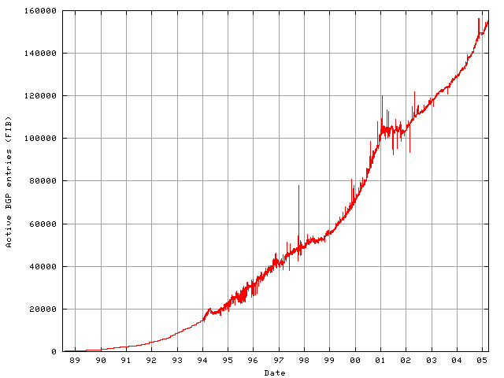
Growth in Routed Prefixes (1989-2005)
Dot-com implosion; Internet bubble bursts
Advent of CIDR allows aggregation: linear growth
Initial growth super-linear; no aggregation
Back in business
Internet boom: multihoming drives superlinear growth

Slide 51
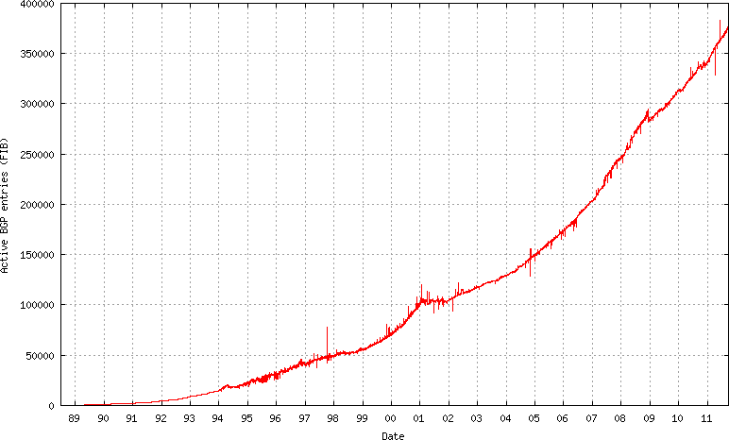
Same Table, Extended to Present
Linear growth
Superlinear growth
What Happened Here?
Stock Market
Crash of 2008

Slide 52
Summary of Addressing
Hierarchical addressing
Critical for scalable system
Don’t require everyone to know everyone else
Reduces amount of updating when something changes
Non-uniform hierarchy
Useful for heterogeneous networks of different sizes
Class-based addressing was far too coarse
Classless InterDomain Routing (CIDR) more flexible
But how do you forward on these addresses in ASes? Next week…

