Slide 1
Network Layer: Some Missing Pieces
Alefiya Hussain
Spring 2016

Slide 2
Where Are We
Context (History, Goals, Principles, etc.)
Done
Fundamental Challenges (Routing, Reliable Trans.)
Done
Today’s Internet
IP: Done
Addressing: Done
IP Header: Done
IPv6, ICMP, LMP: Today
Homework Review: Thursday
Midterm: Friday

Slide 3
Recall: End-Host How to Handle Packet
Application
SMTP
HTTP
DNS
NTP
Transport
TCP
UDP
Network
IP
Data link
Ethernet
FDDI
PPP
Physical
optical
copper
radio
PSTN

Slide 4
Recall: Layer Encapsulation
Alice
Bob
app
transport
Router
network
network
network
link
Notes:
Deepest level most header

Slide 5
Review of Addressing
Notation: dotted quad (set of four 8-bit numbers)
16.45.231.117=00010000|00101101|11100111|01110101
Structure: (prefix, suffix)
Network component (prefix)
Host component (suffix)
Use “slash” notation to denote the network component
/8 means prefix is first 8 bits
Routers only look at network component
L2 networks mostly look at host component

Slide 6
History of Addressing Schemes
Original: prefix of length 8 (all addresses in /8s)
Classful: opening bits determined length of prefix
0 meant /8
10 meant /16
110 meant /24
1110 meant mcast
1111 meant experimental
Classless (CIDR): explicit mask defines prefix

Slide 7
CIDR Addressing
Use two 32-bit numbers to represent a network location
Address + Mask
IP Address : 12.4.2.1 IP Mask: 255.254.0.0
Address
00001100
00000100
00000010
00000001
Mask
11111111
11111110
00000000
00000000
Network Prefix
for hosts
Notes:
What is slash notation for this prefix?

Slide 8
CIDR Prefixes
Use two 32-bit numbers to represent a network prefix
Address + Mask
Prefix: 12.4.0.0 IP Mask: 255.254.0.0
Address
00001100
00000100
00000000
00000000
Mask
11111111
11111110
00000000
00000000
Network Prefix
for hosts
Written as 12.4.0.0/15 or 12.4/15
Notes:
What is slash notation for this prefix?

Slide 9
Let’s take a quick look at the IPv6 header…

Slide 10
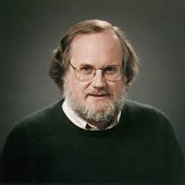
IPv6
Motivated by address exhaustion
Addresses four times as big
Steve Deering focused on simplifying IP
got rid of all fields that were not absolutely necessary
“spring cleaning” for IP
Result is an elegant, if unambitious, protocol

Slide 11
What “clean up” would you do?
4-bit
Version
4-bit
Header
Length
8-bit
Type of Service
16-bit Total Length (Bytes)
16-bit Identification
3-bit
Flags
13-bit Fragment Offset
8-bit Time to
Live (TTL)
8-bit Protocol
16-bit Header Checksum
32-bit Source IP Address
32-bit Destination IP Address
Options (if any)
Payload

Slide 12
IPv4 and IPv6 Header Comparison
IPv4
IPv6
Version | IHL | Type of Service | Total Length
Identification |  |  | Flags | Fragment Offset
Time to Live |  | Protocol | Header Checksum
Source Address
Destination Address
Options |  |  |  |  | Padding
Version | Traffic Class | Flow Label
Payload Length |  |  | Next Header | Hop Limit
Source Address
Destination Address
Field name kept from IPv4 to IPv6
Fields not kept in IPv6
Name & position changed in IPv6
New field in IPv6

Slide 13
Philosophy of Changes
Don’t deal with problems: leave to ends
Eliminated fragmentation
Eliminated checksum
Why retain TTL?
Simplify handling:
New options mechanism (uses next header approach)
Eliminated header length
Why couldn’t IPv4 do this?
Provide general flow label for packet
Not tied to semantics
Provides great flexibility

Slide 14
Missing Pieces

Slide 15
Where are we?
We have covered the “fundamentals”
How to deliver packets (routing)
How to build reliable delivery on an unreliable network
With this, we could build a decent network
How can we send/receive on the network
Too many missing pieces
We now want to identify those pieces
Will guide what we cover rest of semester

Slide 16
Scenario: Joan Wants Her Music
Joan is sitting in her dorm room, with a laptop
Wants to watch a video on youtube
What needs to happen to make this possible?
Not in terms of today’s protocols…
……but in terms of basic tasks

Slide 17
What Are The Steps Involved?
Accessing the network from laptop
Wireless or ethernet
Network management (someone needs to make it work)
Mapping “real world name” to “network name”
Mapping network name to location
Download content from location
Notes:
Stop for input!

Slide 18
What Are The Steps Involved?
Accessing the network from laptop
Wireless or ethernet
Network management (someone needs to make it work)
Mapping “real world name” to “network name”
Mapping network name to location
Download content from location

Slide 19
Access Networks
If access network is “switched”, we understand it
Just like any other packet-switched network
If the access network is shared medium, then we need to figure out how to share the medium
Wireless
Classical ethernet

Slide 20
Media Access Control (MAC)
Carrier sense: (CSMA)
Don’t send if someone else is sending
Collision detection: (CD)
Stop if you detect someone else was also sending
Collision avoidance: (CA)
How to arrange transmissions so that they don’t collide

Slide 21
What Are The Steps Involved?
Accessing the network from laptop
Wireless or ethernet
Network management (need to make it work)
Mapping “real world name” to “network name”
Mapping network name to location
Download content from location
Addressing general security concerns
Verifying that this is the right content
And that no one can tell what she’s downloading
Notes:
Stop for input!

Slide 22
Network Management
Control how dorm network interconnects to Internet
Intradomain routing
Interdomain routing
Keep unwanted traffic off network
Firewalls and access control
Share limited number of public addresses in dorm
NAT
Keep links from overloading
Traffic engineering through rate limiting
Autoconfiguration
DHCP

Slide 23
What Are The Steps Involved?
Accessing the network from laptop
Wireless or ethernet
Network management (someone needs to make it work)
Mapping “real world name” to “network name”
Mapping network name to location
Download content from location
Addressing general security concerns
Verifying that this is the right content
And that no one can tell what she’s downloading
Notes:
Stop for input!

Slide 24
“Real World Name” to “Network Name”
Joan knows what youtube video she wants
Doesn’t know how to tell network what she wants
Needs to map “real world name” (youtube.com)….
…..to a name that the infrastructure understands
We will call this the “network name” but this isn’t a name at the IP level, but another portion of the infrastructure
Search engine!
Maps keywords to URL
How can we do this?

Slide 25
What is a “Network Name”?
HTTP://www.youtube.com/watch?v=hUJagb7hL0E
HTTP is host-to-host protocol
www.youtube.com is a “host name”
Widely replicated, but still represents a host
Need to convert youtube to IP address
watch?v=hUJagb7hL0E is meaningful to youtube

Slide 26
What Are The Steps Involved?
Accessing the network from laptop
Wireless or ethernet
Network management (someone needs to make it work)
Mapping “real world name” to “network name”
Mapping network name to location
Download content from location
Addressing general security concerns
Verifying that this is the right content
And that no one can tell what she’s downloading
Notes:
Stop for input!

Slide 27
Map Network Name to Location
“Name resolution” converts name to location
Location is IP address of host
We would like location to be nearby copy
Speeds up download
Reduce load on backbone and access networks

Slide 28
How is this done today?
Name resolution: Domain Name System (DNS)
Hand in a hostname, get back an IP address
Nearby copy of the data?
CDNs: content distribution networks (like Akamai)
3/22 : Talk from Akamai on CDNs
P2P systems can also point you to nearby content

Slide 29
What Are The Steps Involved?
Accessing the network from laptop
Wireless or ethernet
Network management (someone needs to make it work)
Mapping “real world name” to “network name”
Mapping network name to location
Download content from location
Notes:
Stop for input!

Slide 30
Download Data from Location
Need a reliable transfer protocol: TCP
Must share network with others: congestion control
But must be able to use URL to retrieve content
Need higher-level protocol like HTTP to coordinate

Slide 31
What Are The Steps Involved?
Accessing the network from laptop
Wireless or ethernet
Network management (someone needs to make it work)
Mapping “real world name” to “network name”
Mapping network name to location
Download content from location
Security?
Notes:
Stop for input!

Slide 32
Ensuring Security
Privacy: prevent sniffers from knowing what she downloaded (“it was for CS353, I promise!”)
Integrity: ensure data wasn’t tampered with during its trip through network
Provenance: ensure that music actually came from the youtube company (and not some imposter)

Slide 33
Scenario Requires
Media Access Control
Network Routing
Naming and name resolution
Content distribution networks
And perhaps P2P
TCP and Congestion control
HTTP
Security..

Slide 34
How does Joan’s laptop get access to the Internet?

Slide 35
Layers of Addresses
Application
Transport
Host IP: 171.67.76.65
Network
IP Hdr
IP Datagram
Payload
IP Hdr
IP Data
Link
Link Data
Link Hdr
Link
Frame
Interface: 00:13:72:4C:D9:6a
35

Slide 36

The Addressing Problem
USC gateway
192.168.0.5
171.43.22.5
A
B
Interface: 3:3:3:3:3:3
Interface: 9:9:9:9:9:9

Slide 37
Addressing and Encapsulation
gateway
Interface: 00:13:72:AA:BB:6a
Interface: 00:13:72:AA:BB:7a
192.168.0.1
171.43.22.8
192.168.0.5
171.43.22.5
A
B
Interface: 3:3:3:3:3:3
Interface: 9:9:9:9:9:9

Slide 38
Example Addressing
gateway
Internet
Interface: 00:13:72:AA:BB:6a
192.168.0.1
A
B
C
192.168.0.5
192.168.0.6
192.168.0.7

Slide 39
Address Translation Protocol (ARP)
Map IP addresses into physical addresses
destination host
next hop router
Techniques
encode physical address in host part of IP address
table-based
ARP (Address Resolution Protocol)
table of IP to physical address bindings
broadcast request if IP address not in table
target machine responds with its physical address
table entries are discarded if not refreshed

Slide 40
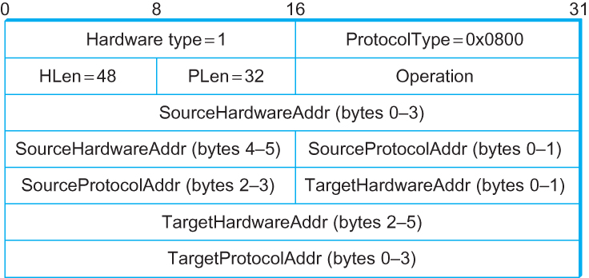
ARP Packet Format (RFC 826)
HardwareType: type of physical network (e.g., Ethernet)
ProtocolType: type of higher layer protocol (e.g., IP)
HLEN & PLEN: length of physical and protocol addresses
Operation: request or response
Source/Target Physical/Protocol addresses
48bits
48bits

Slide 41
How did Joan’s laptop get the IP address in the dorm?

Slide 42
Configuration
gateway
Internet
Interface: 00:13:72:AA:BB:6a
192.168.0.1
A
B
C
Home
network
192.168.0.5
192.168.0.6
192.168.0.7

Slide 43
Host Configurations
Ethernet addresses configured into network by manufacturer and they are unique
IP addresses must be unique on a given internetwork but also must reflect the structure of the internetwork
Most host Operating Systems provide a way to manually configure the IP information for the host
Drawbacks of manual configuration
A lot of work to configure all the hosts in a large network
Configuration process is error-prune
Automated Configuration Process is required

Slide 44
Dynamic Host Configuration Protocol (DHCP)
DHCP server is responsible for providing configuration information to hosts
There is at least one DHCP server for an administrative domain
DHCP server maintains a pool of available addresses

Slide 45
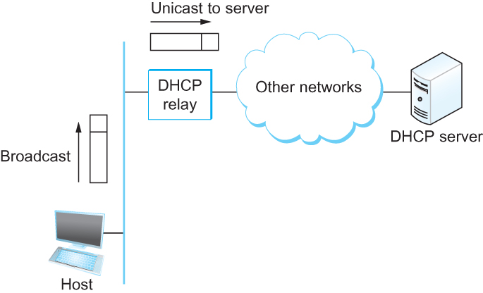
DHCP
Newly booted or attached host sends DHCPDISCOVER message to a special IP address (255.255.255.255)
DHCP relay agent unicasts the message to DHCP server and waits for the response

Slide 46
How can we get to youtube?
http://youtube.com → IP address?

Slide 47
DNS

Slide 48
Internet Names & Addresses
Machine addresses: e.g., 128.125.253.146
router-usable labels for machines
conforms to network structure (the “where”)
Machine names: e.g., www.usc.edu
human-usable labels for machines
conforms to organizational structure (the “who”)
The Domain Name System (DNS) is how we map from one to the other

Slide 49
DNS: History
Initially all host-address mappings were in a hosts.txt file (in /etc/hosts):
Maintained by the Stanford Research Institute (SRI)
Changes were submitted to SRI by email
New versions of hosts.txt periodically FTP’d from SRI
An administrator could pick names at their discretion
As the Internet grew this system broke down:
SRI couldn’t handle the load; names were not unique; hosts had inaccurate copies of hosts.txt
The Domain Name System (DNS) was invented to fix this

Slide 50
Goals
No naming conflicts (uniqueness)
Scalable
many names
(secondary) frequent updates
Distributed, autonomous administration
Ability to update my own (machines’) names
Don’t have to track everybody’s updates
Highly available
Lookups are fast
Non-goal?: perfect consistency

Slide 51
Key idea: Hierarchy
Three intertwined hierarchies
Hierarchical namespace
As opposed to original flat namespace
Hierarchically administered
As opposed to centralized
(Distributed) hierarchy of servers
As opposed to centralized storage

Slide 52
Hierarchical Namespace
root
edu
com
gov
mil
org
net
uk
fr
…
usc
ucla
“Top Level Domains” are at the top
Domains are subtrees
E.g: .edu, usc.edu,
Name is leaf-to-root path
nsl.ee.usc.edu
Depth of tree is arbitrary (limit 128)
Name collisions trivially avoided
each domain is responsible
ee
cs
nsl

Slide 53
Hierarchical Administration
root
root
edu
edu
gov
gov
mil
mil
net
net
uk
uk
fr
com
fr
com
org
org
usc
ucla
ee
cs
A zone corresponds to an administrative authority that is responsible for that portion of the hierarchy
E.g., USC controls names: *.usc.edu and *.cs.usc.edu
E.g., EE controls names: *.ee.usc.edu
nsl

Slide 54
Server Hierarchy
Top of hierarchy: Root servers
Location hardwired into other servers
Next Level: Top-level domain (TLD) servers
.com, .edu, etc.
Managed professionally
Bottom Level: Authoritative DNS servers
Actually store the name-to-address mapping
Maintained by the corresponding administrative authority

Slide 55
Server Hierarchy
Each server stores a (small!) subset of the total DNS database
An authoritative DNS server stores “resource records” for all DNS names in the domain that it has authority for
Each server needs to know other servers that are responsible for the other portions of the hierarchy
Every server knows the root
Root server knows about all top-level domains

Slide 56
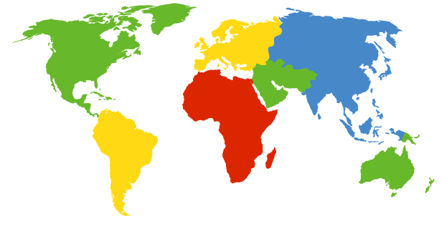
DNS Root
Located in Virginia, USA
How do we make the root scale?
Verisign, Dulles, VA

Slide 57
DNS Root Servers
13 root servers (labeled A-M; see http://www.root-servers.org/)
A Verisign, Dulles, VA
C Cogent, Herndon, VA
D U Maryland College Park, MD
G US DoD Vienna, VA
H ARL Aberdeen, MD
J Verisign
K RIPE London
I Autonomica, Stockholm
E NASA Mt View, CA
F Internet Software
Consortium
Palo Alto, CA
M WIDE Tokyo
B USC-ISI Marina del Rey, CA
L ICANN Los Angeles, CA

Slide 58
DNS Root Servers
13 root servers (labeled A-M; see http://www.root-servers.org/)
Replicated via any-casting
A Verisign, Dulles, VA
C Cogent, Herndon, VA (also Los Angeles, NY, Chicago)
D U Maryland College Park, MD
G US DoD Vienna, VA
H ARL Aberdeen, MD
J Verisign (21 locations)
K RIPE London (plus 16 other locations)
I Autonomica, Stockholm (plus 29 other locations)
E NASA Mt View, CA
F Internet Software
Consortium,
Palo Alto, CA
(and 37 other locations)
M WIDE Tokyo
plus Seoul, Paris, San Francisco
B USC-ISI Marina del Rey, CA
L ICANN Los Angeles, CA

Slide 59
Anycast in a nutshell
Routing finds shortest paths to destination
If several locations are given the same address, then the network will deliver the packet to the closest location with that address
This is called “anycast”
Very robust
Requires no modification to routing algorithms

Slide 60
Using DNS (Client/App View)
Two components
Local DNS servers
Resolver software on hosts
Local DNS server (“default name server”)
Usually near the endhosts that use it
Hosts configured with local server address (e.g., /etc/resolv.conf) or learn server via a host configuration protocol (e.g., DHCP)
Client application
Obtain DNS name (e.g., from URL)
Do gethostbyname() to trigger DNS request to its local DNS server

Slide 61
How Does Resolution Happen?
root DNS server
Host at cis.poly.edu wants IP address for gaia.cs.umass.edu
2
3
TLD DNS server
4
local DNS server
dns.poly.edu
5
7
6
1
8
authoritative DNS server
dns.cs.umass.edu
requesting host
cis.poly.edu
gaia.cs.umass.edu

Slide 62
Recursive vs. Iterative Queries
root DNS server
Recursive query
Ask server to get answer for you
E.g., request 1 and response 8
Iterative query
Ask server who to ask next
E.g., all other request-response pairs
2
3
TLD DNS server
4
local DNS server
dns.poly.edu
5
7
6
1
8
authoritative DNS server
dns.cs.umass.edu
requesting host
cis.poly.edu
Notes:
Most common case: this mixed usage: host to local: recursive; local to all: iterative

Slide 63
Inserting Resource Records into DNS
Example: just created company “FooBar”
Get a block of address space from ISP
Say 212.44.9.128/25
Register foobar.com at registrar (e.g., Network Solutions)
Provide registrar with names and IP addresses of your authoritative name server (primary and secondary)
Registrar inserts RR pairs into the .com TLD server:
(foobar.com, dns1.foobar.com, NS)
(dns1.foobar.com, 212.44.9.129, A)
You store appropriate records in your server dns1.foobar.com:
e.g., type A record for www.foobar.com
e.g., type MX record for foobar.com

Slide 64
How can we get the content on to Joan’s laptop?
http://youtube.com?watch=xyxtyw13 render in browsers?

Slide 65
The Web

Slide 66

The Web – Precursor
1967, Ted Nelson, Xanadu:
A world-wide publishing network that would allow information to be stored not as separate files but as connected literature
Owners of documents would be automatically paid via electronic means for the virtual copying of their documents
Coined the term “Hypertext”
Ted Nelson

Slide 67

The Web – History
World Wide Web (WWW): a distributed database of “pages” linked through Hypertext Transport Protocol (HTTP)
First HTTP implementation - 1990
Tim Berners-Lee at CERN
HTTP/0.9 – 1991
Simple GET command for the Web
HTTP/1.0 –1992
Client/Server information, simple caching
HTTP/1.1 - 1996
Tim Berners-Lee

Slide 68
Web Components
Infrastructure:
Clients
Servers
Content:
URL: naming content
HTML: formatting content
Protocol for exchanging information: HTTP

Slide 69
Uniform Record Locator (URL)
protocol://host-name[:port]/directory-path/resource
Extend the idea of hierarchical hostnames to include anything in a file system
http://www.isi.edu/~hussain/
Extend to program executions as well…
http://us.f413.mail.yahoo.com/ym/ShowLetter?box=%40B%40Bulk&MsgId=2604_1744106_29699_1123_1261_0_28917_3552_1289957100&Search=&Nhead=f&YY=31454&order=down&sort=date&pos=0&view=a&head=b
Server side processing can be incorporated in the name

Slide 70
Uniform Record Locator (URL)
protocol://host-name[:port]/directory-path/resource
protocol: http, ftp, https, smtp, rtsp, etc.
hostname: DNS name, IP address
port: defaults to protocol’s standard port; e.g. http: 80 https: 443
directory path: hierarchical, reflecting file system
resource: Identifies the desired resource

Slide 71
Web and DNS
URLs use hostnames
Thus, content names are tied to specific hosts
Makes persistence of content difficult!

Slide 72
Hyper Text Transfer Protocol (HTTP)
Client-server architecture
server is “always on” and “well known”
clients initiate contact to server
Synchronous request/reply protocol
Runs over TCP, Port 80
Stateless
ASCII format

Slide 73
Steps in HTTP Request/Response
Client
Server
TCP Syn
Establish
connection
TCP syn + ack
Client
request
TCP ack + HTTP GET
.
.
Request
response
.
Close connection

Slide 74
Client-to-Server Communication
HTTP Request Message
Request line: method, resource, and protocol version
Request headers: provide information or modify request
Body: optional data (e.g., to “POST” data to the server)
request line
GET /somedir/page.html HTTP/1.1
Host: www.someschool.edu
User-agent: Mozilla/4.0
Connection: close
Accept-language: fr
(blank line)
header
lines
carriage return line feed
indicates end of message

Slide 75
Server-to-Client Communication
HTTP Response Message
Status line: protocol version, status code, status phrase
Response headers: provide information
Body: optional data
status line
(protocol, status code, status phrase)
HTTP/1.1 200 OK
Connection close
Date: Thu, 06 Aug 2006 12:00:15 GMT
Server: Apache/1.3.0 (Unix)
Last-Modified: Mon, 22 Jun 2006 ...
Content-Length: 6821
Content-Type: text/html
(blank line)
data data data data data ...
header lines
data
e.g., requested HTML file

Slide 76
Performance Goals
User
fast downloads (not identical to low-latency commn.!)
high availability
Content provider
happy users (hence, above)
cost-effective infrastructure
Network (secondary)
avoid overload

Slide 77
Improving HTTP Performance: Caching: Where?
Baseline: Many clients transfer same information
Generate unnecessary server and network load
Clients experience unnecessary latency
Server
Tier-1 ISP
ISP-1
ISP-2
Clients

Slide 78
Improving HTTP Performance: Caching with Reverse Proxies
Cache documents close to server → decrease server load
Typically done by content provider
Server
Reverse proxies
Backbone ISP
ISP-1
ISP-2
Clients

Slide 79
Improving HTTP Performance: Caching with Forward Proxies
Cache documents close to clients
→ reduce network traffic and decrease latency
Typically done by ISPs or enterprises
Server
Reverse proxies
Backbone ISP
ISP-1
ISP-2
Forward proxies
Clients

Slide 80
Improving HTTP Performance: Replication
Replicate popular Web site across many machines
Spreads load on servers
Places content closer to clients
Helps when content isn’t cacheable
Problem: Want to direct client to particular replica
Balance load across server replicas
Pair clients with nearby servers
Common solution:
DNS returns different addresses based on client’s geo location, server load, etc.

Slide 81
Improving HTTP Performance: Content Distribution Networks
Caching and replication as a service
Large-scale distributed storage infrastructure (usually) administered by one entity
e.g., Akamai has servers in 20,000+ locations
Combination of (pull) caching and (push) replication
Pull: Direct result of clients’ requests
Push: Expectation of high access rate
Also do some processing
Handle dynamic web pages
Transcoding
Notes:
Transcoding = change compression rate per user’s bandwidth

Slide 82
Improving HTTP Performance: CDN Example – Akamai
Akamai creates new domain names for each client
e.g., a128.g.akamai.net for cnn.com
The CDN’s DNS servers are authoritative for the new domains
The client content provider modifies its content so that embedded URLs reference the new domains.
“Akamaize” content
e.g.: http://www.cnn.com/image-of-the-day.gif becomes http://a128.g.akamai.net/image-of-the-day.gif
Requests now sent to CDN’s infrastructure…

Slide 83
Cost-Effective Content Delivery
General theme: multiple sites hosted on shared physical infrastructure
efficiency of statistical multiplexing
economies of scale (volume pricing, etc.)
amortization of human operator costs
Examples:
Web hosting companies
CDNs
Cloud infrastructure

