Slide 1
CS 353 Designing a Network
Spring 2016
Alefiya Hussain

Slide 2
Administrivia
Quiz and Exam Schedule on Piazza
This week: basics, philosophy, principles,…
Read Chapter 1
Next week: routing!
Slides will be on Piazza right after class

Slide 3
Need a Notetaker
We need a note taker for this class
One volunteer?
Please contact DSP Note Taking at notetake@usc.edu
Note Takers receive a token of appreciation $100 at the end of the semester

Slide 4
Today
What do today’s access networks look like?
Just for context
How would you build the rest of a network?
Keys are efficiency and reliability
Packet dynamics
Delays, queues, and all that….

Slide 5
Remember our Internet Diagram
link
end-system
switch

Slide 6
ISP Technologies
ISPs have very similar backbone technologies to connect regions and connect to each other
But they differ substantially in their “last mile”
The “access technology” that reaches the consumer

Slide 7
Some ISPs are phone companies
phone company

Slide 8
Telephony Access Technology
phone company

Slide 9
Last Mile (logically)
home PC
switch

Slide 10
Last Mile (in reality)
central office
DSL modem
DSLAM
phone line
...
home PC
switch
telephone
telephone network

Slide 11
Digital Subscriber Line (DSL)
Twisted pair copper
3 separate channels
Downstream data channel
Upstream data channel
2-way phone channel

Slide 12
Cable Access Technology
cable head end
cable modem
CMTS
copper
fiber
...
home PC
switch

Slide 13
Many households share access
cable head end
CMTS
fiber
switch

Slide 14
Cable
Coaxial copper & fiber
Shared broadcast medium
Why?

Slide 15
Enterprise Access Technology
Ethernet cable
...
workstation
“local” switch
“aggregate” switch

Slide 16
Ethernet
Twisted pair copper
1 Gbps, 10 Gbps, 100Gbps (each direction)

Slide 17
Other access technologies
Cellular (smart phones)
Satellite (remote areas)
Fiber to the Home (home)

Slide 18
Access Technologies
From an architectural perspective…
Access technologies are a boring detail
Logical equivalent of a wire to the first-hop switch
From an infrastructure perspective…
That’s where all the money goes
Deployment, maintenance, speed limitations, etc.
We won’t discuss access networks any more
But this is what keeps ISP CEOs up at night…
Routing protocols, etc., are the least of their problems..

Slide 19
What about the rest of the network?
Access technologies are specialized
What about the rest of the network?
How do you scale such a network?
Billions of endpoints!

Slide 20
What about this design?
Advantage:
Every source-destination pair has its own link
Disadvantages:
No sharing
Would require too many links O(n²)

Slide 21
What about this design?
Advantage:
Lots of sharing
Disadvantages:
Too much sharing
Transport capacity O(1/n)
Not very resilient

Slide 22
What about this design?
Advantage:
Lots of sharing
Disadvantages:
Too much sharing
Transport capacity O(1/n)
Not very resilient
Last two designs were used for local area nets
Bad for wide area networks

Slide 23
Requirements for network topology
Resilient to failures
Several paths between each source and destination
Enough sharing to be feasible
Number of links not too high
Provide adequate transport capacity
Number of links not too small

Slide 24
Switched Networks
Provide reasonable and flexible compromise

Slide 25

Requires sharing of links/switches
shared link and switch resources

Slide 26
Two approaches to sharing
Reservations:
“Flows” reserve bandwidth needed in advance
Must reserve their peak bandwidth
On demand: (also known as “best effort”)
Send packets when you have them
Hope for the best….

Slide 27
Example of “Statistical Multiplexing”
Statistical multiplexing:
Combining demands to share resources efficiently
Long history in computer science
Processes on an OS
Cloud computing
…
Two Types:
Reservation: sharing at flow level
On-demand: sharing at packet level

Slide 28
Which is better?

Slide 29
Example: three constant sources
Total bandwidth 30Mbps
Demands: Each source needs 10Mbps
Reservation and on-demand give same result
Every source gets what they need
No wasted bandwidth
….

Slide 30

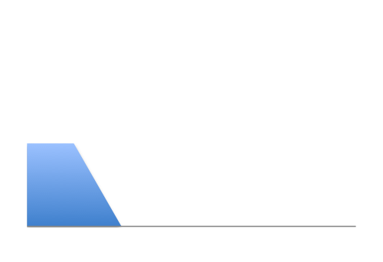
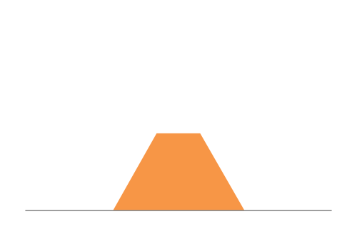
Example: Three “bursty” sources
12Mbps
Link capacity = 30Mbps
11Mbps
13Mbps
Time

Slide 31
What happens with reservations?
Option #1: allow two flows to reserve peak rate
Must turn away third flow!
12Mbps
Link capacity = 30Mbps
11Mbps
13Mbps
Time

Slide 32
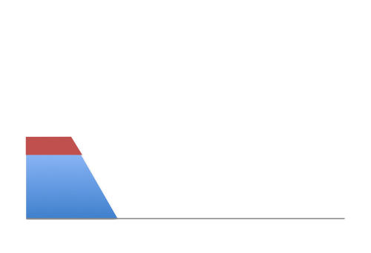
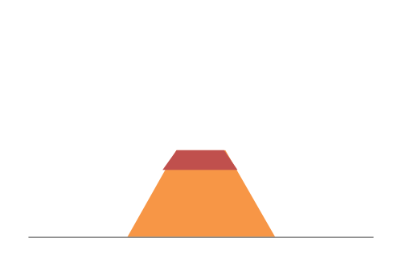
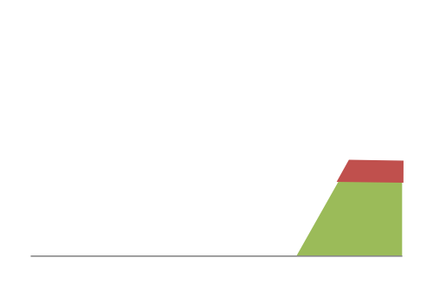
What happens with reservations?
Option #2: allow flows to reserve equal rates
Frequent overloading!
12Mbps
Link capacity = 30Mbps
11Mbps
Each source gets 10Mbps
13Mbps
Time

Slide 33
What happens with on-demand?
No overloading
Link capacity = 30Mbps
Time

Slide 34
Peak vs Average Rates
For each flow, define:
P = peak rate
A = average rate
Reservations must reserve P:
But flows only use A (on average)
Level of utilization is A/P
On-demand:
Can achieve higher utilizations
Depends on degree of sharing, burstiness of flows
Peak of aggregate approaches sum of averages

Slide 35
Smooth vs Bursty Applications
Some apps have relatively small P/A ratios
Voice might have a ratio of 3:1 or so
Data applications tend to be rather bursty
Ratios of 100 or greater are common
That’s why the phone network used reservations
And the Internet does not….
More in next lectures

Slide 36
Two approaches to sharing
Reservations
On demand
How are these implemented?

Slide 37
Two approaches to sharing
Reservations → circuit switching
On demand → packet switching

Slide 38
Circuit Switching
dst
10Mb/s?
src
✔
10Mb/s?
✔
10Mb/s?
✔
(1) src sends a reservation request for 10Mbps to dst
(2) Switches “establish a circuit”
(3) src starts sending data
(4) src sends a “teardown circuit” message

Slide 39
Circuit Switching
switch
src
dst
Reservation also establishes a “circuit” within a switch

Slide 40
Many kinds of “circuits”
Time division multiplexing
divide time in time slots
separate time slot per circuit
Frequency division multiplexing
divide frequency spectrum in frequency bands
separate frequency band per circuit
time
frequency
time

Slide 41

Timing in Circuit Switching
time

Slide 42
Timing in Circuit Switching
time

Slide 43
Timing in Circuit Switching
time

Slide 44
Timing in Circuit Switching
time

Slide 45
Timing in Circuit Switching
Circuit establishment
time

Slide 46
Timing in Circuit Switching
Data
Circuit establishment
Data transfer
time

Slide 47
Timing in Circuit Switching
Data
Circuit establishment
Data transfer
time
Circuit teardown
Notes:
Why the delays in the first pass of the establishment, but not in subsequent passes (or in teardown)?

Slide 48
Efficiency in Circuit Switching
Circuit establishment
Data transfer
time
Circuit teardown
Notes:
Why the delays in the first pass of the establishment, but not in subsequent passes (or in teardown)?

