Slide 1
CS 353 Getting Connected Reliable Transport, Ethernet, Wireless
Spring 2016
Alefiya Hussain

Slide 2
Last few lectures
Networking is distributed across many machines
Hosts
Routers
Layers: physical/datalink, network, transport, application
Introduced the concept of “cloud” to represent a network. How to connect a host to a cloud?

Slide 3
Goals for next few lectures
Different communication medium over which we can send data (Ch 2: 2.1)
Types of links
Types of topologies
Make the links reliable in spite of transmission problems
Media Access Control
Carrier Sense Multiple Access (CSMA) networks
Wireless Networks with different available technologies and protocol

Slide 4
Non Goal: We will not cover (Ch 2:2.2-2.4)
Encoding bits onto transmission medium so that they can be understood by the receiving end
Packing the sequence of into messages that can be delivered to the end node
Error Detection and Correction

Slide 5
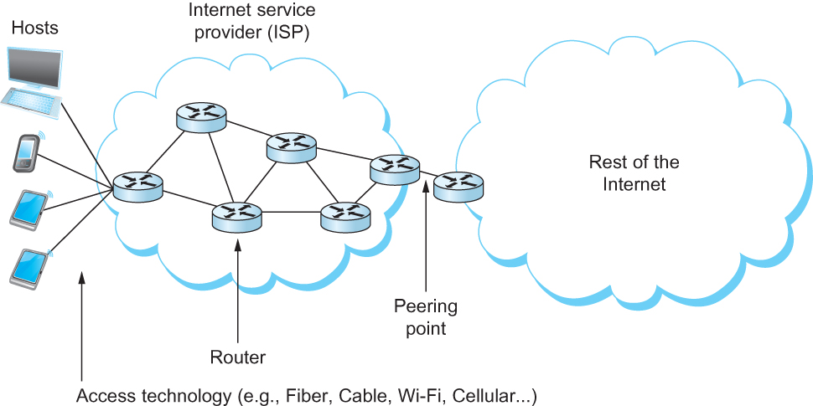
Links
Electromagnetic radiation/optical propagating through a medium or, in some cases, through free space
One way to characterize links, then, is by the medium they use
Typically copper wire in some form (as in Digital Subscriber Line (DSL) and coaxial cable),
Optical fiber (as in both commercial fiber-to-the home services and many long-distance links in the Internet’s backbone), or
Air/free space (for wireless links)

Slide 6
Reliable Transmission
Checksum/CRC is used to detect and correct errors
The overhead is typically too high
Corrupt frames must be discarded
A link-level protocol that wants to deliver frames reliably must recover from these discarded frames
This is accomplished using a combination of two fundamental mechanisms
Acknowledgements and Timeouts

Slide 7
Transmission: Perfect World
In a perfect world, reliable transport is easy
@Sender
send packets
@Receiver
wait for packets

Slide 8
Reliable Transmission
In a perfect world, reliable transport is easy
All the bad things best-effort can do
a packet is corrupted (bit errors)
a packet is lost (why?)
a packet is delayed (why?)
packets are reordered (why?)
a packet is duplicated (why?)

Slide 9
Mechanisms for Coping with Bad Events?
Checksums: to detect corruption
ACKs: receiver tells sender that it received packet
NACK: receiver tells sender it did not receive packet
Sequence numbers: a way to identify packets
Retransmissions: sender resends packets
Timeouts: a way of deciding when to resend a packet

Slide 10
Dealing with Packet Corruption
1
☑
ack
2
☒
nack
2
Sender
Receiver
Time
Notes:
Checksums: to detect corruption
ACKs: receiver tells sender that it received packet
NACK: receiver tells sender it did not receive packet
Sequence numbers: a way to identify packets
Retransmissions: sender resends packets
Timeouts: a way of deciding when to resend a packet
Corruption
Reordering

Slide 11
Dealing with Packet Corruption
1
P(1)
☑
ack(1)
☒
1
P(1)
Packet #1 or #2?
ack(1)
2
P(2)
Data and ACK packets carry sequence numbers
What if the ACK/NACK is corrupted?
Sender
Receiver
Time

Slide 12
Mechanisms for Coping with Bad Events?
ACKs: receiver tells sender that it received packet
NACK: receiver tells sender it did not receive packet
Sequence numbers: a way to identify packets
Notes:
Retransmissions: sender resends packets
Timeouts: a way of deciding when to resend a packet

Slide 13
Dealing with Packet Loss
1
P(1)
☒
Timeout
1
P(1)
ack(1)
P(2)
Sender
Receiver
Timer-driven loss detection Set timer when packet is sent; retransmit on timeout
Time

Slide 14
Dealing with Packet Loss (of ack)
1
P(1)
Timeout
☒
1
P(1)
duplicate!
ack(1)
P(2)
Sender
Receiver
Time

Slide 15
Dealing with Packet Loss
1
P(1)
Timeout
1
P(1)
ack(1)
.
.
.
duplicate!
ack(1)
P(2)
Sender
Receiver
Timer-driven retx. can lead to duplicates
Time

Slide 16
Components of a solution (so far)
checksums (to detect bit errors)
timers (to detect loss)
acknowledgements (positive or negative)
sequence numbers (to deal with duplicates)
But we haven’t put them together into a coherent design…

Slide 17
Designing Reliable Transport

Slide 18
A Solution: “Stop and Wait”
@Sender
send packet(I); (re)set timer; wait for ack
If (ACK)
I++; repeat
If (NACK or TIMEOUT)
repeat
@Receiver
wait for packet
if packet is OK, send ACK
else, send NACK
repeat
We have a correct reliable transport protocol!
Probably the world’s most inefficient one (why?)

Slide 19
Stop & Wait is Inefficient
TRANS
DATA
RTT
ACK
If TRANS << RTT then
Throughput ~ DATA/RTT
Sender
Receiver

Slide 20
Orders of Magnitude
Transmission time for 10Gbps link:
~ microsecond for 1500 byte packet
RTT:
1,000 kilometers ~ O(10) milliseconds
Can we increase link utilization?
How do we deal with loss/corruption?
Notes:
For loss and corruption divide discussion at sender and receiver

Slide 21
Three Design Decisions
Which packets can sender send?
Sliding window
How does receiver ack packets?
Cumulative
Selective
Which packets does sender resend?
Go-Back-N (GBN)
Selective repeat

Slide 22
Sliding Window
window = set of adjacent sequence numbers
The size of the set is the window size; assume window size is n
General idea: send up to n packets at a time
Sender can send packets in its window
Receiver can accept packets in its window
Window of acceptable packets “slides” on successful reception/acknowledgement
Window contains all packets that might still be in transit
Sliding window often called “packets in flight”

Slide 23
Sliding Window
Let A be the last ack’d packet of sender without gap; then window of sender = {A+1, A+2, …, A+n}
Let B be the last received packet without gap by receiver, then window of receiver = {B+1,…, B+n}
n
Already ACK’d
A
Sent but not ACK’d
Cannot be sent
sequence number →
n
Received and ACK’d
B
Acceptable but not yet received
Cannot be received

Slide 24
Throughput of Sliding Window
If window size is n, then throughput is roughly
MIN[ nDATA/RTT, Link Bandwidth]
Compare to Stop and Wait: Data/RTT
Two questions:
What happens when n gets too large?
How do we choose n?

Slide 25
Acknowledgements w/ Sliding Window
Two common options
Cumulative ACK
Selective ACKS
cumulative ACKs: ACK carries next in-order sequence number that the receiver expects

Slide 26
Cumulative Acknowledgements (1)
At receiver
n
Received and ACK’d
B
Acceptable but not yet received
Cannot be received
After receiving B+1, B+2
B_{new}= B+2
n
Receiver sends ACK(B+3) = ACK(B_{new}+1)

Slide 27
Cumulative Acknowledgements (2)
At receiver
n
Received and ACK’d
B
Acceptable but not yet received
Cannot be received
After receiving B+4, B+5
B
n
Receiver sends ACK(B+1)

Slide 28
Acknowledgements w/ Sliding Window
Two common options
cumulative ACKs: ACK carries next in-order sequence number the receiver expects
selective ACKs: ACK individually acknowledges correctly received packets
Selective ACKs offer more precise information but require more complicated book-keeping

Slide 29
Selective Acknowledgements
At receiver
n
Received and ACK’d
B
Acceptable but not yet received
Cannot be received
After receiving B+4, B+5
B
n
Receiver sends ACK(B+4), ACK(B+5)

Slide 30
Sliding Window Protocols
Resending packets: two canonical approaches
Go-Back-N
Selective Repeat
Many variants that differ in implementation details

Slide 31
Go-Back-N (GBN)
Sender transmits up to n unacknowledged packets
Receiver only accepts packets in order
discards out-of-order packets (i.e., packets other than B+1)
Receiver uses cumulative acknowledgements
i.e., sequence# in ACK = next expected in-order sequence#
Sender sets timer for 1st outstanding ack (A+1)
If timeout, retransmit A+1, … , A+n

Slide 32
Sliding Window with GBN
Let A be the last ack’d packet of sender without gap; then window of sender = {A+1, A+2, …, A+n}
Let B be the last received packet without gap by receiver, then window of receiver = {B+1,…, B+n}
n
Already ACK’d
A
Sent but not ACK’d
Cannot be sent
sequence number →
n
Received and ACK’d
B
Acceptable but not yet received
Cannot be received

Slide 33
GBN Example w/o Errors
Sender Window
Window size = 3 packets
Receiver Window
{1}
1
{1, 2}
2
{1, 2, 3}
3
{2, 3, 4}
4
{3, 4, 5}
5
.
.
.
{4, 5, 6}
6
.
.
.
Sender
Receiver
Time

Slide 34
GBN Example with Errors
Window size = 3 packets
1
2
3
4
5
Timeout
Packet 4
6
4
5
6
Sender
Receiver

Slide 35
Selective Repeat (SR)
Sender: transmit up to n unacknowledged packets
Assume packet k is lost, k+1 is not
Receiver: indicates packet k+1 correctly received
Sender: retransmit only packet k on timeout
Efficient in retransmissions but complex book-keeping
need a timer per packet

Slide 36
SR Example with Errors
Window size = 3 packets
{1}
1
{1, 2}
2
{1, 2, 3}
3
{2, 3, 4}
4
{3, 4, 5}
5
Timeout
Packet 4
{4, 5, 6}
6
ACK=5
{4,5,6}
ACK=6
4
{4,5,6}
Time
ACK=4
{7, 8, 9}
7
Sender
Receiver

Slide 37
GBN vs Selective Repeat
Which link environments would GBN be better?
Which link environment would SR be better?

Slide 38
Recap: components of a solution
Checksums (for error detection)
Timers (for loss detection)
Acknowledgments
cumulative
selective
Sequence numbers (duplicates, windows)
Sliding Windows (for efficiency)
Reliability protocols use the above to decide when and what to retransmit or acknowledge

Slide 39
Recap: Stop-Wait/Sliding Window
Stop and Wait: simple, poor utilization
Sliding windows: it is possible to fully utilize a link, provided the window size is large enough.
Sender has to buffer all unacknowledged packets, because they may require retransmission
Receiver may be able to accept out-of-order packets, but only up to its buffer limits
Implementation complexity depends on protocol details (GBN vs. SR)
See elements in: TCP and Application level protocols

Slide 40
Admin
Friday is Quiz 1
All material covered until today
Review by TA’s on Thursday
Assignment 1
DETER
Start early, hard deadline

Slide 41
Readings
Chapter 2: 2.1-Types of Links, 2.5-Reliable Transport,

