Slide 1
CS 353 Getting Connected Reliable Transport, Ethernet, Wireless
Spring 2016
Alefiya Hussain

Slide 2
Goals for next few lectures
Different communication medium over which we can send data (Ch 2: 2.1)
Types of links
Types of topologies
Make the links reliable in spite of transmission problems
Media Access Control
Carrier Sense Multiple Access (CSMA) networks
Wireless Networks with different available technologies and protocol (next class)

Slide 3
Three Ways to Share the Media
Channel partitioning MAC protocols (TDMA, FDMA):
Share channel efficiently and fairly at high load
Inefficient at low load (where load = # senders):
1/N bandwidth allocated even if only 1 active node!
“Taking turns” protocols
Eliminates empty slots without causing collisions
Overhead in acquiring the token
Vulnerable to failures (e.g., failed node or lost token)
Random access MAC protocols
Efficient at low load: single node can fully utilize channel
High load: collision overhead

Slide 4
Key Ideas of Random Access
Carrier sense
Listen before speaking, and don’t interrupt
Checking if someone else is already sending data
… and waiting till the other node is done
Collision detection
If someone else starts talking at the same time, stop
Realizing when two nodes are transmitting at once
…by detecting that the data on the wire is garbled
Randomness
Don’t start talking again right away
Waiting for a random time before trying again

Slide 5
Multiple Access Control (MAC)
Single shared broadcast channel
Must avoid having multiple nodes speaking at once
Otherwise, collisions lead to garbled data
Need distributed algorithm for sharing the channel
Algorithm determines which node can transmit
Classes of techniques
Channel partitioning: divide channel into pieces
Taking turns: scheme for trading off who gets to transmit
Random access: allow collisions, and then recover
We focus on this last approach (most Internet-like!)

Slide 6
Random Access MAC Protocols
When node has packet to send
Transmit at full channel data rate
No a priori coordination among nodes
Two or more transmitting nodes ⇒ collision
Data lost
Random access MAC protocol specifies:
How to detect collisions
How to recover from collisions
Examples
ALOHA and Slotted ALOHA (background)
CSMA, CSMA/CD, CSMA/CA (used in practice)

Slide 7

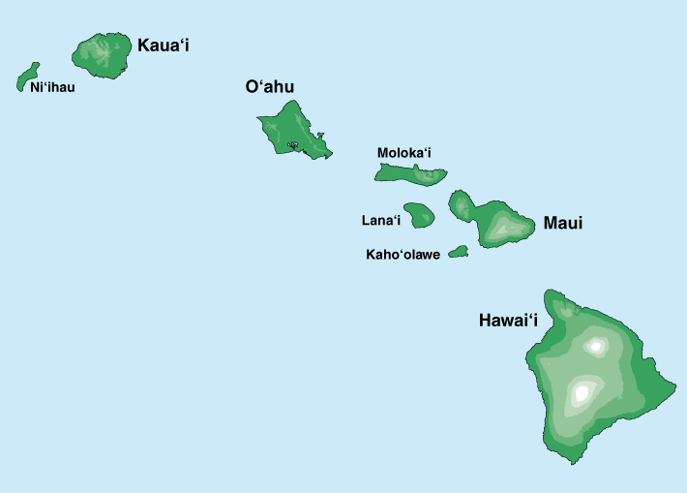
Where it all Started: AlohaNet
Norm Abramson moved to Hawaii in 1970
So he could surf!
Set up first data communication system for Hawaiian islands
Hub at U. Hawaii, Oahu
Had two radio channels:
Random access:
Sites sending data
Broadcast:
Hub rebroadcasting data
Notes:
Who is he, and why is he my hero?

Slide 8
CSMA (Carrier Sense Multiple Access)
CSMA: listen before transmit
If channel sensed idle: transmit entire frame
If channel sensed busy, defer transmission
Human analogy: don’t interrupt others!
Does this eliminate all collisions?
No, because of nonzero propagation delay

Slide 9
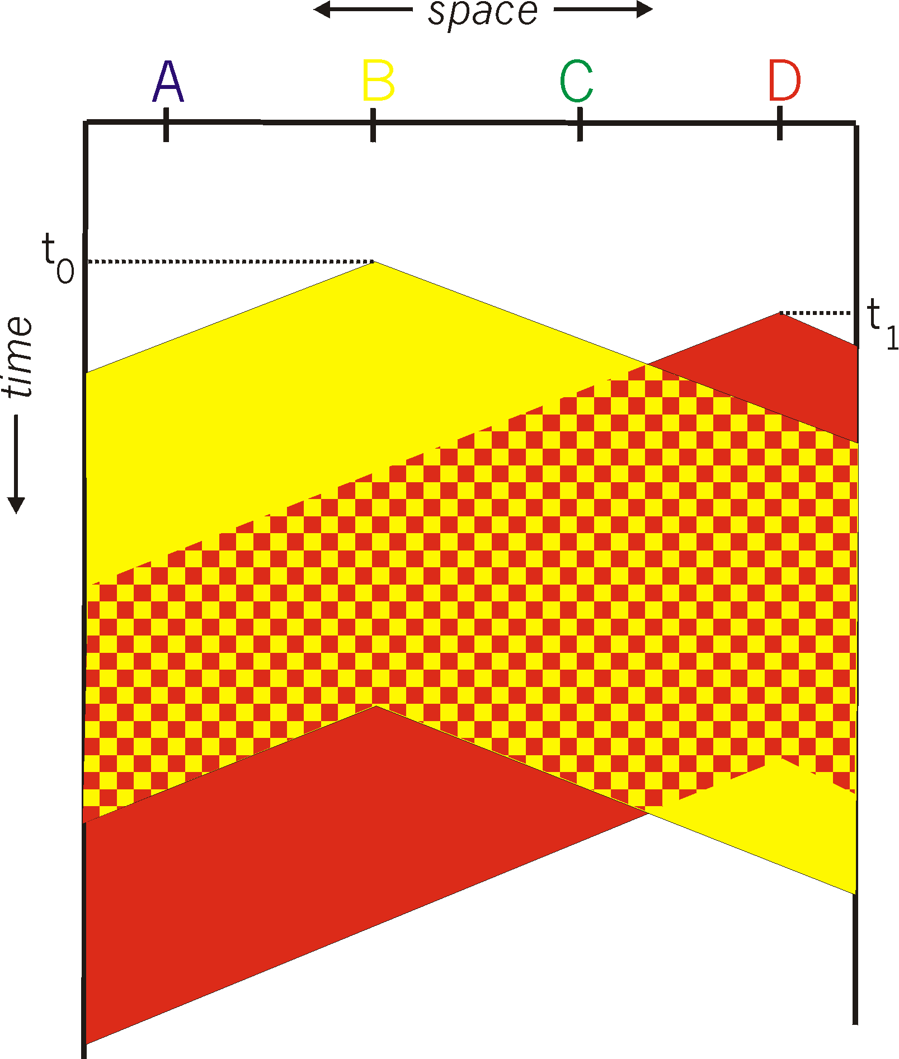
CSMA Collisions
Collisions can still occur:
propagation delay means
two nodes may not hear
each other’s transmission in time.
At time t₁, D still hasn’t heard B’s signal sent at the earlier time t₀, so D goes ahead and transmits: failure of carrier sense.
Collision:
entire packet transmission
time wasted

Slide 10
CSMA Collisions
Propagation delay: two nodes may not hear each other’s before sending.
CSMA reduces but does not eliminate collisions
Biggest remaining problem?
Collisions still take full slot!
How do you fix that?
Notes:
Ask: who knows? (from knowing ethernet)?
At time t₁, D still hasn’t heard B’s signal sent at the earlier time t₀, so D goes ahead and transmits: failure of carrier sense.
Someone who doesn’t, how to do this?
Listen before sending to detect possible collision
Why not listen to detect current collision!

Slide 11
CSMA/CD (Collision Detection)
CSMA/CD: carrier sensing, deferral as in CSMA
Collisions detected within short time
Colliding transmissions aborted, reducing wastage
Collision detection
Easy in wired LANs: measure signal strengths, compare transmitted, received signals
Difficult in wireless LANs
Reception shut off while transmitting
Even if on, might not be able to hear the other sender, even though the receiver can
Leads to use of collision avoidance instead

Slide 12
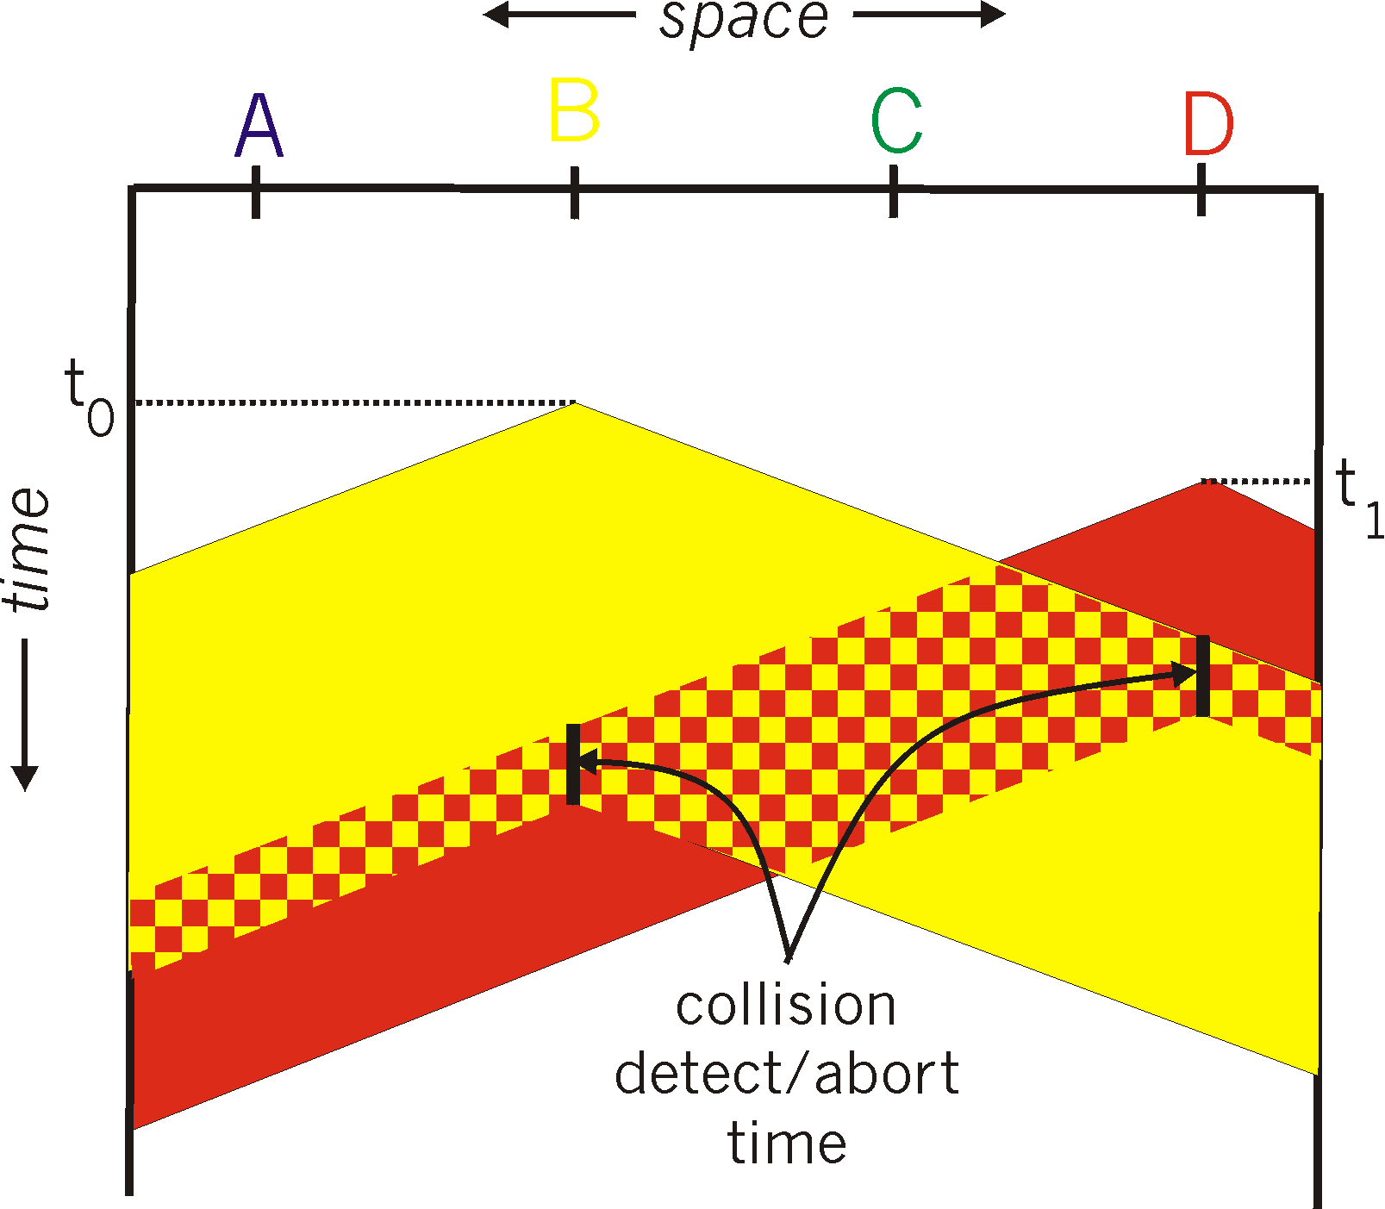
CSMA/CD Collision Detection
Both B and D can tell that collision occurred.
This lets them (1) know that they need to resend the frame,
and (2) recognize that there’s contention and adopt a strategy for dealing with it.
Note: for this to work, we need restrictions on minimum frame size and maximum distance

Slide 13
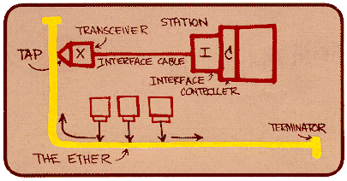
Ethernet: CSMA/CD Protocol
Carrier sense: wait for link to be idle
Collision detection: listen while transmitting
No collision: transmission is complete
Collision: abort transmission & send jam signal
Random access: exponential back-off
After collision, wait a random time before trying again
After m^{th} collision, choose K randomly from {0, …, 2^{m}-1}
… and wait for K*512 bit times before trying again
The wired LAN technology
Hugely successful: 3/10/100/1000/10000 Mbps

Slide 14
Minimum Packet Size
Why enforce a minimum packet size?
Give a host enough time to detect collisions
In Ethernet, minimum packet size = 64 bytes (two 6-byte addresses, 2-byte type, 4-byte CRC, and 46 bytes of data)
If host has less than 46 bytes to send, the adaptor pads (adds) bytes to make it 46 bytes
What is the relationship between minimum packet size and the length of the LAN?

Slide 15
Minimum Packet Size (more)
Host 1
Host 2
a) Time = t; Host 1
starts to send frame
propagation delay (d)
Host 1
Host 2
b) Time = t + d; Host 2
starts to send a frame,
just before it hears from
host 1’s frame
propagation delay (d)
c) Time = t + 2*d; Host 1
hears Host 2’s frame →
detects collision
Host 1
Host 2
propagation delay (d)
LAN length = (min_frame_size)*(light_speed)/(2*bandwidth) =
= (8*64b)*(2.5*10⁸mps)/(2*10⁷ bps) = 6400m approx
What about 100 mbps? 1 gbps? 10 gbps?

Slide 16
Limits on CSMA/CD Network Length
A
B
latency d
Latency depends on physical length of link
Time to propagate a packet from one end to the other
Suppose A sends a packet at time t
And B sees an idle line at a time just before t+d
… so B happily starts transmitting a packet
B detects a collision, and sends jamming signal
But A can’t see collision until t+2d

Slide 17
Limits on CSMA/CD Network Length
A
B
latency d
A needs to wait for time 2d to detect collision
So, A should keep transmitting during this period
… and keep an eye out for a possible collision
Imposes restrictions. E.g., for 10 Mbps Ethernet:
Maximum length of the wire: 2,500 meters
Minimum length of a frame: 512 bits (64 bytes)
512 bits = 51.2 μsec (at 10 Mbit/sec)
For light in vacuum, 51.2 μsec ≈ 15,000 meters vs. 5,000 meters “round trip” to wait for collision

Slide 18

Ethernet Frame Structure
Sending adapter encapsulates packet in frame
Preamble: synchronization
Seven bytes with pattern 10101010, followed by one byte with pattern 10101011
Used to synchronize receiver & sender
Type: indicates the higher layer protocol
Usually IP (but also Novell IPX, AppleTalk, …)
CRC: cyclic redundancy check
Receiver checks & simply drops frames with errors

Slide 19
Ethernet Frame Structure (Continued)
Addresses: 48-bit source and destination MAC addresses
Receiver’s adaptor passes frame to network-level protocol
If destination address matches the adaptor’s
Or the destination address is the broadcast address (ff:ff:ff:ff:ff:ff)
Or the destination address is a multicast group receiver belongs to
Or the adaptor is in promiscuous mode
Addresses are globally unique
Assigned by NIC vendors (top three octets specify vendor)
During any given week, > 500 vendor codes seen at LBNL
Data:
Maximum: 1,500 bytes
Minimum: 46 bytes (+14 bytes header + 4 byte trailer = 512 bits)

Slide 20
Ethernet, con’t
Connectionless
No handshaking between sending and receiving adapter
Unreliable
Receiving adapter doesn’t send ACKs or NACKs
Packets passed to network layer can have gaps
Gaps will be filled if application is using TCP
Otherwise, application will see the gaps
2,700 page IEEE 802.3 standardization
http://standards.ieee.org/getieee802/802.3.html
Note, “classical” Ethernet has no length field …
… instead, sender pauses 9.2 μsec when done
802.3 shoehorns in a length field

Slide 21
Benefits of Ethernet
Easy to administer and maintain
Inexpensive
Increasingly higher speed
Evolved from shared media to switches
And from electrical signaling to also optical
Changes everything except the frame format
A good general lesson for evolving the Internet:
The right interface (service model) can often accommodate unanticipated changes

Slide 22
Shuttling Data at Different Layers
Different devices switch different things
Physical layer: electrical signals (repeaters and hubs)
Link layer: frames (bridges and switches)
Network layer: packets (routers)
Application gateway
Transport gateway
Frame header
Packet header
TCP header
User
data
Router
Bridge, switch
Repeater, hub

Slide 23
Physical Layer: Repeaters
Distance limitation in local-area networks
Electrical signal becomes weaker as it travels
Imposes a limit on the length of a LAN
In addition to limit imposed by collision detection
Repeaters join LANs together
Analog electronic device
Continuously monitors electrical signals on each LAN
Transmits an amplified copy
Repeater

Slide 24
Physical Layer: Hubs
Joins multiple input lines electrically
Do not necessarily amplify the signal
Very similar to repeaters
Also operates at the physical layer
hub
hub
hub
hub

Slide 25
Limitations of Repeaters and Hubs
One large collision domain
Every bit is sent everywhere
So, aggregate throughput is limited
E.g., three departments each get 10 Mbps independently
… and then if connect via a hub must share 10 Mbps
Cannot support multiple LAN technologies
Repeaters/hubs do not buffer or interpret frames
So, can’t interconnect between different rates or formats
E.g., no mixing 10 Mbps Ethernet & 100 Mbps Ethernet
Limitations on maximum nodes and distances
Does not circumvent limitations of shared media
E.g., still cannot go beyond 2500 meters on Ethernet

Slide 26
Link Layer: Switches / Bridges
Connect two or more LANs at the link layer
Extracts destination address from the frame
Looks up the destination in a table
Forwards the frame to the appropriate LAN segment
Or point-to-point link, for higher-speed Ethernet
Each segment is its own collision domain
switch/bridge
collision domain
hub
collision domain
collision domain

Slide 27
Switches & Concurrent Comunication
Host A can talk to C, while B talks to D
B
A
C
switch
D
If host has (dedicated) point-to-point link to switch:
Full duplex: each connection can send in both directions
At the same time (otherwise, “half duplex”)
Completely avoids collisions
No need for carrier sense, collision detection, and so on

Slide 28
Advantages Over Hubs & Repeaters
Only forwards frames as needed
Filters frames to avoid unnecessary load on segments
Sends frames only to segments that need to see them
Extends the geographic span of the network
Separate collision domains allow longer distances
Improves privacy by limiting scope of frames
Hosts can “snoop” the traffic traversing their segment
… but not all the rest of the traffic
If needed, applies carrier sense & collision detection
Does not transmit when the link is busy
Applies exponential back-off after a collision
Joins segments using different technologies

Slide 29
Disadvantages Over Hubs & Repeaters
Higher cost
More complicated devices that cost more money
Delay in forwarding frames
Bridge/switch must receive and parse the frame
… and perform a look-up to decide where to forward
Introduces store-and-forward delay
Can ameliorate using cut-through switching
Start forwarding after only header received
Need to learn where to forward frames
Bridge/switch needs to construct a forwarding table
Ideally, without intervention from network administrators
Solution: self-learning

