Slide 1
CS 353 Internetworking: Routing Fundamentals
Spring 2016
Alefiya Hussain

Slide 2
Administrivia
Assignment #2 is posted, due March 4th
Facebook talk tomorrow, not to be missed,
Bring your resumes
Bring your friends
Ask lots of questions

Slide 3
Taking Stock
What is a network made of?
How is it shared?
How do we evaluate a network?
How is communication architected?

Slide 4
Taking Stock
Basic concepts
components: end-systems, links, switches, routers
performance: delay, throughput
Basic design choices
packet vs. circuit switching
Best-effort vs. guaranteed service
Layering
“Dumb” network, “smart” ends

Slide 5
Coming up next
“How”, in detail, by layer
Network layer: next few weeks
Transport layer start
Midterm
Transport layer
Application layer (HTTP)
Newer topics (e.g., datacenters, management)

Slide 6
The Network Layer

Slide 7
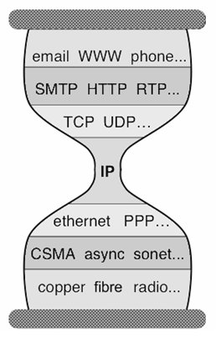
Five Layers
Applications
…built on…
Reliable (or unreliable) transport
…built on…
Best-effort global packet delivery
…built on…
Best-effort local packet delivery
…built on…
Physical transfer of bits

Slide 8
Which of these tasks are hard?
Application: not a fundamental challenge
Not general, and not necessarily hard
Reliable transport: a fundamental challenge
General, and difficult
Global and local packet delivery:
Local and global packet delivery both require routing
This is a general and difficult challenge
Physical transfer: not a fundamental challenge
Not general, and not conceptually difficult

Slide 9
Two Fundamental Challenges
Reliable delivery: building a reliable transport service on top of best-effort delivery
Routing: guiding packets from source to destination
Other pieces required to build operational networks
Naming, addressing, congestion control,….
We will get to those later in the course
But these two are inherent and hard
Routing: next few lectures
Reliable transport: sliding window/stop and wait

Slide 10
A Few Preliminaries
Before we can study routing, we need to clarify:
Network Topologies
Switches/Routers
Forwarding
Packets

Slide 11
Example of Network Graph
Router with 6 attached links
Router with 4 attached links

Slide 12
A Variety of Networks
ISPs: carriers
Backbone
Edge (connecting to customers)
Border (to other ISPs)
Enterprises: companies, universities
Core
Edge (connecting to hosts)
Border (to outside)
Datacenters: massive collections of machines
Aggregation and Core
Top-of-Rack
Border (to outside)

Slide 13
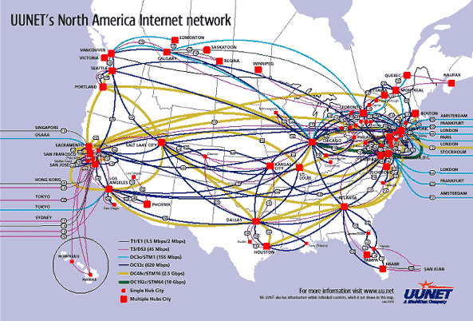
UUNET’s North American Network
Notes:
Very irregular

Slide 14
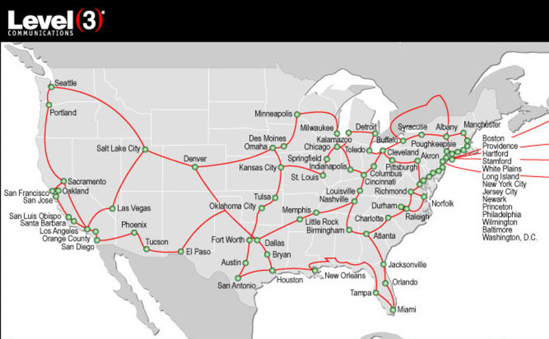
Level3’s American Network (check out their interactive map)

Slide 15
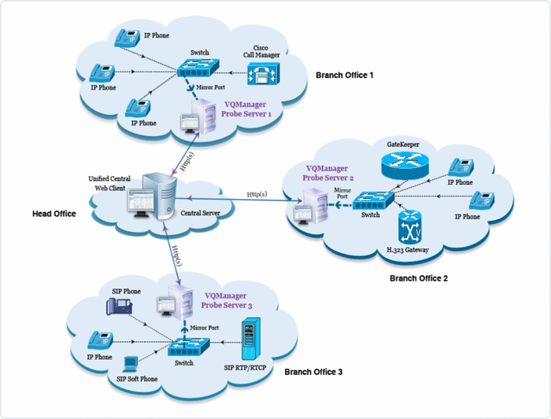
Enterprise Network
Notes:
Not very detailed, couldn’t get a better one….

Slide 16
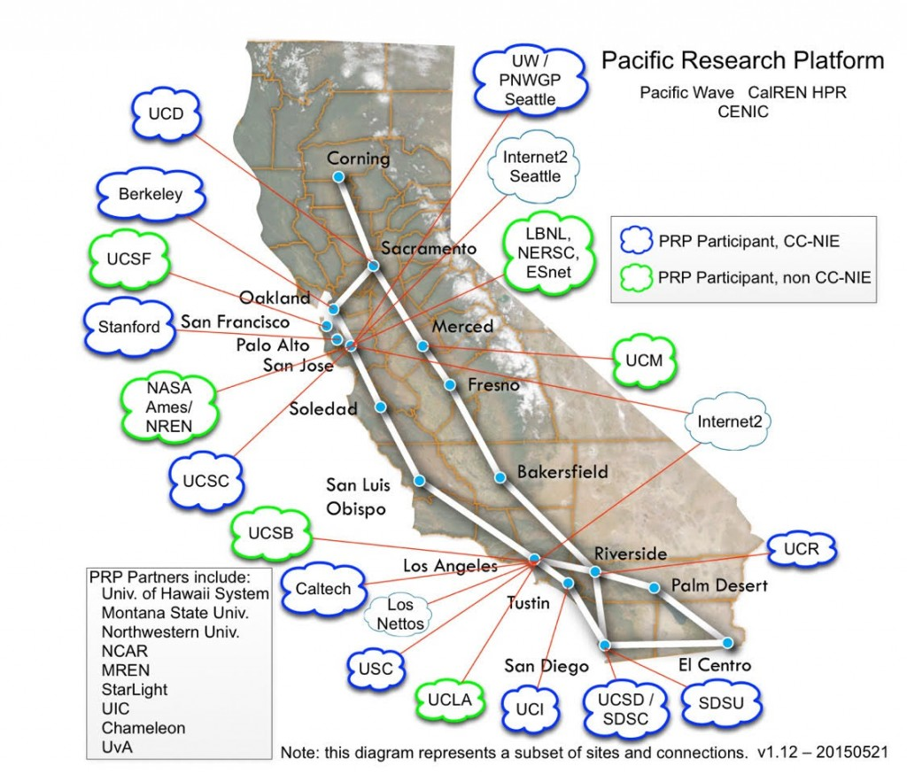
Campus Networks

Slide 17
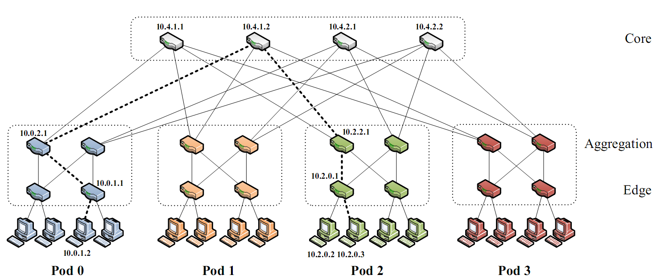
Partial Datacenter Network
Notes:
Only a part of the network, but the takeaway is that the network is very regular, involving levels of hierarchy.

Slide 18
Switches/Routers
Multiple attached links, often called “ports”
Ports are typically duplex (incoming and outgoing)
But in this picture will show them separately
(Don’t confuse this notion of “port” with transport “ports”)
incoming links
Switch
outgoing links

Slide 19
Forwarding Decisions
When packet arrives, must choose outgoing port
Decision is based on routing state (table) in switch
incoming links
Switch
outgoing links
Consider
packet header
and routing
table

Slide 20
Forwarding Decisions
Switches and routers make the following mapping:
PacketState + RoutingState ➔ OutgoingPort
Most do so in single transmission time
Forwarding decisions must be simple
Assume forwarding decisions are deterministic
Packets with same state always routed to same port

Slide 21
Packets (at a conceptual level)
Assume packet headers contain:
Destination ID
Source ID
…and perhaps other information
Destination
Identifier
Source
Identifier
Payload

Slide 22
How to forward packets?
Could also depend on :
Source: requires n² state
Destination: requires n state
Input port: not clear what this buys you
Other header information: ignore for now
Internet uses destination-based routing
But first consider the alternative

Slide 23
Source/Destination-Based Routing
Paths from two different sources (to same destination) can be very different

Slide 24
Destination-Based Routing
Paths from two different sources (to same destination) must coincide once they overlap
Notes:
Why coincide?

Slide 25
Destination-Based Routing
Once paths to destination meet, they never split
Set of paths to destination create a “delivery tree”
Must cover every node exactly once
Only one outgoing arrow at each node
All nodes have path to destination
Produces Spanning Tree rooted at destination
Notes:
You all know what a spanning tree is?

Slide 26
A “Delivery Tree” for a Destination

Slide 27
Assume Destination-Based Routing
For rest of lecture (and course)…..

Slide 28
to USC
to MIT
switch#4
switch#2
Forwarding Table
111010010
MIT
Destination | Next Hop
USC | switch#4
UW | switch#5
MIT | switch#2
FSU | switch#3
switch#5
to UW
To FSU
switch#3

Slide 29
Forwarding
The act of forwarding in a router:
Read address from packet’s header
Search routing state for correct output port
Send (within router) to correct output port
Forwarding is a local process within a router

Slide 30
to USC
to MIT
switch#4
switch#2
Forwarding Table
111010010
MIT
Destination | Next Hop
USC | switch#4
UW | switch#5
MIT | switch#2
FSU | switch#3
switch#5
to UW
To FSU
switch#3

Slide 31
Routing
Routing is what computes the routing state
Also called forwarding state
This is inherently a global process
How can you know where to send packets without knowing what the overall network looks like?

Slide 32
Destination | Next Hop
Usc | switch#1
UW | switch#1
MIT | switch#6
FSU | switch#1
to USC
to MIT
switch#4
switch#2
Forwarding Table
111010010
MIT
Destination | Next Hop
USC | switch#4
UW | switch#5
MIT | switch#2
FSU | switch#3
Switch#1
switch#5
to UW
To FSU
switch#3

Slide 33
Forwarding vs Routing
Forwarding: “data plane”
Directing a data packet to an outgoing link
Individual router using routing state
Routing: “control plane”
Computing paths the packets will follow
Routers talking amongst themselves
Jointly creating the routing state
Two very different timescales….
Nanoseconds vs (hopefully) 10s of milliseconds

Slide 34
Local vs Global View of State
Local routing state is table in a single router
By itself, the state in a single router can’t be evaluated
It must be evaluated in terms of the global context
Global state is collection of tables in all routers
Global state determines which paths packets take
(Will discuss later where this routing state comes from)

Slide 35
“Valid” Routing State
Global routing state is “valid” if it produces forwarding decisions that always deliver packets to their destinations
Valid or correct…
Goal of routing protocols: compute valid state
But how can you tell if routing state if valid?
Need a succinct correctness condition for routing
Suggestions?
Notes:
What could go wrong?

Slide 36
Necessary and Sufficient Condition
Global routing state is valid if and only if:
There are no dead ends (other than destination)
There are no loops
A dead end is when there is no outgoing port
A packet arrives, but the forwarding decision does not yield any outgoing port
A loop is when a packet cycles around the same set of nodes forever

Slide 37
Packet Hitting Dead End
Packet reaches deadend and stops (and dropped)

Slide 38
Packet Entering Loop
Packet falls into loop and never reaches destination

Slide 39
Two Questions
How can we verify given routing state is valid?
How can we produce valid routing state?

Slide 40
Checking Validity of Routing State
Focus only on a single destination
Ignore all other routing state
Mark outgoing port with arrow
There can only be one at each node
Eliminate all links with no arrows
Look at what’s left….
State is valid if and only if remaining graph is spanning tree rooted at destination

Slide 41
Example 1

Slide 42
Pick Destination

Slide 43
Put Arrows on Outgoing Ports (output ports towards green dot)

Slide 44
Remove Unused Links
Leaves Spanning Tree: Valid

Slide 45
Second Example

Slide 46
Second Example
Is this valid?

Slide 47
Lesson….
Very easy to check validity of routing state for a particular destination
Deadends are obvious
Node without outgoing arrow
Loops are obvious
Disconnected from destination (and rest of graph)

Slide 48
Two Questions
How can we verify given routing state is valid?
How can we produce valid routing state?

Slide 49
The “Secret” of Routing
Avoiding deadends is easy
Avoiding loops is hard
And here we mean persistent loops
The key difference between routing protocols is how they avoid loops!
Don’t focus on details of mechanisms
Just ask “how are loops avoided?”
Many different variations of route computations
Notes:
Most modern routing research is about how to make the loop-freeness a more fundamental part of the algorithm. In what I’m going to present today, it is only loop-free AFTER convergence. That’s not good enough

Slide 50
Goal (for routing)
v1: Find a path to a given destination
v2: Find a least cost path to a given destination

Slide 51
next hop
dest.
z
?
u
?
next hop
next hop
dest.
dest.
z
?
u
?
v
?
v
v
?
1
2
u
4
z
could represent:
-- propagation delay
-- load
-- cost
link costs
Notes:
(First example, link costs.)
Let’s suppose that there are only 3 routers in the entire Internet,
and they are all directly connected to each other in this triangle.
For each router, we will decide how it should reach every other router.
For example, router u can reach router z directly,
or it can reach router z indirectly, through router v.
Which of the two routes (paths) is better?
In other words, for each source router,
we will decide which is the best next hop to every destination router.
How will we decide? We will rely on these 3 clicks things called click “link costs”.
Each link is associated with a link cost.
The lower the link cost, the better the quality of the link.
So, link costs could represent, for example,
click the propagation delay of the link,
or its click current load.

Slide 52
next hop
dest.
z
z
u
u
next hop
next hop
dest.
dest.
z
v
u
v
v
v
v
v
v
1
2
u
4
z
least-cost path from u to z:
u v z
least cost path from u to v:
u v
Notes:
(Least-cost routing.)
For each pair of routers, we will find the path that has the least total cost.
For example, from source router click u to destination router z,
- there is the click direct path, which has cost 4;
- and the click indirect one, through v, which has cost 1 + 2 = 3.
So, the click indirect one is the best path.
Now, let’s fill in the forwarding table of router u:
- the best next hop to destination router z is click router v.
click
Similarly, from click source router u to destination router v,
- there is a click direct path, of cost 1;
- and an click indirect one, through z, of cost 4 + 2 = 6.
So, the best path is the direct one.
Now, let’s fill in the forwarding table of router u:
- the best next hop to destination router v is click router v itself.
click
In a similar manner, we can fill in the forwarding tables of routers 2 clicks z and 2 clicks v.

Slide 53
Least-cost path routing
Given: router graph & link costs
Goal: find least-cost path
from each source router
to each destination router
Next time: how we compute these

