Slide 1
CS 353 Getting Connected Reliable Transport, Ethernet, Wireless
Spring 2016
Alefiya Hussain

Slide 2
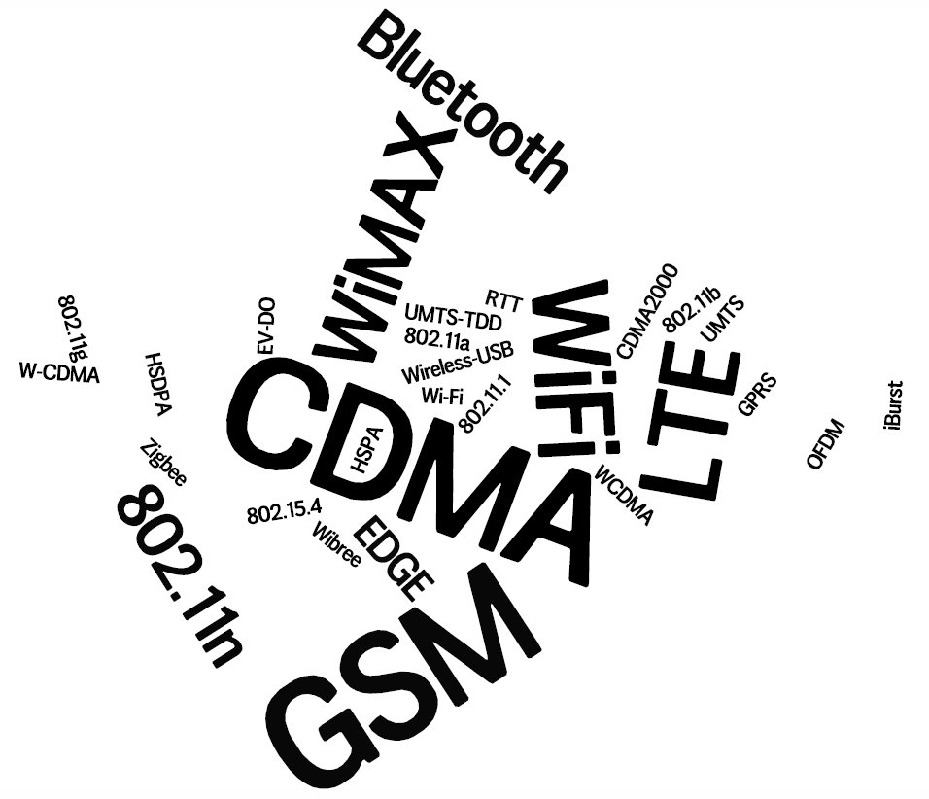
Notes:
Rapid evolution in the wireless eco-system – hard to keep up.
Both technologies and business-models

Slide 3
Metrics for evaluation / comparison of wireless technologies
Bitrate or Bandwidth
Range - PAN, LAN, MAN, WAN
Two-way / One-way
Multi-Access / Point-to-Point
Digital / Analog
Applications and industries
Frequency – Affects most physical properties: Distance (free-space loss) Penetration, Reflection, Absorption Energy proportionality Policy: Licensed / Deregulated
Line of Sight (Fresnel zone)
Size of antenna
Determined by wavelength
Notes:
Bitrate or Bandwidth
Range - PAN, LAN, MAN, WAN personal area networks
Two-way / One-way
Multi-Access / Point-to-Point
Digital / Analog
Applications and industries
Frequency – Affects most physical properties: Distance (free-space loss) Penetration, Reflection, Absorption Energy proportionality Policy: Licensed / Deregulated
Line of Sight (Fresnel zone)
Size of antenna
(determined by wavelength – )

Slide 4

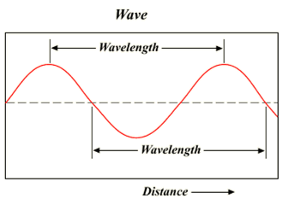
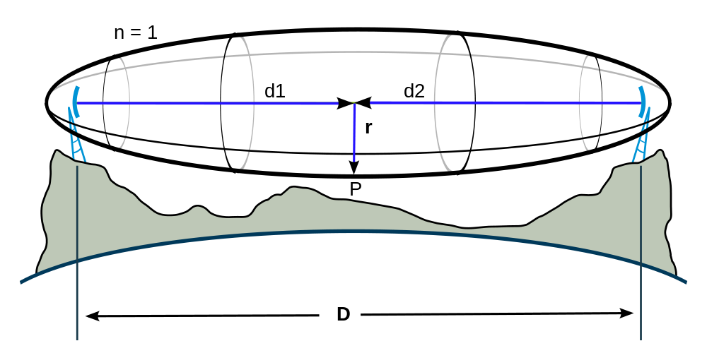
Physical Properties of a Signal
Frequency
Line of Sight: Fresnel Zone
Notes:
Bitrate or Bandwidth
Range - PAN, LAN, MAN, WAN personal area networks
Two-way / One-way
Multi-Access / Point-to-Point
Digital / Analog
Applications and industries
Frequency – Affects most physical properties: Distance (free-space loss) Penetration, Reflection, Absorption Energy proportionality Policy: Licensed / Deregulated
Line of Sight (Fresnel zone)
Size of antenna
(determined by wavelength – )

Slide 5
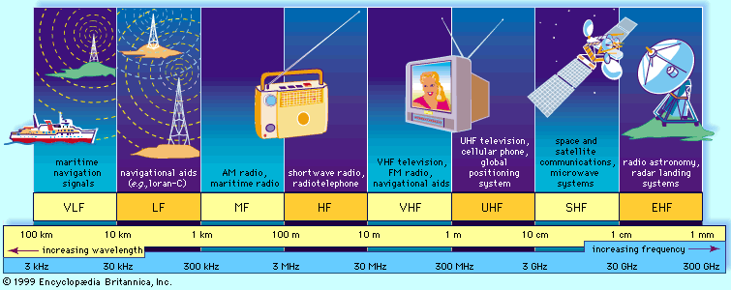
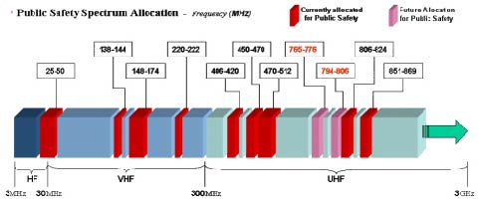
The Wireless Spectrum
Notes:
FCC allocates spectrum to users – who are these?
Govt. itself (various agencies), military.
Public-safety.
Broadcasters
Telecommunications providers (aka operators) – license holders.
Different bands behave differently …
Most wave propagation properties are frequency/wave-length dependent:
The wireless spectrum
Q: Is spectrum a scarce resource?
•Reclaim spectrum from old analog broadcasters.
•White-spaces / Cognitive radios.
•Tiered use policy.
•Enable roaming (technically and commercially).

Slide 6
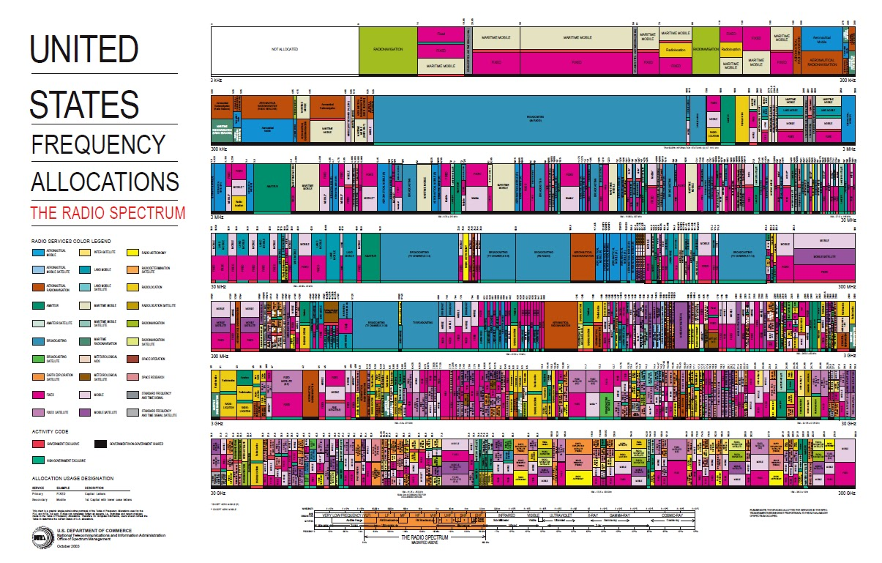
Modern art?

Slide 7
Wireless Communication Standards
Cellular (800/900/1700/1800/1900Mhz):
2G: GSM / CDMA / GPRS /EDGE
3G: CDMA2000/UMTS/HSDPA/EVDO
4G: LTE, WiMax
IEEE 802.11 (aka WiFi):
b: 2.4Ghz band, 11Mbps (~4.5 Mbps operating rate)
g: 2.4Ghz, 54-108Mbps (~19 Mbps operating rate)
a: 5.0Ghz band, 54-108Mbps (~25 Mbps operating rate)
n: 2.4/5Ghz, 150-600Mbps (4x4 mimo).
IEEE 802.15 – lower power wireless:
802.15.1: 2.4Ghz, 2.1 Mbps (Bluetooth)
802.15.4: 2.4Ghz, 250 Kbps (Sensor Networks)
7

Slide 8
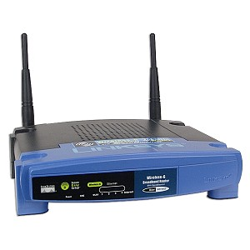
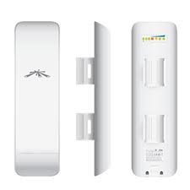
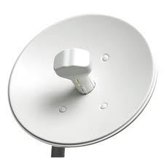
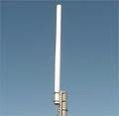
Antennas / Aerials
An electrical device which converts electric currents into radio waves, and vice versa.
2-3dB 8-12dB 15-18dB 28-34dB
Antennas are passive devices more gain means focused and more directional.
Directionality means more energy gets to where it needs to go and less interference everywhere.
What are omni-directional antennas?
Notes:
What antennas are inside a cell-phone?
GPS
Wifi
Primary cellular antena
Diversity cellular antenna

Slide 9
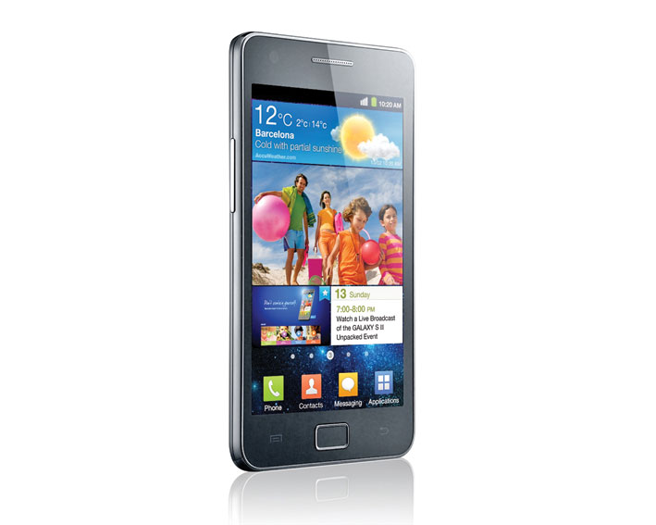
How many radios/antennas ?
WiFi 802.11n (maybe MiMo?)
2G - GSM
3G – HSDPA+
4G – LTE
Bluetooth (4.0)
GPS Receiver
FM-Radio receiver (antenna is the headphones cable)

Slide 10
What Makes Wireless Different?
Broadcast and multi-access medium…
Anybody in proximity can hear and interfere
Cannot receive while transmitting
Own transmission (or nearby xmission) is deafening the receiver
Signals sent by sender don’t always end up at receiver intact
Complicated physics involved, which we won’t discuss
But what can go wrong?

Slide 11
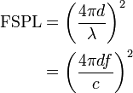
Path Loss / Path Attenuation
Free Space Path Loss:
d = distance
λ = wave length
f = frequency
c = speed of light
Reflection, Diffraction, Absorption
Terrain contours (Urban, Rural, Vegetation).
Humidity
Notes:
reduction in power density (attenuation) of an electromagnetic wave as it propagates through space.
Path loss may be due to many effects, such as free-space loss,refraction, diffraction, reflection, aperture-medium coupling loss, and absorption. Path loss is also influenced by terrain contours, environment (urban or rural, vegetation and foliage), propagation medium (dry or moist air), the distance between the transmitter and the receiver, and the height and location of antennas.

Slide 12
Multipath Effects
Ceiling
S
R
Floor
Signals bounce off surface and interfere with one another
Self-interference
12

Slide 13
Ideal Radios (courtesy of Gilman Tolle and Jonathan Hui, ArchRock)

Slide 14
Real Radios (courtesy of Gilman Tolle and Jonathan Hui, ArchRock)

Slide 15
The Amoeboed “cell” (courtesy of David Culler, UCB)
Signal
Noise
Distance
15
Notes:
15

Slide 16
Wireless Bit Errors
The lower the SNR (Signal/Noise) the higher the Bit Error Rate (BER)
We could make the signal stronger…
Why is this not always a good idea?
Increased signal strength requires more power
Increases the interference range of the sender, so you interfere with more nodes around you
And then they increase their power…….
How would flow control behave in face of losses?
16

Slide 17
802.11
aka - WiFi …
What makes it special?
Deregulation > Innovation > Adoption > Lower cost = Ubiquitous technology
17
Notes:
17

Slide 18
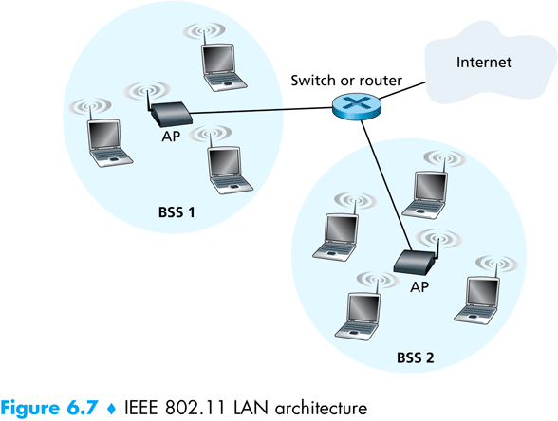
802.11 Architecture
Designed for limited area
AP’s (Access Points) set to specific channel
Broadcast beacon messages with SSID (Service Set Identifier) and MAC Address periodically
Hosts scan all the channels to discover the AP’s
Host associates with AP
802.11 frames exchanges
802.3 (Ethernet) frames exchanged
18

Slide 19
Wireless Multiple Access Technique?
Carrier Sense?
Sender can listen before sending
What does that tell the sender?
Collision Detection?
Where do collisions occur?
How can you detect them?

Slide 20
Hidden Terminals
A
B
C
transmit range
20
A and C can both send to B but can’t hear each other
A is a hidden terminal for C and vice versa
Carrier Sense will be ineffective
Notes:
20

Slide 21
Exposed Terminals
Exposed node: B sends a packet to A; C hears this and decides not to send a packet to D (despite the fact that this will not cause interference)!
Carrier sense would prevent a successful transmission.
A
B
C
D
21
Notes:
21

Slide 22
Key Points
No concept of a global collision
Different receivers hear different signals
Different senders reach different receivers
Collisions are at receiver, not sender
Only care if receiver can hear the sender clearly
It does not matter if sender can hear someone else
As long as that signal does not interfere with receiver
Goal of protocol:
Detect if receiver can hear sender
Tell senders who might interfere with receiver to shut up

Slide 23
Basic Collision Avoidance
Since can’t detect collisions, we try to avoid them
Carrier sense:
When medium busy, choose random interval
Wait that many idle timeslots to pass before sending
When a collision is inferred, retransmit with binary exponential backoff (like Ethernet)
Use ACK from receiver to infer “no collision”
Use exponential backoff to adapt contention window
Notes:
Why do we wait?
Why not just send right away as medium becomes clear?

Slide 24
CSMA/CA -MA with Collision Avoidance
sender
receiver
other node in
sender’s range
RTS
CTS
data
ACK
Before every data transmission
Sender sends a Request to Send (RTS) frame containing the length of the transmission
Receiver respond with a Clear to Send (CTS) frame
Sender sends data
Receiver sends an ACK; now another sender can send data
When sender doesn’t get a CTS back, it assumes collision
24
Notes:
24

Slide 25
CSMA/CA, con’t
receiver
other node in
sender’s range
sender
RTS
CTS
data
data
If other nodes hear RTS, but not CTS: send
Presumably, destination for first sender is out of node’s range …
25
Notes:
25

Slide 26
CSMA/CA, con’t
sender
receiver
other node in
sender’s range
RTS
CTS
data
ACK
If other nodes hear RTS, but not CTS: send
Presumably, destination for first sender is out of node’s range …
… Can cause problems when a CTS is lost
When you hear a CTS, you keep quiet until scheduled transmission is over (hear ACK)
26
Notes:
26

Slide 27
RTS / CTS Protocols (CSMA/CA)
B sends to C
RTS
A
B
C
D
Overcome hidden terminal problems with contention-free protocol
B sends to C Request To Send (RTS)
A hears RTS and defers (to allow C to answer)
C replies to B with Clear To Send (CTS)
D hears CTS and defers to allow the data
B sends to C
CTS
27
Notes:
27
Does not solve the exposed terminal problem.
High overhead and especially increase latency.
assumes symmetric signal qualities - if node A hears node B - than also node B hears node A. - not always the case. (Especially local interference at receiver).

Slide 28
Preventing Collisions Altogether
Frequency Spectrum partitioned into several channels
Nodes within interference range can use separate channels
Now A and C can send without any interference!
Most cards have only 1 transceiver
Not Full Duplex: Cannot send and receive at the same time
Aggregate Network throughput doubles
B
A
C
D
28

Slide 29

Multi-Hop Wireless Ad Hoc Networks (Courtesy of Tianbo Kuang and Carey Williamson University of Calgary)
S
A
C
B
D
R
Notes:
Maybe can be self-healing !
Maybe can be multipath?

Slide 30
Multi-Hop Wireless Ad Hoc Networks
S
A
C
B
D
R
30

Slide 31
Multi-Hop Wireless Ad Hoc Networks
(Assume ideal world…)
1
2
3
4
S
5
6
7
8
9
10
11
12
A
C
B
D
R
31

Slide 32
Multi-Hop Wireless Ad Hoc Networks
2
3
4
S
5
6
1
7
8
9
10
11
12
A
C
B
D
R
32

Slide 33
Multi-Hop Wireless Ad Hoc Networks
3
4
S
5
2
6
7
8
9
10
11
1
12
A
C
B
D
R
33

Slide 34
Multi-Hop Wireless Ad Hoc Networks
4
S
5
6
3
7
8
9
10
1
11
2
12
A
C
B
D
R
34

Slide 35
Multi-Hop Wireless Ad Hoc Networks
5
S
6
4
7
8
9
10
2
11
3
1
12
A
C
B
D
R
35

Slide 36
Multi-Hop Wireless Ad Hoc Networks
S
6
5
7
8
9
10
11
3
12
A
4
C
2
B
D
1
R
36

Slide 37
Multi-Hop Wireless Ad Hoc Networks
S
6
7
8
9
10
11
4
3
12
A
5
C
B
D
2
1
R
37

Slide 38
Multi-Hop Wireless Ad Hoc Networks
S
7
8
9
10
11
5
12
A
6
C
4
B
D
3
1
2
R
38

Slide 39
Multi-Hop Wireless Ad Hoc Networks
S
8
9
10
11
6
12
A
7
C
5
B
D
4
1
2
3
R
39

Slide 40
Multi-Hop Wireless Ad Hoc Networks
S
9
10
11
7
12
A
8
C
6
B
D
5
1
2
3
4
R
40

Slide 41
Multi-Hop Wireless Ad Hoc Networks
S
10
11
8
12
A
9
C
7
B
D
6
1
2
3
4
R
5
41

Slide 42
Multi-Hop Wireless Ad Hoc Networks
S
11
12
9
8
A
10
C
B
D
7
1
2
3
4
R
5
6
42

Slide 43
Multi-Hop Wireless Ad Hoc Networks
S
12
10
A
11
C
9
B
D
8
1
2
3
4
R
5
6
7
43

Slide 44
Multi-Hop Wireless Ad Hoc Networks
S
11
10
A
12
C
B
D
9
1
2
3
4
R
5
6
7
8
44

Slide 45
Multi-Hop Wireless Ad Hoc Networks
S
12
11
A
C
B
D
10
1
2
3
4
R
5
6
7
8
9
45

Slide 46
Multi-Hop Wireless Ad Hoc Networks
S
A
C
12
B
D
11
1
2
3
4
R
5
6
7
8
9
10
46

Slide 47
Multi-Hop Wireless Ad Hoc Networks
S
A
C
B
D
12
1
2
3
4
R
5
6
7
8
9
10
11
47

Slide 48
Multi-Hop Wireless Ad Hoc Networks
S
A
C
B
D
1
2
3
4
R
5
6
7
8
9
10
11
48
12

Slide 49
Wireless Multihop Networks
Vehicular Networks
Delay Tolerant (batch) sending over several hops carry data to a base station
Common in Sensor Network for periodically transmitting data
Infrastructure Monitoring
E.g., structural health monitoring of the Golden Gate Bridge

Slide 50
The end of ISPs and telephone companies?
Multihop networking for shared Internet access
Routing traffic over several hops to base station connected to Internet
Deregulated technology (license free)
WiFi is ubiquitous
Self healing
Multipath routing

Slide 51
Multi-Hop Wireless Ad Hoc Networks (Courtesy of Tianbo Kuang and Carey Williamson University of Calgary)
S
What Do YOU Think Really Happens?
R
Notes:
Maybe can be self-healing !
Maybe can be multipath?

Slide 52
Multi-Hop Wireless Ad Hoc Networks
(Reality check…)
1
Problem 1: node A can’t use both
of these links at the same time
- shared wireless channel
- transmit or receive, but not both
2
3
4
S
5
6
7
8
9
10
11
12
A
C
B
D
Needs to Store and Forward.
R
52

Slide 53
Multi-Hop Wireless Ad Hoc Networks
Problem 2: S and B can’t use both
of these links at same time
- range overlap at A
1
2
3
4
S
5
6
7
8
9
10
11
12
A
C
B
D
R
53

Slide 54
Multi-Hop Wireless Ad Hoc Networks
Problem 3: LOTS of contention for the channel
- in steady state, all want to send
- need RTS/CTS to resolve contention
1
2
3
4
S
5
6
7
8
9
10
11
12
A
C
B
D
RTS: Request-To-Send
CTS: Clear-To-Send
R
54

Slide 55
Multi-Hop Wireless Ad Hoc Networks
1
RTS
CTS
2
3
4
S
5
6
7
8
9
10
11
12
A
C
B
D
R
55

Slide 56
Multi-Hop Wireless Ad Hoc Networks
2
3
4
S
5
6
1
7
8
9
10
11
12
A
C
B
D
R
56

Slide 57
Multi-Hop Wireless Ad Hoc Networks
2
RTS
CTS
3
4
S
5
6
7
8
9
10
11
12
A
C
1
B
D
R
57

Slide 58
Multi-Hop Wireless Ad Hoc Networks
2
3
4
S
5
6
7
8
9
10
11
12
A
1
C
B
D
R
58

Slide 59
Multi-Hop Wireless Ad Hoc Networks
2
3
4
S
5
6
7
8
9
10
11
1
12
A
C
B
D
R
59

Slide 60
Multi-Hop Wireless Ad Hoc Networks
3
4
S
5
6
2
7
8
9
10
11
12
A
C
1
B
D
R
60

Slide 61
Multi-Hop Wireless Ad Hoc Networks
3
4
S
5
6
7
8
9
10
11
12
A
2
C
B
D
1
R
61

Slide 62
Multi-Hop Wireless Ad Hoc Networks
3
4
S
5
6
7
8
9
10
11
2
12
A
C
B
D
1
R
62

Slide 63
Multi-Hop Wireless Ad Hoc Networks
4
S
5
6
3
7
8
9
10
11
12
A
C
2
B
D
1
R
63

Slide 64
Multi-Hop Wireless Ad Hoc Networks
4
S
5
6
7
8
9
10
11
12
A
3
C
B
D
2
1
R
64

Slide 65
Multi-Hop Wireless Ad Hoc Networks
4
S
5
6
7
8
9
10
11
3
12
A
C
B
D
1
2
R
65

Slide 66
Multi-Hop Wireless Ad Hoc Networks
5
S
6
4
7
8
9
10
11
12
A
C
3
B
D
1
2
R
66

Slide 67
Multi-Hop Wireless Ad Hoc Networks
5
S
6
7
8
9
10
11
12
A
4
C
B
D
3
1
2
R
67

Slide 68
Multi-Hop Wireless Ad Hoc Networks
5
S
6
7
8
9
10
11
4
12
A
C
B
D
1
2
3
R
68

Slide 69
Multi-Hop Wireless Ad Hoc Networks
Problem 4: TCP uses ACKS to
indicate reliable data delivery
- bidirectional traffic (DATA, ACKS)
- even more contention!!!
1
2
3
4
S
5
6
7
8
9
10
11
12
A
C
B
D
R
69

Slide 70
Multi-Hop Wireless Ad Hoc Networks
2
3
4
S
5
6
1
7
8
9
10
11
12
A
C
B
D
R
70

Slide 71
Multi-Hop Wireless Ad Hoc Networks
2
3
4
S
5
6
7
8
9
10
11
12
A
1
C
B
D
R
71

Slide 72
Multi-Hop Wireless Ad Hoc Networks
2
3
4
S
5
6
7
8
9
10
11
1
12
A
C
B
D
R
72

Slide 73
Multi-Hop Wireless Ad Hoc Networks
3
4
S
5
6
2
7
8
9
10
11
12
A
C
1
B
D
R
73

Slide 74
Multi-Hop Wireless Ad Hoc Networks
3
4
S
5
6
7
8
9
10
11
12
A
2
C
B
D
1
R
74

Slide 75
Multi-Hop Wireless Ad Hoc Networks
3
4
S
5
6
7
2
8
9
10
11
2
1
12
A
C
B
2
D
1
1
1
R
75

Slide 76
Multi-Hop Wireless Ad Hoc Networks
4
S
5
6
3
7
8
9
10
11
1
12
A
C
2
B
D
1
R
76

Slide 77
Multi-Hop Wireless Ad Hoc Networks
4
S
5
6
7
8
9
10
11
1
12
A
C
3
B
D
2
1
R
77

Slide 78
Multi-Hop Wireless Ad Hoc Networks
4
S
5
6
7
8
9
10
11
12
A
C
1
3
B
D
2
1
R
78

Slide 79
Multi-Hop Wireless Ad Hoc Networks
4
S
5
6
7
8
1
9
10
11
12
A
C
3
B
D
2
1
R
79

Slide 80
Multi-Hop Wireless Ad Hoc Networks
4
S
5
6
7
8
1
9
10
11
12
A
3
C
B
D
2
1
R
80

Slide 81
Multi-Hop Wireless Ad Hoc Networks
4
S
5
6
7
8
1
9
10
11
12
A
C
B
3
D
2
1
2
R
81

Slide 82
Lesson
Multihop wireless is hard to make efficient
Store and forward (over a single channel)
Halves the bandwidth for every hop.
Doubles the latency for every hop
Increases Interference (internal and external).
Horrible idea for Internet access.
Even worse for interactive applications (such as video-conferencing).

Slide 83
Summary
Wireless is a tricky
Distributed multiple access problem
Hidden terminals
Exposed terminals
Current protocols sufficient, given overprovisioning
Multihop and adhoc routing
Several practical challenges

