Slide 1
TCP: Concept of Fair Sharing
CS 353
Spring 2016
Alefiya Hussain

Slide 2
Announcements:
Assignment 3 Due: 4/22
Homework 2: Given Today Due 4/29 at 10am
Discussed in the discussion at 12noon.
Avoid a 50% score reduction by:
1. Include a Makefile
2. The executable has to be named "watchdog" or "desman" and should accept any order of command line parameters
3. Executable has to be generated in the same location as the makefile
4. Flushing when writing to logfiles or before quitting while reading an interface.
5. Code has to work on on Ubuntu or Mac (please ensure the latest version of xcode for Mac and gcc for Ubuntu)
6. Assignment description: page 2 say "UID can be" → "UID must be"
7. Do not include the angle bracket "<" and ">" in logfile.

Slide 3
The Transport Layer
(brief review from last lecture)

Slide 4
What Is Needed to Address These?
Demultiplexing: identifier for application process
Going from host-to-host (IP) to process-to-process
Translating between bytestreams and packets
Do segmentation and reassembly
Reliability: ACKs and all that stuff
Corruption: checksum
Not overloading receiver: “Flow Control”
Limit data in recvr’s buffer
Not overloading network: “Congestion Control”
Limit data based on network capacity

Slide 5
Recall: Three Issues
Discovering the available (bottleneck) bandwidth
Slow Start
Adjusting to variations in bandwidth
AIMD
Sharing bandwidth between flows

Slide 6
Bandwidth Discovery with Slow Start
Goal: estimate available bandwidth
start slow (for safety)
but ramp up quickly (for efficiency)
For each RTT: double CWND
Simpler implementation: for each ACK, CWND += 1

Slide 7
AIMD
Additive increase
Window grows by one MSS for every RTT with no loss
For each successful RTT, CWND = CWND + 1
Simple implementation:
for each ACK, CWND = CWND+ 1/CWND
Multiplicative decrease
On loss of packet, divide congestion window in half
On loss, CWND = CWND/2

Slide 8
Slow-Start vs. AIMD
What are two ways to stop Slow start?
Loss: DupACK
Introduce a “slow start threshold” (ssthresh)
Initialized to a large value
On timeout, ssthresh = CWND/2
When CWND = ssthresh, sender switches from slow-start to AIMD-style increase

Slide 9
TCP Throughput Equation

Slide 10
A Simple Model for TCP Throughput
cwnd
Loss
½ W_{max} RTTs between drops
A
Avg. ¾ W_{max} packets per RTTs
1
time
RTT

Slide 11
A Simple Model for TCP Throughput
cwnd
Loss
½ W_{max} RTTs between drops
A
Avg. ¾ W_{max} packets per RTTs
time

Slide 12
Last Lecture
TCP Congestion control: the gory details
Today
Wrap-up CC details (fast retransmit)
Critically examining TCP
Advanced techniques

Slide 13
A Critical Analysis of TCP

Slide 14
The Many Failings of TCP CC
Cumulative ACKs are silly
Fills up queues (large delays)
Depends on losses (noncongestive losses)
Does not scale to high-speed
Produces irregular saw-tooth behavior
Depends on RTT (unfair)
Takes a long time to reach steady state
Easy to cheat
Relies on homogeneity for performance/fairness

Slide 15
(1) Cumulative ACK Stupidity
When we have cumulative ACKs, we must:
Guess which data has arrived
Play games with CWND to send additional packets
TCP SACK:
Selective Acknowledgements
Think: complete listing of all received packets
Would remove need for “fast recovery”
Could design very simple CC algorithm
Just slow-start, congestion avoidance, fast-retransmit
Much more robust to drops (almost never time out)

Slide 16
(2) TCP fills up queues
TCP only slows down when queues fill up
Means that delays are large for everyone
And many packets are dropped when buffer fills
Not always, but it does tend to increase packet drops
Alternative: Random Early Drop (Sally Floyd)
Drop packets on purpose before queue is full

Slide 17
Random Early Drop (or Detection)
Measure avg queue size A with exp. weighting
Allows short bursts of packets without over-reacting
Drop probability is a function of A
No drops if A is very small
Low drop rate for moderate A’s
Drop everything if A is too big
Drop probability applied to incoming packets
Intuition: link is fully utilized well before buffer is full

Slide 18
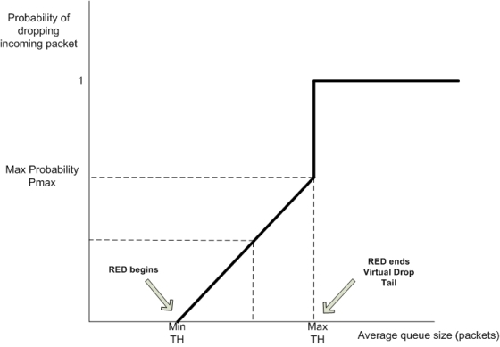
RED Dropping Probability

Slide 19
Advantages of RED
Keeps queues smaller, while allowing bursts
Just using small buffers in routers can’t do the latter
Reduces synchronization between flows
Not all flows are dropping packets at once
Increase/decrease are more gentle

Slide 20
Why Isn’t RED Fair?
RED gives all flows roughly the same drop rate
The TCP equation gives the following
Resulting throughputs depend on RTT…

Slide 21
(3) Non-congestion-related Losses?
Can use Explicit Congestion Notification (ECN)
Bit in IP packet header (actually two)
TCP receiver returns this bit in ACK
When RED router would drop, it sets bit instead
Congestion semantics of bit exactly like that of drop
Advantages:
Separate corruption from congestion
Separate recovery from rate adjustment

Slide 22
(4) Does AIMD work at high speed?
Throughput = (MSS/RTT) sqrt(3/2p)
Assume that RTT = 100ms, MSS=1500bytes
What value of p is required to go 100Gbps?
Roughly 2 x 10⁻¹²
How long between drops?
Roughly 16.6 hours
How much data has been sent in this time?
Roughly 6 petabits
These are not practical numbers!

Slide 23
Adapting TCP to High Speed
One approach:
Let AIMD “constants” depend on CWND
At very high speeds,
Increase CWND by more than MSS in a RTT
Decrease CWND by less than ½ after a loss
We will discuss other approaches later…

Slide 24
High-Speed TCP Proposal (Floyd)
Bandwidth | AvgCwnd (pkts) | Increase a(w) | Decrease b(w)
1.5 Mbps | 12.5 | 1 | 0.50
10 Mbps | 83 | 1 | 0.50
100 Mbps | 833 | 6 | 0.35
1 Gbps | 8333 | 26 | 0.22
10 Gbps | 83333 | 70 | 0.10

Slide 25
High-Speed TCP

Slide 26
This changes the TCP Equation
Throughput ~ p^{-.8} (rather than p^{-.5})
Packet drops every tens of seconds
To achieve high throughput:
Don’t need such a tiny drop rate…
Can ramp up more quickly
How can this coexist with normal TCP?
Only invoke new parameters at large window sizes
Competes fairly with normal TCP at normal speeds

Slide 27
(5) Sawtooth Behavior Uneven
TCP throughput is “choppy”
Repeated swings between W/2 to W
Some apps would prefer sending at a steady rate
e.g., streaming apps
A solution: “Equation-Based Congestion Control”
Ditch TCP’s increase/decrease rules and just follow the equation
Measure drop percentage p, and set rate accordingly
Following the TCP equation ensures we’re “TCP friendly”
i.e., use no more than TCP does in similar setting

Slide 28
These Problems Are All Solved
With published and often standardized solutions
TCP-SACK
RED (and its many variants)
ECN
High-Speed TCP
Equation-based congestion control (EBCC)
Datagram congestion control protocol (DCCP)
Not widely used, as far as I know (but Apple just adopted ECN a few months ago!)

Slide 29
(6) Bias Against Long RTTs
Flows get throughput inversely proportional to RTT
TCP unfair in the face of heterogeneous RTTs!
A1
B1
100ms
200ms
A2
bottleneck
link
B2

Slide 30
Possible Solutions?
Make additive constant proportional to RTT
But people don’t really care about this….

Slide 31
(7) How do short flows fare?
50% of flows have < 1500B to send; 80% < 100KB
Short flows are slowed down by slow-start
It takes several round-trips to send 8 packets!
Handshake, CWND=1, CWND=2, CWND=4, CWND=8
Too few packets to trigger dupACKs
Isolated loss may lead to timeouts
At typical timeout values of ~500ms…
...might severely impact flow completion time

Slide 32
Possible Solutions?
Larger initial window?
Google proposed moving from ~4KB to ~15KB
Covers ≈90% of HTTP Web
Decreases delay by ~5%
Recursively cautious congestion control (RC3)
Run normal TCP at normal priority
Send aggressively at lower priorities
With a limit on each priority level
Ramps up to full speed immediately, no harm to others

Slide 33
(8) Cheating
TCP was designed assuming a cooperative world
No attempt was made to prevent cheating
Many ways to cheat, will present three

Slide 34
Cheating #1: ACK-splitting (Rcvr)
Sender
Receiver
Round-
Trip
Time
(RTT)
Data 1:1461
Rule: grow window by one
full-sized packet for each
valid ACK received
Send M (distinct) ACKs for one packet
Growth factor proportional
to M
What’s the fix?
ACK 486
ACK 973
ACK 1461
Data 1461:2921
Data 2921:4381
Data 4381:5841
Data 5841:7301

Slide 35
10 line change to Linux TCP
(Courtesy of
Stefan Savage)

Slide 36
Cheating #2: Increasing CWND Faster
y
C
x increases by 2 per RTT
y increases by 1 per RTT
Limit rates:
x = 2y
x

Slide 37
Cheating #3: Open Many Connections
x
A
B
y
D
E
Assume
A starts 10 connections to B
D starts 1 connection to E
Each connection gets about the same throughput
Then A gets 10 times more throughput than D

Slide 38
Cheating
Either sender or receiver can independently cheat!
Why hasn’t Internet suffered congestion collapse yet?
How can we prevent cheating?
Verify TCP implementations?
Controlling end points is hopeless!
So what should we do?

Slide 39
(9) Converse of Cheating
To be fair, need to be TCP-friendly
Everyone uses “similar” CC algorithm
Slows down innovation!

Slide 40
How do you solve these problems?
Bias against long RTTs
Slow to ramp up (for short flows)
Cheating
Need for uniformity

Slide 41
Get the Network Involved!
Routers can help by:
Providing guidance for speed to send at
Providing isolation/fairness
Guidance for sending rate deals with
Slow to ramp up
Bias against long RTTs
Providing Isolation/Fairness deals with
Cheating
Need for uniformity

Slide 42
Routers tell hosts how fast to send
Packets carry “rate field”
Routers insert “fair share” f in packet header
End-hosts set sending rate (or window size) to f
Hopefully (still need some policing of endhosts!)
This is the basic idea behind the “Rate Control Protocol” (RCP) from Dukkipati et al. ’07

Slide 43
A Few More Details
How does this work?
Router estimates rate f that will use its capacity
Adaptive process of guessing (why not exact?)
This is what it tells hosts
Why does this work?
Flows get immediately up to speed
And no need to “probe” (gently or otherwise)
How do you evaluate the resulting performance?

Slide 44
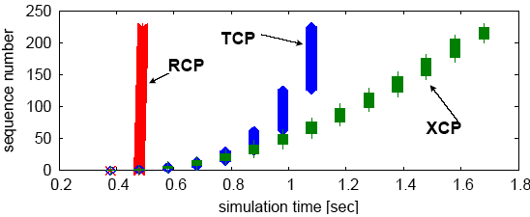
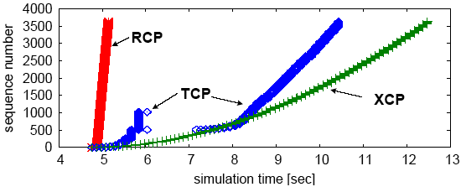
Why the improvement?

Slide 45
How can routers ensure each flow gets its “fair share”?

Slide 46
Isolation
Treat each “flow” separately
For now, flows are packets between same Source/Dest.
Each flow has its own FIFO queue in router
Service flows in a round-robin fashion
When line becomes free, take packet from next flow
Assuming all flows are sending MTU packets, all flows can get their fair share

Slide 47
Benefits
Each flow can use their own adjustment algorithm
Perhaps aided by the router telling them how fast to send
This solves the innovation problem!
People can experiment with any CC algorithm
And the cheating problem!
No matter what you do, you can’t get more than your share

Slide 48
Four Challenges
What is fair?
How to implement fairness in general
Going beyond round-robin
Are there simpler ways to implement this?
And what’s wrong with this approach?

Slide 49
Four Challenges
What is fair?
How to implement fairness in general
Going beyond round-robin
Are there simpler ways to implement this?
And what’s wrong with this approach?

Slide 50
Fairness
When all flows want the same rate, fair is easy
Fair share = C/N
C = capacity of link
N = number of flows
Notes:
This is fair share per link. This is not a global fair share.
When not all flows have the same demand?
Either flow isn’t high bandwidth
Or limited by C/N on some other link

Slide 51
Example 1
Requests: ri Allocations: ai
C=20
Requests: r1=6, r2=5, r3=4
Solution: a1=6, a2=5, a3=4
When bandwidth is plentiful, everyone gets their request
This is the easy case

Slide 52
Example 2
C=12
Requests: r1=6, r2=5, r3=4
One solution: a1=4, a2=4, a3=4
Everyone gets the same
Why not proportional to their demands?
ai = (12/15)ri
Asking for more gets you more!
Not incentive compatible (i.e., cheating works)

Slide 53
Example 3
C=14; Requests: r1=6, r2=5, r3=4
a3=4 (can’t give more than a flow wants)
Remaining bandwidth is 10, with demands 6 and 5
From previous example, if both want more than their share, they both get half
a1=a2=5

Slide 54
Max-Min Fairness
Given set of bandwidth demands r_{i} and total bandwidth C, max-min bandwidth allocations are:
a_{i} = min(f, r_{i})
where f is the unique value such that Sum(a_{i}) = C
or set f to be infinite if no such value exists
This is what round-robin service gives
if all packets are MTUs
Property:
If you don’t get full demand, no one gets more than you
Use it or lose it: you don’t get credit for not using link

Slide 55
Example
Assume link speed C is 10mbps
Have three flows:
Flow 1 is sending at a rate 8mbps
Flow 2 is sending at a rate 6mbps
Flow 3 is sending at a rate 2mbps
How much bandwidth should each get?
According to max-min fairness?

Slide 56
Example
C = 10; r₁ = 8, r₂ = 6, r₃ = 2; N = 3
C/3 = 3.33 →
Can service all of r₃
Remove r₃ from the accounting: C = C – r₃ = 8; N = 2
C/2 = 4 →
Can’t service all of r₁ or r₂
So hold them to the remaining fair share: f = 4
8
f = 4:
min(8, 4) = 4
min(6, 4) = 4
min(2, 4) = 2
10
4
6
4
2
2

Slide 57
Four Challenges
What is fair?
How to implement fairness in general
Going beyond round-robin
Are there simpler ways to implement this?
And what’s wrong with this approach?

