Slide 1
Review
CS 353
Alefiya Hussain
Spring 2016

Slide 2
Logistics
Homework due tomorrow 12:00pm
Solutions during discussion
Hand in before class
May 10th at 11am
Final is closed book, closed notes
No calculators, electronic devices, etc.
Does not require any complicated calculation

Slide 3
General Guidelines
Test based on material covered in lecture & sections from the entire semester
Text: only to clarify details and context for the above
More emphasis on post-midterm material
But you really can’t tackle post-midterm material without thoroughly understanding the pre-midterm material!

Slide 4
General Guidelines (2)
Be prepared to:
Weigh design options outside of the context we studied them in
e.g., run BGP between datacenter sites?
Contemplate new designs we haven’t talked about
e.g., HTTP-like protocol built on top of UDP
Consider the `complete picture’
e.g., persistent TCP connection when my DNS server fails…
If you’re unsure, put down your assumptions

Slide 5
From here on…
Walk through what I expect you to know: key topics, important aspects of each
Just because I didn’t cover it in review doesn’t mean you don’t need to know it
But if I covered it today, you should know it
My plan: summarize, not explain
Stop me when you want to discuss something further!

Slide 6
For example: questions on …
Congestion control: TCP and advanced CC
HTTP performance
E2E operation: “steps when A talks to B”
Wireless
Ethernet spanning tree and self learning
Datacenters

Slide 7
Basic concepts
You should know:
statistical multiplexing
packet vs. circuit switching
Flow control vs congestion control
ACK types
link characteristics
packet delays

Slide 8
Topics
Basic concepts
Architecture and principles
Network layer
Concepts: valid routing state, convergence, least-cost paths
Overall context (inter- and intra-domain routing)
Computing least-cost routes (DV, LS)
IP addressing
Inter-domain
Router architecture
Transport
Role of the transport layer
UDP vs. TCP
TCP details: reliability and flow control
TCP congestion control: general concepts only

Slide 9
How are network resources shared?
Two approaches
Reservations
On demand

Slide 10
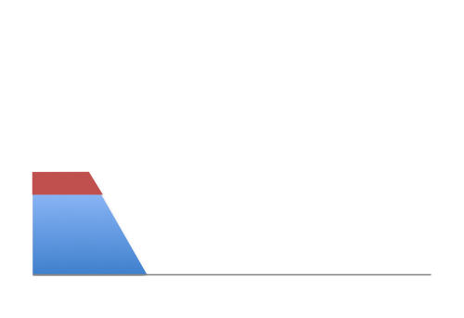
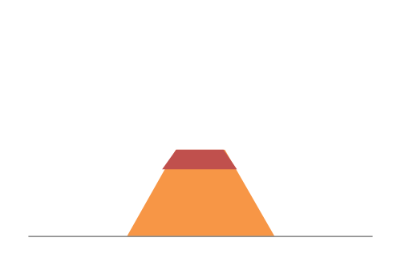
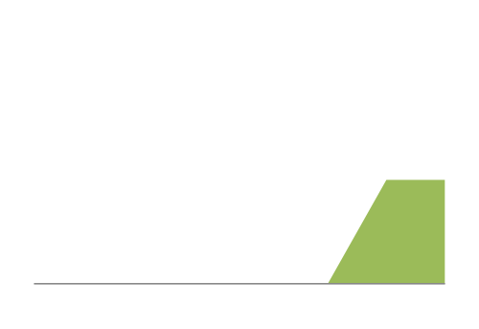
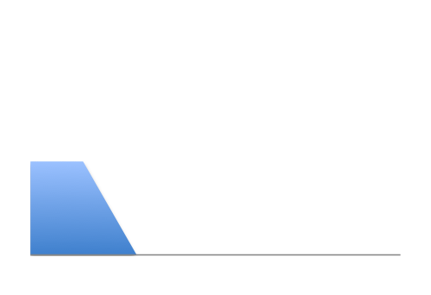
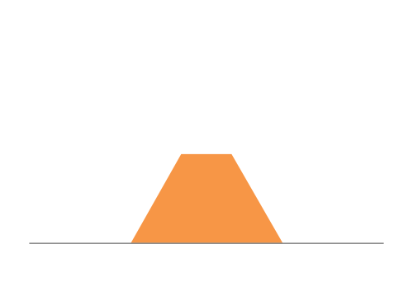
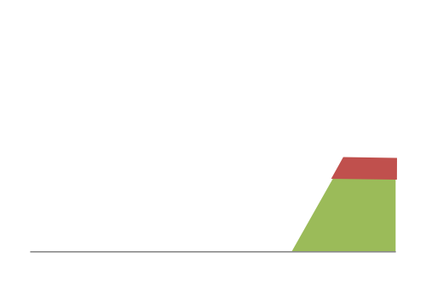
Intuition: reservations
Overloading/
Underutilization
12Mbps
Link capacity = 30Mbps
11Mbps
Each source gets 10Mbps
13Mbps
Time

Slide 11
Intuition: on demand
Buffering
No overloading
Link capacity = 30Mbps
Time

Slide 12
Two approaches to sharing
Reservations → circuit switching
On demand → packet switching

Slide 13
Two approaches to sharing
Packet switching
network resources consumed on demand per-packet
“admission control”: per packet
Circuit switching
network resources reserved a priori at “connection” initiation
"admission control": per connection

Slide 14
Packet switching exploits statistical multiplexing better than circuit switching
Sharing using the statistics of demand
Good for bursty traffic (average << peak demand)

Slide 15
Circuit Switching
10Mb/s?
dst
src
✔
10Mb/s?
✔
10Mb/s?
✔
src sends a reservation request to dst
(2) Switches “establish a circuit”
(3) src starts sending data
(4) src sends a “teardown circuit” message
Notes:
multiple conversations in parallel
resources are shared

Slide 16
Packet Switching
Data is sent as chunks of formatted bits (Packets)
Packets consist of a “header” and “payload”
Switches “forward” packets based on their headers
Each packet travels independently
No link resources are reserved in advance

Slide 17
Circuit Switching
Pros
predictable performance
simple/fast switching (once circuit established)
Cons
inefficient when traffic is bursty
complexity of circuit setup/teardown
circuit setup adds delay
switch fails → its circuit(s) fails

Slide 18
Packet Switching
Pros
efficient use of network resources
simpler to implement
robust: can “route around trouble”
Cons
requires buffer management and congestion control
unpredictable performance

Slide 19
Performance Metrics
Delay
Loss
Throughput

Slide 20
A network link
bandwidth
delay x bandwidth
Propagation delay
Link bandwidth
number of bits sent/received per unit time (bits/sec or bps)
Propagation delay
time for one bit to move through the link (seconds)
Bandwidth-Delay Product (BDP)
number of bits “in flight” at any time
BDP = bandwidth × propagation delay

Slide 21
Delay
Consists of four components
transmission delay
propagation delay
queuing delay
processing delay
due to link properties
due to traffic mix and
switch internals

Slide 22
End-to-end delay
transmission
propagation
queuing
processing
transmission
propagation
queuing
processing
transmission
propagation

Slide 23

Packet Delay Sending 100B packets from A to B?
A
B
1Mbps, 1ms
100Byte packet
time=0
Time to transmit one bit = 1/10⁶s
Time when that bit reaches B = 1/10⁶+1/10³s
Time to transmit 800 bits=800x1/10⁶s
The last bit reaches B at
(800x1/10⁶)+1/10³s
= 1.8ms
Time

Slide 24
Topics
Basic concepts
Architecture and principles
Network layer
Concepts: valid routing state, convergence, least-cost paths
Overall context (inter- and intra-domain routing)
Computing least-cost routes (DV, LS)
IP addressing
Inter-domain
Router architecture
Transport
Role of the transport layer
UDP vs. TCP
TCP details: reliability and flow control
TCP congestion control: general concepts only

Slide 25
Architecture
You should know
Layering: what/where/why
Protocols: what/where/why
Principles: layering, end-to-end argument, “narrow waist”
Benefits and weaknesses/consequences of principles/choices
E.g., layering is good because… but has hurt…

Slide 26
Layering
Layering is a particular form of modularization
System is broken into a vertical hierarchy of logically distinct entities (layers)
Service provided by one layer is based solely on the service provided by layer below

Slide 27
Internet Layers
Applications
…built on…
Reliable (or unreliable) transport
…built on…
L7
Application
Best-effort global packet delivery
L4
Transport
…built on…
L3
Network
Best-effort local packet delivery
L2
Data link
L1
Physical
…built on…
Physical transfer of bits

Slide 28
What gets implemented where?
Lower three layers implemented everywhere
Top two layers implemented only at hosts
Application
Application
Transport
Transport
Network
Network
Network
Datalink
Datalink
Datalink
Physical
Physical
Physical
End system
Switch
End system
Notes:
Why go up? Why not stay down in the lower levels?

Slide 29
Logical Communication
Layers interacts with peer’s corresponding layer
Application
Application
Transport
Transport
Network
Network
Network
Datalink
Datalink
Datalink
Physical
Physical
Physical
Host A
Router
Host B

Slide 30
Physical Communication
Communication goes down to physical network
Then up to relevant layer
Application
Application
Transport
Transport
Network
Network
Network
Datalink
Datalink
Datalink
Physical
Physical
Physical
Host A
Router
Host B

Slide 31
Protocols and Layers
L7
Application
Application
L7
L4
Transport
Transport
L4
L3
Network
Network
L3
L2
Data link
Data link
L2
L1
Physical
Physical
L1
Communication between peer layers on different systems is defined by protocols

Slide 32
Protocols at different layers
L7
Application
SMTP
HTTP
DNS
NTP
L4
Transport
TCP
UDP
L3
Network
IP
L2
Data link
Ethernet
FDDI
PPP
L1
Physical
optical
radio
copper
PSTN
There is just one network-layer protocol!

Slide 33
Layer Encapsulation
App
msg
msg
Transport
H_{t}
msg
H_{t}
msg
Network
H_{n}
H_{t}
msg
H_{n}
H_{t}
msg
H_{n}
H_{t}
msg
Link
H_{l}
H_{n}
H_{t}
msg
H_{l}
H_{l}
H_{n}
H_{n}
H_{t}
H_{t}
msg
msg
H_{l}
H_{n}
H_{t}
msg
Physical
Alice
Router
Bob

Slide 34
Layers: pros and cons
Why layer?
Reduce complexity
Improve flexibility/innovation
(Each layer can evolve independently)
Why not layer?
sub-optimal performance
cross-layer information often useful

Slide 35
End-to-end argument: Intuition
Some application requirements can only be correctly implemented end-to-end
reliability, security, etc.
End-systems
Can satisfy the requirement without network’s help
Will/must do so, since they can’t rely on the network
Notes:
Contrary to wisdom of the day!
Talmud

Slide 36
Implications of the E2E argument
In layered design, the E2E principle provides guidance on which layers are implemented where
Key argument for why IP offers only “best effort” delivery (leading to “dumb network / smart ends”)
Reliability implemented at the end host (TCP)
Often credited as key to the Internet’s success

Slide 37
Architectural Wisdom
Layering
reduce complexity, increase flexibility
IP as the “narrow waist”
eases interoperability
“smart ends, dumb network” (E2E argument)
No application knowledge in network → more general
Minimal state in the network → more robust to failure

Slide 38
Forwarding vs. Routing
Forwarding: “data plane”
Directing one data packet
Each router using local forwarding table
Routing: “control plane”
Computing the forwarding tables that guide packets
Jointly computed by routers using a distributed algorithm

Slide 39
Routing: basic concepts
Valid routing state
Convergence
Least-cost paths

Slide 40
“Valid” Routing State
Global forwarding state is “valid” if it produces forwarding decisions that always deliver packets to their destinations
Global routing state is valid if and only if:
There are no dead ends (other than destination)
There are no loops
Notes:
What could go wrong?

Slide 41
Convergence Delay
Time to achieve convergence
E.g., all nodes have the same link-state database
Sources of convergence delay?
time to detect failure
time to flood link-state information
time to re-compute forwarding tables
Performance during convergence period?
lost packets due to blackholes
looping packets
out-of-order packets reaching the destination

Slide 42
Least-cost path routing
Given: router graph & link costs
Goal: find least-cost path
from each source router
to each destination router
Distance-Vector and Link-State are examples

Slide 43
“Least Cost” Routes
“Least cost” routes an easy way to avoid loops
No sensible cost metric is minimized by traversing a loop
Least cost routes are destination-based
i.e., do not depend on the source
Least-cost paths form a spanning tree

Slide 44
“Autonomous System (AS)” or “Domain” Region of a network under a single administrative entity
“Border Routers”
An “end-to-end” route
“Interior Routers”

Slide 45
Internet Routing
Internet Routing works at two levels
Each AS runs an intra-domain routing protocol that establishes routes within its domain
Intra-domain routes are “least cost”
e.g., Link State (OSPF) and Distance Vector (RIP)
ASes participate in an inter-domain routing protocol that establishes routes between domains
Inter-domain routes determined by policy (need not be least-cost)
e.g., Path Vector (BGP)

Slide 46
Link State Routing
Every router knows its local “link state”
A router floods its link state to all other routers
Every router learns the entire network graph
Every router locally runs Dijkstra’s to compute its forwarding table
Will not test your ability to solve Dijkstra’s under pressure
But you should know the high level properties of LS
every node maintains complete topology
link updates flooded everywhere
may have loops while nodes have inconsistent topology information

Slide 47
Distance-vector routing
Distributed algorithm (Bellman-Ford)
All routers run it “together”
each router runs its own instance
neighbors exchange and react to each other’s messages
Notes:
A distance-vector routing algorithm is a click distributed algorithm,
in the sense that click all routers run it together:
- they exchange messages
- and they keep reacting to each other’s messages.

Slide 48
Distance Vector Routing
Each router knows the links to its neighbors
Each router has provisional “least cost” estimate to every other router -- its distance vector (DV)
E.g.: Router A: “A can get to B with cost 11”
Routers exchange this DV with their neighbors
Routers look over the set of options offered by their neighbors and select the best one
Iterative process converges to set of shortest paths

Slide 49
y
2
x
7
u
z
1
w
dx(z) =
minn{
cost(x,n) + dn(z)
}
for all neighbors n
Bellman-Ford equation
Notes:
... which is called the Bellman-Ford equation.

Slide 50
Counting-to-Infinity
Cause
z routes through y, y routes through x (to reach dst)
y loses connectivity to x
y decides to route through z (to reach dst)
Can take a very long time to resolve

Slide 51
Poisoned Reverse
How:
If z routes to dst through y, z advertises to y that its cost to dst is infinite
y never decides to route to dst through z
Often avoids the count-to-infinity problem

Slide 52
Addressing Goal: Scalable Routing
State: Small forwarding tables at routers
Churn: Limited rate of change in routing tables
Ability to aggregate addresses is crucial for both
(one entry to summarize many addresses)

Slide 53
Hierarchy in IP Addressing
32 bits are partitioned into a prefix and suffix components
Prefix is the network component; suffix is host component
Interdomain routing operates on the network prefix
“slash” notation: 12.34.158.0/23 → network with a 23 bit prefix and 2⁹ host addresses
12
34
158
5
00001100
00100010
10011110
00000101
Network (23 bits)
Host (9 bits)

Slide 54
IP addressing → scalable routing?
Hierarchical address allocation helps routing scalability if allocation matches topological hierarchy
Problem: may not be able to aggregate addresses for “multi-homed” networks

Slide 55
IP addressing → scalable routing?
Hierarchical address allocation helps routing scalability if allocation matches topological hierarchy
Problem: may not be able to aggregate addresses for “multi-homed” networks
Two competing forces in scalable routing
aggregation reduces number of routing entries
multi-homing increases number of entries

Slide 56
BGP and Inter-Domain Routing
Destinations are IP prefixes (12.0.0.0/8)
Nodes are Autonomous Systems (ASes)
Links represent both physical connections and business relationships
customer-provider or peer-to-peer
BGP is the protocol for inter-domain routing

Slide 57
Topology and policy is shaped by the business relationships between ASes
Three basic kinds of relationships between ASes
AS A can be AS B’s customer
AS A can be AS B’s provider
AS A can be AS B’s peer
Business implications
Customer pays provider
Peers don’t pay each other
Notes:
Ehy???

Slide 58
BGP extends DV
With some important differences
routes selected based on policy, not just shortest path
path vector (useful to avoid loops)
Selective route advertisement
may aggregate routes (aggregating prefixes)

Slide 59
Policy imposed in how routes are selected and exported
Route export
Route selection
P
A
B
Can reach 128.3/16
blah blah
Q
C
Selection: Which path to use?
controls whether/how traffic leaves the network
Export: Which path to advertise?
controls whether/how traffic enters the network
Notes:
Arrows: routing messages!

Slide 60
Typical Export Policy
Destination prefix advertised by… | Export route to…
Customer | Everyone (providers, peers, other customers)
Peer | Customers
Provider | Customers
We’ll refer to these as the “Gao-Rexford” rules
(capture common -- but not required! -- practice!)

Slide 61
Typical Selection Policy
In decreasing order of priority
make/save money (send to customer > peer > provider)
maximize performance (smallest AS path length)
minimize use of my network bandwidth (“hot potato”)
…
BGP uses route attributes to implement the above
ASPATH, LOCAL_PREF, MED, …
You should know the general idea/goal for each attribute; we won’t quiz you on the detailed implementation

Slide 62

Policy Dictates Route Selection
Pr
Cu
Q
Peer
Peer
A
B
C
D
E
F
traffic allowed
traffic not allowed

Slide 63
IP Packet Structure
We’ll give you the header format but you should know what each field is and its use/misuse
4-bit
Version
4-bit
Header
Length
8-bit
Type of Service
16-bit Total Length (Bytes)
16-bit Identification
3-bit
Flags
13-bit Fragment Offset
8-bit Time to
Live (TTL)
8-bit Protocol
16-bit Header Checksum
32-bit Source IP Address
32-bit Destination IP Address
Options (if any)
Payload

Slide 64
IPv4 and IPv6 Header Comparison
IPv4
IPv6
Version | IHL | Type of Service | Total Length
Identification |  |  | Flags | Fragment Offset
Time to Live |  | Protocol | Header Checksum
Source Address
Destination Address
Options |  |  |  |  | Padding
Version | Traffic Class | Flow Label
Payload Length |  |  | Next Header | Hop Limit
Source Address
Destination Address
Field name kept from IPv4 to IPv6
Fields not kept in IPv6
Name & position changed in IPv6
New field in IPv6

Slide 65
What’s inside a router?
Input and Output for the same port are on one physical linecard
Processes packets on their way in
Route/Control Processor
Processes packets before they leave
Linecards (input)
Linecards (output)
1
1
2
2
Interconnect (Switching)
Fabric
Transfers packets from input to output ports
N
N

Slide 66
What’s inside a router?
(1) Implement IGP and BGP protocols; compute routing tables
(2) Push forwarding tables to the line cards
Route/Control Processor
Linecards (input)
Linecards (output)
1
1
2
2
Interconnect (Switching)
Fabric
N
N

Slide 67
What’s inside a router?
Constitutes the control plane
Route/Control Processor
Constitutes the data plane
Linecards (input)
Linecards (output)
1
1
2
2
Interconnect Fabric
N
N
Notes:
Control plane: software. Makes decisions over long time horizons.
Data plane: mostly hardware. A decision for each packet.

Slide 68
Challenges in Router Design
@ Line cards: destination lookups at high speed
e.g., find the longest prefix match (LPM) in the table that matches the packet destination address
@ Switch fabric: head-of-line blocking, scheduling the switch fabric at high speed
@ Route processor: complexity/correctness more a problem than performance
You should understand why these challenges arise but we don’t expect you to know how to fix them
e.g., specifics of scheduling algorithms or LPM lookups

Slide 69
Role of the Transport Layer
(1) Communication between application processes
Mux and demux from/to application processes
Implemented using ports
(2) Provide common end-to-end services for app layer
Reliable, in-order data delivery
Well-paced data delivery

Slide 70
UDP vs. TCP
Both UDP and TCP provide mux/demux-ing via ports
 | UDP | TCP
Data abstraction | Packets (datagrams) | Stream of bytes of arbitrary length
Service | Best-effort (same as IP) | Reliability In-order delivery Congestion control Flow control
Applications | Video, audio streaming | File transfer, chat

Slide 71
Reliable Transport: General Concepts
Checksums (for error detection)
Timers (for loss detection)
Acknowledgments (feedback from receiver)
cumulative: “received everything up to X”
selective: “received X”
Sequence numbers (detect duplicates, accounting)
Sliding Windows (for efficiency)
You should know:
what these concepts are
why they exist
how TCP uses them

Slide 72
Things to know about TCP
How TCP achieves reliability
RTT estimation
Connection establishment/teardown
Flow Control
Congestion Control (concepts only)
For each, know how the functionality is implemented and why it is needed

Slide 73
E.g., RTT Estimation
Why? TCP uses timeouts to retransmit packets
But RTT may vary (significantly!) for different reasons and on different timescales
due to temporary congestion
due to long-lived congestion
due to a change in routing paths
An incorrect RTT estimate might introduce spurious retransmissions or overly long delays
RTT estimators should react to change but not too quickly
proposed solutions use EWMA, incorporate deviations

Slide 74
E.g., Reliability
Why? IP is best-effort but many apps. need reliable delivery
Having TCP take care of it simplifies application development
How
checksums and timers (for error and loss detection)
fast retransmit (for faster-than-timeout loss detection)
cumulative ACKs (feedback from receiver -- what’s lost/what’s not)
sliding windows (for efficiency)
buffers at sender (to hold packets while waiting for ACKs)
buffers at receiver (to reorder packets before delivery to app.)

Slide 75
E.g., Connection Establishment
Why?
TCP is a stateful protocol (CWND, buffer space, ISN, etc.)
Need to initialize connection state at both ends
Exchange initial sequence numbers
How? Three-way handshake
Host A sends a SYN to host B
Host B returns a SYN acknowledgment (SYN ACK)
Host A sends an ACK (+ data) to acknowledge the SYN ACK
Hosts exchange proposed Initial Sequence Numbers at each step

Slide 76
E.g., Flow Control
Why?
TCP offers a reliable in-order byte stream abstraction
Hence, TCP at the receiver must buffer a packet until all packets before it (in byte-order) have arrived and the receiving application has consumed available bytes
Hence receiver advances its window when the receiving application consumes data
But sender advances its window when new data ACK’d
Hence, risk the sender might overrun the receiver’s buffers
How? “Advertised Window” field in TCP header
Receiver advertises the “right hand edge” of its window to sender
Sender agrees not to exceed this amount

Slide 77
E.g., Congestion Control
Why?
Because a sender shouldn’t overload the network itself
But yet, should make efficient use of available network capacity
While sharing available capacity fairly with other flows
And adapting to changes in available capacity
How?
Dynamically adapts the size of the sending window (don’t worry about the exact algorithms used to do the adaptation)

Slide 78
Application Layer
Domain Name System (DNS)
What’s behind (e.g.) xyz.cs.usc.edu
HTTP and the Web
What happens when you click on a link?

Slide 79
Internet Names & Addresses
Machine addresses: e.g., 169.229.131.109
router-usable labels for machines
conforms to network structure (the “where”)
Machine names: e.g., cs.usc.edu
human-usable labels for machines
conforms to organizational structure (the “who”)
The Domain Name System (DNS) is how we map from one to the other

Slide 80
Key to DNS design: Hierarchy
Three intertwined hierarchies
Hierarchical namespace
As opposed to original flat namespace
Hierarchically administered
As opposed to centralized
(Distributed) hierarchy of servers
As opposed to centralized storage

Slide 81
Things to know about DNS
Steps in resolving a DNS request
from the viewpoint of three different hierarchies
make sure you can walk through the sequence of messages exchanged between different servers
Role of caching
impact on performance, availability, consistency
repeat above walk-through with “cold” vs. “warm” cache
Pros/cons of the design

Slide 82
Web and HTTP
Web content is named using URLs
URLs use DNS hostnames
Thus, content names are tied to specific hosts
HTTP is the protocol for exchanging information
Synchronous request/reply protocol
Runs over TCP, Port 80
Stateless (modulo cookies)
Client-server architecture
server is “always on” and “well known”
clients initiate contact to server

Slide 83
Steps in HTTP Request/Response
Client
Server
TCP Syn
Establish
connection
TCP syn + ack
Client
request
TCP ack + HTTP GET
.
.
Request
response
.
Close connection

Slide 84
Things to know about HTTP
Steps in HTTP request/response
Broad form of request/response messages
only to the level of detail covered in lecture/section
not details of request/response headers
Performance
persistent vs. concurrent vs. pipelined connections
why they’re needed; what performance benefit they offer
when and how caching and replication help performance

Slide 85
Broadcast Ethernet
Traditional Ethernet: broadcast medium
dedicated vs. shared
Challenge with broadcast media
Must avoid having multiple nodes speaking at once
Otherwise, collisions lead to garbled data
Need algorithm that determines which node can transmit
(Old) Ethernet used random access protocols
Contrast: a priori partitioning among nodes

Slide 86
Random Access Protocols
A node may send at any time
Contrast: node waits for its turn
Two or more transmitting nodes ⇒ collision
Data lost
Random access MAC protocol specifies:
How to detect or avoid collisions
How to recover from collisions

Slide 87
Key Ideas of Random Access
Carrier sense
Before sending, check if someone else is already sending data
Collision detection
If someone else starts talking at the same time, stop
But make sure everyone knows there was a collision!
Collision avoidance
Explicit ACK from receiver signals (lack of) collision and impending communication
Randomness
If you can’t talk, wait for a random time before trying again

Slide 88
Broadcast Ethernet, CSMA/CD
Things to know/understand
why CSMA alone does not eliminate all collisions (because of nonzero propagation delay)
That collision detection is easy in wired (broadcast) LANs but difficult in wireless LANs (hence CSMA/CA)
That collision detection imposes a bound on max length of a wire and minimum length of frame

Slide 89
Switched Ethernet
B
A
C
switch
D
Why? Concurrent communication
Host A can talk to C, while B talks to D
No collisions → no need for CSMA, CD
No constraints on link lengths, etc.

Slide 90
Switched Ethernet
What you should know about switched Ethernet
Ethernet frame format
Concept of framing and sentinel bits
Ethernet addresses
Why spanning tree and self-learning are needed
How the spanning tree is constructed
role of soft state
How self-learning works
role of caching (see HW3 problem)
contrast style of Ethernet vs. IP addressing and routing
with implications that follow
scalability, plug-n-play, portability, …

Slide 91
Switched Ethernet
How? Two pieces
Build a spanning tree
Why? For loop-free flooding
Why flooding?: plug-n-play
How? Shortest path tree rooted at node with the lowest ID (MAC address)
“Self Learning” switches
Why? Optimization; so switches can reach destination without flooding
How? If packet from A arrives on port X, switch learns to send packets to A via port X

Slide 92
Naming and Discovery
What you should know
Naming schemes at different layers (Ethernet, IP, DNS)
format; what they represent; what role they play
How we discover and translate between names
DNS, ARP, DHCP
role of broadcast, soft state and caching

Slide 93
Naming
Application layer: URLs and domain names
names “resources” -- hosts, content, program
Network layer: IP addresses
host’s network location
Link layer: MAC addresses
host identifier
Use all three for end-to-end communication!

Slide 94
Discovery
A host is “born” knowing only its MAC address
Must discover lots of information before it can communicate with a remote host B
what is my IP address?
what is B’s IP address? (remote)
what is B’s MAC address? (if B is local)
what is my first-hop router’s address? (if B is not local)
…

Slide 95
ARP and DHCP
Link layer discovery protocols
Serve two functions
Discovery of local end-hosts
for communication between hosts on the same LAN
Bootstrap communication with remote hosts
what’s my IP address?
who/where is my local DNS server?
who/where is my first hop router?

Slide 96
DHCP
“Dynamic Host Configuration Protocol”
A host uses DHCP to discover
its own IP address
its netmask
IP address(es) for its DNS name server(s)
IP address(es) for its first-hop “default” router(s)

Slide 97
DHCP: operation
One or more local DHCP servers maintain required information
Client broadcasts a DHCP discovery message
One or more DHCP servers responds with a DHCP “offer” message
Client broadcasts a DHCP request message
Selected DHCP server responds with an ACK

Slide 98
ARP: Address Resolution Protocol
ARP provides IP-to-MAC translation
Every host maintains an ARP table
list of (IP address → MAC address) pairs
But: what if IP address not in the table?
Sender broadcasts: “Who has IP address 1.2.3.156?”
Receiver responds: “MAC address 58-23-D7-FA-20-B0”
Sender caches result in its ARP table

Slide 99
Key Ideas in Both ARP and DHCP
Broadcasting: used for initial bootstrap
Caching: remember the past for a while
Store the information you learn to reduce overhead
Key optimization for performance
Soft state: eventually forget the past
Associate a time-to-live field with the information
… and either refresh or discard the information
Key for robustness

Slide 100

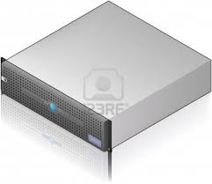


Putting the pieces together
Walk through the steps required to download www.google.com/index.html from your laptop
yourDNS
yourDHCP
Google’s datacenter
You
R
USC
router
Assume: `cold start’ -- nothing cached anywhere
Assume: yourDNS on a different subnet from yourDHCP
Ignore intra- and interdomain routing protocols
Dorm

Slide 101
Wireless
Things you need to know:
Properties of the medium
broadcast
→ collisions happen
but broadcast has limited range
→no concept of a “global” collision
→ simultaneous transmissions are possible
can’t receive while transmitting
can’t detect collisions

Slide 102
Wireless
Things you need to know:
Properties of the medium
Canonical scenarios
hidden terminal (carrier sense fails to prevent collisions)
exposed terminal (carrier sense needlessly limits commn.)

Slide 103
Wireless
Things you need to know:
Properties of the medium
Canonical scenarios
Techniques for collision avoidance
carrier sense
explicit request/response (RTS/CTS)
backoff

Slide 104
Wireless
Things you need to know:
Properties of the medium
Canonical scenarios
Techniques for collision avoidance
How to analyze a given media access protocol that uses the above techniques
We’ll give you the protocol rules; you analyze how (and how well) data exchange proceeds
You don’t need to memorize protocol rules
e.g., Q7 on HW3

Slide 105
Wireless
Things you need to know:
Properties of the medium
Canonical scenarios
Techniques for collision avoidance
How to analyze a given media access protocol that uses the above techniques
Things we don’t expect you to know
mathematical understanding of wireless signals (free space loss, interference, attenuation, etc.)
details of specific wireless protocols (e.g., 802.11)

Slide 106
Datacenters
What you should know
How and why DC networks are different (vs. WAN)
in terms of workload, goals, characteristics
How traditional solutions fare in this environment
e.g., IP, Ethernet, TCP
Understand Fat-Tree DC networks
Why “fat”; how we do addressing and routing on a fat-tree
High level understanding of DC-TCP
mostly the “why” for the approach taken

Slide 107
Typical datacenter architecture
Servers organized in racks
Each rack has a `Top of Rack’ (ToR) switch
An `aggregation fabric’ interconnects ToR switches
Connected to the outside via `core’ switches

Slide 108
Typical datacenter traffic workload
“North-South traffic”
Traffic between outside world and the datacenter
Primarily latency sensitive
“East-West traffic”
Traffic between machines in the datacenter
Commn. within “big data” computations (e.g. Map Reduce)
Throughput intensive
“Elephants and Mice”

Slide 109
Characteristics of a datacenter network
Huge scale
Limited geographic scope
Limited heterogeneity
regular topologies, link speeds, technologies, latencies, …
Single administrative domain
Control over network and endpoints
Control over the placement of traffic sources/sinks
Control over topology (e.g., trees/fat-trees)
Lower concern: interoperability, backward compatibility
New degrees of design freedom

Slide 110
Fat-Tree Topologies
What: “scale out” approach to building a high bisection bandwidth network
“high bisection BW” → high BW between servers
Why?
Lots of east-west traffic
(think shuffle in map-reduce)
But traditional tree topologies expensive to scale
(“scale up” → links near root exorbitantly expensive)
How? Topology in which each switch has many links going “up”

Slide 111
Datacenter Transport Designs
Know: rationale and approach at a high level only
E.g., DC-TCP
Why? Datacenters need both high throughput and low latency but TCP isn’t good at this
What? Incremental change to TCP to achieve both
How?: two ideas
react early (using ECN)
react in proportion to the extent of congestion (by adapting CWND based on fraction of packets with ECN set)

Slide 112
Thanks & Good luck!

