Slide 1
TCP: More Congestion Control
CS 353
Spring 2016
Alefiya Hussain

Slide 2
Announcements:
Assignment 3 Due: 4/22
Quiz 3: Tomorrow 4/15
Avoid a 50% score reduction by:
1. Include a Makefile
2. The executable has to be named "watchdog" or "desman" and should accept any order of command line parameters
3. Executable has to be generated in the same location as the makefile
4. Flushing when writing to logfiles or before quitting while reading an interface.
5. Code has to work on on Ubuntu or Mac (please ensure the latest version of xcode for Mac and gcc for Ubuntu)
6. Assignment description: page 2 say "UID can be" → "UID must be"
7. Do not include the angle bracket "<" and ">" in logfile.

Slide 3
The Transport Layer
(brief review from last lecture)

Slide 4
Role of Transport Layer
Application layer
Communication for specific applications
E.g., HyperText Transfer Protocol (HTTP), File Transfer Protocol (FTP), Simple Mail Transfer Protocol (SMTP)
Transport layer
What do we need here?
Network layer
Logical communication between nodes
Hides details of the link technology, ex: IP

Slide 5
What Is Needed to Address These?
Demultiplexing: identifier for application process
Going from host-to-host (IP) to process-to-process
Translating between bytestreams and packets
Do segmentation and reassembly
Reliability: ACKs and all that stuff
Corruption: checksum
Not overloading receiver: “Flow Control”
Limit data in recvr’s buffer
Not overloading network: “Congestion Control”
Limit data based on network capacity

Slide 6
Timeouts and Retransmissions
Reliability requires retransmitting lost data
Involves setting timer and retransmitting on timeout
TCP resets timer whenever new data is ACKed
Retx of packet containing “next byte” when timer goes off

Slide 7
Setting the Timeout Value
1
1
Timeout
RTT
RTT
1
Timeout
1
Timeout too long → inefficient
Timeout too short →
duplicate packets

Slide 8
RTT Estimation
Use exponential averaging of RTT samples
SampleRTT
EstimatedRTT
Time

Slide 9
Karn/Partridge Algorithm
Measure SampleRTT only for original transmissions
Once a segment has been retransmitted, do not use it for any further measurements
Computes EstimatedRTT using α = 0.875
Timeout value (RTO) = 2 × EstimatedRTT
Use exponential backoff for repeated retransmissions
Every time RTO timer expires, set RTO ← 2·RTO
(Up to maximum ≥ 60 sec)
Every time new measurement comes in (= successful original transmission), collapse RTO back to 2 × EstimatedRTT

Slide 10
Jacobson/Karels Algorithm
Problem: need to better capture variability in RTT
Directly measure deviation
Deviation = | SampleRTT – EstimatedRTT |
EstimatedDeviation: exponential average of Deviation
RTO = EstimatedRTT + 4 x EstimatedDeviation

Slide 11
Advertised Window
Flow control: adjusting the sending rate to keep from overwhelming a slow receiver
Self-Clocking
Congestion control: adjusting the sending rate to keep from overloading the network

Slide 12
Statistical Multiplexing → Congestion
If two packets arrive at a router at the same time
Router will transmit one and buffer/drop the other
Internet traffic is bursty
If many packets arrive close in time
the router cannot keep up → gets congested
causes packet delays and drops

Slide 13
Congestion is Harmful
Typical queuing system with bursty arrivals
Average
Packet
delay
Average
Packet
loss
Load
Load
Must balance utilization versus delay and loss

Slide 14
TCP’s Approach in a Nutshell
TCP connection has window
Controls number of packets in flight
Sending rate: ~Window/RTT
Vary window size to control sending rate

Slide 15
All These Windows…
Congestion Window: CWND
How many bytes can be sent without overflowing routers
Computed by the sender using congestion control algorithm
Flow control window: AdvertisedWindow (RWND)
How many bytes can be sent without overflowing receiver’s buffers
Determined by the receiver and reported to the sender
Sender-side window = minimum{CWND, RWND}
Assume for this lecture that RWND >> CWND

Slide 16
Two Basic Questions
How does the sender detect congestion?
How does the sender adjust its sending rate?
To address three issues
Finding available bottleneck bandwidth
Adjusting to bandwidth variations
Sharing bandwidth

Slide 17
Detecting Congestion
Packet delays
Tricky: noisy signal (delay often varies considerably)
Routers tell endhosts when they’re congested
Packet loss
Fail-safe signal that TCP already has to detect
Complication: non-congestive loss (e.g., checksum errors)

Slide 18
Not All Losses the Same
Duplicate ACKs: isolated loss
Still getting ACKs
Timeout: much more serious
Not enough dupacks
Must have suffered several losses
Will adjust rate differently for each case

Slide 19
Rate Adjustment
Basic structure:
Upon receipt of ACK (of new data): increase rate
Upon detection of loss: decrease rate
How we increase/decrease the rate depends on the phase of congestion control we’re in:
Discovering available bottleneck bandwidth vs.
Adjusting to bandwidth variations

Slide 20
Bandwidth Discovery with Slow Start
Goal: estimate available bandwidth
start slow (for safety)
but ramp up quickly (for efficiency)
Consider
RTT = 100ms, MSS=1000bytes
Window size to fill 1Mbps of BW = 12.5 packets
Window size to fill 1Gbps = 12,500 packets
Either is possible!

Slide 21
“Slow Start” Phase
Sender starts at a slow rate but increases exponentially until first loss
Start with a small congestion window
Initially, CWND = 1
So, initial sending rate is MSS/RTT
Double the CWND for each RTT with no loss
Notes:
MSS vs MTU??

Slide 22
Slow Start in Action
For each RTT: double CWND
Simpler implementation: for each ACK, CWND += 1
Linear increase per ACK(CWND+1) ➔ exponential increase per RTT (2xCWND)

Slide 23
Slow Start in Action
For each RTT: double CWND
Simpler implementation: for each ACK, CWND += 1
1
2
3
4
8
Src
D
A
D
D
A
A
D
D
D
D
A
A
A
A
Dest

Slide 24
Adjusting to Varying Bandwidth
Slow start gave an estimate of available bandwidth
Now, want to track variations in this available bandwidth, oscillating around its current value
Repeated probing (rate increase) and backoff (decrease)
TCP uses: “Additive Increase Multiplicative Decrease” (AIMD)
We’ll see why shortly…

Slide 25
AIMD
Additive increase
Window grows by one MSS for every RTT with no loss
For each successful RTT, CWND = CWND + 1
Simple implementation:
for each ACK, CWND = CWND+ 1/CWND
Multiplicative decrease
On loss of packet, divide congestion window in half
On loss, CWND = CWND/2

Slide 26
Leads to the TCP “Sawtooth”
Window
Loss
Exponential “slow start”
t

Slide 27
Slow-Start vs. AIMD
When does a sender stop Slow-Start and start Additive Increase?
Introduce a “slow start threshold” (ssthresh)
Initialized to a large value
On timeout, ssthresh = CWND/2
When CWND = ssthresh, sender switches from slow-start to AIMD-style increase

Slide 28
Why AIMD?

Slide 29
Recall: Three Issues
Discovering the available (bottleneck) bandwidth
Slow Start
Adjusting to variations in bandwidth
AIMD
Sharing bandwidth between flows

Slide 30
Goals for bandwidth sharing
Efficiency: High utilization of link bandwidth
Fairness: Each flow gets equal share

Slide 31
Why AIMD?
Some rate adjustment options: Every RTT, we can
Multiplicative increase or decrease: CWND→ a*CWND
Additive increase or decrease: CWND→ CWND + b
Four alternatives:
AIAD: gentle increase, gentle decrease
AIMD: gentle increase, drastic decrease
MIAD: drastic increase, gentle decrease
MIMD: drastic increase and decrease

Slide 32
Simple Model of Congestion Control
1
Efficiency line (x₁+x₂ = 1)
Fairness line (x₁ =x₂)
Two users
rates x₁ and x₂
Congestion when x₁+x₂ > 1
Unused capacity when x₁+x₂ < 1
Fair when x₁ =x₂
User 2’s rate (x₂)
congested →
← inefficient
User 1’s rate (x₁)
1

Slide 33
Example
1
fairness
line
Efficient: x₁+x₂=1
Fair
Congested: x₁+x₂=1.2
(0.2, 0.5)
(0.7, 0.5)
User 2: x₂
(0.5, 0.5)
Inefficient: x₁+x₂=0.7
congested →
(0.7, 0.3)
← inefficient
Efficient: x₁+x₂=1
Not fair
efficiency
line
User 1: x₁
1

Slide 34
AIAD
(x₁-a_{D}+a_{I}), x₂-a_{D}+a_{I}))
fairness
line
Increase: x + a_{I}
Decrease: x - a_{D}
Does not converge to fairness
(x₁,x₂)
User 2: x₂
(x₁-a_{D},x₂-a_{D})
congested →
← inefficient
efficiency
line
User 1: x₁

Slide 35
AIAD Sharing Dynamics
x₁
A
B
x₂
D
E

Slide 36
MIMD
fairness
line
Increase: x*b_{I}
Decrease: x*b_{D}
Does not converge to fairness
(x₁,x₂)
(b_{I}b_{D}x₁, b_{I}b_{D}x₂)
User 2: x₂
(b_{d}x₁,b_{d}x₂)
congested →
← inefficient
efficiency
line
User 1: x₁

Slide 37
AIMD
fairness
line
Increase: x+a_{I}
Decrease: x*b_{D}
Converges to fairness
(x₁,x₂)
(b_{D}x₁+a_{I}, b_{D}x₂+a_{I})
User 2: x₂
(b_{D}x₁,b_{D}x₂)
congested →
← inefficient
efficiency
line
User 1: x₁

Slide 38
AIMD Sharing Dynamics
x₁
A
B
x₂
50 pkts/sec
D
E
Rates equalize → fair share

Slide 39
TCP Congestion Control Details

Slide 40
Implementation
State at sender
CWND (initialized to a small constant)
ssthresh (initialized to a large constant)
[Also dupACKcount and timer, as before]
Events
ACK (new data)
dupACK (duplicate ACK for old data)
Timeout

Slide 41
Event: ACK (new data)
If CWND < ssthresh
CWND += 1
CWND packets per RTT
Hence after one RTT with no drops: CWND = 2xCWND

Slide 42
Event: ACK (new data)
If CWND < ssthresh
CWND += 1
Else
CWND = CWND + 1/CWND
Slow start phase
“Congestion Avoidance” phase (additive increase)
CWND packets per RTT
Hence after one RTT with no drops: CWND = CWND + 1

Slide 43
Event: TimeOut
On Timeout
ssthresh ← CWND/2
CWND ← 1

Slide 44
Event: dupACK
dupACKcount ++
If dupACKcount = 3 /* fast retransmit */
ssthresh = CWND/2
CWND = CWND/2

Slide 45
Example
Window
Timeout
SSThresh
Set to Here
Fast Retransmission
Slow start in operation until it reaches half of previous CWND, I.e., SSTHRESH
t
Slow-start restart: Go back to CWND = 1 MSS, but take advantage of knowing the previous value of CWND

Slide 46
One Final Phase: Fast Recovery
The problem: congestion avoidance too slow in recovering from an isolated loss

Slide 47
Example
Consider a TCP connection with:
CWND=10 packets
Last ACK was for packet # 101
i.e., receiver expecting next packet to have seq. no. 101
10 packets [101, 102, 103,…, 110] are in flight
Packet 101 is dropped
What ACKs do they generate?
And how does the sender respond?

Slide 48
Timeline (at sender)
101
In flight: 101, 102, 103, 104, 105, 106, 107, 108, 109, 110
ACK 101 (due to 102) cwnd=10 dupACK#1 (no xmit)
ACK 101 (due to 103) cwnd=10 dupACK#2 (no xmit)
ACK 101 (due to 104) cwnd=10 dupACK#3 (no xmit)
RETRANSMIT 101 ssthresh=5 cwnd= 5
ACK 101 (due to 105) cwnd=5 + 1/5 (no xmit)
ACK 101 (due to 106) cwnd=5 + 2/5 (no xmit)
ACK 101 (due to 107) cwnd=5 + 3/5 (no xmit)
ACK 101 (due to 108) cwnd=5 + 4/5 (no xmit)
ACK 101 (due to 109) cwnd=5 + 5/5 (no xmit)
ACK 101 (due to 110) cwnd=6 + 1/5 (no xmit)
ACK 111 (due to 101) ⬅ only now can we transmit new packets
Plus no packets in flight so ACK “clocking” (to increase CWND) stalls for another RTT
✗

Slide 49
Solution: Fast Recovery
Idea: Grant the sender temporary “credit” for each dupACK so as to keep packets in flight
If dupACKcount = 3
ssthresh = cwnd/2
cwnd = ssthresh + 3
While in fast recovery
cwnd = cwnd + 1 for each additional duplicate ACK
Exit fast recovery after receiving new ACK
set cwnd = ssthresh

Slide 50
Timeline (at sender)
In flight: 101, 102, 103, 104, 105, 106, 107, 108, 109, 110
ACK 101 (due to 102) cwnd=10 dup#1
ACK 101 (due to 103) cwnd=10 dup#2
ACK 101 (due to 104) cwnd=10 dup#3
REXMIT 101 ssthresh=5 cwnd= 8 (5+3)
ACK 101 (due to 105) cwnd= 9 (no xmit)
ACK 101 (due to 106) cwnd=10 (no xmit)
ACK 101 (due to 107) cwnd=11 (xmit 111)
ACK 101 (due to 108) cwnd=12 (xmit 112)
ACK 101 (due to 109) cwnd=13 (xmit 113)
ACK 101 (due to 110) cwnd=14 (xmit 114)
ACK 111 (due to 101) cwnd = 5 (xmit 115) ⬅ exiting fast recovery
Packets 111-114 already in flight
ACK 112 (due to 111) cwnd = 5 + 1/5 ← back in congestion avoidance
✗

Slide 51
Recap: Implementation
State at sender
CWND (initialized to a small constant)
ssthresh (initialized to a large constant)
Events
ACK (new data)
dupACK (duplicate ACK for old data)
Timeout

Slide 52
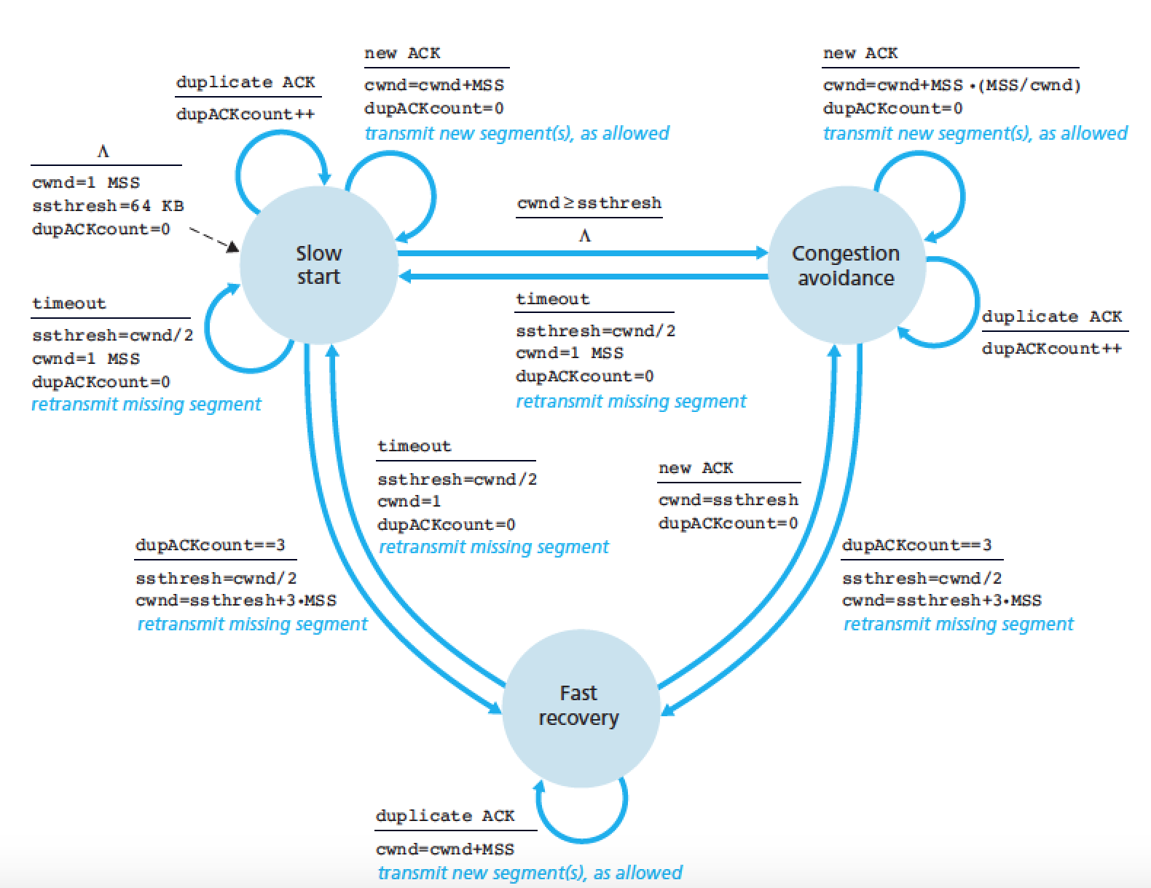

Slide 53
TCP Flavors
TCP-Tahoe
CWND =1 on triple dupACK
TCP-Reno
CWND =1 on timeout
CWND = CWND/2 on triple dupack
TCP-newReno
TCP-Reno + improved fast recovery
TCP-SACK
incorporates selective acknowledgements
Our default assumption

