Slide 1
Introduction to
Network Security
CS 353
Alefiya Hussain

Slide 2
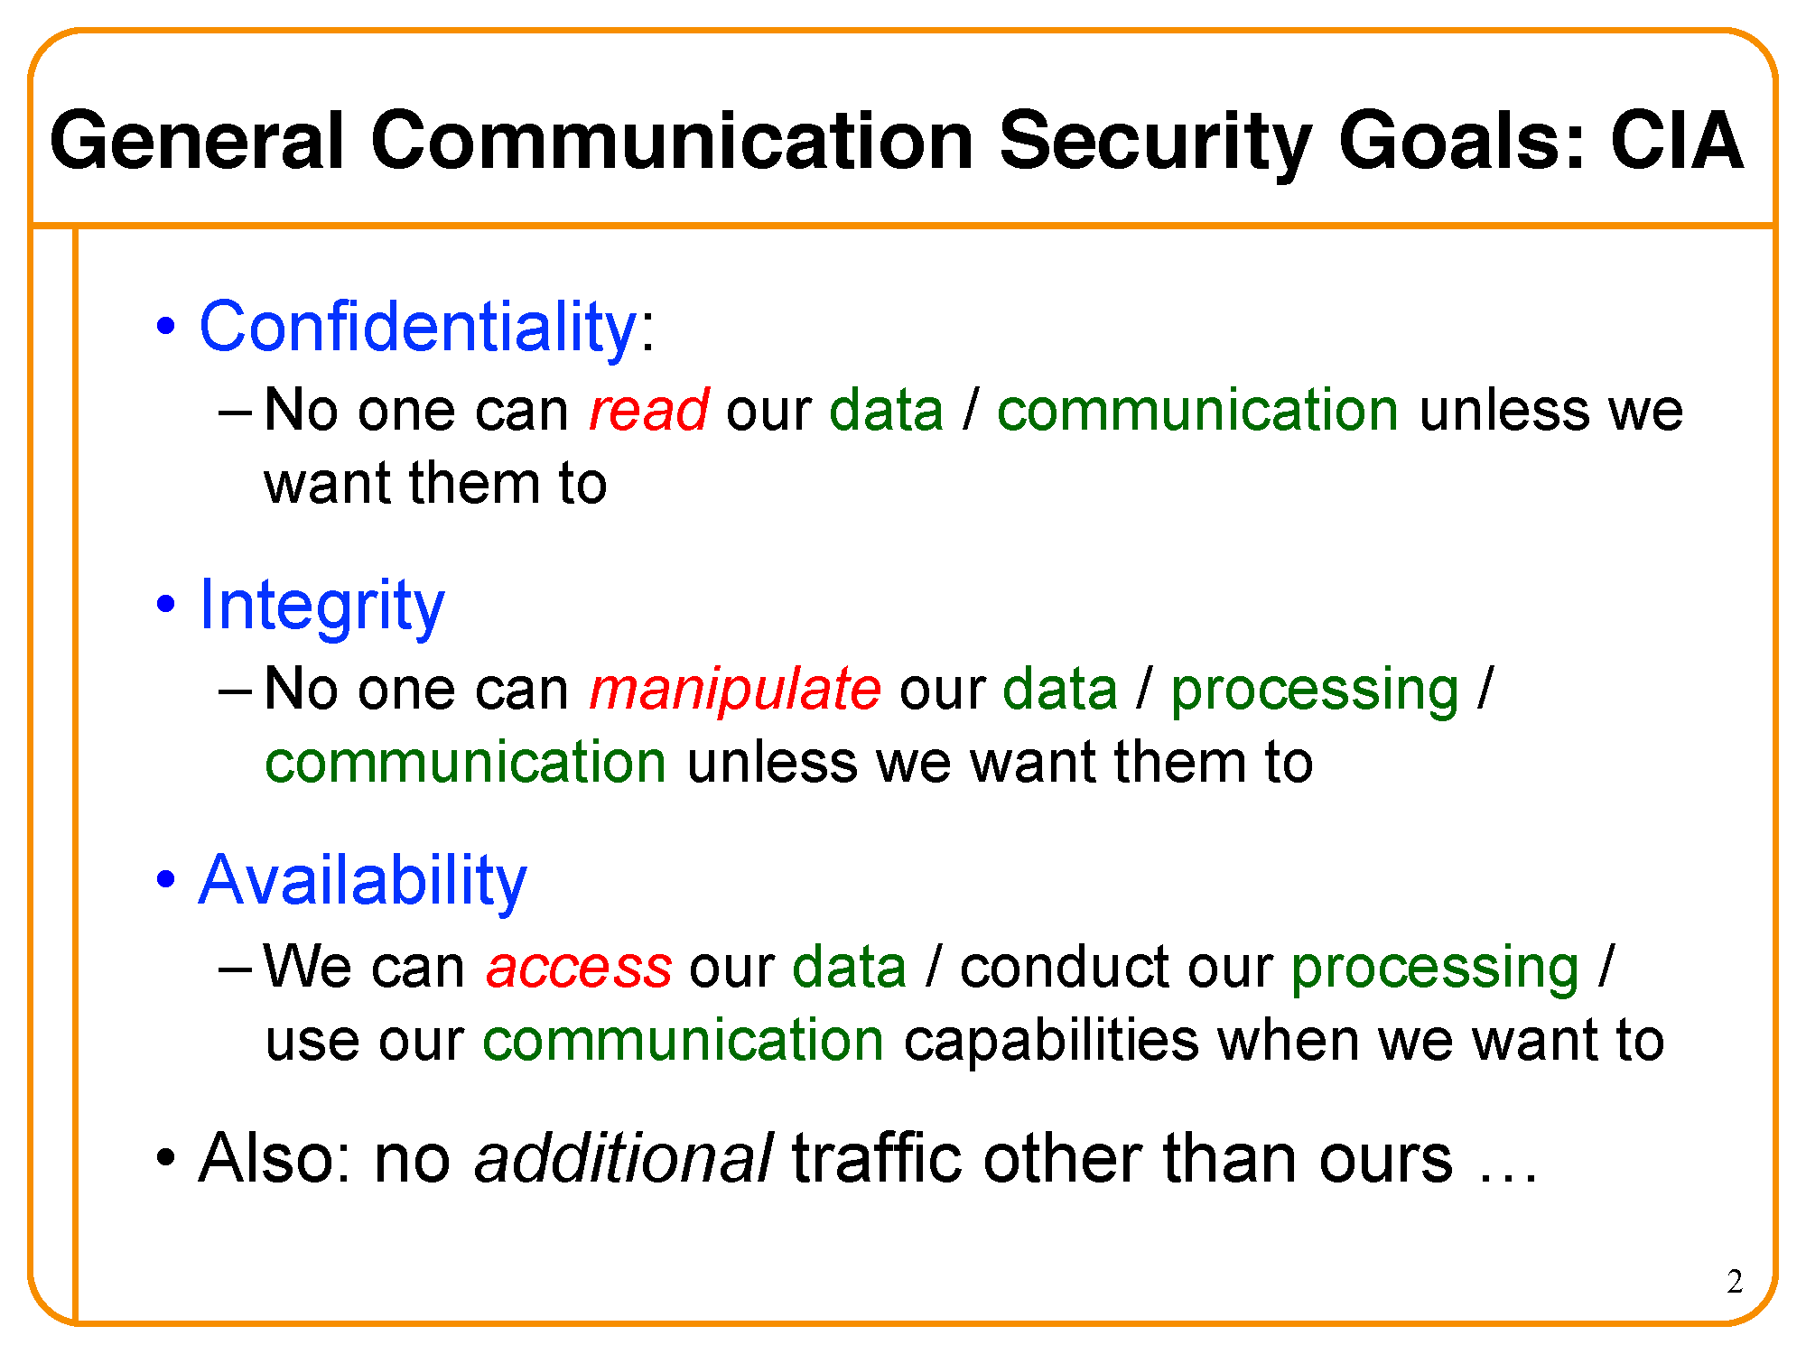

Slide 3
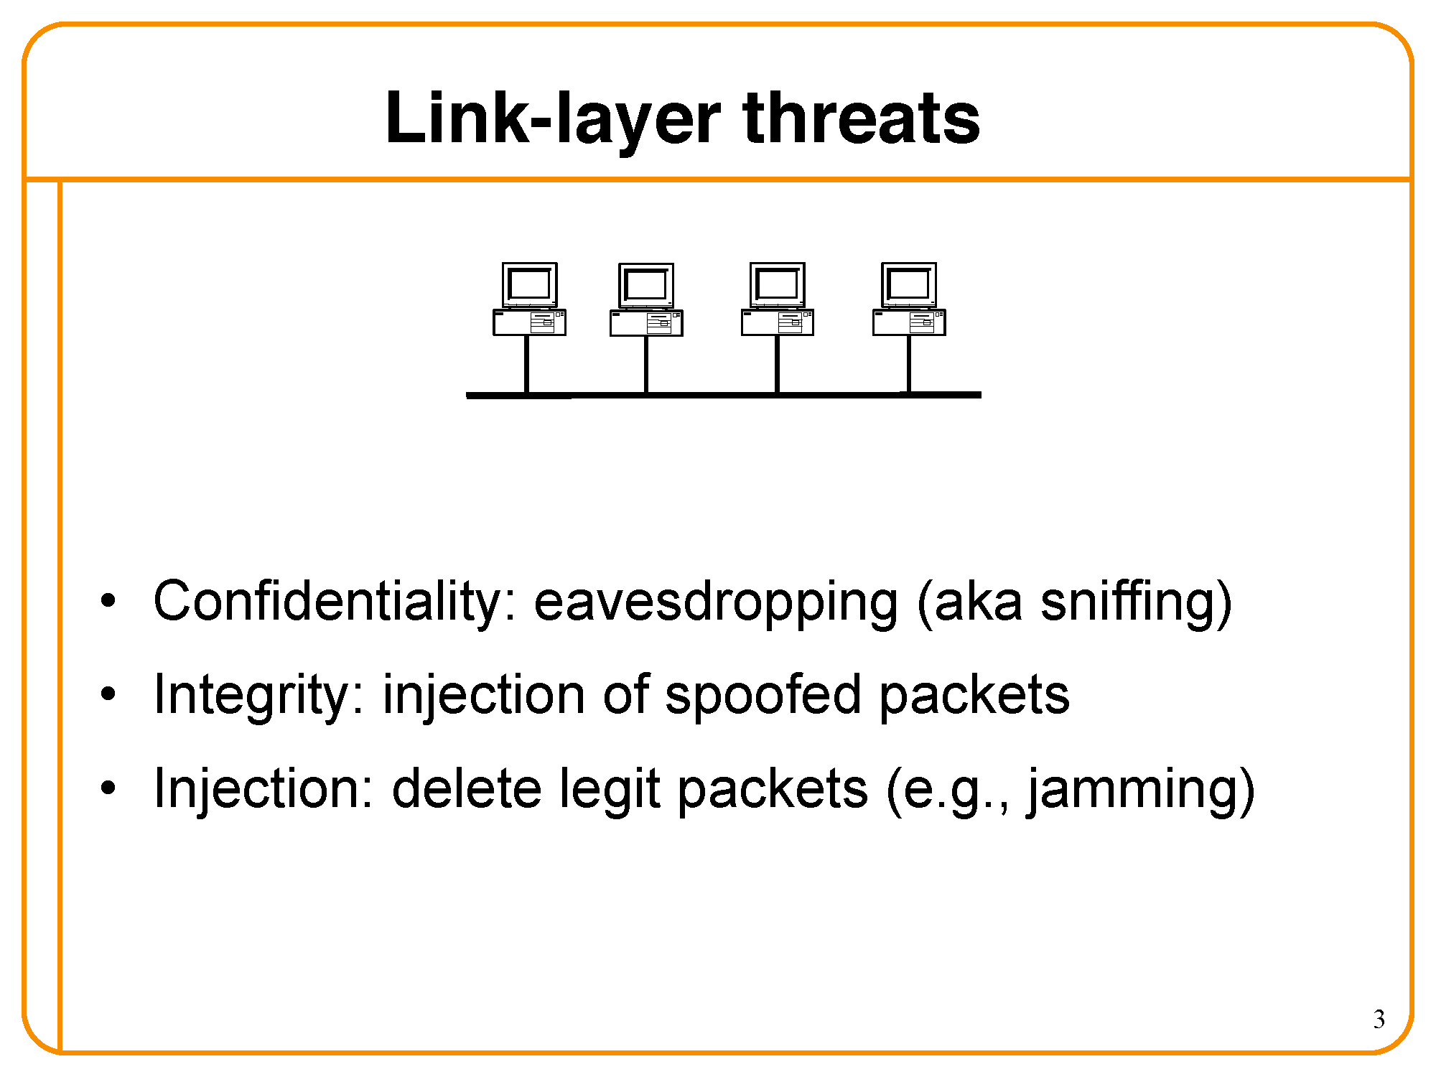

Slide 4
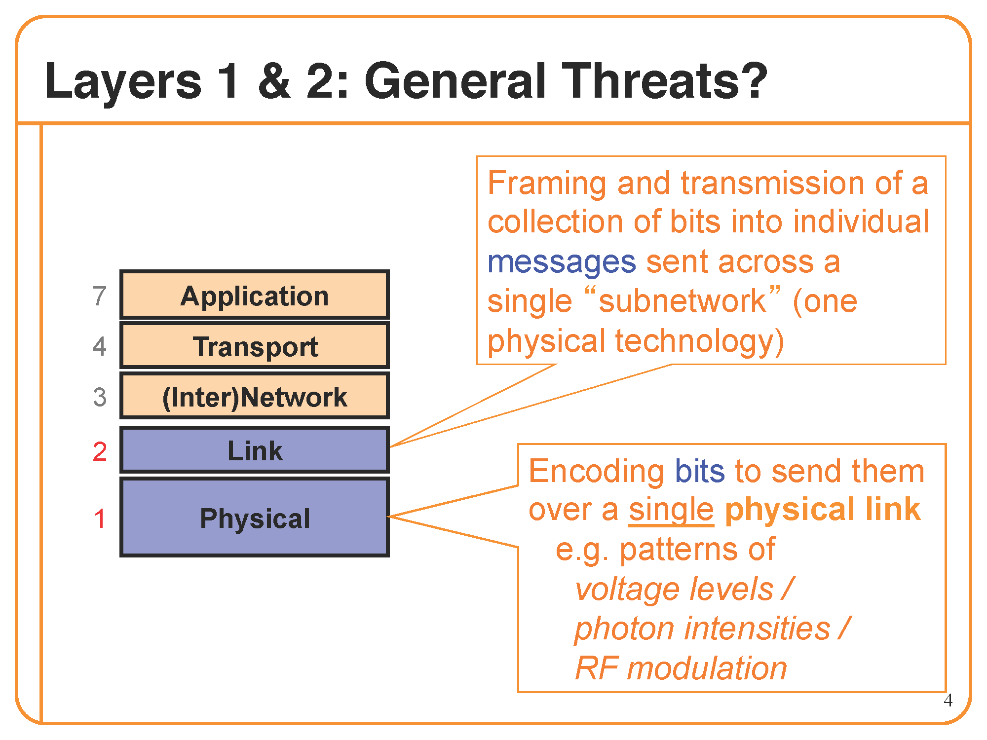

Slide 5
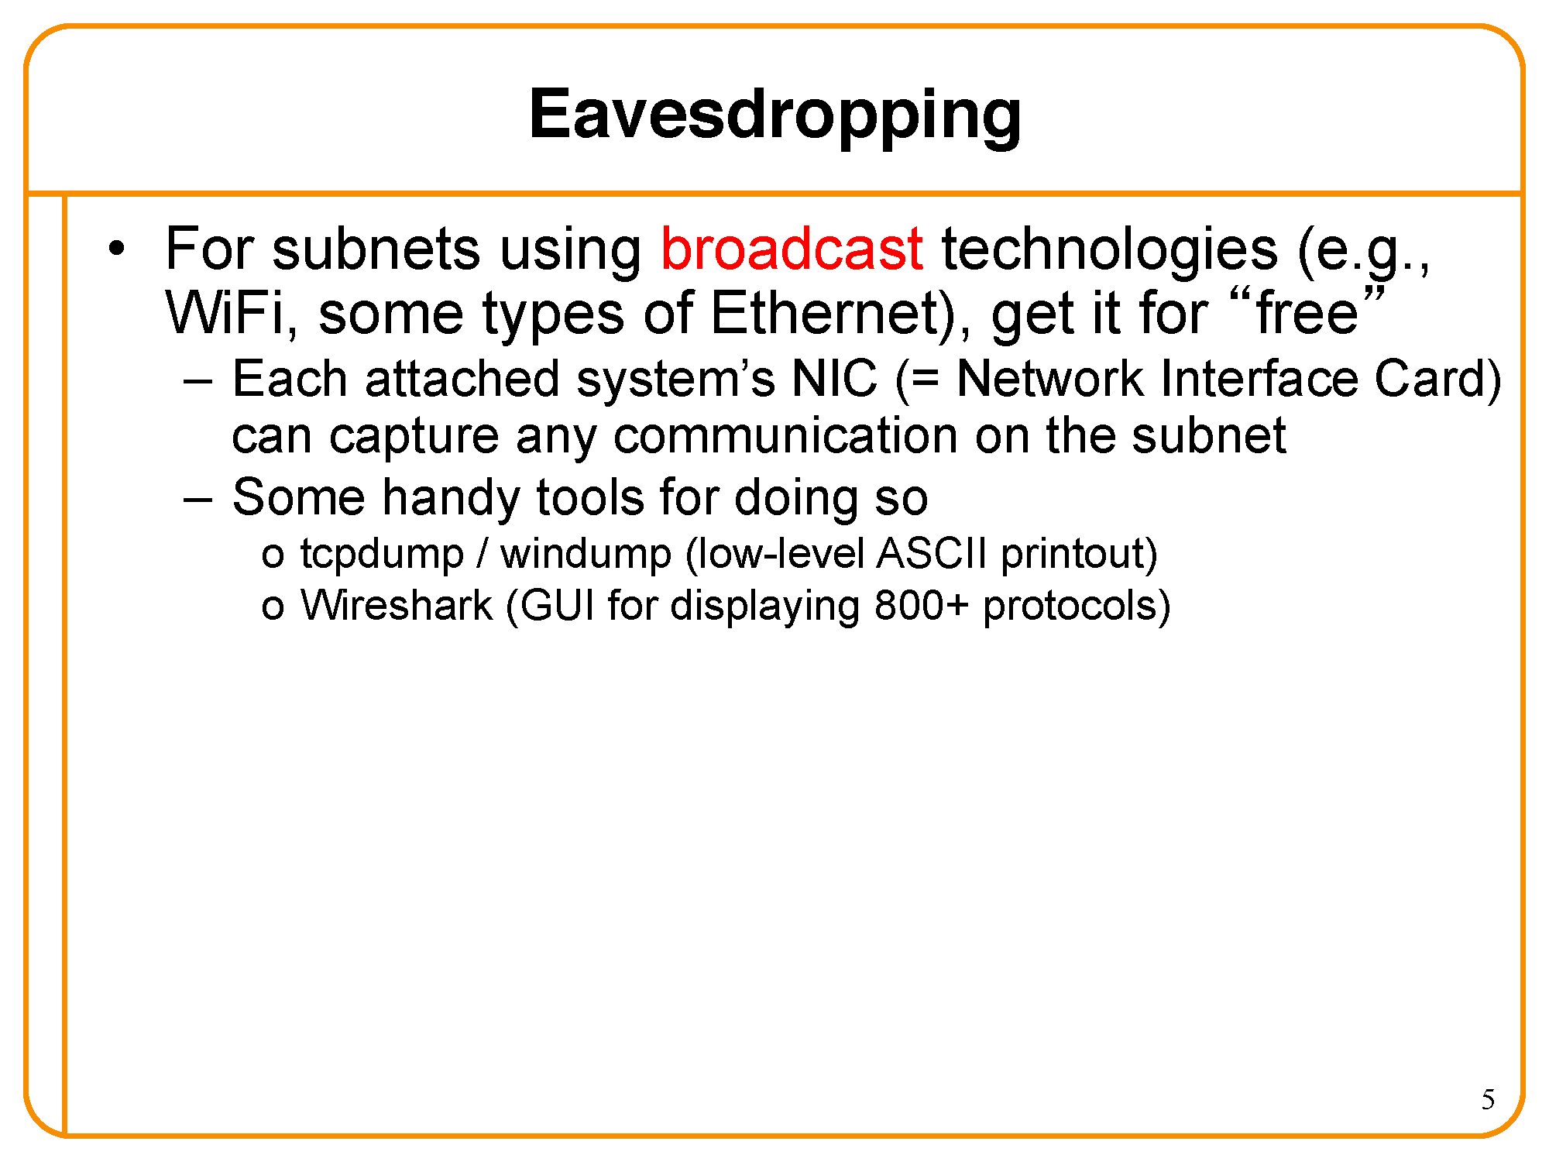

Slide 6
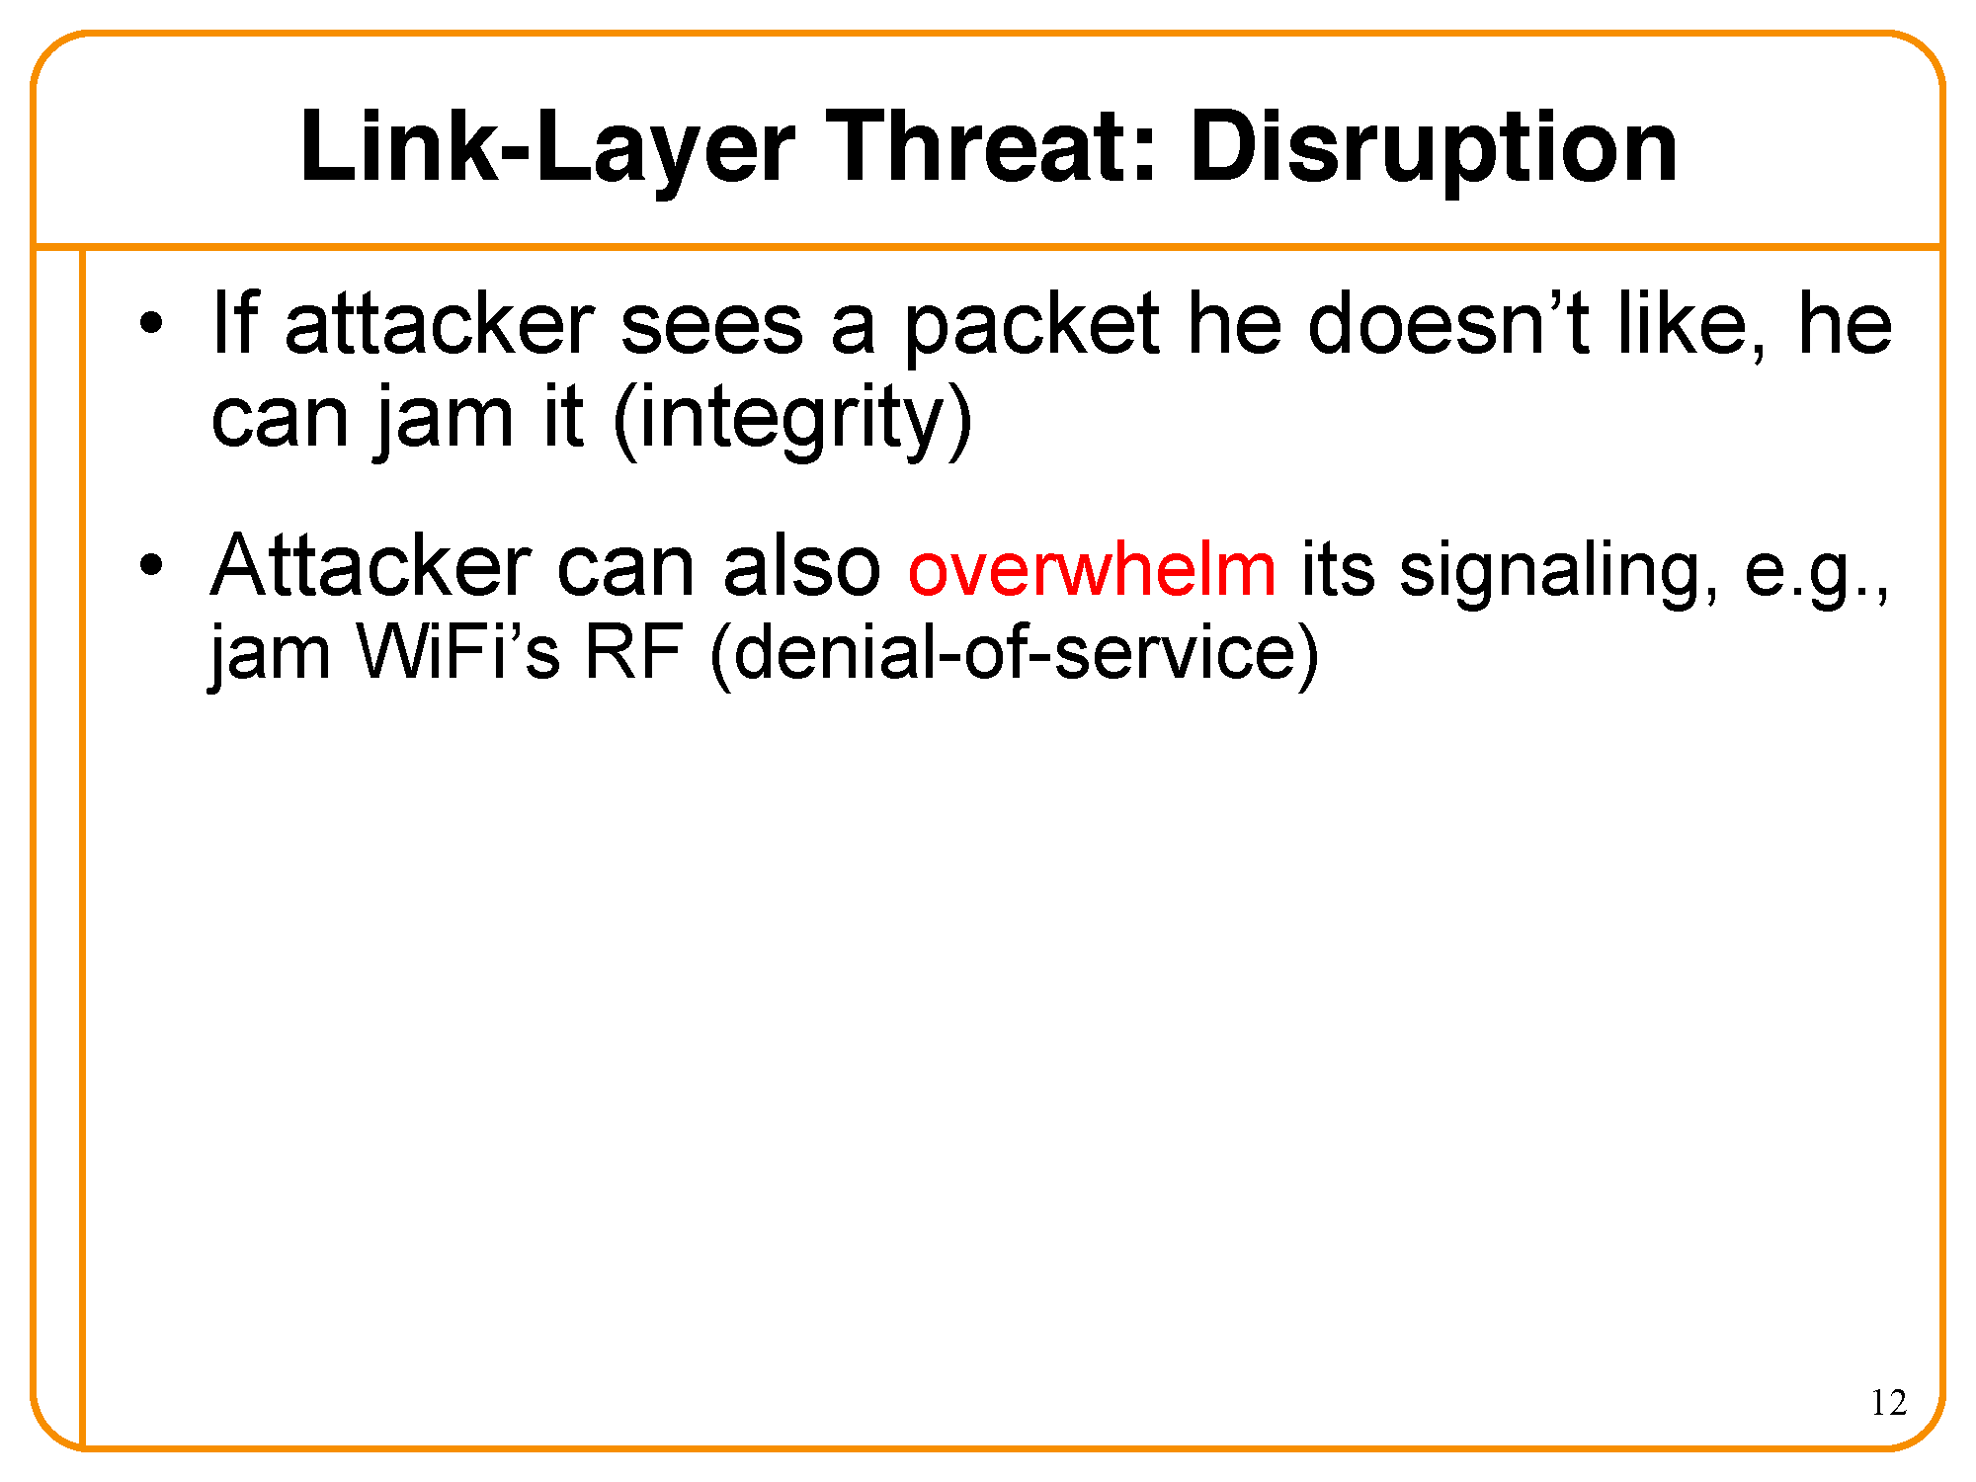

Slide 7
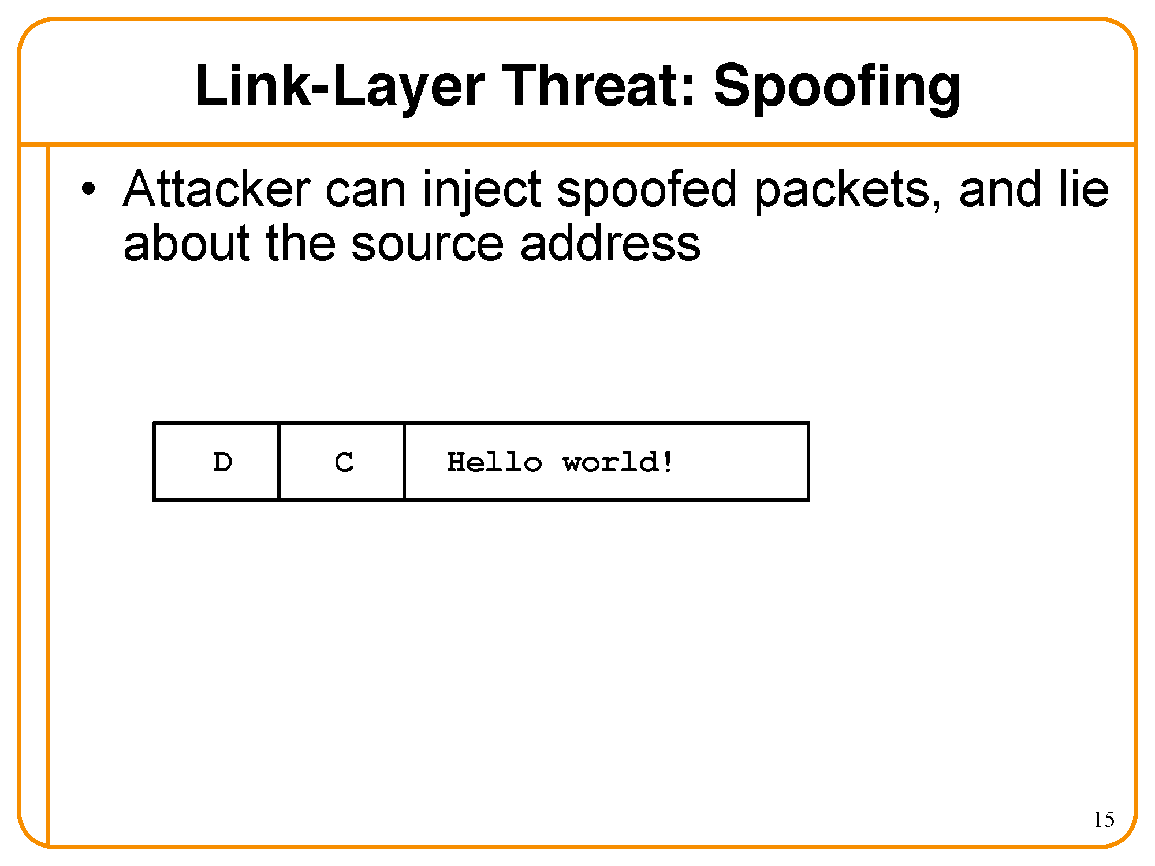

Slide 8
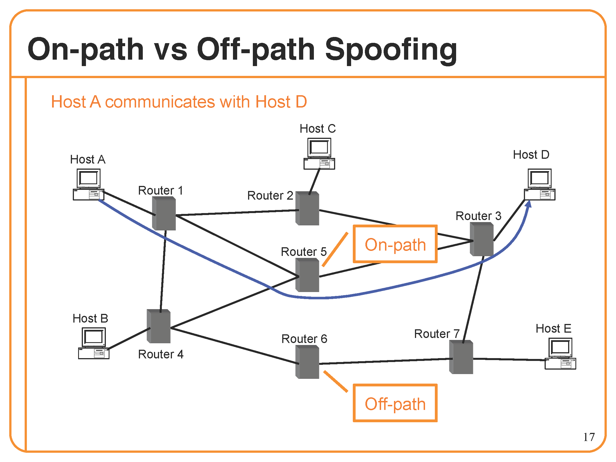

Slide 9
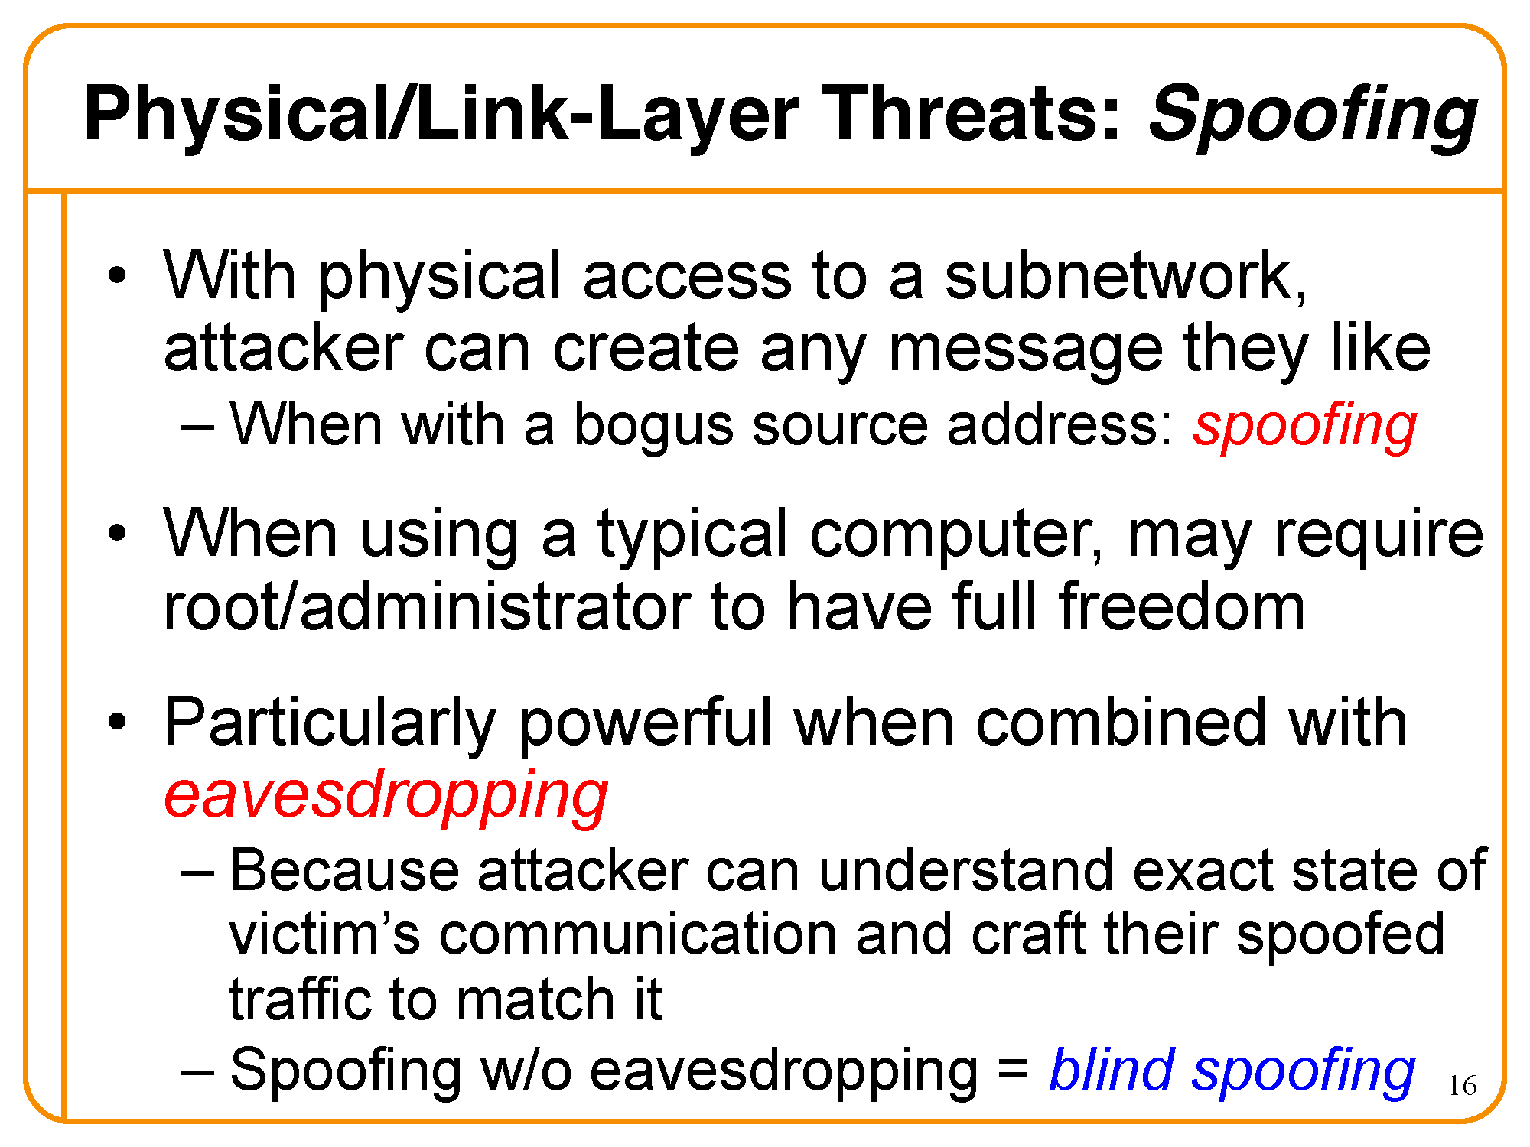

Slide 10
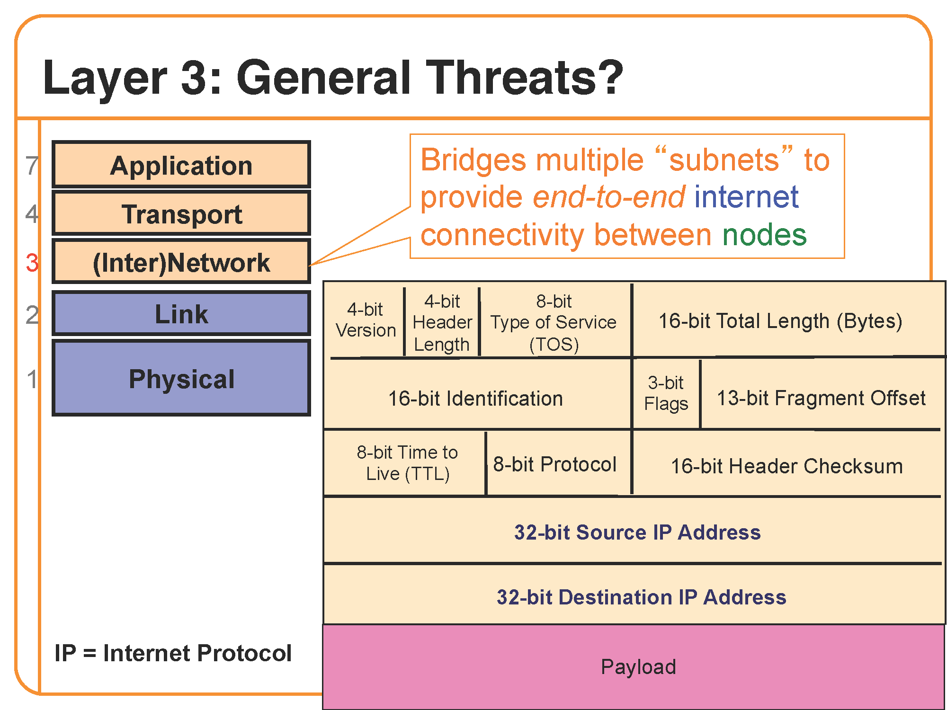

Slide 11
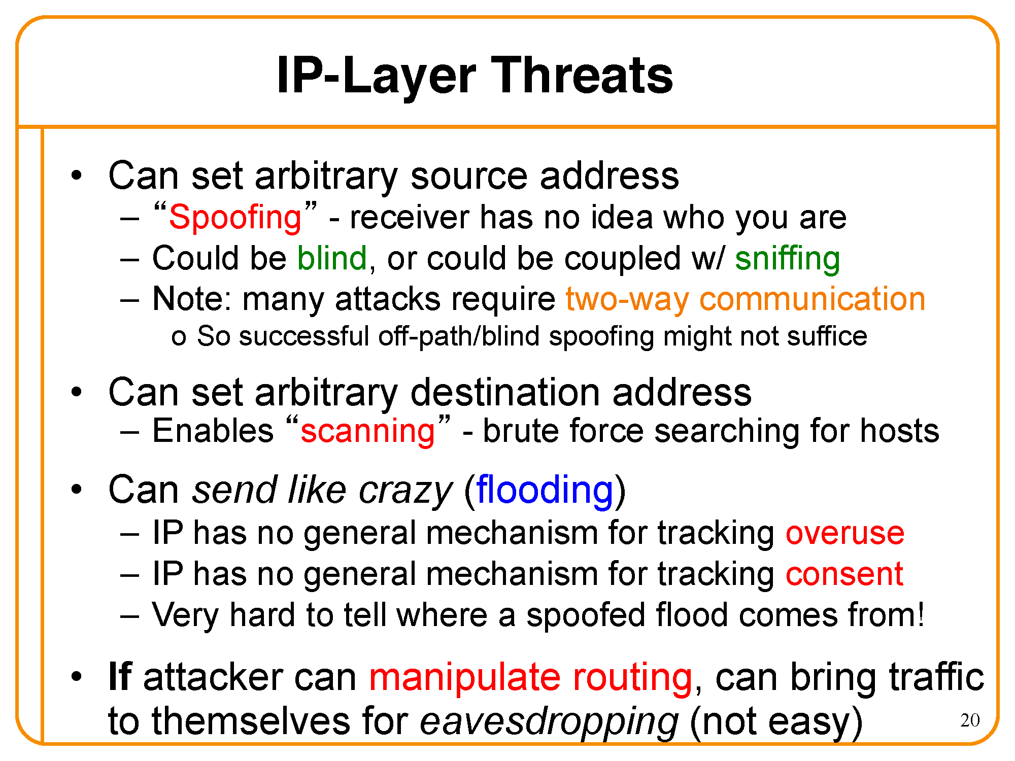

Slide 12
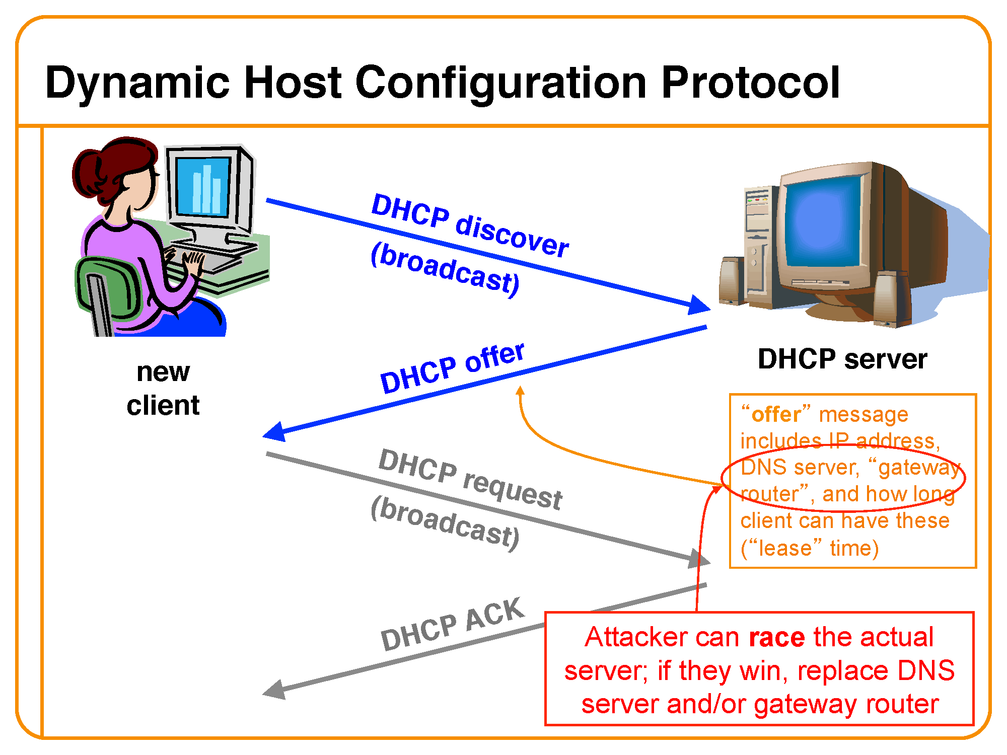

Slide 13
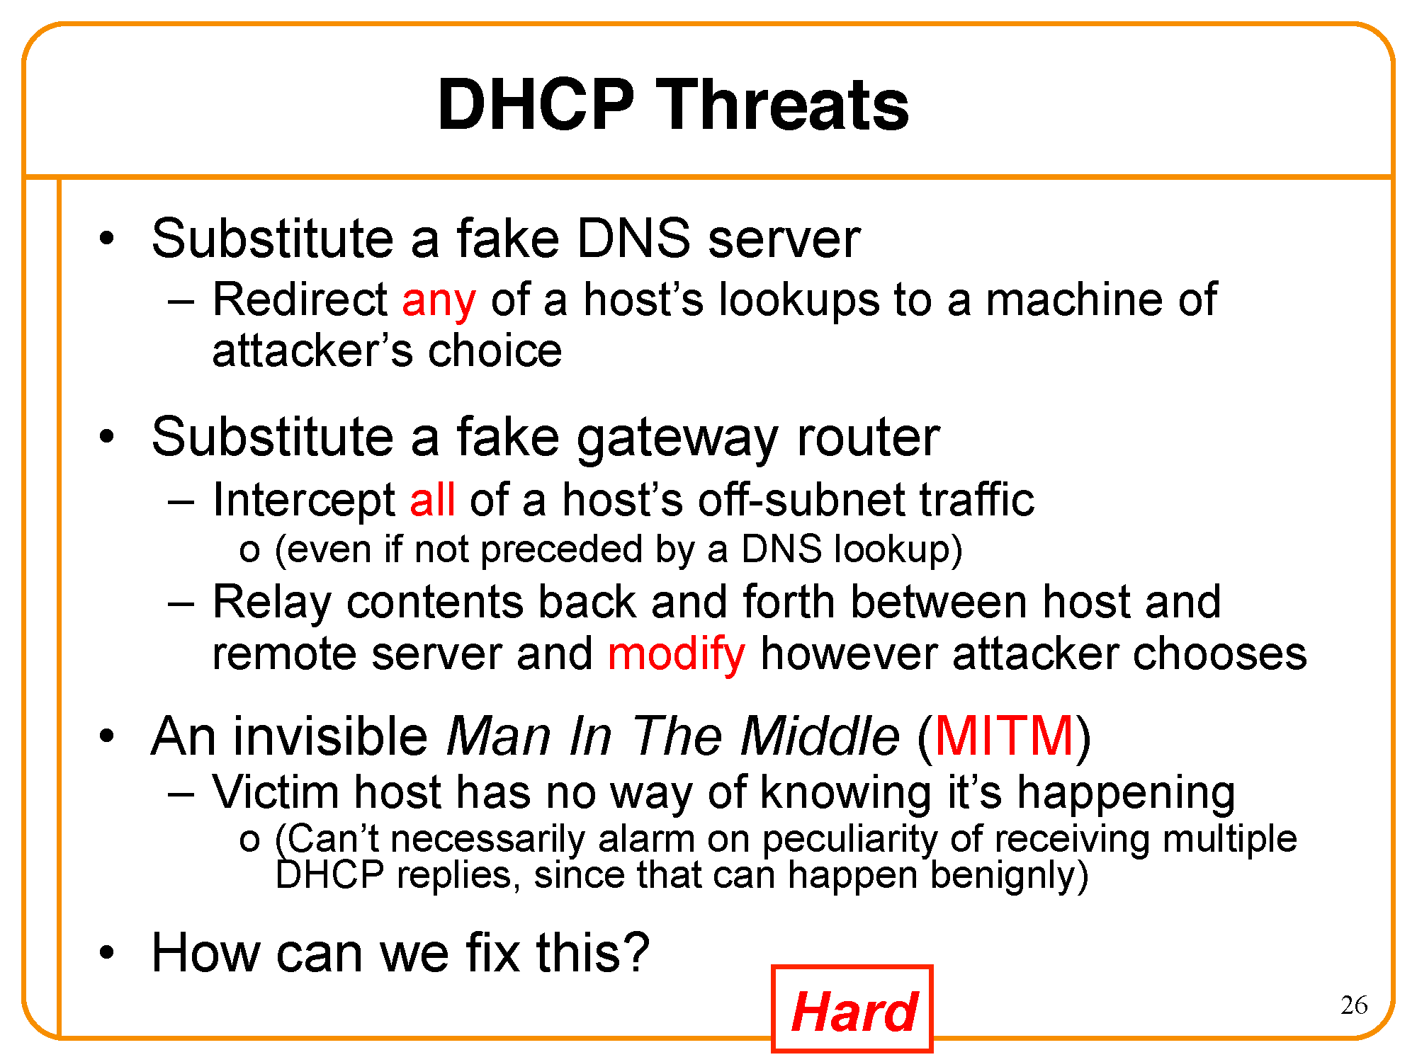

Slide 14
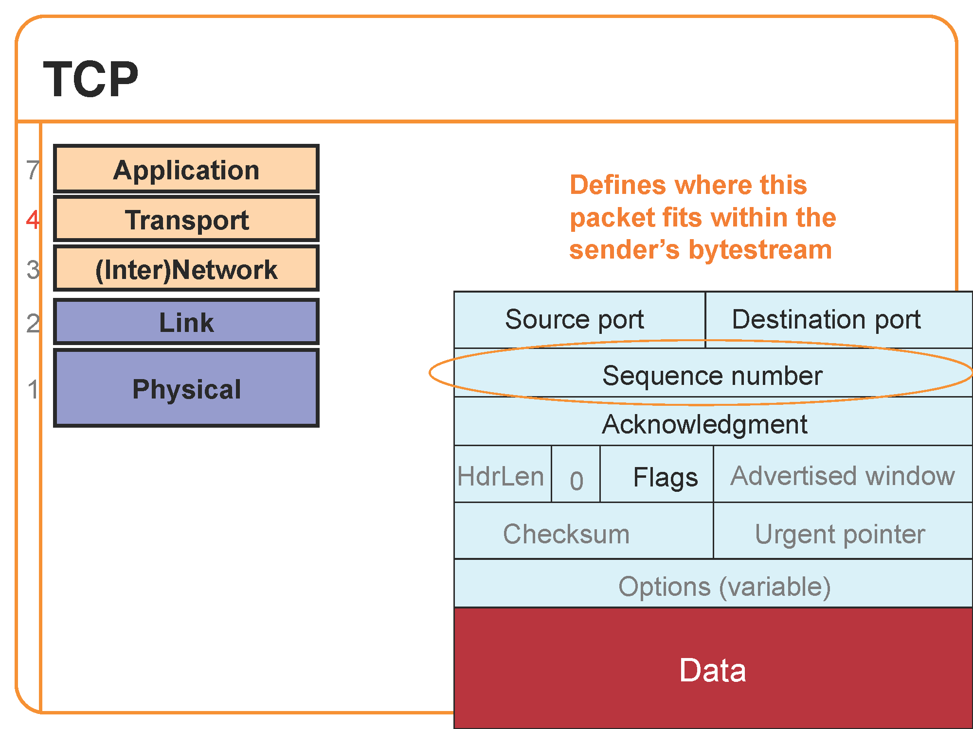

Slide 15
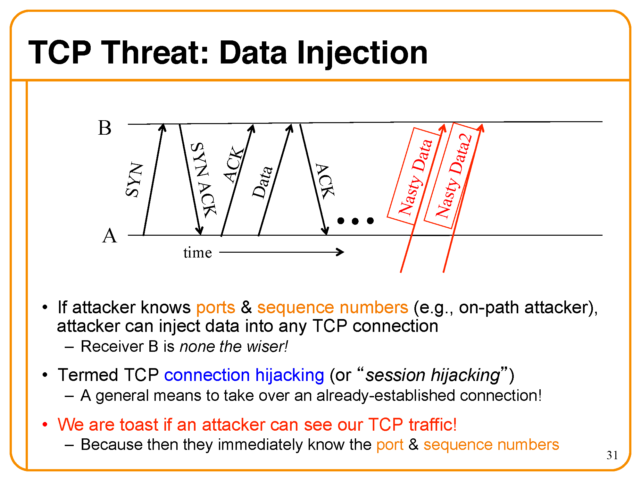

Slide 16
Internet Security
Security Vulnerabilities
DoS and D-DoS
Firewalls
Intrusion Detection Systems

Slide 17
Security Vulnerabilities
Security Problems in the TCP/IP Protocol Suite – Steve Bellovin - 89
Attacks on Different Layers
  IP Attacks
  ICMP Attacks
  Routing Attacks
  TCP Attacks
  Application Layer Attacks

Slide 18
Why?
Internet was designed for connectivity
  Assumed to have lots of trust
Host implementation vulnerabilities
  Software “had/have/will have” bugs
  Some elements in the specification were left to the implementers

Slide 19
Security Flaws in IP
The IP addresses are filled in by the originating host
  Address spoofing
2.1.1.1
C
Can A claim it is B to the server S?
Can C claim it is B to the server S?
Internet
1.1.1.3
S
A
1.1.1.1
1.1.1.2
B

Slide 20
Security Flaws in IP
IP fragmentation attack
  End hosts need to keep the fragments till all the fragments arrive
Traffic amplification attack
  IP allows broadcast destination
  Problems?

Slide 21


Ping Flood
Internet
Attacking System
Broadcast Enabled Network
Victim System

Slide 22
ICMP Attacks
No authentication
ICMP redirect message
  Can cause the host to switch gateways
  Benefit of doing this?
    Man in the middle attack, sniffing
ICMP destination unreachable
  Can cause the host to drop connection
ICMP echo request/reply
Many more…
  http://www.sans.org/rr/whitepapers/threats/477.php

Slide 23
Routing Attacks
Distance Vector Routing
  Announce 0 distance to all other nodes
    Blackhole traffic
    Eavesdrop
Link State Routing
  Can drop links randomly
  Can claim direct link to any other routers
  A bit harder to attack than DV
BGP
  ASes can announce arbitrary prefix
  ASes can alter path

Slide 24
Denial of Service
Objective → make a service unusable, usually by overloading the server or network
Consume host resources
  TCP SYN floods
  ICMP ECHO (ping) floods
Consume bandwidth
  UDP floods
  ICMP floods

Slide 25
Denial of Service
Crashing the victim
  Ping-of-Death
  TCP options (unused, or used incorrectly)
Forcing more computation
  Taking long path in processing of packets

Slide 26
Simple DoS
The Attacker usually spoofed
source address to hide origin
Easy to block
Attacker
Victim
Victim
Victim

Slide 27
Coordinated DoS
Attacker
Attacker
Attacker
Victim
Victim
Victim
The first attacker attacks a different victim to cover up the real attack
The Attacker usually spoofed source address to hide origin
Harder to deal with

Slide 28
Distributed DoS
Attacker
Handler
Handler
Agent
Agent
Agent
Agent
Agent
Victim

Slide 29
Distributed DoS
The handlers are usually very high volume servers
  Easy to hide the attack packets
The agents are usually home users with DSL/Cable
  Already infected and the agent installed
Very difficult to track down the attacker
How to differentiate between DDoS and Flash Crowd?
  Flash Crowd → Many clients using a service legimitaly
    Slashdot Effect
    Victoria Secret Webcast
  Generally the flash crowd disappears when the network is flooded
  Sources in flash crowd are clustered

Slide 30
Firewalls
Lots of vulnerabilities on hosts in network
Users don’t keep systems up to date
  Lots of patches
  Lots of exploits in wild (no patch for them)
Solution?
  Limit access to the network
  Put firewalls across the perimeter of the network

Slide 31
Firewalls (contd…)
Firewall inspects traffic through it
Allows traffic specified in the policy
Drops everything else
Two Types
  Packet Filters, Proxies
Internal Network
Firewall
Internet

Slide 32
Packet Filters
Packet filter selectively passes packets from one network interface to another
Usually done within a router between external and internal networks
  screening router
Can be done by a dedicated network element
  packet filtering bridge
  harder to detect and attack than screening routers

Slide 33
Packet Filters Contd.
Data Available
  IP source and destination addresses
  Transport protocol (TCP, UDP, or ICMP)
  TCP/UDP source and destination ports
  ICMP message type
  Packet options (Fragment Size etc.)
Actions Available
  Allow the packet to go through
  Drop the packet (Notify Sender/Drop Silently)
  Alter the packet (NAT?)
  Log information about the packet

Slide 34
Packet Filters Contd.
Example filters
  Block all packets from outside except for SMTP servers
  Block all traffic to a list of domains
  Block all connections from a specified domain

Slide 35
Typical Firewall Configuration
Internet
Internal hosts can access DMZ and Internet
External hosts can access DMZ only, not Intranet
DMZ hosts can access Internet only
Advantages?
  If a service gets compromised in DMZ it cannot affect internal hosts
DMZ
X
X
Intranet

Slide 36
Example Firewall Rules
Stateless packet filtering firewall
Rule → (Condition, Action)
Rules are processed in top-down order
  If a condition satisfied – action is taken

Slide 37
Sample Firewall Rule
Allow SSH from external hosts to internal hosts
  Two rules
    Inbound and outbound
  How to know a packet is for SSH?
    Inbound: src-port>1023, dst-port=22
    Outbound: src-port=22, dst-port>1023
    Protocol=TCP
  Ack Set?
  Problems?
Client
Server
SYN
SYN/ACK
ACK
Rule
Dir
Src Addr
Src Port
Dst Addr
Dst Port
Proto
Ack Set?
Action
SSH-1
In
Ext
> 1023
Int
22
TCP
Any
Allow
SSH-2
Out
Int
22
Ext
> 1023
TCP
Yes
Alow

Slide 38
Default Firewall Rules
Egress Filtering
  Outbound traffic from external address → Drop
  Benefits?
Ingress Filtering
  Inbound Traffic from internal address → Drop
  Benefits?
Default Deny
  Why?
Rule
Dir
Src Addr
Src Port
Dst Addr
Dst Port
Proto
Ack Set?
Action
Egress
Out
Ext
Any
Ext
Any
Any
Any
Deny
Ingress
In
Int
Any
Int
Any
Any
Any
Deny
Default
Any
Any
Any
Any
Any
Any
Any
Deny

Slide 39
Packet Filters
Advantages
  Transparent to application/user
  Simple packet filters can be efficient
Disadvantages
  Usually fail open
  Very hard to configure the rules
  Doesn’t have enough information to take actions
    Does port 22 always mean SSH?
    Who is the user accessing the SSH?

Slide 40
Alternatives
Stateful packet filters
  Keep the connection states
  Easier to specify rules
  More popular
  Problems?
    State explosion
    State for UDP/ICMP?

Slide 41
Alternatives
Proxy Firewalls
  Two connections instead of one
  Either at transport level
    SOCKS proxy
  Or at application level
    HTTP proxy
Requires applications (or dynamically linked libraries) to be modified to use the proxy

Slide 42
Intrusion Detection Systems
Firewalls allow traffic only to legitimate hosts and services
Traffic to the legitimate hosts/services can have attacks
  CodeReds on IIS
Solution?
  Intrusion Detection Systems
  Monitor data and behavior
  Report when identify attacks

Slide 43
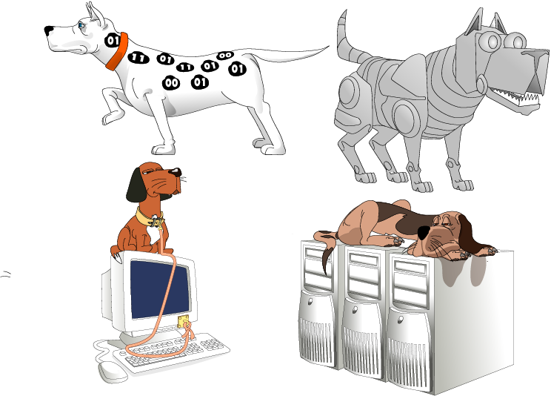
Types of IDS
Signature-based
Anomaly-based
Host-based
Network-based

Slide 44
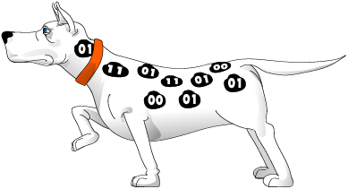
Signature-based IDS
Characteristics
  Uses known pattern matching
  to signify attack
Advantages?
  Widely available
  Fairly fast
  Easy to implement
  Easy to update
Disadvantages?
  Cannot detect attacks for which it has no signature

Slide 45

Anomaly-based IDS
Characteristics
  Uses statistical model or machine learning engine to characterize normal usage behaviors
  Recognizes departures from normal as potential intrusions
Advantages?
  Can detect attempts to exploit new and unforeseen vulnerabilities
  Can recognize authorized usage that falls outside the normal pattern
Disadvantages?
  Generally slower, more resource intensive compared to signature-based IDS
  Greater complexity, difficult to configure
  Higher percentages of false alerts

Slide 46

Network-based IDS
Characteristics
  NIDS examine raw packets in the network passively and triggers alerts
Advantages?
  Easy deployment
  Unobtrusive
  Difficult to evade if done at low level of network operation
Disadvantages?
  Fail Open
  Different hosts process packets differently
  NIDS needs to create traffic seen at the end host
  Need to have the complete network topology and complete host behavior

Slide 47

Host-based IDS
Characteristics
  Runs on single host
  Can analyze audit-trails, logs, integrity of files and directories, etc.
Advantages
  More accurate than NIDS
  Less volume of traffic so less overhead
Disadvantages
  Deployment is expensive
  What happens when host get compromised?

Slide 48
Summary
TCP/IP security vulnerabilities
  Spoofing
  Flooding attacks
  TCP session poisoning
DOS and D-DOS
Firewalls
  Packet Filters
IDS
  Signature and Anomaly IDS
  NIDS and HIDS

