Slide 1

Implementing AdaBoost for Predicting
Online Shoppers' Purchase Intentions
Team: 404 Not Found
Diksha Krishnan, Xinyu Zhou, Shen Yu, Dongyan Sun
December 9, 2024
Notes:
Today, we're here to talk about AdaBoost, For our final project, we used different types of feature, such as the number of pages and the duration that the visitor visits or stays in the online shopping site. to perform Binary classification using Adaboost to predict the purchasing intentions of online shoppers
At its core, AdaBoost is a strong predictive model combined by multiple weak learners.

Slide 2
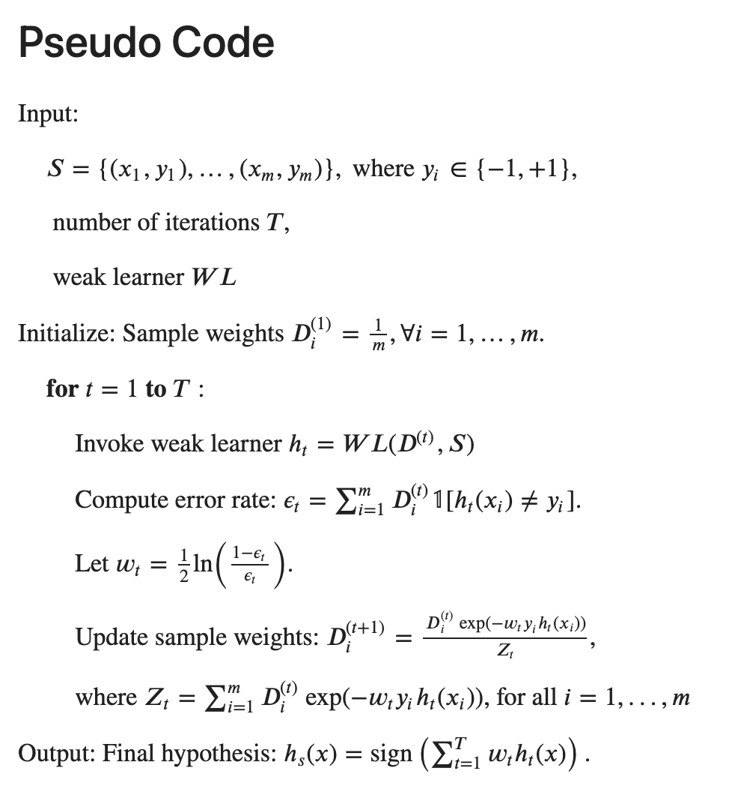
How does it work?
Weak Learners
Weighting
Iteration T
Prediction
Notes:
So How Does AdaBoost Work?
Let’s break it down step by step. first All samples are initialized with equal weights
AdaBoost starts by training a weak learner, in our case, the decision stump. which is just a very basic decision tree with a single decision boundary. While these learners are individually weak, they form the foundation of iterative improvement process.
Once the weak learner is trained, it assigns the weight based on its accuracy. Learners with smaller errors get larger weights, emphasizing their contribution to the overall model. This weighting mechanism allows AdaBoost to focus on the strengths of each learner while minimizing their individual weaknesses.
Next, AdaBoost shifts its attention to the misclassified samples and update the weights accordingly. It increases the weights of these difficult examples so that the next weak learner will pay more attention to them. This process ensures that each new learner improves on the weaknesses of the previous ones to refine the model.
Finally, all the weak learners are combined into a single, strong model. Each weak learner contributes to the final prediction, weighted by its performance. This weighted combination creates a complex decision boundary, enabling AdaBoost to handle challenging, non-linear datasets.
In AdaBoost, the number of iteration is crucial for managing the bias-variance tradeoff:
If TT is too low, the model will have high bias and underfit the data.
If TT is too high, the model will have high variance and overfit.

Slide 3
Advantages
Disadvantages
Simplicity and Flexibility
Non-Linear Problems
Resistant to Overfitting
Sensitive
Computational Complexity
Dependence on Weak Learners
Notes:
Now that we’ve covered the process, let’s talk about what makes AdaBoost so powerful:
Simplicity and Flexibility AdaBoost is simple to implement and highly flexible. It can work with various weak learners,and decision stumps are a popular choice.
Second By combining multiple simple learners, AdaBoost can effectively create complex decision boundaries, allowing it to handle non-linear problems that other algorithms might struggle with.
Most importantly, When properly tuned, AdaBoost can avoid overfitting, by balance through the bias-variance tradeoff, gradually increasing complexity with each boosting round.
However, like any algorithm, AdaBoost has its limitations:
First, AdaBoost’s weighting mechanism makes it sensitive to noisy data. If misclassified samples are actually outliers, they may disproportionately influence the model, reducing its overall performance.
it is also computationally expensive because of its iterative nature, especially for large datasets or complex weak learners.
Lastly, The effectiveness of AdaBoost depends heavily on the quality of the weak learners. If the weak learners are too simple, the model may fail to perform well. On the other hand, overly complex weak learners can lead to overfitting.

Slide 4

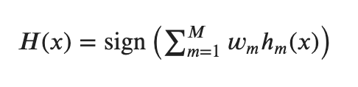
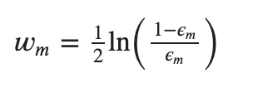

Math Behind AdaBoost
Equations of AdaBoost
1. The weak learner is Decision Stumps
2. A weighted sum of the predictions from all weak learners
3. Smaller error leads to a larger weight, indicating a better learner
Representation
Loss Function
1. Minimizes an exponential loss function which ensures that large errors (misclassified points) contribute more significantly to the loss
2. Encouraging the model to focus on correcting them
Optimizer

Slide 5
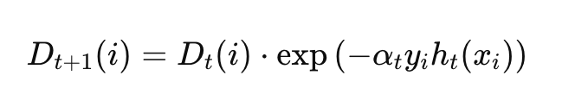
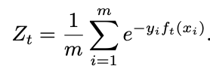
Math Behind AdaBoost
Representation
Optimizer
Loss
Notes:
Representation:
- AdaBoost uses simple, weak models called Decision Stumps as the building blocks.
- The final AdaBoost model is a weighted sum of the predictions from all the weak Stumps.
- Stumps with smaller errors get higher weights, contributing more to the final prediction.
Loss Function:
- AdaBoost uses the Exponential Loss function, which places more emphasis on large mistakes than small errors.
- Minimizing this loss encourages the model to focus on correcting the significant errors made by the weak learners.
Mathematically, the Exponential Loss is defined as L(H) = Σ_i exp(-y_i * H(x_i)), where y_i is the true label and H(x_i) is the predicted label for the i-th training example. The exponential term ensures that examples that are misclassified by a large margin contribute much more to the overall loss than those that are classified correctly or have small errors.
By minimizing this Exponential Loss, AdaBoost encourages the model to focus on correcting those large mistakes made by the weak learners.
Optimizer:
- The Optimizer adjusts the weights of the weak classifiers and training samples to minimize the overall error.
- For weak classifiers, higher weights are assigned to those with smaller errors.
- For training samples, higher weights are given to those consistently misclassified by the weak learners.
- The key idea is the "binding normalization factor (Z_t)", which ensures the weights are properly normalized.
Equations:
1. The input data is represented as x ∈ ℝ^d, and the labels are y ∈ {1, -1}.
2. The final AdaBoost model is H(x) = sign(Σ_m w_m * h_m(x)), where w_m is the weight of the m-th weak learner.
3. The weight w_m is calculated as 1/2 * ln((1-ε_m)/ε_m), where ε_m is the error rate of the m-th weak learner.
4. The overall loss function is L(H) = Σ_i exp(-y_i * H(x_i)).

Slide 6
Numerical Techniques
1. ensures that the weight updates are correctly scaled
2. prevent underflow or overflow errors
Exponentiation of Weight Updates
ensures weak classifiers with low error receive higher weights
introduces stability, by avoiding extremely large or small values of alpha​
Logarithm of Alpha Computation
Normalization of Weights
after updating the weights, they are normalized
prevent the weights from growing too large, which could lead to numerical instability
Notes:
Normalization of Weights:
- This step ensures the weight updates are correctly scaled and prevents the weights from growing too large.
- The normalization factor is Z_t = 1/m * Σ_i e^(-y_i * f_t(x_i)), where m is the number of samples, y_i is the true label, and f_t(x_i) is the prediction of the t-th weak classifier.
- Normalizing the weights helps the AdaBoost algorithm converge and maintain numerical stability
This normalization step serves two key purposes:
1. Ensuring the Weights are Properly Scaled: After the Optimizer adjusts the weights, the normalization step ensures that the weight updates are correctly scaled. This prevents underflow or overflow errors that could arise from using extremely large or small weight values.
2. Preventing the Weights from Growing Too Large: Without normalization, the weights could continue to grow larger and larger with each iteration, leading to numerical instability in the overall model. The normalization step helps keep the weights within a reasonable range, maintaining the stability of the AdaBoost algorithm.

Slide 7
Previous Work We Reproduced
Target Variable
Y: which online shoppers will end with shopping
{1, -1}
Binary Classification
Feature
X: URL information of the pages visited
10 continuous
7 categorical
Preprocess
One Hot Encoder
Standard Scaler
Imbalance
Stratified Split
60% Train
20% Validation
20% Test
Main Function to Combine All
Preprocess
+ Split
Initialize Function
Weak Classifier
Function
Train Function
Predict Function

Slide 8
Functions
Initialize Function
Initialize Variables
Iterate Over Features
Evaluate Thresholds
Test Polarities
Calculate Weighted Error
Weak Classifier
Function
identify best decision stump
1. Initialize Weights
2. Build Weak Classifiers
3. Calculate Alpha
4. Update Sample Weights
5. Store Stump and Alpha
Train Function
return combination of stumps
Predict Function
return final prediction
1. Initialize Predictions
2. Iterate Over Weak Classifiers
3. Make Weak Predictions
4. Aggregate Weighted Predictions
5. Return Final Prediction
Main Function
combine all steps and parameter tuning

Slide 9
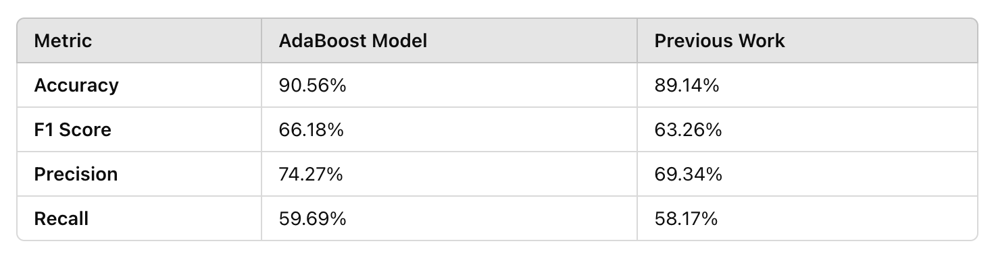
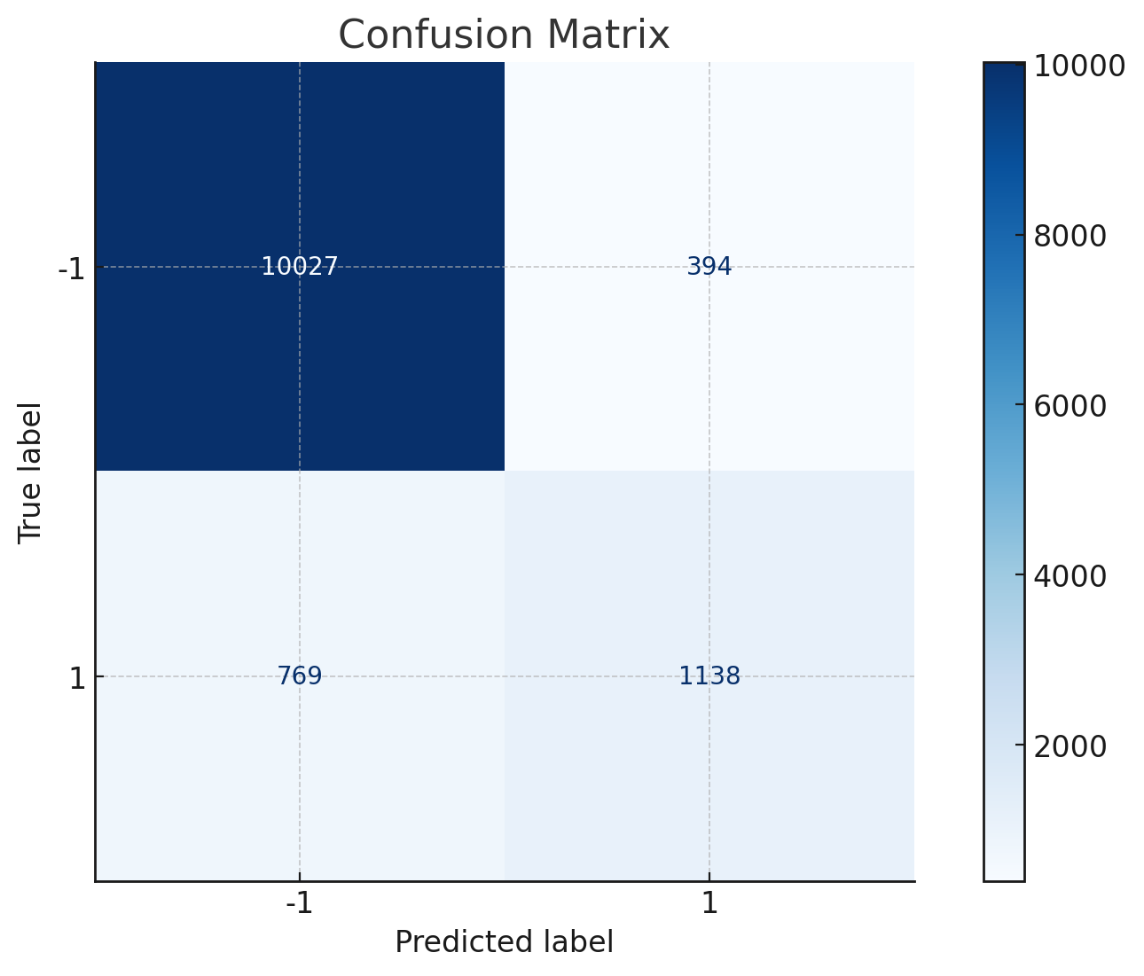
Result
Slightly Higher Accuracy & F1 Score
Low Recall reduces Low F1 Score
Poor to Capture True Positives
Action 1: Oversampling or Undersampling
Goal 1 : Improve Balance
Action 2: Replace Weak Classifier with Decision Tree
Goal 2: More Sensitive to Minority Class

Slide 10
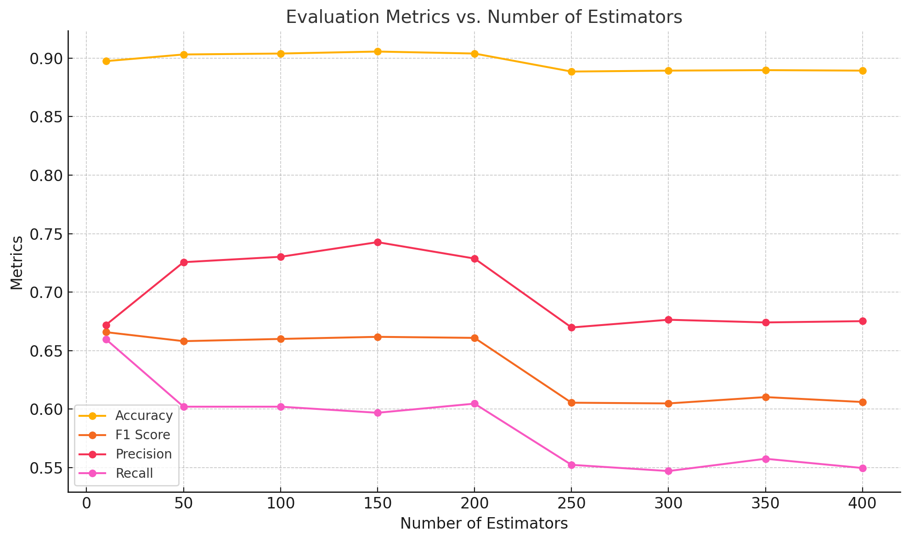
Result
Tune the Number of Estimators
150: Best Performance Above 200: Overfitting
Trade-off between Bias and Variance

Slide 11
Interesting Things about AdaBoost
combines weak learners (like decision stumps) into a strong ensemble
easy to implement
works effectively for both classification and regression problems
1. prioritizes correcting mistakes made by earlier weak learners
2. iteratively updating weights for misclassified samples
3. focus on hard-to-classify points, making the model highly adaptive
Error Focusing and Adaptive
Simple but Powerful
in the early stages, when bias is high, it focuses on improving the model by giving more weight to the misclassified examples
as the model improves, focus shifts toward balancing bias reduction with variance control
Balancing Bias and Variance
Notes:
Let’s rub up and talk about the interesting things we found about AdaBoost.
First, AdaBoost is error focusing and adaptive. It prioritizes correcting mistakes by iteratively updating weights for misclassified samples. This means the model focus on hard-to-classify points, making the model highly adaptive and robust. This allows the model to handle the imbalanced nature of the real-world dataset.
Second, AdaBoost is simple in concept but powerful in application. It combines weak learners, such as decision stumps, into a strong ensemble to achieve impressive results. It’s easy to implement and works effectively for both classification and regression problems. This has made AdaBoost perform well in our predicting task, even when using a relatively small number of estimators
Finally, AdaBoost is great at balancing bias and variance. In the early stages, when bias is high, the model focuses on reducing it by giving more weight to misclassified examples. As the model improves, this focus shifts toward balancing bias reduction with variance control, leading to a highly accurate classifier. This well-balanced nature helped mitigate overfitting while still capturing complex patterns in user behavior.
So, these make it an elegant and effective algorithm.

Slide 12
Challenges when implemented AdaBoost
Sensitivity to Noise
misclassified samples are given higher weights
if the misclassified samples are just noises or outliers, it can lead to poor performance
carefully preprocess the data
requires sequential training of multiple weak learners
slow when dealing with large datasets or complex base learners
this sequential nature also makes it less parallelizable
Computational Intensity
requires careful tuning of hyperparameters, such as the number of iterations and learning rate
incorrect tuning may lead to underfitting or overfitting
if the weak learners are too complex, the model may overfit the training data
Complex Parameter Tuning
Notes:
However, implementing AdaBoost also comes with some challenges. Let’s take a closer look at these.
The first challenge is sensitivity to noise. Misclassified samples are given higher weights. If these misclassified samples are noise or outliers, their influence can overly affect the model and lead to poor performance. To mitigate this, it’s essential for us to carefully preprocess the data.
The second challenge is computational intensity. AdaBoost requires sequential training of multiple weak learners, which can be slow when dealing with large datasets or complex base learners. This sequential nature also makes it less parallelizable than other ensemble methods.
Finally,parameter tuning can be tricky. It requires careful tuning of hyperparameters, such as the number of iterations and learning rate. If the number of iterations is too low, the model underfits, failing to capture the data's patterns. On the other hand, too many iterations can lead to overfitting, especially when weak learners are overly complex. Therefore, extensive testing and validation are required to strike the right balance.
In conclusion, while AdaBoost is powerful, these challenges highlight the importance of thoughtful implementation.

Slide 13
Q&A
References:
1. Shalev-Shwartz, S. and Ben-David, S. (2014) Understanding Machine Learning: From Theory to Algorithms. Cambridge: Cambridge University Press.
2. Swetha, T., R, R., Sajitha, T., B, V., Sravani, J. and Praveen, B. (2024) 'Forecasting Online Shoppers Purchase Intentions with Cat Boost Classifier', 2024 International Conference on Distributed Computing and Optimization Techniques (ICDCOT), Bengaluru, India, 2024, pp. 1-6. doi: 10.1109/ICDCOT61034.2024.10515309.
3. Sakar, C. & Kastro, Y. (2018). Online Shoppers Purchasing Intention Dataset [Dataset]. UCI Machine Learning Repository. https://doi.org/10.24432/C5F88Q.
Githubs:
https://github.com/delio05/AdaBoost

