Slide 1
Credit Risk Analysis based on Customer Behavior
Dongyan Sun
Data Science Institute
October 20, 2023
https://github.com/EmmaSun19902023/Midterm_Project_EmmaSun.git

Slide 2
introduction
Predict Credit Card Repayment
according to Clients’ Background and Payment Information
Risk Analyst:
Quantifying Credit
Financial Company:
Control Loss
Credit-Worthy Client:
Low Capital Cost
Society:
Capital Allocation
Data from Kaggle: https://www.kaggle.com/datasets/pradip11/amexpert-codelab-2021/code
Collected by American Express Company

Slide 3
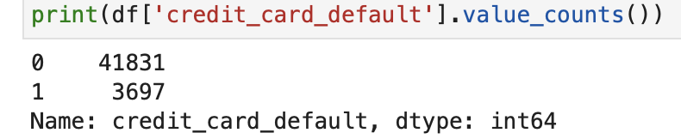
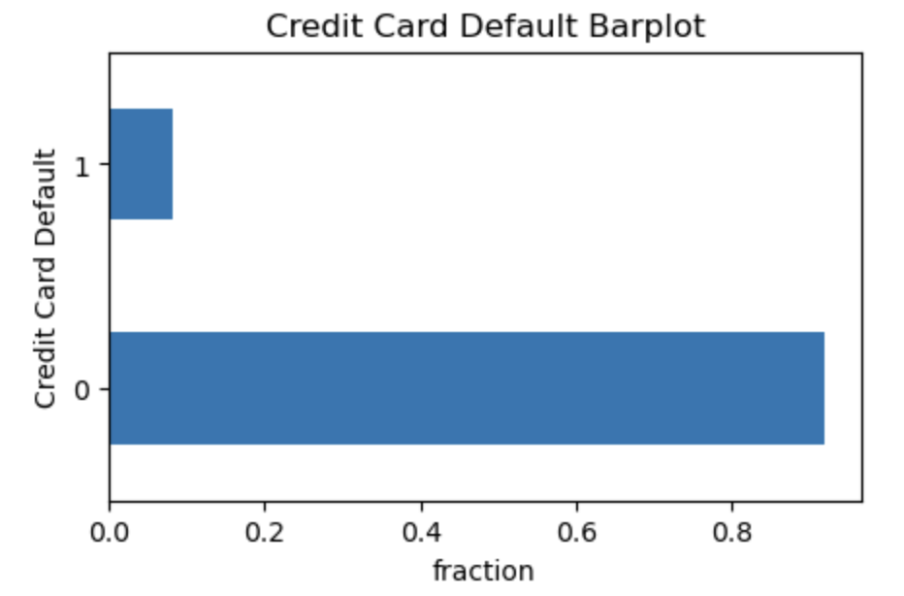
45528 rows *19 columns
credit_card_default
Past Due on Payment ( = 1 )
VS
Pay On Time( = 0 )
Categorical Feature
Classification Problem

Slide 4
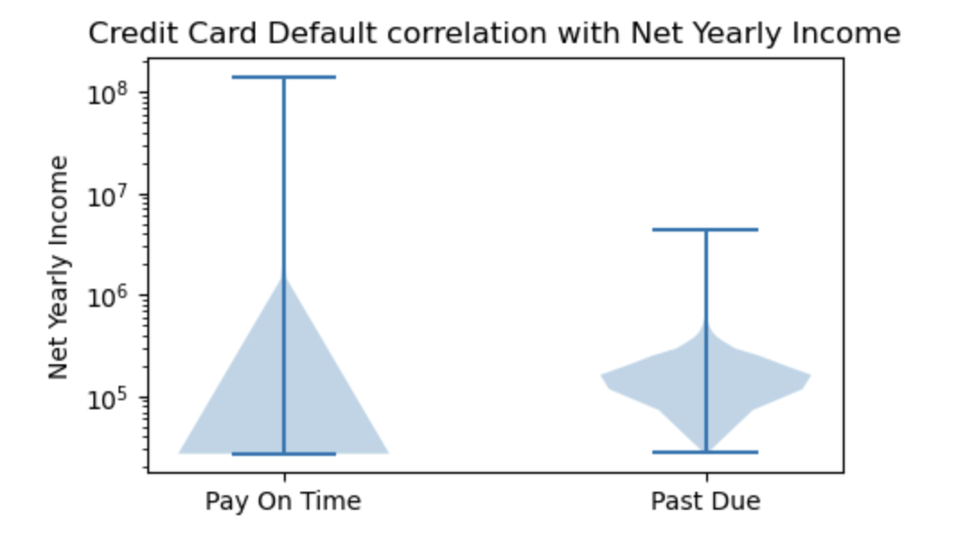


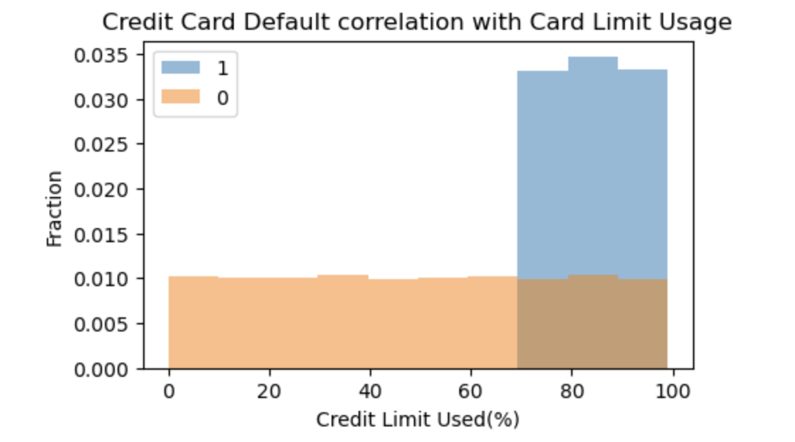
EDA
Super Rich
Middle Income Group but Default
use Credit Card Limit up to 65% -100%
Financial Crisis Hint
Greater Tendency to Default

Slide 5
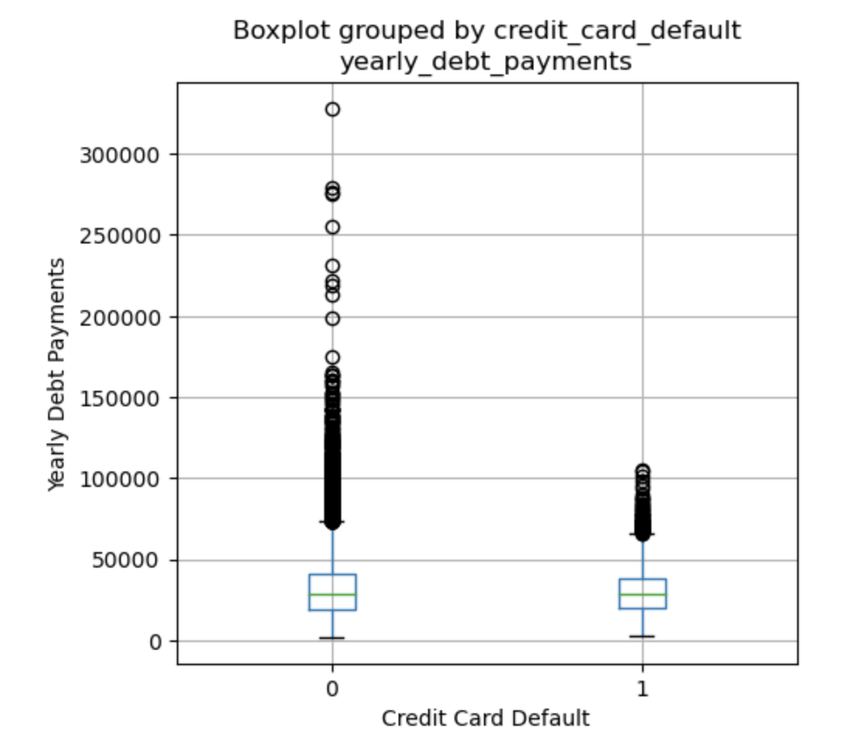
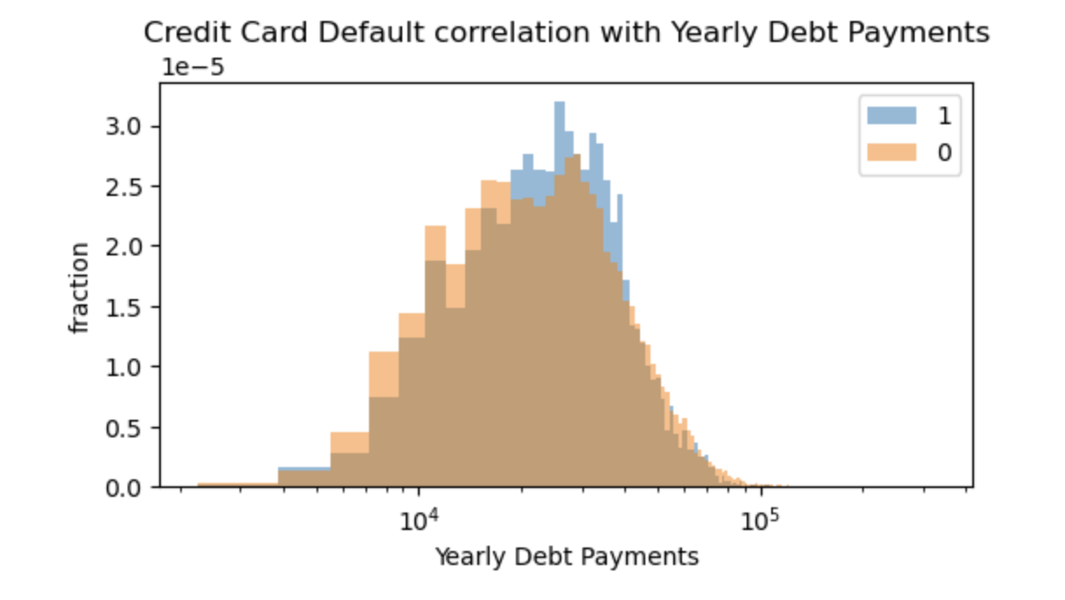
EDA
Yearly Debt Payment
( Lower )
Debt Burden
( Lower )
Trustworthy

Slide 6
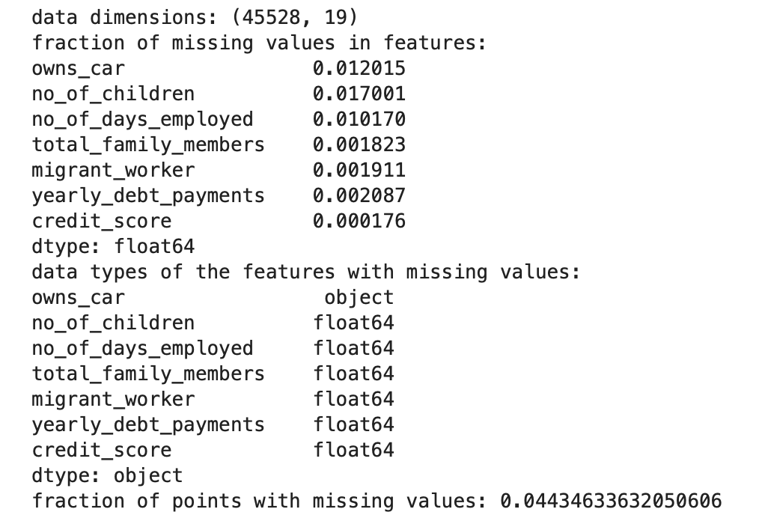
Missing VALUE
7 out of 19 features
4.43% of points
4 categorical features
3 continuous features
0.01% - 1.70%
OneHotEncoder

Slide 7
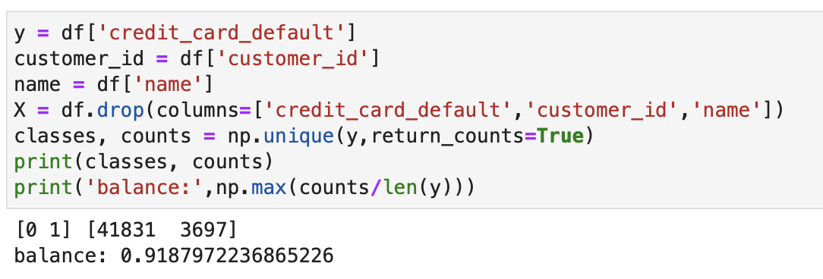
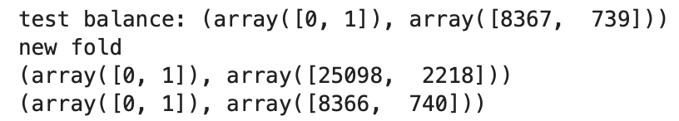
Split
Imbalanced Data
( stratified KFold )
i.i.d Data
( no group structure )
(no time structure )
Small Data Set
(45528 rows)
(60%, 20%, 20%)

Slide 8
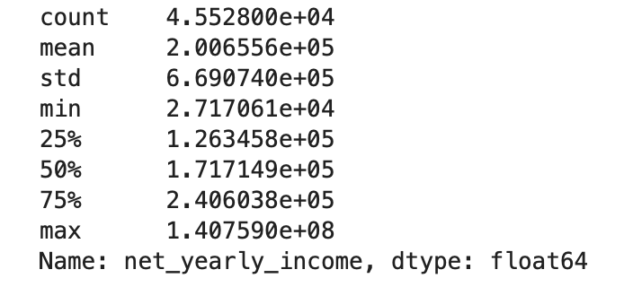
preprocess
OrdinalEncoder
OneHotEncoder
gender
owns_car
owns_house
no_of_children
occupation_type
total_family_members
migrant_worker
MinMaxScaler
age
credit_limit_used(%)
credit_score
prev_defaults
default_in_last_6months
StandardScaler
net_yearly_income
no_of_days_employed
yearly_debt_payments
credit_limit

Slide 9
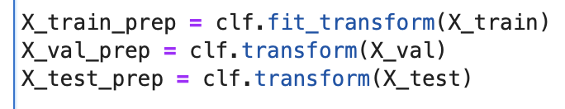

preprocess
fit_transform
VS
transform
scikit-learn pipeline
before preprocess
VS
after preprocess
combine preprocessing steps
avoid leaking statistics

Slide 10

Q&A
Emma Sun Dongyan_sun@brown.edu

