Slide 1


Processing Benthic Macroinvertebrate Data in R
Emma Jones, Lucy Baker, and
Jason Hill

Slide 2

Expectation Setting
What this session is:
What this session is not:
Inspiration for using R for reproducible workflows
Discussion on automating reports
General how to, when, why
Rmarkdown primer
Showcase some Virginia DEQ tools capitalizing on reproducible reports
Introduction to R
Programming 101
Shiny tutorial
Troubleshooting sesh
Reproducible Reports
Rmarkdown

Slide 3
Part 1: Benthic Stressor Analysis Tool

Slide 4
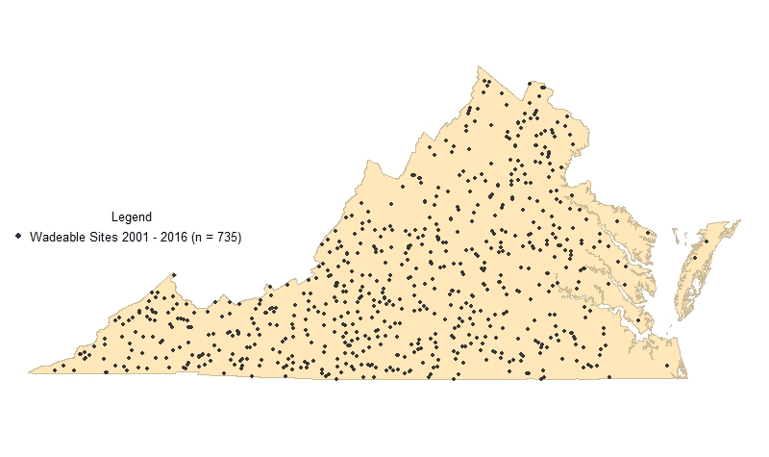
Freshwater Probabilistic Monitoring in Virginia
Monitoring statewide 2001 - present
~ 60 ProbMon Sites / Year
735 paired benthic and water chemistry/habitat data points
(2001 – 2016)

Slide 5
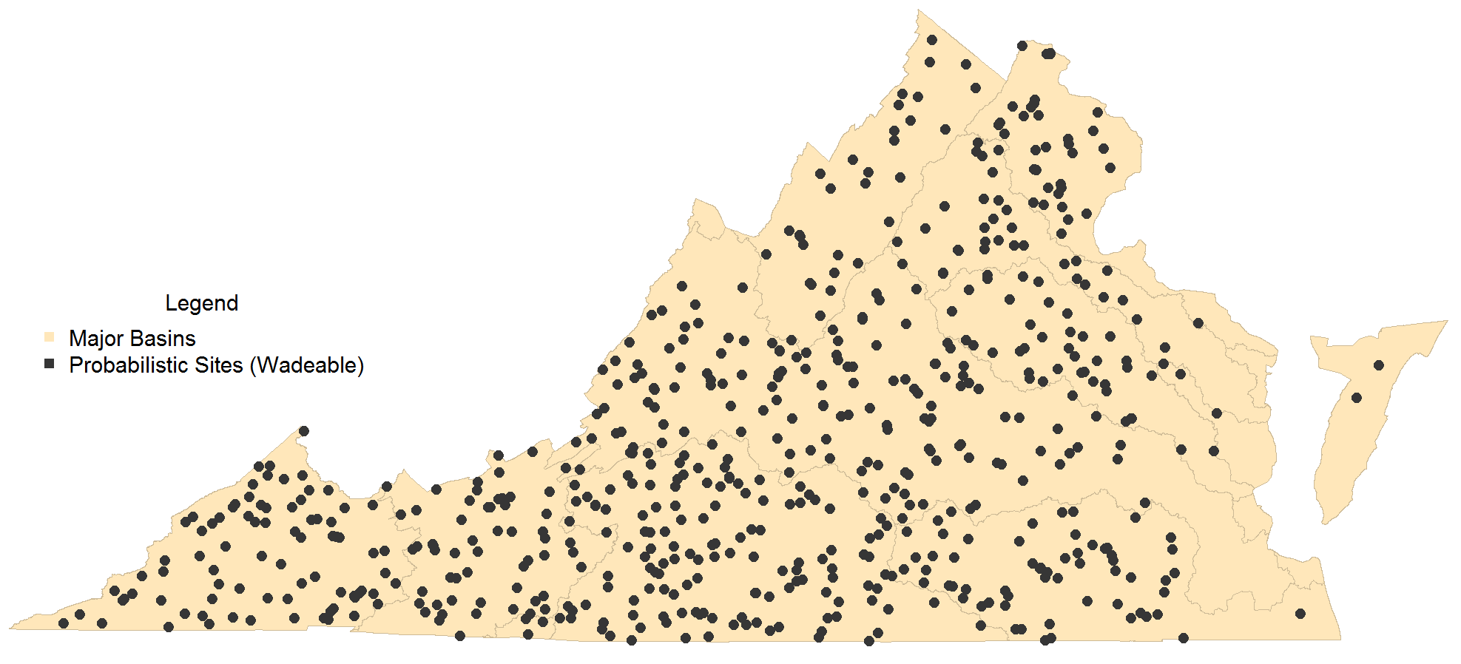
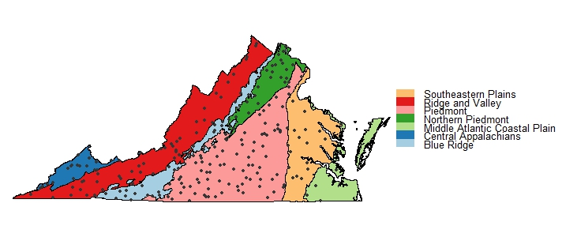
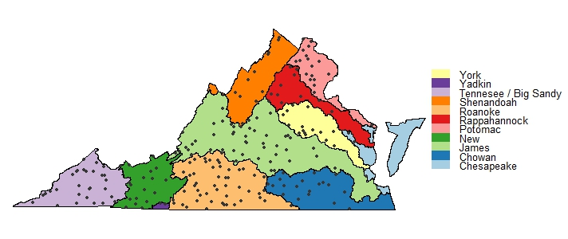
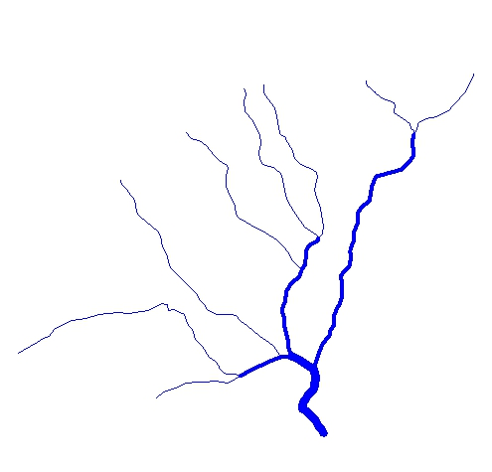
Analysis Scale
US EPA Level III
Ecoregion
Statewide
00
00
Stream Order
Major Basin

Slide 6
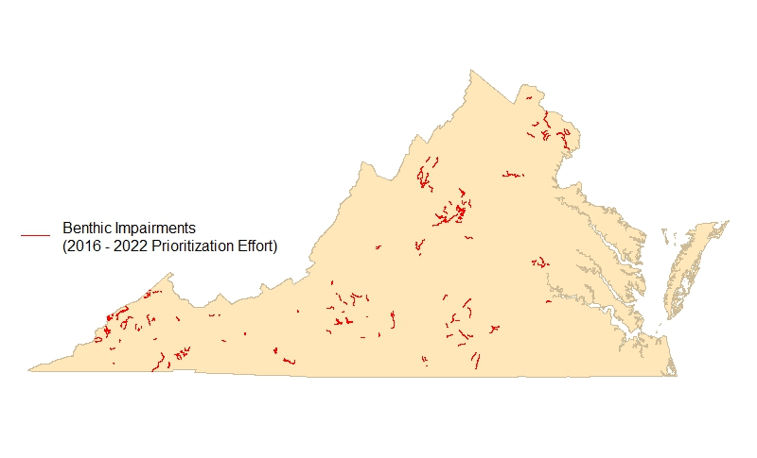
Stressor Analysis in Virginia
Virginia’s Prioritization effort includes 204 benthic macroinvertebrate community impaired segments (assessment units with benthic cause)
Identified as either “TMDL” or “TMDL alternative”
Commitment to EPA for completion: 2016-2022
Stressor analyses need to be developed internally or by a contractor

Slide 7

Stressor Analysis in Virginia (continued)
Identifies the cause of the benthic macroinvertebrate community shift
Weight-of-evidence approach
Relies on all available data
Parameters classified as…
Non-stressor
Possible stressor
Most probable stressor
Multiple stressors may be identified

Slide 8
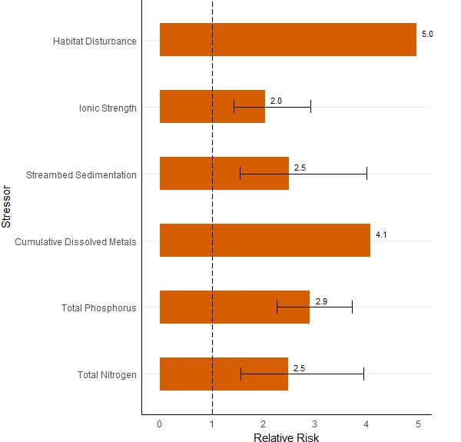
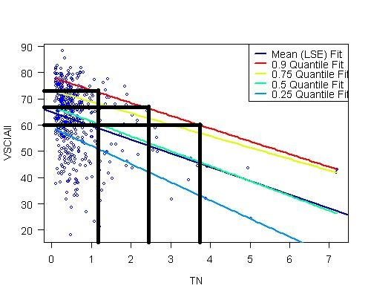
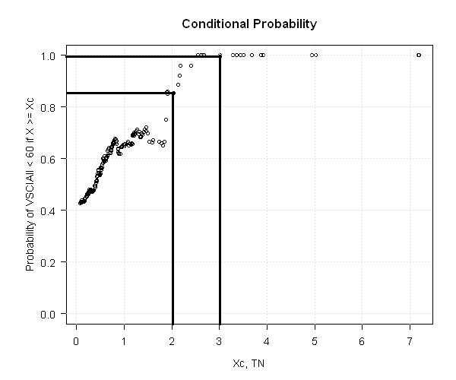
Developing Stressor Thresholds: Statistical Approach
Quantile Regression
Conditional Probability
Relative Risk

Slide 9
Developing Stressor Thresholds
Probabilistic Data used to define parameter thresholds:
Probability of Stress to Aquatic Life
High
Medium
Low
None

Slide 10
Stressor Parameters
Dissolved Oxygen
pH
Total Phosphorus
Total Nitrogen
Total Habitat
Ionic Strength
Dissolved Sulfates
Dissolved Chloride
Dissolved Potassium
Dissolved Sodium
Specific Conductance / Total Dissolved Solids
Relative Bed Stability (Quantitative Habitat analysis)
Dissolved Metals (Cumulative Criterion Unit)
Dissolved Oxygen
Probability of Stress to Aquatic Life | Concentration (mg/L)
High | < 7
Medium | > 7, < 8
Low | > 8, < 10
None | > 10

Slide 11
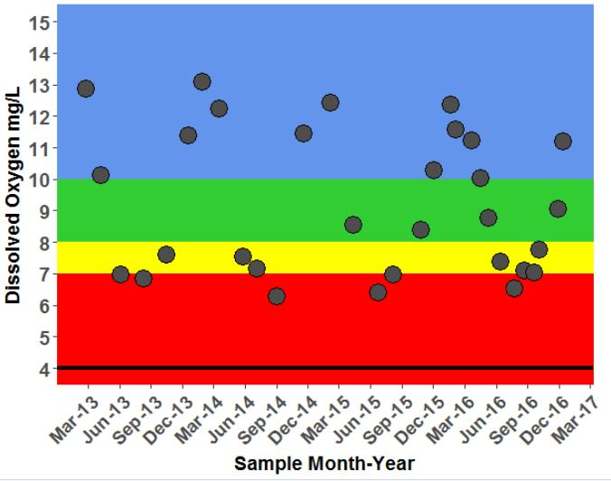
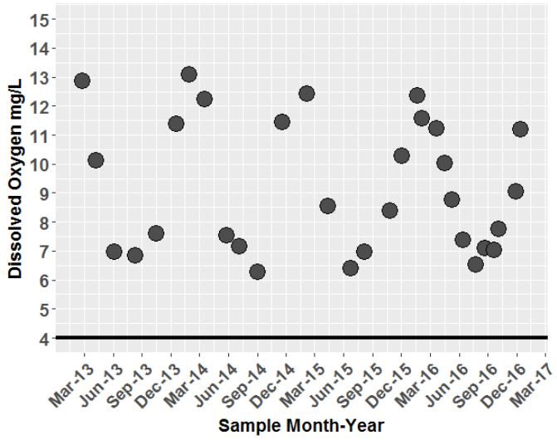
Context is Everything

Slide 12
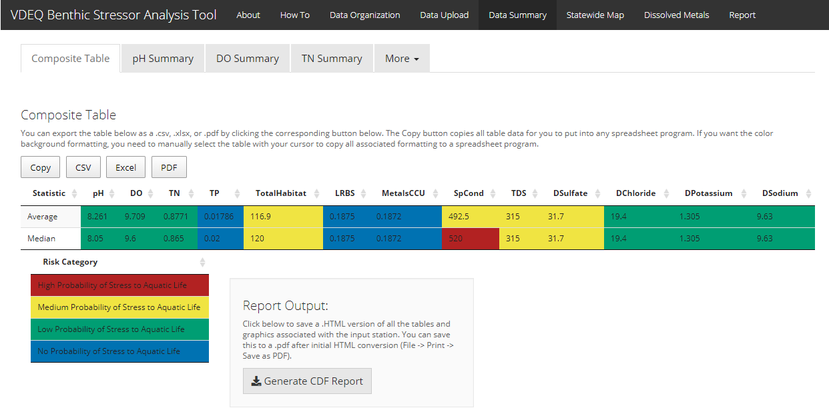

Slide 13
Tool Benefits
Anticipated:
Standardize thresholds statewide
Increase biological knowledge of TMDL coordinators
Simplify analytical updates with increasing n
Standardize data collection for follow up monitoring
Standardize data manipulation/analyses
Expedite data manipulation/analyses
Standardize reporting process and products
Expedite reporting process
Cost savings
Unanticipated:
Inadvertently developed nesting rationale and
landowner report tools
Build culture of reproducible reports/research
Introduce automation to regular business practices
Initiate open source culture within VDEQ
Gateway app for the development of additional
analytical applications for cross media business needs

Slide 14
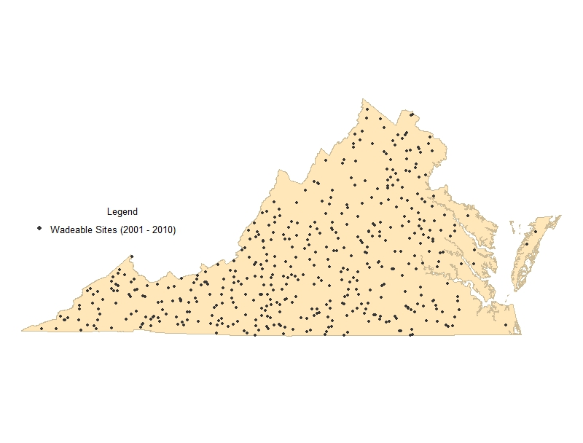
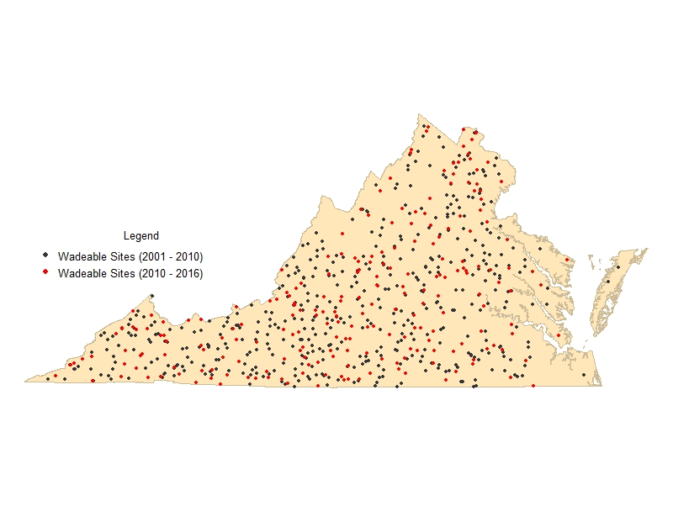
Probabilistic Monitoring Sites: 2001-2016 (n = 735)
Paired benthic and water chemistry/habitat data points Published report (2001 – 2010): n = 474 Interactive Application (2001 – 2016): n = 735

Slide 15
Tool Benefits
Anticipated:
Standardize thresholds statewide
Increase biological knowledge of TMDL coordinators
Simplify analytical updates with increasing n
Standardize data collection for follow up monitoring
Standardize data manipulation/analyses
Expedite data manipulation/analyses
Standardize reporting process and products
Expedite reporting process
Cost savings
Unanticipated:
Inadvertently developed nesting rationale and
landowner report tools
Build culture of reproducible reports/research
Introduce automation to regular business practices
Initiate open source culture within VDEQ
Gateway app for the development of additional
analytical applications for cross media business needs

Slide 16
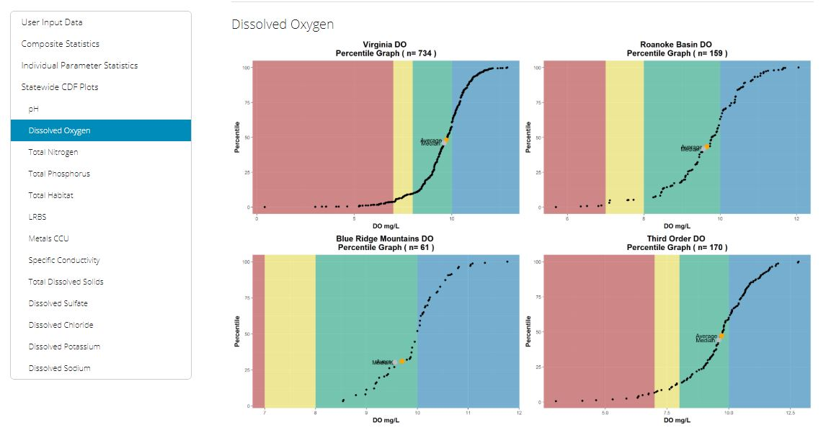
Tool Uses (so far)
Benthic Stressor Reports for:
Catawba Creek (preliminary EPA approval)
Unnamed Tributary to Roanoke River
Mountain Run
Crane Creek
Briery Creek
Smith River
Naked Creek
Lynch Creek
Reed Creek
Allens Branch
Devil Fork
Bark Camp Branch
Monitoring/Landowner Reports
Assessment/Monitoring planning
Dissolved metals assessment
BCG/Tolerance document

Slide 17
Stressor Tool Demo

Slide 18

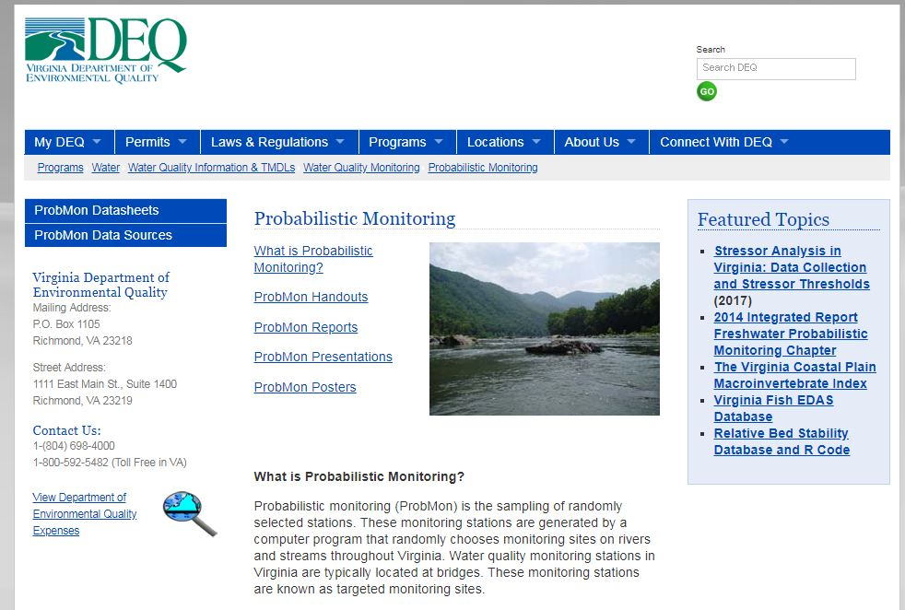
All code and datasets necessary to run tool:
www.github.com/VDEQ/VDEQ_Benthic
StressorAnalysis
Report Available here:
www.deq.virginia.gov/Programs/Water/WaterQuality
InformationTMDLs/ WaterQualityMonitoring/
ProbabilisticMonitoring.aspx

Slide 19
Part 2: Introduction to Rmarkdown
Hands on component if you want to follow along
http://github.com/EmmaVJones/NCTC_Processing-Benthic-Macroinvertebrate-Data-in-R

Slide 20
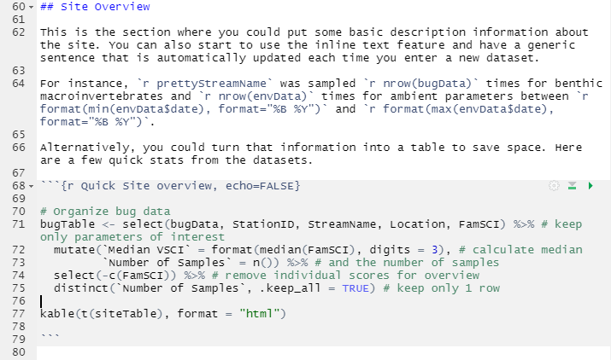

What is Rmarkdown?
Record of analyses for literate programming, reproducible research, and reporting
Combine plain text and code (multiple programming languages) into single document that can generate static and interactive reports
Generate the same report (style) given correct data input *
Repeatable: can be generate on the fly or using cron
* data templates are critical

Slide 21
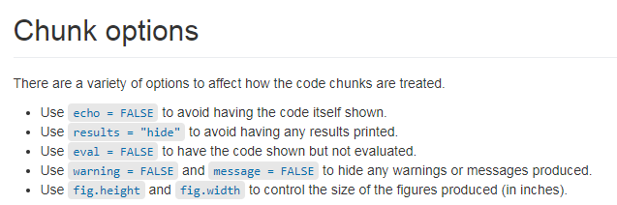
https://datacarpentry.org/genomics-r-intro/XX-knitr-markdown/index.html

Slide 22
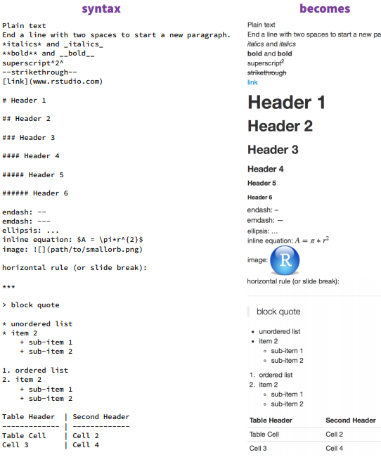
https://www.rstudio.com/wp-content/uploads/2015/02/rmarkdown-cheatsheet.pdf

Slide 23
Use case: Landowner Reports for Benthic and Field Data

Slide 24
Resources
RStudio RMarkdown Introduction
https://rmarkdown.rstudio.com/lesson-1.html
RStudio Cheat Sheets
Data Carpentry
https://swcarpentry.github.io/r-novice-gapminder/15-knitr-markdown/
https://www.rstudio.com/wp-content/uploads/2015/02/rmarkdown-cheatsheet.pdf

Slide 25
Part 3: Discussion

Slide 26
Contact Information
Emma Jones emma.jones@deq.virginia.gov
All code and datasets utilized in this workshop available here:
https://github.com/EmmaVJones/NCTC_Processing-Benthic-Macroinvertebrate-Data-in-R

