Slide 1


Processing Benthic Macroinvertebrate Data in R
Emma Jones, Lucy Baker, and
Jason Hill

Slide 2

Expectation Setting
What this session is:
What this session is not:
Inspiration for using R for reproducible workflows
Discussion on automating reports
General how to, when, why
Rmarkdown primer
Showcase some Virginia DEQ tools capitalizing on reproducible reports
Introduction to R
Programming 101
Shiny tutorial
Troubleshooting sesh
Reproducible Reports
Rmarkdown
Notes:
Important to all get on the same page prior to diving in.
Overview some of the ways VA is taking advantage of these reproducible workflows to expedite analyses, streamline workflows, standardize end products.
Start by showing one of the directions we have taken these ideas of automated analyses and reports: Benthic Stressor analysis process
Next: Semi hands on section- Use benthic data to build an automated report in Rmarkdown
Last: Discussion of other Virginia uses of these techniques- Landowner reports for Biologists, Biologist Fact Sheets for Assessment Process (shiny), ProbMon Integrated Report Chapter

Slide 3
Part 1: Benthic Stressor Analysis Tool
Notes:
Describe split between assessment and probmon program

Slide 4
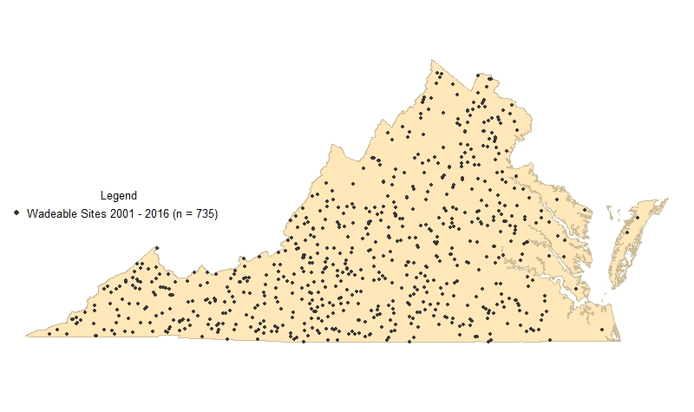
Freshwater Probabilistic Monitoring in Virginia
Monitoring statewide 2001 - present
~ 60 ProbMon Sites / Year
735 paired benthic and water chemistry/habitat data points
(2001 – 2016)
Notes:
Since 2001 we have collected about 60 sites year, such that, through 2016, we have 735 sites of paired benthic, water chemistry, and habitat data

Slide 5
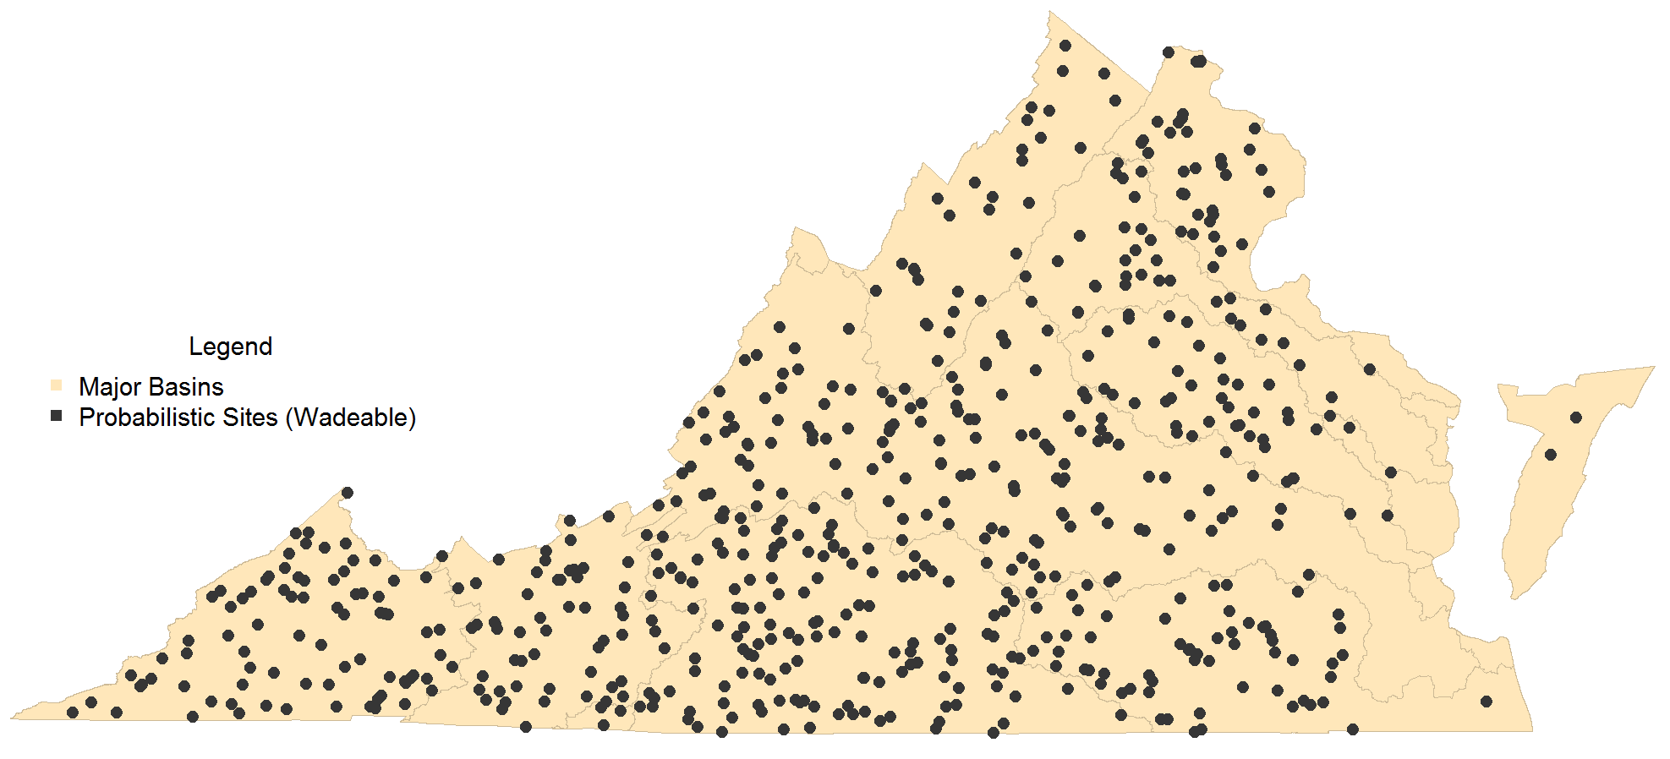
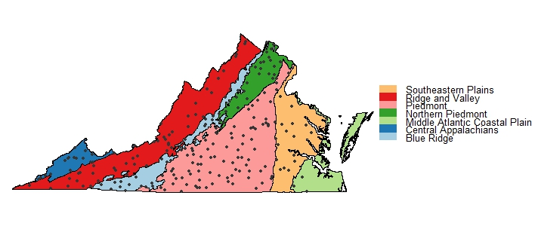
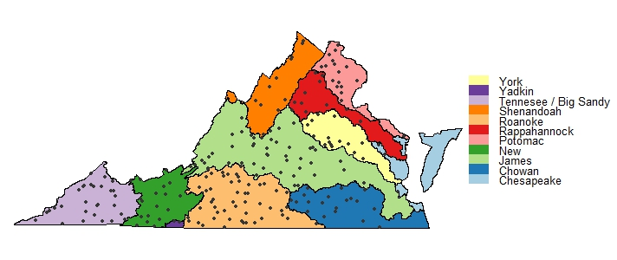
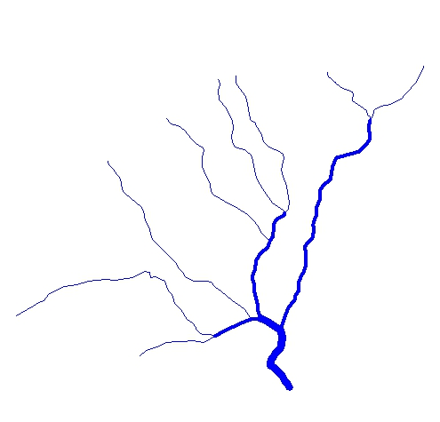
Analysis Scale
US EPA Level III
Ecoregion
Statewide
00
00
Stream Order
Major Basin
Notes:
The density of this dataset has allowed us to start breaking up out estimates at various spatial scales instead of just statewide estimates.
Allowing us to drill in by ecoregion, basin, and stream order .
We finally have the n to make statistically valid statements about these different spatial scales and can start to compare different parameters and biological response spatially

Slide 6
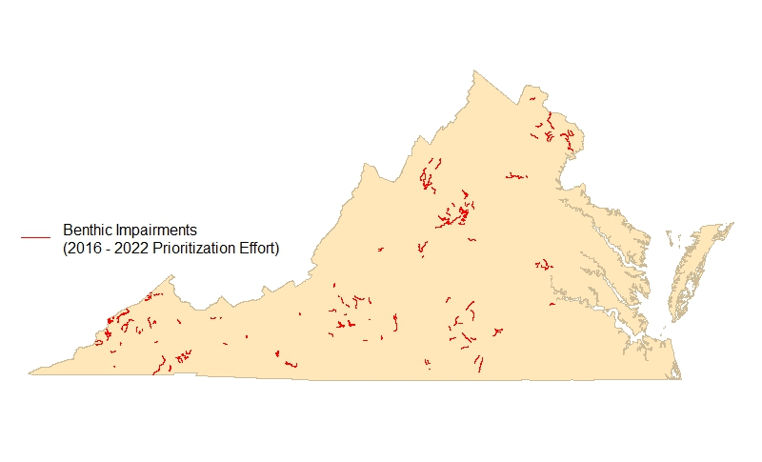
Stressor Analysis in Virginia
Virginia’s Prioritization effort includes 204 benthic macroinvertebrate community impaired segments (assessment units with benthic cause)
Identified as either “TMDL” or “TMDL alternative”
Commitment to EPA for completion: 2016-2022
Stressor analyses need to be developed internally or by a contractor
Notes:
Virginia’s most recent prioritization identified 204 segments listed as impaired for benthic macroinvertebrate community
Each of these require stressor analyses to be completed by us or a contractor
BY 2022
But our TMDL staff are not necessarily biologists who can look at taxa list and start to understand data, so we wrote a report offering guidance on how to complete benthic stressor analyses in VA

Slide 7
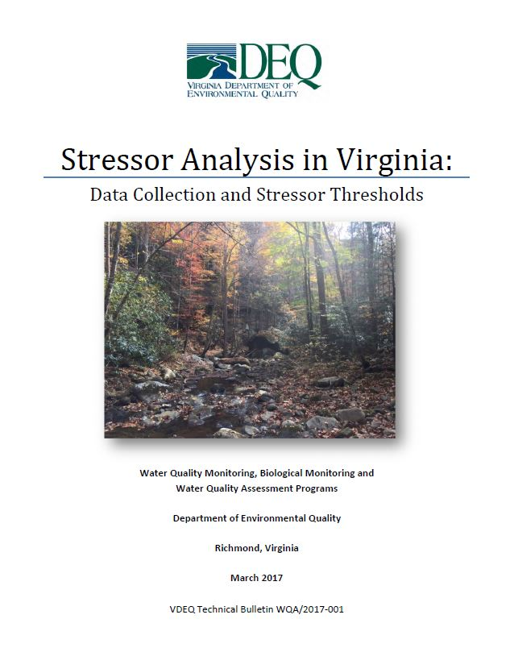
Stressor Analysis in Virginia (continued)
Identifies the cause of the benthic macroinvertebrate community shift
Weight-of-evidence approach
Relies on all available data
Parameters classified as…
Non-stressor
Possible stressor
Most probable stressor
Multiple stressors may be identified
Notes:
Report published in 2017
Uses probmon data- paired benthic and water chemistry dataset- to categorize all available data as either a non stressor, possible, most probable in order to identify potential causes of the shift in biological community
This weight of evidence approach seeks to identify the main stressor or stressors contributing to the response in biology and is really a guide to help walk users through teasing out potential stressors in the multitude of real life cases where there is no apparent smoking gun

Slide 8
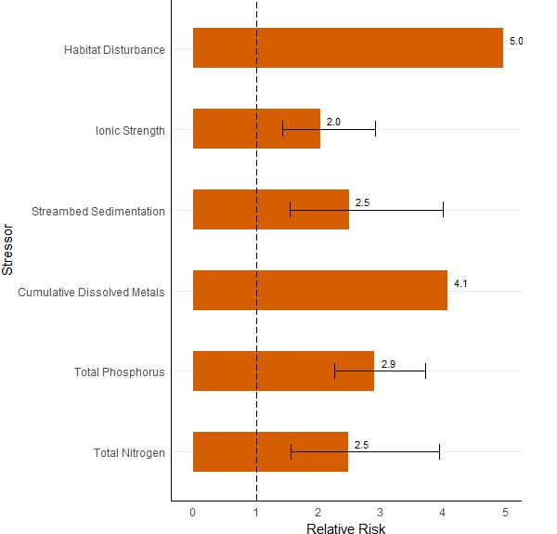
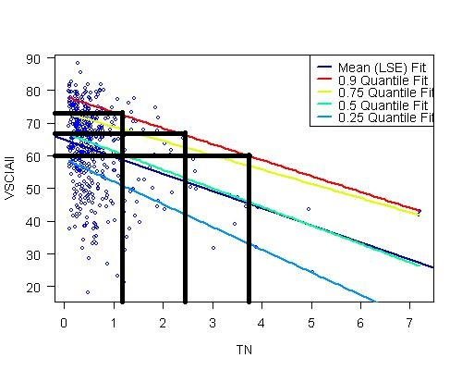
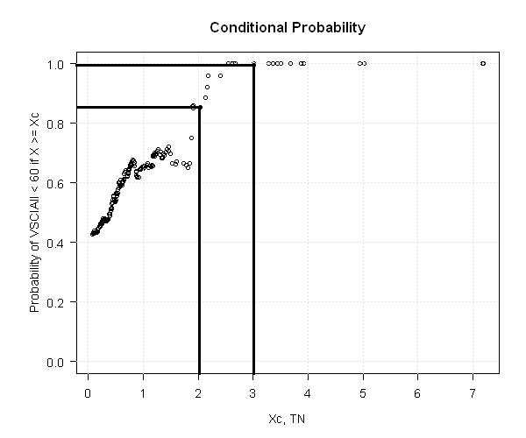
Developing Stressor Thresholds: Statistical Approach
Quantile Regression
Conditional Probability
Relative Risk
Notes:
To develop stressor thresholds published in document, began by comparing our Probmon parameters against benthic community to identify parameters with demonstrated stressor response
After identifying list of parameters where relationships exist, use combination of statistical methods used in our ProbMon program but not readily utilized in TMDL work of quantile regression, conditional probability, and relative risk to find cutoff points at which we could state varying levels of increased risk to biological community

Slide 9
Developing Stressor Thresholds
Probabilistic Data used to define parameter thresholds:
Probability of Stress to Aquatic Life
High
Medium
Low
None
Notes:
Effectively, allow us to put the continuous scale of each parameter into neat little boxes, helping us identify set zones where we can expect incrementally increasing stress to aquatic life.
Stress categories translate to:
“No Stress to Aquatic Life” means that a parameter range reflects an undisturbed, or background, condition in Virginia.
“Low Probability of Stress to Aquatic Life” represents a benthic macroinvertebrate community response that is slightly above background conditions but unlikely to cause a major community shift.
“Medium Probability of Stress to Aquatic Life” and means there is noticeable evidence of harm causing a possible shift in benthic communities with changes noticeably above background conditions
“High Probability of Stress to Aquatic Life” threshold corresponds to values that are among the highest in the Commonwealth and result in degredaton of the benthic community

Slide 10
Stressor Parameters
Dissolved Oxygen
pH
Total Phosphorus
Total Nitrogen
Total Habitat
Ionic Strength
Dissolved Sulfates
Dissolved Chloride
Dissolved Potassium
Dissolved Sodium
Specific Conductance / Total Dissolved Solids
Relative Bed Stability (Quantitative Habitat analysis)
Dissolved Metals (Cumulative Criterion Unit)
Dissolved Oxygen
Probability of Stress to Aquatic Life | Concentration (mg/L)
High | < 7
Medium | > 7, < 8
Low | > 8, < 10
None | > 10
Notes:
We published analyses for 13 parameters
*NOTE* these are not Water Quality Standards. Thresholds are based on biological response apparent in our dataset and can vary considerably from the established WQS
Virginia freshwater DO standard is 4.0 mg/L but we establish 7mg/L as the cutoff where benthic macroinvertebrates most likely to be highly stressed
Why took a lot of work to get through management and have to continually reiterate that these are not WQS

Slide 11
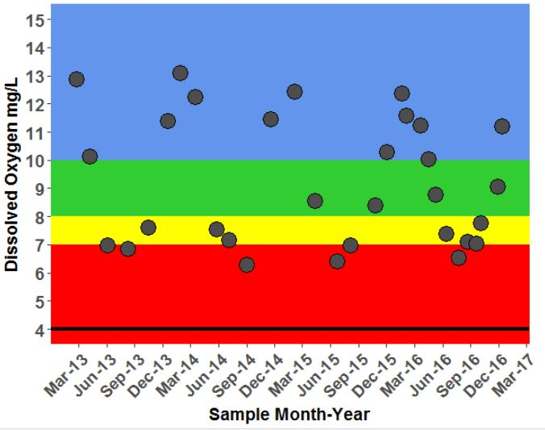
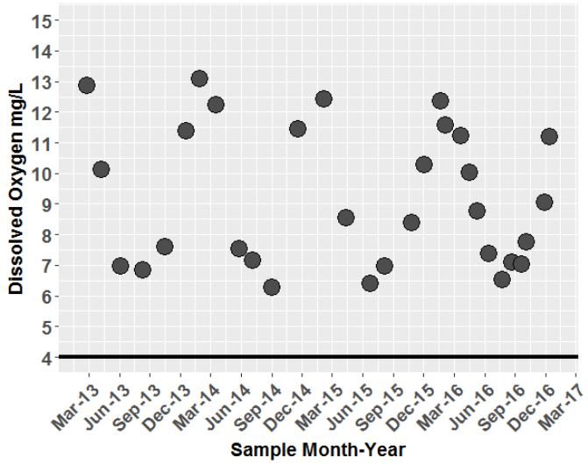
Context is Everything
Notes:
How are these thresholds actually useful?
Imagine TMDL coordinator trying to sift through a pile of data you’ve collected for benthic TMDL and don’t know bugs
Well above WQS and see some seasonal fluctuations in DO with lowest DO during summer months
Doesn’t look alarming until consider probably collected middle of the day, some of highest DO’s this section of stream experiences, okay maybe something going on here
Instead, when we apply the parameter thresholds to each dataset can bring it to life and help see the data from the bug perspective, and impart understanding much faster
Translates to faster sifting through parameters and faster identification of potential issues vs non issues

Slide 12
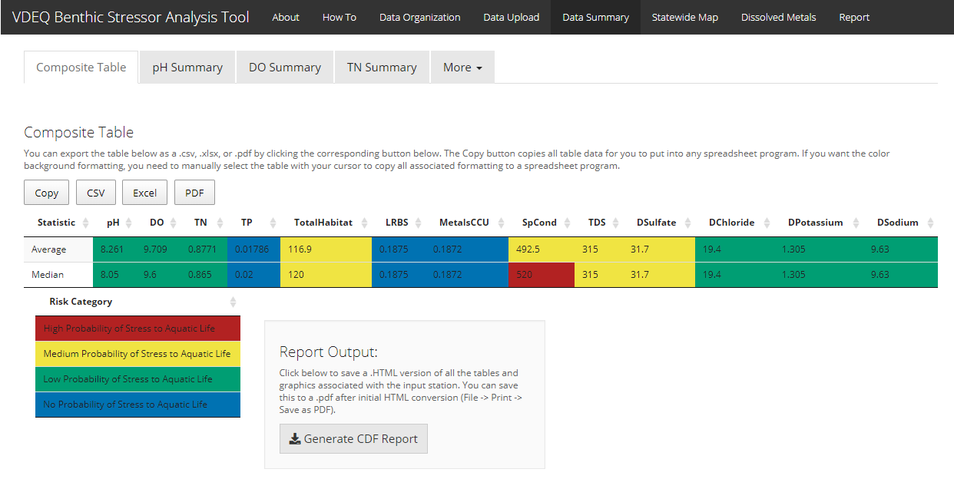
Notes:
To distribute this wealth of information quickly we built Shiny application (R based interactive web application) that allows app users to access the same data analysis and visualization capabilities that have previously only been available people well versed in R programming
App allows users to upload their data to quickly cross reference it with parameter thresholds and drill into where their data fall statewide, and by that specific basin, ecoregion, and stream order
Our second iteration of app also generates about half a draft report pre written for users to further streamline and expedite the analysis and reporting process

Slide 13
Tool Benefits
Anticipated:
Standardize thresholds statewide
Increase biological knowledge of TMDL coordinators
Simplify analytical updates with increasing n
Standardize data collection for follow up monitoring
Standardize data manipulation/analyses
Expedite data manipulation/analyses
Standardize reporting process and products
Expedite reporting process
Cost savings
Unanticipated:
Inadvertently developed nesting rationale and
landowner report tools
Build culture of reproducible reports/research
Introduce automation to regular business practices
Initiate open source culture within VDEQ
Gateway app for the development of additional
analytical applications for cross media business needs
Notes:
Benefits:
Standardize thresholds statewide
Using R so easy to update tool as our prob dataset grows – next slide

Slide 14
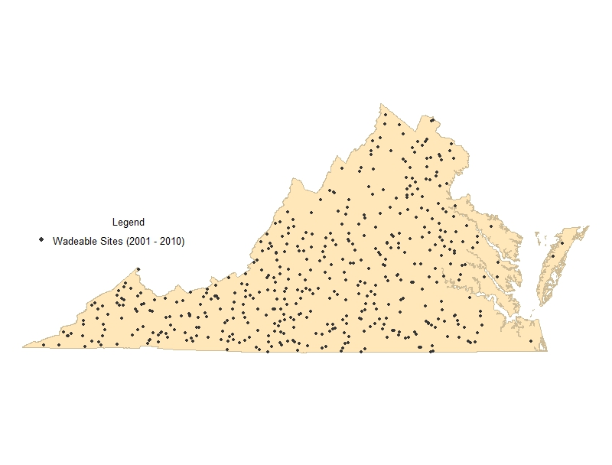
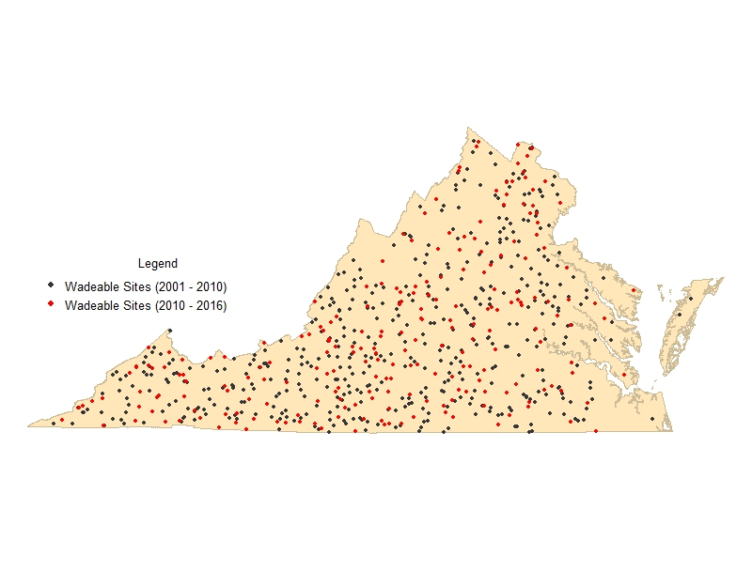
Probabilistic Monitoring Sites: 2001-2016 (n = 735)
Paired benthic and water chemistry/habitat data points Published report (2001 – 2010): n = 474 Interactive Application (2001 – 2016): n = 735
Notes:
Report published on 474 data points
*click*
Currently at 735 and counting
About every two years we push a few hundred more sites into the app to further tighten our confidence intervals on analyses

Slide 15
Tool Benefits
Anticipated:
Standardize thresholds statewide
Increase biological knowledge of TMDL coordinators
Simplify analytical updates with increasing n
Standardize data collection for follow up monitoring
Standardize data manipulation/analyses
Expedite data manipulation/analyses
Standardize reporting process and products
Expedite reporting process
Cost savings
Unanticipated:
Inadvertently developed nesting rationale and
landowner report tools
Build culture of reproducible reports/research
Introduce automation to regular business practices
Initiate open source culture within VDEQ
Gateway app for the development of additional
analytical applications for cross media business needs
Notes:
Standardize reports:
By standardizing reports with Rmarkdown, all graphics, style, and formatting of reports similar
Faster for TMDL coordinators to get the data analyzed and get the report out the door
Allows reviewers to have better understanding of what to expect in reports
Cost Savings:
By giving the data to the people that need it we can complete more internal Benthic stressor analyses- save money on contracting out projects and when contractors are involved it allows TMDL staff to double check and understand data, further expediting larger projects
Unanticipated:
Didn’t expect people to find so many uses for the tool. A hit with biologists and TMDL management for quickly generating nesting rationales
Gateway app- first big app we rolled out from ProbMon group and inspired the tools mentioned previously for the Permit group as well as using Shiny apps for Pollution response, Water quality assessment, etc

Slide 16
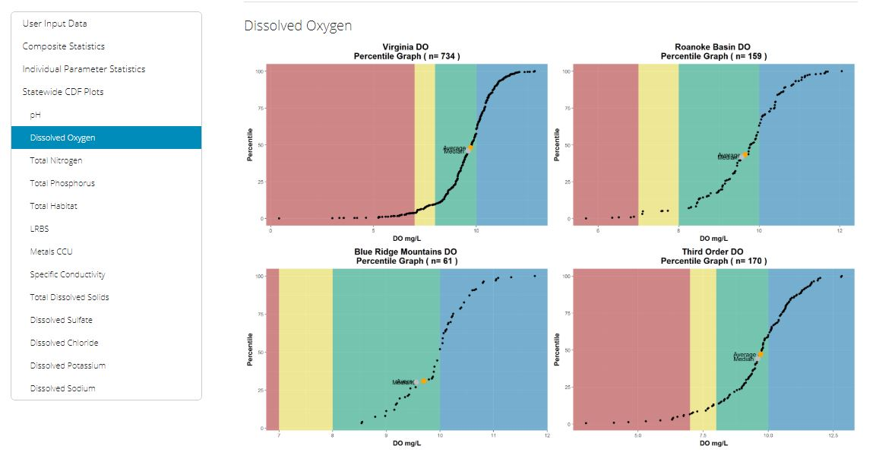
Tool Uses (so far)
Benthic Stressor Reports for:
Catawba Creek (preliminary EPA approval)
Unnamed Tributary to Roanoke River
Mountain Run
Crane Creek
Briery Creek
Smith River
Naked Creek
Lynch Creek
Reed Creek
Allens Branch
Devil Fork
Bark Camp Branch
Monitoring/Landowner Reports
Assessment/Monitoring planning
Dissolved metals assessment
BCG/Tolerance document
Notes:
A number of stressor reports and previously mentioned landowner reports
Use threshold in Assessment application for additional contexts for assessors
Bring it full circle back to some of the other projects mentioned at beginning:
Original Dissolved metals assessment gave birth to the whole background metals application for the permit group
Thresholds were useful throughout BCG projects and statewide tolerance attribution activity

Slide 17
Stressor Tool Demo
Notes:
Deer Branch Example Dataset into app

Slide 18

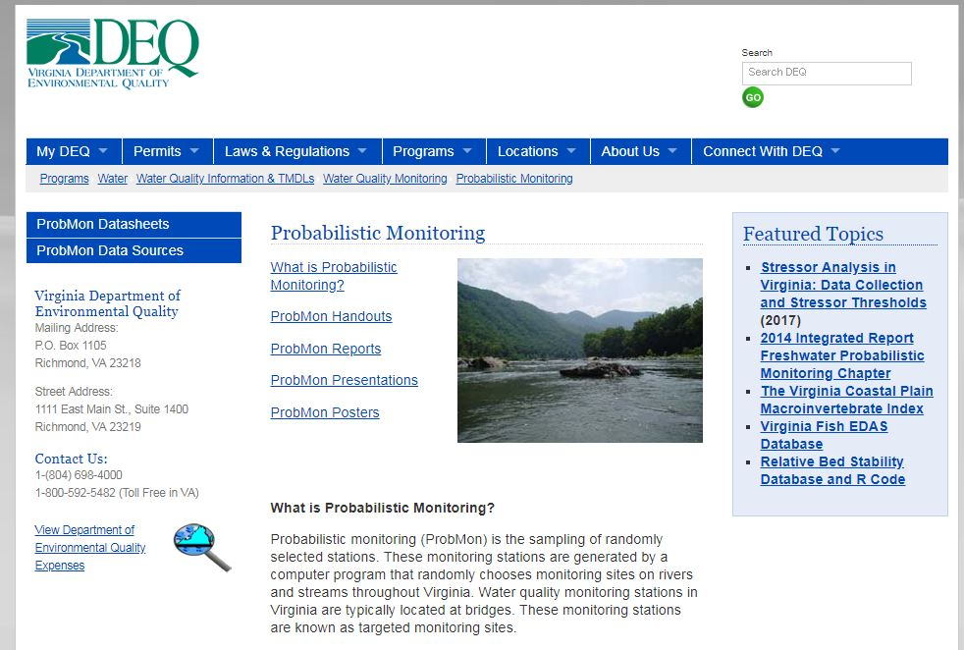
All code and datasets necessary to run tool:
www.github.com/VDEQ/VDEQ_Benthic
StressorAnalysis
Report Available here:
www.deq.virginia.gov/Programs/Water/WaterQuality
InformationTMDLs/ WaterQualityMonitoring/
ProbabilisticMonitoring.aspx

Slide 19
Part 2: Introduction to Rmarkdown
Hands on component if you want to follow along
http://github.com/EmmaVJones/NCTC_Processing-Benthic-Macroinvertebrate-Data-in-R

Slide 20
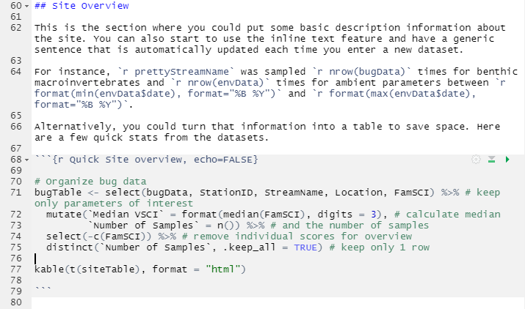

What is Rmarkdown?
Record of analyses for literate programming, reproducible research, and reporting
Combine plain text and code (multiple programming languages) into single document that can generate static and interactive reports
Generate the same report (style) given correct data input *
Repeatable: can be generate on the fly or using cron
* data templates are critical
Notes:
R Markdown files are designed to be used in three ways:
For communicating to decision makers, who want to focus on the conclusions, not the code behind the analysis.
For collaborating with other data scientists (including future you!), who are interested in both your conclusions, and how you reached them ( i.e. the code).
As an environment in which to do data science, as a modern day lab notebook where you can capture not only what you did, but also what you were thinking.
https://r4ds.had.co.nz/r-markdown.html
Build your .Rmd, render sends report to knitr engine and creates new markdown document (plain text version), then pandoc makes it pretty
Rmardown combines all these steps into a single package and makes it super easy to use
Fire up new project
Talk through:
Making new report on their own (File -> New File -> Rmarkdown)
Types of output, implications
chunk
Comment
How to run report
How to test report

Slide 21
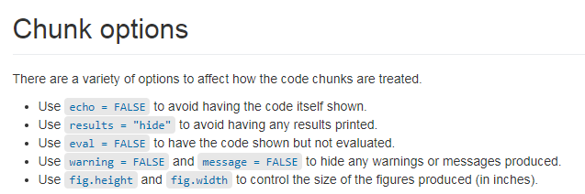
https://datacarpentry.org/genomics-r-intro/XX-knitr-markdown/index.html

Slide 22
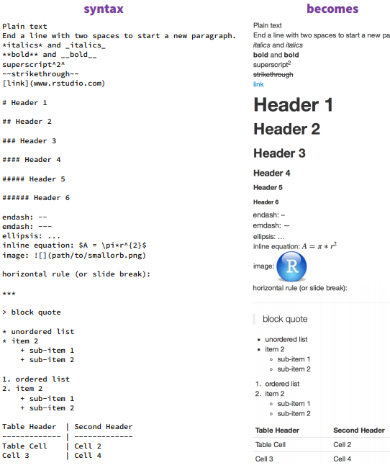
https://www.rstudio.com/wp-content/uploads/2015/02/rmarkdown-cheatsheet.pdf

Slide 23
Use case: Landowner Reports for Benthic and Field Data

Slide 24
Resources
RStudio RMarkdown Introduction
https://rmarkdown.rstudio.com/lesson-1.html
RStudio Cheat Sheets
Data Carpentry
https://swcarpentry.github.io/r-novice-gapminder/15-knitr-markdown/
https://www.rstudio.com/wp-content/uploads/2015/02/rmarkdown-cheatsheet.pdf

Slide 25
Part 3: Discussion
Notes:
Other uses:
Currently Building out benthic report further to link in to our benthic database to allow biologists to analyze their data and save their comments for a site with particular reporting cycle
This will feed into our riverine assessment applications so assessor will have permanent record (on the fly) of all biologist assessments of benthic communities
Faster assessments of sites by assessors (who are not biologists) and fewer duplicated biologist assessment reports floating around
Landowner report for biologists to get out faster at appropriate assessment level for audience
Landowner report tool NLA (can demo), NRSA 2019
Pipeline monitoring automated report for data exploration, shiny capabilities
Chesapeake Bay Watershed Implementation Plan (WIP) Data Dashboard by Steven Hummel

Slide 26
Contact Information
Emma Jones emma.jones@deq.virginia.gov
All code and datasets utilized in this workshop available here:
https://github.com/EmmaVJones/NCTC_Processing-Benthic-Macroinvertebrate-Data-in-R

