Slide 2
2018 Integrated Report
Probabilistic Monitoring Chapter Updates
Jason Hill, Emma Jones, Larry Willis, Mary Dail, and Lucy Baker
December 4, 2019

Slide 3
Basics about ProbMon
Statewide overview program providing collocated biological, chemical, and physical habitat data
Wadeable data used in development of novel tools & analyses
Largely Grant funded program
Study design flexible for future monitoring needs (emerging contaminants)
Headwater stream assessment
Only DEQ program built to assess and monitor the 65% of Virginia stream miles that are unmonitored by other programs
Notes:
Broad purpose- baseline for scale of analyses, statewide overview program
Colocated data is important- development of novel tools/analyses
Largely Grant funded program
Design flexible for future monitoring needs (emerging contaminants)
Headwater stream assessment (only program built to assess and monitor) 65% miles unmonitored by other programs
WADEABLE DATA
Site selection- say random but have pictures as backup
CDF (pictures backup)
Condition estimates
Stressor extent
Relative risk picture backup

Slide 4
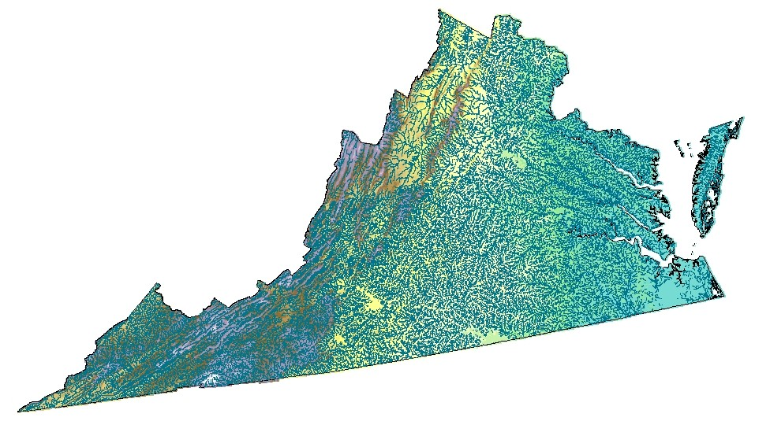
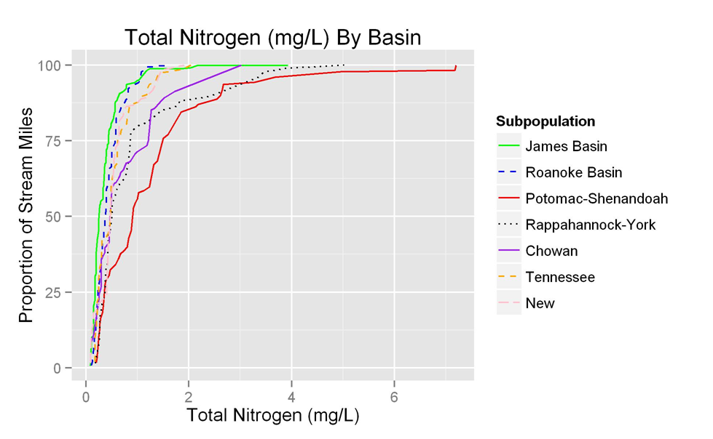
Basics about ProbMon
Notes:
Random site selection
CDF (pictures backup)
Condition estimates
Stressor extent
Relative risk picture backup

Slide 5
Major Changes Since 2016 IR Report
Executive summary rewrite
IR window estimates vs statewide status
Major basin status- micromaps
Major basin ranks- heatmap
Relative risk and stressor extent

Slide 6
Successes
Tish’s slide
Data supports standards are not being violated in things we’ve looked at.
However, we are going to highlight some bad things coming up…

Slide 7
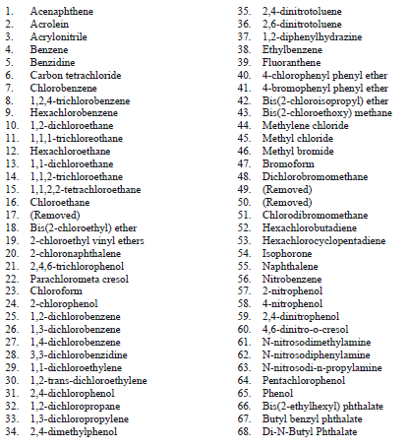
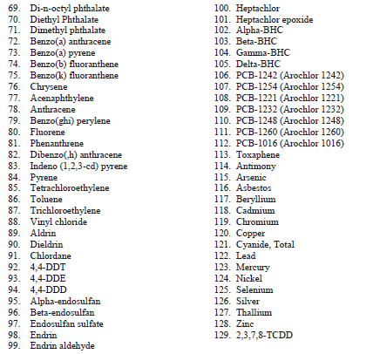

Slide 8
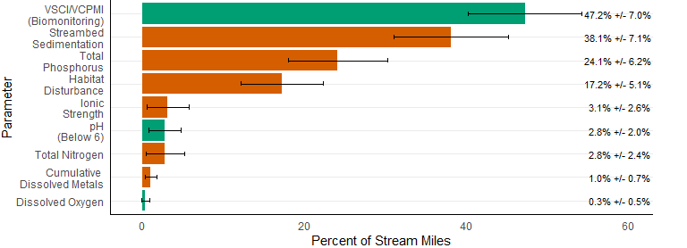
Percentage of stream miles with water quality parameters exceeding criteria. Figure represents data collected from 2011 - 2016.
Notes:
IN line with NRSA results

Slide 9
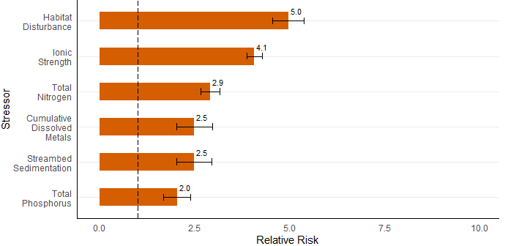
Relative risk (2001 – 2016)
Notes:
Cancer vs cardiovascular comparison to hammer scale of risk associated with our RR calculations

Slide 10
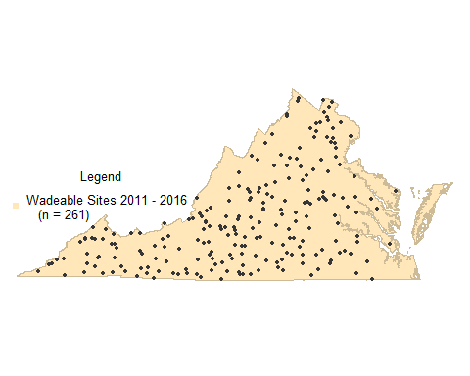
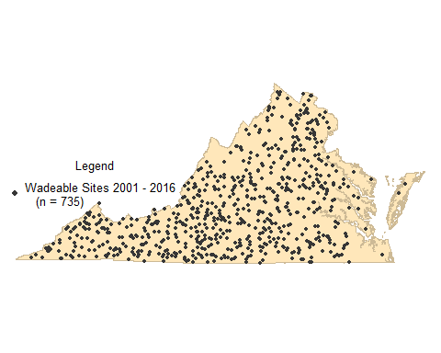
IR Window Estimates vs Statewide Status
2011 – 2016 (n = 261)
2001 – 2016 (n = 735)
Notes:
Some statistics have always required entire dataset available in order to make meaningful estimates (RR & stressor extent)

Slide 11
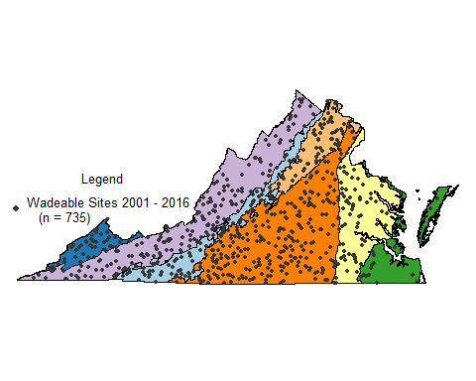
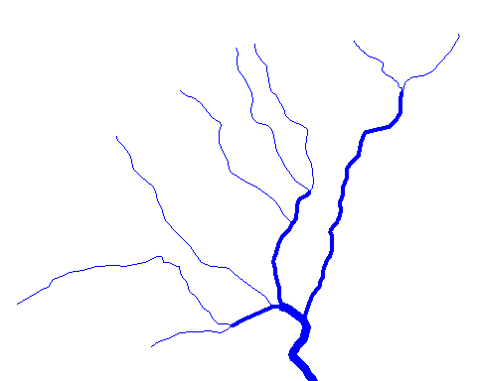
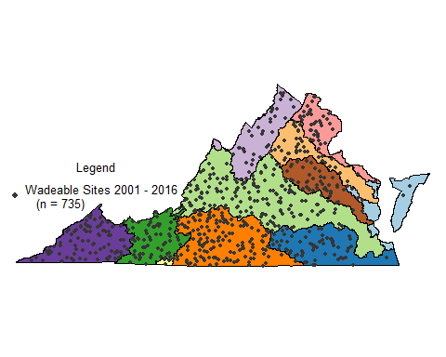
Statewide Status
US EPA Level III
Ecoregion
Stream Size
Statewide
Major Basin
Notes:
Equal effort across spatial scales and requires more time to make comparisons among SOME basins
Yearly sample effort based on data requirements to make statistical estimate statewide

Slide 12
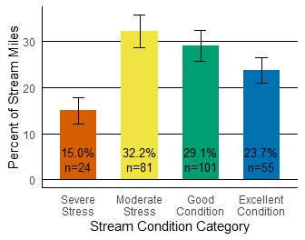
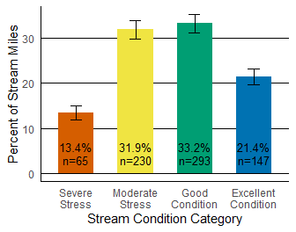
IR Window vs Statewide Status
Biological stream condition index based on VSCI/VCPMI Scores (2001 - 2016, n = 735)
Biological stream condition index based on VSCI/VCPMI Scores (2011 - 2016, n = 261)

Slide 13
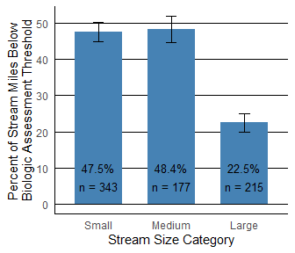

Biological condition by stream size category (2001 – 2016)
Notes:
Hammer conf limits, unoverlapping indicates significance

Slide 14
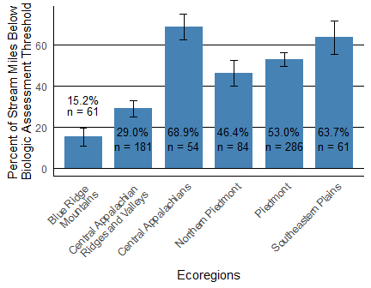
Biological condition by US Level III Ecoregions (2001 – 2016)
Mid-Atlantic Coastal Plain Ecoregion was not included due to insufficient data.

Slide 15
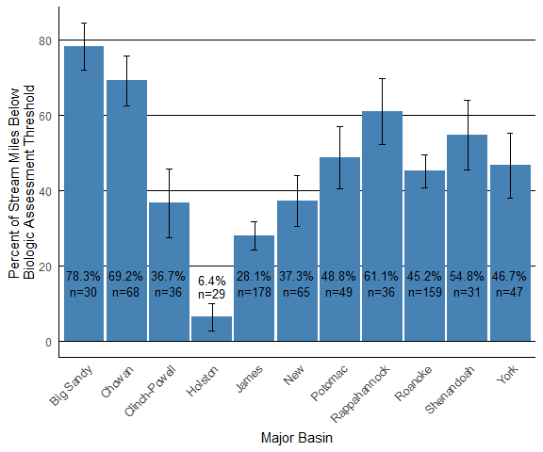
Biological condition by major river basins (2001 – 2016)

Slide 16
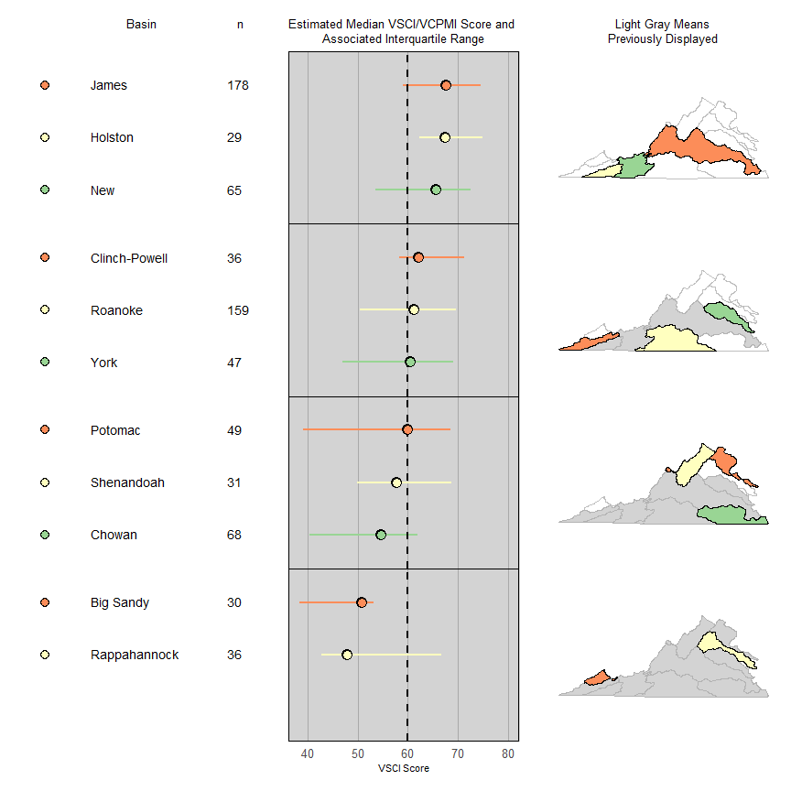
Parameters without WQS: major basin status using micromaps
VSCI/VCPMI status by basin
VSCI/VCPMI status by basin. The vertical dashed line at 60 highlights the biologic assessment threshold

Slide 17
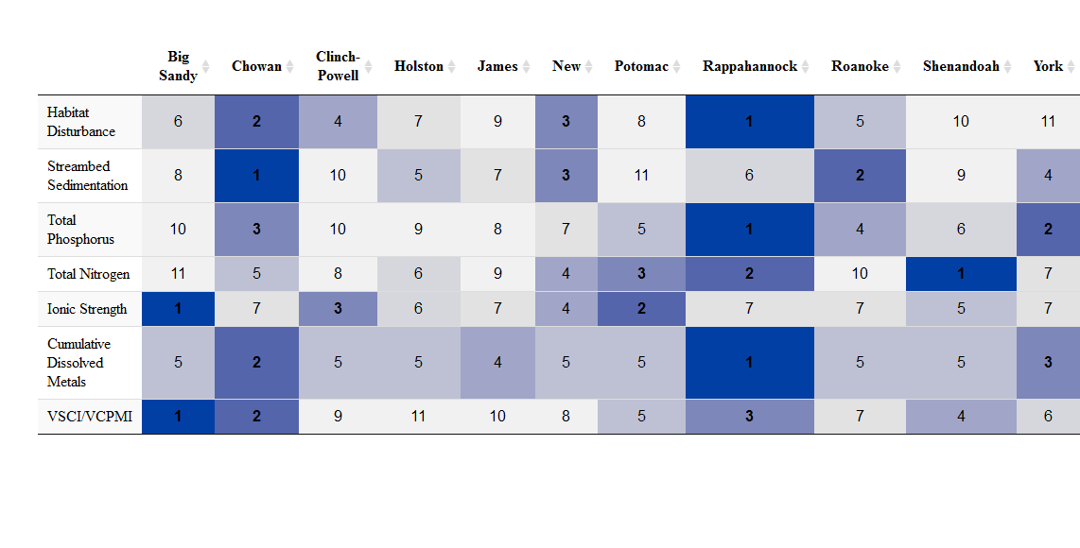
Basin Rank
1 = MOST suboptimal stream miles
11 = LEAST suboptimal stream miles

Slide 18
Other uses of ProbMon
Environmental Disaster Interpretation (Dan River Coal Ash)
Biomonitoring Improvement (Validation of VCPMI & VSCI)
TMDL support (Benthic Stressor Analysis Tool)
Permit Tool
Tolerance Assignment (BCG, Genus level biological tool development)
Change analysis

Slide 19
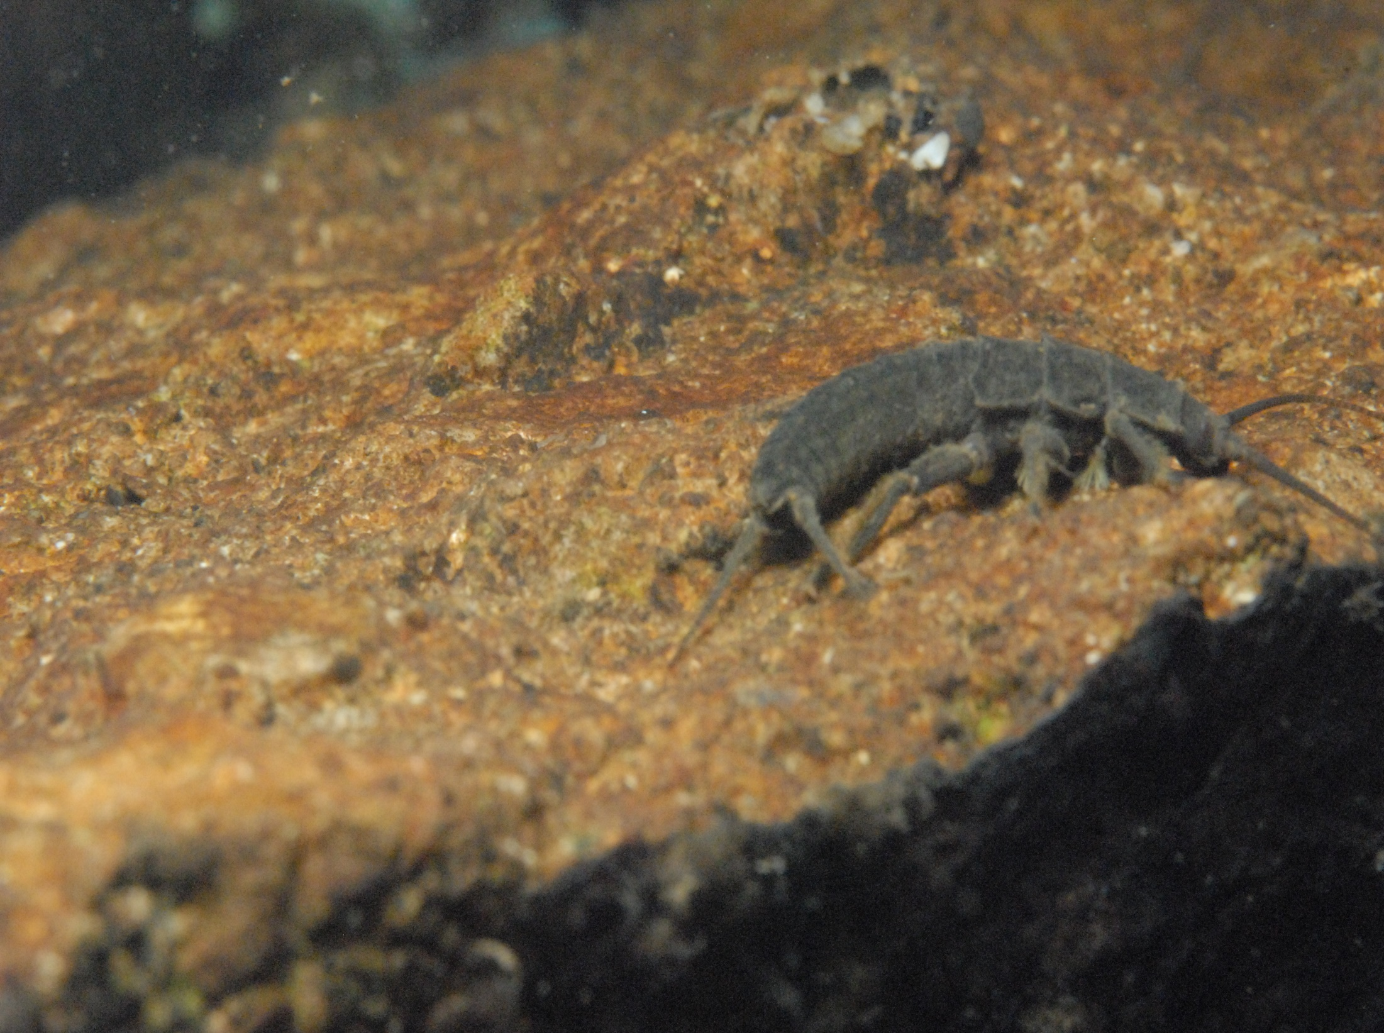
Questions?

Slide 20
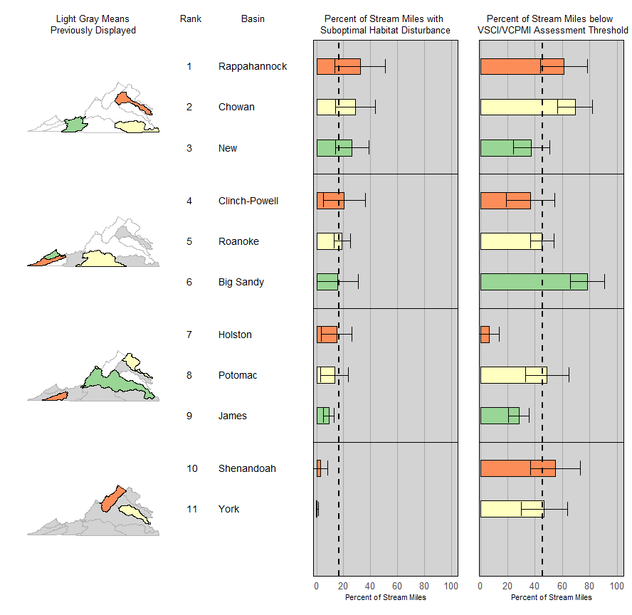
Parameters without WQS: major basin status using micromaps
Percent of stream miles with suboptimal habitat disturbance
Vertical dashed lines represent the percent of stream miles across Virginia with suboptimal habitat disturbance and biologic condition below the assessment threshold, respectively.

Slide 21
Parameters without WQS: major basin status using micromaps
Percent of stream miles with suboptimal total phosphorus
Vertical dashed lines represent the percent of stream miles across Virginia with suboptimal total phosphorus and biologic condition below the assessment threshold, respectively.

Slide 22
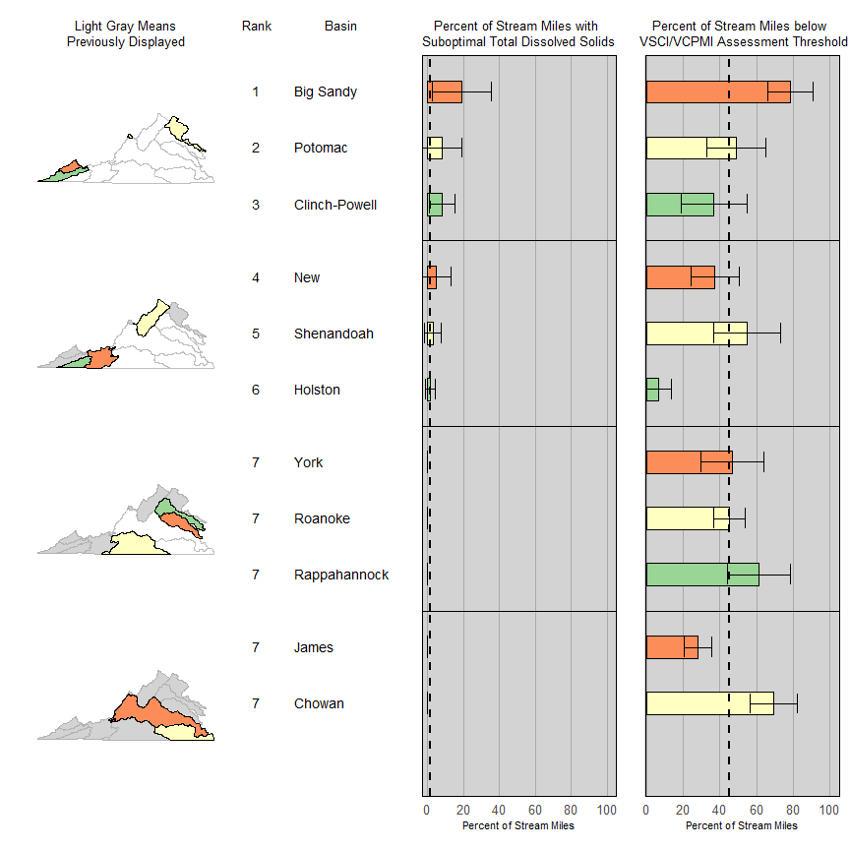
Parameters without WQS: major basin status using micromaps
Percent of stream miles with suboptimal ionic strength
Vertical dashed lines represent the percent of stream miles across Virginia with suboptimal ionic strength and biologic condition below the assessment threshold, respectively.

Slide 23
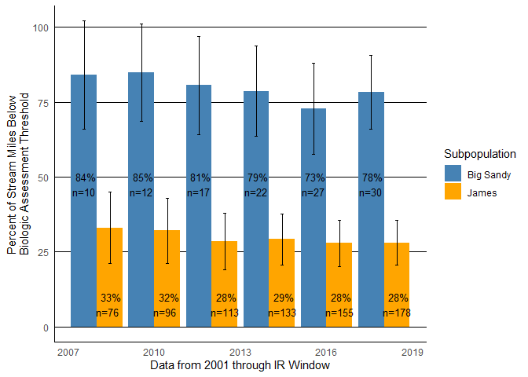
Temporal Variability
VSCI/VCPMI status in James River and Big Sandy River basins with increasing n.

Slide 24
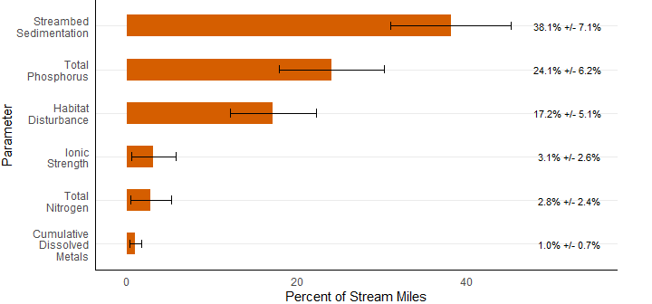
Stressor extent (2011 – 2016)

Slide 25
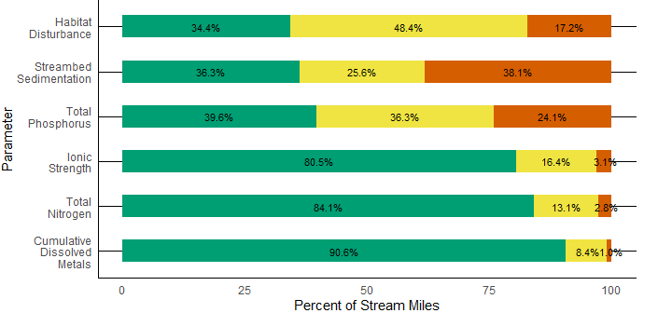
Stressor extent, all condition classes (2011 – 2016)

Slide 26
Virginia’s Freshwater Resources
Target population perennial freshwater river and streams
NHD circa 1999 sample frame is 49,142 miles

Slide 27
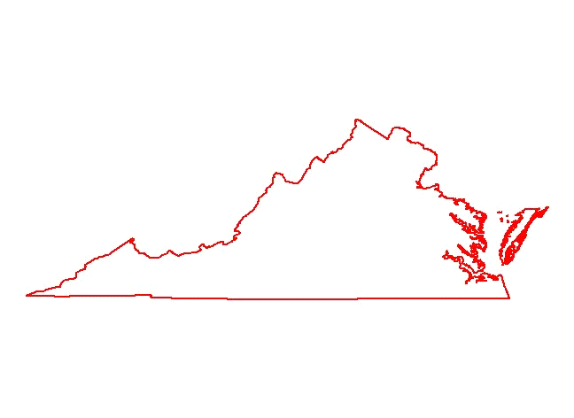
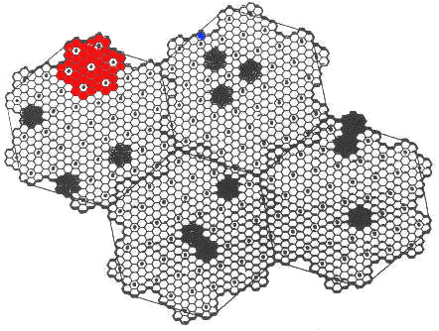
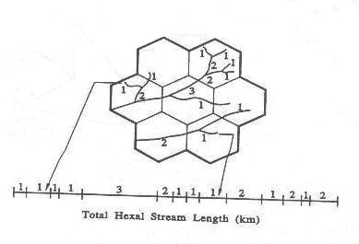
Site Selection
1.8
1.8
90 km²
1.8
90
90
90
km
km
km
2
2
km
2
km
km
2
2
2
13
13
13
13
km
km
km
2
2
2
km²
EMAP
EMAP Hexagon
13 km
13 km
13 km
13 km
Hexagon
Hexagon
Hexagon
2
Hexagon
2
2
2
640 km
640 km
640 km
2
2
2
Hexagon
Hexagon
Hexagon

Slide 28
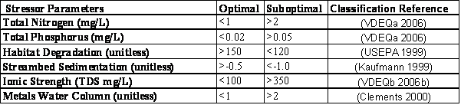
Water Quality Stressors
Relative Risk and Attributable Risk Calculations
Borrowed terminology from the medical field
Report RR greater than 1 (CI included)

Slide 29
Statewide Relative Risk
Pr(Poor VSCI/CPMI, given poor sediment condition) RR = --------------------------------------------------------------- Pr(Poor VSCI/CPMI, given good sediment condition)

Slide 30
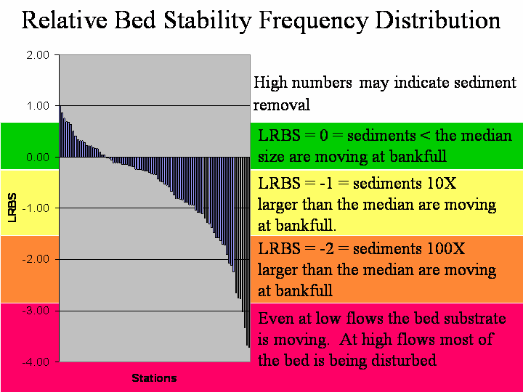
Innovative Monitoring
Sediment endpoint in many biological studies
Relative bed stability=quantitative habitat data

Slide 31
Stressor Screening Results

Slide 32
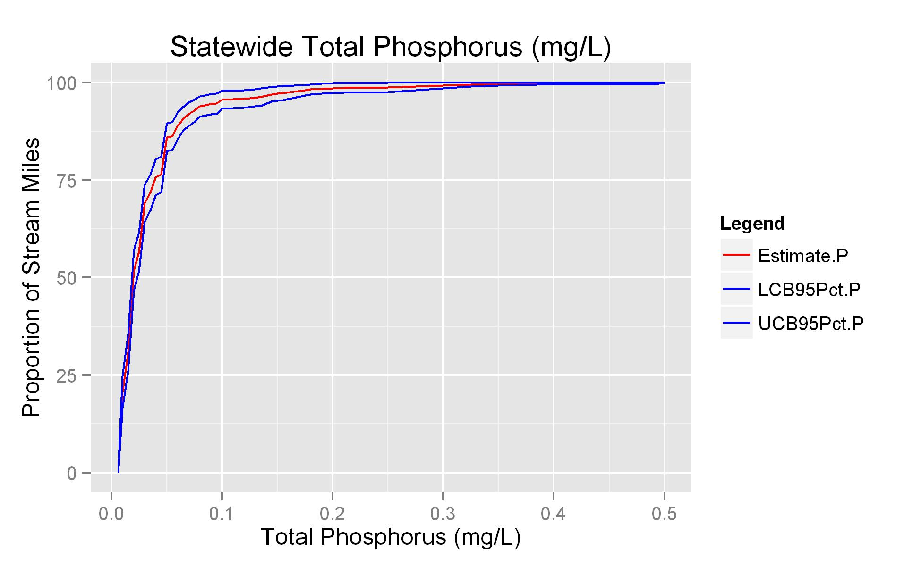
CDF Curves
50th percentile is 0.02 mg/L
95th percentile is 0.1 mg/L
0.02 mg/L

Slide 33
Stressor Distribution
Notes:
80% below 1

