Slide 1
Cyclistic: analysis
Emma Vermeire

Slide 2
Business task
Annual members are more profitable. To maximize the number of annual members, we need to find a way to convert casual riders into annual members. The first step is to identify the differences between casual riders and annual members. Afterwards, we can use that data to understand what motivates an annual member to get a membership and why a casual rider might not want to. This way, we can develop a targeted marketing strategy for casual riders based on their demographics, behavior, and other differences.
To identify the differences I will clean and analyze our data, from the Cyclistic trip datasets, and create a clear visualization.

Slide 3
Data sources
I will be using the divvy-tripdata dataset for the data files of 'January 2022,' 'May 2022,' and 'September 2022,' ensuring that there is sufficient up-to-date data to use. Making sure my data is non-compromised, credible and not biased. This way, we can examine how the year 2022 unfolded across three different months, each with varying temperature, climate, hour cycle, etc.
The data has been made available by Motivate International Inc. under their license. Due to privacy, there will be no use of personally identifiable information.

Slide 4
Cleaning steps
• I make a backup of my dataset
• Split each variable into separate columns, using a comma as the delimiter
• Make them all the same alignment and correct formatting
• Get rid of duplicate ride ids
• Put a filter on the whole data set
• Checking for misfielded values, errors and missing values
• Remove blanks from each column with filter
• Check for typos like: misspellings, inconsistent capitalization, incorrect punctuation. And correcting them if necessary.
• Copying the filtered/cleaned table to a new sheet. Now I have a clean dataset.
• Created a new column, to show how long each ride took and formatted it as [HH]:MM:SS time. I needed to use the square brackets, because my time exceeded 24 hours.
• Created a new column, to show the day of the week they started their ride
• Repeat for all my datasets

Slide 5
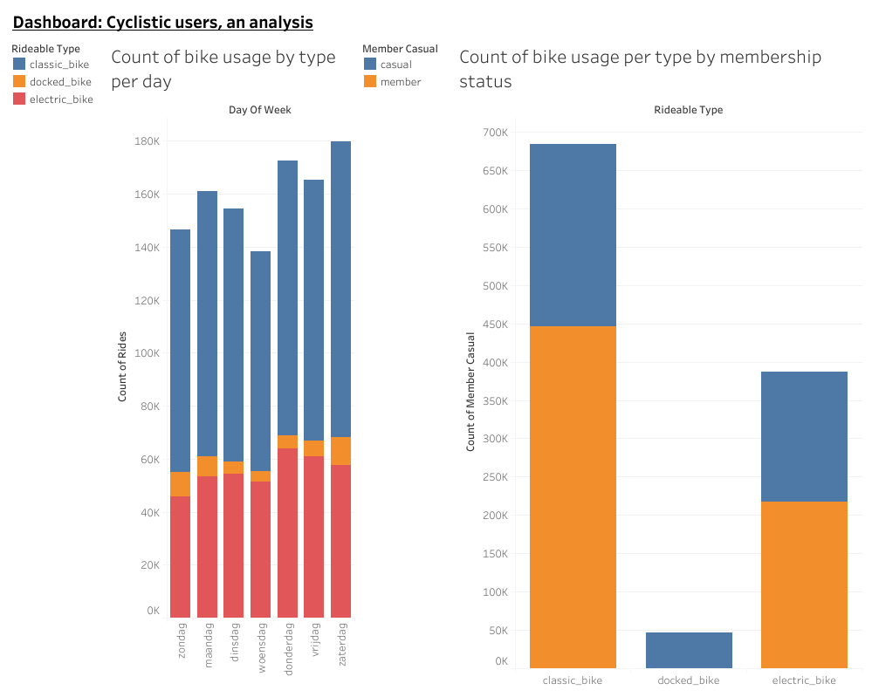
The analysis
The graph revealed that both casual and members favor the classic bike, while only casual riders utilize the docked bike. The electric bike is used almost 50% less then the classic bike. With this graph, we also see how members do use the Cyclitic bikes more often.

Slide 6
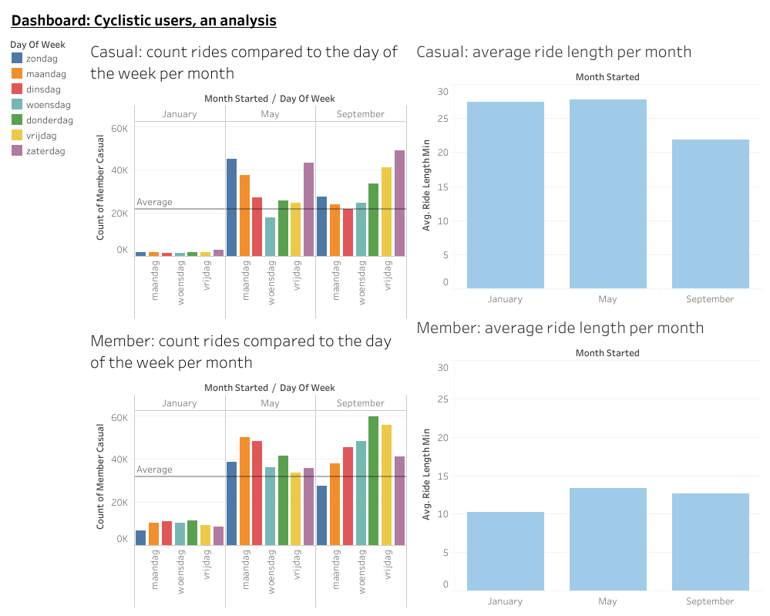
I explored the correlation between user types and daily bike usage for each month. This analysis reveals that members use bikes more frequently each month compared to casual riders. On average, casual riders use their bikes more on weekends than weekdays, whereas members use their bikes more on weekdays than weekends. Interestingly, bike usage, for both casuals and members, decreases in January. However, it's noteworthy that members use bikes significantly more in January than casual riders. Casual users do take longer trips, on average, compared to members

Slide 7
Conclusion
Casual bikes most popular among both users, docked bike only popular among casual riders
Members use their bike more often in the work week and casuals more in the weekend
While way less, members still use the bikes in January, compared to casuals
Members are more consistent with bike usage
Casuals go on longer bike trips, almost twice as much

Slide 8
Recomondations
Put out a campaign about how usefull biking to work/school is, to maximize work week usage
Collab with trip agency for a deal package, to go on a bike trip
Get more usefull bikes around, for example with a carrying area for shopping

Slide 9
Cyclistic: analysis
Emma Vermeire

