Slide 1

Developer Profiles &
Job Market Analysis
Sandra Tang and Emma Woods
2020-0108 IST 652 Scripting for Data Analysis

Slide 2

Project Introduction
Software Development Job Market & Career Opportunities
Job openings for developers with certain skill set Ex. location, skills/requirements, benefits, etc.
Factors and trends in the current development job market
Software Developers and Coders
Characteristics and background of people who code
Ex. job role, country, age, experience, gender, etc.
Compensation analysis based on developer profiles and groups
Ex. location, age, job role, gender, age first started coding, etc.
Programming skills and job preferences

Slide 3


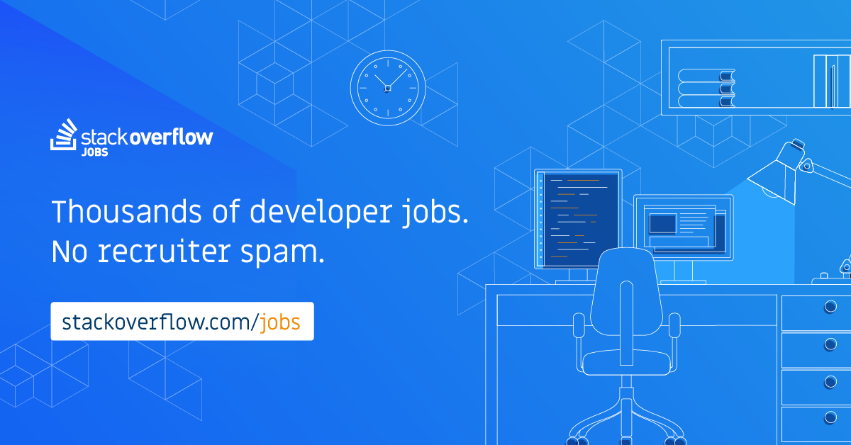

Data Sources
Structured dataset (CSV file)
88K rows (1 x survey response)
85 columns (1 x survey question/answer)
Demographic, education, skills, tools, work experience, compensation, etc.
Interesting Questions
Do you believe you need to be a manager to make more money?
How confident are you that your manager knows what they are doing? (“MgrIdiot”)
Are you the "IT support person" for your family?
Collections of Job Search Results
800+ Python jobs
80+ R jobs
Semi-structured data (RSS XML)
Keys: id, title/location, published date, html content
Unstructured job descriptions (HTML)
https://stackoverflow.com/jobs/feed
Collections of Job Search Results
240+ Github jobs
70+ Working Nomads jobs
Semi-structured data (RSS JSON)
Unstructured job descriptions (HTML)
https://jobs.github.com/positions.json
https://www.workingnomads.co/api/exposed_jobs

Slide 4
Analysis Question
Python or Java? … Python or R?

Slide 5
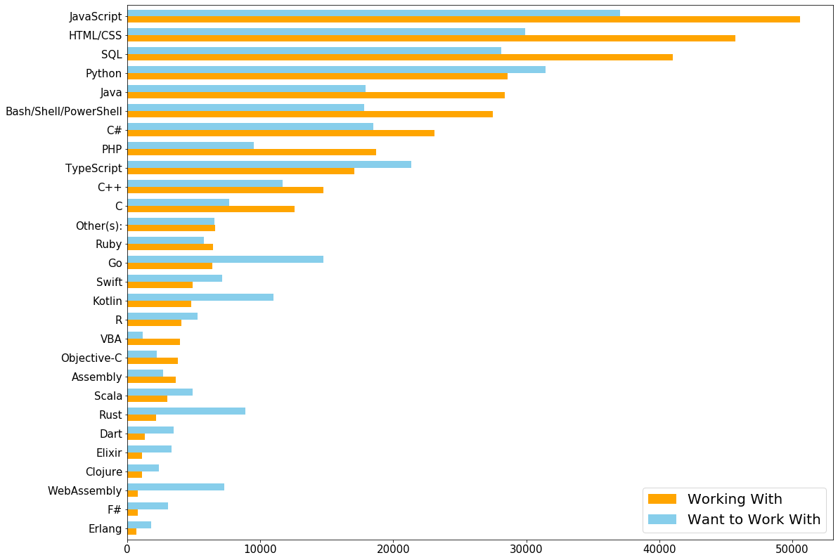
Programming Skills and Preferences
Stack Overflow Survey Questions
Which of the following programming, scripting, and markup languages have you done extensive development work in over the past year?
Which do you want to work in over the next year?
Worked with in Want to work
the PAST year in NEXT year
Assembly ▢ ▢
Bash/Shell/PowerShell ▢ ▢
C ▢ ▢
C++ ▢ ▢
C# ▢ ▢
….. ▢ ▢

Slide 6


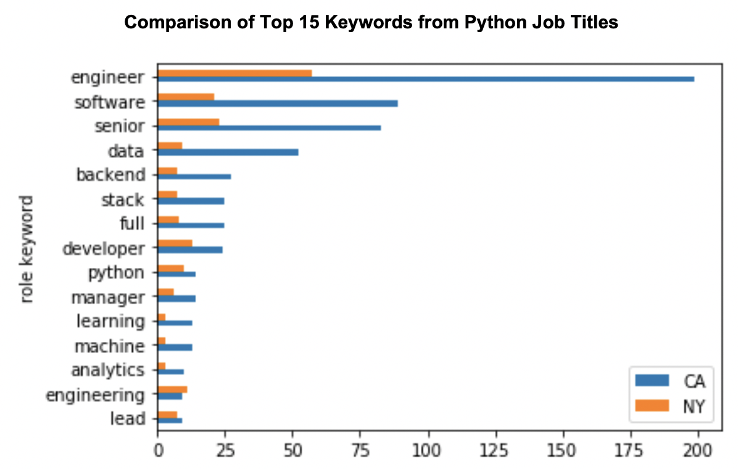
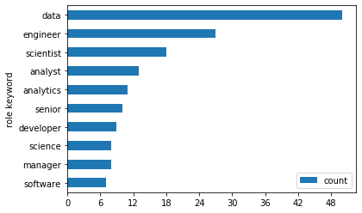
Stack Overflow Jobs
Python Job Postings
825 job openings between 1/24/2020 and 2/25/2020
30% located in California, 10% in NY
Extract and analyze keywords from Python job titles
Highest in demand: Senior software engineer (full-stack then backend)
Lead and manager positions available
California has more data related opportunities comparing to NY
R Job Postings
88 job openings between 1/25/2020 and 2/23/2020
Top locations: California (27%) and Texas/Virginia (9%)
Extract and analyze keywords from R job titles
Companies are hiring data engineers and data scientists
R jobs are clearly more data and analytics driven than Python jobs
Top 10 Keywords from R Job Titles (U.S.)

Slide 7
Analysis Question
What skills are being sought after in today’s Python job market?

Slide 8
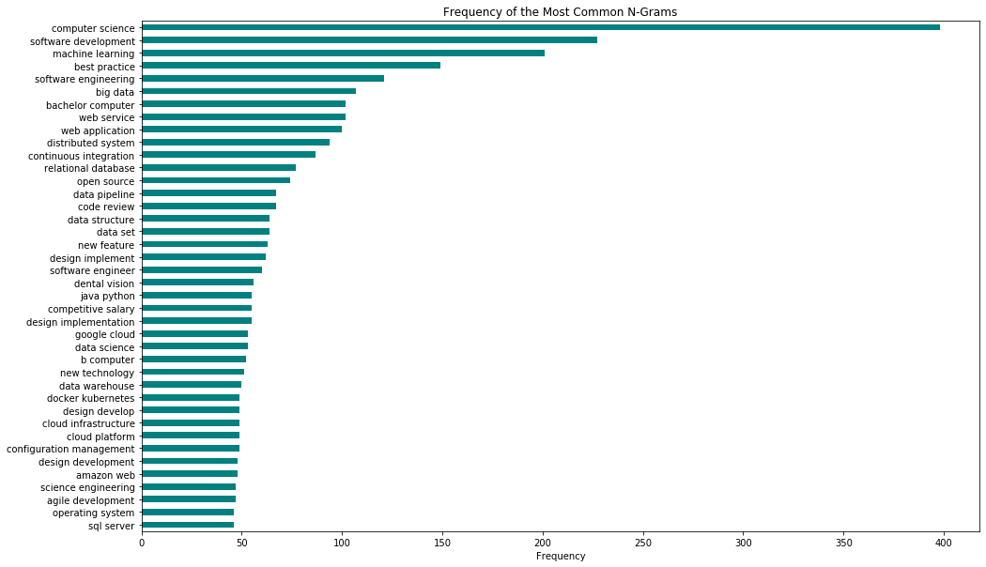
Stack Overflow Python Jobs - Bigrams
Responsibilities & Qualifications
Identified using HTML tag <li> within job descriptions
NLTK (lemmatization + stop words removal -> bigrams)
Key job duty: software development & engineering (design and implement, web application)
Degree in Computer Science
Data skills: machine learning, big data, relational db, data pipeline, data science, DW, etc.
Cloud technologies and development practices (agile, devOps, code review, etc.)

Slide 9
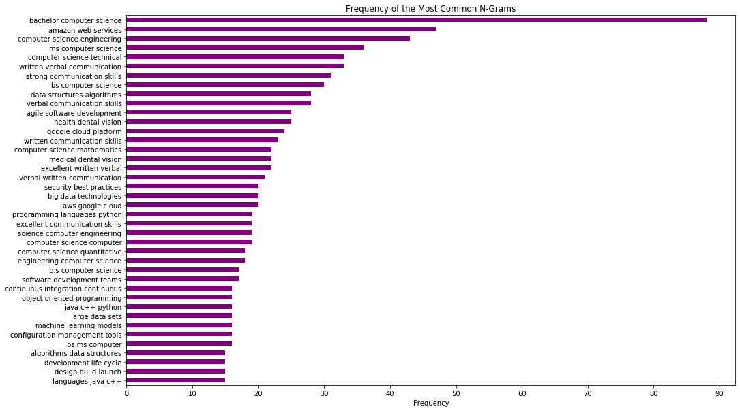
Stack Overflow Python Jobs - Trigrams
Responsibilities & Qualifications
Similar pre-processing as bigrams
NLTK (stop words removal only -> trigrams)
Formal education is highly preferred (bachelor’s and master’s)
Additional context: AWS, data structures and algorithms, agile software development, security best practices, object-oriented programming
Key skill along with degree and technical acumen: excellent communication (verbal/written)
Notes:
Degree - 12, Communication - 6

Slide 10
Analysis Questions
Which factors are most influential when comparing jobs?
How do these compare with actual job postings?

Slide 11
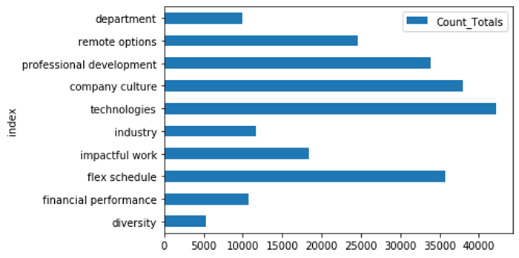
Most Important Job Factors
Question on the 2019 Stack Overflow Developer Survey:
“Imagine that you are deciding between two job offers with the same compensation, benefits and location.
Of the following factors, which 3 are MOST important to you?”
Survey Responses:
Job Factors: Developer Top 4
“Languages, frameworks and
technologies I’ll be working with”
“Office environment or company culture “
“Flex time or a flexible schedule”
“Opportunities for professional development”

Slide 12






Factors on the Job
Applying key job factor terms to job descriptions using NLTK Concordance:
Languages, frameworks and technologies I’ll be working with (keyword = ‘frameworks’)
66 matches on Github (Working Nomads = 11)
Examples:
“in particular angular v5+ frameworks html5 css3 and javascript”
“the most common javascript frameworks such react or angular”
Office environment or company culture (keyword = ‘culture’)
71 matches on Github (Working Nomads = 26)
Examples:
“establishing a culture of openness positive communication”
“strong remote culture work wherever you are most productive”
Flex time or a flexible schedule (keywords = ‘schedule’ and ‘flexible’)
9 matches on Github (Working Nomads = 29)
Examples:
“we offer schedule flexibility”
“in control of your own schedule”

Slide 13
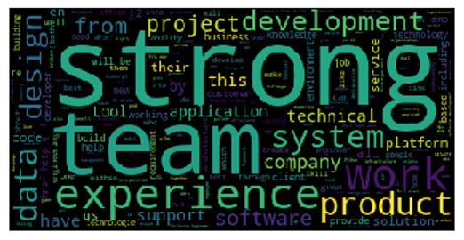


Key Job Description Terms
Top Bigrams by Frequency:
'computer', 'science'
'software', 'development'
'opportunity', 'employer'
'communication', 'skills'
Top Trigrams by Frequency:
'equal, 'employment', 'opportunity'
'verbal', 'communication', 'skills'
'flexible', 'working', 'hours'
'personal', 'development', 'budget'
By Pointwise Mutual Information score (PMI):
senior software engineer ping pong
amazon web services cloud guru
front end developer morning coffee
solve complex problems transcendental meditation
Notes:
The lists proves interesting, as terms such as “excellent communication skills” and “flexible working hours” point to ‘soft skills’ and job factors that would not otherwise be identifiable

Slide 14
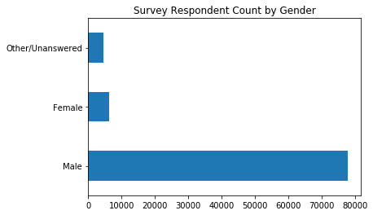
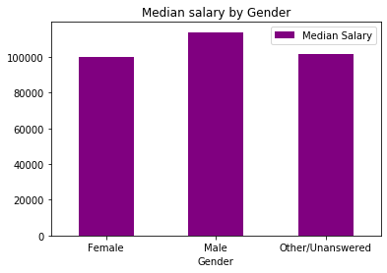
Key Findings & Insights
Developer Profiles
Majority of developers are males in the U.S.
Women overall get paid less (across job roles, age group, country)
Exception is lowest professional coding category (0-5 years)
Girls start to code at earlier age than males in youngest age group (0-18 years)
Experience & organization size results suggest developers should go freelance or large corp
Notes:
The lists proves interesting, as terms such as “excellent communication skills” and “flexible working hours” point to ‘soft skills’ and job factors that would not otherwise be identifiable

Slide 15

Key Findings & Insights
Skills and Experience
Full-stack developers most highly sought after
Back-end developers & data scientists are not far behind
Developer jobs are increasingly dynamic (New languages, platforms, data expertise, development practices)
Formal computer science & engineering education backgrounds still preferred
Developers MUST have excellent verbal + written communication skills
Work Trends
Online marketplaces are a great resource
California has hottest markets for both Python and R jobs
Senior level in high demand; management and lead positions are available
Best way to attract candidates is via tech and company culture
Notes:
The lists proves interesting, as terms such as “excellent communication skills” and “flexible working hours” point to ‘soft skills’ and job factors that would not otherwise be identifiable

Slide 16

Python Program Description
Tools & Techniques Used
Authored in Jupyter Notebook
Google Colab for code integration
Similar methodology for each data source
Data load and pre-processing (i.e. data cleaning, extraction, standardization, transformation)
CSV to Pandas
XML to JSON to Pandas
BeautifulSoup for HTML
JSON to MongoDB to Pandas
Extensive use of Pandas and Numpy functions/methods for data exploration and analysis
NLTK to handle unstructured text data (tokenization, lemmatization, n-grams, etc.)
Matplotlib and Seaborn for charts and graphs; word clouds

Slide 17

Any Questions?

