Slide 1
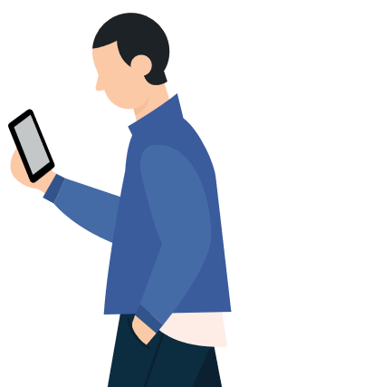


Analysis on Facebook Utilization
By – Sridhar Emmadi
Notes:
https://www.freepik.com/free-vector/people-doing-different-actions_3521084.htm
https://www.freepik.com/free-vector/hand-drawn-people-doing-outdoor-activities_2620727.htm

Slide 2
Agenda
Introduction & Problem Statement
Data Insights
Conclusion
Notes:
https://www.freepik.com/free-vector/social-influencer-background_3466233.htm
https://www.freepik.com/free-vector/social-media-elements_2795653.htm

Slide 3
Introduction & Problem Statement
According to Human Psychology "The more you spend on others, the happier you feel" & "90% of the people text things they can't say in person"
On these concepts many social media platforms developed and most of them are currently became part of our life!
One of the Social Media Giant is "Facebook", which is an American social media conglomerate corporation, founded on February, 2004 by Mark Zuckerberg.
Here we have a dataset from Facebook to analyze the usage pattern with respect to different gender, age groups etc.

Slide 4
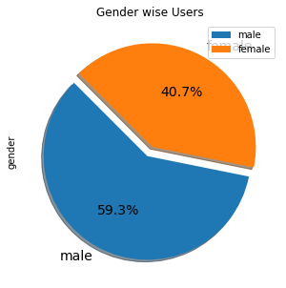
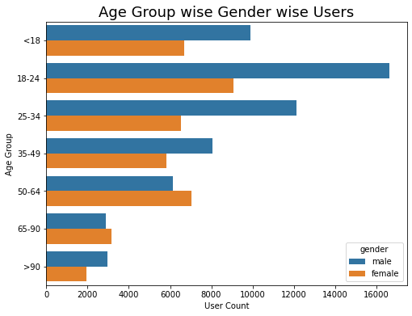
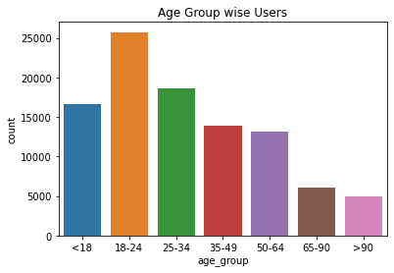
EDA
Male users are comparatively more than female
Users are more in 18-24 Yrs age group and less in >90 Yrs age group
Across age groups male users are more except 50 to 64 & 65 to 90 Yrs group

Slide 5
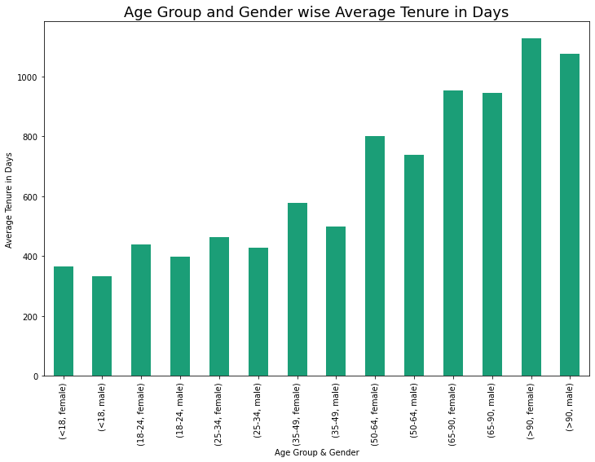
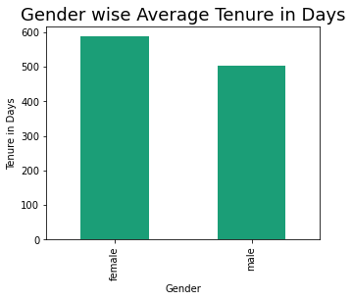
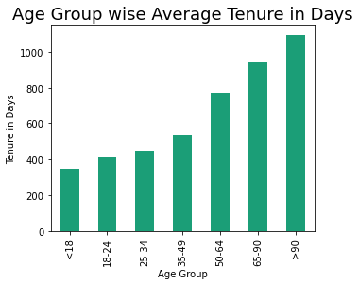
EDA
Female users are having long tenure comparatively
Age group wise trend showing seniors having more tenure
In each group also female users having long tenure

Slide 6
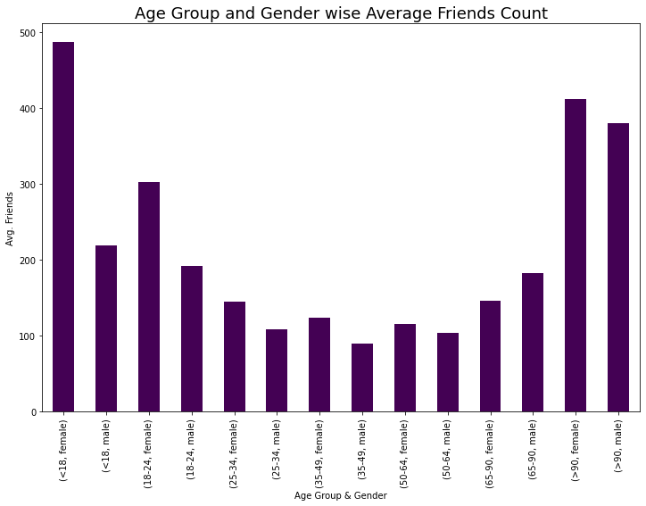
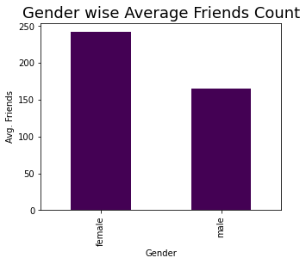
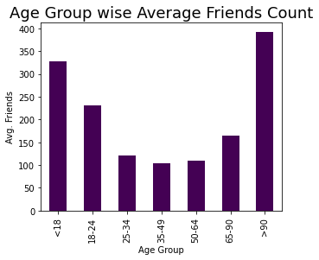
EDA
Female users having almost 50% more friends than male
Teenagers and >90 Yrs users having high friends in FB
In these age groups also females are having high friends

Slide 7
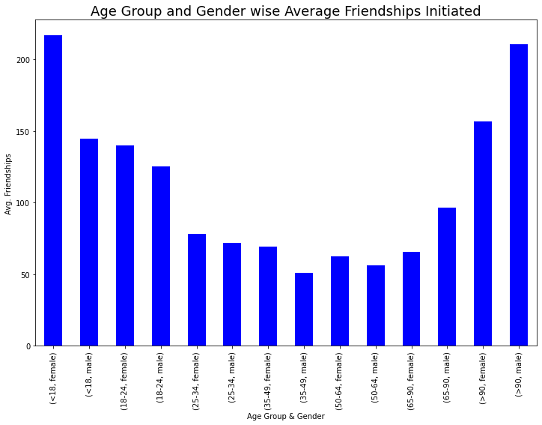
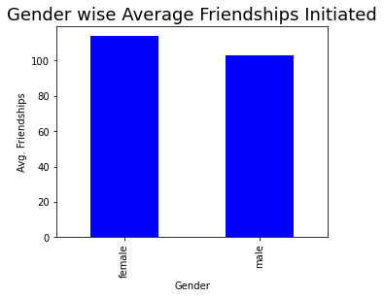
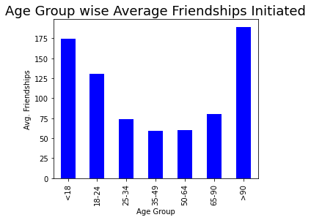
EDA
Almost same amount of friendships initiated by male and female
Teenagers and >90 Yrs users initiated more friend requests in FB
>90 Yrs – Male users initiated more friends

Slide 8
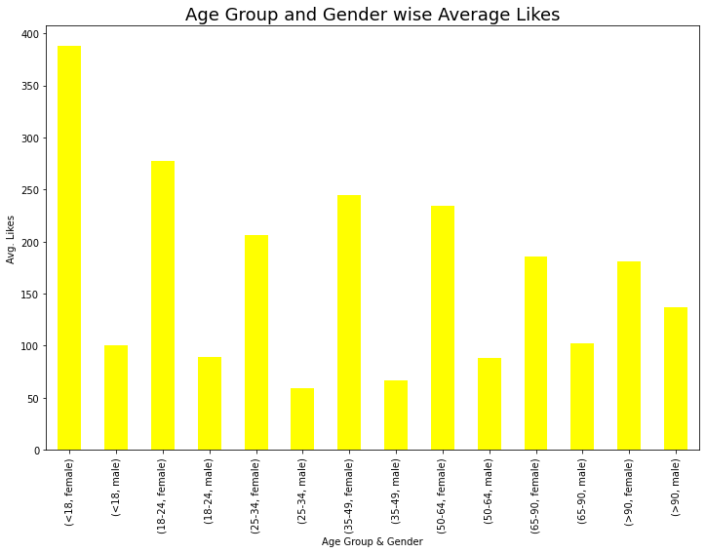
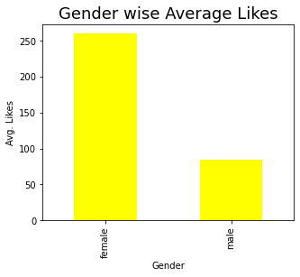
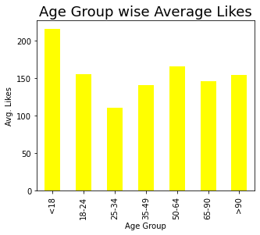
EDA
Female users are more generous in giving likes!
Teenagers are comparatively giving more likes

Slide 9
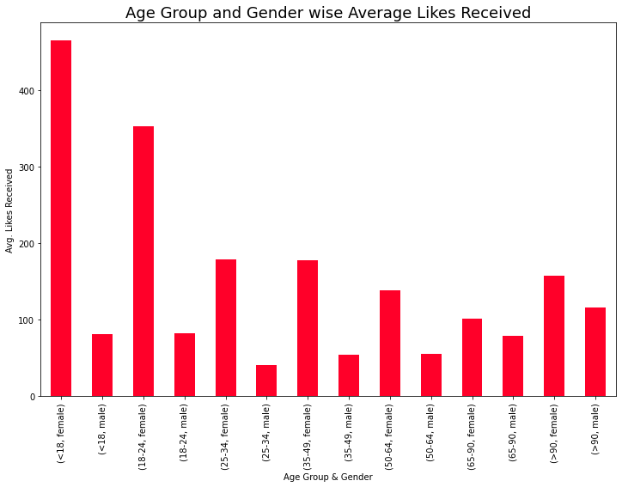
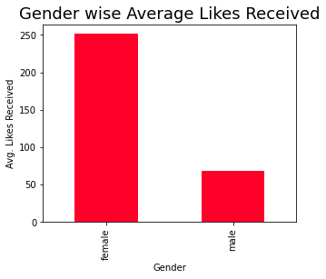
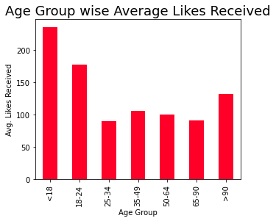
EDA
Female users received almost 5 times more likes than male
Teenagers and 18-25 Yrs users received more likes

Slide 10
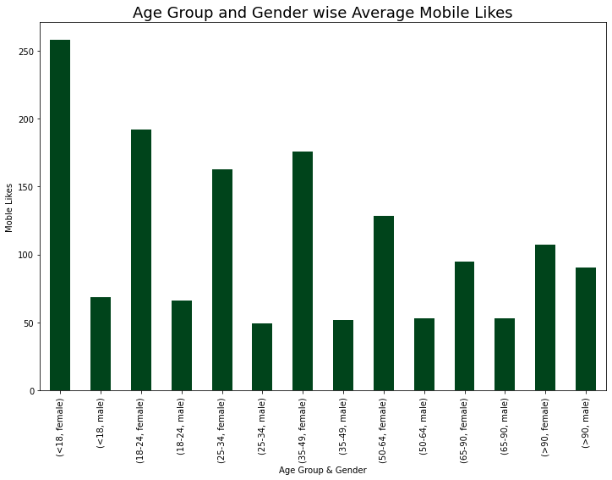
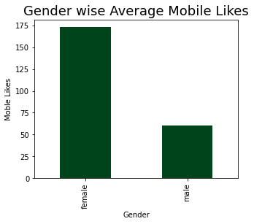
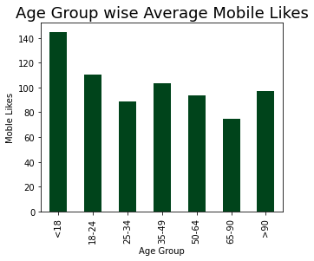
EDA
Female users are more generous in giving likes!
Teenagers are comparatively giving more likes

Slide 11
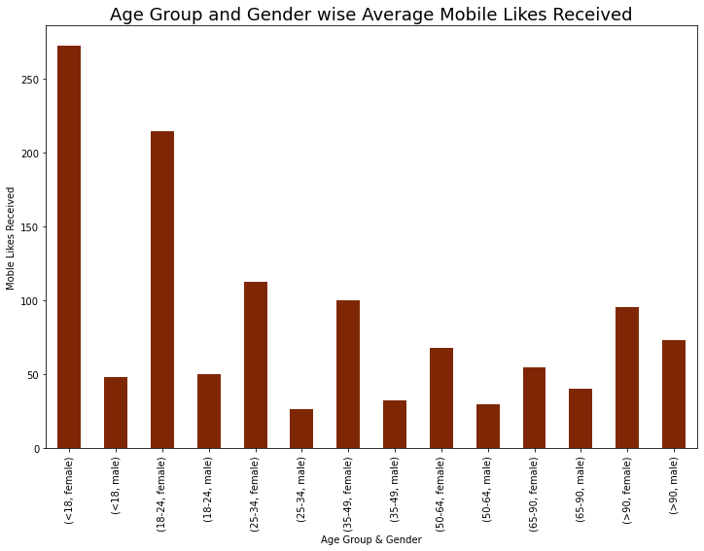
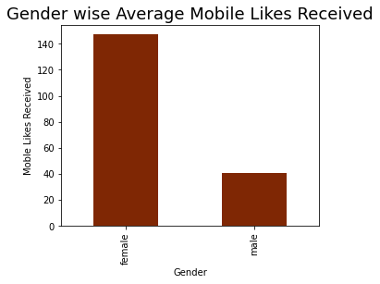
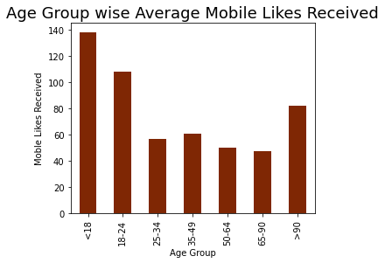
EDA
Female users received more than 3 times more likes than male
Teenagers and 18-25 Yrs users received more likes

Slide 12
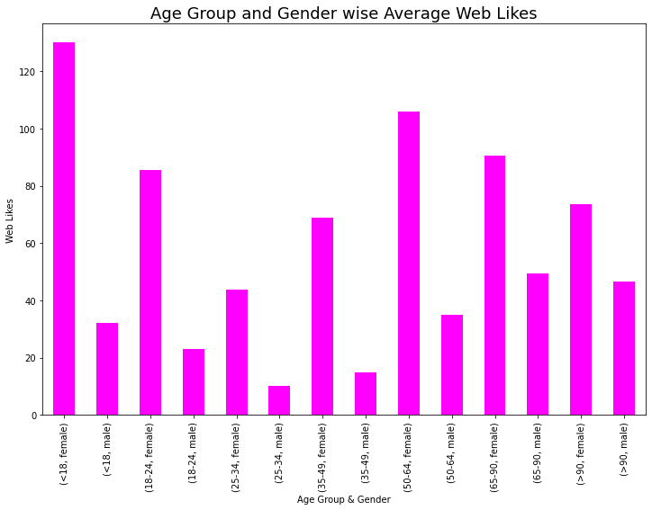
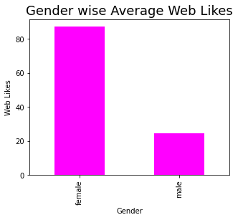
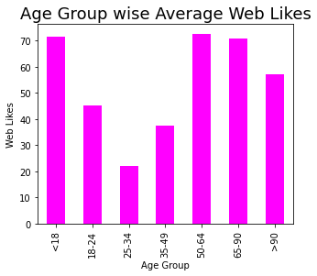
EDA
Female users are more generous in giving likes!
Teenagers and >50 Yrs age people using website to give likes!

Slide 13
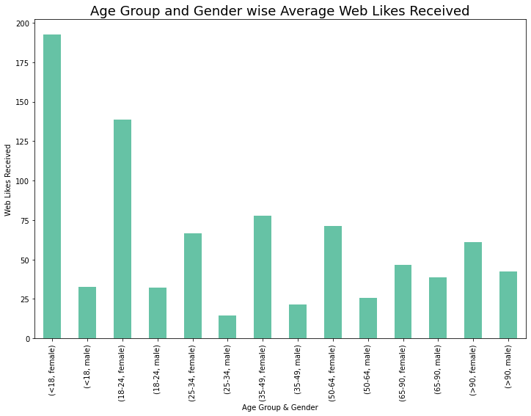
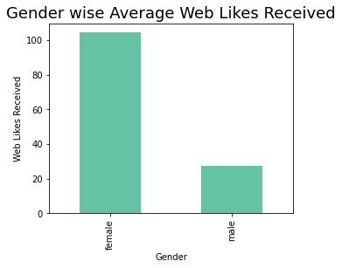
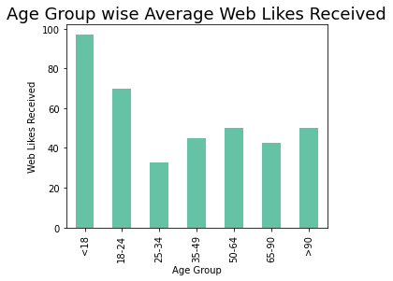
EDA
Female users received more than 3 times more likes than male
Teenagers and 18-25 Yrs users received more likes

Slide 14
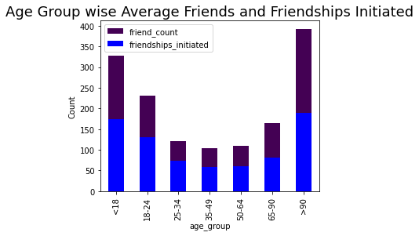
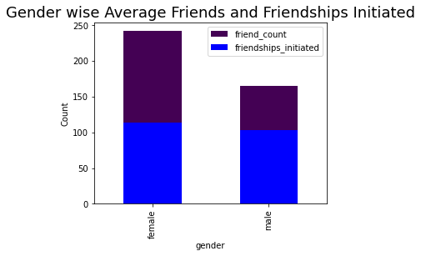
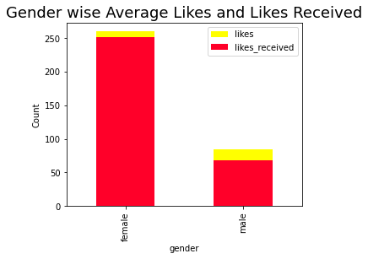
EDA
Female users having more friends where both initiated almost same amount of frieds
Users in the dataset received more like than they gave!
Female users received more likes than male

Slide 15
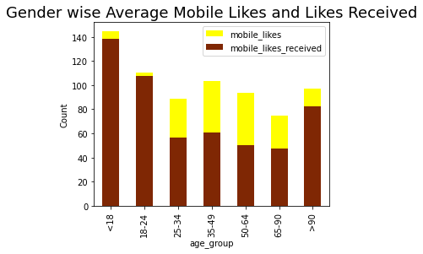
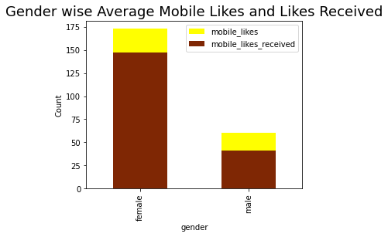
EDA
Female users received more likes where both given almost same amount of likes
Teenagers and 18-24 Yrs users received more likes

Slide 16
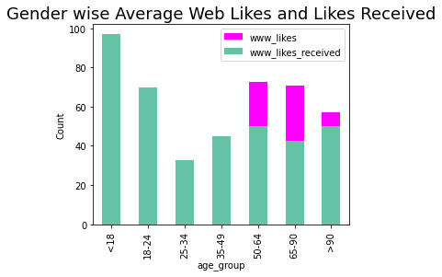
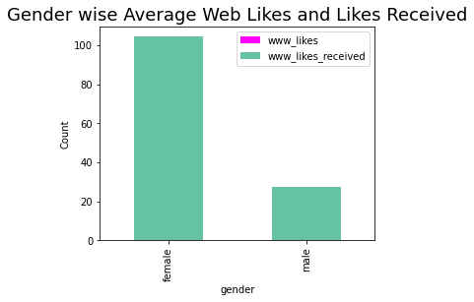
EDA
Female users received more likes where both given almost same amount of likes
Teenagers and 18-24 Yrs users received more likes
>50 Yrs users alone using website more to give their likes

Slide 17
EDA
Female users received more likes where both given almost same amount of likes
Teenagers and 18-24 Yrs users received more likes
>50 Yrs users alone using website more to give their likes

Slide 18
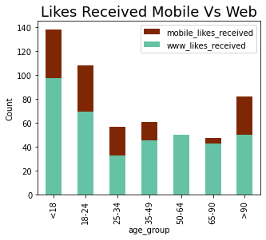
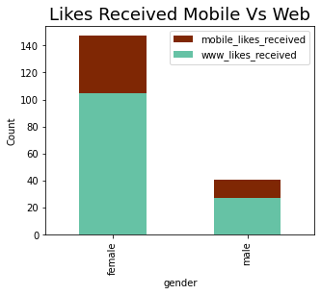
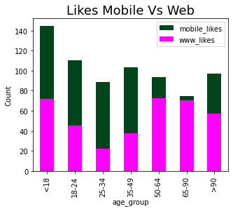
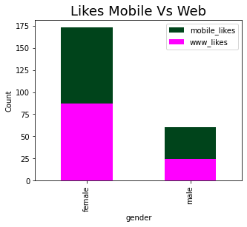
EDA
Users received more likes through website
Gender level usage of mobile and website is almost same to give likes
> 50 Yrs users using website to give likes than mobile!

Slide 19
Conclusion
Male users are comparatively more than female
Users are more in 18-24 Yrs age group and less in >90 Yrs age group
Across age groups male users are more except 50 to 64 & 65 to 90 Yrs group
Female users and old age people having long tenure
Female users having almost 50% more friends than male where almost same amount of friendships initiated by male and female
Teenagers and >90 Yrs users having high friends in FB
'>90 Yrs – Male users initiated more friends
Female users are more generous in giving likes!
Teenagers are comparatively giving more likes
Female users received almost 5 times more likes than male
Teenagers and 18-25 Yrs users received more likes
Users in the dataset received more like than they gave!
Female users received more likes where both given almost same amount of likes
Teenagers and 18-24 Yrs users received more likes
Users received more likes through website
'>50 Yrs users using website to give likes than mobile!

Slide 20
Thank You!

