Slide 1
Comprehensive Programming Practice 1
Group 1

Slide 2
Tasks:
Read two text files
Find overlap words between the two files
Find unique words between those two files
Calculating percentage of the overlaps

Slide 3
Procedures:
Create two ArrayList: list1, list2
Read two text files using scanner
Put the strings of the two files into the two ArrayLists consecutively
Sort(list1), sort(list2)
getRidOfDuplicates(list1), getRidOfDuplicates(list2)
Sum = list1.size() + list2.size()
Merge both lists into list1: list1 = merge(list1, list2)
sort(list1)
ArrayList uniqueWords = getUniqueWords(list1)
ArrayList overlappedWords = getOverlappedWords(list1)
Percentage_of_overlap = (sum/overlappedWords.size)*100

Slide 4
getUniqueWords(ArrayList list)
(We assume the list is sorted.)
uniqueWords = new empty list
current = list.get(0)
For i = 1 to list.size() :
If list.get(i) is not equal to current :
current = list.get(i)
If i<list.size()-1 and current is not equal to list.get(i+1) :
UniqueWords.add(current)
Else if i==list.size()-1 :
UniqueWords.add(current)
Return uniqueWords

Slide 5
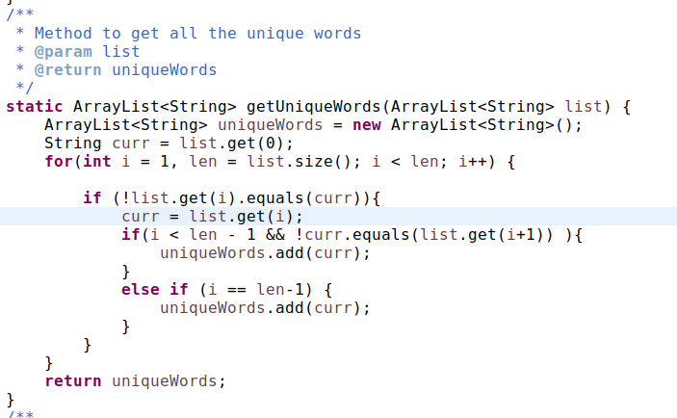
Source code:getUniqueWords(ArrayList list)

Slide 6
getOverLappedWOrds(ArrayList list)
overlaps = new empty list
Prev = list.get(0)
For i=1 to list.size() :
current = list.get(i)
If current equals prev:
overlaps.add(prev)
Prev = current
Else if i==list.size()-1
Overlaps.add(prev)
Return overlaps

Slide 7
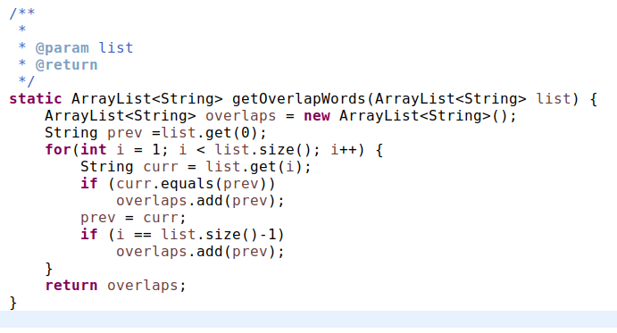
Source code:

Slide 8
Time Complexity:
Methods:
fileToArray(Scanner, ArrayList)
Collections.sort(list)
getRidOfDuplicates(ArrayList)
mergeTwoArrayList(list1, list2)
getUniqueWords(ArrayList)
getOverlappedWords(ArrayList)

Slide 9
Time Complexity:
Time complexity of each method
No method with time complexity more than linear time
Thus by rule 2: T₁(n)+T₂(n)=max O(f(n)),O(g(n))
The time complexity is Linear.

Slide 10
THANKS EVERYONE FOR LISTENING!!

