Slide 1

Informal Worker Credit Intelligence
Millions of hardworking Ghanaians have real income and years of MoMo transaction history — yet remain invisible to formal lenders. AI can change that.

Slide 2

The Credit Gap Is a Data Gap
Informal workers — traders, artisans, farmers, drivers — have real income and consistent transaction history. But banks ask for documents they simply don't have.
What Banks Require
What Workers Have
Payslips, registered business documents, and collateral
Years of MoMo transaction data, income patterns, and repayment behavior
The Result
Millions locked out of formal credit despite being creditworthy

Slide 3




Turn Transaction History Into a Credit Profile
An AI system can convert raw MoMo data into a structured, lender-readable credit profile — surfacing signals traditional underwriting misses.
Income Regularity
Savings Consistency
Detect consistent income patterns and cash flow stability over time
Identify habitual saving behavior as a proxy for financial discipline
Spending Behavior
Repayment Capacity
Analyze expenditure patterns to assess lifestyle and financial priorities
Surface evidence of ability and willingness to repay — actionable for lenders

Slide 4
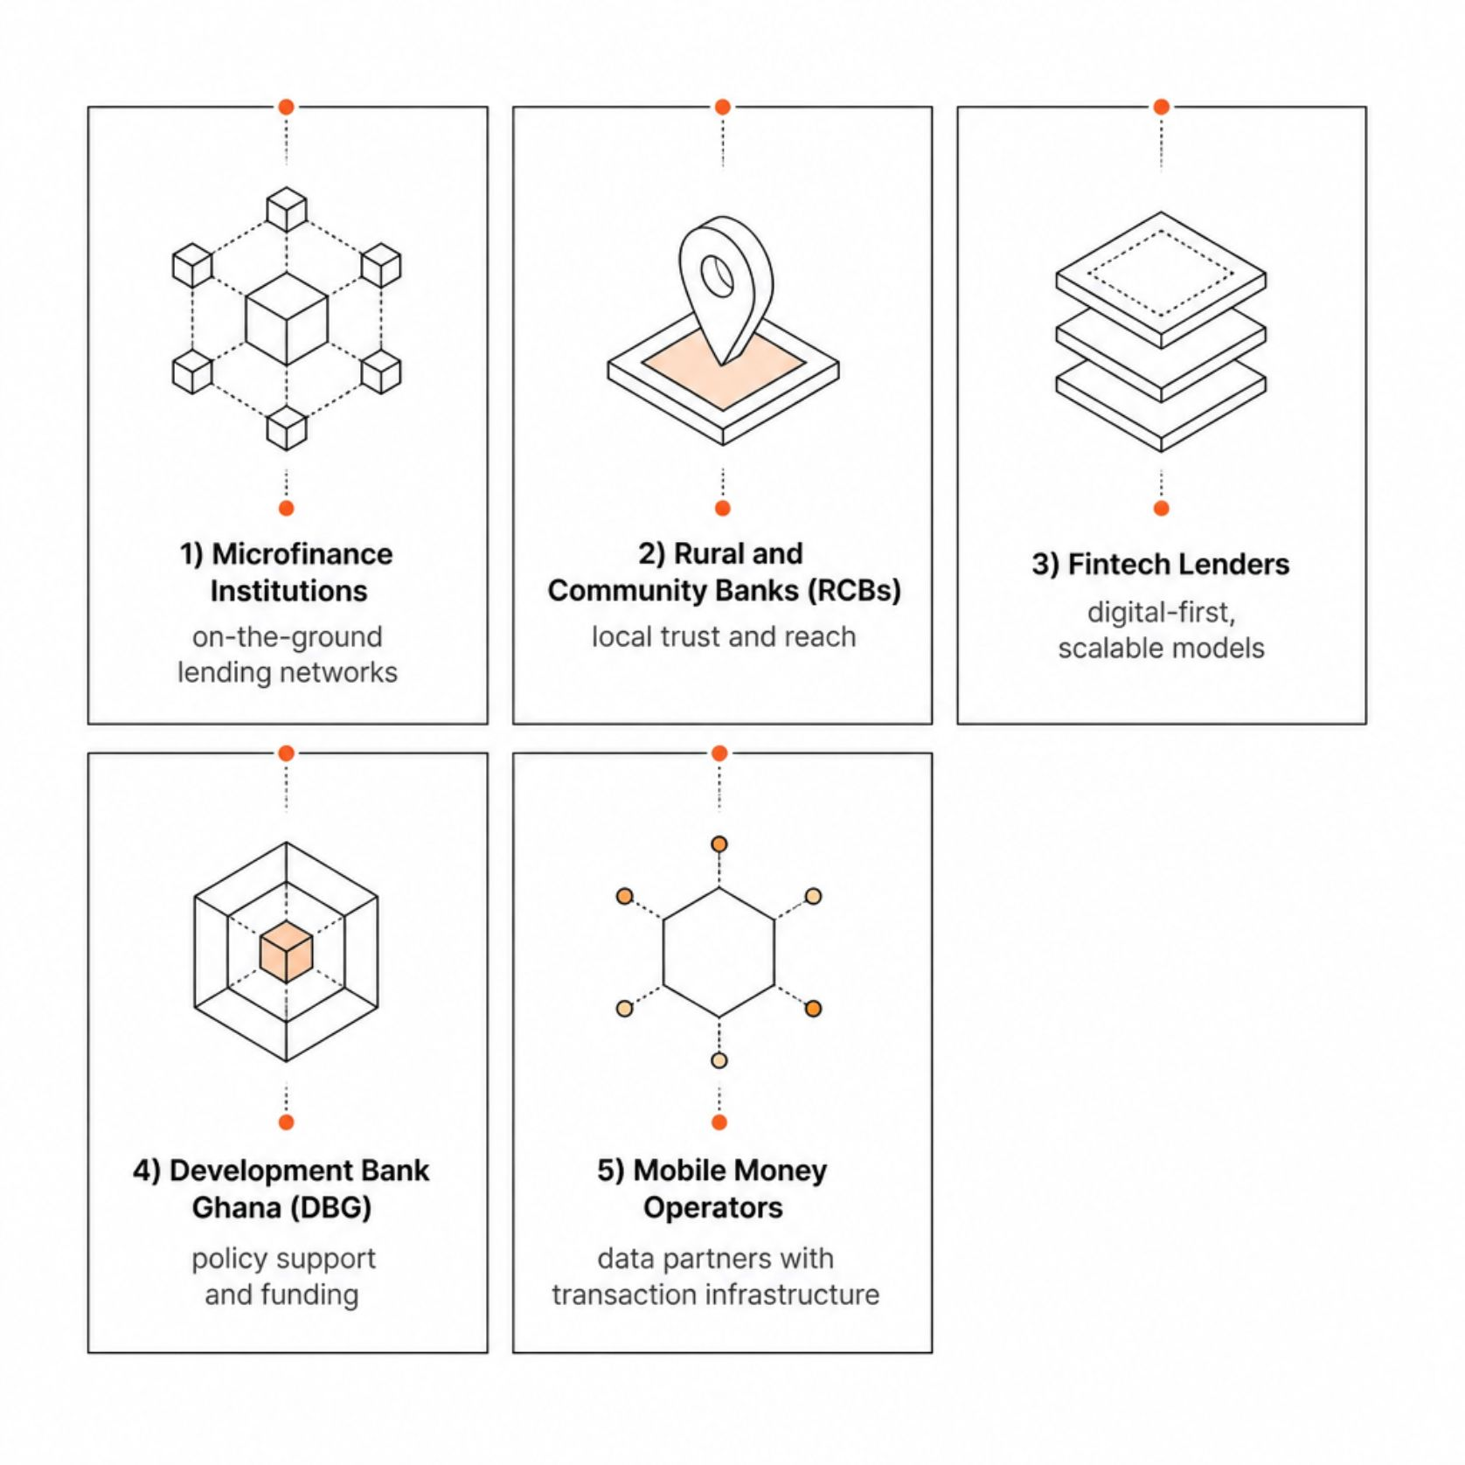

Who Can Build This — and How
AI Capabilities to Deploy
Transaction pattern analysis — decode behavioral signals from MoMo history
Alternative credit scoring — build models that don't rely on traditional documentation
LLM-powered explanations — plain-language score summaries for applicants
Voice AI — serve low-literacy users in local languages

Slide 5


What Success Looks Like
48hrs
0
Application Readiness
Required Payslips
Reduce credit application preparation time from weeks to under 48 hours
No traditional documentation needed — MoMo history becomes the evidence
100%
Structured Evidence
Lenders receive clear, actionable creditworthiness data they can act on immediately
The vision: Faster, more confident lending decisions for millions of Ghanaians who have always deserved access to credit — they just needed a way to prove it.

