Slide 1
ANALYSIS PROCESS
MODEL USED IN OOAD

Slide 2
DESIGN METHODOLOGY
A methodology is a description of the steps a development team should go through in order to produce a high-quality system.
A methodology must describe what should be produced (documents, diagrams, code, etc.) and what form the products should take (for example, content, icons, coding style) and technology to be used.
When object-oriented programming was catching on, in the 1990s, developers invented.
object-oriented methodologies, better suited to an object-oriented programming style.
A very good model should produce a high quality product if well implemented.

Slide 3
Popular methodologies in OOAD
Booch
OMT
Objectory
RUP
Etreme Programing ( Agile model)

Slide 4
UNIFIED PROCESS
The Unified Software Development Process or Unified Process is a popular iterative and incremental software development process model for OOD systems.
It is an extensible framework which should be customized for specific organizations or projects.
Has all necessary tools, documentation and procedures for software development.

Slide 5
Characteristics
Iterative
Incremental
Use case driven
Time boxed

Slide 6
Unified Process Lifecycle.
Inception Phase
Very short amongst all
Typical goals for the Inception phase are:
Establish a justification or business case for the project.
Establish the project scope and boundary conditions.
Outline the use cases and key requirements that will drive the design tradeoffs.
Outline one or more candidate architectures.
Prepare a preliminary project schedule and cost estimate.

Slide 7
Unified Process Lifecycle.
Elaboration Phase
During the Elaboration phase the project team is expected to capture a healthy majority of the system requirements.
Typical goals for the elaboration phase are:
Address known risk factors.
Establish the system architecture.
Validate the system architecture

Slide 8
Elaboration Phase
Activities undertaken.
The creation of use case diagrams.
Creation of conceptual diagrams (class diagrams with only basic notation)
Creation package diagrams (architectural diagrams)

Slide 9
Unified Process Lifecycle.
Construction Phase.
Construction is the largest phase in the project.
Typical goal for the construction phase is:
Implementation of system features in a series of short, time boxed iterations.
Coding and module testing are major activities
Common UML diagrams applied are:
Activity,.
Sequence.
Collaboration.
State (Transition)

Slide 10
Transition Phase
The final project phase is Transition.
In this phase the system is deployed to the target users.
Feedback received from an initial release (or initial releases) may result in further refinements to be incorporated over the course of several Transition phase iterations.

Slide 11
NEED FOR UNIFIED LANGUAGE
Other industries have languages and notations, which are understood by every member of that particular field.
Mathematicians have a common language.
So do musicians, electronic engineers, and many other disciplines and professions.
Software Engineering has lacked such a notation.
In the past more than 50 software modelling languages were in common use.
Each of them carrying their own notations!
Each language contained syntax peculiar to itself.

Slide 12
NEED FOR UNIFIED LANGUAGE
In 1996 the Object Management Group (OMG) the most important standardization Group, body for object-oriented software development, called for the specification of a uniform modeling standard to solve issues related to unification. Their aim was to:
Use of object-oriented concepts to represent complete systems rather than just one part of the software.
Establish of an explicit relationship between modeling concepts and executable program code.
Consider scaling factors that are inherent in complex and critical systems.
Creation of a modeling language that can be processed by machines but can also be read by human beings.

Slide 13
NEED FOR UNIFIED LANGUAGE
Today, UML is one of the most widespread graphical object-oriented modeling languages.
UML is simply a language, a notation, a syntax, whatever you want to call it. Crucially, it does not tell you how to develop software.
The first thing to notice about the UML is that there are a lot of different diagrams (models) to get used to.
The reason for this is that it is possible to look at a system from many different viewpoints.
A software development will have many stakeholders playing a part for:
Notes:
Analysts • Designers • Coders • Testers • QA • the Customer • Technical Authors.

Slide 14
UML
The Unified Modelling Language, or the UML, is a graphical modelling language.
UML is for visual modelling.
Provides us with a syntax for describing the major elements in software engineering projects.
Rational Unified Process is the model implemented

Slide 15
Why modelling?
A model is a simplification of reality. A model provides the blueprints of a system.
Every system may be described from different aspects using different models, and each model is therefore a semantically closed abstraction of the system.
A model may be structural, emphasizing the organization of the system, or it may be behavioral, emphasizing the dynamics of the system.
We build models so that we can better understand the system we are developing.

Slide 16
Aims of the model
Through modeling, we achieve four aims.
1. Models help us to visualize a system as it is or as we want it to be.
2. Models permit us to specify the structure or behavior of a system.
3. Models give us a template that guides us in constructing a system.
4. Models document the decisions we have made.

Slide 17
Principles of Modeling:
"The choice of what models to create has a profound influence on how a problem is attacked and how a solution is shaped“.
Every model may be expressed at different levels of precision ". Best approach to a given problem results in a best model. If the problem is complex mechanized level of approach & if the problem is simple decent approach is followed.
"The best models are connected to reality.“ The model built should have strong resemblance with the system.
" No single model is sufficient. Every nontrivial system is best approached through a small set of nearly independent models.“ If you constructing a building, there is no single set of blueprints that reveal all its details. At the very least, you will need floor plans, elevations, electrical, plans, heating plans, and plumbing plans.

Slide 18
Understanding UML
To understand the UML, we need to form a conceptual model of the language, and this requires learning three major elements:
* Basic Building blocks of the UML
* Rules of the UML
* Common mechanisms in the UML.

Slide 19
Building blocks
UML is composed of three main building blocks, i.e. things, relationships, and diagrams.
Building blocks generate one complete UML model diagram by rotating around several different blocks.
Things
Relationships
Diagrams

Slide 20
Things
Things are the abstractions that are first-class citizens in a model; relationships tie these things together.
Anything that is a real world entity or object is termed as things.
There are four kinds of things in the UML:
Structural things
Behavioral things
Grouping things.
Annotational things

Slide 21
Things
Structural things
Structural things are the nouns of UML models. These are the mostly static parts of a model, representing elements that are either conceptual or physical.
They display the physical and conceptual components of the system.
They include class, object, interface, node, collaboration, component, and a use case.

Slide 22
Structural things
Objects
An object is an entity which is used to describe the behavior and functions of a system.
It is an instance of class
The class and object have the same notations.
The only difference is that an object name is always underlined in UML

Slide 23
Structural things
Collaboration
A collaboration defines an interaction and is a society of roles and other elements that work together to provide some cooperative behavior.
Collaborations and use cases have structural, as well as behavioral, dimensions.
A given class or object might participate in several collaborations. These collaborations therefore represent the implementation of patterns that make up a system.
Use cases have processes the define actions implemented in the system.
Graphically, a collaboration is rendered as an ellipse with dashed lines, sometimes including only its name.

Slide 24
Structural things
Interface
An interface is a collection of operations that specify a service of a class or component.
An interface therefore describes the externally visible behavior of that element.
An interface defines a set of operation specifications (that is, their signatures) but never a set of operation implementations.
The declaration of an interface looks like a class with the keyword «interface» above the name; attributes are not relevant.

Slide 25
Structural things
Use Case.
A use case is a description of sequences of actions that a system performs that yield observable results of value to a particular actor.
A use case is used to structure the behavioral things in a model.
A use case is realized by a collaboration.
Graphically, a use case is rendered as an ellipse with solid lines, usually including only its name.

Slide 26
Structural things
Class
A class is a description of a set of objects that share the same attributes, operations, relationships, and semantics.
A class implements one or more interfaces.
Graphically, a class is rendered as a rectangle, usually including its name, attributes, and operations

Slide 27
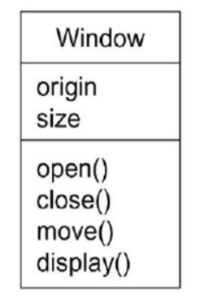
Structural things

Slide 28
Behavioral Things
Behavioral things are the dynamic parts of UML models.
These are the verbs of a model, representing behavior over time and space.
In all, there are three primary kinds of behavioral things.
Interaction.
State machine.
Activity.

Slide 29
Behavioral Things
Interaction.
First, an interaction is a behavior that comprises a set of messages exchanged among a set of objects or roles within a particular context to accomplish a specific purpose.
The behavior of a society of objects or of an individual operation may be specified with an interaction.
The behavior of a society of objects or of an individual operation may be specified with an interaction.
An interaction involves a number of other elements, including messages, actions, and connectors.
Graphically, a message is rendered as a directed line with arrow head, almost always including the name of its operation.

Slide 30
Behavioral Things
State machine.
A state machine is a behavior that specifies the sequences of states an object or an interaction goes through during its lifetime in response to events, together with its responses to those events.
The behavior of an individual class or a collaboration of classes may be specified with a state machine.
A state machine involves a number of other elements, including states, transitions (the flow from state to state), events (things that trigger a transition), and activities (the response to a transition).
Graphically, a state is rendered as a rounded rectangle, usually including its name and its sub states.

Slide 31
Grouping things
Grouping things are the organizational parts of UML models. These are the boxes into which a model can be decomposed. There is one primary kind of grouping thing, namely, packages.
A package is a general-purpose mechanism for organizing elements into groups.
Structural things, behavioral things, and even other grouping things may be placed in a package.
Graphically, a package is rendered as a tabbed folder, usually including only its name and, sometimes, its contents.

Slide 32
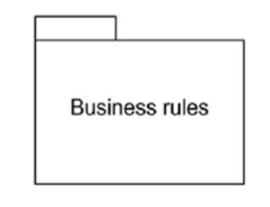
Package

Slide 33
Annotational things:
Annotational things are the explanatory parts of UML models. These are the comments you may apply to describe, illuminate, and remark about any element in a model.
There is one primary kind of Annotational thing, called a note.
A note is simply a symbol for rendering constraints and comments attached to an element or a collection of elements.
Graphically, a note is rendered as a rectangle with a dogeared corner, together with a textual or graphical comment.

Slide 34
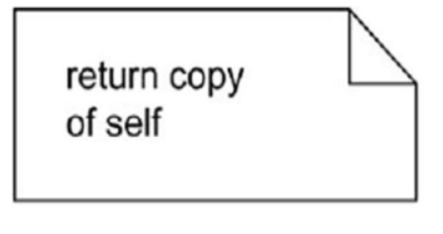
Note

Slide 35
Behavioral Things
Activity.
An activity is a behavior that specifies the sequence of steps a computational process performs.
In an interaction, the focus is on the set of objects that interact.
In a state machine, the focus is on the life cycle of one object at a time.
In an activity, the focus is on the flows among steps without regard to which object performs each step.
A step of an activity is called an action. Graphically, an action is rendered as a rounded rectangle with a name indicating its purpose.
States and actions are distinguished by their different contexts.
Notes:
Grouping things.
Annotational things
Reading assignment.

Slide 36
Relationships
When we are modeling the system first of all we start is identifying things. These things will not stay alone.
They collaborate with each other. This means they are connected with others in some way. It is called relationship of things.
The relationship allows you to show on a model how two or more things relate to each other.
The relationship in UML will enable you to capture meaningful connections between things.
It shows how each element is associated with each other and how this association describes the functionality of an application.

Slide 37
Relationships
Association.
An association is a structural relationship which connects one thing with another.
Simple link between things.
Given an association between two things, we can navigate from one thing to the other thing and vice versa.
It is also common for a thing to have a self association.
Multiplicity is introduced that tells us how many objects of a particular element are associated.
It can be denoted as simple dotted or solid line graphically

Slide 38


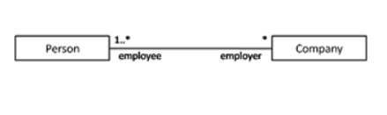
Simple association

Slide 39
Relationships
Dependency
A dependency is a using relationship. In this relationship one thing depends on the other thing.
It is a semantic relationship in which a change to one element (the independent one) may affect the semantics of the other element (the dependent one).
Graphically, a dependency is rendered as a dashed line, possibly directed, and occasionally including a label.

Slide 40
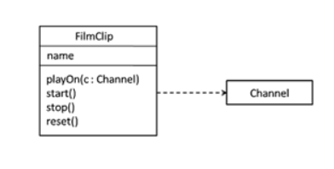
Dependency

Slide 41
Relationships
Generalization
The generalization relationship also known as the is-a relationship is between two things where one thing is general (superclass) and the other is specific thing (subclass) of the general thing.
Graphically, generalization is represented as a solid line with a closed arrow head pointing towards the general thing.
A class with no parents and having one or more child classes is called root class.
A class with no child’s is called a leaf class

Slide 42
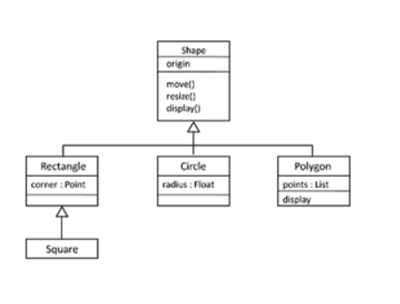
Generalization

Slide 43
Diagrams in UML
A diagram is the graphical presentation of a set of elements, most often rendered as a connected graph of vertices (things) and arcs (relationships). The UML includes nine such diagrams:
1. Class diagram 2. Object diagram
3. Use case diagram 4. Sequence diagram
5. Collaboration diagram 6. State chart diagram
7. Activity diagram 8. Component diagram
9. Deployment diagram

Slide 44
Diagrams in UML
Class diagram:
A class diagram shows a set of classes, interfaces, and collaborations and their relationships. These diagrams are the most common diagram found in modeling object-oriented systems. Class diagrams address the static design view of a system.
Object diagram:
An object diagram shows a set of objects and their relationships. Object diagrams represent static snapshots of instances of the things found in class diagrams. These diagrams address the static design view or static process view of a system .

Slide 45
UML DIAGRAMS
Use case diagram:
A use case diagram shows a set of use cases and actors (a special kind of class) and their relationships.
Use case diagrams address the static use case view of a system. These diagrams are especially important in organizing and modeling the behaviors of a system.
Sequence diagram:
A sequence diagram is an interaction diagram that emphasizes the time-ordering of messages;
Interaction diagrams address the dynamic view of a system. Sequence diagrams and collaboration diagrams are isomorphic, meaning that you can take one and transform it into the other.

