Slide 1
Cloudimart Prototype: System Architecture and Design Decisions
Emmanuel Mukumbwa
emukumbwa2419@gmail.com
GitHub: https://github.com/Emmanuel-Mukumbwa/cloudimart-university-ecommerce
Technical Interview Presentation
February 22, 2026.

Slide 2
Introduction
Cloudimart uses a decoupled architecture: a Laravel backend serving a REST API and a Next.js frontend consuming that API. This separation allows independent scaling and follows modern best practices. The prototype focuses on core e‑commerce flows with location‑restricted checkout for the Mzuzu University community."

Slide 3
Technology Stack
Backend: Laravel (PHP) – MVC, Eloquent ORM
Frontend: Next.js (React, TypeScript, Bootstrap CSS)
Database: MySQL – normalized schema with foreign keys
Authentication: Laravel Sanctum (token‑based, stateless)
Payments: Integrated with PayChangu (online) + manual proof upload

Slide 4
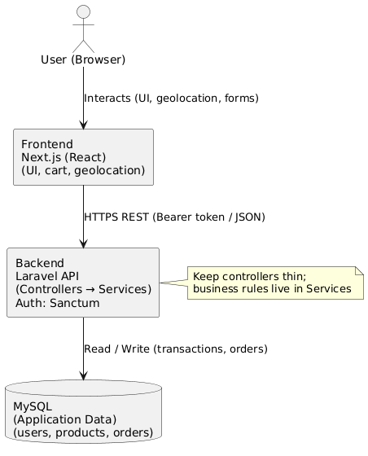
Architecture Overview

Slide 5
Architecture Overview
Frontend communicates with backend via RESTful API.
Backend is stateless – each request carries an authentication token.
Business logic is encapsulated in Service classes (LocationService, OrderService).
Controllers are thin; they orchestrate requests and return JSON responses.

Slide 6
Core Features: MVP Scope
Product Catalog (Stationery & Dairy categories)
Shopping Cart with persistent user cart
Location‑Based Checkout (GPS validation against seeded zones)
Order Processing with unique human‑readable order ID
Delivery Verification (Order ID + phone number)
Admin Tools (CRUD for products, categories, locations)
Payment Handling (PayChangu + manual proof upload)

Slide 7
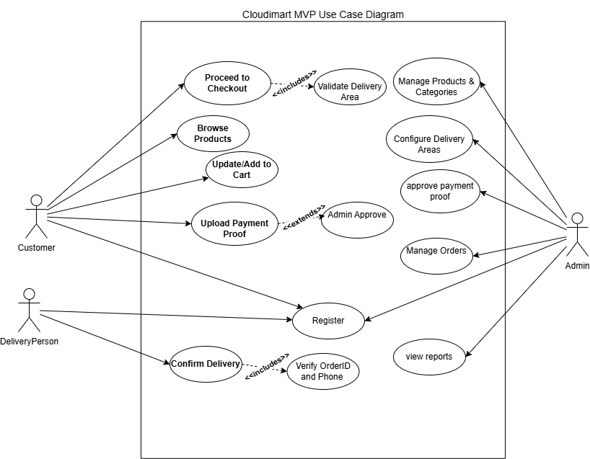

Slide 8
Location Validation and How It Works
Radius‑based geofencing using Haversine formula
Each delivery zone defined by a center point + radius (1.0–1.8 km)
User's GPS compared to all active zones; if within any radius then checkout allowed
Server‑side validation ensures rules cannot be bypassed
Coordinates collected manually via Google Maps pin‑drops and seeded in database

Slide 9
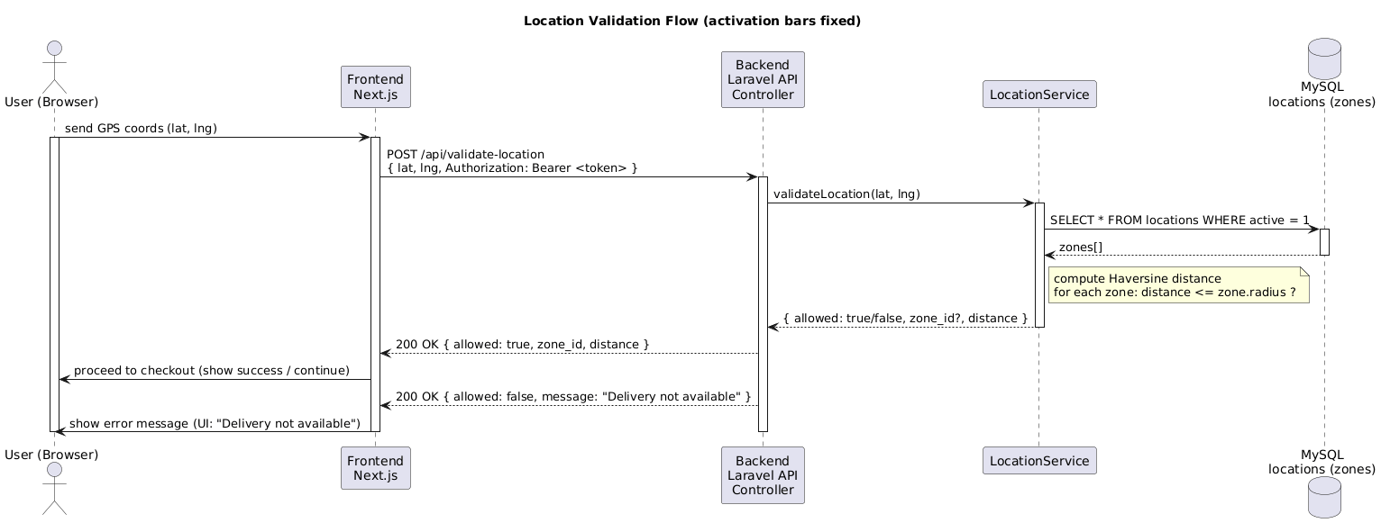

Slide 10
Checkout Flow with Location Validation
1. Browser sends GPS coordinates to backend.
2. Backend validates against seeded zones using LocationService.
3. If valid, payment is initiated (PayChangu or manual proof).
4. After payment confirmation, order is created with stock locking.
5. Delivery record with verification code is generated.

Slide 11
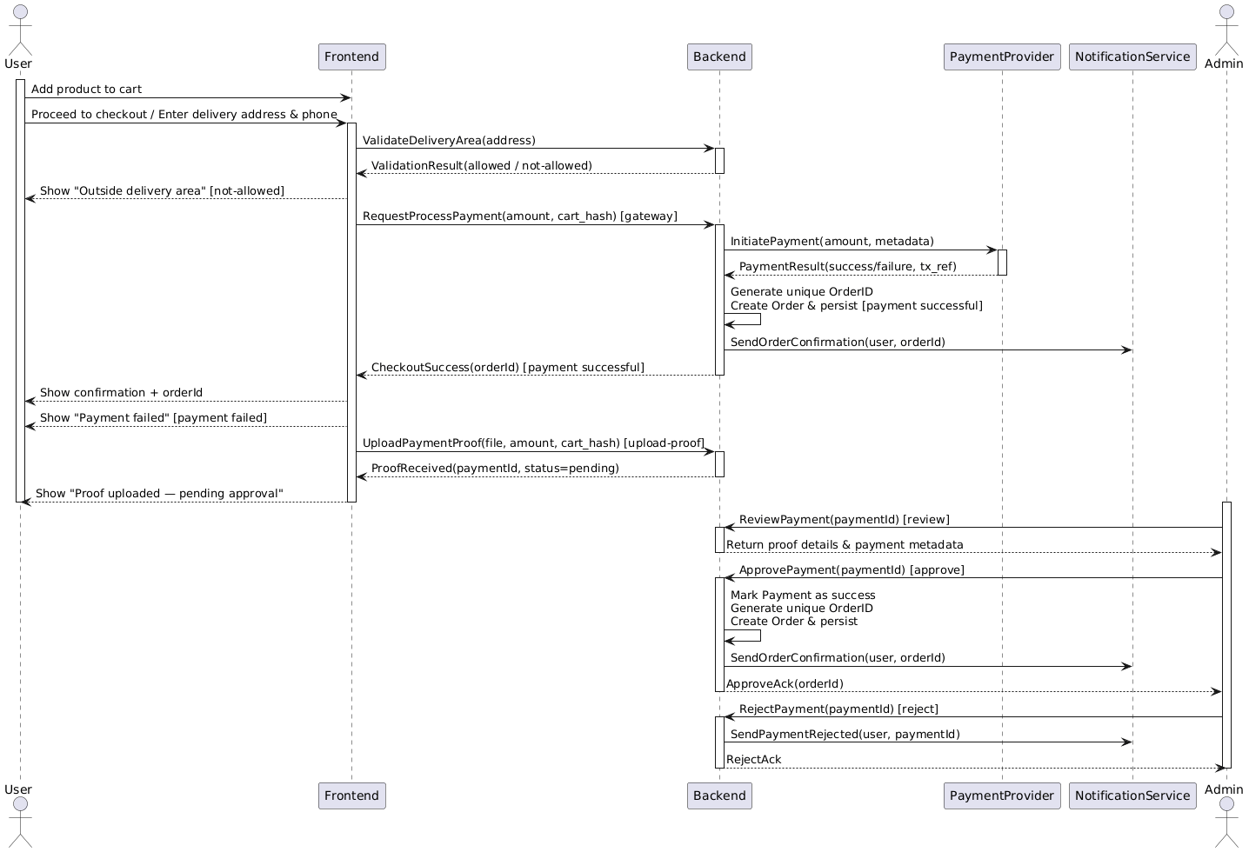

Slide 12
Database Design
Key tables: users, locations, products, categories, carts, cart_items, payments, orders, order_items, deliveries

Slide 13
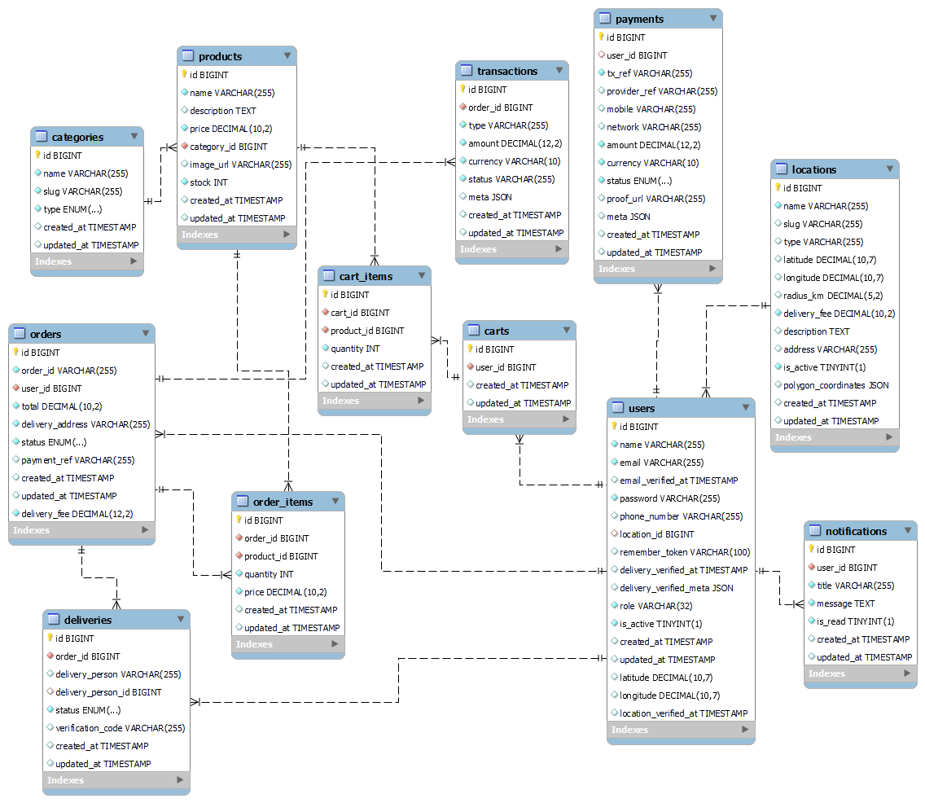

Slide 14
Key Design Decisions
Backend‑first development: Core business rules enforced server‑side
Radius‑based geofencing: Simple, maintainable, accurate for campus
Stateless API with Sanctum tokens: Enables horizontal scaling
Human‑readable order ID: Easy for customers and support
Cart snapshot in payments: Prevents price/stock changes after payment
Row locking for stock: Prevents overselling under concurrent requests
Server‑trusted location verification: Reduces friction for returning users

Slide 15
Info‑Driven Design
Brand alignment: Analyzed live Cloudimart site for colors, navigation, terminology
User expectations: Researched Jumia/Amazon for checkout and cart patterns
Cart behavior: Single persistent cart per user (merged on login)
Stock awareness: Add-to-cart disabled when insufficient stock with clear messaging

Slide 16
Conclusion
The Cloudimart prototype meets all core requirements: a product catalog, shopping cart, location‑restricted checkout, unique order ID generation, delivery verification, and admin controls. It is built with a clean, scalable architecture and designed with real user expectations and brand identity in mind. The system is ready for a pilot and can be extended with additional features as the business grows.

Slide 17
Thank You

