Slide 2
Input Volume for Vectorized RNN Computation
Length of each input (T_{x})
One forward pass of the RNN operates on a 2D slice of the input volume which holds the t^{th} word of every sample (size n_{x} x m)
Size of dictionary (n_{x})
# of samples (m)
One-hot vector for the second word of the last sample
One-hot vector for the first word of the last sample (size n_{x} x 1)

Slide 3
Unit Computation on a Single Element of a Single Sample
W_{ax}
x^{<t>}
W_{aa}
a^{<t-1>}
a^{<t>}
n_{x}
n_{a}
+
→
n_{a}
n_{a}
n_{x}
n_{a}
n_{a}
W_{ay}
a^{<t>}
y^{<t>}
n_{a}
→
n_{y}
n_{a}
n_{y}

Slide 4
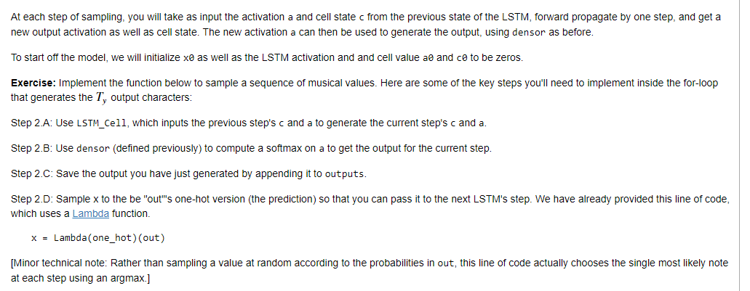

Slide 5
Input Volume for Vectorized RNN Computation
Size of dictionary (n_{x})
One forward pass of the RNN operates on a 2D slice of the input volume which holds the t^{th} value of every sample (size n_{x} x m)
# samples (m)
Length of each input (T_{x})

Slide 6
Input Volume for Vectorized RNN Computation
Length of each input (T_{x})
One forward pass of the RNN operates on a 2D slice of the input volume which holds the t^{th} word of every sample (size n_{x} x m)
# samples (m)
Size of dictionary (n_{x})
One-hot vector for the second word of the last sample
One-hot vector for the first word of the last sample (size n_{x} x 1)

