Slide 1


GeoAI-Driven Precision Agriculture: A Self-Trained 1D-CNN for Spectral-Temporal Vegetation Health Mapping and Variable-Rate Nitrogen Prescription in the Prestea Huni-Valley Municipality, Ghana
Presented by: Emmanuel Yerbo
Research Presentation & Scientific Discussion
Session: Agriculture, Food Security & Water Management

Slide 2
Presentation Outline
1. Background to Study
2. Statement of the Problem
3. Research Objectives
4. Study Area: Training & Inference Domains
5. Methodology
6. Results
7. Conclusion & Research Limitations

Slide 3
Background: Core Concepts
GeoAI (Geospatial Artificial Intelligence):
• Integration of GIS, Remote Sensing, and Deep Learning to automate spatial decision-making [14].
Precision Agriculture (PA):
• Site-specific management using spatial inputs to optimize resource use and crop yield [13].
The Gap in Sub-Saharan Africa:
• Smallholders rely on blanket fertilizer rates, leading to environmental runoff and yield loss [8, 11].
[8] Biney et al. (2022); [11] Amoah & Drechsel (2022); [13] Vizzari et al. (2019); [14] Kamilaris & Prenafeta-Boldú (2018).

Slide 4
Statement of the Problem & Scientific Foundations
PREVIOUS WORK | GHANA'S PROBLEM | METHOD ERROS
Burke & Lobell (2017) [12] Mapped smallholder yield variability using satellites in East Africa, proving crop responses to nitrogen are highly localized rather than uniform. | Yield & Resource Gap [17] Maize yields average only ~1.7 t/ha under uniform fertilizer recommendations. National CSIR target is 5.0-6.0 t/ha using site-specific inputs. | The Transferability Gap Most agricultural deep learning models only report within-site and within-year accuracy. Performance in unseen regions/seasons remains untested [7].
Zhong et al. (2019) [15] Demonstrated that 1D Convolutional Neural Networks (1D-CNNs) can map crop health directly from raw spectral bands, outperforming traditional machine learning. | Digital Advisory Gaps [18] Ghana's mobile digital extension platforms are ready to deliver advisory service, but lack high-resolution spatial diagnostics at field scale. | Spatial Data Leakage Random train-test splits allow autocorrelated pixels to leak between training and validation folds, producing artificially inflated model accuracy [1, 4].
Vizzari et al. (2019) [13] Used Sentinel-2 Red-Edge bands for Variable-Rate Application (VRA) nitrogen prescriptions in wheat, saving 20-30% fertilizer with zero yield loss. | Environmental Runoff [8, 11] Uniform fertilizer application causes heavy nitrogen leaching into the Ankobra River basin, compounding ecological stress from gold mining. | Spectral Index Saturation [5] Standard NDVI indices saturate under dense tropical vegetation canopies, limiting their capability to differentiate variations in crop nitrogen needs.
1. East Africa (Kenya & Uganda) [12]:
• Burke & Lobell (2017) mapped smallholder yield variability using satellites, proving that crop nitrogen responses are highly localized rather than uniform.
2. Mediterranean Basin (Italy) [13]:
• Vizzari et al. (2019) applied Sentinel-2 Red-Edge indices for Variable-Rate nitrogen prescriptions in wheat, saving 20–30% fertilizer with zero yield loss.
3. Midwest United States [15]:
• Zhong et al. (2019) demonstrated that 1D-CNNs can map crop health directly from multi-spectral bands, outperforming traditional machine learning models.
[12] Burke & Lobell (2017); [13] Vizzari et al. (2019); [15] Zhong et al. (2019).
[1] Meyer & Pebesma (2021); [4] Roberts et al. (2017); [5] Clevers & Gitelson (2013); [7] Ploton et al. (2020); [8] Biney et al. (2022); [11] Amoah & Drechsel (2022); [12] Burke & Lobell (2017); [13] Vizzari et al. (2019); [15] Zhong et al. (2019); [17] Asante & Temoso (2019); [18] Adu-Poku et al. (2022).

Slide 5
Background: Local Necessity in Ghana
1. The Yield & Resource Gap [17]:
• Smallholder maize yields average only ~1.7 t/ha due to blanket fertilizer rates. CSIR targets 5.0–6.0 t/ha using hybrid seeds and site-specific inputs.
2. Environmental Runoff [8, 11]:
• Uniform fertilizer application causes nitrogen leaching into the Ankobra River basin, compounding ecological stress from gold mining (galamsey).
3. Digital Advisory Gaps [18]:
• Ghana's mobile extension infrastructure is ready to deliver agronomic advice, but lacks the field-scale spatial data needed for localized prescriptions.
[8] Biney et al. (2022); [11] Amoah & Drechsel (2022); [17] Asante & Temoso (2019) Agric. Syst.; [18] Adu-Poku et al. (2022) IFPRI.

Slide 6
Statement of the Problem
1. Spatial Data Leakage:
• Random train-test splits allow autocorrelated pixels to leak between folds, producing artificially high validation accuracies [1, 4].
2. The Transferability Gap:
• Most crop classifiers only report within-site and within-year accuracy. Real-world performance in unseen regions/seasons remains untested [7].
3. Spectral Index Saturation:
• Standard NDVI crop health indices saturate in dense tropical canopies, limiting their utility for variable-rate fertilizer mapping [5].
[1] Meyer & Pebesma (2021) Methods Ecol. Evol.; [4] Roberts et al. (2017) Ecography; [5] Clevers & Gitelson (2013); [7] Ploton et al. (2020) Nat. Commun.

Slide 7
Research Objectives
Main Objective:
To develop and evaluate a dual-axis (spatial and temporal) transferability framework for GeoAI-driven vegetation health mapping and variable-rate nitrogen prescribing in Ghana.
Specific Objectives:
• To train a lightweight 1D-CNN (VegHealthCNN) on Sentinel-2 imagery from the Akaakuma area using Spatial Block Cross-Validation [1, 3].
• To evaluate spatial transferability by deploying the frozen model to the geographically separate Prestea Huni-Valley Municipal Assembly (PHMA) for the same year (2024).
• To evaluate temporal transferability by applying the frozen model to PHMA 2025 composites without retraining.
• To couple the transferred classification with an NDRE-modulated variable-rate nitrogen prescription model [5].
[1] Meyer & Pebesma (2021); [3] Valavi et al. (2019) Methods Ecol. Evol.; [5] Clevers & Gitelson (2013) Int. J. Appl. Earth Obs. Geoinf.

Slide 8
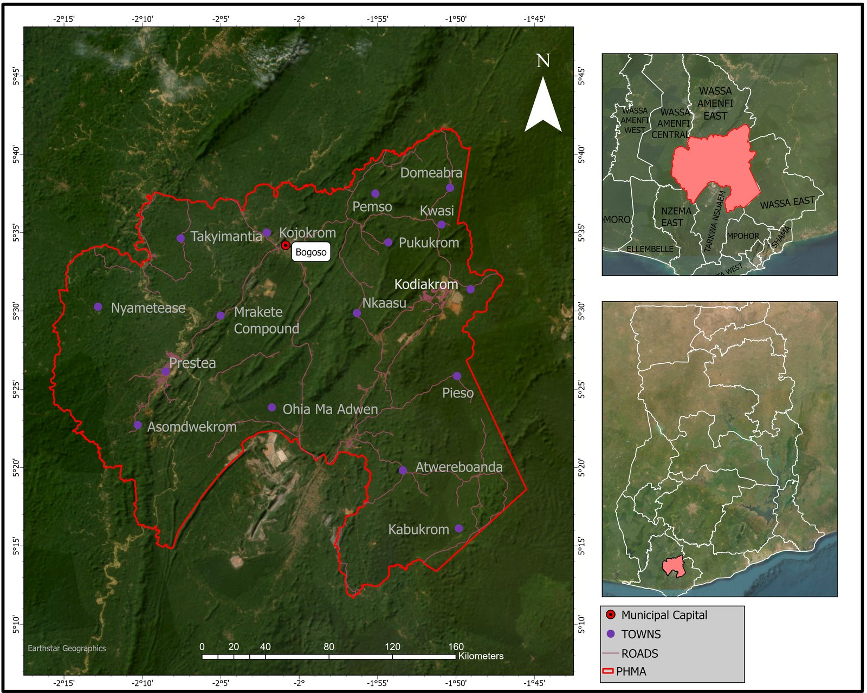
Study Area: Training & Inference Domains
Training Site: Akaakuma
• Western Region, Ghana.
• 1,500 self-labeled coordinates.
Inference Domain: PHMA
• ~1,808 km², artisanal mining pressure [8, 9].
Feature Stack (14 variables):
• 9 Sentinel-2 bands + 5 indices (EVI, SAVI, NDRE, BSI, NDMI) [5].
• NDVI excluded to prevent label circularity.
[5] Clevers & Gitelson (2013); [8] Biney et al. (2022); [9] Baddianaah et al. (2023).

Slide 9
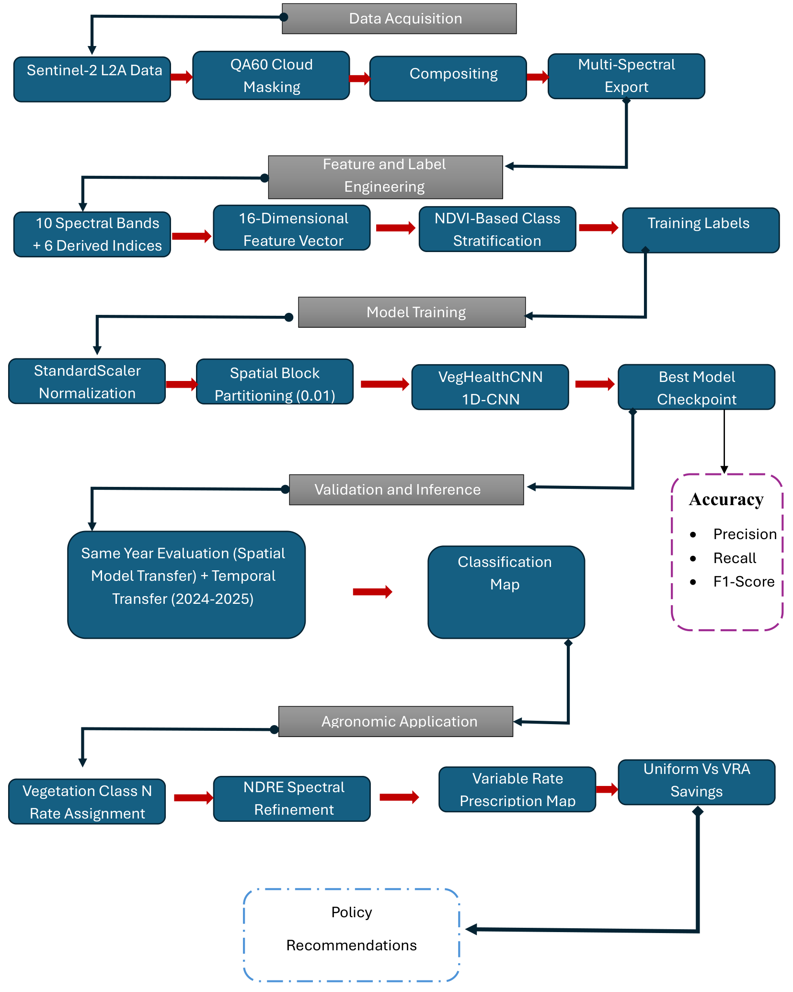
Methodology: Research Pipeline Workflow
Phase 1: Dataset Construction & Feature Extraction
• Sampled 1,500 coordinates in Akaakuma training site.
• Generated 14-variable stack using Google Earth Engine.
• Proxy labels [5]: Healthy (NDVI ≥ 0.70) | Stress (0.40–0.70) | Non-Veg (< 0.40).
Phase 2: Model Development & Validation
• VegHealthCNN 1D-CNN (57K parameters) developed [2].
• 0.01° grid spatial blocks built for Block CV [3].
• Evaluated spatial block performance on independent test blocks.
Phase 3: Inference Domain Transfer & VRA Prescription
• Transferred frozen model spatially (PHMA 2024) [1].
• Transferred frozen model temporally (PHMA 2025).
• Coupled with NDRE variable-rate nitrogen prescription.
[1] Meyer & Pebesma (2021); [2] Hu et al. (2015); [3] Valavi et al. (2019); [5] Clevers & Gitelson (2013).

Slide 10
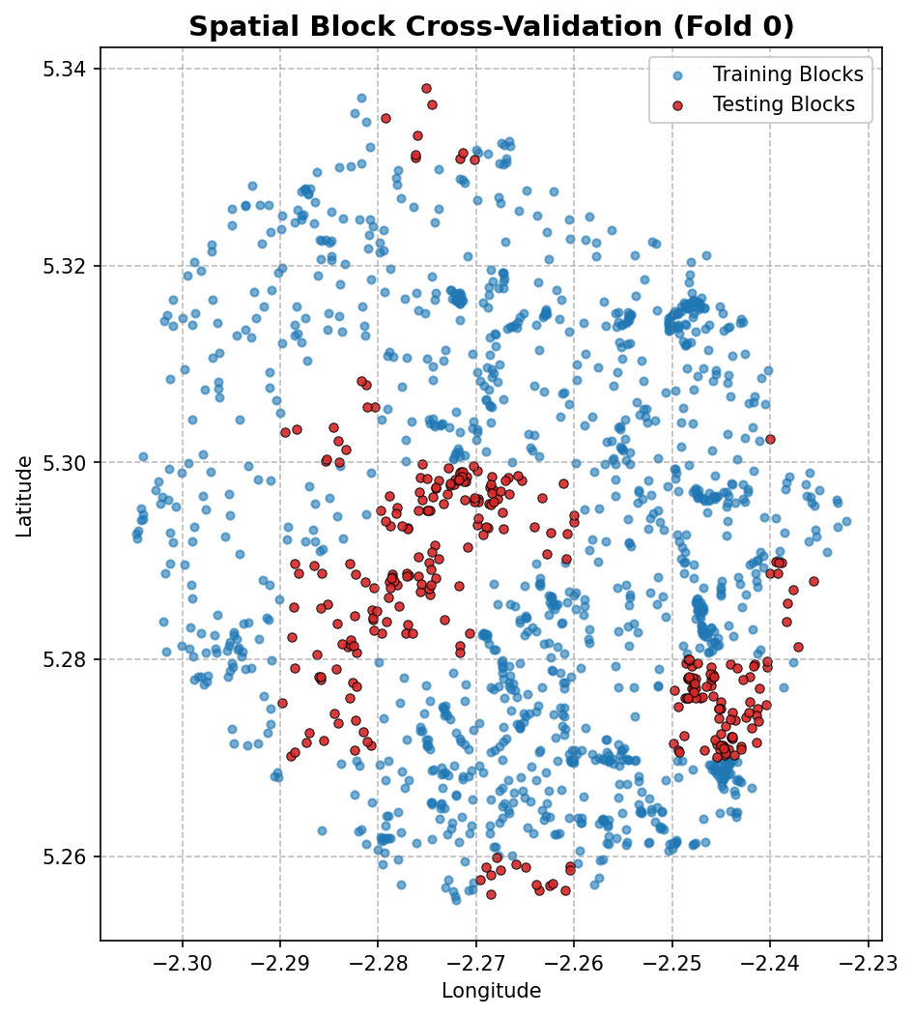
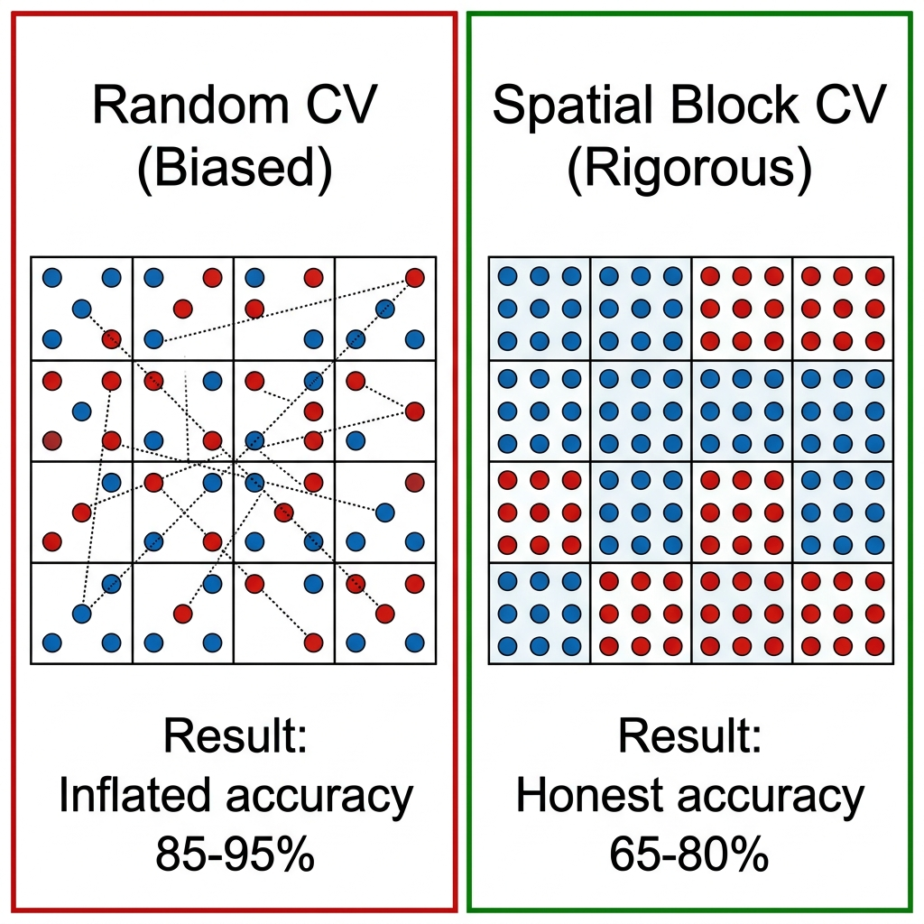
Methodology: Spatial Block Cross-Validation
• Training domain tessellated into 0.01° blocks (~1.1 km) [3].
• GroupKFold: no training/test samples share a geographic block [1].
• 301 spatially independent test samples.
• Eliminates spatial autocorrelation leakage [4].
🔵 Blue = Training blocks
🔴 Red = Held-out test blocks
[1] Meyer & Pebesma (2021); [3] Valavi et al. (2019); [4] Roberts et al. (2017) Ecography.

Slide 11
Results: Within-Domain Accuracy
Per-class performance under Spatial Block CV (n = 301 test samples)
Class | Precision | Recall | F1-Score
Healthy Vegetation | 99.4% | 99.4% | 99.4%
Moderate Stress | 97.4% | 96.2% | 96.8%
Non-Vegetation | 96.6% | 99.4% | 98.0%
• Overall Accuracy: 98.7%
• High scores across all classes confirm generalized, block-invariant spectral feature learning [1, 4].
[1] Meyer & Pebesma (2021); [4] Roberts et al. (2017).

Slide 12
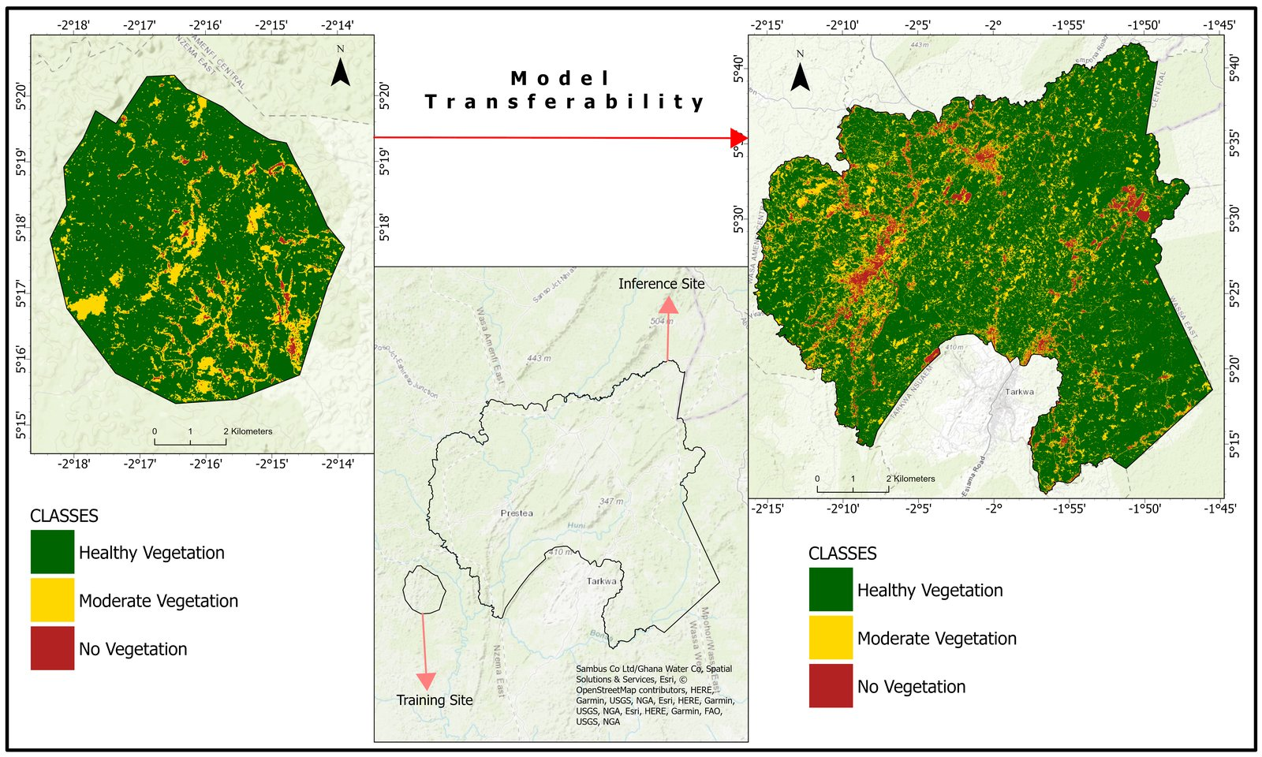
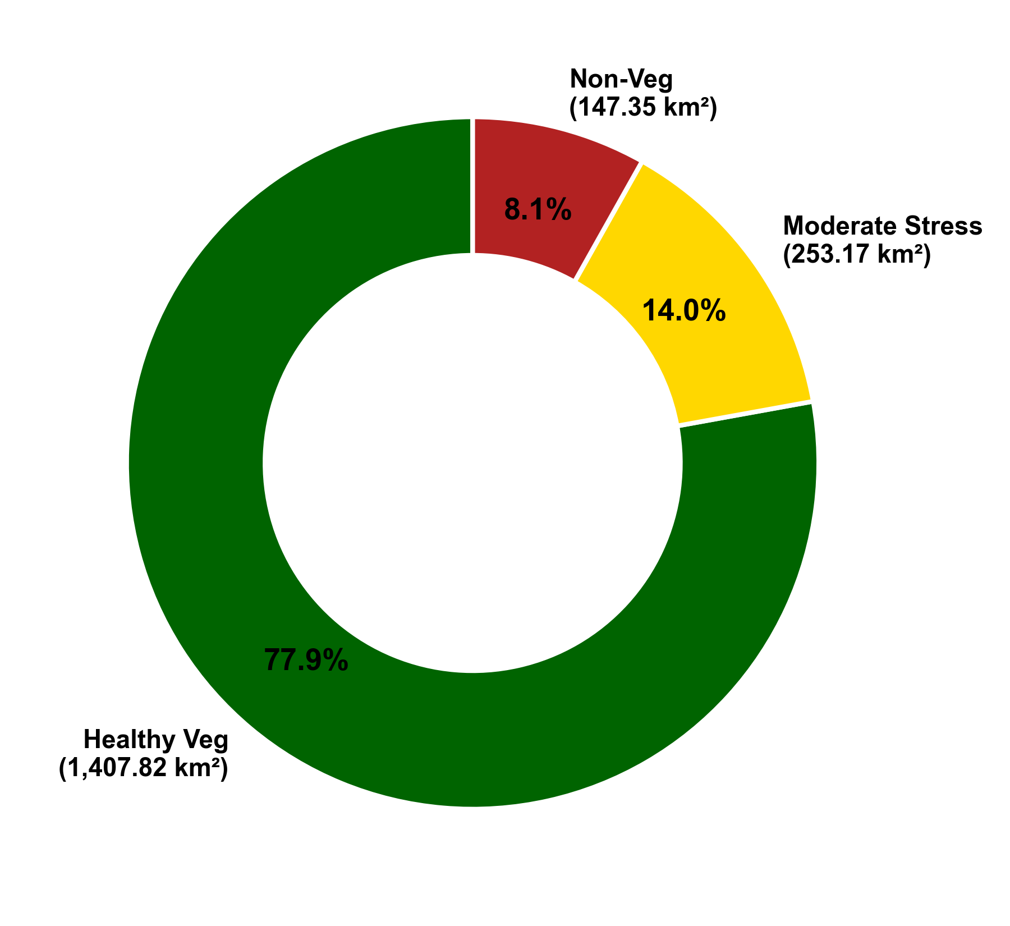
Results: Spatial Transferability
• Frozen Akaakuma model deployed wall-to-wall to PHMA (2024) [1].
• Mapped 1,808.34 km² total area.
→ Patterns match known gradients.
[1] Meyer & Pebesma (2021); [8] Biney et al. (2022) J. Landsc. Ecol.

Slide 13
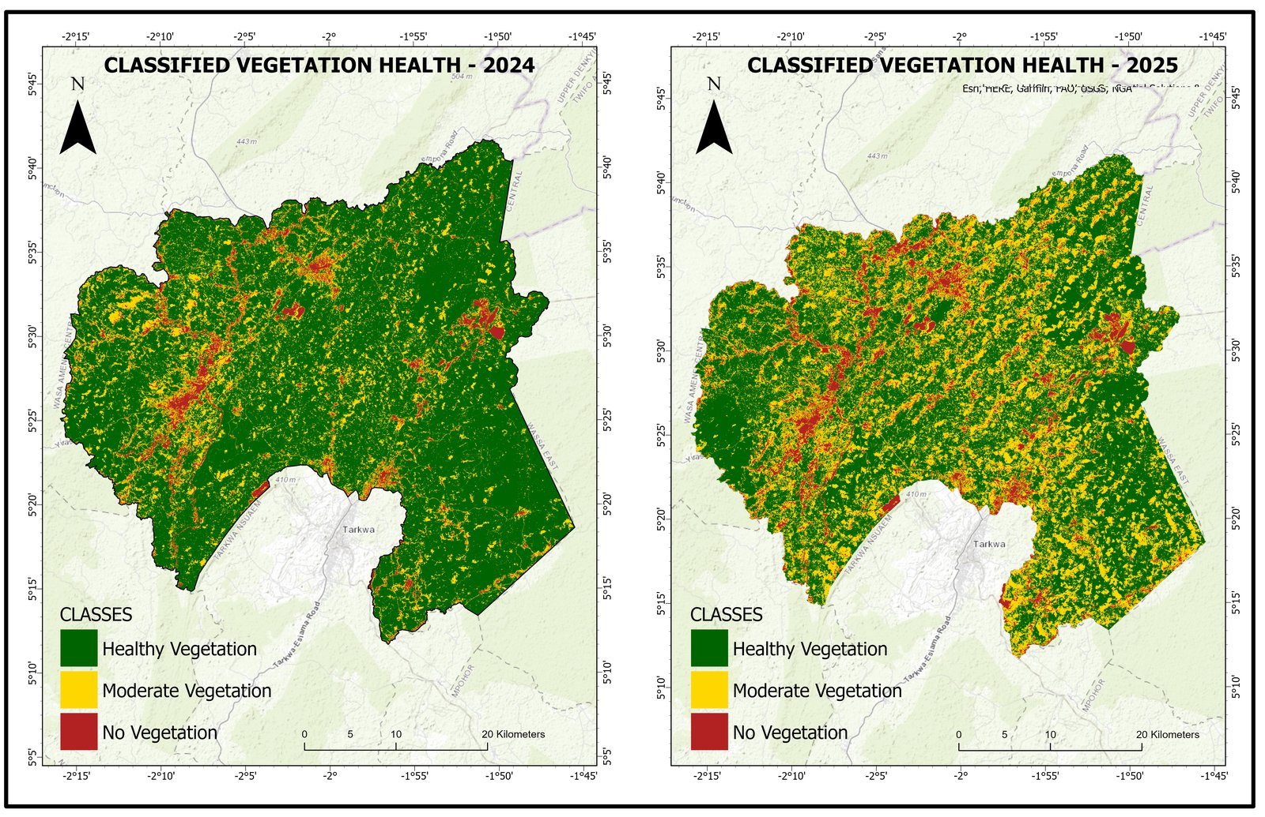
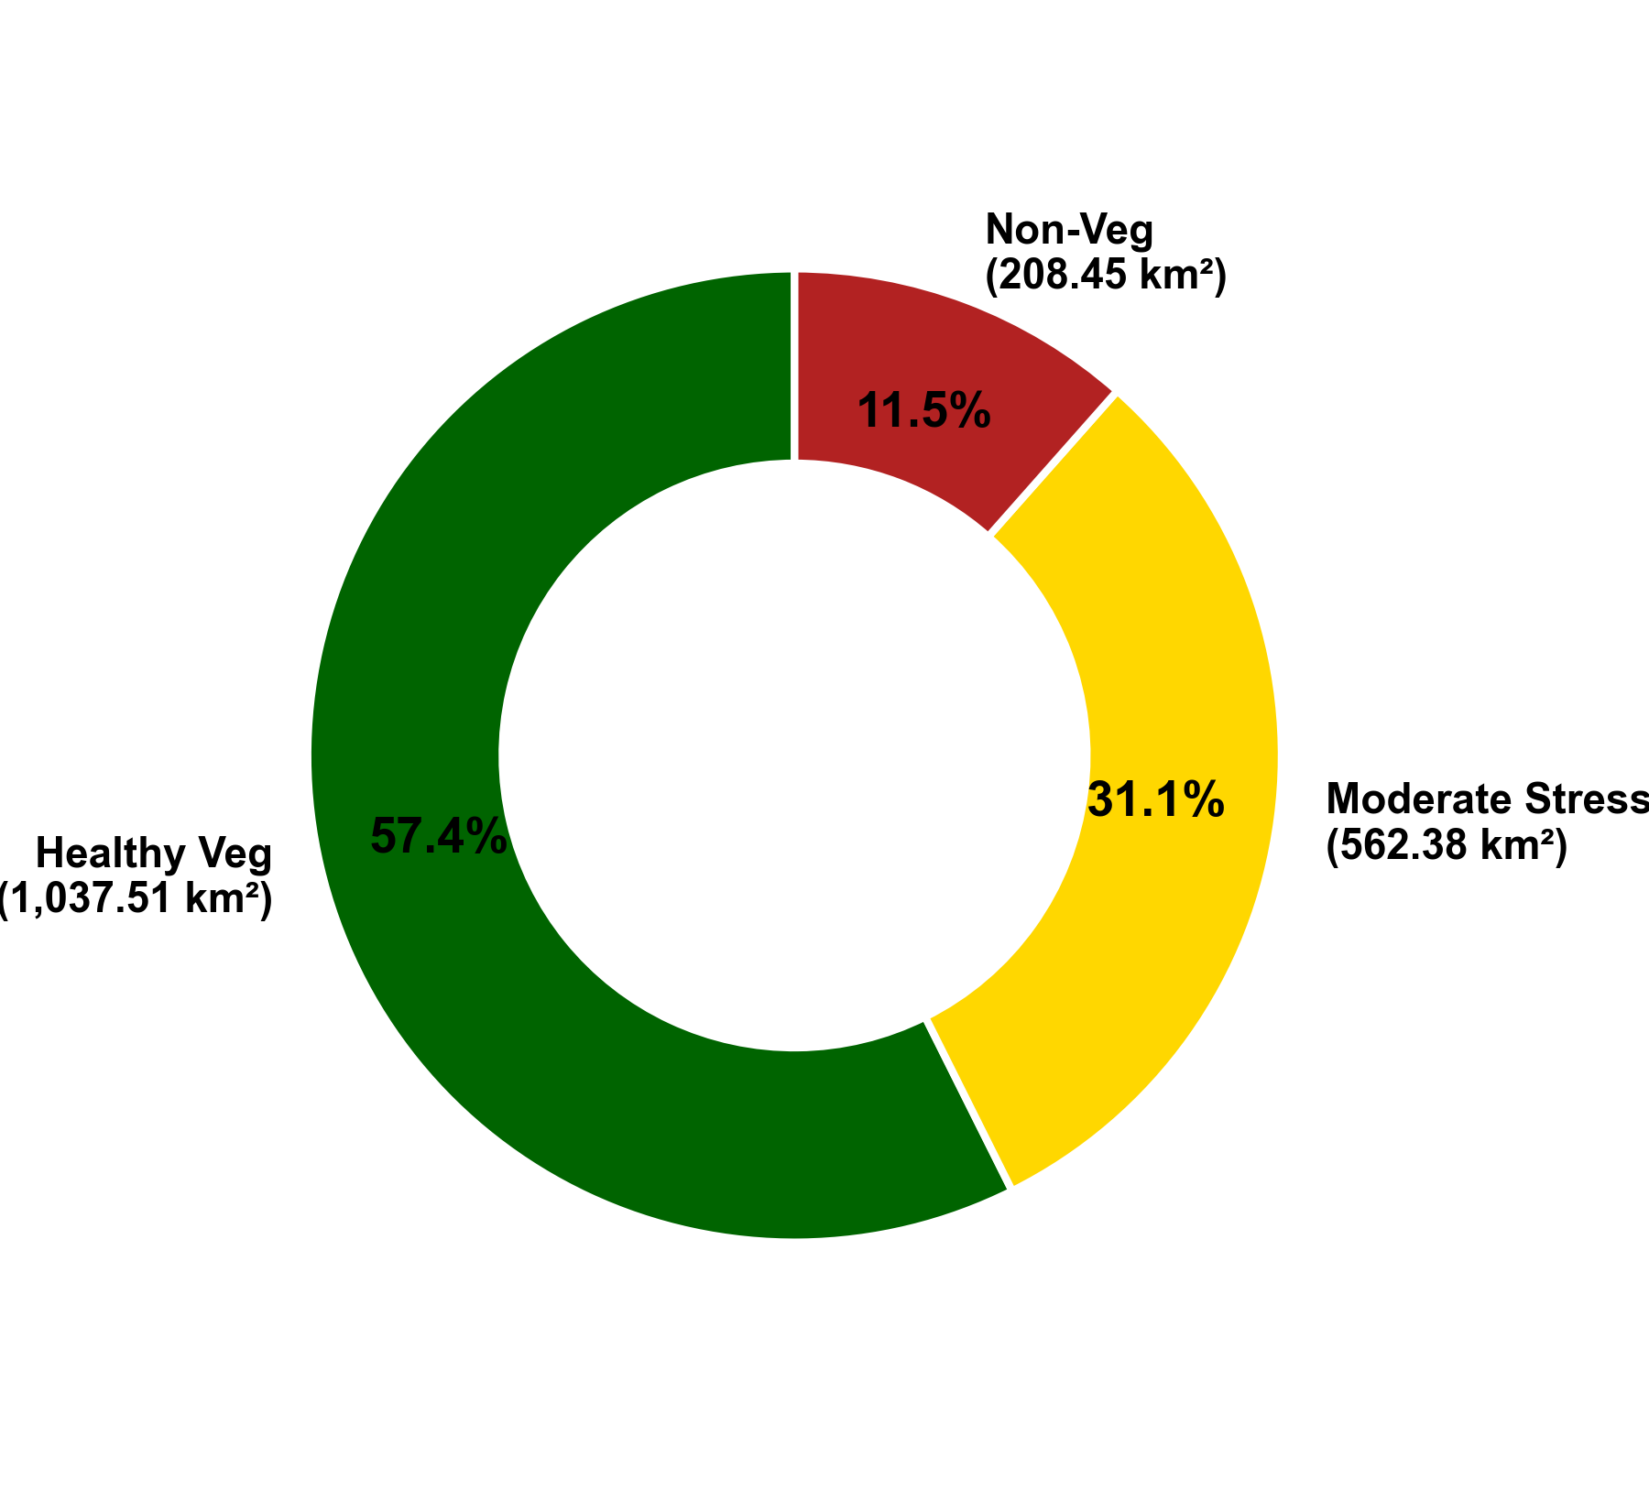
Results: Temporal Transferability
• Applied to 2025 composites without retraining.
• Detects 370.31 km² veg loss concentrated along Ankobra [8, 9].
→ Consistent with GNA reports [10].
[8] Biney et al. (2022); [9] Baddianaah et al. (2023); [10] Ghana News Agency (2026).

Slide 14
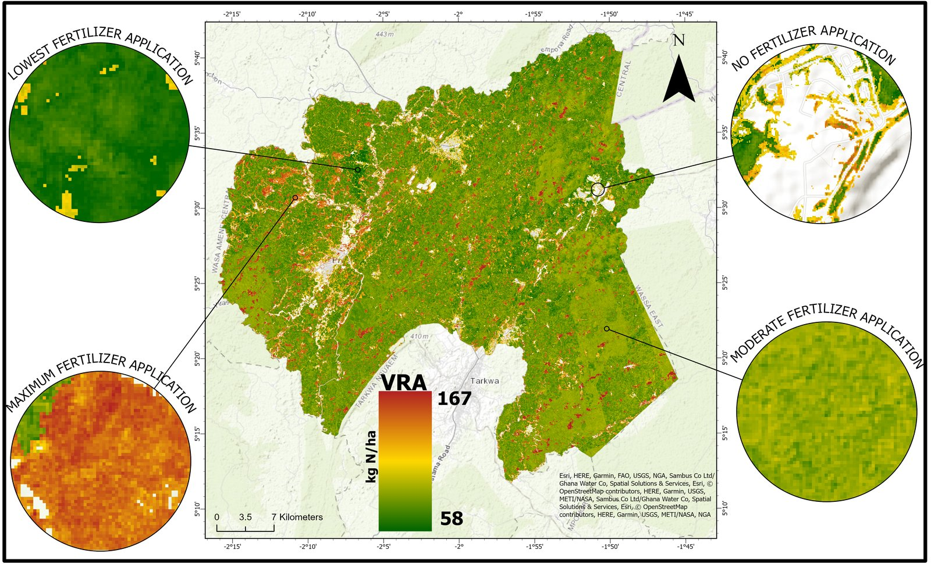
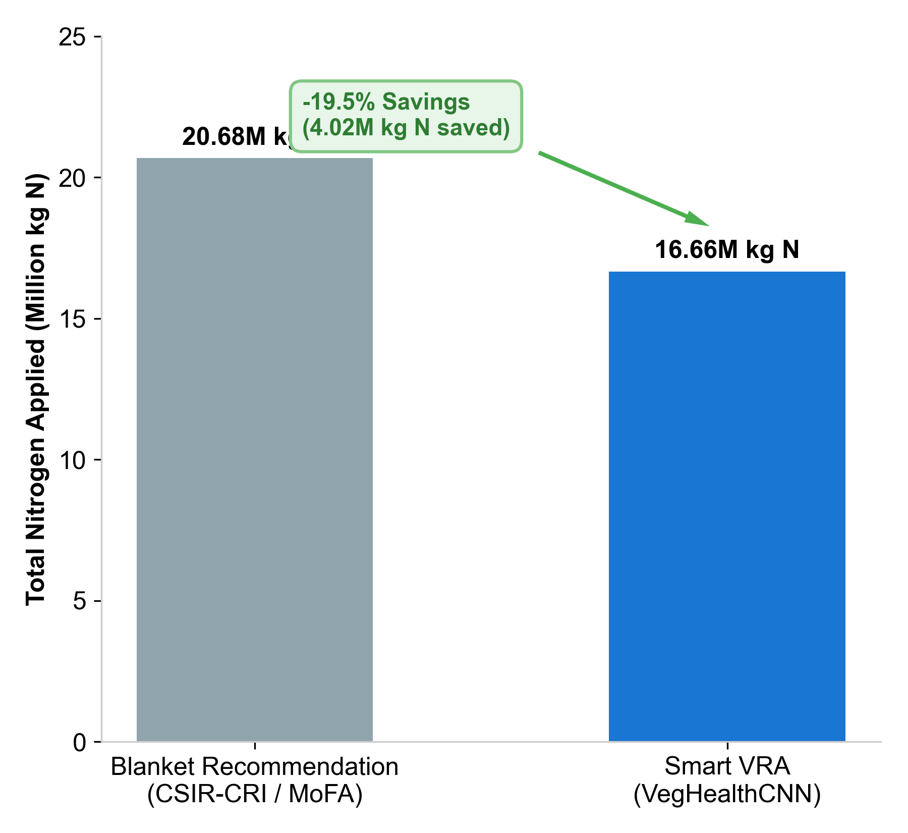
Results: Variable-Rate Nitrogen Prescription
• Area: 172,334 ha of vegetated land.
• NSI-Adapted VRA Model [5, 12]: R = 120 × (1.0 − NDRE) kg N/ha.
• Prevents watershed runoff in Ankobra basin [11].
[5] Clevers & Gitelson (2013); [11] Amoah & Drechsel (2022); [12] Nigon et al. (2013); [16] CSIR-CRI (2015).

Slide 15
Conclusion & Research Limitations
Conclusions:
1. VegHealthCNN (57K params) achieves 98.7% accuracy under strict Spatial Block CV [1, 3].
2. Spatial transfer generalises the frozen model from Akaakuma to PHMA without retraining.
3. Temporal transfer detects 370.31 km² galamsey-driven vegetation loss (2024 → 2025) [8, 10].
4. NDRE-modulated VRA projects 19.5% nitrogen saving (~4.02 million kg N) [5].
Limitations:
• NDVI-derived proxy labels lack field-level verification.
• Spatial transfer assessed qualitatively (no ground-truth in PHMA).
• Cannot distinguish seasonal phenology from permanent land-cover change.
• VRA model requires in-situ agronomic calibration prior to field deployment.
[1] Meyer & Pebesma (2021); [3] Valavi et al. (2019); [5] Clevers & Gitelson (2013); [8] Biney et al. (2022); [10] GNA (2026).

Slide 16
Project Recommendations
1. Methodological Standard (Research & Reporting):
• Academic and research institutions should adopt Spatial Block Cross-Validation as the standard validation protocol for spatial ML models to prevent accuracy inflation and report defensible generalization metrics.
2. Environmental Policy (Monitoring & Enforcement):
• The EPA and Forestry Commission should deploy municipal-scale temporal satellite monitoring pipelines to track galamsey-driven forest degradation and target reclamation along critical river basins.
3. Agronomic Practice (Digital Agricultural Extension):
• MoFA should integrate NDRE-modulated variable-rate nitrogen prescriptions into digital extension platforms to transition smallholders from wasteful blanket fertilisation to site-specific applications, saving ~19.5% of input costs.

Slide 17
References
[1] H. Meyer & E. Pebesma, Methods Ecol. Evol., vol. 12, 2021.
[2] W. Hu et al., J. Sensors, vol. 2015.
[3] R. Valavi et al., Methods Ecol. Evol., vol. 10, 2019.
[4] D. R. Roberts et al., Ecography, vol. 40, 2017.
[5] J. Clevers & A. Gitelson, Int. J. Appl. Earth Obs. Geoinf., vol. 23, 2013.
[6] A. Wadoux et al., Ecol. Modelling, vol. 457, 2021.
[7] P. Ploton et al., Nat. Commun., vol. 11, 2020.
[8] E. Biney et al., J. Landsc. Ecol., vol. 15, 2022.
[9] I. Baddianaah et al., Mineral Econ., vol. 36, 2023.
[10] Ghana News Agency, GNA News, Accra, 2026.
[11] E. Amoah & P. Drechsel, Environ. Monit. Assess., vol. 194, 2022.
[12] T. J. Nigon et al., "Evaluation of the nitrogen sufficiency index for use with high resolution, broadband aerial imagery in a commercial potato field," Precision Agric., 2014.
[13] M. Vizzari et al., Agronomy, vol. 9, 2019.
[14] A. Kamilaris & F. X. Prenafeta-Boldú, Comput. Electron. Agric., vol. 147, 2018.
[15] L. Zhong et al., Remote Sens. Environ., vol. 221, 2019.
[16] CSIR-Crops Research Institute (CRI), Technical Advisory Bulletin, Kumasi, 2015.
[17] B. O. Asante & O. Temoso, Agric. Syst., vol. 176, 2019.
[18] S. Adu-Poku et al., IFPRI Policy Brief, 2022.

Slide 18
Thank You
Questions & Discussion
Emmanuel Yerbo
Email: emmanuel.yerbo@ucc.edu.gh
GeoAI4SD 2026 Conference Participant

