Slide 1


React

Slide 2
Components
<div>, <span>
<ActionButton>, <Counter>

Slide 3
Anatomy of a Component

Slide 4
<ActionButton text="Book flight" onAction={someFunc} />

Slide 5
var ActionButton = React.createClass({ render: function() {
}
});
<ActionButton text="Book flight" onAction={someFunc} />

Slide 6


var ActionButton = React.createClass({ render: function() {
}
});
<ActionButton text="Book flight" onAction={someFunc} />

Slide 7
var ActionButton = React.createClass({ render: function() {
return (
<button class="ActionButton">
<span>button text</span>
</button>
);
}
});
<ActionButton text="Book flight" onAction={someFunc} />

Slide 8
var ActionButton = React.createClass({ render: function() {
return (
<button class="ActionButton">
<span>{this.props.text}</span>
</button>
);
}
});
<ActionButton text="Book flight" onAction={someFunc} />

Slide 9
var ActionButton = React.createClass({ render: function() {
return (
<button class="ActionButton" onClick={this.props.onAction}>
<span>{this.props.text}</span>
</button>
);
}
});
<ActionButton text="Book flight" onAction={someFunc} />

Slide 10




var ActionButton = React.createClass({ render: function() {
return (
<button class="ActionButton" onClick={this.props.onAction}>
<span>{this.props.text}</span>
</button>
);
}
});
<ActionButton text="Book flight" onAction={someFunc} />

Slide 11

var ActionButton = React.createClass({ render: function() {
return (
<button class="ActionButton" onClick={this.props.onAction}>
<span>{this.props.text.toUpperCase()}</span>
</button>
);
}
});
<ActionButton text="Book flight" onAction={someFunc} />

Slide 12
var ActionButton = React.createClass({ render: function() {
return (
<button class="ActionButton" onClick={this.props.onAction}>
<span>{this.props.text}</span>
</button>
);
}
});
<ActionButton text="Book flight" onAction={someFunc} />

Slide 13
<Counter initialCount={4} />

Slide 14
var Counter = React.createClass({ getInitialState: function() {
return {count: this.props.initialCount};
},
addToCount: function(delta) { this.setState({count: this.state.count + delta})
},
render: function() { return (
<div>
<h3>Count: {this.state.count}</h3>
<ActionButton text="+1" onAction={this.addToCount.bind(this, 1)} />
<ActionButton text="-1" onAction={this.addToCount.bind(this, -1)} />
</div>
);
}
});
<Counter initialCount={4} />

Slide 15
var Counter = React.createClass({ getInitialState: function() {
return {count: this.props.initialCount};
},
addToCount: function(delta) { this.setState({count: this.state.count + delta})
},
render: function() { return (
<div>
<h3>Count: {this.state.count}</h3>
<ActionButton text="+1" onAction={this.addToCount.bind(this, 1)} />
<ActionButton text="-1" onAction={this.addToCount.bind(this, -1)} />
</div>
);
}
});
<Counter initialCount={4} />

Slide 16



var Counter = React.createClass({ getInitialState: function() {
return {count: this.props.initialCount};
},
addToCount: function(delta) { this.setState({count: this.state.count + delta})
},
render: function() { return (
<div>
<h3>Count: {this.state.count}</h3>
<ActionButton text="+1" onAction={this.addToCount.bind(this, 1)} />
<ActionButton text="-1" onAction={this.addToCount.bind(this, -1)} />
</div>
);
}
});
<Counter initialCount={4} />

Slide 17


var Counter = React.createClass({ getInitialState: function() {
return {count: this.props.initialCount};
},
addToCount: function(delta) { this.setState({count: this.state.count + delta})
},
render: function() { return (
<div>
<h3>Count: {this.state.count}</h3>
<ActionButton text="+1" onAction={this.addToCount.bind(this, 1)} />
<ActionButton text="-1" onAction={this.addToCount.bind(this, -1)} />
</div>
);
}
});
<Counter initialCount={4} />

Slide 18
var Counter = React.createClass({ getInitialState: function() {
return {count: this.props.initialCount};
},
addToCount: function(delta) { this.setState({count: this.state.count + delta})
},
render: function() { return (
<div>
<h3>Count: {this.state.count}</h3>
<ActionButton text="+1" onAction={this.addToCount.bind(this, 1)} />
<ActionButton text="-1" onAction={this.addToCount.bind(this, -1)} />
</div>
);
}
});
<Counter initialCount={4} />

Slide 19
What makes React different?

Slide 20
Components, not templates
Re-render on update
Virtual DOM (and events)

Slide 21
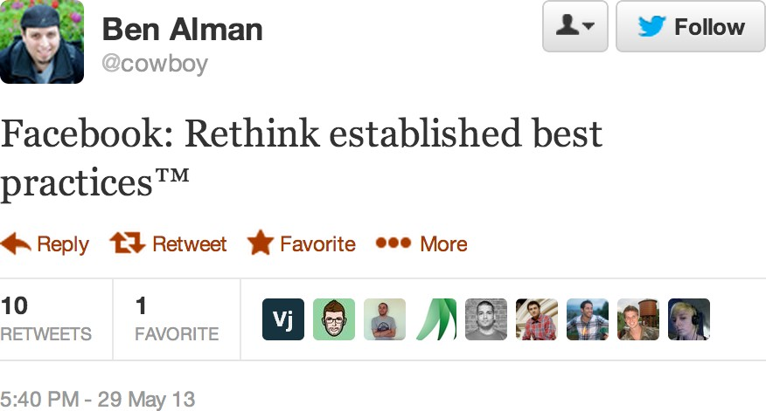

Slide 22
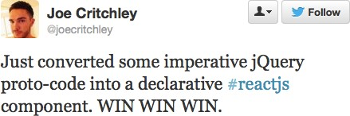

Slide 23
1. Components, not templates

Slide 24
Separation of concerns:
Reduce coupling, increase cohesion.

Slide 25
Coupling is:
“The degree to which each program module relies on each of the other modules.”
http://en.wikipedia.org/wiki/Coupling_(computer_science)

Slide 26
Cohesion is:
“The degree to which elements of a module belong together.”
http://en.wikipedia.org/wiki/Cohesion_(computer_science)

Slide 27
“View model” tightly couples template to display logic.
[{“price”: “7.99”, “product”: “Back scratcher”, “tableRowColor”: “rgba(0, 0, 0,
0.5)”}]

Slide 28
Templates separate technologies, not concerns

Slide 29
React components are loosely coupled and highly cohesive

Slide 30
var Counter = React.createClass({ getInitialState: function() {
return {count: this.props.initialCount};
},
addToCount: function(delta) { this.setState({count: this.state.count + delta})
},
render: function() { return (
<div>
<h3>Count: {this.state.count}</h3>
<ActionButton text="+1" onAction={this.addToCount.bind(this, 1)} />
<ActionButton text="-1" onAction={this.addToCount.bind(this, -1)} />
</div>
);
}
});
<Counter initialCount={4} />

Slide 31
2. Re-render on every change

Slide 32
var Counter = React.createClass({ getInitialState: function() {
return {count: this.props.initialCount};
},
addToCount: function(delta) { this.setState({count: this.state.count + delta})
},
render: function() { return (
<div>
<h3>Count: {this.state.count}</h3>
<ActionButton text="+1" onAction={this.addToCount.bind(this, 1)} />
<ActionButton text="-1" onAction={this.addToCount.bind(this, -1)} />
</div>
);
}
});
<Counter initialCount={4} />

Slide 33
Best analogy: Website from 1994

Slide 34
Data changing over time is the root of all evil.

Slide 35
Re-rendering on every change makes things simple.
Every place data is displayed is guaranteed to be up-to-date.

Slide 36
Re-rendering on every change makes things simple.
No magical data binding.

Slide 37
Re-rendering on every change makes things simple.
No model dirty checking.

Slide 38
Re-rendering on every change makes things simple.
No more explicit DOM operations – everything is declarative.

Slide 39
3. Virtual DOM

Slide 40
Won’t rerendering be as slow as molasses?!

Slide 41
React has a virtual DOM (and events system).
Optimized for performance and memory footprint

Slide 42
On every update…
React builds a new virtual DOM subtree
…diffs it with the old one
…computes the minimal set of DOM mutations and puts them in a queue
…and batch executes all updates

Slide 43
It’s fast!
Because the DOM is slow!

Slide 44
It’s fast!
Computes minimal DOM operations

Slide 45
It’s fast!
Batched reads and writes for optimal DOM performance

Slide 46
It’s fast!
Usually faster than manual DOM operations

Slide 47
It’s fast!
Automatic top-level event delegation (with cross-browser HTML5 events)

Slide 48
It’s fast!
Can do all this at 60fps, even in a (non-JIT) UIWebView on the iPhone.

Slide 49
Why Should YOU Use React?
Can be used for parts of your application
Plays well with other libraries and technologies (meteor, rails, node)
Components allow you to split work easily

