Slide 1
PM ACCELERATOR’S MISSION
By making industry-leading tools and education available to individuals from all backgrounds, we level the playing field for future PM leaders. This is the PM Accelerator motto, as we grant aspiring and experienced PMs what they need most – Access. We introduce you to industry leaders, surround you with the right PM ecosystem, and discover the new world of AI product management skills.

Slide 2
Weather Forecasting Using Global Weather Repository Data
In this project, we analyze the "Global Weather Repository.csv“
dataset to forecast future weather trends and demonstrate data
science skills using both fundamental and advanced techniques.
The dataset provides daily weather information from cities around the world, featuring over 40 attributes that capture diverse meteorological conditions. Through thorough exploration, feature engineering, and predictive modeling, this study aims to derive meaningful insights and improve forecasting accuracy.

Slide 3
Features or columns analysis
In this analysis, I analyzed the correlation between all the numerical columns in this dataset
This help to identify the effect of other columns on the target columns
It also help to identify important columns that have great impact on model performance

Slide 4
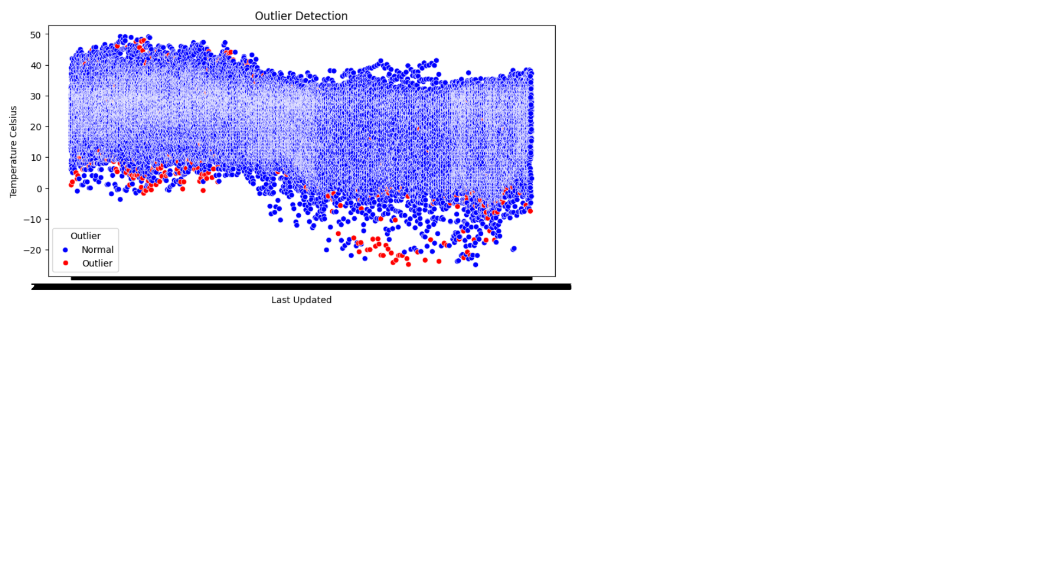
Outlier Detections and handling
In this analysis, I used Isolation forest to detect outliers
It detected that 100% of the dataset contains outliers meaning all the integer data type contained and outliers
I visualized the outliers in the dataset using seaborn

Slide 5
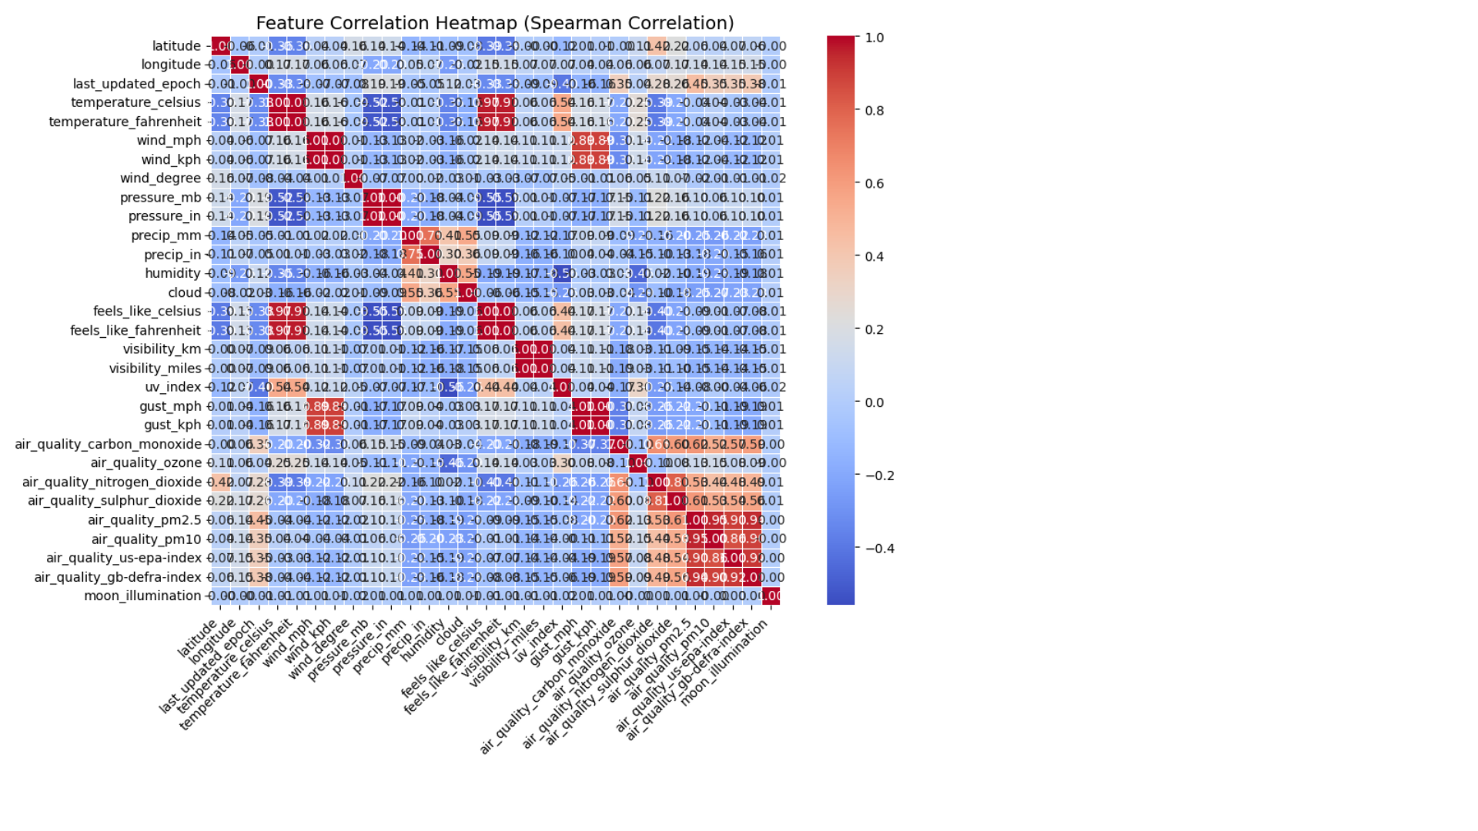
Correlation of numeric columns
I analyzed the correlation between numeric columns
This assist in determined the correlation between numeric columns and also between a particular column and the target columns

Slide 6
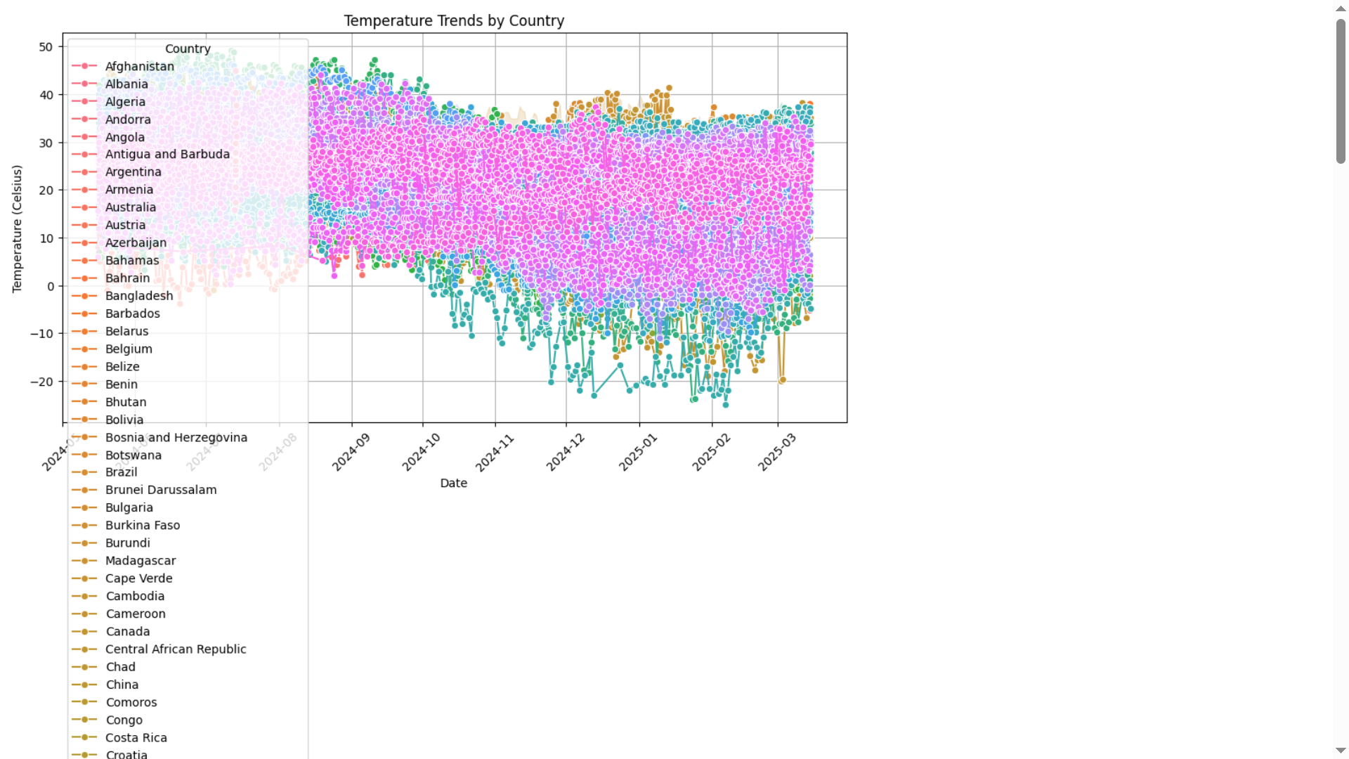
Temperature Trend analysis
I analyzed the temperature trend by country by visualizing temperature trends across all country using matplotlib

Slide 7
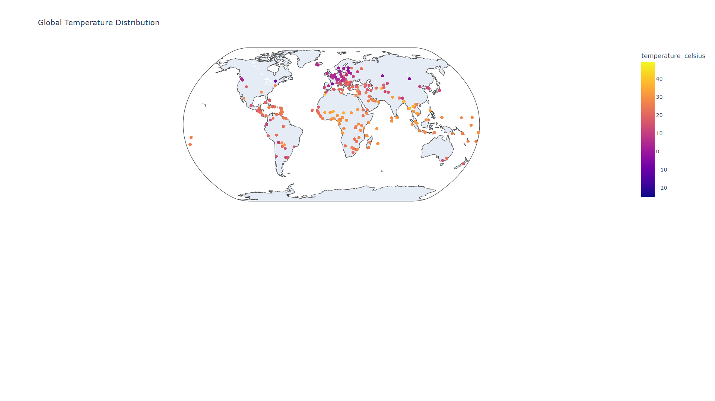
Spatial Analysis
In this analyses, I analyzed the distribution across different continent using plot
This helped me to know the temperature variation and trends in continent

Slide 8
Preprocessing of Target feature
In this stage I preprocessed the target feature which is the temperature Celsius
I applied normalization to normalized the target columns
I set the index of the target column by converting the last_updated column to datetime

Slide 9
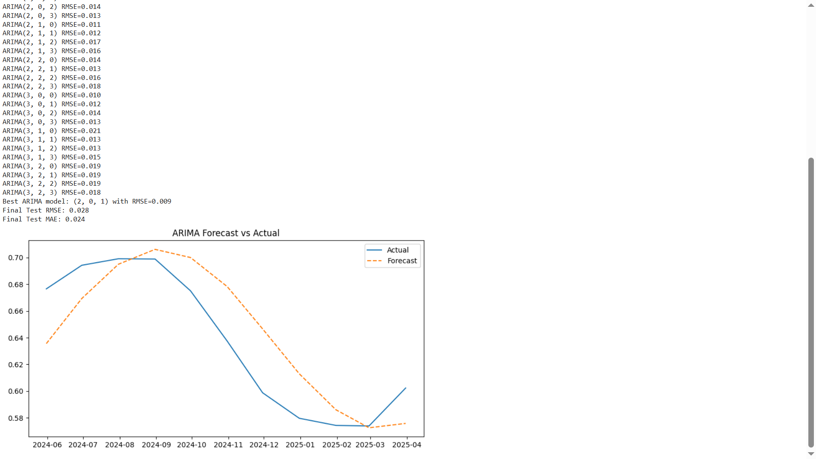
Building ARIMA forecast Model
I build the ARIMA model to forecast temperature for the next 12 months.
I achieved a RMSE of 0.028 and MAE of 0.024.
I visualized the forecasted temperature against the actual temperature

Slide 10
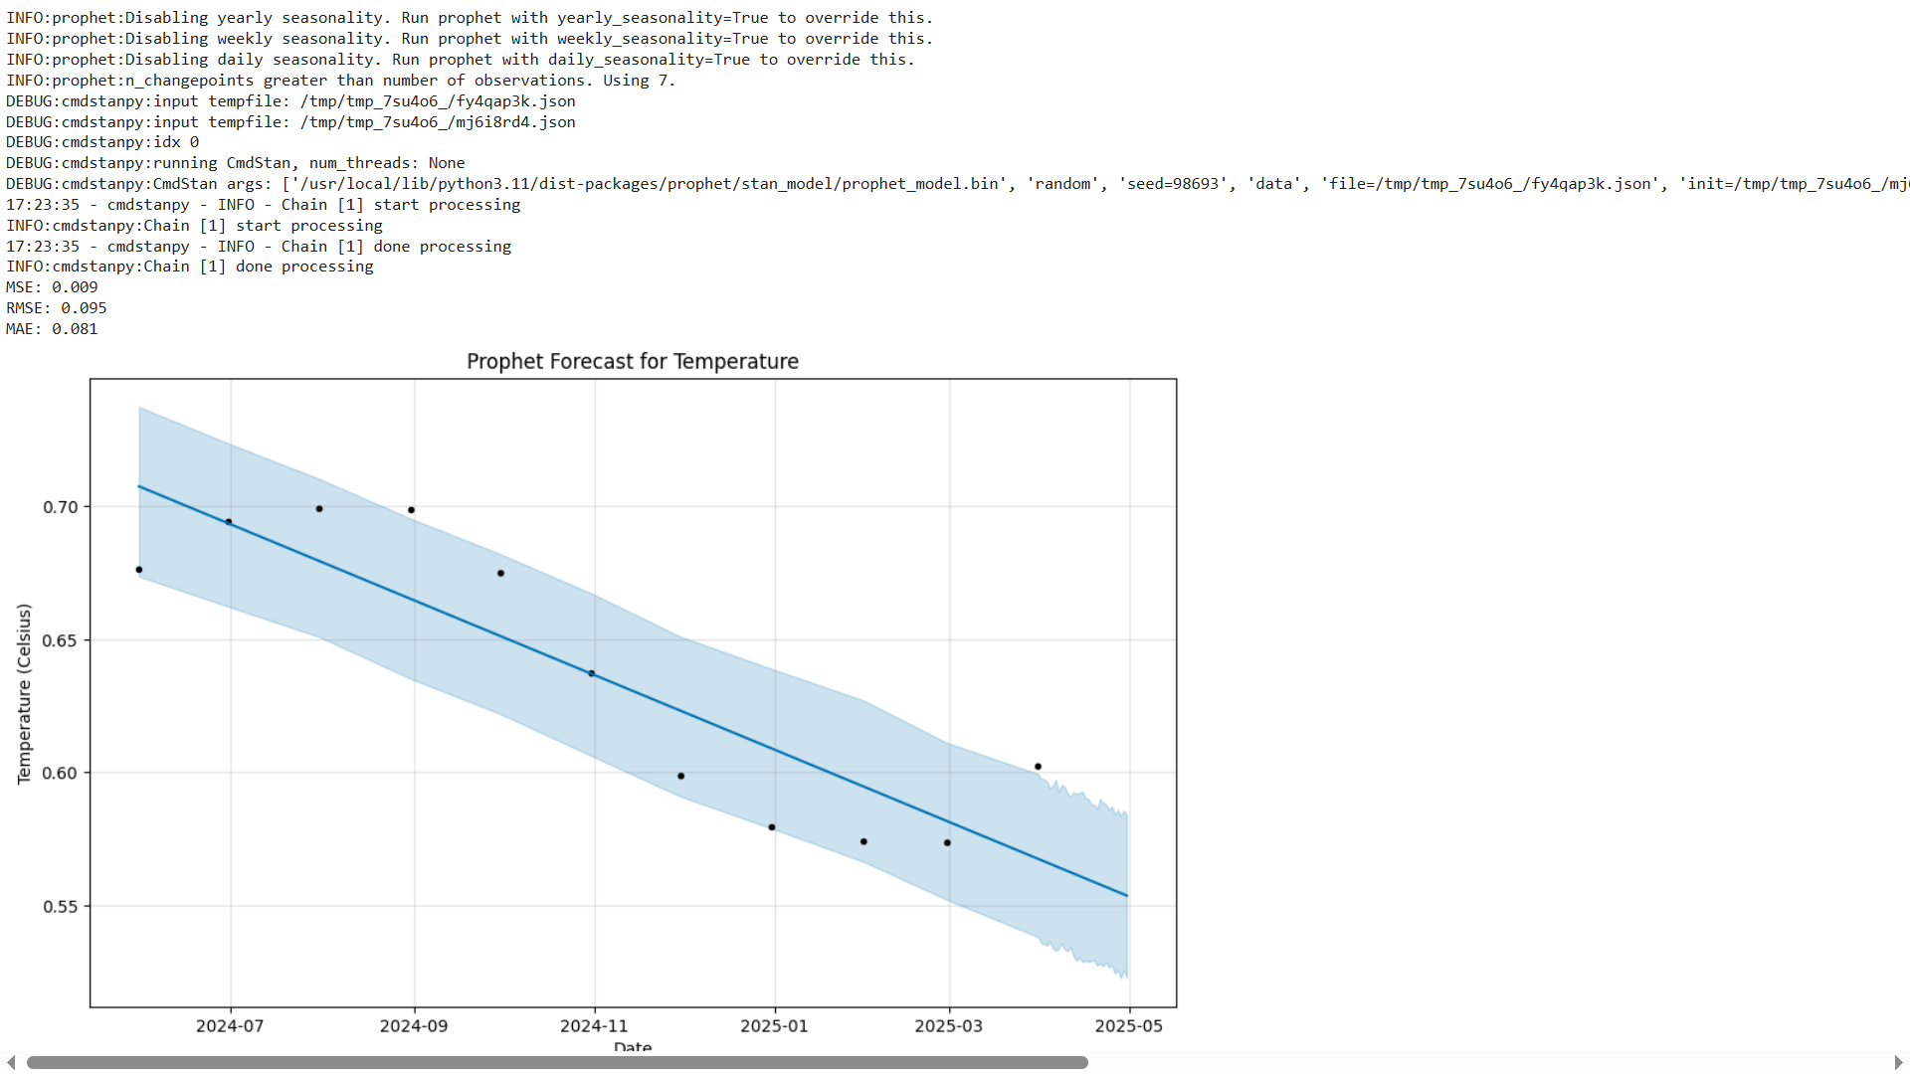
Building Prophet model
I built a prophet forecast model to forecast temperature for 30 days period
I achieved a RMSE of 0.095 and a MAE of 0.081

Slide 11
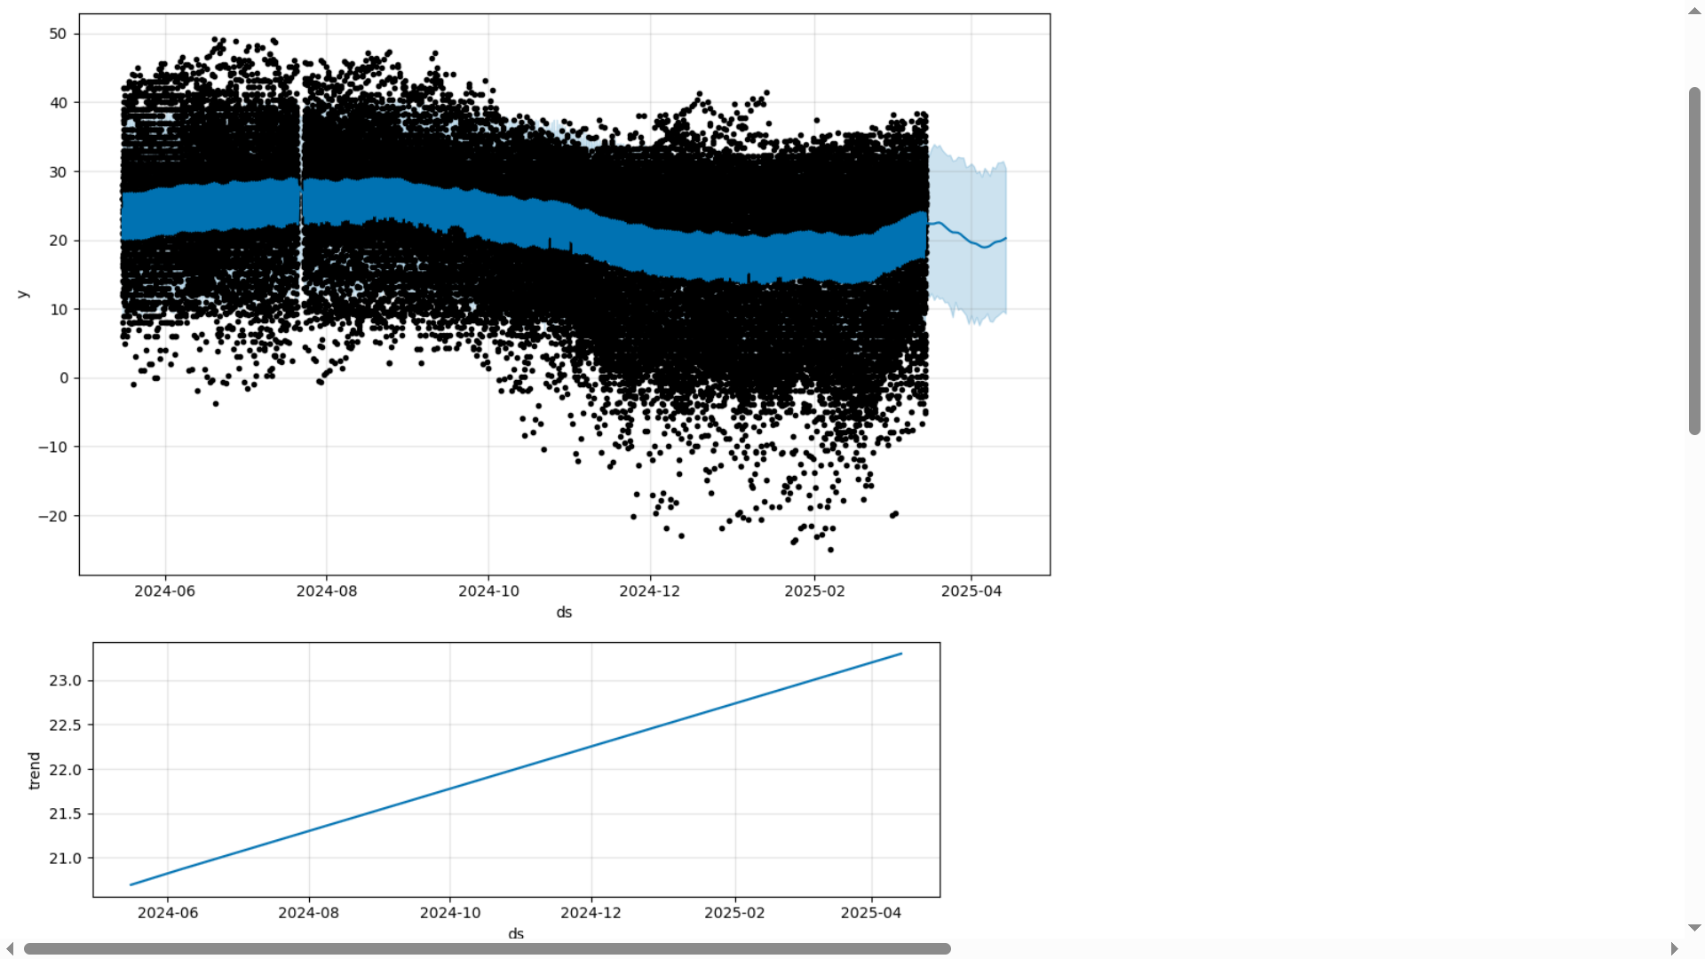
Seasonal and Trend Analysis
In this stage I analyzed the trends and patterns of temperature over a day, a week, year using prophet

Slide 12
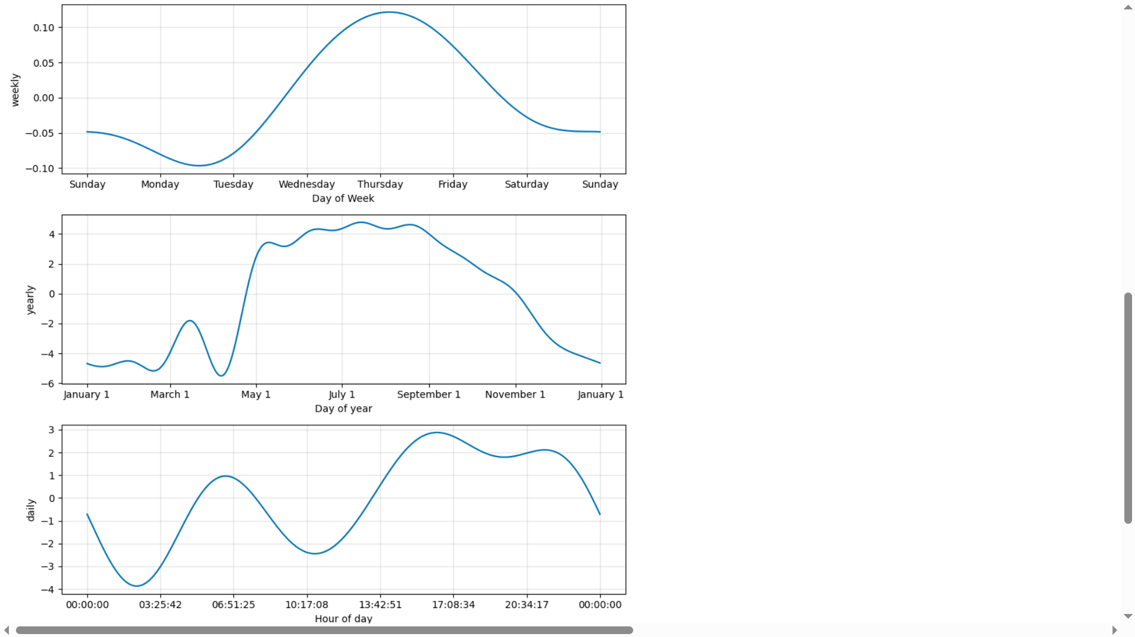
Seasonal and trend analysis con’t

Slide 13
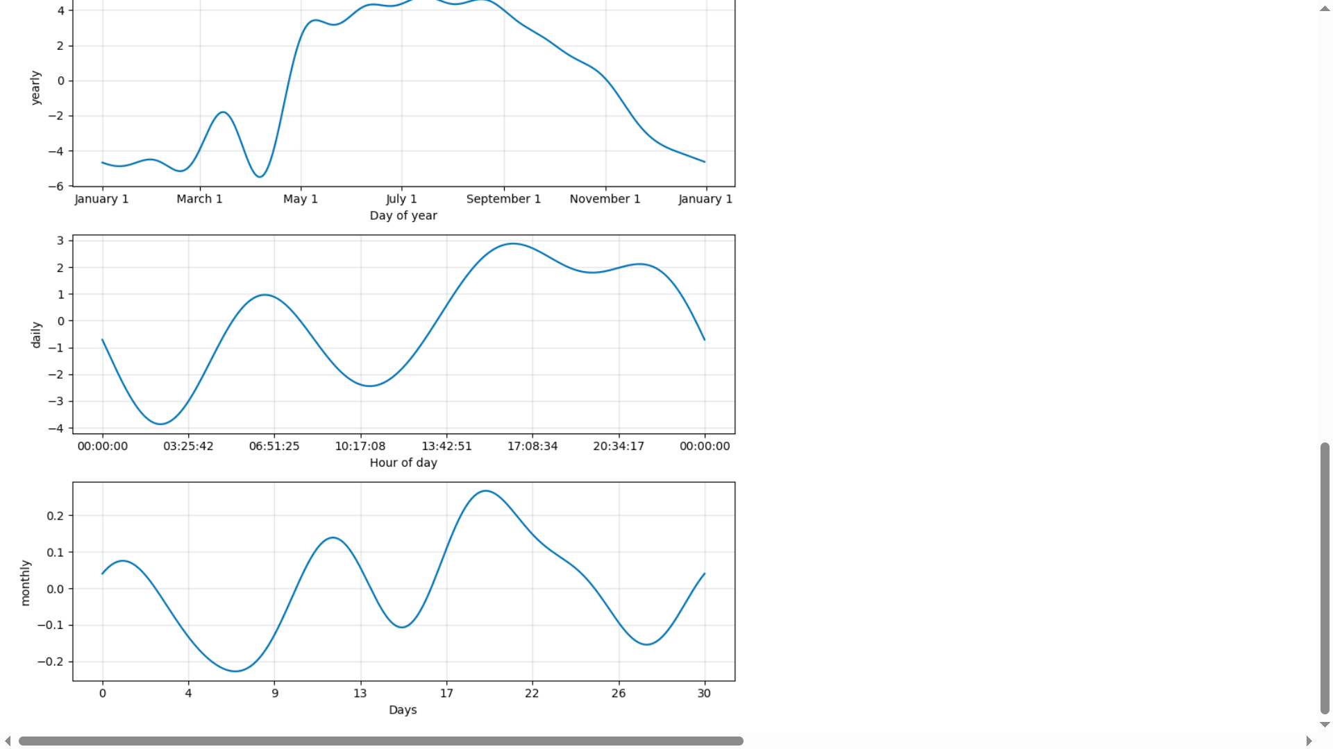
Seasonal and trend analysis con’t

Slide 14
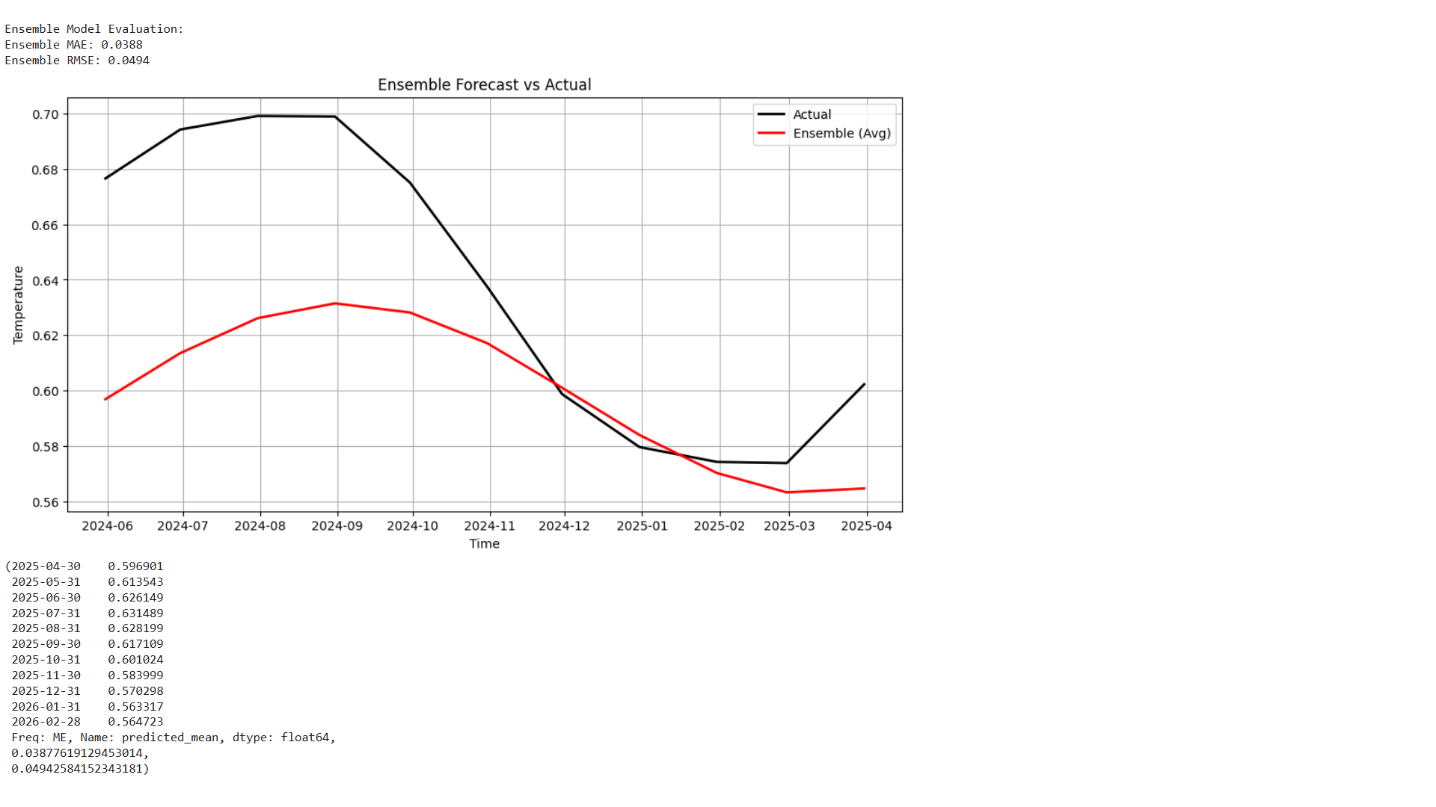
Ensemble Model
This model combined the predictions from various model and compute the mean of the predictions
This aim to improve the accuracy of the model predictions

Slide 15
Important columns selection
In this stage I selected important columns that have great impact on the temperature prediction using Mutual information, RFE, shap, XGBoostRegressor.
15 columns were selected and they are ‘latitude', 'air_quality_nitrogen_dioxide', 'air_quality_pm10', 'longitude', 'cloud', 'air_quality_carbon_monoxide', 'last_updated_epoch', 'pressure_mb', 'uv_index', 'humidity', 'air_quality_sulphur_dioxide', 'wind_degree', 'wind_mph', 'precip_mm', 'air_quality_pm2.5'

Slide 16
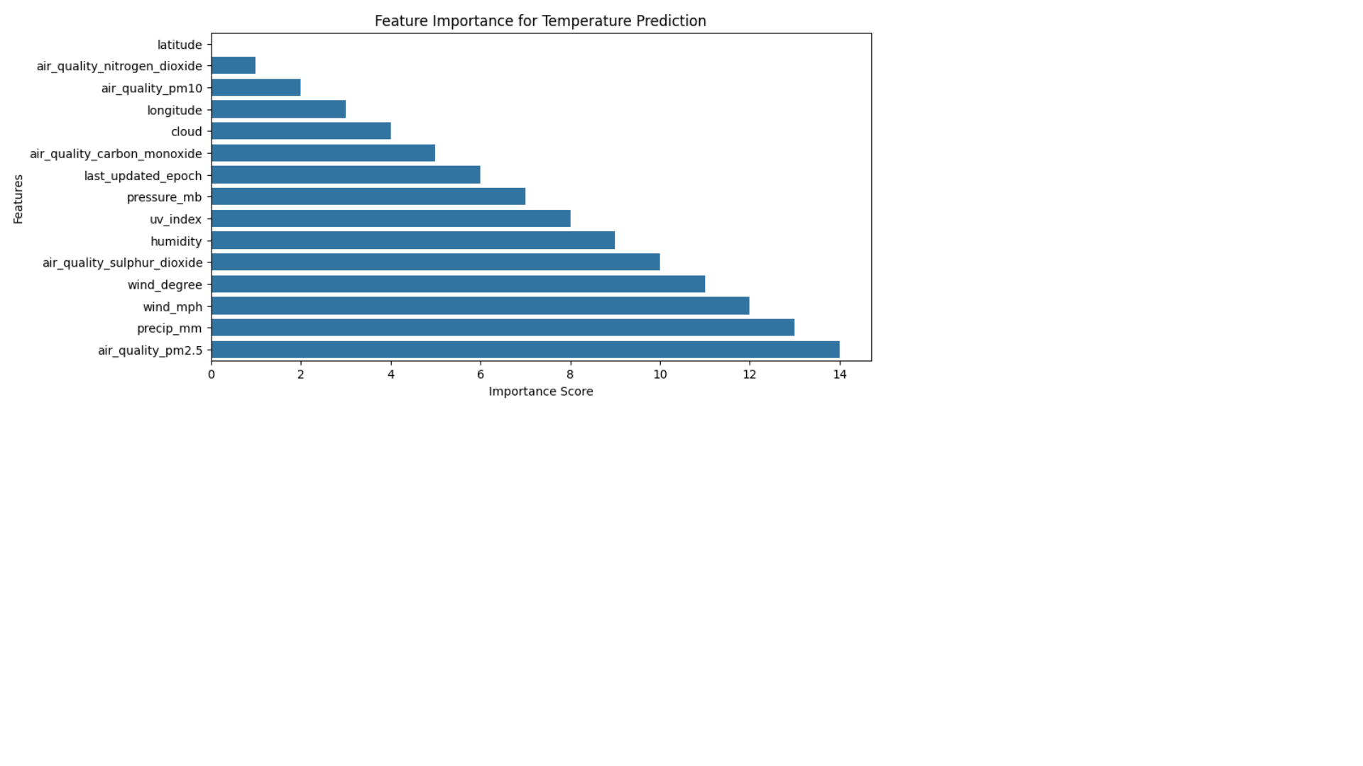
Important column selection
In this phase, I selected important columns in the dataset by utilizing correlation, mutual information XGBoostRegressor, RFE and shap
This is very important for feature engineering.
I visualized the importance features and anlyzed them.

Slide 17
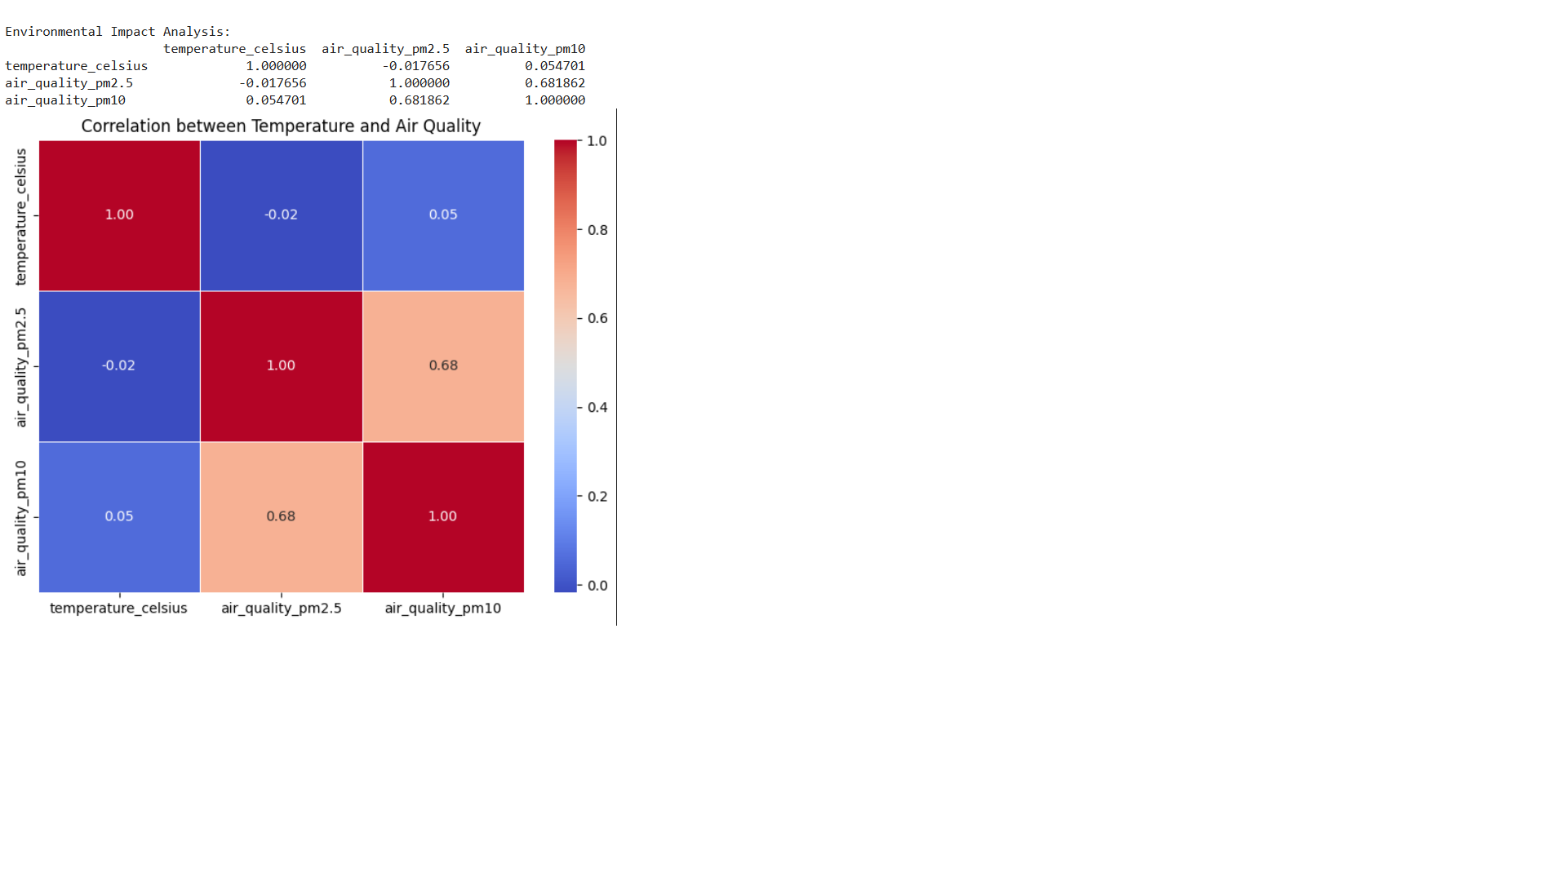
Environmental Impact Analysis
I analyzed the impact of temperature on air quality by computing the correlation between them
I visualized the impact analysis visualizing the correlation heatmap between temperature and air quality features

Slide 18
Building RNN
Since statistical model are mostly limited one target, I will build a deep learning model to predict all or multiple environmental conditions using LSTM

